Slide 1
Speaking Anxiety through Interactions with an AI Chatbot: A Qualitative Case Study of EFL Students
Anh Duong Nguyen, Phuong Thao Nguyen
Presenter: Nguyen Lam Anh Duong (Ms.)
Affiliation: Industrial University – Ho Chi Minh City (IUH)
Co-author: Nguyen Dang Phuong Thao (UEF)

Slide 2


Table Of Contents
01.
INTRODUCTION
02.
LITERATURE REVIEW
03.
METHODOLOGY
04.
FINDINGS
05.
DISCUSSION
06.
CONCLUSION

Slide 3
Introduction
Unwilling or shy students in speaking classes?
Avoid eye contact or speaking with peers?
A need for a personal assistant or a virtual conversational partner
The emergence of Generative AI in education
  Generative AI tools (e.g., ChatGPT, Bard, DALL-E) are transforming education through pattern recognition and content generation (Chan & Hu, 2023).
  ➔ The reduction of language anxiety and the enhancement of participation

Slide 4


LITERATURE REVIEW
DEFINITION OF AI
VIRTUAL CONVERSATIONAL PARTNERS (VCPS)
  Generative AI creates new material (e.g., text, images, audio) using training data (Dasborough, 2023).
  Models like GPT-4, DALL-E, and GitHub Copilot support multimodal content creation.
  Challenges: Copyright violations, academic dishonesty, and data privacy risks (Gillotte, 2019).
  Provide customized feedback in real-time using NLP and machine learning (Liu et al., 2023).
  Offer a nonjudgmental space to reduce language anxiety and improve immersion.
  Deliver instant feedback on grammar, vocabulary, and fluency (Deng & Huang, 2024).
  Enable adaptive learning tailored to individual needs (Jiang, 2023).

Slide 5
LITERATURE REVIEW
FOREIGN LANGUAGE ANXIETY (FLA)
- complex issue that can hinder language learning process
- a mix of negative perception, feelings, and actions that derive from the issues related to learning a foreign language.
Horwitz et al. (1986), Scovel (1991)
Tension: feel both physically and mentally uncomfortable during mutual interactions in class
Apprehension: avoidance or hesitations when it comes to answering questions.
Nervousness or Worry: when students are frightened of obtaining low grades in comparison with their peers or teachers or falling behind in their studies.

Slide 6

Results of previous studies
The influence of AI in learning English
  Provide personalized feedback and tailored learning experiences (Chan, 2023).
  Reduce anxiety and create low-pressure practice environments (Kim, Cha, & Kim, 2021).
  AI has a beneficial impact on enhancing learners’ individualization in learning and adaptive platforms which could assess learner data to modify instructional content and pacing, thereby developing individualized learning trajectories that foster deeper engagement and motivation (Ding et al., 2025; Alam, 2021; Yin & Fathi, 2025; Zhai & Wibowo, 2023)

Slide 7

Results of previous studies
Students’ Perceptions
Call Annie
  Generally positive attitudes towards AI chatbots for engagement and learning support.
  Concerns about mistake correction, limited discussion depth, and predictability (Bibauw et al., 2019).
  Cautiously optimistic but highlight the need for improved features and capabilities.
  Call Annie: AI-powered conversational app launched in 2024, personalizing English learning experiences in its ability to generate authentic conversations in diverse situations that replicate a person in human contexts and a non-threatening environment in which students would not receive negative judgements would be highly praised thanks to the use of a virtual partner, as compared to interactions with their peers or teachers (Sharma, 2023, Wan & Moorhouse, 2024; Nguyen et. al, 2025; Nguyen & Le, 2025).

Slide 8
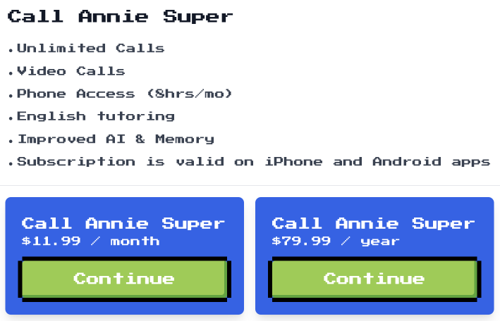
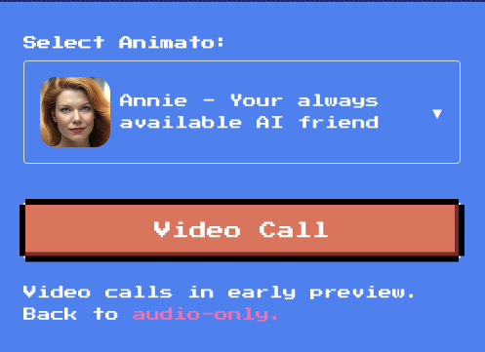

- GPT-3.5
- developed by ​​Animato ➔ was programmed from the “conversational capabilities” of Generative AI to produce audio voice texts,
- From textual dialogues to two-way communication between two conversation partners.
- accessible on both iOS and Android devices, or https://callannie.ai

Slide 9

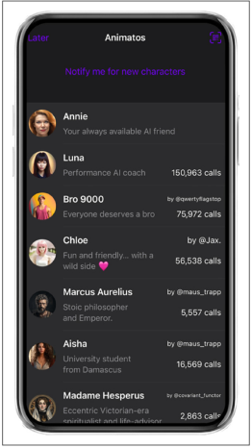


Convenient
Personalized
Annie is available 24/7 and allows students to practice anytime, anywhere.
Besides the main characters, students can pick and choose their favorites figures, from fiction to non-fiction ones.

Slide 10
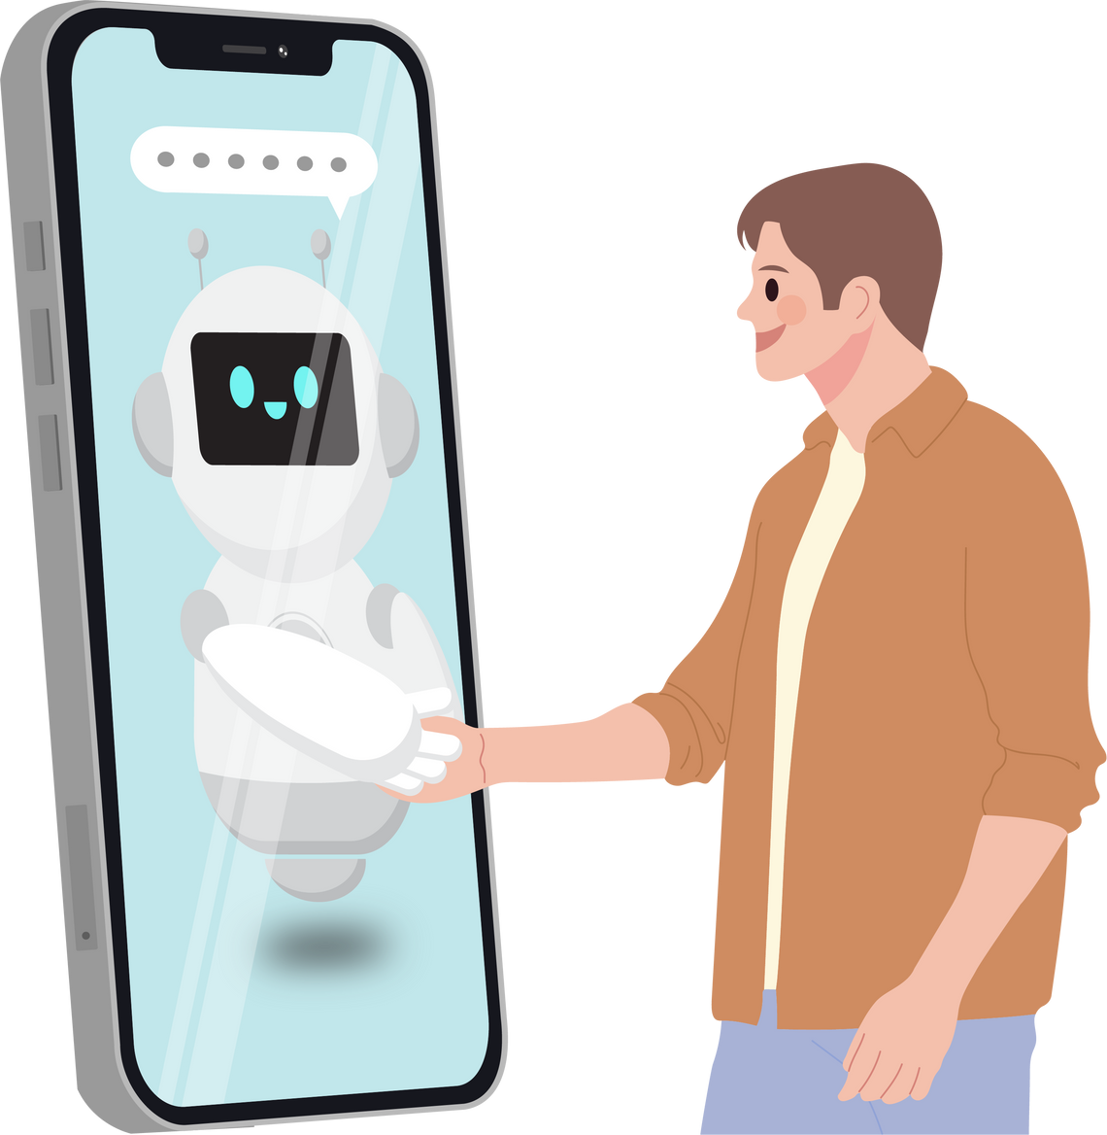
RESEARCH GAP
Despite an extensive amount of research on AI-powered tools on language enhancement, investigations into students' anxiety levels based on their perception towards the incorporation of AI chatbots for daily interaction practice have remained scant, thereby requiring thorough insights into how students perceive their anxiety change regarding the use of Call Annie. Hence, this study was conducted to seek the answer of whether English-majored students recognize the importance of AI chatbot to improve their motivation for using AI technologies in the future.

Slide 11

RESEARCH QUESTIONS
Question 1: How do students interpret the changes of their anxiety levels after interacting with AI?
Question 2: What factors influence students' anxiety level when utilizing an AI chatbot as their conversational partner?

Slide 12
METHODOLOGY
PARTICIPANTS
Number of participants | 4
Gender | Females
Level of English | A2~B1
Courses | Speaking 1
Major | English
Conditions | Intended to improve English in language centres
Experience using AI or technology in studying English | None or very little
Topics to be covered | Schools, hobbies, music

Slide 13
METHODOLOGY
Instrument
Individual interviews were conducted for each volunteer. 12 questions related to the frequency of using Call Annie for speaking practice and emotions were asked. Each student's answer was recorded by Zoom meeting, instead of face-to-face meetings to ensure a safe space for students to raise their thoughts. Inquiries are listed as follows:
1.How often and how long did you practice speaking with Call Annie every week?
2. Do you think that your English has improved after speaking with Call Annie? Why do you think so?
3. Do you think that you can speak with fewer hesitations or pauses after speaking with Call Annie? Why do you think so?
4. Do you think that you can speak better after speaking with the AI voice chatbot? Why do you think so?
5. When first introduced to this app, how would you feel?
6. After using this, do you feel less nervous?
7. If you continue using this app, would you feel less nervous? Are there any drawbacks?
8. What makes you feel most nervous when speaking English with Call Annie?
9. Do you feel more or less anxious compared to speaking with a real person?
10. In what topics during the conversation do you feel most confident / most nervous?
11. Has the chatbot helped you reduce your fear of making mistakes? Why or why not?
12. How do you feel when the chatbot responds slowly or mishears or interrupts you?

Slide 14


DATA COLLECTION & ANALYSIS
  This paper employs a qualitative approach to analyze participants' responses in interviews, which is one of the methods that numerous researchers used to extract data (Opie, 2004).
  Starting from the raw data of candidates' answers, thematic analysis was then adopted to help researchers obtain patterns, from which final results were deduced through the emergence of themes and categories (Fereday & Muir-Cochrane, 2006).
  This study also is grounded in a case study design to provide insights into unique situations or a group of people in a particular location or length of time (Stake, 1995).
  In-depth depiction and complexity of a single case would be scrutinized, making it an advantage in generalizing theories, rather than populations or numerical data.(Yin, 1994; David, 2006).

Slide 15

Phase 1 | Phase 2 | Phase 3 | Phase 4
- Announce the project and call for participants - Select the short-listed candidates by giving instructions. - Students were introduced to Call Annie and the tasks done: regular conversations with Call Annie for familiar topics: schools, hobbies and music. | - After week one, students were interviewed and their answers were recorded between intervals to have feedback about their first encounter with the app. | - Regular meetings with the AI chatbot under the supervision of teachers. - Students join Zoom meetings individually 2 or 3 evenings. - One meeting lasts 10 minutes. - Topics for discussion: Week 1: schools Week 2: Hobbies Week 3: Music - Prompts/requests for the chatbot: 1. Questions and answers 2. Ask for feedback/correction on language: vocab, grammar and pronunciation. | - A semi-structured interview was conducted to record students’ opinions about how they experience anxiety.
DATA COLLECTION

Slide 16
Table.
Main Themes and Individual Interview Responses
Samples from candidates. | Codes | Frequency % | Themes
“Twice a week and about 30 minutes” | Usage frequency | 75% | Frequency
“20 to 30 mins” | Usage time | 75%
“It provides a lot of vocabulary” | Vocabulary gain | 50% | Perceived Improvement
“I love immediate corrections” | Error correction | 50%
“She showed me the mistakes in my pronunciation” | Pronunciation support | 50%
“Still hesitate and shaking” | Hesitation | 50% | Nervousness
“Yes. I feel less nervous” | Reduced anxiety | 75%
“Nervous: Deeper topics such as science” | Lack of knowledge | 50%
“Nervous (much), curious, excited” | Initial enthusiasm | 75% | First Impressions of the App
“Curious. Does it have benefits or any drawbacks” | Initial concern | 50%
“Slow sometimes. Internet matters” | Technical issues | 50% | Drawbacks and Concerns
“I got familiar with it, not shy” | Familiarity | 50% | Fluency and Hesitation
“Yes. Because I got familiar with it” | Familiarity | 50%
“Yes, especially words that are hard to pronounce” | Pronunciation | 50% | Confidence
“Less anxious because it doesn’t judge me” | Reduced anxiety | 75%
“Yes. Speaking better” | Skill development | 75%
“Confidence: girly topics, movies” | Comfort | 75%

Slide 17
Perceived Improvement
Users thought that using the chatbot helped them learn in a clear way. “It provides a lot of vocabulary” (Vocabulary gain, 50%), “I love immediate corrections” (Error correction, 50%), and “She showed me the mistakes in my pronunciation” (Pronunciation support, 50%) were commonly mentioned. These answers suggest that the chatbot helps people learn new words and speak more accurately.
Nervousness
People talked about how they felt when they were nervous. “Still hesitate and shaking” reflects Hesitation (50%), “Yes. I feel less nervous” indicates Reduced anxiety (75%), and “Nervous: Deeper topics such as science” shows Lack of knowledge (50%). Many people felt more confident, but some still felt apprehensive when talking about new or hard issues.
Drawbacks and Concerns
Some people who used the app had worries about it.“Slow sometimes. Internet matters” was linked to technical issues (50%). Some users may have had a worse learning experience because of these problems, which shows how important infrastructure is in tech-based education.
Fluency and Hesitation
Getting to know the chatbot made people less shy and hesitant. “I got familiar with it, not shy” and “Yes. Because I got familiar with it” were both coded as familiarity (50%). These remarks show that talking to each other more often helped people communicate more fluently and with greater confidence over time.

Slide 18
Confidence
Developing confidence was a common theme. “Yes, especially words that are hard to pronounce” (Pronunciation, 50%), “Less anxious because it doesn’t judge me” (Reduced anxiety, 75%), “Yes. Speaking better” (Skill development, 75%), and “Confidence: girly topics, movies” (Comfort, 75%), all of which show that people are becoming more confident in how they use language, especially in situations that aren't frightening or that they know well.
Fear
Some people felt more confident, but others still had a lot of anxieties. “AI is more intelligent than us” (AI intimidation, 25%), “Yes, but it’s just a little bit” (Mistakes, 50%), “With AI, I am not shy” (Safe space, 50%), “Fear of making mistakes” (Fear of judgment, 50%), “My accent causes miscommunication” (Pronunciation barrier, 50%), “I’m afraid that it knows who I am” (Privacy, 25%), and “My limited vocabulary and accents” (Limited vocab, 75%). These show that people are still worried about their accuracy, identity, and skill.
Uncertainty
Some users said they weren't sure what to think or didn't have a strong view. “50-50 Not sure” was categorized as Mixed preference (25%), showing that some users were still unsure about how effective the chatbot was overall or how it was better than talking to a person.
Reaction to Technical Problems
Technical problems made people feel different things. “I feel annoyed” (Frustration, 50%) and “I feel normal. I just repeat” (Patience, 50%) show varying tolerance levels among users. Meanwhile, “AI doesn’t update. Lost interest” (Disengagement, 50%) and “Should be used when no friends” (AI as backup, 50%) illustrate that AI can be a substitute, but it could not always keep people interested.

Slide 19

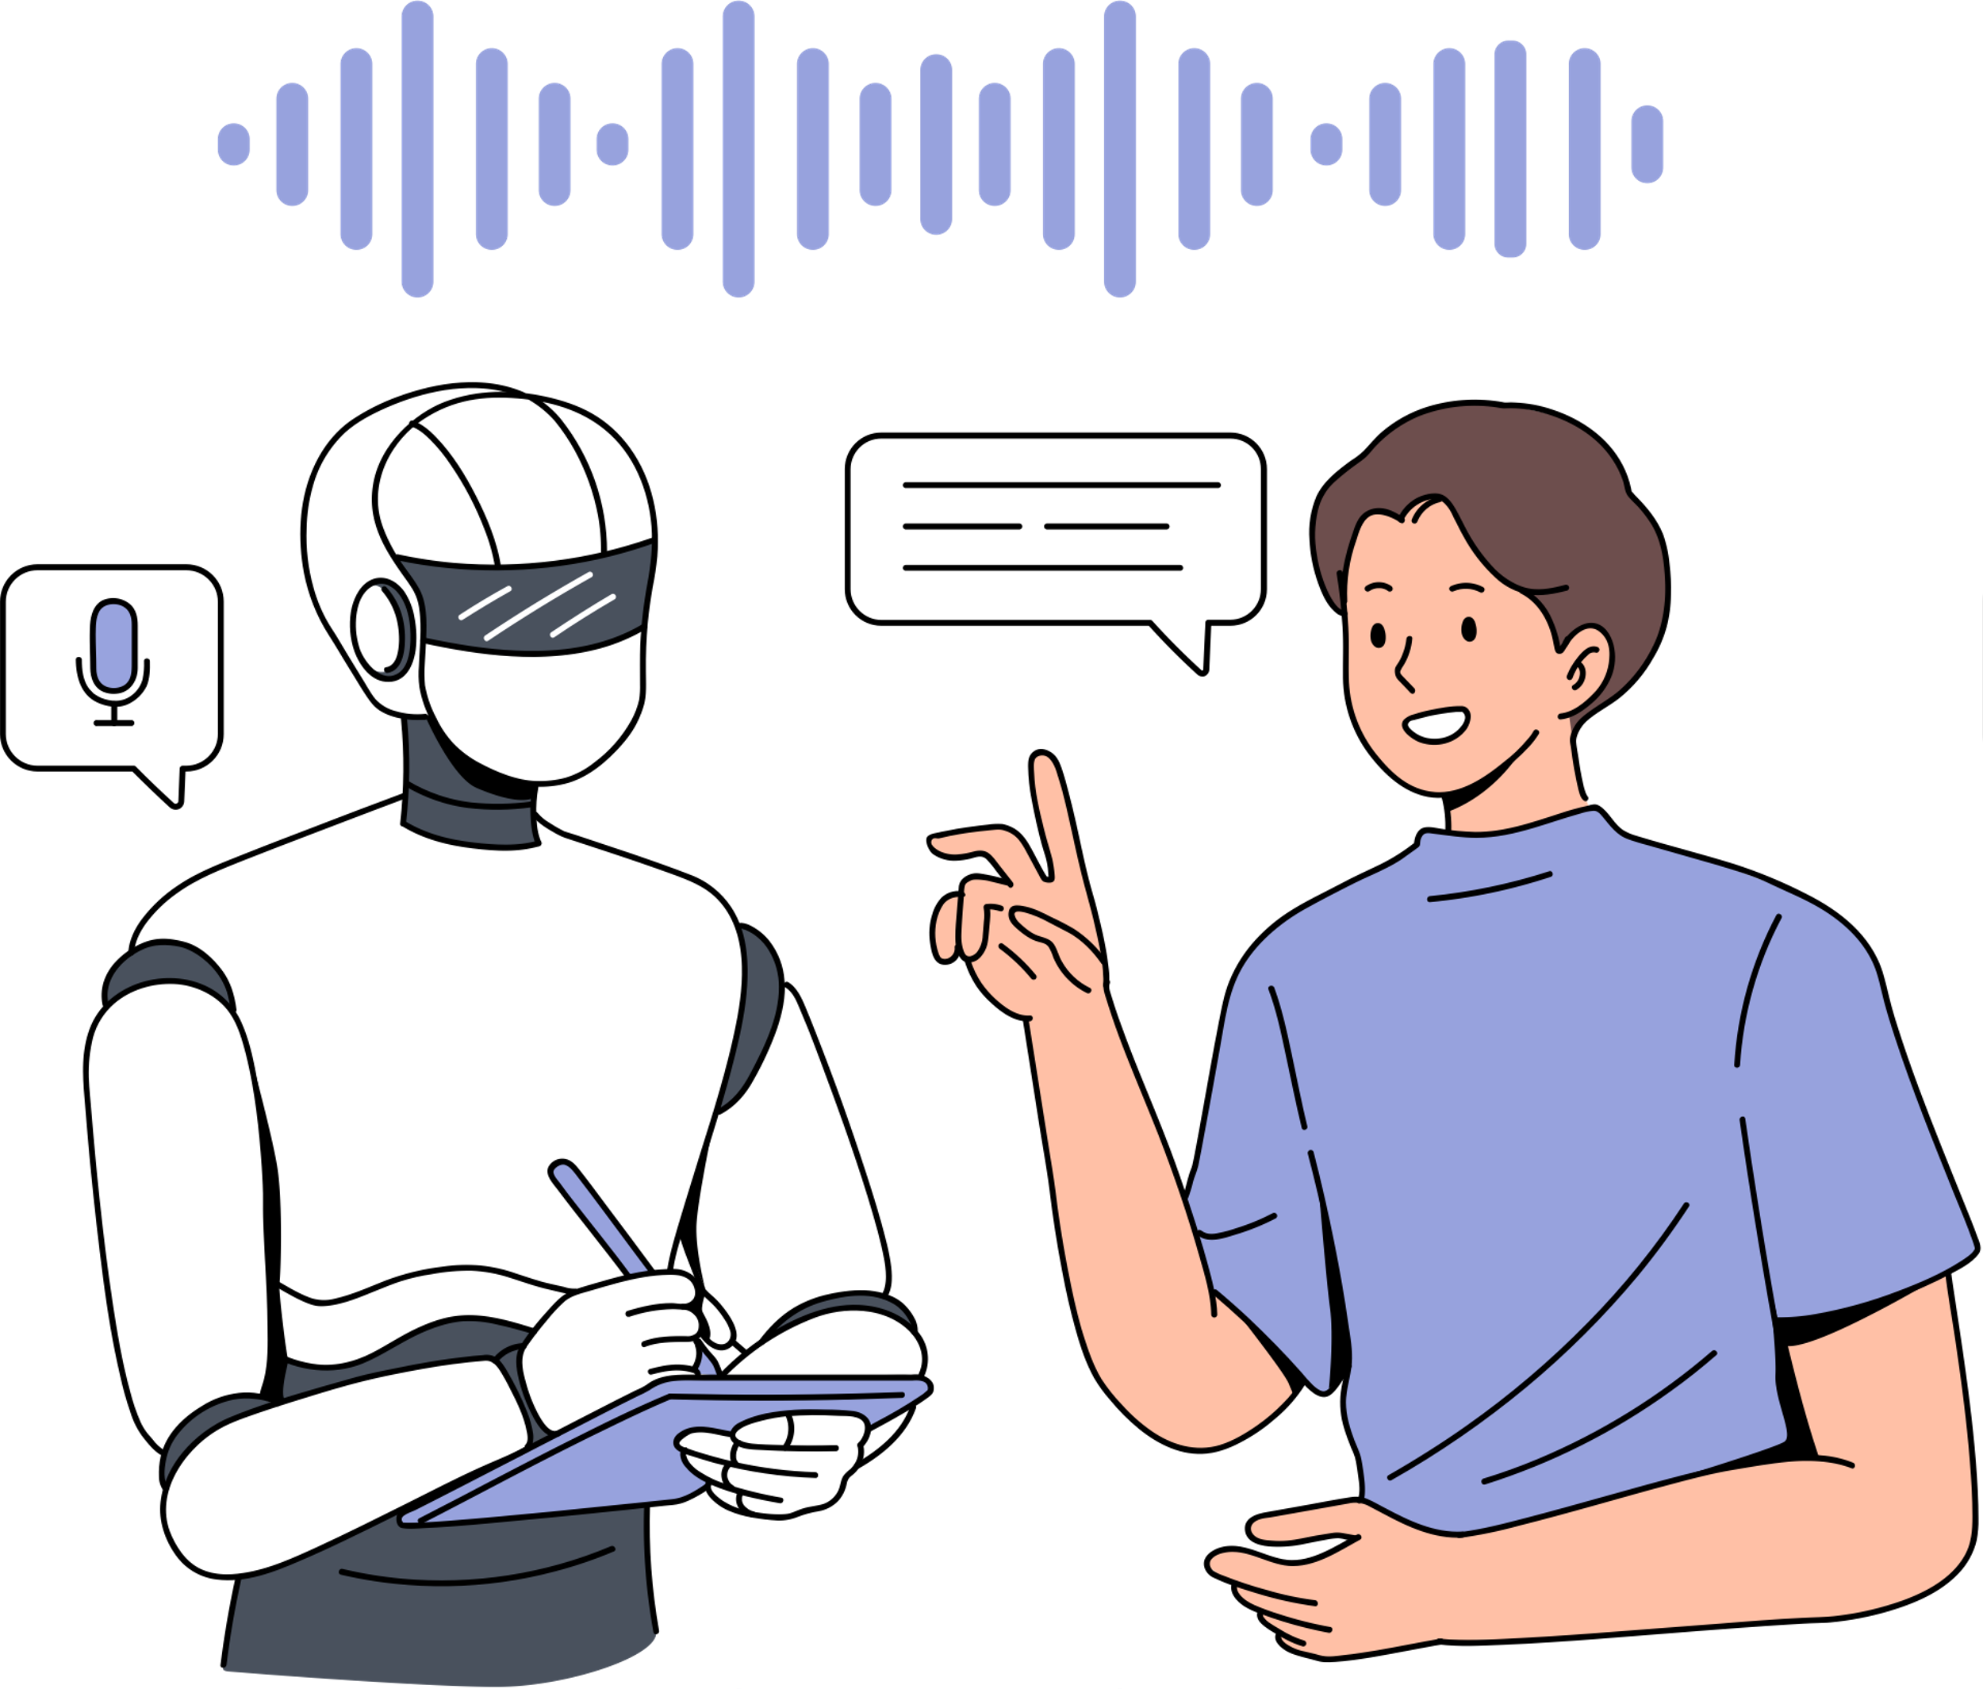
DISCUSSION
  The interpretation of students’ anxiety towards interactions with an AI chatbot
    Mixed reactions
      Some students are eager to continue using Call Annie for convenience and practice.
      Others prefer genuine human interaction for communicative development.
      “My accent can cause misunderstanding” ➔ personalized assistant could aid interactions
      Increased frequency of using the tool would enhance confidence during conversations
  Factors affecting speaking anxiety
  Technical issues and robotic feedback from the chatbot could be a hinderance to students’ motivation to share in class.
  Lack of language competence could create awkwardness when students remain silent in conversing with AI.
1

Slide 20

CONCLUSION
  Limitations
    Sample size needs variety and expansion for the enrichment of data.
    Methods for collecting data and reflections should be revised and adapted.
  Recommendations for effective use
    Teachers should guide students to use Call Annie for improving vocabulary and conversation skills.
    Balance efficient usage and error correction to maintain enthusiasm in social and academic contexts.
    Supports shy students with one-on-one interaction, reducing pressure in speaking.
  Future research suggestions
    Expand studies with larger and more diverse samples for generalizability.
    Conduct longitudinal studies to explore long-term impacts of AI tools on language learning.

Slide 21


