Slide 1
DEVELOPING AN ESSENTIAL ENGLISH VOCABULARY LIST (EVL)
FOR VIETNAMESE ELEMENTARY SCHOOL STUDENTS
August, 2025

Slide 2

01
Introduction
02
Research questions
Overview
03
Methodology
04
Results
05
Conclusion

Slide 3
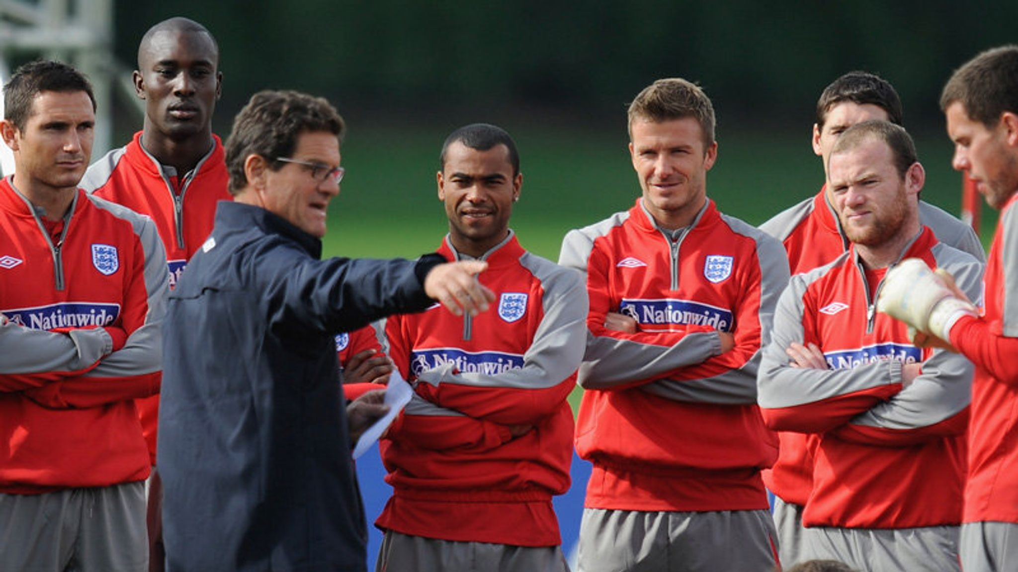
Introduction
01
1. How many words do our students need?
“I only need 100 words of English to communicate with England’s players.”
Fabio Capello
Former England national football team’s coach

Slide 4
Introduction & Rationale
01
1. How many words do our students need?
Primary level | 600-700 vocabulary items
Lower secondary level | 800-1000 vocabulary items (excluding the vocabulary at the primary level).
Upper secondary level | 600-800 vocabulary items (excluding the vocabulary at the primary and lower secondary levels).
MOET’s General Education English Curriculum 2018 (GEEC)

Slide 5
Introduction & Rationale
01
2. Which words should be taught?
English is estimated to contain around 10 million distinct words (Brysbaert, Stevens, Mandera, & Keuleers, 2016)
Instructional time is limited, making it essential to decide what content should be selected from the vast corpus of the target language to include in teaching.
Teachers often rely on their chosen textbooks to decide which words to teach
Notes:
/ˌsuː.pə.kæl.ɪ.frædʒ.ɪˌlɪs.tɪk.eks.pi.æl.ɪˈdəʊ.ʃəs/

Slide 6
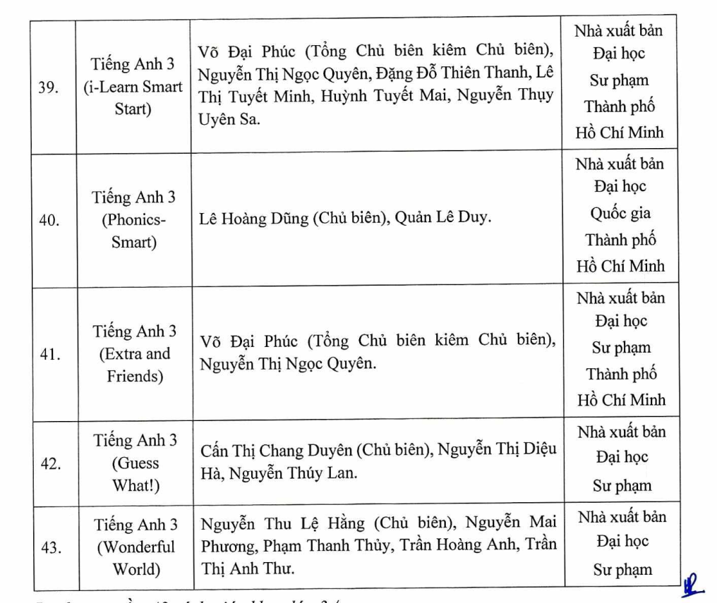
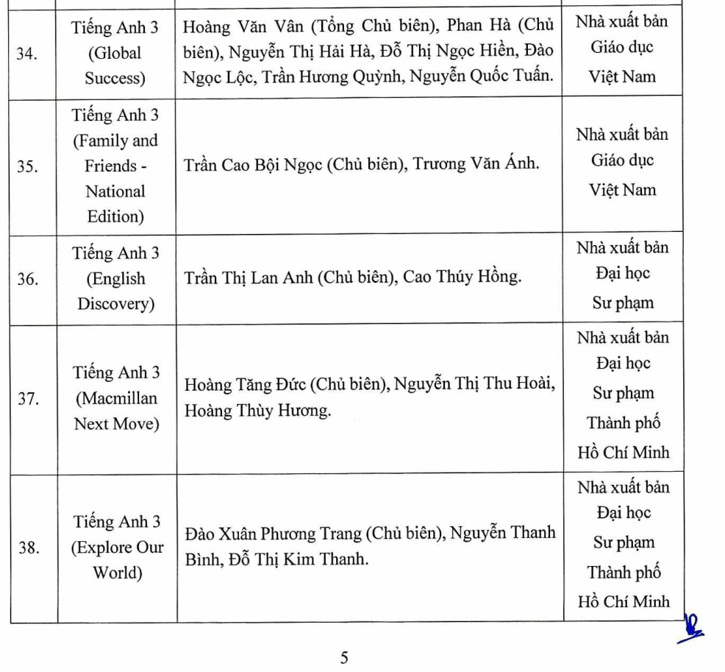
Decision 438/QĐ-BGDĐT
👉 This highlights the need for a standardized, relevant vocabulary list for Vietnamese learners.

Slide 7
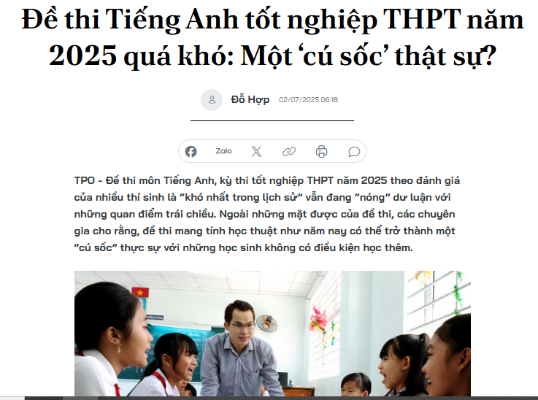
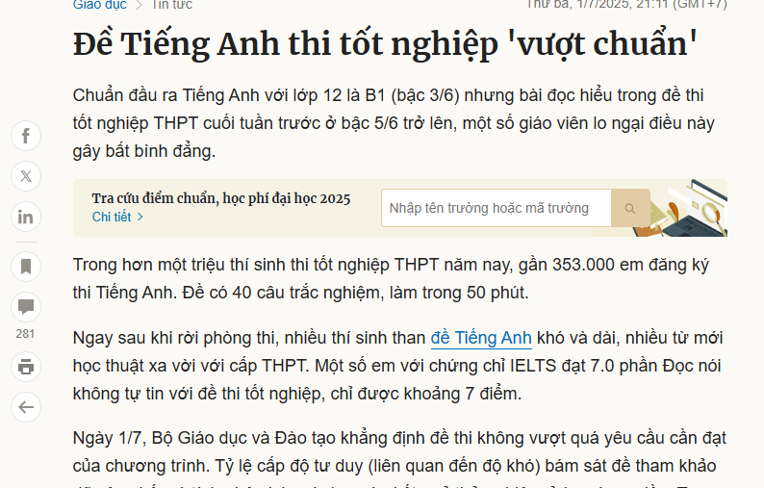
👉 This study aims to develop an essential vocabulary list (EVP) for Vietnamese learners at primary school level

Slide 8
Literature review
02
1. Criteria for Vocabulary Selection
Laufer & Nation (2012) proposed three key criteria:
Frequency
Difficulty
Usefulness
Notes:
/ˌsuː.pə.kæl.ɪ.frædʒ.ɪˌlɪs.tɪk.eks.pi.æl.ɪˈdəʊ.ʃəs/

Slide 9
Literature review
02
1.1. Frequency
Frequency is the most established criterion (Palmer, 1917; Nation, 2013).
About 80% of any English text comes from the 2,000 most frequent word families (Nation, 2015).
Frequent words appear often in speech and writing
=> Frequent words = easier to learn

Slide 10
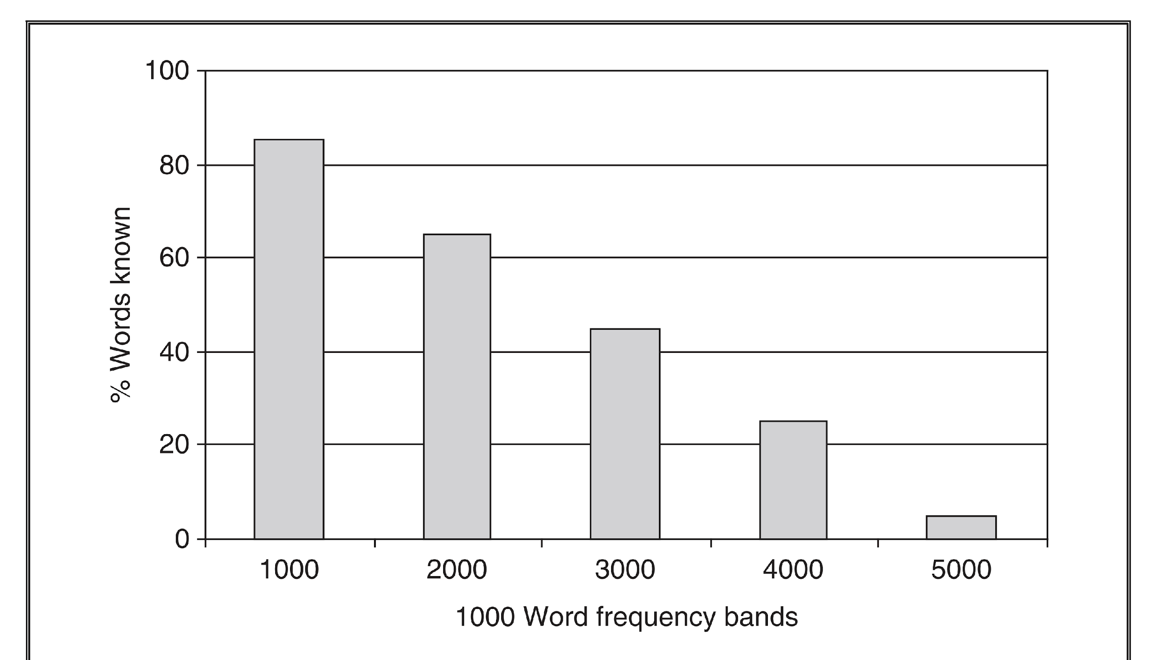
Vocabulary profile of a typical learner (Meara, 1992)

Slide 11
Literature review
02
1.1. Frequency
Measuring Frequency
With modern computing, frequency can be done by counting how often a word appears in a corpus (a large digital collection of texts)
Rank | Word | Frequency | Rank | Word | Frequency
1 2 3 4 5 | the he and to a | ﻿52,003 29,099 27,705 26,919 23,746 | 6 7 8 9 10 | of Harry was say have | 21,953 18,169 15,643 15,583 15,462
The top 10 most frequent word in all 7 Harry Potter books (1,091,462 tokens)

Slide 12
Literature review
02
1.1. Frequency
Frequency-based Wordlists
Many wordlists are built based on frequency data from large corpora.
Their size makes them reliable benchmarks of “normal” language use.
Wordlist | Corpus size
Nation’s (2012) BNC/COCA 2000 | 10 million tokens
Browne’s (2014) NGSL | >300 million tokens
Brezina and Gablasova’s (2015) New-GSL | > 12 billion tokens

Slide 13
Literature review
02
1.1. Frequency
Vietnamese teachers rarely use these lists (Dang et al., 2022).
Why?
Lists reflect native use, not L2 teaching materials
increase, economy, product, council: top 300.
Weekdays (Monday, Tuesday…): 2k–3k range.
Everyday classroom words (soap, chalk, stomach) are missing (Nation, 2016).
=> Frequency rank does not match how L2 learners should be taught.

Slide 14
Literature review
02
1.1. Frequency
Frequency-based CEFR-aligned wordlists
CEFR-based lists are useful because they show which words belong to each level, linked to the can-do descriptors.
Word lists | No. of items | Corpora
English Vocabulary Profile (Capel, 2010) | 4600 | CIC (1 billion words), CLC (40 million words)
Global Scale of English (Benigno & De Jong, 2019) |  | LCN (330 million words) UkWaC (2 billion words) corpus, COCA spoken (90 million words).
Oxford 3000 (Moore, 2020) | 3000 | OEC (2 billion words) OMC (7 million words)
Cambridge YLE (A1) | 776
CEFR-J (Tono, 2019) | 7815
Notes:
These lists use frequency from both authentic L1 texts and L2 teaching materials => ensures vocabulary reflects real language use and classroom priorities.
But to find the most suitable words for Vietnamese learners, we also need to consider the other two criteria: Usefulness and Learnability/Difficulty.

Slide 15
Literature review
02
1.2. Usefulness
Usefulness and frequency overlap, but one cannot replace the other (Laufer & Nation, 2012).
Frequent words are often useful.
Yet some infrequent words are also crucial, depending on learners’ need
  Curriculum content and teaching materials
  Societal and parental expectations
  Learner characteristics

Slide 16
Literature review
02
1.2. Usefulness
In EFL settings, teachers play a key role.
Their close involvement in instruction and interaction gives them insight into which words are most essential for communication and academic success (Laufer, 2003; Schmitt, 2008).
=> Teachers can identify the most useful words for their students (Laufer, 2003; Schmitt, 2008)

Slide 17
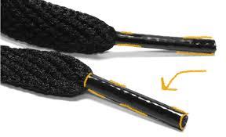
Literature review
02
1.3. Difficulty
Even frequent and useful words must be “just right”—not too easy, not too hard.
What Makes a Word Difficult?
Psycholinguistic properties – abstract words are harder; concrete words are easier.
Frequency – rare words are harder to learn
L1 influence – cognates/loanwords are easier
  Example: TV, salad, pizza, internet
aglet

Slide 18
Literature review
02
1.3. Difficulty
Measuring Word Difficulty
Like usefulness, difficulty can be judged by teachers
Teachers often rely (quite successfully) on their intuition about what is easy or hard (McCrostie, 2007; Sánchez-Gutiérrez et al., 2022).
Research on lexical richness uses teacher judgment to classify words as basic or advanced (Daller et al., 2003).

Slide 19
Literature review
02
Research question
This study draws on the three criteria—frequency, usefulness, and difficulty, to answer the question:
What are the most frequent, useful, and easy words for primary school learners at A1 level (CEFR).

Slide 20
Methodology
03
Participants
20 ESL teachers served as expert raters.
17 primary school teachers (Vietnam):
8 from Hanoi
3 from Ho Chi Minh City
3 from Hai Phong
2 from Thai Nguyen
1 from Lao Cai
3 university lecturers with experience in textbook writing and material development.
Average teaching experience: 9.52 years (SD = 3.22).

Slide 21
Methodology
03
Step 1. Creating a Master List
Combined A1-level items from 5 CEFR-aligned wordlists.
Selected only single-word items (excluded multi-word items).
Chose lemma as the unit of counting:
  A word family assumes knowledge of both inflected and derived forms (e.g., act → actor, actress, active).
  L2 beginners usually recognize only inflectional forms (act → acts, acted, acting).
=> Lemma is therefore more appropriate for A1 learners and is widely used in CEFR wordlists.

Slide 22
Methodology
03
Step 1. Creating a Master List
Only 310 lemmas are shared among all 5 wordlists
Total number of combined lemmas are 1610.
Wordlist | Number of A1 lemmas
CEFR-J (A1) | 1024
EVP (A1) | 555
Cambridge A1 | 776
GSE (A1) | 760
Oxford A1 | 863

Slide 23
Methodology
03
Step 2. Creating a corpus
To obtain reliable frequency counts, a specialized corpus was created using materials widely used in Vietnam:
Vietnamese primary textbooks – texts from all 10 MOET-approved sets of textbook.
International ESL textbooks – 10 widely used titles, selected based on teachers’ recommendations.
Cambridge exam practice tests – 11 Starters and Movers practice test books.
Texts from the selected materials were scanned and digitalized using OCR tools and checked for spelling accuracy.
=> Total corpus: 578,231 tokens.

Slide 24
Corpus | Sources | Tokens
(1)MOET textbooks | Phonics – Smart (1, 2, 3, 4, 5) | 40650
 | Macmillan Next Move (1, 2, 3, 4, 5) | 33356
 | Explore Our World (1, 2, 3, 4, 5) | 42650
 | i-Learn Smart Start (1, 2, 3, 4, 5) | 47450
 | Extra and Friends (1, 2, 3, 4, 5) | 39063
 | Global success (1, 2, 3, 4, 5) | 42594
 | Family and Friends - National Edition (1, 2, 3, 4, 5) | 39982
 | English Discovery (1, 2, 3, 4, 5) | 35180
 | Guess What (3, 4, 5) | 38102
 | Wonderful World (3, 4, 5) | 36431

Slide 25
Corpus | Sources | Tokens
(2) International ESL Books A1 level | Practise and Pass YLE Starters | 12781
 | Practise and Pass YLE Movers | 14106
 | Prepare! A1 Level 1 | 34196
 | Empower: A1 Starter | 26294
 | Fun for Starters | 4426
 | Fun for Movers | 6742
 | Let’s Go: Starter | 3847
 | Get ready for Starters | 5078
 | Get ready for Movers | 4816
 | Navigate A1 Beginner | 7239

Slide 26
Corpus | Sources | Tokens
(3) Practice tests A1 level | YLE Test For Starters | 4312
 | Practice Tests Plus: Pre A1 Starters | 4843
 | Practice Tests Plus: A1 Movers | 8524
 | Pre A1 Starters Mini Trainer | 4642
 | A1 Movers Mini Trainer | 7954
 | Starters Authentic Examination Paper | 8798
 | Movers Authentic Examination Paper | 12609
 | Richmond Practice Tests Starters | 2559
 | Richmond Practice Tests Movers | 6523
 | Pre A1 Starters Three Practice Test | 2484
 | A1 Movers Three Practice Test | 6813

Slide 27
Methodology
03
Step 3. Frequency Counting
Frequencies of the headwords in the master list were calculated using AntWordProfiler (Anthony, 2024).
Frequencies were calculated by summing all forms of each lemma.
Rank | Headword | Members of lemma | Freq.
1 | a | a an | 28069
2 | be | be is are was am were being | 24738
3 | and | and | 21774
4 | I | I me my mine | 21662
5 | you | you your | 20234
… | … | ... | …
14 | what | what | 6477
15 | listen | listen listening listened listens | 6441
Notes:
The most frequent items were function words.
The first content word (listen) appeared only at rank 15.

Slide 28
Methodology
03
Step 4. Adjusting the master list
Treatment of Function Words
Function words are not typically taught as vocabulary items.
Most function words were removed using the list by Biber et al. (1999).
Exceptions were kept (do, half, have, like, back, round, last) because they also serve as content words in different contexts.
Words for days of the week and months of the year were also removed.
In total, 159 words were removed from the original master list.
These words will be included in the Appendix of the final list.

Slide 29
Auxiliary verbs am are is was were be been being get gets getting got can could may might must ought shall should will would
Conjunctions after albeit although and as because before but for how however if neither nor or since so than that though till unless until what whatever when whenever where whereas wherever while whither which who whoever whom whose why yet
Prepositions about above across against along among around at behind below beside besides between beyond by despite down during except from in into near of off on onto over per round through throughout towards under unlike up upon via with within without
Adverb particles aside away out still
Determiners a all an another any both each either enough every few less many more most much no other others several some such the these this those
Pronouns he her hers herself him himself his I it its itself me mine my myself our ours ourselves she their theirs them themselves they us we you your yours yourself yourselves anybody anyone anything anywhere everybody everyone everything everywhere nobody none nothing nowhere somebody someone something somewhere
Numbers eight eighteen eighteenth eighth eightieth eighty eleven eleventh fifteen fifteenth fifth fiftieth fifty first five fortieth forty four fourteen fourteenth fourth hundred next nine nineteen nineteenth ninetieth ninety ninth once one second seven seventeen seventeenth seventh seventieth seventy six sixteen sixteenth sixth sixtieth sixty ten tenth third thirteen thirteenth thirtieth thirty thousand three twelve twentieth twenty twice two zero
Days and Months Monday, Tuesday, Wednesday, Thursday, Friday, Saturday, Sunday January, February, March, April, May, June, July, August, September, October, November, December.
Others there not to

Slide 30
Methodology
03
Step 4. Adjusting the master list
Spelling Variations
Items with British / American spelling were merged.
The more frequent form was kept as the headword.
  chips (74) + fries (38) → chips (112)
  gray (32) + grey (67) → grey (99)
  burger (63) + hamburger (37) → burger (100)
Final Master list
After all adjustments, the master list contains 1,231 lemmas.

Slide 31
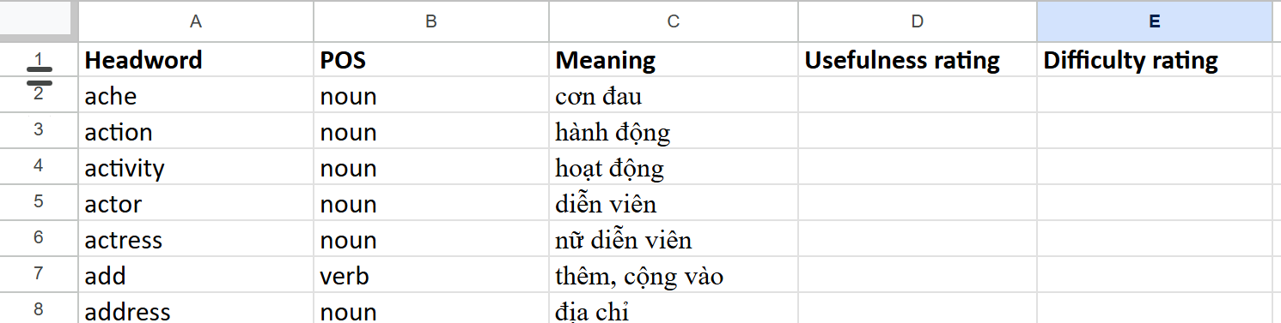
Methodology
03
Step 5. Rating usefulness and difficulty
An online survey was created to gather teacher ratings.
  Section 1: Teacher background (academic training, teaching experience).
  Section 2: Ratings of usefulness and difficulty for 1,231 lemmas.

Slide 32
Methodology
03
Step 5. Rating usefulness and difficulty
Rating Scales
Teachers rated each lemma on two Likert scales
Usefulness (Simpson-Vlach & Ellis, 2010)
  7-point scale: 1 = indispensable → 7 = not worth teaching.
Difficulty (Bardel et al., 2012)
  7-point scale: 1 = basic/easy → 7 = advanced/difficult.

Slide 33
Methodology
03
Step 6. Measuring Reliability of Ratings
Agreement among raters measured as the largest proportion in any two adjacent categories (value between 0 and 1).
A one-point difference does not indicate real disagreement (e.g., 2 vs. 3).
Example
20 ratings: 10 rated 2, 5 rated 3, 5 rated 4 → Reliability = (10+5)/20 = 0.75.
20 ratings: 8 rated 2, 5 rated 3, 7 rated 4 → Reliability = (8+5)/20 = 0.65.

Slide 34
Methodology
03
Step 7. Rescaling raw frequency
Frequency values of 1,231 lemmas ranged from 9983 to 0.
To align with teacher ratings, the data was rescaled in three steps:
Absolute ranking: 1 (most frequent) → 9983 (least frequent).
Normalization: rankings converted using Fischer’s z transformation.
Linear regression scaling: z-scores mapped to a 1,0–7,0 scale
  1,0 = highest frequency
  7,0 = lowest frequency

Slide 35
Methodology
03
Step 8. Combining frequency, usefulness and difficulty
A formula was used to combine frequency with usefulness and difficulty ratings into one value to ranks the lemmas.
FreqRank → how frequent the word is (on 1–7 scale).
Usefulness_avg → average usefulness rating from teachers.
Difficult_avg → average difficulty rating from teachers.
Rᵤ → reliability of usefulness ratings.
Rd → reliability of difficulty ratings.
Notes:
This formula blends three criteria—frequency, usefulness, and difficulty—into one combined score.
If Rᵤ is big, usefulness gets more influence.
If R_d is big, difficulty gets more influence.
If both are small, frequency dominates.

Slide 36
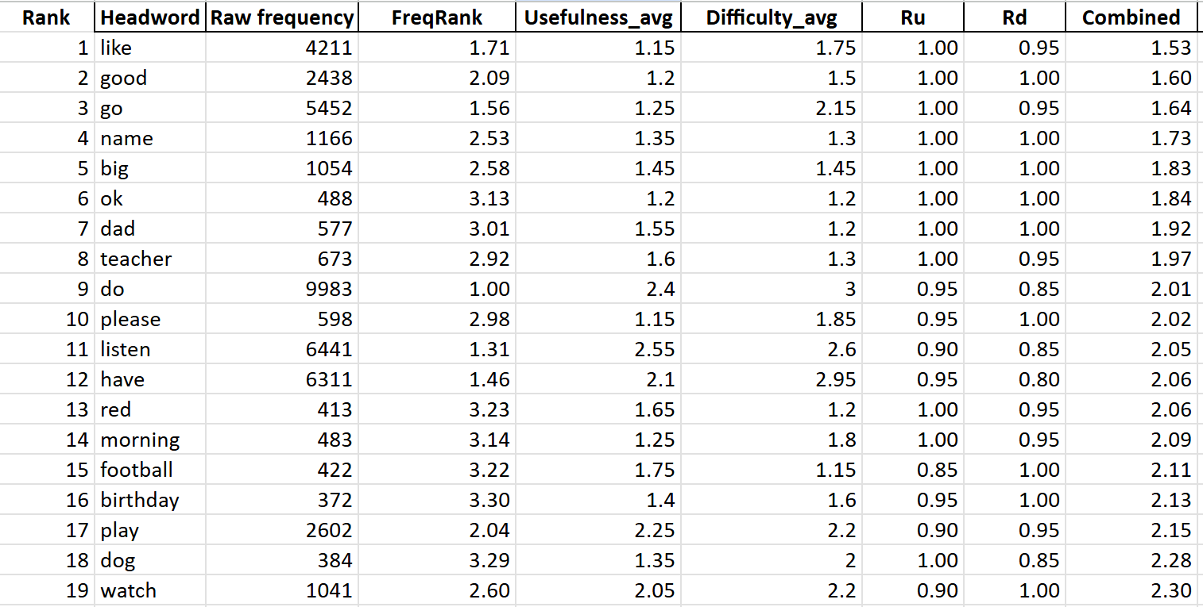
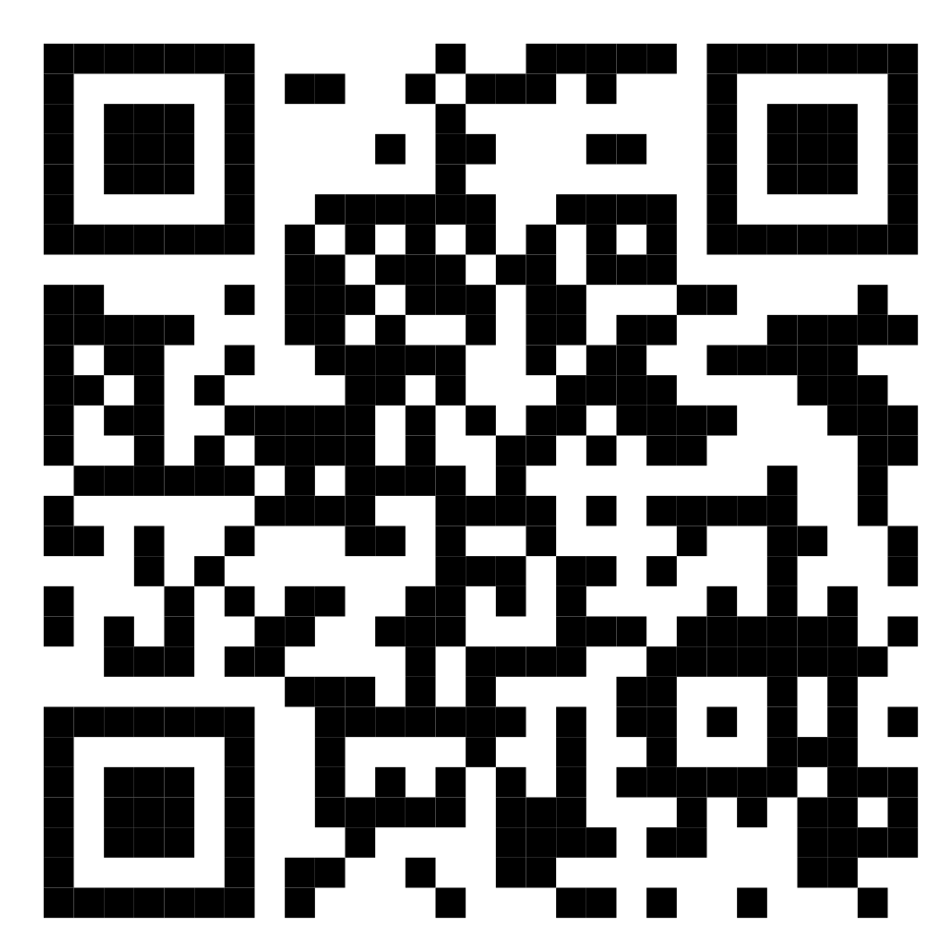
RESULTS AND DISCUSSION
04
Ranking of 1,231 A1-level lemmas
This list shows the ranking of 1231 A1-level lemmas according to the combined score

Slide 37
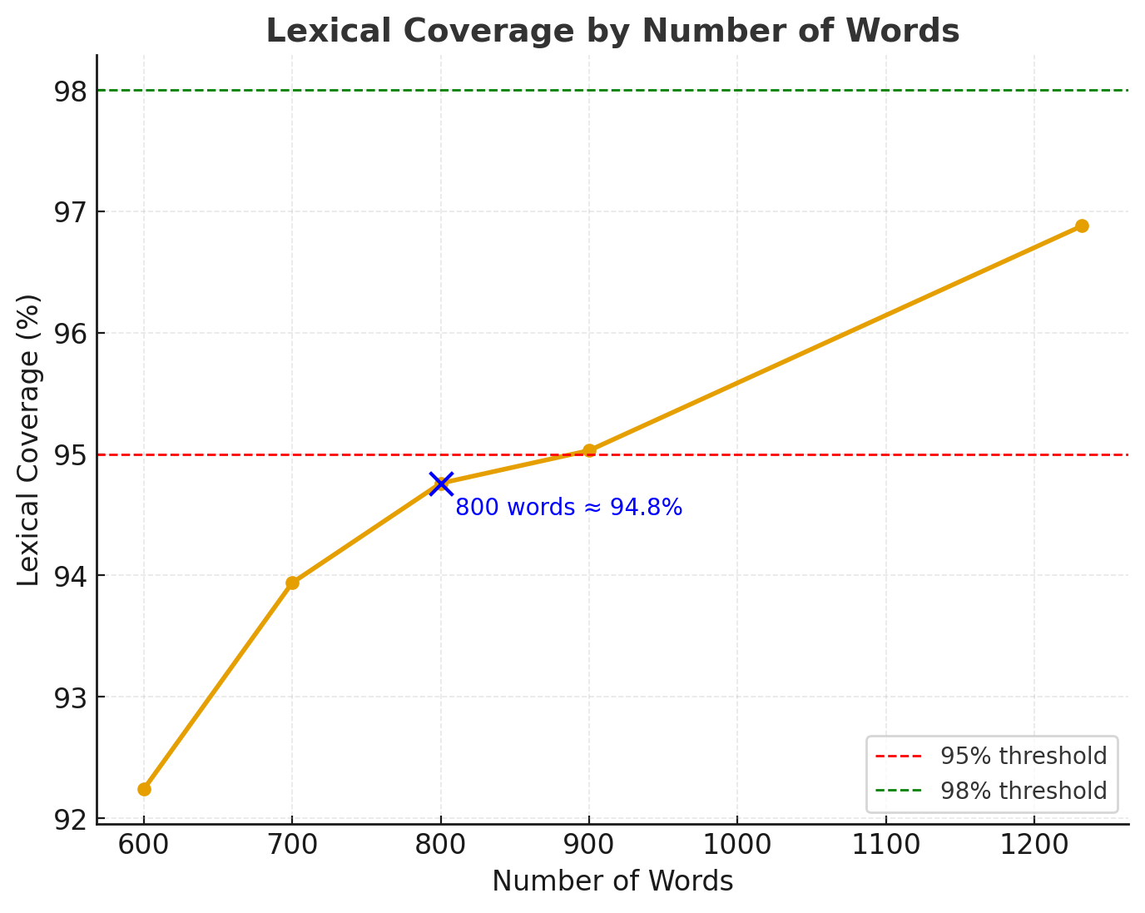
RESULTS AND DISCUSSION
04
Number of headwords for EVP
Coverage of the corpus
All 1,231 items = 96.88%.
First 600 words = 92.24%.
First 700 words = 93.94% (+1.7%).
First 800 words = 94.76% (+0.82%).
First 900 words = 95.03% (+0.27%).
95% coverage = minimal comprehension
(Laufer & Ravenhorst-Kalovski, 2010).

Slide 38
05
CONCLUSION
Developed a list of of 800 A1-level lemmas for Vietnamese primary learners.
Applied the three key criteria: Frequency, Usefulness, Difficulty.
This study offers a practical, CEFR-aligned vocabulary list to support teaching, learning, and material development in Vietnam.

Slide 39
THANK YOU FOR LISTENING

