Slide 1
Exploring the Role of AI
in Vietnamese-English Translation Pedagogy:
Insights from EFL Learners
By Tat Thien Thu, Trinh Quoc Lap, Le Cong Tuan,
Nguyen Thi Phuong Hong & Vo Kim Huong
Can Tho University

Slide 2
Outline
Introduction
Research Aim & Questions
Literature Review Highlights
Theoretical Framework: Sociocultural Theory
Methodology
Findings & Discussions
Conclusion & Impication

Slide 3
Introduction
- AI is reshaping education, especially language learning.
- Vietnamese EFL students increasingly use tools like Chat GPT, Gemini.
- Raises questions: AI as a tool or a crutch?

Slide 4
Research Aims & Questions
Aim:
- Explore how AI tools mediate Vietnamese-English translation for EFL learners.
Research Questions:
1. How do students perceive and use AI?
2. How does AI affect translation skill development?
3. What role do lecturers play in guiding AI use?

Slide 5
Literature Review Highlights
Benefits of AI:
- Speed, grammar support, fluency
Challenges:
- Over-reliance, handwriting loss, AI opacity
Gap:
- Limited research in Vietnamese EFL translation contexts

Slide 6
Theoretical Framework: Sociocultural Theory
- AI as a cultural tool (Vygotsky, 1978):
  - Mediated action in learning
  - Zone of Proximal Development (ZPD)
- Lecturers as More Knowledgeable Others (MKO)

Slide 7
Methodology
Research design:
- Mixed-methods approach
- 61 EFL university students
Instruments:
- AI-assisted vs. traditional translation tests
-Semi-structured interviews with top & bottom scorers

Slide 8
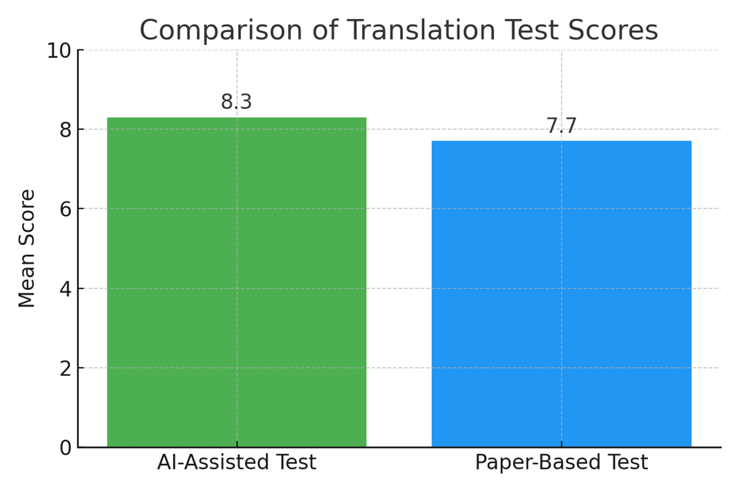
Key Findings – Test Results

Slide 9
Key Findings – Test Results
Scores with AI (8.3 vs. 7.7)
- AI benefits: 100% test completion
- AI errors:
  + lexical confusion (e.g., Bơ: Butter/ avocado),
  + grammatical inappropriateness (e.g., compound nouns),
  + formatting (e.g., justification, indent, paragraph separation),
  + structures (e.g., affirmative vs negative)
Paper-based issues:
+ grammar,
+ time,
+ handwriting

Slide 10
Samples of AI Translation
7. Dịch lá thư sau sang tiếng Anh/ Translate the letter into English
Dear Mr. Minh,
We would like to thank your company's offer letter dated March 20, 2022, which includes a promotion program for some items during the upcoming holiday. Would you please send us 50 sets of high-quality ceramic tableware with Minh Hoa brand, 100 tablecloths with size 50 x 70 cm in blue cotton fabric code MH 02022, 100 bags of Thai oolong tea. Original premium, 100g/bag.
Pay in cash on delivery as usual.
We hope to receive the goods by the end of this week and appreciate your expedited order.
Yours faithfully,
Head of purchases,
Huong Que Hotel, Restaurant & Service Joint Venture Company.

Slide 11
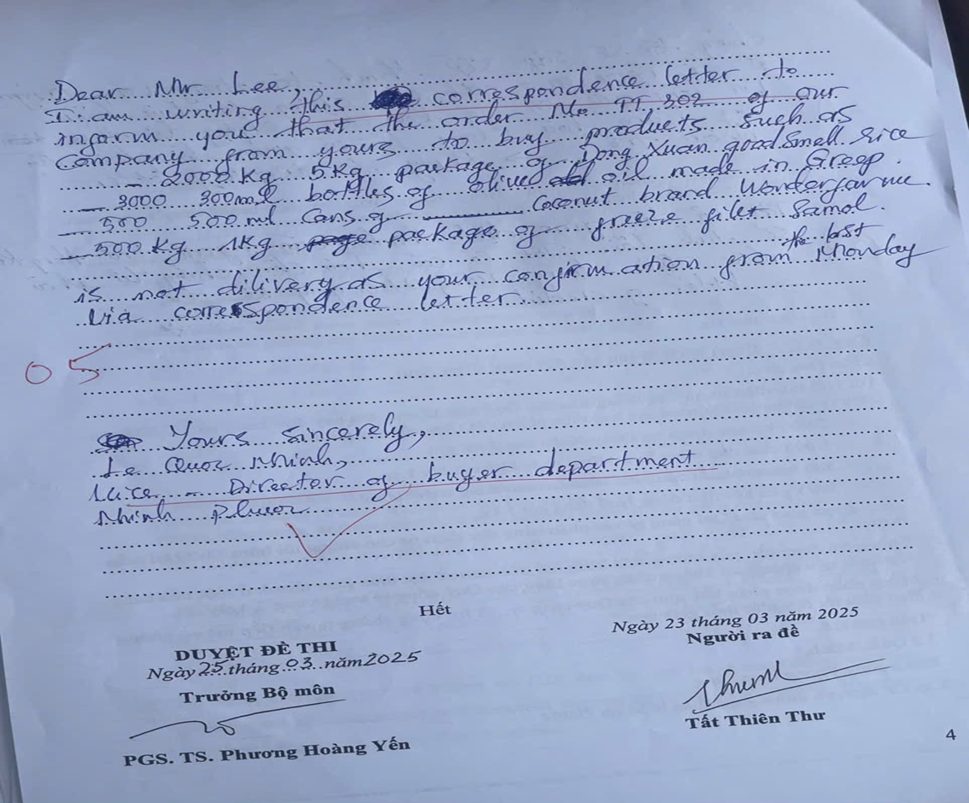




A Sample of Paper-Based Translation

Slide 12
Key Findings – Student Voices (1)
1. AI Benefits:
- Speed and efficiency
- Confidence,
- Corrections
2. AI Limitations:
- Dependency
- Cultural issues
- Time pressure
- Shallow engagement
- False confidence

Slide 13
Key Findings and Discussions
1. AI Benefits
- Efficiency and Speed: (Charles-Kenechi, 2024; Han, 2020)
- AI as a Vocabulary and Grammar Aid (Lee, 2020; Zhai & Wibowo, 2023)
- Post-editing (PE) Skills: (Alharbi, 2023; Olkhovska & Frolova, 2020).
- A friendly, helpful tutor to students
2. AI Limitations
- Lack of Cultural and Contextual Understanding (Zetzsche, 2019; Wilks, 2008).
- The Need for Human Intervention (Olkhovska & Frolova, 2020).
3. Students’ Risks:
- Over-reliance
- Lack of deskilling (Almusharraf & Bailey, 2023;
- False confidence

Slide 14
Key Findings and Discussions (2)
4. The Role of Lecturers
- Traditional roles
+ Teaching theory and principles of translation,
+ Assigning and managing tasks and classroom activities
+ Reviewing and revising students’ mistakes
- New Roles:
+ Higher-order skills
(Hazaea & Qassem, 2024; Karamanoğlu Mehmetbey Üniversitesi, 2023).
+ Training AI literacy (Tavares et al., 2023).
+ Evaluating AI output
+ Explaining AI decisions

Slide 15
Conclusion & Implications
- AI can enhance but not replace learning
- Lecturers needed to
+ Scaffold AI use and must balance its use
+ Promote reflection and critical thinking
+ Promote AI literacy & reflective practice
+ Apply hybrid assessments
Students
+ upgrade AI literacy
+ use AI as a friendly aid

Slide 16
Reference
Alharbi, A. S. (2023). AI technology in foreign language teaching and learning: Advantages and disadvantages. International Journal of Language and Linguistic Studies, 19(2), 1-13.
Almusharraf, N. S., & Bailey, J. (2023). Exploring the use of machine translation tools in foreign language education: A study of Saudi and Korean university students. Frontiers in Psychology, 14, 1-12.
Charles-Kenechi, S. (2024). Artificial Intelligence in Translation Studies: Benefits and Challenges. Cascades: Revue Internationale du Departement de Francais Et D'etudes Internationales, 2(1), 1-14.
Hazaea, M., & Qassem, A. (2024). The Benefits and Challenges of AI Translation Tools in Translation Education at the Tertiary Level: A Systematic Review. International Journal of TESOL & Education, 4(1), 1-22.
Karamanoğlu Mehmetbey Üniversitesi. (2023). Enhancing Translation Studies with Artificial Intelligence (AI): Challenges, Opportunities, and Proposals. Karamanoğlu Mehmetbey Üniversitesi.
Koka, S. (2024). The Benefits and Challenges of AI Translation Tools in Translation Education at the Tertiary Level: A Systematic Review. International Journal of TESOL & Education, 4(1), 1-22.
Lee, Y. (2020). The Use of Machine Translation in EFL Writing: Effects on Students' Writing Quality and Perceptions. Journal of English Language Teaching and Applied Linguistics, 2(1), 1-15.
Musa, A. S., et al. (2022). Evaluating Translation AI's Effectiveness in Enhancing English Vocabulary Acquisition Among University Students. Journal of English Language Education, 9(1), 115-130.
Olkhovska, A., & Frolova, I. (2020). Using Machine Translation Engines in the Classroom: A Survey of Translation Students' Performance. Advanced Education, (15), 47-55.
Tavares, P., et al. (2023). Artificial Intelligence-Assisted Translation in Education: Academic Perspectives and Student Approaches. ResearchGate.
Wilks, Y. (2008). Machine translation: Its scope and limits. Oxford University Press.
Zetzsche, L. (2019). Machine Translation and the Human Factor. The ATA Chronicle, 48(4), 16-19.
Zhai, Y., & Wibowo, S. (2023). The Impact of Using AI on Students' Performance in Translation Courses. Journal of Humanities and Social Sciences, 10(2), 1-14.

Slide 17
Thank You.
Questions & Answers

