Slide 1
Developing learners listening skills. by Sid Ali RAHBA
VIETESOL International Convention 2025
29 August 2025

Slide 2
Which one we are NOT doing today?
    Understand the difference between Practicing and developing listening skills.
    Learn the advantages of developing (decoding) skills?
    Look at an example activity.
    Plan an activity together.

Slide 3
Concept clarification
Do you know the difference between practicing and developing listening skills?​

Slide 4
Concept clarification
məst teɪk
məst teɪk
    Practicing vs developing listening skills
A: Alright, I've got “yes”.
B: I’ve got “no”.
A: You must take the side of yes in the debate.
B: And you must take the side of no the debate.
A: Okay! Should children wear uniform at school?
Listen and write the missing words.
A: Alright, I've got “yes”.
B: I’ve got “no”.
A: You must take the side of “yes” in the debate.
B: And you must take the side of “No” in the debate.
A: Okay! should children wear uniform at school?
/məsteɪk/
/məsteɪk/
……….………
/ʃəˈʧɪldrən/
………………
……….………
……….………
Notes:
1- show the first shape: say “ look at this listening task. This task targets key information to understand the text, this can help students with test preps. We can also hide the modals must and should if we want to encourage students to notice them before teaching a grammar lesson. Both wouldn’t help students develop their listening skills.
2- now look at this ( and show next task). What does this task focus on? Phonology. The elision of /t/ in should take and /d/ in should children. Now this task helpos your students develop their listening skills or their decodinf skills. It helps them match sounds to the words they probably already know, but just couldn’t understand because they were said fast ……
Image source: https://www.youtube.com/watch?v=J34H9wn2_ms
( if we can’t use the video, there is an audio on top to be used instead)

Slide 5
What are the benefits of developing learners ' decoding skills?

Slide 6
The benefits of developing decoding skills
    It helps students recognize how words sound in rapid/connected speech.
    Helps learners understand authentic use of English.
    Prepares for real life English not coursebook/tests English.
    Better pronunciation
Notes:
Ask : What do you think is the benefit of this approach? ( focusing on phonology instead of key information or language) then reveal answers
Image source: https://www.youtube.com/watch?v=J34H9wn2_ms

Slide 7
Let’s look at an example activity

Slide 8
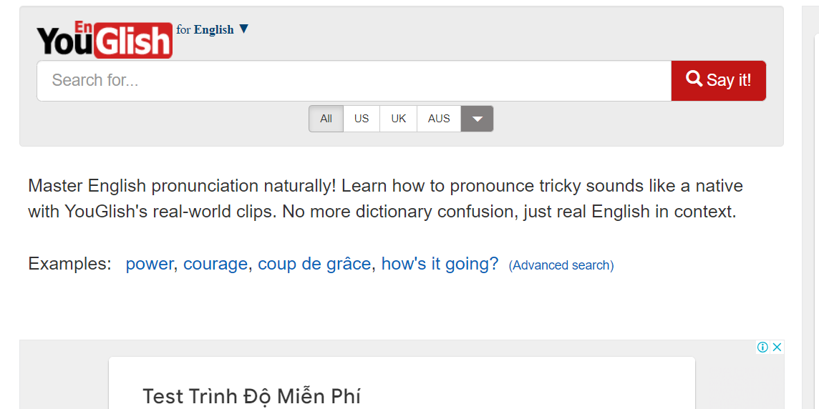
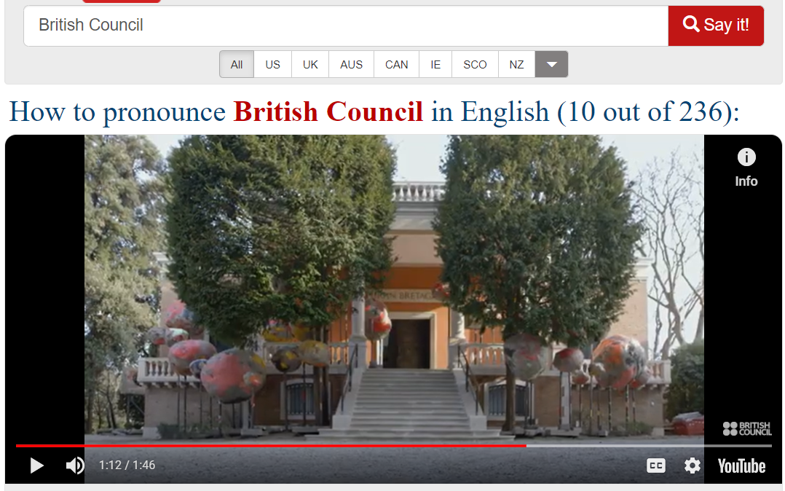



Let’s look at an example activity
    Gap-fill
idea from R. Cauldwell, www.speechinaction.org
Connected speech
Spontaneous speech
Citation speech
?
Explain why
“Should children”
/ʃʊˈʧɪldrən/
When a word ends with /d/ and the next one starts with a consonant sound, the /d/ sound disappears.
?
?
No Technology in the classroom?
Micro dictation
1- You ……………. the side of yes in the debate.
2- ………………………….. wear uniform at school?
Was it easy to listen ?
Why couldn’t you understand?
… should be
… cold shower
… left the party
.. managed to
What do you hear?
1- …………………………………..
2- …………………………………..
3- …………………………………..
Can you give me a few elision examples? ( elision of /t/ or /d/).
..... Should be
….. Hard choice
…… Proud parents
…… Kind gesture
Notes:
Take them through the activity
1 see the activity. Explain how the activity is done. And explain Richard C’s botanic garden concept and how it helps with noticing features.
Raise awareness to phonology features and their rules.
Ask Have you ever used YouGlish with your students? Tell me in the chat/ comments
Talk about how to do a practice activity using YouGlish.
5 Ask : Would you try this with your students ? Do you think they will enjoy it?

Slide 9
Tell me in the chat/comments
What are TWO things that you want to remember from this session?

Slide 10
Any questions?
Q/A

Slide 11
Thank you for listening!
You can find me on: https://www.linkedin.com/in/sid-ali-rahba-056040101/

