Slide 1

IMPACTS OF SOCIAL AND EMOTIONAL LEARNING (SEL) INTEGRATION INTO VIETNAMESE HIGHER EDUCATION CURRICULA ON STUDENT WELL-BEING AND ACADEMIC SUCCESS
Can Tho, August 30th, 2025
Nguyen Thi Kieu Huong
Tao Thi Thuy Khe
Nguyen Thanh Xuan

Slide 2
INTRODUCTION
Higher education => A vital context
Social and Emotional Learning (SEL) framework foster essential competencies
Its limited integration in higher education in VN
Notes:
In recent years, higher education has increasingly been recognized as a vital context for supporting students’ holistic development, particularly their mental and emotional well-being. University students often encounter stressors such as academic demands, financial burdens, and social transitions, which can negatively impact their mental health and academic performance. In response, Social and Emotional Learning (SEL) has emerged as a promising framework to foster essential competencies like self-awareness, emotional regulation, and interpersonal skills. While SEL has been widely implemented at the K-12 level globally, its integration in higher education—especially in non-Western contexts like Vietnam—remains limited. Vietnam’s higher education system, amid rapid reform and globalization, faces growing mental health challenges among students. However, the lack of structured, culturally responsive SEL initiatives—exacerbated by traditional pedagogy and limited awareness—continues to hinder comprehensive student support.

Slide 3
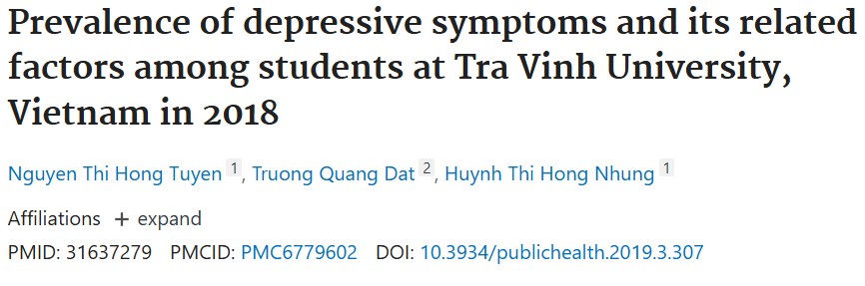
Context of Student Mental Health
in Vietnam
Depressive Symptoms – Tra Vinh University (2018)
405 students
+ 52.3% prevalence of depressive symptoms including
+ First-year students had a rate of 39.9%, rising to 47.1% by the fourth year
Notes:
Recent studies highlight a serious mental health concern among Vietnamese university students.
Depressive Symptoms – Tra Vinh University (2018)
A study of 405 students reported an overall prevalence of depressive symptoms at 52.3%, including 24.2% with mild-to-moderate depression and 20.7% with major depression. First-year students had a rate of 39.9%, rising to 47.1% by the fourth year

Slide 4

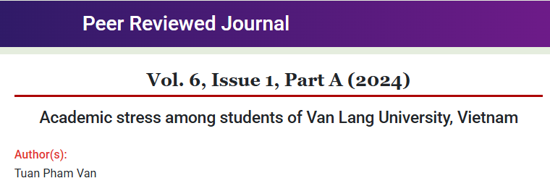
A cross-sectional survey of 439 students found that:
70.5% experienced moderate academic stress
13.9% had mild stress
15.3% suffered from severe stress

Slide 5
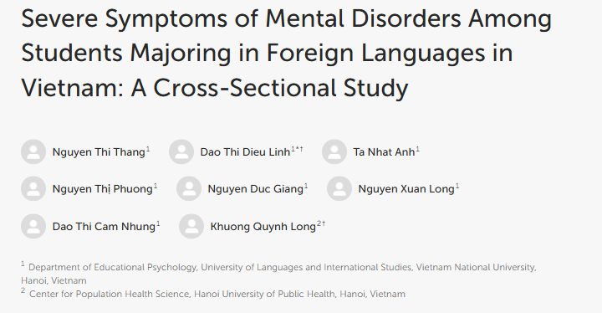
Context of Student Mental Health
in Vietnam
Among students majoring in foreign languages:
21.1% suffered severe depression,
35.0% suffered severe anxiety,
and
16.3% suffered severe stress
Notes:
Mental health disorders among university students have been a serious issue in many countries and can negatively affect academic performance and all aspects of daily living, relationships, and physical health.

Slide 6
Context of Student Mental Health
in Vietnam
1.8% of students showed stress symptoms,
81.6% had anxiety,
57.1% reported depression, with severe-to-very severe cases in 7.96% (stress),
35.9% (anxiety),
and 8.6% (depression)

Slide 7
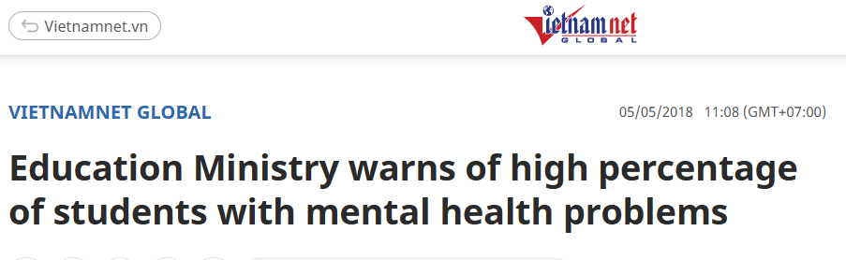
The MOET also found:
80% of students expressed the need for private counseling spaces at school,
and
20% exhibited mental health problems needing treatment

Slide 8
These alarming statistics
the urgency of integrating Social and Emotional Learning (SEL) initiatives
to support student well-being and academic performance in Vietnamese higher education.
Notes:
These alarming statistics underscore the urgency of integrating Social and Emotional Learning (SEL) initiatives to proactively support student well-being and academic resilience in Vietnamese higher education.

Slide 9
RESEARCH OBJECTIVES
General Objective
To evaluate the impacts of integrating Social and Emotional Learning (SEL) into higher education curricula on student well-being and academic performance in the context of Vietnamese universities from 2025 to 2026.

Slide 10
RESEARCH OBJECTIVES
Specific Objectives
To assess the influence of SEL competencies on students’ mental health, focusing on indicators such as stress, anxiety, and emotional regulation.
To examine the relationship between students’ SEL competencies (e.g., self-awareness, empathy, responsible decision-making) and their academic performance (GPA).

Slide 11
RESEARCH OBJECTIVES
Specific Objectives
To identify factors facilitating or hindering the effective implementation of SEL in Vietnamese higher education institutions.
To propose practical recommendations for the adaptation and application of SEL in university curricula tailored to the Vietnamese cultural and educational context.

Slide 12
RESEARCH QUESTIONS
How does the integration of SEL into the university curriculum influence students’ mental health and emotional well-being?
What is the relationship between students’ SEL competencies and their academic performance?
What challenges and facilitating factors affect the implementation of SEL in Vietnamese higher education settings?
Notes:
This study addresses the critical need to explore how SEL can be meaningfully integrated into Vietnam’s higher education system to support student well-being and academic achievement. Specifically, the research seeks to answer the following key questions:

Slide 13
METHODOLOGY
A mixed-method approach
quantitative surveys
300 English-major students
in-person or online
qualitative interviews
15 lecturers and 20 students
Notes:
To answer these questions, the study adopts a mixed-methods approach, combining quantitative surveys with qualitative interviews. Quantitative data will be collected from 300 English-major students through standardized scales measuring mental health and academic outcomes. Qualitative data will be obtained through in-depth interviews with 15 faculty members and 20 students to gain deeper insights into their experiences and perceptions of SEL in the academic setting.

Slide 14
Data Analysis Methods
Qualitative data:
Audio recordings will be transcribed and coded thematically.
Quantitative data: SPSS.
Descriptive statistics (frequency, mean, standard deviation)
Inferential statistics (T-tests, ANOVA, linear regression)

Slide 15
THEORETICAL FRAMEWORK
Emotional Intelligence Theory
(Goleman, 1995)
Social Cognitive Theory
(Bandura, 1986)
Self-Determination Theory
(Deci & Ryan, 1985)
CASEL framework
(Collaborative for Academic, Social, and Emotional Learning)

Slide 16
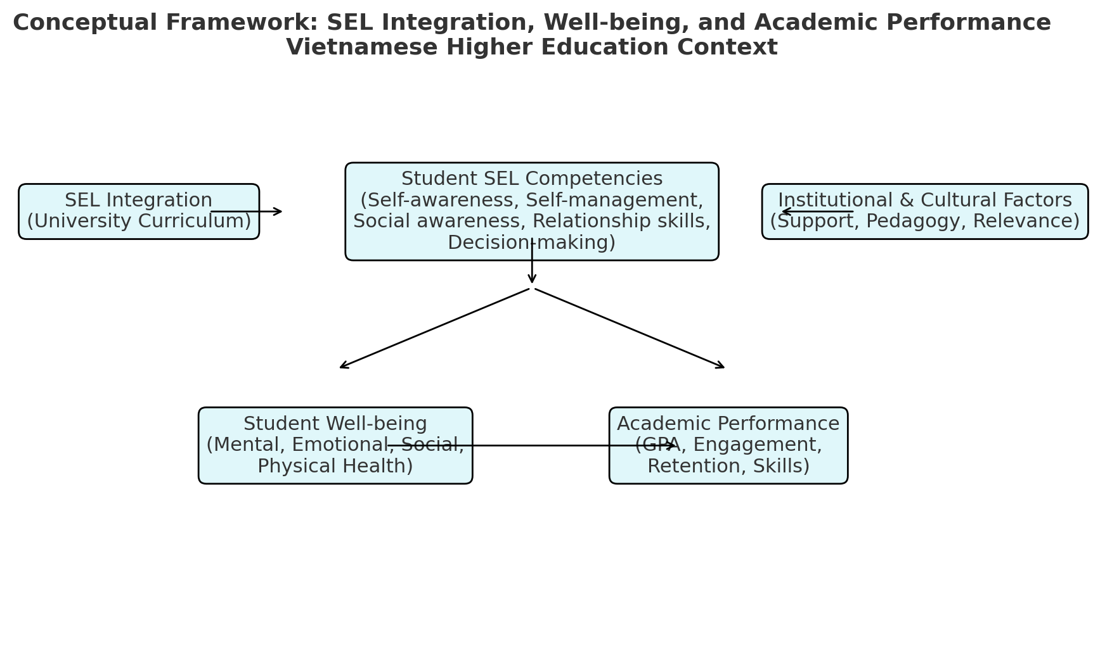

Slide 17
Hypothesis 1: The integration of SEL into higher education curricula significantly improves students’ mental well-being.
Hypothesis 2: Higher levels of SEL competencies are positively associated with better academic performance (as measured by GPA).
Hypothesis 3: Cultural relevance and institutional support are critical to the successful implementation of SEL in Vietnamese universities.
RESEARCH HYPOTHESES

Slide 18
Practical Implications of the Study
  For Educational Policy (MOET and university governance)
  For Curriculum Design and Teaching Practices
  For Student Support and Campus Life
  For Broader Social and Employment Outcomes

Slide 19
Practical Implications of the Study
For Educational Policy (MOET and university governance)
Provide empirical evidence to support the integration of student well-being indicators into national quality assurance frameworks for higher education.
Inform MOET and universities about the urgent need to establish institutional counseling services, mental health support centers, and SEL-based student support systems.
Offer policy recommendations to incorporate SEL-based well-being programs into university development strategies aligned with the National Strategy for Education Development 2021–2030.

Slide 20
Practical Implications of the Study
For Curriculum Design and Teaching Practices
Guide curriculum developers in embedding SEL competencies (e.g., self-awareness, emotional regulation, responsible decision-making) into English language programs and other disciplines.
Provide practical models for integrating SEL into teaching methodology courses (e.g., Language Teaching Strategies, Classroom Management), making teaching more student-centered.
Develop SEL-informed instructional strategies that help lecturers manage classroom dynamics, reduce academic pressure, and enhance engagement.

Slide 21
For Student Support and Campus Life
Recommend the creation of peer-support programs and SEL workshops to help students manage stress, anxiety, and academic challenges.
Contribute to the design of orientation programs for first-year students, focusing on resilience, social belonging, and emotional adjustment.
Provide evidence to support extracurricular initiatives (clubs, mentoring, leadership training) that reinforce SEL competencies in authentic contexts.

Slide 22
For Broader Social and Employment Outcomes
Help universities prepare graduates who are not only academically competent but also emotionally resilient, empathetic, and adaptable, aligning with the needs of the 21st-century workforce.
Encourage collaboration between universities, employers, and community organizations to integrate SEL into career readiness and employability training.

Slide 23




Q&A
Colors

