Slide 1
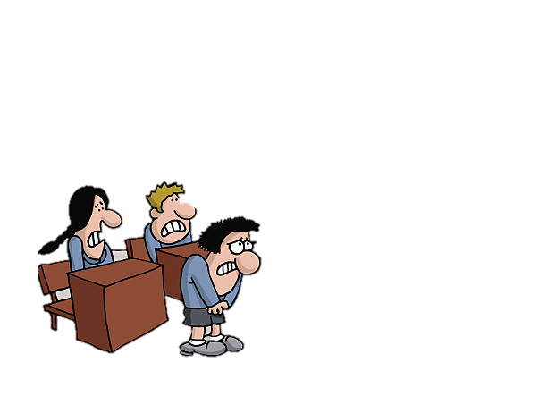
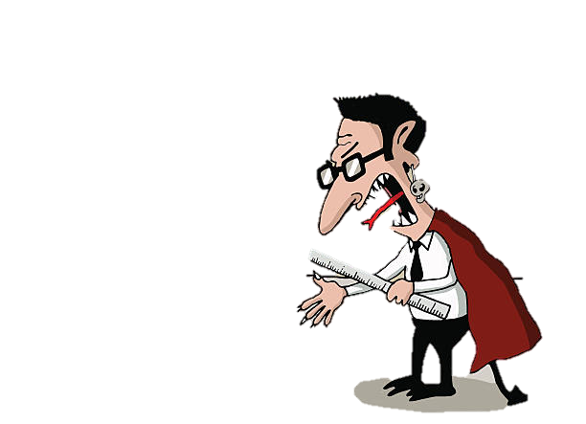
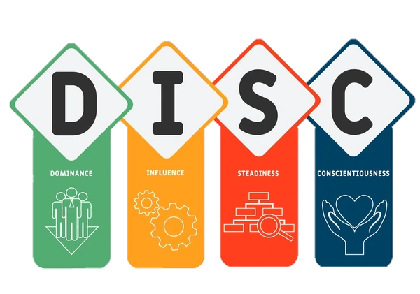



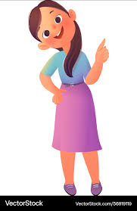


Viettesol International Convention 2025
Le Nhu Mai, Pham Lang Uyen, Le Thi Van, Sai Gon University
Exploring Students’ Attitudes towards
Their Teachers’ DISC Personality Types
Students
Teacher
Originated by William Moulton Marston

Slide 2

VIETTESOL INTERNATIONAL CONVENTION 2025
Exploring Students’ Attitudes towards
their Teachers’ DISC Personality Types
Authors: Lê Như Mai (presenter)
Pham Lang Uyen
Lê Thị Vân (presenter)

Slide 3


Timmerman University | 2024
VIETTESOL INTERNATIONAL CONVENTION 2025
Page
RESEARCH QUESTIONS
RQ1: What DISC personality type does each participating teacher exhibit ?
RQ2: What are the tenth-grade students’ attitudes toward each type of their DISC teachers ?
Notes:
Bỏ RQ1

Slide 4

VIETTESOL INTERNATIONAL CONVENTION 2025

Slide 5

Methodology
Timmerman University | 2024
VIETTESOL INTERNATIONAL CONVENTION 2025
Page
Page
Research Design
Qualitative Methodology
Notes:
In this study, to address these research questions, we adopted a qualitative methodology, because it allows us to deeply understand real-life experiences, beliefs, and behaviors.

Slide 6
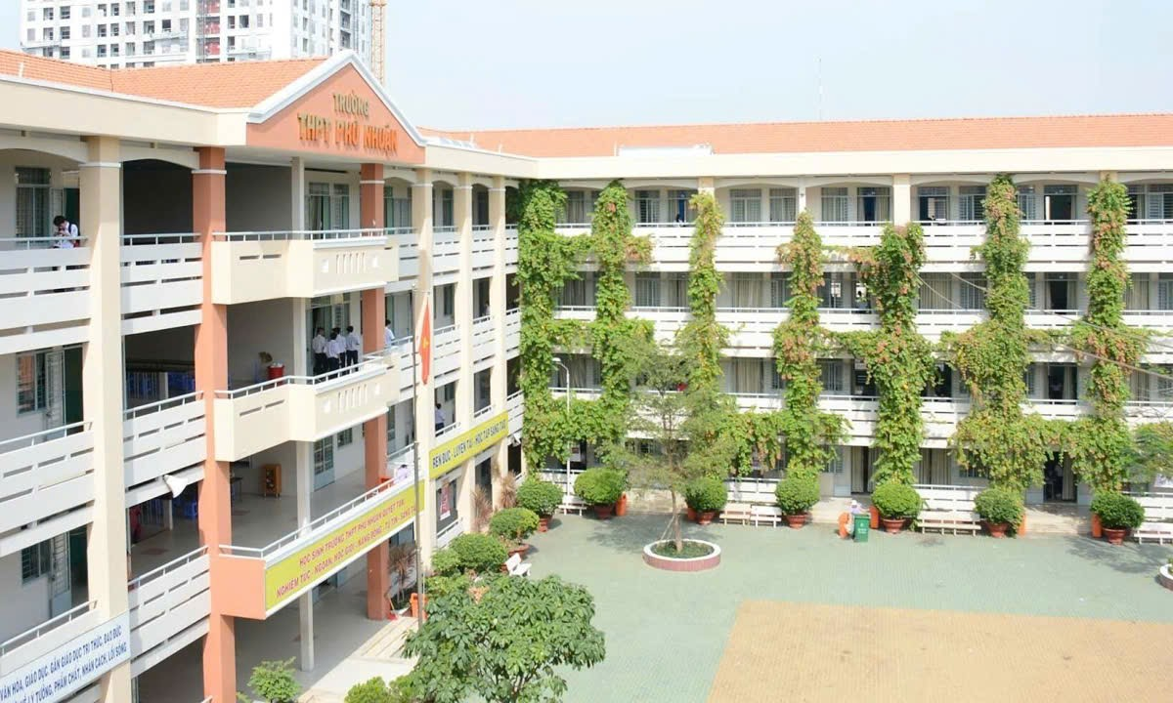
Methodology
Timmerman University | 2024
VIETTESOL INTERNATIONAL CONVENTION 2025
Page
Context
A High School
in Ho Chi Minh City

Slide 7


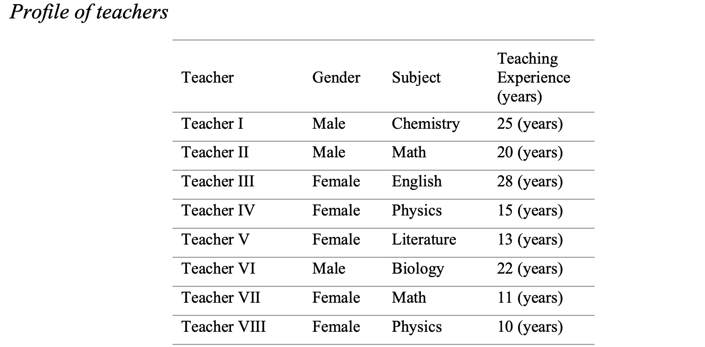
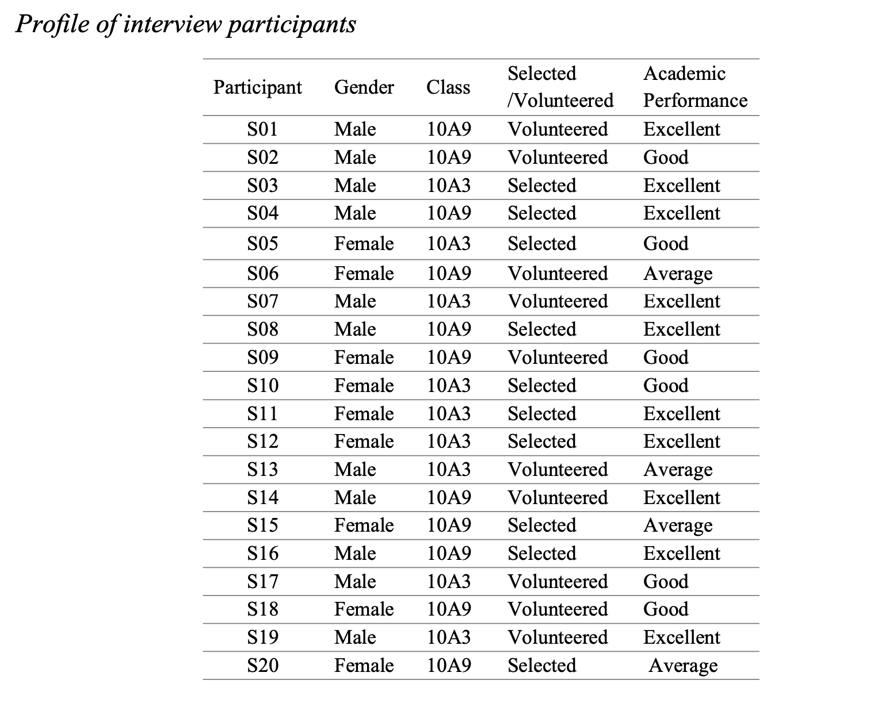
Methodology
Timmerman University | 2024
Page
Page
VIETTESOL INTERNATIONAL CONVENTION 2025
Participants
8 teachers
20 students
DISC online test
Semi-structured Interviews

Slide 8
Methodology
Timmerman University | 2024
Page
VIETTESOL INTERNATIONAL CONVENTION 2025
R. Instruments
& Data Analysis
DISC online test
Semi-structured Interviews
Reflexive Thematic Analysis
To identify, analyze, and interpret patterns of meaning within qualitative data (Clarke & Braun, 2017)
To identify DISC personality types among surveyed teachers

Slide 9
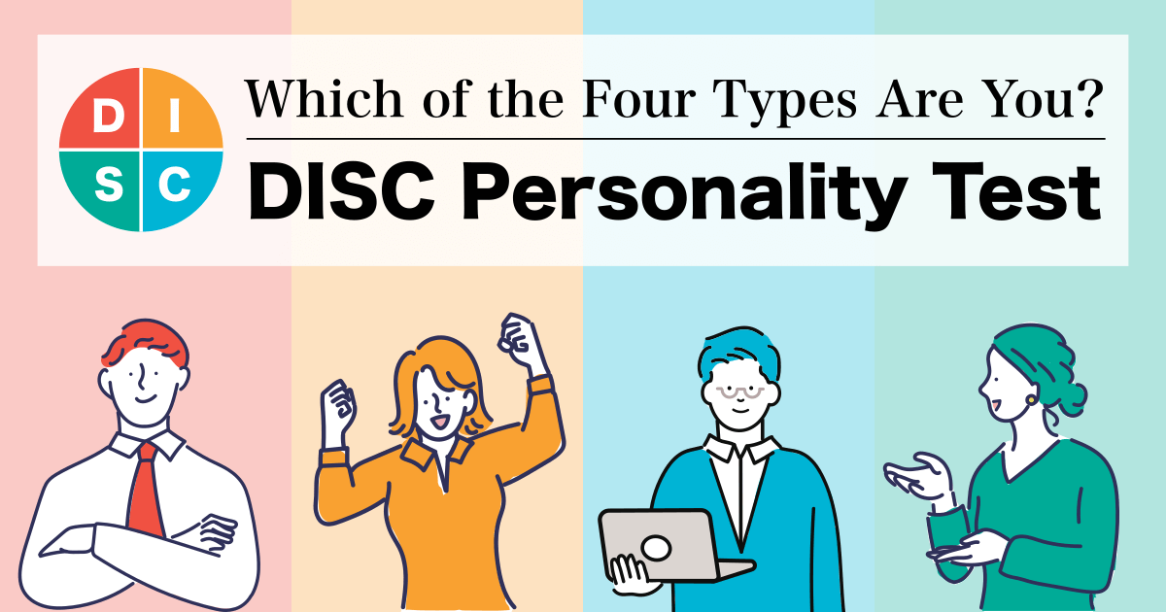
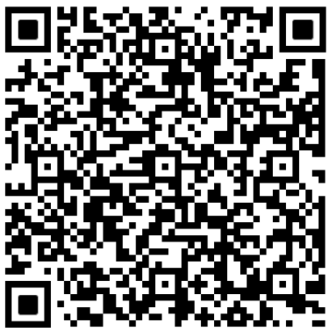

Methodology
DISC online test
Timmerman University | 2024
Page
VIETTESOL INTERNATIONAL CONVENTION 2025
Data Collection Procedures
Invite teachers to participate via GG forms
Use DISC test websites
to analyze teachers’ personality types
Return the results to teachers via emails

Slide 10






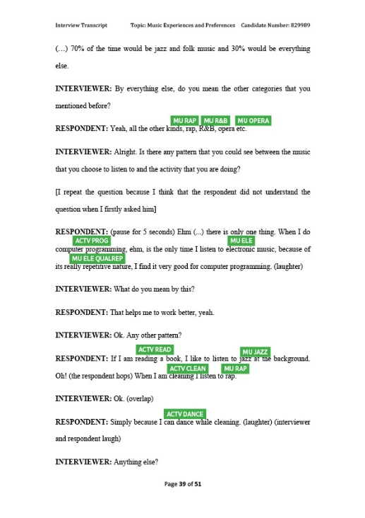
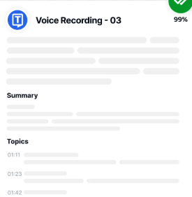


Methodology
Semi-structured Interviews
Timmerman University | 2024
Page
Page
VIETTESOL INTERNATIONAL CONVENTION 2025
Data Collection Procedures
4 pilot interviews
inter-coder reliability check
consistency and accuracy
Notes:
Semi-structured Interviews

Slide 11

VIETTESOL INTERNATIONAL CONVENTION 2025
Page

Slide 12

Timmerman University | 2024
VIETTESOL INTERNATIONAL CONVENTION 2025
Page
Students’ attitudes toward their DISC teachers

Slide 13



D - Type Teachers
Timmerman University | 2024
Page
VIETTESOL INTERNATIONAL CONVENTION 2025
Direct, focused,
Strict
Significant Engagement and Preference
Result-driven
High Dominance
Tension
Overly Decisive

Slide 14



I -Type Teachers
Timmerman University | 2024
Page
VIETTESOL INTERNATIONAL CONVENTION 2025
Enthusiastic,
Emotional
Connection
Engaging
Flexible,
creative
Talkative, spontaneous
Distraction,
Disorganization
Sensitive

Slide 15


S -Type Teachers
Timmerman University | 2024
Page
VIETTESOL INTERNATIONAL CONVENTION 2025
Calm, patient
Comfort,
Family
members
Supportive
Overly gentle
Distance in communication,
Boredom, disengament
Passive

Slide 16


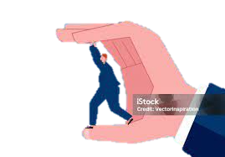
C -Type Teachers
Timmerman University | 2024
Page
VIETTESOL INTERNATIONAL CONVENTION 2025
Logical, organize
Admiration
Detail- Oriented
Perfectionism
Pressure
High Accurate Demands
4.2.1.4 Admiration of Organized, Systematic, and Detail-Oriented Teaching of C-Type Teachers

Slide 17
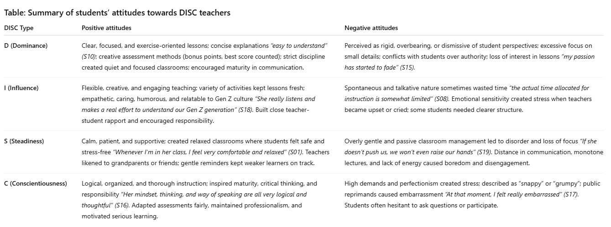

Slide 18

VIETTESOL INTERNATIONAL CONVENTION 2025

Slide 19


Implications
Timmerman University | 2024
Page
Page
VIETTESOL INTERNATIONAL CONVENTION 2025
Teachers
Metacognitive awareness
Notes:
The findings from this study highlight the critical role of metacognitive awareness in helping teachers understand how their personality traits -based teaching styles influence students’ emotions, thoughts, and behaviors.

Slide 20


Implications
Timmerman University | 2024
Page
VIETTESOL INTERNATIONAL CONVENTION 2025
Teacher training
DISC integration
Notes:
Doing so not only enhances self-awareness among educators but also equips them with practical tools to adjust their teaching methods and manage classrooms more effectively.

Slide 21

Implications
Timmerman University | 2024
Page
Page
VIETTESOL INTERNATIONAL CONVENTION 2025
Educational leaders
Personality diversity
Notes:
educational leaders can promote professional growth, encourage inclusive teaching, and foster a psychologically responsive learning environment.
Using DISC insights can help schools adjust teaching methods, mentoring, and policies so that teachers can grow, feel included, and create a supportive learning environment for students.

Slide 22

Implications
Timmerman University | 2024
Page
VIETTESOL INTERNATIONAL CONVENTION 2025
Further Research
Personality-driven teaching styles
Notes:
Finally, these insights open promising directions for future research. Specifically, exploring how personality-driven teaching styles interact with factors like class size, subject area, and gender can offer deeper

Slide 23

VIETTESOL INTERNATIONAL CONVENTION 2025
LIMITATIONS
&
RECOMMENDATIONS

Slide 24
LIMITATIONS | RECOMMENDATIONS
Focused mainly on affective attitudes. | Study behavioral and cognitive attitudes too.
Only tenth-grade students | Broaden sample size (more schools, grades, regions). Compare across grades and education levels.
Timmerman University | 2024
Page
VIETTESOL INTERNATIONAL CONVENTION 2025

Slide 26
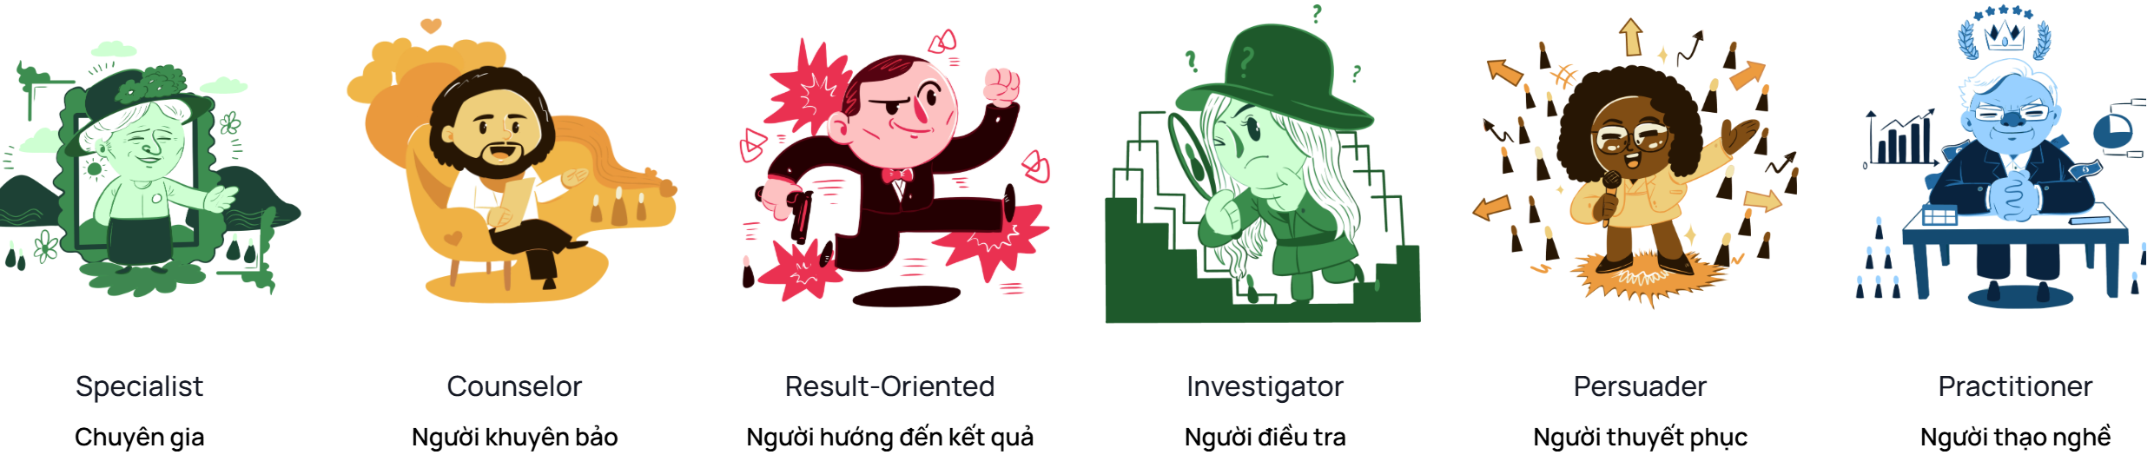
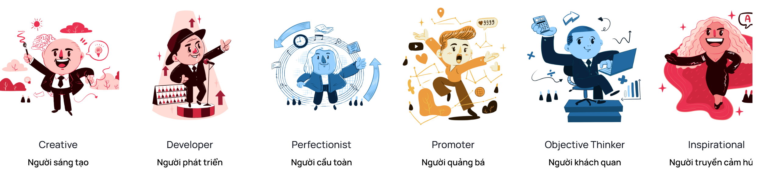
Test DISC | tracnghiemtinhcach.vn
Notes:
Test DISC | tracnghiemtinhcach.vn

Slide 27
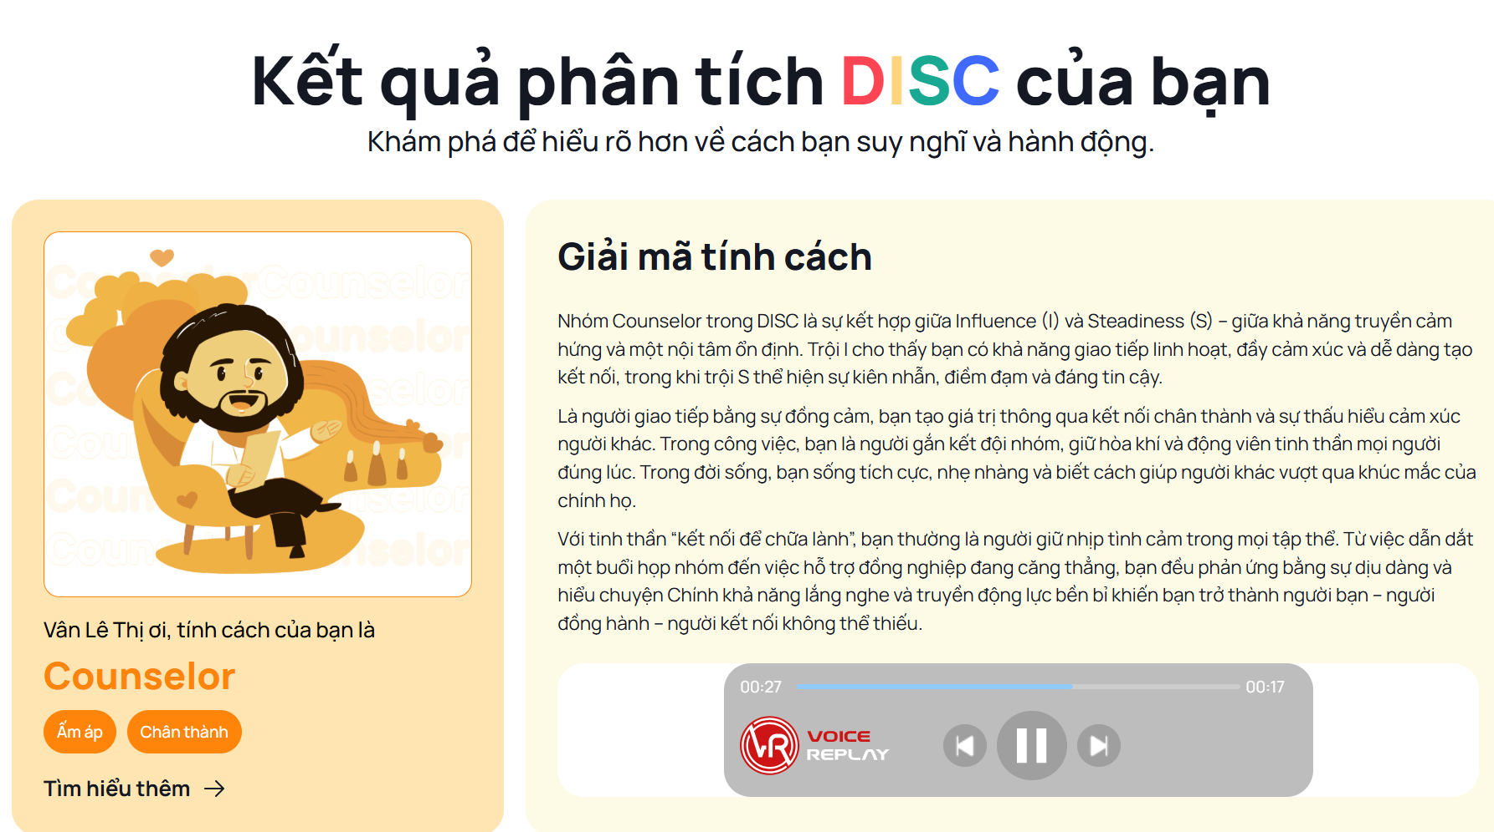

Slide 28
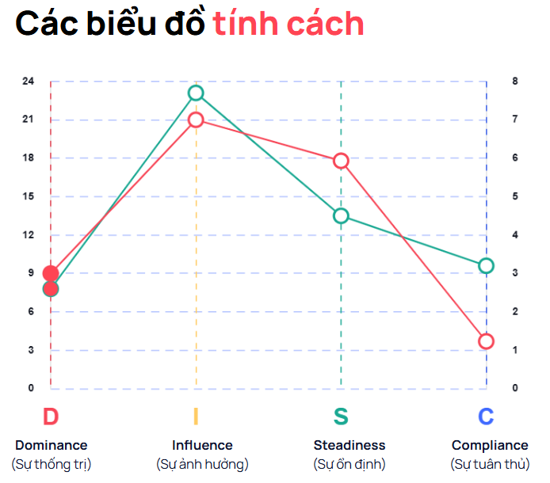
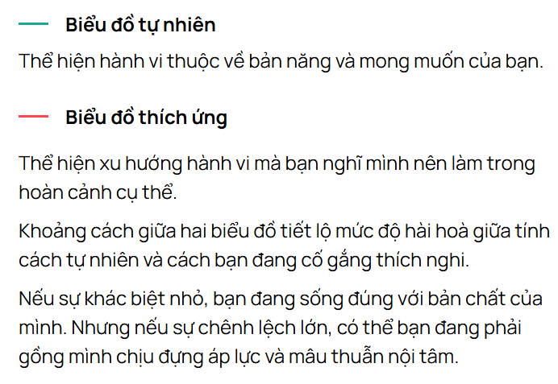

Slide 29
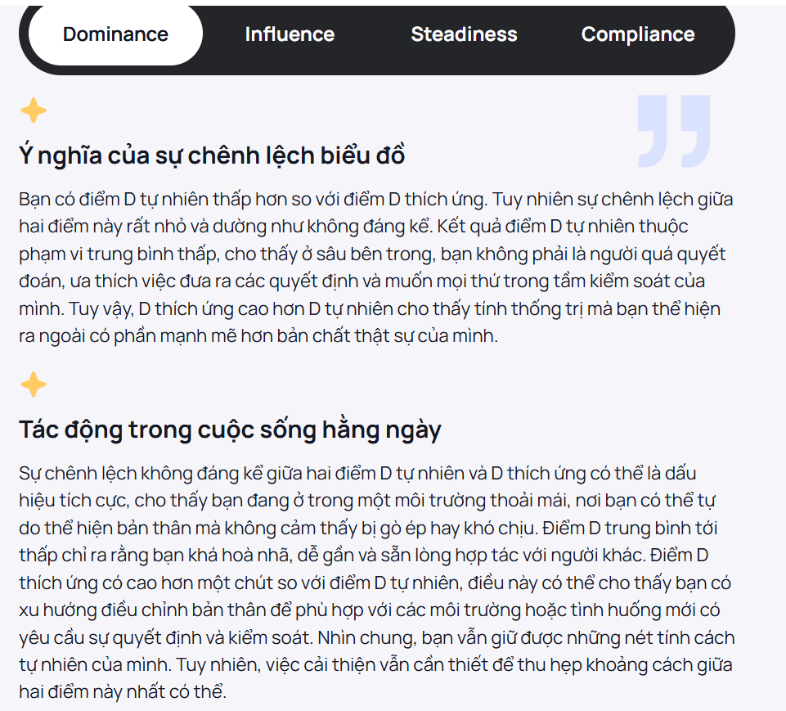
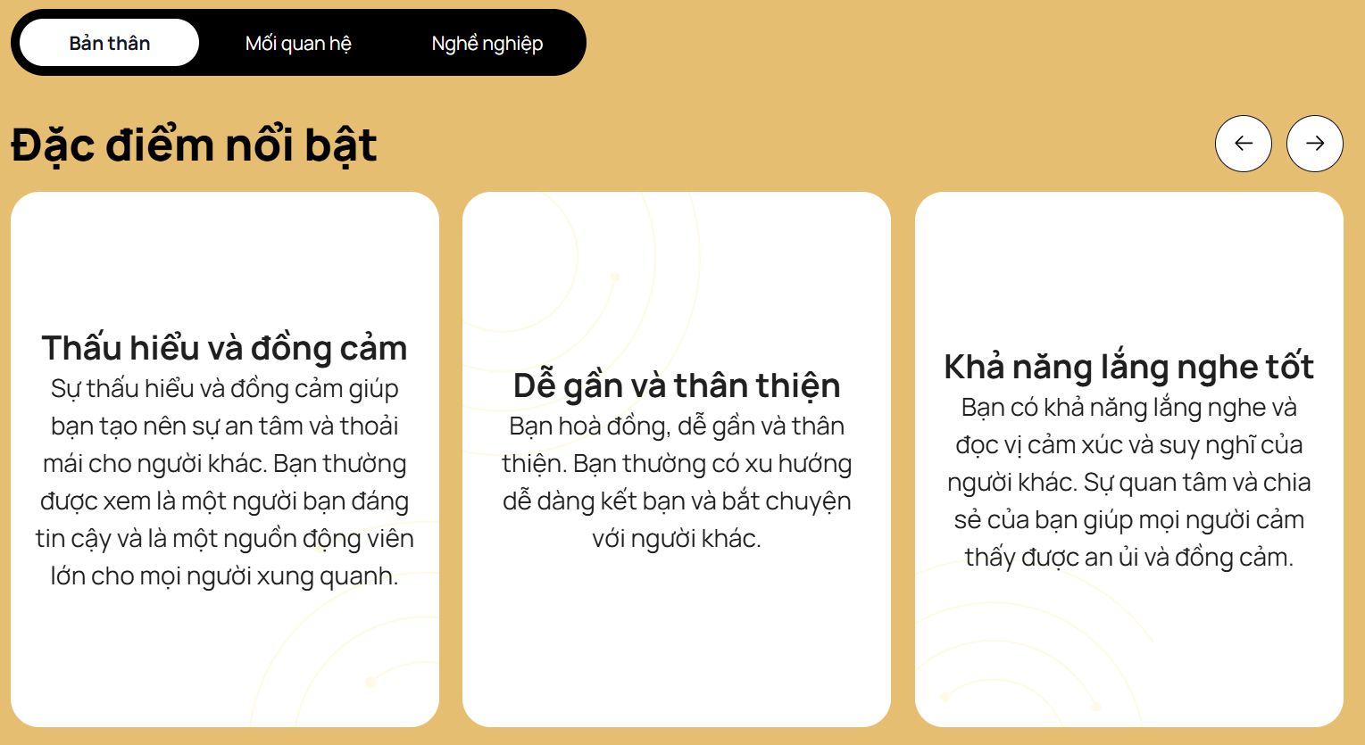
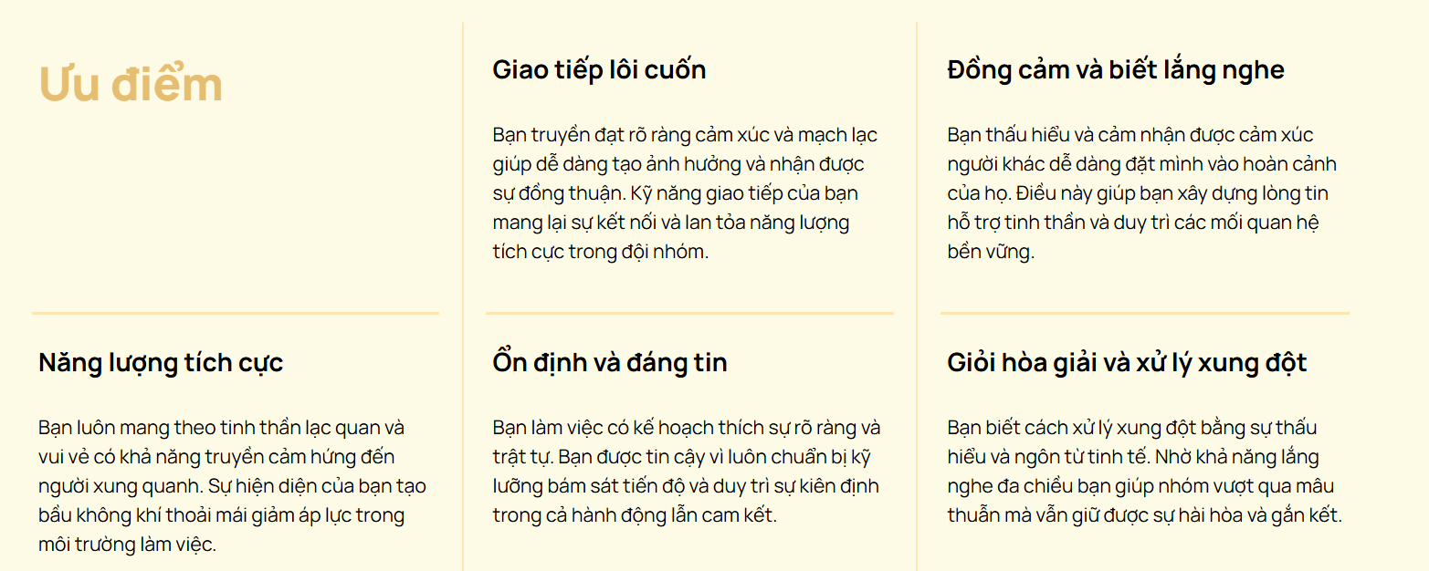
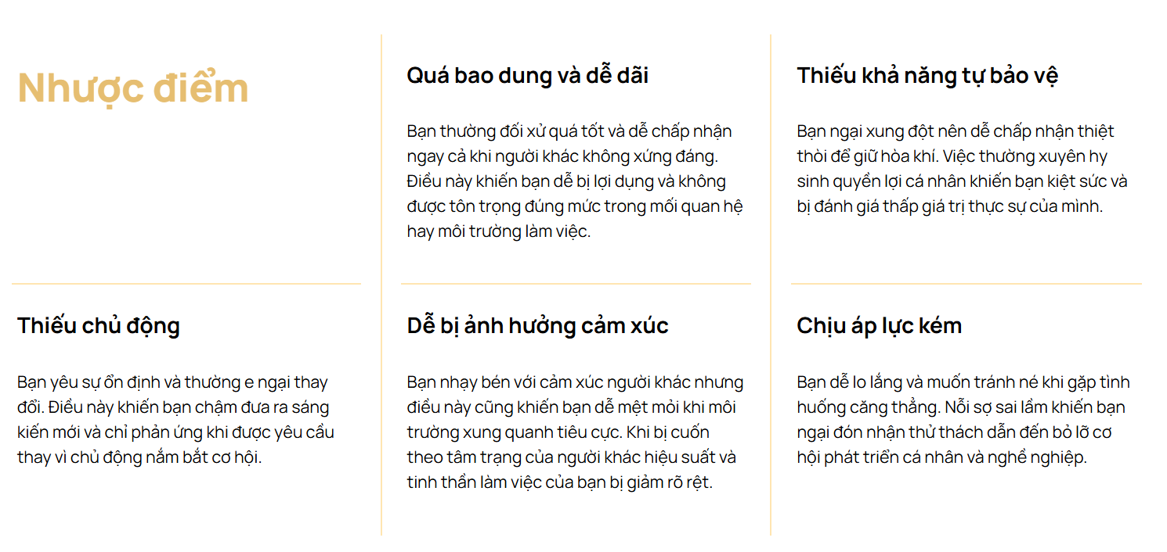
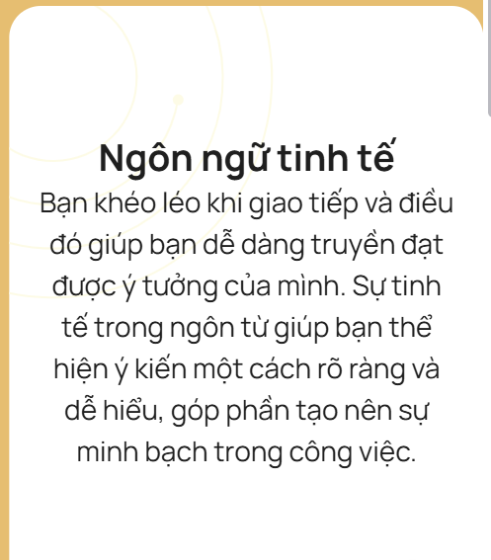
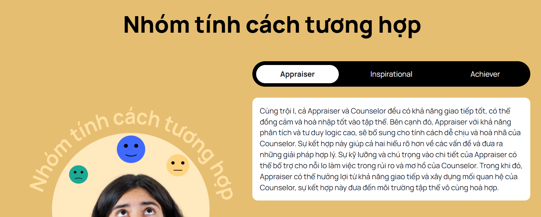
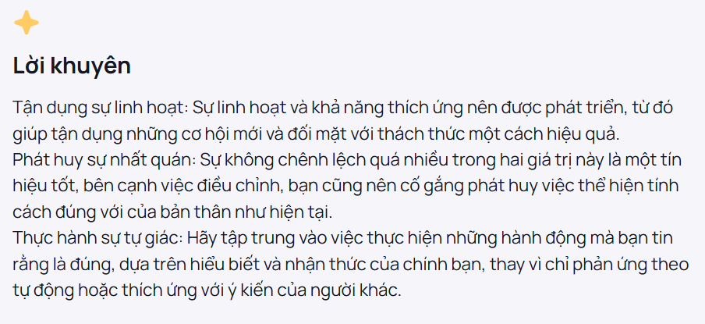

Slide 30

VIETTESOL INTERNATIONAL CONVENTION 2025

Slide 31
VIETTESOL INTERNATIONAL CONVENTION 2025
“Students may forget what you said, but they will never forget how you made them feel.”
— Carl W. Buehner
“What the teacher is,
Is more important than what he teaches.”
— Karl A.Menninger
Notes:
The importance of understanding teacher personality
is emphasized,

Slide 32

15
THANK YOU
HAVE A GREAT DAY!

Slide 34
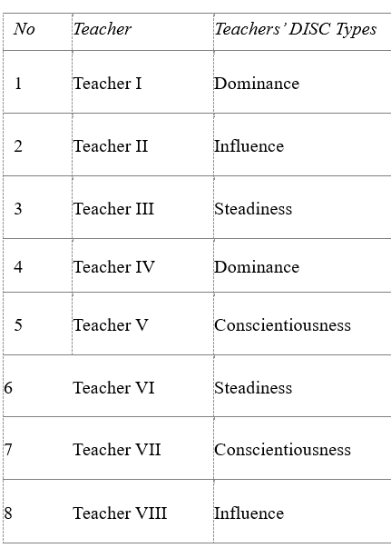
The DISC test to decide the type of teacher

Slide 35
Timmerman University | 2024
Page
QUESTIONS
Q1: How was the conceptual framework of the study adapted?

Slide 36
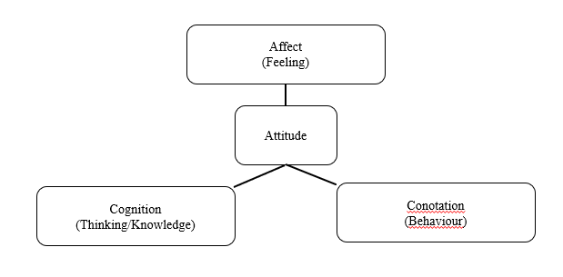
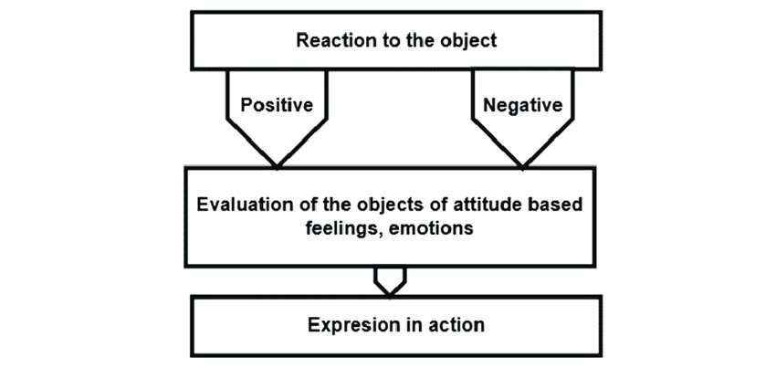
The Tri-components attitudes models (Makanyeza,2014)
Page
Affective component (level) (Bakanauskas, 2022))

Slide 37
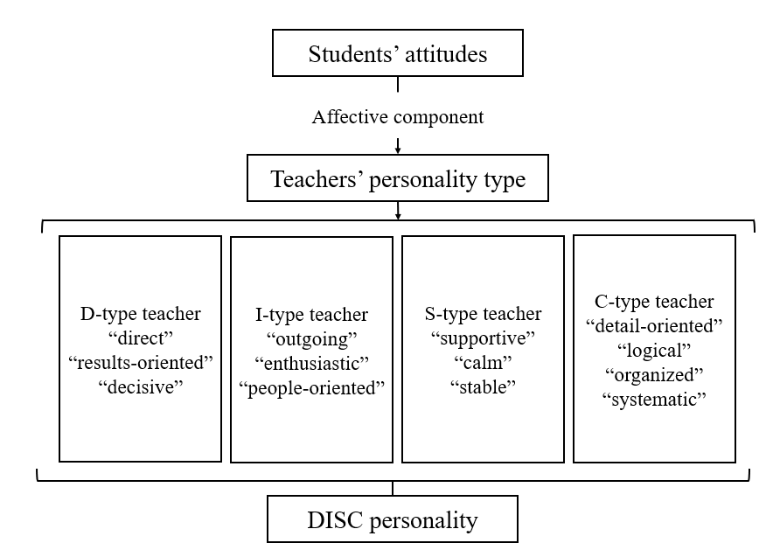

Conceptual Framework
Timmerman University | 2024

Slide 38
Timmerman University | 2024
Page
QUESTIONS
Q2: There were 8 teachers and 20 students involving in the research. Which students gave comments for which teachers?

Slide 39
15
THANK YOU
FOR YOUR ATTENTION

Slide 40
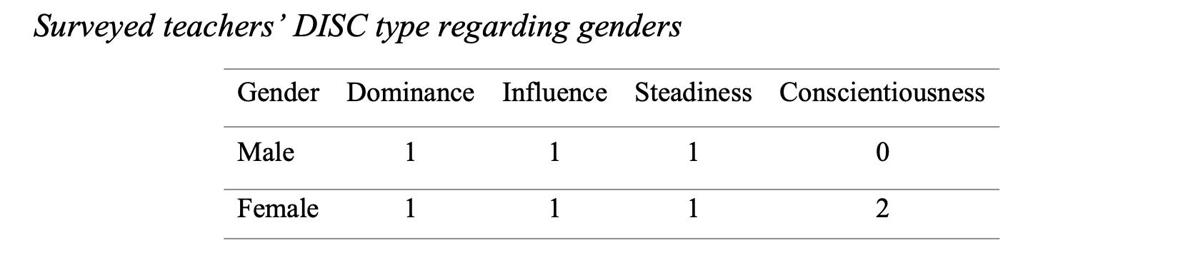
04
Timmerman University | 2024
Page
4.1 Teachers’ DISC Type
Results

Slide 41
In align with
05
Discussion
Timmerman University | 2024
Page
Discussion & Implications
a singular presence of female educators within the C-type (Javahery & Kamali,2023)
In contrast to
Our study:
Students’ favor to extroverted teachers (I-type), agreeableness (S-type) & Conscentiousness (C-type) (Eryilmaz,2014)
Other studies:
Low engagement and decreased motivation led by overly strict D-type teachers
Increased focus and positive engagement in such classrooms towards D-type teachers
- Saidi et al. (2024)
- Masruddin & Pratiwi (2016)

Slide 42
03
Timmerman University | 2024
Participants – Online Survey
Page
VIETTESOL INTERNATIONAL CONVENTION 2025
Methodology
8 teachers are responsible for teaching at classes 10A3 and 10A9
Notes:
Delete ??

