Slide 1
Enhancing B1 EFL Learners’ Vocabulary Retention in Vietnam Using Mnemonic Acrostics Strategies
An experiment at WESET English Center
Phuong Trinh (Suzie) Nguyen – 30 August 2025

Slide 2
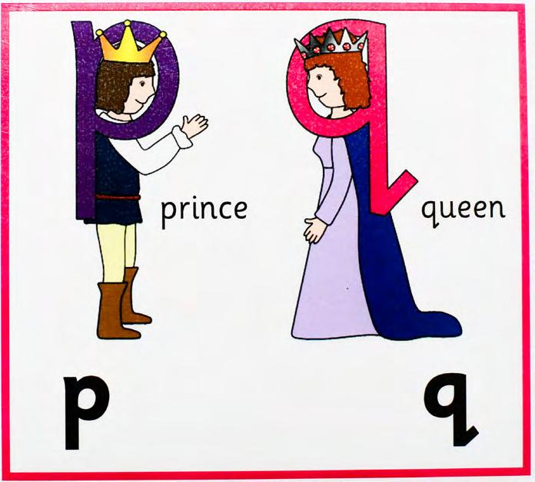
AGENDA OVERVIEW
1. The significance of the research
2. A brief introduction into Mnemonic Devices
3. Research questions
4. Literature Review
5. Research background & participants
6. Methodology
7. Findings & Discussion
8. Conclusions

Slide 3

1. The significance of the research
Vietnamese high school students are required to attain B1-level of English in the CEFR to graduate. (Minh Nga, 2020)
Vietnamese university students (non-English majored students) need at least 4.5 IELTS Academic to graduate (British Council IELTS, n.d.)
Vietnamese learners face many difficulties when learning new vocabulary (Vu & Peters, 2021)

Slide 4

1. The significance of the research
Nation (2013) pointed out that ESL students face difficulties in remembering and retaining a vast amount of vocabulary.
B1-level learners have foundational vocabulary but must broaden their range to enhance fluency and precision (British Council, n.d.).
Impede:
writing skills (Cai, 2021)
speaking competence (Lingga et al., 2020)
reading ability (Joshi, 2006)
listening comprehension (Darti & Asmawati, 2017)
at B1-level, retaining vocabulary in context, forming meaningful associations, transferring knowledge to long-term memory can be challenging (Schmitt, 2008)

Slide 5
2. A brief introduction into Mnemonic Devices
analyze bias coherent derive evaluate
interpret justify predict
Analyze kỹ để tránh bias (phân tích kỹ để tránh thiên vị), ý tưởng phải coherent (mạch lạc), và derive from evidence (bắt nguồn từ bằng chứng). Sau đó evaluate (đánh giá), interpret (giải thích), justify (biện minh) quan điểm, rồi predict (dự đoán) kết quả.
Mnemonic technique used:
- Acrostics Sentence → first letters follow the target word order
- Narrative Channing → words are linked in a logical story/sequence
- Dual Coding → English term paired with native language meaning

Slide 6
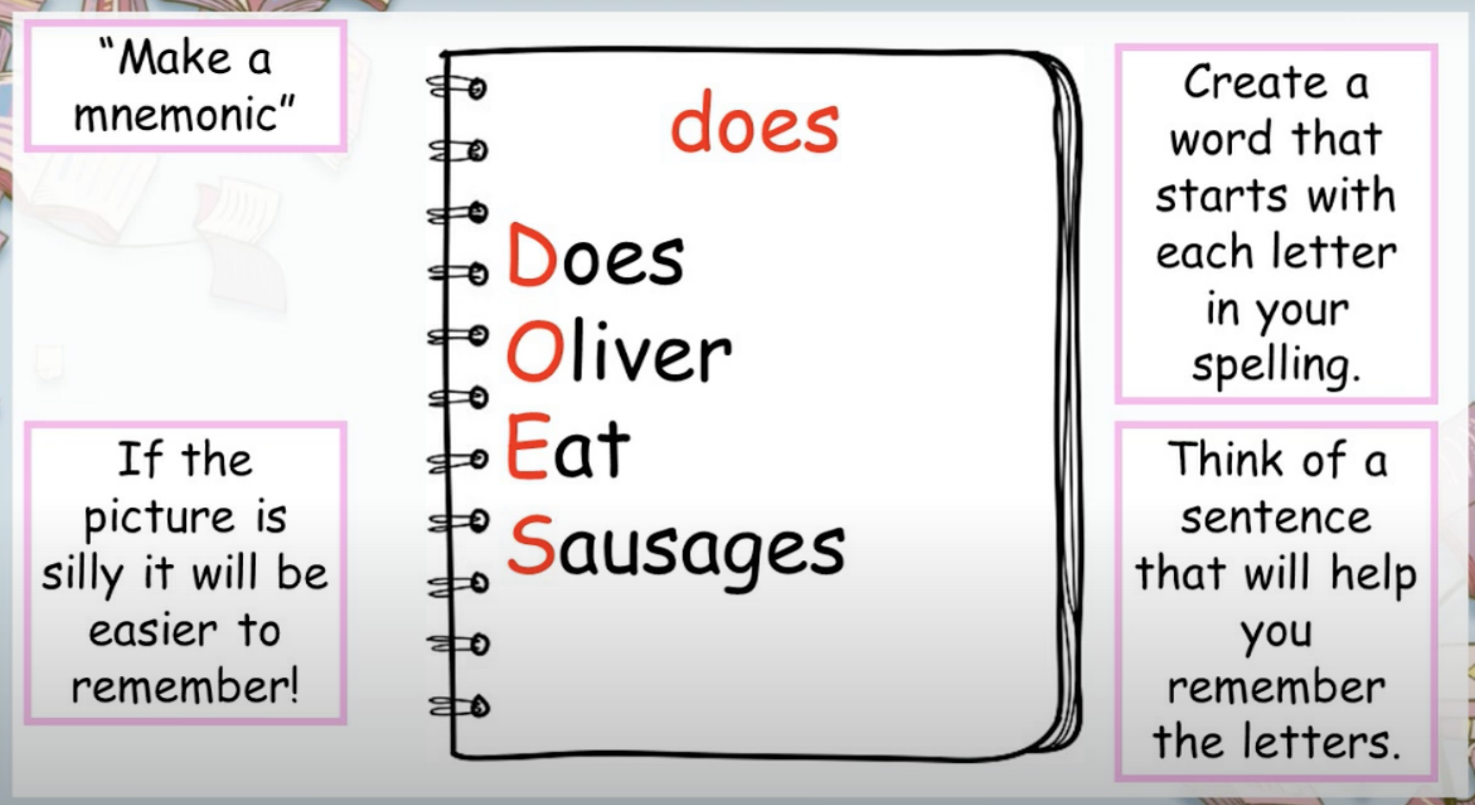
2. A brief introduction into Mnemonic Devices
Cognitive tools that helps us recall information (Bellezza, 1981).
These devices have shown promise in various educational contexts, especially on improving the retention and recall of information (Azmi et al., 2016; Fasil et al. 2018; Hill, 2022).
(Maher, 2021)

Slide 7
3. Research questions:
To what extent does mnemonic devices impact the vocabulary retention of B1 Vietnamese ESL learners?
What are the opinions and attitudes of B1 Vietnamese ESL learners towards using mnemonic devices for vocabulary learning?

Slide 8
4. Literature Review
Vocabulary Acquisition & Vocabulary Retention
Ellis (1995); Abbassi et al. (2018)
Vocabulary Learning Strategy (VLS)
Gu & Johnson (1996); Kudo (1999)
Mnemonic Devices
Fasil et al. (2018); Atkinson (1975); Bellezza (1981); Lu & Newman Young (2015)
Mnemonic Devices in different educational context
Condust et al. (1986); Miller (1993); DeLashmutt (2007); Congos (2011)
Mnemonic Devices’ impact on vocabulary retention among ESL learners
Bellezza (1981); Cohen (1987); Philips (2016); Bahrami et al. (2019), Hill (2022)

Slide 9
5. Participants & Experimental Context
E
C
Experimental group
Control group
Experimental context
conducted at a private English center in a metropolis in Southern Vietnam
Received vocabulary instruction on how to use mnemonic devices consistently over a 12-week intervention period.
Received regular vocabulary instruction without the use of mnemonic devices during the intervention period.
60 B1-level Vietnamese ESL learners

Slide 10
6. Methodology
Research design
Quasi-experimental design with an experimental and control group.
Data Collection
a pre-test, a post-test, and a perception survey
Methodology
Quantitative and qualitative methods used to evaluate the impact of mnemonic devices on vocabulary retention.
Data analysis
Objective
To assess the effectiveness of mnemonic strategies in enhancing vocabulary acquisition among Vietnamese ESL learners.

Slide 11
7. Results & Findings
Impact of Mnemonic Strategies
Mnemonic devices significantly improved vocabulary retention in the experimental group.
Participants showed enhanced performance in recalling difficult vocabulary items.
The use of mnemonic techniques positively influenced vocabulary learning outcomes.
Comparison of Experimental and Control Groups
Experimental group students demonstrated better post-test results compared to the control group.
Mnemonic devices were found to be more effective in enhancing vocabulary retention than traditional methods.

Slide 12
7. Results & Findings
Participants’ Perceptions
Learners perceived mnemonic devices as beneficial for vocabulary learning.
Mnemonic strategies were reported to make studying easier and more engaging.
Students expressed positive attitudes towards incorporating mnemonic techniques in ESL instruction.
Recommendations for ESL educators
Suggested optimizing the use of mnemonic devices in ESL classes to improve vocabulary acquisition.
Proposed providing more examples, practice exercises, and mnemonic templates for effective implementation.
Highlighted the importance of workshops and training sessions on mnemonic strategies for educators and learners.

Slide 13
Conclusions
Implications:
Mnemonic strategies significantly improved vocabulary retention, especially for B2-C2 vocabulary.
Recommending the integration of mnemonic techniques in ESL classes to enhance vocabulary learning outcomes.
Future research directions:
Suggesting further studies to explore the long-term effects of mnemonic devices on vocabulary retention.
Proposing investigations into the transferability of mnemonic skills to other language learning areas.
Limitations:
Time constraints.
Only applicable for B1 ESL learners.
Limited numbers of participants.

Slide 14



