Slide 1
Exploring the Integration of Multicultural Elements into the Pre-teaching Stage of Receptive Skills Lessons For Students in a Public High School in Hanoi
Tran Van Tung – Le Tien Dat| 29th Aug

Slide 2
Outline
Rationale
Literature review and Research gap
Methodology
Finding
Discussion

Slide 3
I. Rationale
English as Intercultural Communication
In a globalized world, English is not only a language subject but also a tool for intercultural communication (Byram, 1997; Kramsch, 1993).
In Vietnam, English is compulsory in public high schools as part of national education policy (MOET, 2017).
Problem: ELT focuses on grammar/vocabulary, not intercultural competence (Pham, 2020; Nguyen, 2019)

Slide 4
I. Rationale
Pre-teaching stage is a key for receptive skills (reading & listening) (Harmer, 2015; Nation, 2009; Ur, 2012).
Currently situation in Vietnam
Vietnamese high-school learners face persistent obstacles in listening and reading tasks (speed, vocabulary load, text length, discourse features). (Tran & Duong, 2020; Nguyen, 2020)
Pre-listening pedagogy: listening is sometimes neglected because it isn’t prioritized in national exams; typical practice is “play the cassette → answer tasks” with insufficient pre-listening activities, despite teachers acknowledging pre-listening is crucial. (Ly, 2018)
→ Lack of authentic cultural context
→ Weakens comprehension & engagement

Slide 5
I. Rationale
Suggested Solutions: Integrating multicultural elements
Activate prior knowledge
Increase motivation & engagement
Develop intercultural competence

Slide 6
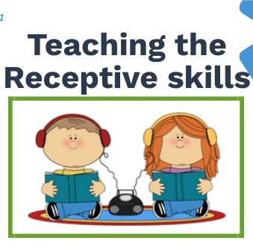
Rationale
Research questions:
1) What are students’ perceptions of lessons incorporating multicultural elements during the pre-teaching stage?
2) What are the teacher’s experiences and perceptions of integrating multicultural elements into the pre-teaching stage of receptive skills lessons?

Slide 7
II. Literature Review
Multicultural education:
Valuing diversity & integrating multiple cultural perspectives (Banks, 2009; Nieto, 2017)
Goals:
Culturally responsive teaching (Gay, 2018)
Build Intercultural Communicative Competence (Byram, 1997)
Benefits: Motivation, inclusivity & readiness for global communication (Bennett, 2018; Gollnick & Chinn, 2017)

Slide 8
II. Literature Review
Activate prior knowledge & reduce comprehension difficulties
(Harmer, 2015; Nation, 2009)
Pre-teaching Stage
Listening: discussions, vocab previews, visual aids (Field, 2008; Brown, 2007)
Reading: pre-reading questions, skimming (Ur, 2012)

Slide 9
II. Literature Review
Multicultural Integration
Reasons to integrate:
Enhances cultural awareness & inclusivity
Prepares students for intercultural communication (Banks, 2009; Nieto, 2017)
Strategies:
• Use multicultural materials (texts, videos, images)
• Comparative activities & cultural discussions
• Address stereotypes & misconceptions (Gay, 2018)

Slide 10
II. Research Gap
Multicultural education fosters diversity & intercultural competence (Banks, 2009; Gay, 2018).
Pre-teaching stage supports comprehension by activating prior knowledge (Harmer, 2015; Nation, 2009; Ur,2012 ).
What need to be explored?
Few studies connect multicultural elements with the pre-teaching stage of receptive skills.
Limited research in the Vietnamese high school context.
This Study Fills the Gap
Explores teachers’ & students’ perceptions of multicultural integration.
Focused on pre-teaching stage in a Hanoi public high school.
Provides practical insights for enhancing intercultural competence in ELT.

Slide 11
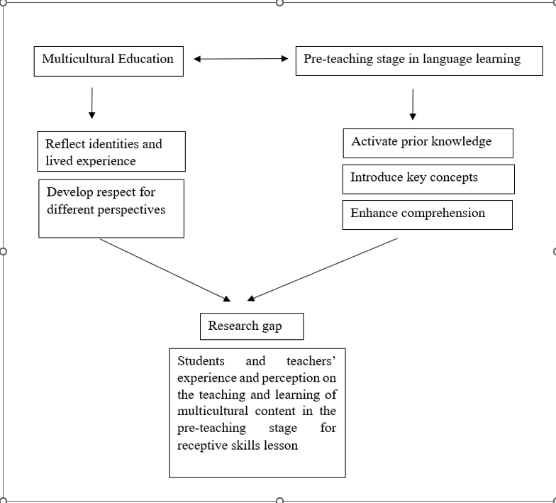

Slide 12
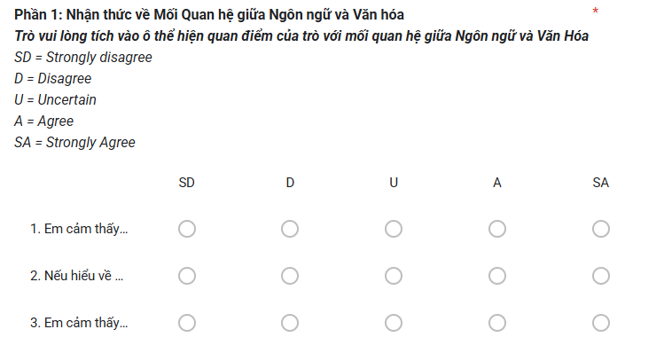
III. Methodology Overview
Research design
Mixed method provide comprehensive insight
Qualitative method – questionnaires (Likert-scale, closed- ended items)
Quantitative method - semi-structured interviews (teachers & students)

Slide 13
III. Methodology Overview
Participants
Students: 97 (Grade 10 & 11) in 2 mixed-ability classes
Yen Hoa High School – Tier 1 High School in Hanoi
Stratified random sampling
Diverse in gender, proficiency, and performance
Teachers: 4 Full-time English teachers
Purposive sampling
Minimum 3 years’ teaching experience (2 long-experienced teachers, 2 Genz teachers)
All are exposed and attempt to integrate multicultural content

Slide 14
III. Methodology Overview
Data collection tools
Questionnaires (Students, N = 97)
5-point Likert scale
Perceptions of multicultural pre-teaching
Administered anonymously in class
Interviews
Teachers (4) → teaching strategies, challenges, perceptions
Students (7) → engagement, difficulties, suggestions
Conducted ~30 minutes each, audio recorded

Slide 15
III. Methodology Overview
Data analysis
Quantitative:
Descriptive statistics (means, SD, frequency)
Software: SPSS
Qualitative:
Braun & Clarke (2006) thematic analysis
Coding → themes → cross-case comparisons

Slide 16
Alignment of Research Questions and instruments
Research question | Instrument (s) | Primary data collected | Justification
What are students’ perceptions of lessons incorporating multicultural elements during the pre-teaching stage? | Student perception survey (Likert + a few open items) | 4–6 subscale scores (e.g., Inclusion, Cultural Relevance, Pre-activity Usefulness, Belonging), plus short open responses | Student-facing measures of culturally responsive teaching/classroom climate exist and have been validated or preliminarily validated
 | mini-interviews, 15–20 min | audio transcripts coded for themes like “identity affirmation,” “relevance,” “comfort to participate,” | richer accounts of which pre-teaching moves felt inclusive (e.g., heritage photos, local examples, L1 brainstorming) and why

Slide 17
Alignment of Research Questions and instruments
Research question | Instrument(s) | Primary data collected | justification
What are the teacher’s experiences and perceptions of integrating multicultural elements into the pre-teaching stage of receptive skills lessons? | Semi-structured teacher interviews | transcripts coded into themes (planning routines, resource curation, differentiation for cultural/linguistic backgrounds, assessment links) | Best for lived experiences, decision-making rationales, and perceived affordances/constraints in culturally responsive practice

Slide 18
IV. Findings
Item | Statement | N | M | S.D
I1 | I feel that understanding culture is important when learning a foreign language. | 97 | 4.14 | 0.82
I2 | If I understand culture, I can use language more appropriately. | 97 | 4.09 | 0.95
I3 | I feel that learning about different cultures through English lessons helps me gain broader knowledge. | 97 | 4.14 | 0.84
Qualitative data
Positive Findings (I1, I3):
Cultural understanding seen as important in learning a foreign language.
Exposure to multicultural content helps broaden general knowledge.
Mixed Finding (I2):
Mean score 4.09 (SD = 0.95).
Students showed varying views on whether cultural knowledge improves accurate language use.

Slide 19
Multicultural content and self-identity
Item | Statement | N | M | S.D
I4 | I feel that multicultural content is relatable/relevant to my personal experiences (e.g., things I have seen in movies, stories, or while traveling, etc.). | 97 | 3.84 | 0.77
I5 | I like multicultural content related to Vietnam (e.g., Vietnamese áo dài, Mường ethnic costumes, etc.). | 97 | 3.94 | 0.83
I6 | I like multicultural content from foreign countries (e.g., Chinese ghost marriage). | 97 | 3.70 | 0.87
Multicultural Content and Self-Identity (I4–I6)
I4 (M = 3.84; SD = 0.77):
  Multicultural content seen as relevant to students’ identities and interests.
Vietnamese vs. Foreign Content:
  Both types rated highly positive.
  Low score dispersion → general agreement among students.
  Students favoured both equally.

Slide 20
Multicultural content and respect for cultural differences
Item | Statement | N | M | S.D
I7 | Learning about multicultural content helps me respect cultural differences among people (e.g., eating with hands in India). | 97 | 4.14 | 0.88
I8 | I tend to be more accepting and open to different perspectives after being exposed to multicultural content. | 97 | 4.02 | 0.80
I9 | Exposure to multicultural content makes it easier for me to discuss topics related to cultural diversity and different viewpoints. | 97 | 4.16 | 0.92
Building Respect (I7, I8):
A strong majority agreed that multicultural content cultivates respect for diversity.
It encourages students to be more open-minded and accepting of new perspectives.
Empowering Dialogue (I9):
Students reported feeling more confident and comfortable discussing cultural diversity.
This suggests multicultural teaching is not only informative but also empowers learners to voice and defend their views in cross-cultural discussions.

Slide 21
Multicultural Content and Its Impact on Learning
Item | Statement | N | M | SD
I10 | If I am not introduced to multicultural elements, I will find it difficult to understand the lesson afterwards. | 97 | 3.35 | 0.79
I11 | Being introduced to multicultural elements makes me feel more motivated and engaged in the lesson. | 97 | 3.79 | 0.78
I12 | Lessons that incorporate multicultural elements leave a strong impression and help me retain knowledge (e.g., vocabulary) for a longer time. | 97 | 3.97 | 0.71
I13 | Exposure to multicultural content encourages me to explore other cultures outside of class. | 97 | 3.56 | 0.78
Impact of Multicultural Content on Learning (I10–I13)
Strong Benefits (I11, I12):
  Multicultural content energizes motivation and makes lessons more engaging.
  It significantly enhances knowledge retention, helping students remember content longer.
Beyond the Classroom (I13):
  Exposure inspires students to explore other cultures independently, extending learning outside class.
Mixed Perceptions (I10):
  Some uncertainty remained about whether the absence of multicultural elements directly reduces comprehension.

Slide 22
The Role of Teachers in Pre-teaching Multicultural Content
Item | Statement | N | M | SD
I14 | Teachers always encourage open discussions about cultural differences and similarities during the pre-teaching stage. | 97 | 3.71 | 0.90
I15 | Teachers actively address misconceptions and misunderstandings about culture. | 97 | 3.93 | 0.84
I16 | Teachers use a variety of methods (e.g., images, videos, role-playing, discussions) to teach multicultural content. | 97 | 4.10 | 0.90
Role of Teachers in Multicultural Pre-Teaching (I14–I16)
Correcting Misconceptions: Teachers ensure students gain a clear and accurate understanding of cultural issues.
Fostering Dialogue: They encourage open discussions, making classrooms more inclusive and interactive.
Using Diverse Methods: Teachers employ videos, images, role-play, and discussions to make lessons engaging and memorable.
Key Insight: Teachers are not just content deliverers—they are cultural guides who shape how students think, question, and connect across cultures.

Slide 23
Students’ Recommended Activities for Teachers
Students’ Recommended Activities for Multicultural Learning
Top Choice – Games (11.34%):
  Students highlighted folk games, cultural exchanges, themed games, and quiz shows.
  Seen as fun, competitive, and immersive ways to experience traditions.
Second Choice – Field Trips (9.28%):
  Visits to museums and heritage sites help students connect more deeply with history and culture.
Other Suggestions (less frequent):
  Creative lesson delivery (4.12%).
  Cultural festivals (3.09%).
Activity | Total | N (Responses) | Frequency (%)
Field trips & experiential learning | 97 | 9 | 9.28
Cultural festivals | 97 | 3 | 3.09
Creative and Engaging Lesson Delivery | 97 | 4 | 4.12
Games | 97 | 11 | 11.34

Slide 24
Most favoured activities for teaching multicultural content
Activity | N (Responses) | Frequency (%)
Watching videos | 71 | 73.28
Word guessing | 15 | 15.46
Group discussion | 13 | 13.4
Role-playing | 13 | 13.4
Presentation | 2 | 2.06
Games | 2 | 2.06
Recording videos | 1 | 1.03
Participating in cultural exchange activities | 1 | 1.03
Most Favoured Classroom Activities
Watching Videos (73.28%) – by far the most popular.
  Students enjoyed the ease and passive learning, yet still absorbed knowledge.
  “A chance to ‘do nothing’ while still learning.” (S12, S61, S63)
Word Guessing (15.46%) – stimulated critical thinking through hints and active problem-solving.
Moderate Interest:
  Group discussions and role-playing gained positive attention.
Least Favoured:
  Presentations, games, recording videos, cultural exchanges – minimal preference.
Key Insight: Students gravitate toward visual, interactive, and low-stress activities, while more demanding tasks like presentations are less appealing.

Slide 25
Qualitative Data
Strategies Used in Multicultural Teaching in Pre-teaching stage
Teachers used multimedia resources to make lessons more engaging.
Lessons designed to be interactive (collaboration, competition).
Activities encouraged personal connections and sharing real-life experiences.
Students’ Reactions and Engagement
Positive Reactions
Students shared personal perspectives and showed curiosity.
  “One student asked if we could try a folk dance in class.” (Female teacher)
Mixed/Negative Reactions
Some interest was only surface-level.
Others showed lack of focus or felt content was irrelevant.
  “One student said, ‘I don’t see why it matters. Tourists just wanna have fun.’” (Male teacher)
Extracts from interviews
“I showed them pictures of different wedding ceremonies.” (Male teacher 1)
“Students researched a tradition and ‘presented it to UNESCO padlet created by myself.’” (Female teacher)
“Students who attended multicultural weddings shared, and the class got interested.” (Male teacher 2)

Slide 26
Qualitative Data
Time constraints → extra workload for research, videos, activities.
Limited multicultural knowledge → anxiety, hesitation.
Implication
Effective multicultural teaching requires teacher training and manageable lesson design.
“I have too much to teach in one lesson if I focus too much on cultural aspects.” (Female teacher)
“Though I’m a teacher, I don’t know much about cultures.” (Male teacher)

Slide 27
Qualitative Data
Perceived Benefits of Multicultural Pre-Teaching
Broadens knowledge beyond textbooks.
Builds connections between culture, tradition, and history.
Helps in predicting and understanding reading content.
Improves comprehension and participation.
Encourages deeper engagement and meaningful discussions.
Extracts from interviews
“Students don’t just learn about weddings; they start making connections…” (Male teacher)
“Guessing traditions made reading way easier to understand.” (Female teacher 1)
“You just don’t get that kind of engagement from a multiple-choice question.” (Female teacher 2)

Slide 28
Qualitative Data
Limitations and Challenges
Relevance matters: distant topics reduce interest.
Students often reluctant to share personal traditions.
Teacher-centered delivery → loss of engagement.
Lack of prior cultural knowledge → students unsure how to respond.
Extract from Interviews
“Some students feel like this stuff doesn’t apply to them… cultural heritage is just ‘history.’” (Female teacher 1)
“Students zone out pretty fast if it’s just straight-up reading.” (Female teacher 2)
“Some students just aren’t familiar with these concepts, so they don’t know how to respond.” (Male teacher 1)

Slide 29
V. DISCUSSION
Context:
  Supports global research on intercultural communicative competence (Byram, Gay).
  In Vietnam, where ELT is still textbook-focused, multicultural integration makes classrooms more dynamic and inclusive.
Key Findings:
  Multicultural pre-teaching enhances motivation, engagement, and comprehension.
  Encourages respect for diversity and greater cultural awareness.
  Multimedia & interactive activities are most effective.
Unexpected Results:
Some students only surface-level engagement.
Content seen as irrelevant if too distant from daily lives.
Vocabulary overload and teacher-centered delivery reduced comprehension.

Slide 30
V. DISCUSSION
Future Research:
  Longitudinal & comparative studies across contexts.
  Test different types of cultural content (local vs. foreign).
  Assess teacher training effectiveness.
Limitations:
  One school, small teacher sample.
  Reliance on self-reported perceptions.
  No long-term outcomes measured.
Conclusion:
  Multicultural pre-teaching has strong potential to improve learning and intercultural skills.
  Success depends on relevance, interactivity, and teacher preparation.
  Embedding systematically in ELT can prepare students for global communication.

Slide 31
WE ARE HONORED TO RECEIVE
A N Y Q U E S T I O NS

