Slide 1

VietTESOL International Convention 2025
Career Readiness of English Graduates: Bridging the gap between academia and employer expectations
Presenting author
Co-author
Trinh Ha Bao Ngoc
Nguyen Thi Tuyet Nhung (M.A)

Slide 2
introduction
Labor surplus
  4.98% from 2009 - 2019 [1]
  5.4% from 2020 – 2024 [2]
  <100,000 degree holders surplus annually in Vietnam [3]
  ~45% of English graduates remain unemployed [4]
Global and
national contexts
Graduates’ low readiness and employers’ struggle
*Note:
[1] Vitaliy, N. (2022, August 2). College majors data dashboard methodology. Big Economics.
[2] Federal Reserve Bank of New York. (2025, April 22). The Labor Market for Recent College Graduates.
  41% of institutions lack a skilled workforce [3]
  64% of business sectors struggle to find satisfied employees [5]
[3] British Council (2020, February, 14). Graduate Employability for Vietnamese students.
[4] Bu, X. (2020, December). A Survey of employers’ feedback on English majors from private colleges. In 2020 6th International Conference on Social Science and Higher Education (ICSSHE 2020) (pp. 437-440). Atlantis Press.
[5] Vietnam News. (2023, July 17). 61% of companies experience difficulty in hiring human capital.

Slide 3
introduction
Local employability at a glance
Underemployed
Unemployed
  Intuitive approach to skill acquisition
  Unclear direction for professional development
  Minimal engagement with industry trends

Slide 4

Objective
01
Skill gaps
  Identify the essential core skills and interpersonal skills prioritized by students and employers
Objective
02
  Uncover any perceptual gaps between students’ performance and employers’ expectations
higher employability for English Graduates

Slide 5
questioning
Areas of
Question 01
Question 02
  From the views of English majors and employers, what core skills and interpersonal skills are needed for EFL graduates to land a job and succeed in the workplace?
  To what extent do the performance of English majors meet employers’ expectations?

Slide 6

Scope
& Limitations
Informants
  100 English-majored students
  Representatives of 13 Human Resource departments
  Exclusion of the other dimension of soft skills and certain external factors
Areas of study
Employability skills
  Ranking of employability skills by significance
  Core language skills
2. Limited variety of sample pools
  Interpersonal skills
  Scale of employers’ satisfaction
3. Partial alignment among stakeholders
  Analysis of 3 University PLOs
4. Lack of employed EFL graduates’ observations

Slide 7


EMPLOYABILITY
influence
Labor Market
influence
Perceived Employability
literature
review
Individual
Attributes & Behaviors
Social
Capital
Human
Capital
Core Skills
Soft Skills
Specialized knowledge and skills for English majors
Interpersonal Skills
Intrapersonal Skills
English Graduate Employability in Theory
  The Blueprint of Skills for Graduate Employability
University
A
University
B
English-studies Training program in Vietnam
University
C

Slide 8

in theory
Components of Language Competence
Employability
of
English graduates
A holistic approach covering grammatical, syntactic, lexical, and functional language constituents (Bachman, 1990)
Interpersonal Skills at Work
  A clearly structured and comprehensive overview of the interpersonal skills at work (Hayes, 2003)
in practice
  Ensuring the depth, relevance, and functionality for the investigation
General University PLOs in English Studies
  A synthesis of English Studies PLOs of 03 universities in Vietnam

Slide 9
A review of related studies
What has been found
Core skills and interpersonal skills
Expectations and satisfaction
  Core skills as a key driver of employability:
  Complete dissatisfaction
  Webb (2010)
  Xie (2017)
  Gagalang (2020)
  Mehdaoui (2022)
  Phuong and Hua (2014)
  Interpersonal skills as an added dimension:
  A balance of satisfaction and dissatisfaction
  Bu (2020) – Interpersonal as a priority
  Phuong and Hua (2014) – Core and interpersonal skills as equal essentials
  Gagalang (2020)
  Shan’a (2020)

Slide 10
The exclusion of one of the following:
  Perceived outcomes
  Direct views of stakeholders
  Employability skills
A review of related studies
What to be found
  A thorough analysis of all essential aspects
2. A wider variety and transferability with 03 universities involved
The restriction within
one institution
Absence of
complete satisfaction
3. A synthesis of 03 English training programs for higher objectivity

Slide 11
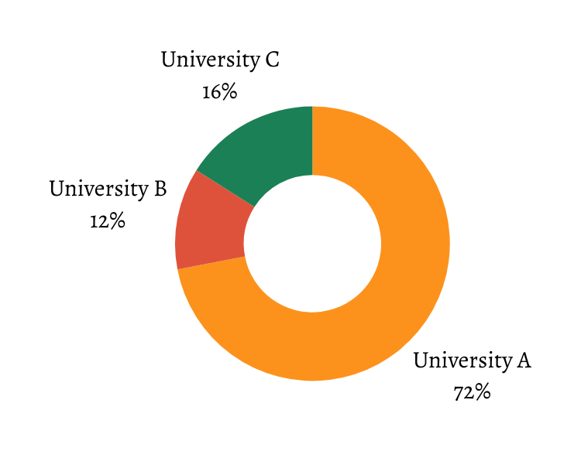
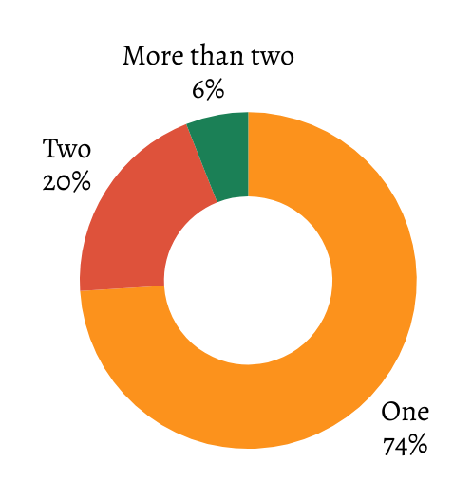
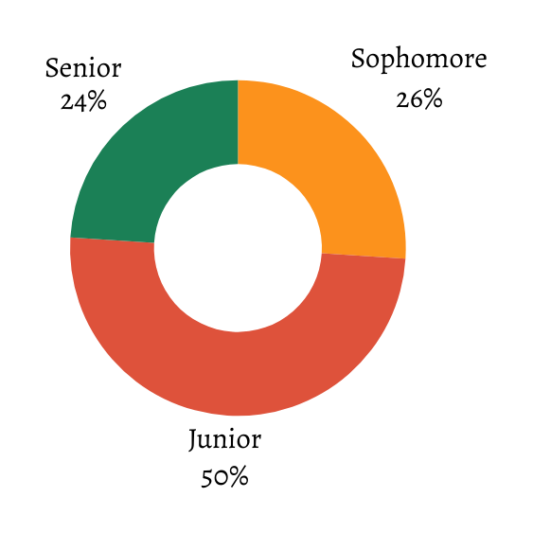
methodology
100 student participants
Year of academia
Distribution of universities
Number of undertaken practicum(s)

Slide 12
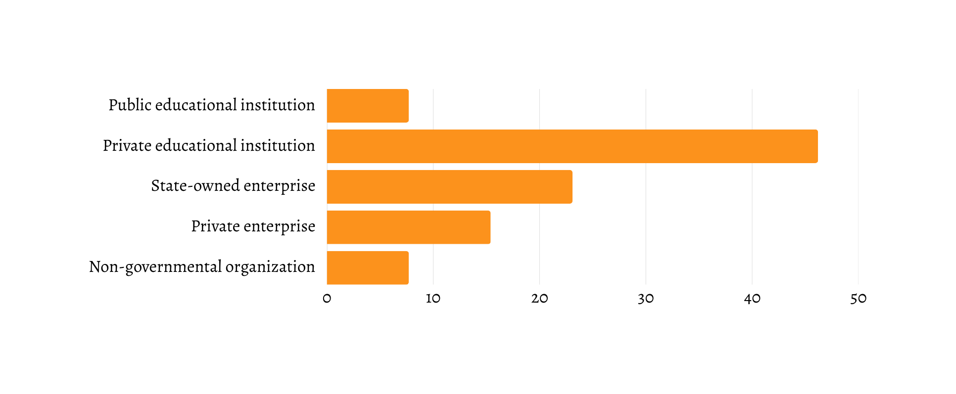
methodology
13 employer participants
Distribution of Business Types (%)

Slide 13

Informant
selection
  Students
  Simple random sampling (accessible groups)
  Voluntary participation (scattering groups)
  Employers
  Quota sampling

Slide 14


Research design
Mixed methods research
Questionnaires
Follow-up interviews
  Adapted from theoretical frameworks and the conceptualized PLOs in English Studies
Developed based on questionnaires’ findings
Work on skills’ significance and expectations
Formulated with 03 main questions

Slide 15
Data
gathering and processing
Administering questionnaires
Conducting interviews
01
02
Delivered in 2 forms:
  paper questionnaires
  online surveys
Carried out via text-messaging applications
Computing and interpreting
04
03
Processing and encoding
Employed SPSS (ver. 27)
Tested the reliability and interpreted data
Utilized Microsoft Excel
Summarized and encoded raw data

Slide 16
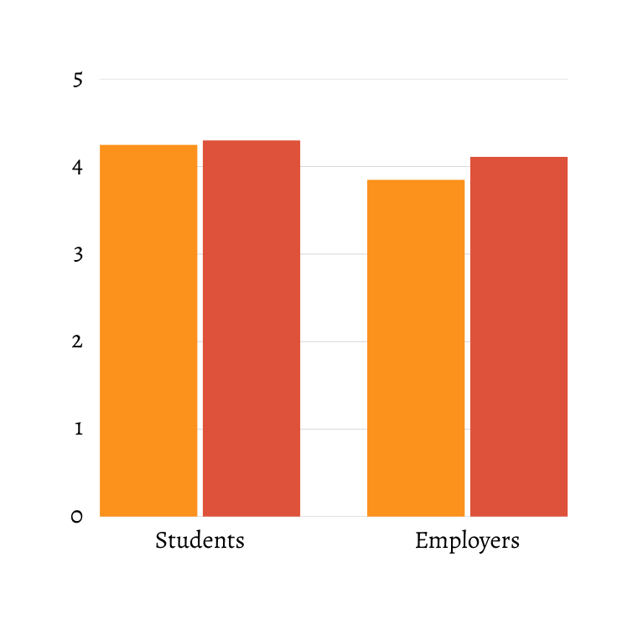
Core skills & Interpersonal skills in significance
4.25
4.30
4.11
  Specialized knowledge
  English communication
  Intercultural competencies
  Production of quality texts/speeches
3.85
  Convincing
  Teamwork
  Colleague support
  Presentation
Core skills
Interpersonal skills
1. Similar perceptual significance
Results

Slide 17
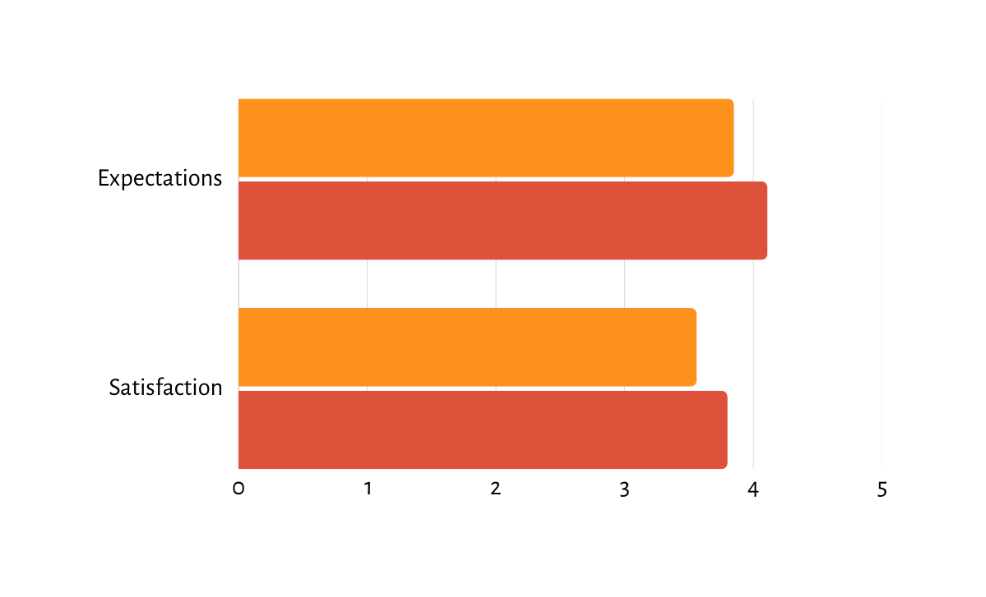
Expectations & Satisfaction in comparison
3.85
  Specialized knowledge
  English communication
4.11
3.56
  Active listening
  Information gathering
  Colleague support
3.80
Core skills
Interpersonal skills
2. Full satisfaction achieved
Results

Slide 18
Results
Interpersonal skills with greater concerns
Students’ competencies - a blend of inner drive and external resources
Joint action that counts
  Comparable role of core skills and interpersonal skills
  yielded less satisfaction
  students’ personal determination
  students
  Overall satisfaction of both skill sets
  an add-on in the training program
  university preparations
  university policymakers
  increasingly important in the near future
  prospective employers

Slide 19
01
Core skills
03
Perceptual mismatches
  Specialized knowledge in application
  Similar importance of both skill sets
= Bu (2020)
= Phuong and Hua (2014)
≠ Web (2010), Xie (2017),Bu (2020), Gagalang (2020), and Mehdaoui (2022)
2. Sociocultural competence
= Bu (2020)
≠ Phuong and Hua (2014)
2.Full satisfaction of both skill sets
= part of Gagalang (2020)
≠ part of Xie (2017), Shan’a (2020), and Gagalang (2020)
≠ Phuong and Hua (2014)
02
Interpersonal skills
  Teamwork
= Shan’a (2020) and Phan et al. (2022)
≠ Mehdaoui (2022)
Skill
2. Convincing
Discussion
≠ Phuong and Hua (2014) and Shan’a (2020)

Slide 20
01
EFL learners
  Self-motivation
= Xie (2017) and Gagalang (2020)
Discussion
University administrators and employers
02
Implications for practice
  Close collaboration between academia and industry
= Phuong and Hua (2014), Xie (2017), Gagalang (2020) and Pham (2021)
2. Substantial provision of hands-on training and opportunities
= Gagalang (2020) and Pham (2021)

Slide 21

emerging
observations
Underexplored skills
Research dimensions
  Sparsely embedded skills
    Colleague support
  Determinants of students’ competencies
  Newly-emerged skills
    Information gathering
  Future trends of the sought-after skills

Slide 22

remarks
Concluding
Research implications
Suggestions for better practices
  Similar importance of:
    core skills (specialized knowledge and English for communication)
    interpersonal skills (teamwork and convincing)
  Students’ determination in reaching out for outside-class opportunities
  University-industry collaboration for optimal training efficacy
  Full employers’ satisfaction of:
    core skills
    interpersonal skills

Slide 23
For
EFL graduating students
a seamless leap
  Leverage available resources
  Embrace well-rounded skill development
University policymakers
to the workforce
  Sustain a well-proportioned theory-practice blend
  Diversify the syllabus into career-specific streams
  Optimize teaching methodologies
  Foster close partnerships with industries
Future researchers
  Investigate other dimensions of employability
  Expand the quantity and diversity of informants
  Examine the efficacy of a divergent syllabus
Prospective employers
  Engage in talent coaching

Slide 24
VietTESOL International Convention 2025
Sincere appreciation
and farewell

