Slide 1

Promoting AI in EFL Speaking Classrooms
at a Vietnamese Vocational College
Huy Pham, Ha Nguyen, Anh Pham, Minh Pham
August 28th -30th, 2025

Slide 2
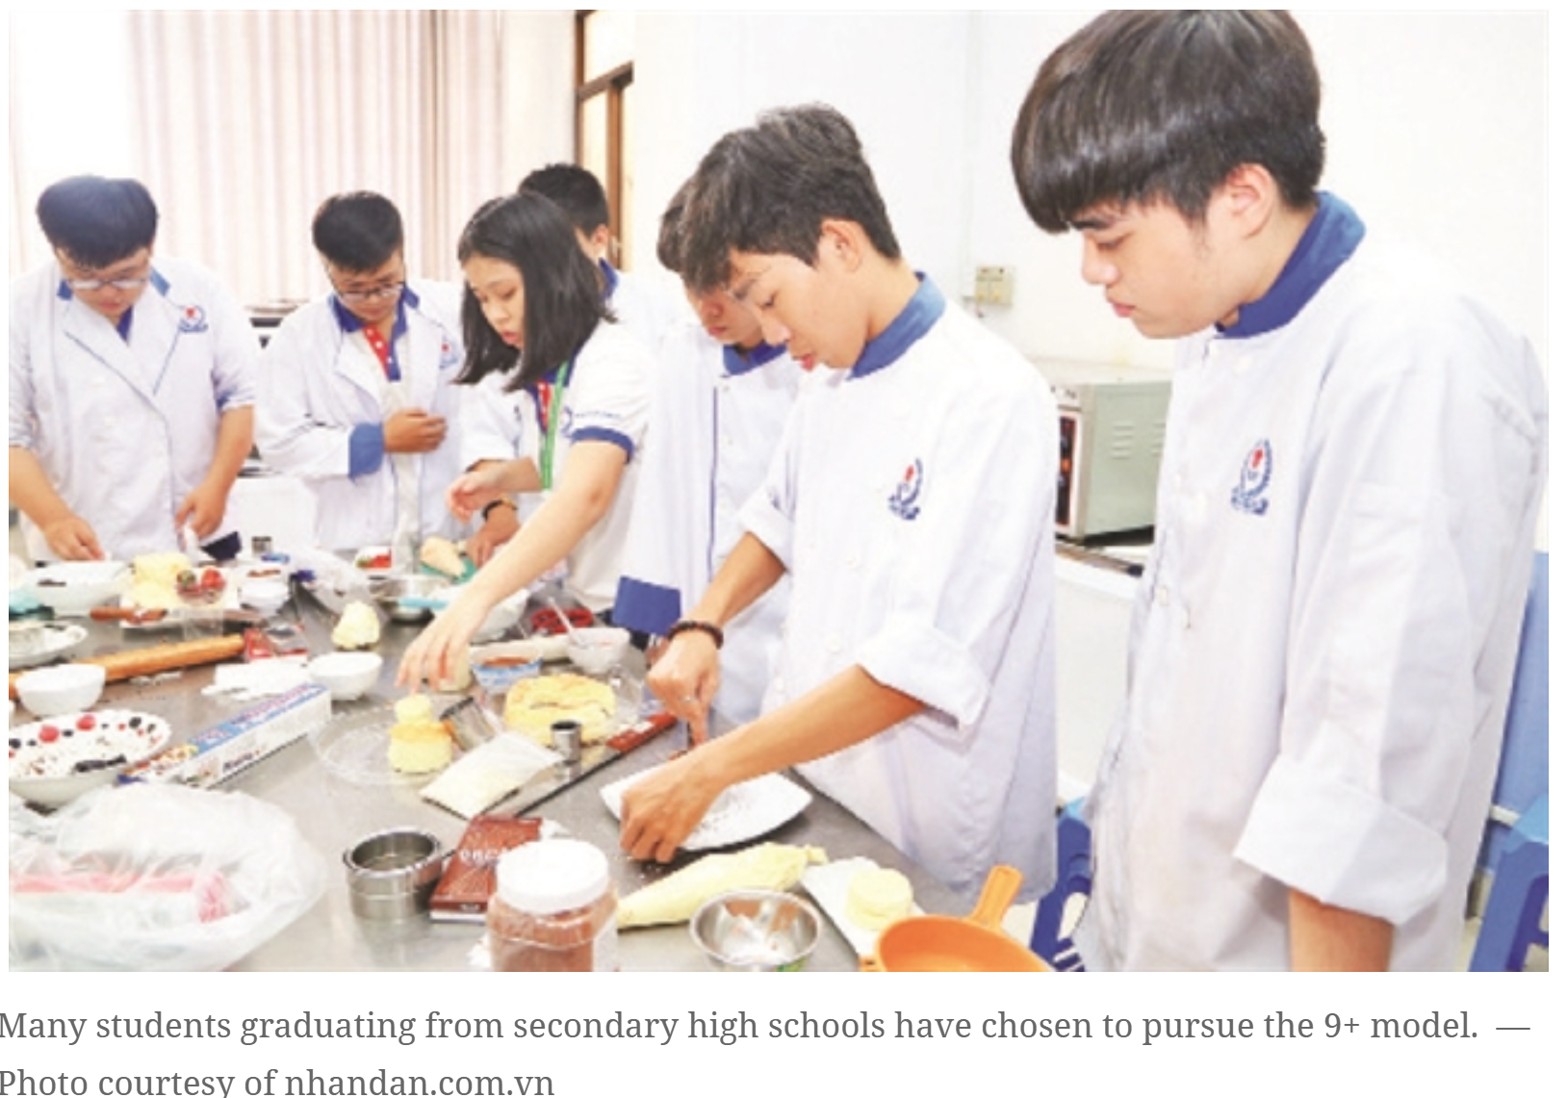
Background & Context
• EFL speaking remains a challenge in vocational colleges
• Non-English majors lack fluency, confidence, and real practice
• Need for tech-based solutions in the digital learning era
Notes:
In many Vietnamese vocational colleges, English speaking remains one of the most difficult skills for students to master. This is especially true for non-English majors, who often have very limited exposure to authentic English communication. Most of them lack the confidence to speak up in class, and their fluency is often hindered by hesitation, fear of making mistakes, or lack of vocabulary.
Moreover, traditional classroom settings don’t always provide enough opportunities for meaningful speaking practice. Students may only have two or three minutes to speak during a lesson, and this is rarely enough to build real communicative competence.
In today’s digital era, however, technology offers new possibilities. With the rise of artificial intelligence, we can now create more personalized, interactive, and low-pressure environments for speaking practice. This is especially important for vocational students, who may not plan to become English professionals—but still need functional communication skills for their future careers. That’s the motivation behind our project, which I’d like to introduce today
Việt Nam commemorates the 50th anniversary of the liberation of the South and National Reunification this year, and the Mekong Delta – the southern delta of the nation – marks significant progress, standing at the threshold of breakthrough opportunities in the new era.
https://vietnamnews.vn/society/1695367/developing-high-quality-human-resources-in-the-new-era.html

Slide 3

Research Purpose
• Investigate how AI tools enhance EFL speaking performance
• Focus on fluency, pronunciation, and learner autonomy
• Conducted at a Mekong Delta vocational college
Dong Thap Community College
Notes:
At Dong Thap Community College, one of our key priorities is to improve English speaking skills for our students—especially those who are not English majors. These students often feel unprepared and lack confidence when speaking, even after years of learning the language.
That’s why this study was designed—to explore how Artificial Intelligence tools can be used to enhance EFL speaking performance in a practical, classroom-based context. We focused on three main aspects: fluency, pronunciation, and learner autonomy. These are essential for vocational students who need to communicate effectively in both academic and workplace settings.
The study was conducted at our college in the heart of the Mekong Delta, involving 22 non-English majors over an eight-week period. Through this project, we aimed not just to apply technology, but to empower students with confidence, consistent practice, and the ability to track their own progress using AI-driven tools.

Slide 4

Participants & Duration
• 22 non-English major students
• 8-week classroom-based implementation
• Speaking-focused EFL lessons with AI tools
Notes:
Our participants were 22 students from the Industrial Electricity class at Dong Thap Community College. None of them were English majors, which means they rarely have the chance to use English in their daily study or work. This made them an ideal group for exploring how technology can bridge the gap in speaking practice.
The project lasted for eight weeks and was implemented entirely in a real classroom environment. The idea was to integrate speaking-focused EFL lessons with AI tools, so that students could receive personalized feedback on their pronunciation, fluency, and overall speaking performance.
By doing this within the actual vocational training context, we ensured that the lessons were practical, relevant, and tailored to the students’ needs—helping them build the confidence and communication skills they can use in both academic and professional settings.

Slide 5
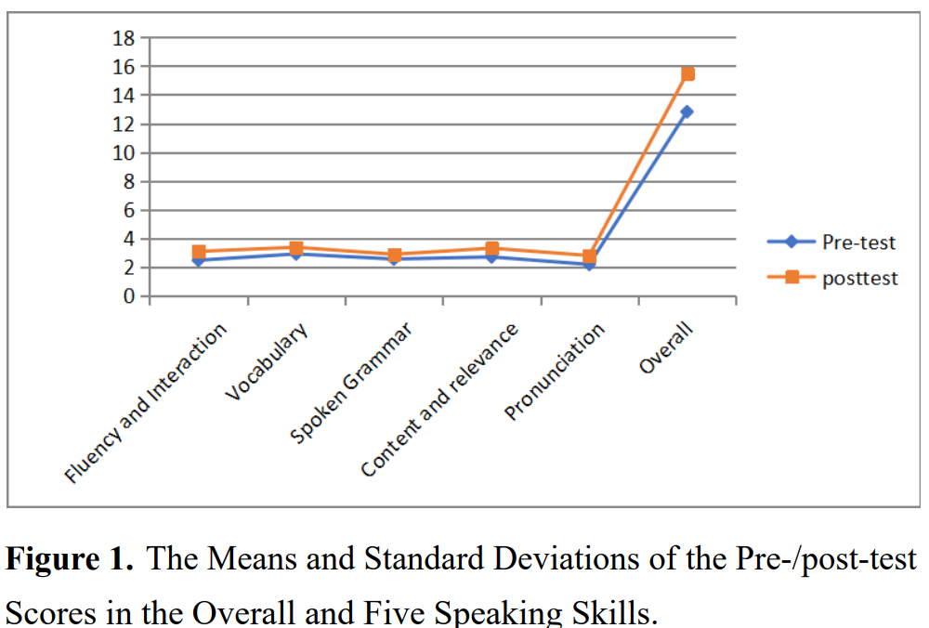
AI Tools Integrated
• Elsa Speak – Pronunciation training
• Google Speech-to-Text – Speech recognition
• ChatGPT – Conversational simulation
• Flipgrid (or similar) – Video-based feedback
Notes:
🧠 Typical AI for English Speaking
1. AI-Powered Pronunciation Trainers
These tools analyze students' pronunciation and offer corrective feedback.
ELSA Speak
Google AI Pronunciation (within Google Translate/Dictionary)
SpeechAce
Sounds: The Pronunciation App (with AI scoring)
2. Speech Recognition & Assessment Platforms
These tools convert speech to text and evaluate fluency, accuracy, and pronunciation.
Google Speech-to-Text API
Microsoft Azure Speech Services
Speechling
iTalki AI Voice Evaluation
3. Conversational AI Chatbots
Allow learners to simulate dialogues and receive feedback in real time.
ChatGPT (OpenAI) – general-purpose conversation and roleplay
Duolingo AI Bots – structured dialogue practice
Replika (with English learner mode) – interactive chatbot conversation
TALKI AI Assistant – customized for English speaking
4. AI Video-Based Feedback Tools
Record and analyze learners' speaking, often with peer or teacher feedback.
Flipgrid (now Microsoft Reflect) – video-based student speaking assignments
Zigazoo EDU – student video responses with engagement
Veo – AI for tracking student speaking over time (pilot tools)
5. Virtual Speaking Tutors / Voice Assistants
AI tutors simulate natural speaking partners.
Google Assistant / Amazon Alexa / Apple Siri (in English mode)
Andy English Bot – casual conversation practice
Mondly AR/VR – immersive speaking with AI avatars
6. AI Fluency Scorers & Analytics
Analyze fluency metrics: speed, pause rate, filler words, etc.
Yoodli – tracks filler words, pacing, and confidence
Orai App – AI-powered public speaking coach
7. Integrated Learning Platforms with AI
Full English courses that include speaking practice powered by AI:
Rosetta Stone AI Coach
Busuu AI Conversation
BBC Learning English (with AI recommendation)
📝 Summary Table
CategorySample ToolsPronunciation TrainersELSA Speak, SpeechAceSpeech RecognitionGoogle STT, Microsoft AzureChatbotsChatGPT, Duolingo BotsVideo FeedbackFlipgrid, ZigazooAI Voice AssistantsGoogle Assistant, ReplikaFluency AnalyticsYoodli, OraiFull PlatformsRosetta Stone, Mondly, Busuu

Slide 6
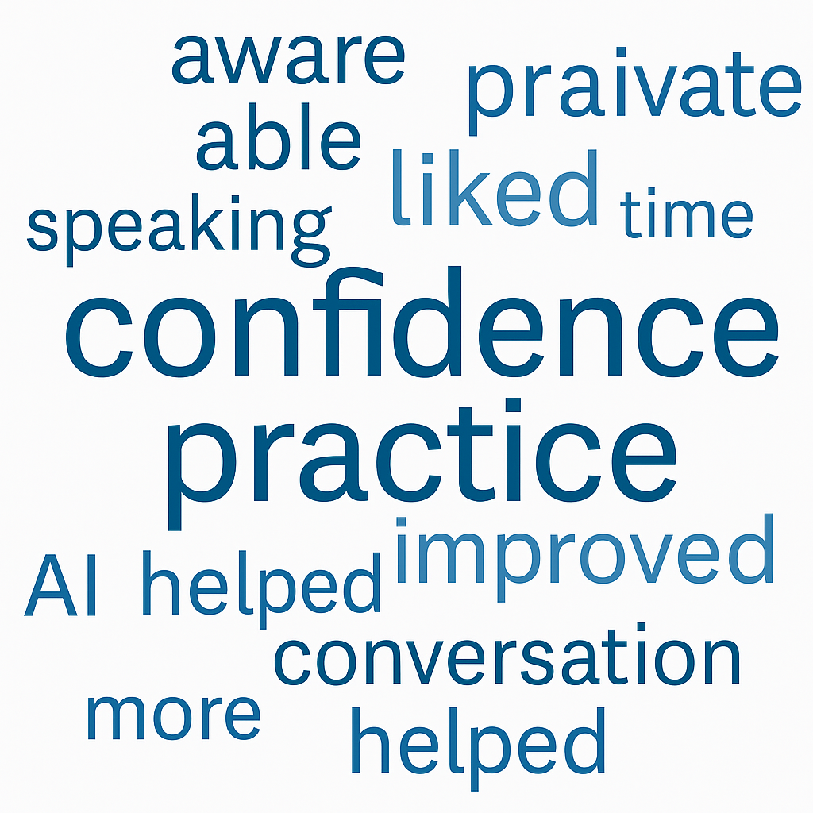
Methodology
• Classroom-based action research
• Data collection:
– Recorded speaking tasks
– Student reflection journals
– Post-activity surveys
Notes:
In this study, we focused on using just one AI tool—ChatGPT—to make the process simple, consistent, and easy for students to follow. At the start, we trained students on how to create effective prompts. This included showing them how to ask questions, set roles, and give clear instructions so that ChatGPT could act as a real speaking partner.
Once they were confident in prompting, we moved to speaking practice. Students would hold short conversations with ChatGPT on assigned topics, gradually extending their responses to build fluency. They were encouraged to record both audio and video of their speaking sessions. This allowed them to review their performance and identify areas for improvement.
For the final assessment, each student submitted a video recording of their speaking task, based on a given topic. This served as both a performance test and a personal progress record. By focusing on a single AI tool, we ensured that students could fully explore its capabilities while developing essential skills in fluency, confidence, and self-monitoring.

Slide 7

Key Findings: Language Gains
• Improved pronunciation
• Increased fluency and accuracy
• Higher speaking confidence
• Personalized, real-time feedback helped

Slide 8
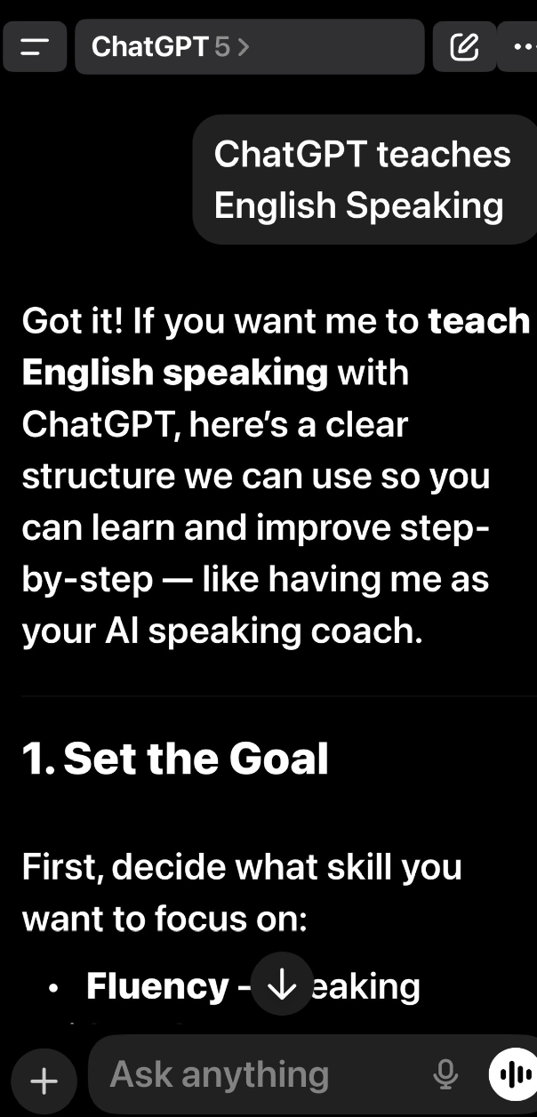
Student Voices
Learner Motivation & Autonomy
• "I feel more confident speaking with AI than with my teacher."
• "Practicing alone helped reduce my anxiety."
• "AI showed me my pronunciation errors instantly."
• Students highly engaged and motivated
• Low-pressure practice using AI tools
• Increased independence in speaking practice
• More awareness of progress

Slide 9
Challenges Encountered
• Limited digital access and devices
• Inconsistent internet and technical skills
• Need for ongoing teacher guidance and support
Pedagogical Implications
• AI complements but doesn't replace teachers
• Importance of guided implementation
• Need for clear learning goals and scaffolding

Slide 10
Conclusion & Recommendations
• AI has strong potential in EFL speaking instruction
• Blend AI with communicative, real-world tasks
• Invest in infrastructure and digital literacy
• Train teachers to maximize AI benefits
“AI does not replace teachers, but becomes a silent companion, creating a background for the role of teachers to shine brighter in the teaching and learning journey.”

Slide 11


Q&A and Discussion
Thank you!
Pham Quang Huy
Dong Thap Community College
Email: huy@dtcc.edu.vn
Website: http://phamquanghuy.com.vn/

