Slide 1
Non-English major’s speaking anxiety from a psychological perspective: Causes and effects
Author: Pham Thi Nhu Y
(presenter)
Co-author: Dr. Hoang Thi Linh Giang
Can Tho, August 28-30, 2025

Slide 2
Table of contents
01.
02.
03.
04.
05.
Introduction
Literature review
Research methodology
Findings and Discussion
Conclusion

Slide 3

01.
Introduction

Slide 4
Rationales
The contrary between the appliance of MoET’s pilot English language curricula and the actual teaching-learning process (Hoang, 2018)
 Lack of practice English communication causes students’ definite fear in speaking English.
Previous study: speaking anxiety among English-majored students (Occhipinti, 2009; Tasee, 2009; Miskam & Saldavi, 2019).
The positive effect of speaking anxiety is unexplored (Vo & Ho, 2011; Hutabarat & Simanjuntak, 2019; Suchona & Shorna, 2019; Habiburrahim et al., 2019; Hasibuan et al., 2020; Rahmat et al., 2020; Chen et al., 2022)
4

Slide 5
Research aims and research questions
1. Research aims
clarify non-English majors’ perceived English speaking anxiety levels
identify causes and effects of speaking anxiety on students’ spoken output in the target language
2. Research questions
What triggers non-English majors’ perceived speaking anxiety?
What are the effects of speaking anxiety on students’ speaking performance?
5

Slide 6

02.
Literature review

Slide 7
Foreign language anxiety (FLA)
“a distinct complex construct of self-perceptions, beliefs, feelings, and behaviors related to classroom language learning arising from the uniqueness of the language learning process” (Horwitz et al., 1986, p. 128)
a negative emotional reaction that happens when learning or using a second language (MacIntyre, 1999)
a certain level of anxiety can help students increase their motivation in learning a foreign language (MacIntyre & Mercer, 2014)
7

Slide 8
Speaking anxiety
Speaking anxiety
Trait anxiety
Context anxiety
Situational anxiety
Audience anxiety
the apprehension students have when they use the language to produce an oral communication (Horwitz et al., 1986; Syahfutra, 2021)
happen when students have nothing to say, have to think of many sources for vocabulary, grammar, pronunciation, and an overuse of mother tongue instead of the target language, leading to teachers’ critics and causing a fear of English speaking (Ur, 1991; Burkart, 1998).
Types of speaking anxiety (McCroskey, 1978)
8

Slide 9
Speech disfluency
interruptions of the execution of a speech plan (Postma et al., 1990; Pöchhacker, 1995; Tissi, 2000)
Cues of disfluency (Lindberg et al., 2021)
unfilled pauses longer than 1.7s (Watt, 1997)
filled pauses over 6 times/100 words (Tree, 1995)
repetitions
repairs
Cues of disfluency
(Zhao, 2022)
pauses
fillers
repetitions
articulatory disfluencies

Slide 10
Conceptualization
Foreign language anxiety: a specific factor that can either negatively or positively affect students’ language learning process, depending on students’ characteristics such as ages, genders and language proficiency.
Speaking anxiety: the increasing level of fear and apprehension during students’ oral presentation, which is easily affected by various factors, such as grammar, vocabulary, pronunciation, fluency and comprehension.
The nature of speaking anxiety: 4 subtypes (trait anxiety, context anxiety, audience anxiety and situational anxiety) => clarify some specific cases that students may suffer from speaking anxiety.
9

Slide 11
Theoretical background
The inverted-U theory (Yerkes-Dodson, 1908) | students reach their peak level of performance with an intermediate level of stress, or arousal; too little or too much arousal results in poorer performance
Cognitive-behavioral theory (Beck, 1983) | an individual may have a negative experience in the past, relying on the so-called cognitive schema; he/she will engrave himself/herself into that experience if it is repeated continuously for a long time
Cognitive load theory (Sweller, 2011) | students’ working memory is only able to hold a small amount of information at any one time; when the students are overwhelmed, they may struggle to process new information or make appropriate decisions.
Trade-off hypothesis (Skehan, 1998) | students’ capacity limitations force them to distribute attentional resources to all processes required for a task; when the task requirements exceed available resources, students will allocate their intention to other less complex performance areas to make their utterances be more understandable.
10

Slide 12
Related studies: Causes of speaking anxiety
Related studies | Participants | Findings | Limitation
Tasee (2009) | 963 students majoring in English 27 lecturers in English | Level of speaking anxiety: moderate Causes: fear of negative evaluation, communicative apprehension and test anxiety | Unthorough investigation on the effect of speaking anxiety on students’ English learning Underrated non-English majors’ speaking anxiety
Asysyifa et al. (2019) | 30 first-grade students in a vocational school | - Level of speaking anxiety: mildly anxious to anxious - Causes: lack preparation, afraid of being left behind in understanding the material or what the teacher talks about, afraid of making mistakes, afraid of being laughed at by his/her friends, and unconfident to spell, pronounce and select the words in English
Akkakoson (2016) | 282 Thai university students of English as a foreign language (EFL) | - Level of speaking anxiety: moderate - Causes: test anxiety, fear of negative evaluation, and limitation of vocabulary knowledge.
Toubot et al. (2018) | 300 senior English department students | - Level of speaking anxiety: moderate to high - Causes: communication apprehension, fear of negative evaluation and low self-confidence (highest mean score)
Suchona & Shorna (2019) | 81 freshmen who have completed a compulsory English course during 12 years of high school | - Causes: unconfidence, fear of criticism, hesitation, poor English background, eye contacts with classmates and unclear target language in non-English major classes
Hutabarat & Simanjuntak (2019) | 10 participants from non-English families living in a rural area who has average English score of 60 to 70 | - Causes: limitation of English exposure, fear of negative evaluation and unconducive learning condition
11

Slide 13
Related studies: Causes of speaking anxiety
Related studies | Participants | Findings | Limitation
Tran (2022) | 150 non-English majors and 4 teachers | - Speaking apprehension among students comes from students themselves, their teachers, and other sources. - Anxiety was an emotional factor that hindered students' academic performance in speaking classes. | Under-examined effect of speaking anxiety on students’ English speaking performance
Le (2023) | 300 students in 3 universities in Central Vietnam (146 males and 154 females) | - Causes: fear of making mistakes, lack of confidence in a speaking task, and fear of being negatively evaluated by friends and teachers. - Negative correlation between students’ foreign language anxiety levels and their English competence.
12

Slide 14
Related studies: Effects of speaking anxiety
Related studies | Participants | Findings | Limitation
Occhipinti (2009) | 100 university-level students of English as a second language | In-class speaking activities made students feel scared and experienced apprehension Students expressed their willingness to give volunteer answers if they are sure to say the right things, or in pairs and group works | Negative effect was mostly focused, while positive effect was under - examined
Miskam & Saldavi (2019) | 42 third-year undergraduates who were taking part in English for professional purpose subject | Level of the impacts: moderate Communication apprehension led to students’ speaking anxiety
Hutabarat & Simanjuntak’s (2019) | 10 participants from non-English families living in a rural area who has average English score of 60 to 70 | Speaking anxiety caused negative attitude among students => decreasing interest and opportunities to successfully complete learning activities)
13

Slide 15

03.
Research methodology

Slide 16
Research design
Audio recording
Qualitative
Quantitative
  Survey
  Data analysis
  Semi-structured interview
  Data analysis
Figure 3.1 Sequential Explanatory Mixed Methods Design (Cresswell & Cresswell, 2009)
15

Slide 17
Participants and sampling
a) For the survey
  Ages: 19-20 (freshmen and sophomores)
  English proficiency level: A2-B1
  VSTEP B1 certificate for the score 4.0-5.5 is also acceptable.
  Sampling: Convenience sampling
191 non-English majors
b) For the audio recording and semi-structured interview
10 out of 191
non-English majors
  have the most ‘true of me’ and ‘totally true of me’ responses
  Sampling: purposeful sampling
16

Slide 18
Demographic information of participants for the questionnaire (N=191)
Variable |  | N | Percentage (%)
Age | 19 | 92 | 48.16
 | 20 | 99 | 51.54
Field | College of Technology | 21 | 10.99
 | Faculty of Information Technology & Communications | 8 | 4.18
 | Institute of Food and Biotechnology | 10 | 5.23
 | College of Economics | 41 | 21.46
 | College of Natural Sciences | 9 | 4.71
 | School of Social Sciences and Humanities | 21 | 10.99
 | School of Political Science | 5 | 2.61
 | School of Law | 6 | 3.14
 | College of Environment and Natural Resources | 5 | 2.61
 | College of Agriculture | 25 | 13.08
 | School of Foreign Languages (except for English-majored students) | 23 | 12.04
 | College of Aquaculture & Fisheries | 7 | 3.66
 | School of Education | 10 | 5.23

Slide 19
Data collection
Stage | Instrument | Purpose
Survey | Close-ended questionnaire (30 items) | - identify students’ level of speaking anxiety - investigate the effect of anxiety on students’ English learning
Audio recording | Students’ transcripts from their audio records of the B1 VSTEP mock test | effects of speaking anxiety on students’ English speaking performance
Follow-up interview | Semi-structured interview (8 items) | examine the causes of anxiety, impacts of anxiety on students’ speaking performance, and their coping strategies for speaking anxiety.
18

Slide 20
Data analysis
Survey: IBM/SPSS 22
Audio recording: + Oxford Text Checker
+ Word Counter web-based app
+ Error-free clause model
+ Thematic analysis
Follow-up interview: Thematic analysis
19

Slide 21
Research ethics
The questionnaire and the semi-structured interview questions were designed using students’ first language
Students were encouraged to use their first language in the interview
Students’ confidentiality and anonymity are maintained during and after the research with the consent provided before collecting data
20

Slide 22

04.
Findings and Discussion

Slide 23
Factors triggering non-English majors’ perceived speaking anxiety
Table 4.1 One-Sample t-Test for trait anxiety cluster (M=3.49; SD=.82) and fear of negative evaluation (M=3.32; SD=.90)
Test value = 3.50
 | t | df | Sig. (2-tailed) | Mean Difference | 95% Confidence Interval of the Difference
 |  |  |  |  | Lower | Upper
Trait | -.15 | 190 | .875 | -.009 | -.12 | .10
Neg.E | -2.63 | 190 | .009 | -.172 | -.30 | -.04
22

Slide 24
Table 4.2 Value of Mean Scores (Oxford, 1990)
Responses | Mean values | Interpretation
Totally not true of me | 1.00 - 1.49 | Low
Not true of me | 1.50 – 2.49
Almost true of me | 2.50 – 3.49 | Moderate
True of me | 3.50 – 4.49 | High
Totally true of me | 4.50 – 5.00 | Very high

Slide 25
Table 4.3 Students’ responses to trait anxiety (N = 191)
Items | Mean | SD
Fear of English speaking despite careful preparation | 3.77 | 1.02
Lack of English communication confidence | 3.64 | 1.12
English speaking competence self-doubt | 3.64 | 1.10
Communication competence self-doubt | 3.55 | 1.08
Communication stress and confusion | 3.52 | 1.08
English speaking nervousness and confusion | 3.51 | 1.05
Uncontrollable heartbeat | 3.43 | 1.09
Negative perception of English learning | 3.32 | 1.15
Low participation in English classes | 3.30 | 1.11
Lack of communication confidence | 3.16 | 1.12
23

Slide 26
Table 4.4 Students’ responses to the fear of negative evaluation (N = 191)
Items | Mean | SD
Fear of negative consequences of poor English proficiency | 3.69 | 1.09
Anxiety about unprepared English speaking | 3.60 | 1.14
Anxiety in answering English questions without preparation | 3.53 | 1.10
Fear of making English language errors | 3.50 | 1.06
English performance anxiety | 3.45 | 1.17
English test anxiety | 3.45 | 1.06
Discomfort during English speaking tasks | 3.16 | 1.16
Social anxiety in English speaking contexts | 3.03 | 1.24
Fear of peer ridicule for English language use | 2.93 | 1.27
Fear of teachers’ correction in English | 2.90 | 1.26
24

Slide 27
Unconfidence
"My biggest worry is that I'll get really nervous and tongue-tied when I'm speaking English with foreigners. I just don't feel confident in my English skills... In Vietnamese classes, I'm always the first to volunteer to give presentations and share my thoughts. But when it comes to English, I'm really scared.” (Student A, interview extract).
Insufficient grammatical competence
"I'm not very confident in my speaking... and my vocabulary is quite limited. So I'm hesitant to speak English... Mostly because I'm afraid of not knowing the right words." (Student H, interview extract)
Mispronunciation
"...Sometimes my pronunciation is unclear, so teachers can't hear me, and they often ask me to repeat two or three times. Some classmates laugh at me then, which makes me feel embarrassed." (Student F, interview extract)
Figure 4.1 Factors triggering students’ speaking anxiety collected from the interview
25

Slide 28
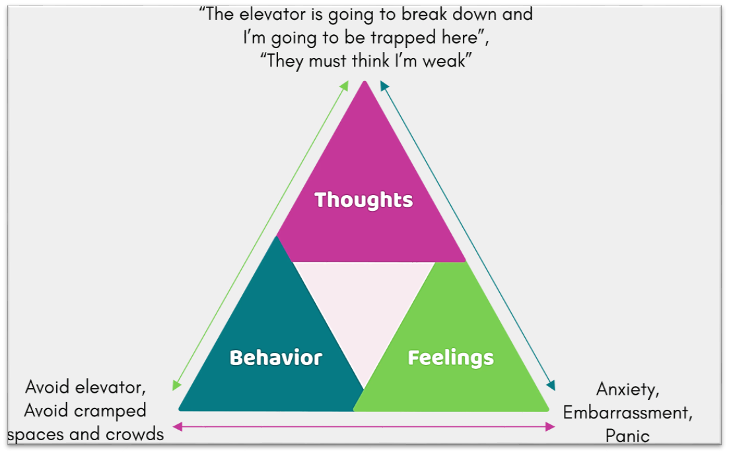
Discussion 1: Factors triggering non-English majors’ perceived speaking anxiety
 | Findings | Similarities | Differences
Level of speaking anxiety | Moderate - high | Tasee (2009) Akkakoson (2016) Toubot et al. (2018) | Asysyifa et al. (2019)
Causes | Trait anxiety (highest level) | Toubot et al. (2018) Asysyifa et al. (2019) Suchona & Shorna (2019) Tran (2022) Le (2023) | Akkakoson (2016)
 | Fear of negative evaluation | Asysyifa et al. (2019) Akkakoson (2016) Toubot et al. (2018) Suchona & Shorna (2019) Hutabarat & Simanjuntak (2019) Tran (2022) Le (2023) | n/a
 | Insufficient grammatical competence Mispronunciation | Asysyifa et al. (2019) Akkakoson (2016) Toubot et al. (2018) Suchona & Shorna (2019) Hutabarat & Simanjuntak (2019) Tran (2022) Le (2023) | n/a
“I can’t speak English as fluent as my friends do.”
“My friends keep laughing at me when I say an English word.”
Avoid speaking English
Speaking anxiety
Figure 4.2 Cognitive model depicting interaction of cognitions, feelings, and actions (Beck, 1983)
26
Notes:
What we see from these findings can be explained by the cognitive-behavioral theory developed by Beck in 1983. Since students might have gone through negative experiences in the past, such as being criticized for their mistakes, or being laughed at when they did something wrong, they hesitated to produce their speech if they did not prepare well in advance, leading to a moderate to high level of speaking anxiety.

Slide 29
Effects of speaking anxiety on students’ speaking performance
Table 4.5 One-Sample t-Test for perceived impacts of speaking anxiety on speaking performance (M=2.70; SD=.91)
Test value = 2.49
 | t | df | Sig. (2-tailed) | Mean Difference | 95% Confidence Interval of the Difference
 |  |  |  |  | Lower | Upper
Impact | 3.31 | 190 | .001 | .219 | .08 | .35
27

Slide 30
Table 4.6 Students’ responses to the impacts of speaking anxiety on their English learning (N = 191)
Items | Mean | SD
English knowledge retrieval difficulties | 3.13 | 1.12
Stuttering more in English than in L1 | 3.03 | 1.16
Becoming overwhelmed when learning English | 2.94 | 1.13
Elevated stress and worriedness in English speaking class | 2.92 | 1.15
Not understanding what the teacher said in English | 2.79 | 1.09
Reduced comprehension in English speech | 2.67 | 1.09
Difficulty catching up with the learning progress in class | 2.60 | 1.14
Increased frustration in English learning | 2.49 | 1.21
Decreased motivation for English language classes | 2.37 | 1.22
Reduced encouragement for English language learning | 2.12 | 1.23
28

Slide 31
1. Lexical diversity
Figure 4.3. Student’s English word usage in CEFR Levels (%)
29

Slide 32
2. Disfluency
Figure 4.4 Student’s unfilled pauses duration (secs/time)
Figure 4.5 Student’s filled pauses frequency (times/100 words)
30

Slide 33
3. Accuracy
Figure 4.6 Student’s accuracy through error-free clauses percentage (%)
31

Slide 34
Difficulties in knowledge retrieval
"I'm really forgetful, especially when I'm speaking. And when I talk to foreigners, I get so nervous that I can't think straight. I feel much more comfortable speaking in Vietnamese." (Student A, interview extract)
Stuttering
"I also tend to repeat the words I'm saying, and I also use fillers like 'um' and 'ah'. I do this in Vietnamese too, but less frequently." (Student I, interview extract)
English learning relinquishment
"Honestly, I've thought about that (giving up) ever since I started learning English. And I still haven't been able to break that habit. I know it's not good, but I just can't stop... It's like I have a hard time concentrating, and memorizing things is really difficult for me." (Student J, interview extract)
Figure 4.7 Effects of speaking anxiety collected from the interview
32

Slide 35
Discussion 2: Effects of speaking anxiety on students’ speaking performance
 | Findings | Similarities | Differences
Level | Moderate | Miskam & Saldavi (2019) | n/a
Indication | Limited lexical diversity Disfluency Inaccuracy | n/a | n/a
Impacts | Difficulties in knowledge retrieval | n/a | n/a
 | Stuttering | Occhipinti (2009) | n/a
 | English learning relinquishment | n/a | Occhipinti (2009)
 | L1 production instead of L2 production | n/a | n/a
33

Slide 36
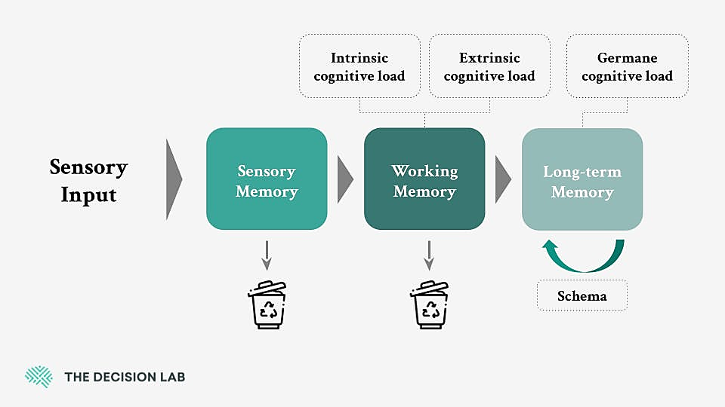
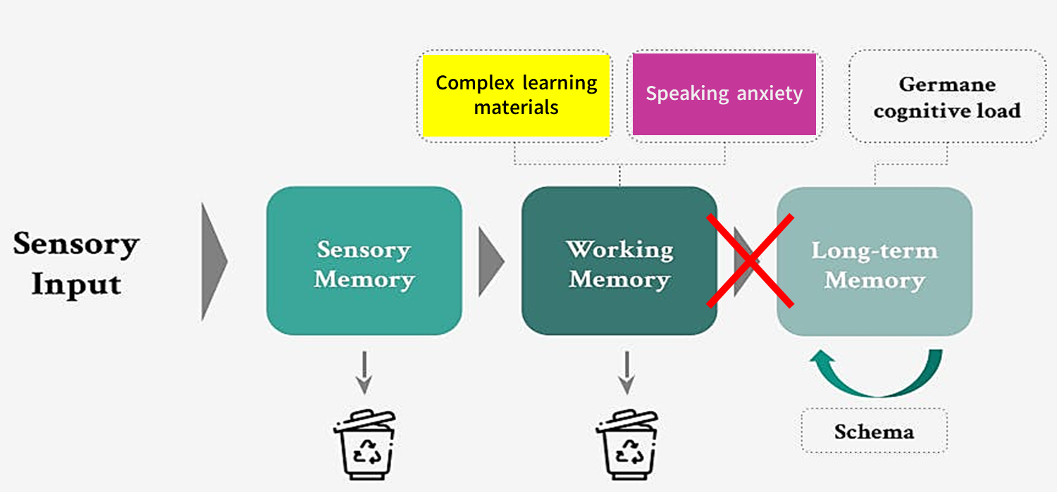
Complex learning materials
Speaking anxiety
L2 schema
L1 schema
L1 production
Figure 4.8 Cognitive load theory (Sweller, 1994)
Figure 4.9 Trade-off hypothesis (Skehan, 1998)
34
Notes:
Students had a limited amount of English vocabulary while they needed to used an abundance of semantic and syntactic knowledge and use to produce an utterance, leading to an obstruction of processing the knowledge from short-term memory to long-term memory, which caused the difficulties in retrieving the knowledge they had learnt. As a result, students used more fillers and silent pauses as a tool to stall for thinking time.
Besides, since the process of students’ brain activation to choose the best way to express an idea will be slowed down or canceled when they couldn’t find out suitable L2 utterances to express their ideas, they may switch to their first language to make their utterances more understandable. It is less complex to produce an L1 utterance than an English one, like what we see in Skehan’s trade-off hypothesis.

Slide 37
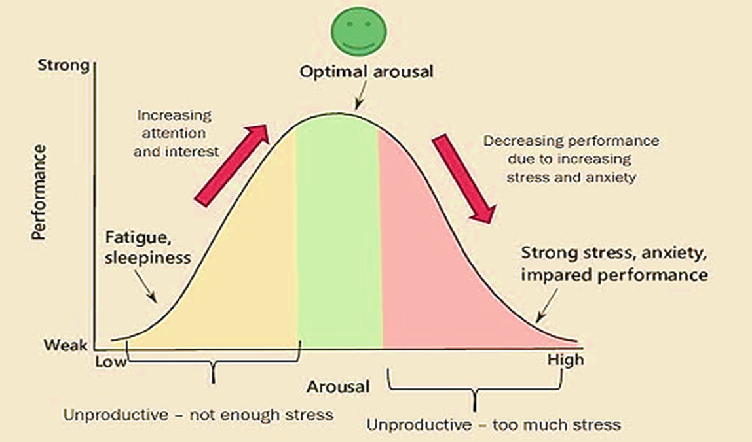
Figure 4.10 The inverted-U theory (Yerkes-Dodson, 1908)
35
Notes:
Next, students’ English learning relinquishment happened since they were overwhelmed by the new knowledge they had to learn. As a result, students gradually lose their motivation to learn English, resulting in their tendency to avoid anything relating to this language in the long run. This is appropriate with what was demonstrate in the inverted-U theory of Yerkes-Dodson (1908), which presented that a certain amount of anxiety may benefit learners’ performance as it motivates them to complete tasks to the best of their potentials, but an excessive amount of anxiety requires greater mental efforts, which also means students’ performances will suffer.

Slide 38

05.
Conclusion

Slide 39
Pedagogical implications
For teachers
For students
suitable teaching methods
meaningful lesson plans
various teaching aids and teaching techniques
good preparation
supportive classes participation
asking others for help
37

Slide 40
Limitations and recommendations
Data collected from audio recording of the B1 VSTEP mock test  insufficient
a real test involving both audio and video recording
The limitation number of students involved in the speaking test.
larger sample sizes for more insightful results
The impact of using L1 to alleviate anxiety in an English conversation session has not been thoroughly examined
=> future research can adopt an experimental design to clarify the potentials of L1 in reducing speaking anxiety among EFL students.
38

Slide 41
Thank you!
“In learning you will teach, and in teaching you will learn.”
- Phil Collins -

Slide 42
References
Akkakoson, S. (2016). Speaking anxiety in English conversation classrooms among Thai students. Malaysian Journal of Learning & Instruction/Malaysian Journal of Learning & Instruction, 13(1), 63–82. https://doi.org/10.32890/mjli2016.13.1.4
Alpert, R., & Haber, R. N. (1960). Anxiety in academic achievement situations. The Journal of Abnormal and Social Psychology, 61(2), 207–215. https://doi.org/10.1037/h0045464
Argyle, M., Alkema, F., & Gilmour, R. (1971). The communication of friendly and hostile attitudes by verbal and non-verbal signals. European Journal of Social Psychology, 1(3), 385–402. https://doi.org/10.1002/ejsp.2420010307
Baran-Łucarz, M. (2011). The relationship between language anxiety and the actual and perceived levels of foreign language pronunciation. Studies in Second Language Learning and Teaching, 1(4), 491. https://doi.org/10.14746/ssllt.2011.1.4.3
Beck, A.T. (1983). Cognitive therapy of depression: New perspectives. In P. J. Clayton, & J. E. Barett (Eds.), Treatment of depression. Old controversies and new approaches (pp. 265-284). New York.

Slide 43
References
Burkart, G. S. (1998). Spoken language: What it is and how to teach it. Washington, DC: Center for Applied Linguistics. http://files.eric.ed.gov/fulltext/ED433722.pdf
Eaton, S.E. (2010). Global trends in language learning in the twenty-first century. Onate Press.
Gregersen, T. (2005). Nonverbal Cues: clues to the detection of foreign language anxiety. Foreign Language Annals, 38(3), 388–400. https://doi.org/10.1111/j.1944-9720.2005.tb02225.x
Harmer, J. (2007). The practice of English language teachers (4th ed.). Longman.
Harris, D. (1974). Testing English as a second language. Mc. Graw. Hill Book Company.
Horwitz, E. K., Horwitz, M. B., & Cope, J. (1986). Foreign language classroom anxiety. The Modern Language Journal, 70(2), 125–132. https://doi.org/10.1111/j.1540-4781.1986.tb05256.x
Hutabarat. A., & Simanjuntak. D. C. (2019). A phenomenological study: Speaking anxiety overwhelms English learners. Acuity 4(1). 44-58. https://doi.org/10.35974/acuity.v4i1.679

Slide 44
References
Le, H. T. T. (2023). The impacts of foreign language anxiety on students in English-medium instruction classes in the central region universities, Vietnam. Vietnam Journal of Education, 7(2), 103–113. https://doi.org/10.52296/vje.2023.265
Lindberg, R., McDonough, K., & Trofimovich, P. (2021). Investigating verbal and nonverbal indicators of physiological response during second language interaction. Applied Psycholinguistics, 42(6), 1403–1425. https://doi.org/10.1017/s014271642100028x
MacIntyre, P. D. (1999). Language anxiety: a review of the research for language teachers. In D. J. Young (Ed.). Affect in Foreign Language and Second Language Teaching: A Practical Guide to Creating a Low-Anxiety Classroom Atmosphere (pp. 23-45). McGraw-Hill.
MacIntyre, P. D., & Mercer, S. (2014). Introducing positive psychology to SLA. Studies in Second Language Learning and Teaching, 4(2), 153–172. https://doi.org/10.14746/ssllt.2014.4.2.2
McCroskey, J. C. (1978). An introduction to rhetorical communication. Prentice Hall.
Miskam. N. N., & Saidalvi. M. (2019). Investigating English language speaking anxiety among Malaysian undergraduate learners. Asian Social Science, 15(1). 1-7. https://doi.org/10.5539/ass.v15n1p1
Occhipinti. A. (2009). Foreign language anxiety in in-class speaking activities: two learning contexts in comparison. [Master’s thesis, University of Oslo]. http://urn.nb.no/URN:NBN:no-24035
Oxford, R. L. (1990). Language Learning Strategies: What every teacher should know. Heinle & Heinle.
Pöchhacker, F. (1995). "Those Who Do.": A profile of research(ers) in interpreting. Target, 7, 47–64. https://doi.org/10.1075/target.7.1.05poc

Slide 45
References
Postma, A., Kolk, H., & Povel, D. J. (1990). On the relation among speech errors, disfluencies, and self-repairs. Lang. Speech 33, 19–29. https://doi.org/10.1177/002383099003300102
Suchona. I. N., Shorna. S. A. (2019). Speaking problems in English and solutions: Scrutinizing students’ perspective. International Journal of English, 8(1). 34-41. http://dx.doi.org/10.34293/english.v8i1.661
Skehan, P. (1998). A cognitive approach to language learning. Oxford University Press.
Sweller, J. (1994). Cognitive load theory, learning difficulty, and instructional design. Learning and Instruction, 4(4), 295–312. https://doi.org/10.1016/0959-4752(94)90003-5
Tasee. P. (2009). Factors affecting English major students’ anxiety about speaking English. [Doctoral dissertation, Suranaree University of Technology]. http://sutir.sut.ac.th:8080/jspui/handle/123456789/3242
Tissi, B. (2000). Silent pauses and disfluencies in simultaneous interpretation: A descriptive analysis. The Interpreters’ Newsletter, 10(4), 103-127.
Toubot, A. M., & Seng, G. H. (2018). Examining levels and factors of speaking anxiety among EFL Libyan English undergraduate students. International Journal of Applied Linguistics and English Literature, 7(5), 47-56. http://dx.doi.org/10.7575/aiac.ijalel.v.7n.5p.47

Slide 46
References
Tran, T. T. L. (2022). An investigation into the causes of students’ anxiety in learning English speaking skills. International Journal of TESOL & Education, 2(3), 183–196. https://doi.org/10.54855/ijte.222312
Tran, T. T. T., & Moni. K. (2016) Management of foreign language anxiety: Insiders’ awareness and experiences. Cogent Education, 2(1). https://doi.org/10.1080/2331186X.2014.992593
Tree, J. E. (1995). The effects of false starts and repetitions on the processing of subsequent words in spontaneous speech. Journal of Memory and Language, 34(6), 709–738. https://doi.org/10.1006/jmla.1995.1032
Tripura, B. L. (2020). Cultural constraints in adopting communicative language teaching approach for teaching English to the secondary students in Bangladesh introduction. American International University-Bangladesh,4, 1-19.
Ur, P. (1991). A course in language teaching practice of theory: Cambridge teacher training and development. Cambridge University Press.

Slide 47
References
Van Van, H. (2018). Moet’s three pilot English language communicational curricula for schools in Vietnam: Rationale, design and implementation. VNU Journal of Foreign Studies, 34(2). https://doi.org/10.25073/2525-2445/vnufs.4258
Watts, R.J., 1997. Silence and the acquisition of status in verbal interaction. In Jaworski, A. (Ed.). Silence: Interdisciplinary Perspectives (pp. 87-115). Mouton de Gruyter, Berlin and New York.
Yerkes, R. M., & Dodson, J.D. (1908). The relation of strength of stimulus to rapidity of habit-formation. Journal of Comparative Neurology and Psychology, 18(5), 459-482. https://psycnet.apa.org/doi/10.1002/cne.920180503
Zhao, N. (2022). Speech disfluencies in consecutive interpreting by student interpreters: The role of language proficiency, working memory, and anxiety. Frontiers in Psychology, 13. https://doi.org/10.3389/fpsyg.2022.881778

