Slide 1
Elevate Your Pronunciation: Active Teaching and Learning with Tongue Twisters and Shadowing Strategies
Presented by Rotvitou Cheat
29th August 2025, Can Tho University, Vietnam
English Lecturer, Cambodian ELT Conference Coordinator,
IFL, RUPP

Slide 2
Table of contents
1
2
3
01
Reflections
Challenges of teaching pronunciation
Strategies
4
5
Practices
Practices

Slide 3
1. Reflections

Slide 4


Agree
‘Clear pronunciation is essential for building students’ confidence in speaking.’
Disagree

Slide 5

Agree
/Ñ/
‘Pronunciation is less important than grammar and vocabulary in helping students communicate effectively.’
/RR/
Disagree

Slide 6
Agree
/Ñ/
‘Students will naturally improve their pronunciation overtime without explicit instruction.’
/RR/
Disagree

Slide 7
Agree
/Ñ/
‘Teaching pronunciation requires specialized training that most teachers do not have.’
/RR/
Disagree

Slide 8

Discussion Questions
As an EFL teacher, do you think perfect (native-like) pronunciation is necessary for your students? Why? Why not?

Slide 9
02
Challenges of Teaching Pronunciation
/Ñ/
/RR/

Slide 10
Factors cause Pronunciation Problem in EFL context (For students)
Overgeneralization (Keuk, 2009)
Fossilization
Lack of Confident
Negative Behavior
Knowledge of pronunciation features

Slide 11
Why is it so difficult to achieve the pronunciation I want?
1. Aiming for perfection (Gilakjani, 2012)
2. Lack of Corrective Feedback (Lyster and Ranta, 1997)
3. Resistant to feedback
4. Inconsistency in practicing pronunciation
5. Lack of motivation

Slide 12
Strategies
03
/Ñ/
/B/

Slide 13
Exploring Different Strategies
Minimal Pairs
02
Shadowing Exercise
04
01
Tongue Twister
03
Make use of Technology

Slide 14
What I am presenting today:
02
Shadowing Exercise
Tongue Twister
03

Slide 15
3.1 Tongue Twister (Level 1)
/Ñ/
Red lorry, yellow lorry
Mixed biscuit, mixed biscuits
A skunk sat on a stump.
I scream, you scream, we all scream for ice cream.
/Ñ/
/RR/
/LL/

Slide 16
3.2. Tongue Twister (Level 2)
Eleven benevolent elephants.
I saw a kitten eating chicken in the kitchen.
Fuzzy Wuzzy was a bear. Fuzzy Wuzzy had no hair. Fuzzy Wuzzy wasn’t fuzzy, was he?
/Ñ/
/Ñ/
/RR/
/LL/

Slide 17
3.3. Tongue Twister (Level 3)
/Ñ/
Betty Botter bought some butter But she said the butter’s bitter. If I put it in my batter, it will make my batter bitter But a bit of butter will make my batter better, so was Better Betty Botter bought a bit of better butter.
/Ñ/
Peter Piper picked a peck of pickled peppers.
A peck of pickled peppers Peter Piper picked.
If Peter Piper picked a peck of pickled peppers,
Where’s the peck of pickled peppers Peter Piper picked?
/RR/
/LL/

Slide 18
Let’s practice
04
/B/

Slide 19
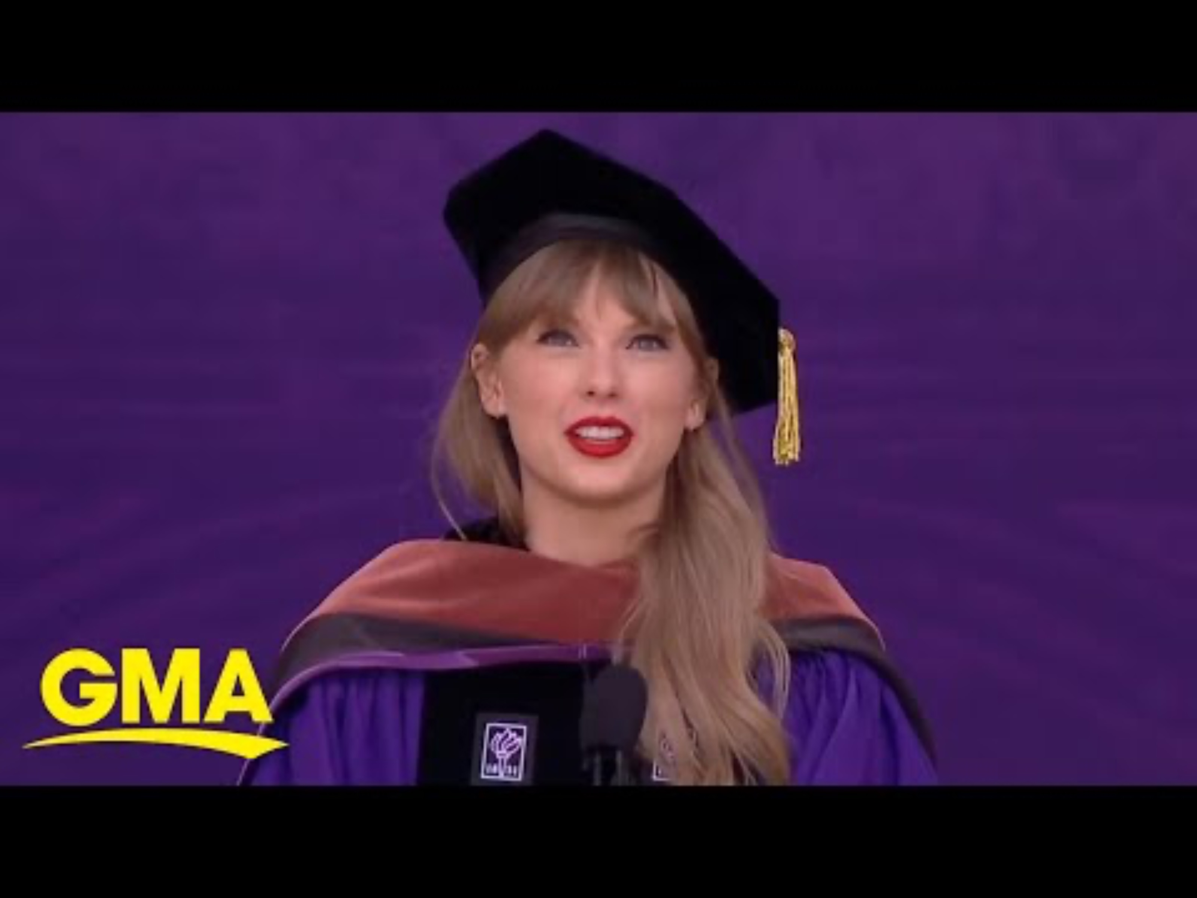
3.2.Shadowing exercise
/Ñ/
Shadowing Exercise: Imitate what you’re hearing – even if you’re not sure what they’re saying yet. Watch and Listen to Taylor Swift giving her graduation speech. Try to imitate the way that she is talking.
/LL/

Slide 20

32. Shadowing

Slide 21
Conclusion
Practice makes Perfect!
Be Curious!
Be Consistent!
Be Confident!
It’s okay to make mistakes and to be made fun by other people because At the end of the day, you are the one who acquires those knowledge.

Slide 22
References
Gilakjani, A. P. (2012). A study of factors affecting EFL learners' English pronunciation learning and the strategies for instruction. International journal of humanities and social science, 2(3), 119-128.
Keuk, C. N. (2009). How intelligible is Cambodian English variety? A look from foreigners’ perspectives. In CamTESOL Conference on English Language Teaching: Selected Papers Volume 5, 2009 (p. 23).
Lyster, R., & Ranta, L. (1997). Corrective feedback and learner uptake: Negotiation of form in communicative classrooms. Studies in second language acquisition, 19(1), 37-66.
Renandya, W. A., & Farrell, T. S. (2011). ‘Teacher, the tape is too fast!’Extensive listening in ELT. ELT journal, 65(1), 52-59.

Slide 23
Thanks!
/Ñ/
/B/
Do you have any questions?
Please keep this slide for attribution

