Slide 1
ChatGPT’s Impact on Metacognition and Motivation in EFL Academic Writing
Vo Thi Thanh Lan, M.A
Hoang Vinh Loc, M.A

Slide 2
ChatGPT’s Impact on Metacognition and Motivation in EFL Academic Writing
Vo Thi Thanh Lan, M.A
Hoang Vinh Loc, M.A
August 2025

Slide 3

Human or AI: Can You Spot the Difference?

Slide 4
Read the two paragraphs and decide which one is written by a student, and which one is written by AI.
A
B
When using AI tools, they make learning English more easier for me. Sometimes studying alone at home, AI can help me like a friend. It give me feedback very fast, so I don’t have to wait the teacher answer. Last week, I use an app that correct my sentences, it was help me understand my mistakes. Also, AI shows me new words which I never know before. When I practice speaking, the AI listening to me and telling what I say wrong. I can learn anytime, even when I was travelling to my hometown. Using AI make me feel more confident to talk with foreign people. It sometimes give very long explanation, which is confusing me. But mostly, I think learning with AI tools are a good way for students like me.
Using AI tools makes learning English easier for me. Sometimes, when I study alone at home, AI helps me like a friend. It gives me feedback very quickly, so I don’t have to wait for the teacher’s answer. Last week, I used an app that corrected my sentences, and it helped me understand my mistakes. AI also shows me new words that I didn’t know before. When I practice speaking, the AI listens to me and tells me where I go wrong. I can learn anytime, even when I am traveling to my hometown. Using AI makes me feel more confident about talking with people from other countries. Sometimes, it gives very long explanations, which can be confusing. Overall, I think learning with AI tools is a good way for students like me.

Slide 5

Overview
II. Theoretical Framework
III. Research Questions
IV. Methodology
V. Key Findings
VI. S.M.A.R.T. AI Framework
VII. Conclusion & Implications
I. Background & Research Gap

Slide 6
I. BACKGROUND
&
RESEARCH GAP

Slide 7
EFL writing challenges: idea generation, structure, confidence
Rise of ChatGPT for planning, feedback, grammar correction
Limited studies on cognitive and motivational impacts
Need for evidence-based AI integration strategies
Background
Research gap

Slide 8
II. THEORETICAL FRAMEWORK

Slide 9
Theory | Key Concepts | Relevance to ChatGPT Use in EFL Writing
Flavell’s Metacognitive Theory (1979) | Planning, monitoring, and evaluating during writing | ChatGPT enhances planning and revision >< may reduce active self-monitoring, especially in lower-proficiency learners.
Bereiter & Scardamalia’s Model (1987) | Distinction between knowledge-telling vs. knowledge-transforming writing processes | Strategic use of ChatGPT enables deeper thinking and revision >< Passive use leads to superficial content improvements.
Bandura’s Self-Efficacy Theory (1997) | Confidence in one’s ability increases effort, persistence, and performance | ChatGPT boosts writing confidence >< overuse may diminish genuine skill development and authorship.
Dörnyei’s L2 Motivational System (2009) | Motivation influenced by identity (Ideal L2 Self), task value, and self-regulation | ChatGPT can increase motivation and engagement if students retain ownership over the task.
Vygotsky’s ZPD (1978) | Learning occurs best within the zone between independent ability and scaffolded support. | ChatGPT serves as a scaffold >< improper scaffolding may hinder learner autonomy and long-term development.

Slide 10
III. RESEARCH QUESTIONS

Slide 11

Research Questions
How does ChatGPT influence EFL learners’ metacognitive strategies (planning, monitoring, revising)?
What effect does ChatGPT use have on EFL learners’ writing self-efficacy and intrinsic motivation?

Slide 12
IV. METHODOLOGY

Slide 13

Participants
👥 120 second-year English majors at the Faculty of English Language, Lac Hong University
📅 Age range: 19–21 years
✍️ Courses: Currently taking both Essay Writing and IELTS Writing
📈 Proficiency levels: Stratified by CEFR B1–B2 (via internal placement test)
Inclusion criteria:
🤖 Prior experience using ChatGPT
🧑‍🏫 No formal AI writing instruction

Slide 14

Research design
Qualitative (open-ended questionnaires)
Quantitative (surveys + writing samples)
Mixed-methods approach

Slide 15
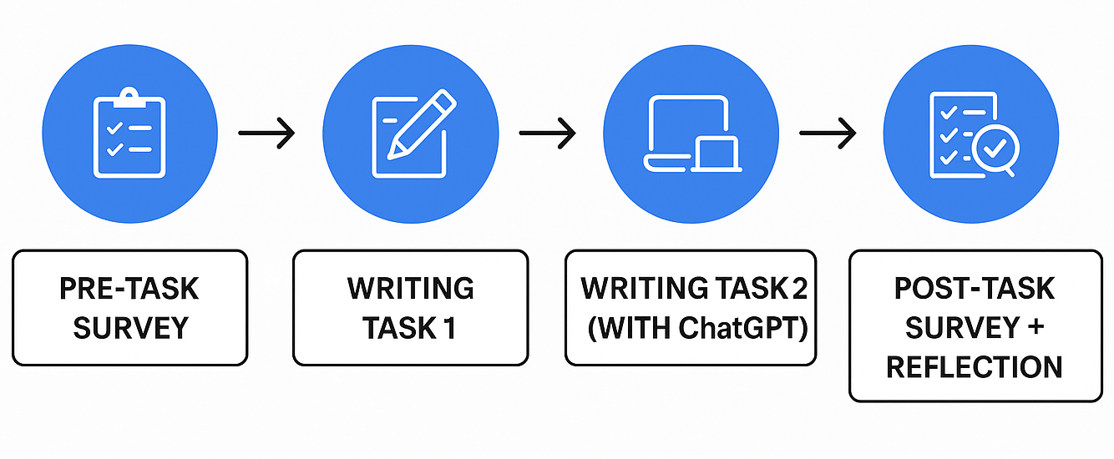
Research Procedures

Slide 16
V. KEY FINDINGS

Slide 17

1. Reliability of Metacognitive Strategy Measures
Table 1. Reliability Statistics for Metacognitive Strategy Items (Pre-task and Post-task)
Task Time | Cronbach’s Alpha | N of Items
Pre-task | 0.908 | 3
Post-task | 0.842 | 3
High internal consistency for metacognitive strategies both before and after the task (α > 0.8).

Slide 18
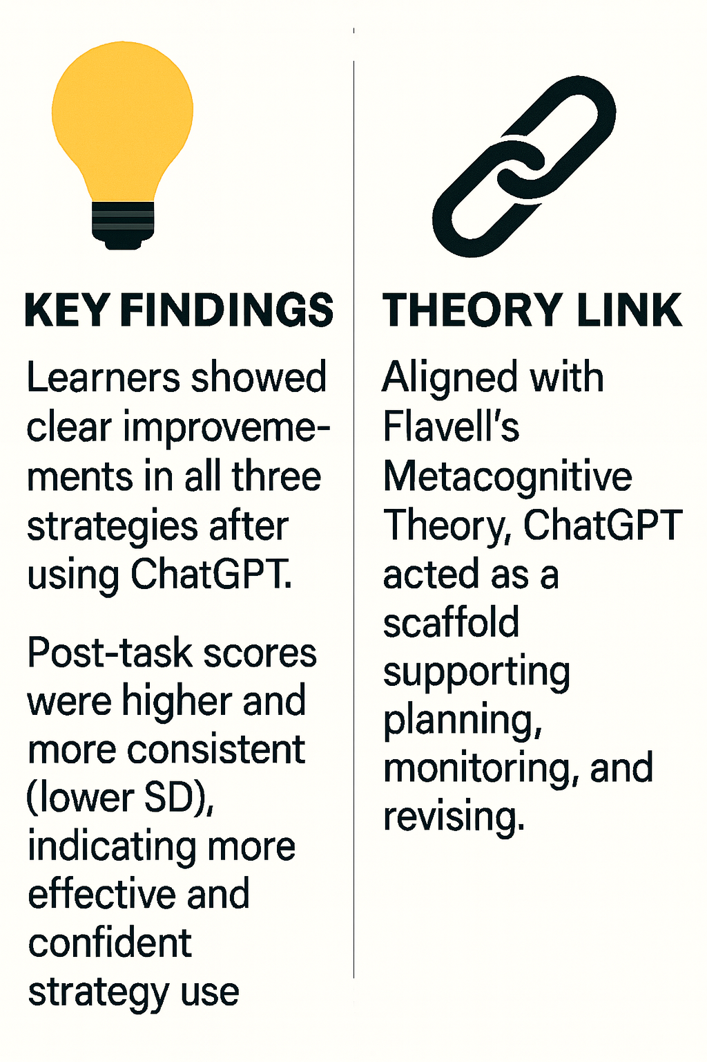
2. Statistical Evidence of Strategic Writing Gains through ChatGPT Support
✅ RQ Addressed: RQ1 – How does ChatGPT influence EFL learners’ metacognitive strategies?
📄 Data Source: Pre/Post Metacognitive Strategy Questionnaire
Table 2: Descriptive Statistics for Metacognitive Strategies
 | Minimum | Maximum | Mean | Std. D
Pre_Planning | 3 | 4 | 3.48 | 0.501
Post_Planning | 3 | 5 | 4.05 | 0.427
Pre_Monitoring | 3 | 4 | 3.46 | 0.500
Post_Monitoring | 3 | 5 | 4.02 | 0.449
Pre_Revising | 3 | 4 | 3.50 | 0.502
Post_Revising | 3 | 5 | 4.04 | 0.418

Slide 19
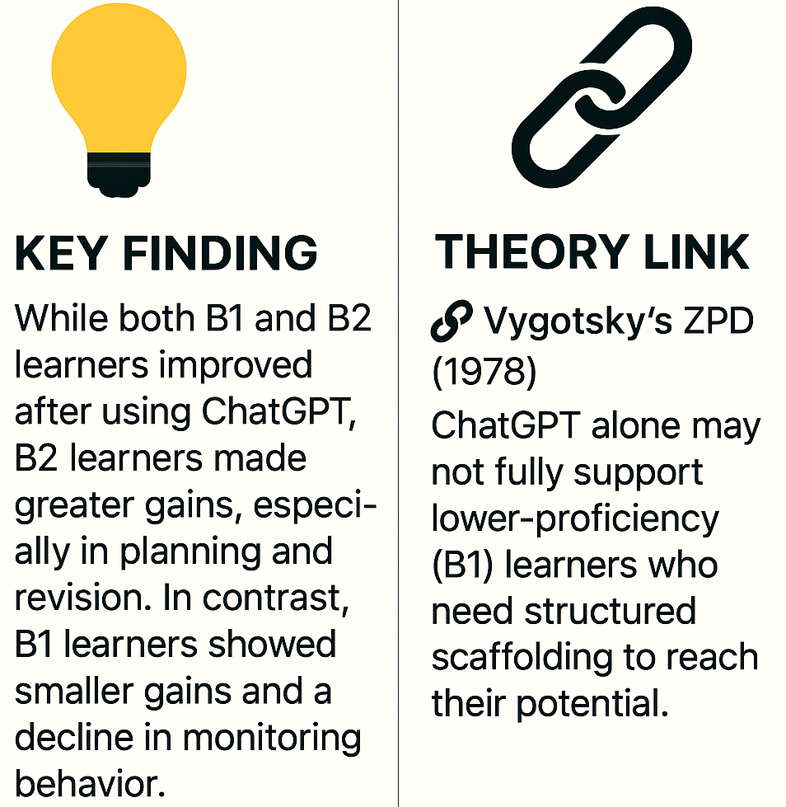
3. Group Differences (B1 vs. B2) in Strategy Gains
✅ RQ Addressed: RQ1 – Influence of ChatGPT on strategic behavior
📄 Data Source: Writing performance scores
Table 3: Pre-Post Score Comparison across Strategy Use and Metacognitive Awareness by Proficiency Level
Proficiency Level | Strategy | Pre-Task Mean | Post-Task Mean | Δ Score
B1 | Planning | 3.1 | 3.5 | +0.4
 | Monitoring | 3.2 | 3.1 | -0.1
 | Revising | 3.0 | 3.2 | +0.2
B2 | Planning | 3.7 | 4.3 | +0.6
 | Monitoring | 3.6 | 4.0 | +0.4
 | Revising | 3.4 | 4.3 | +0.9

Slide 20
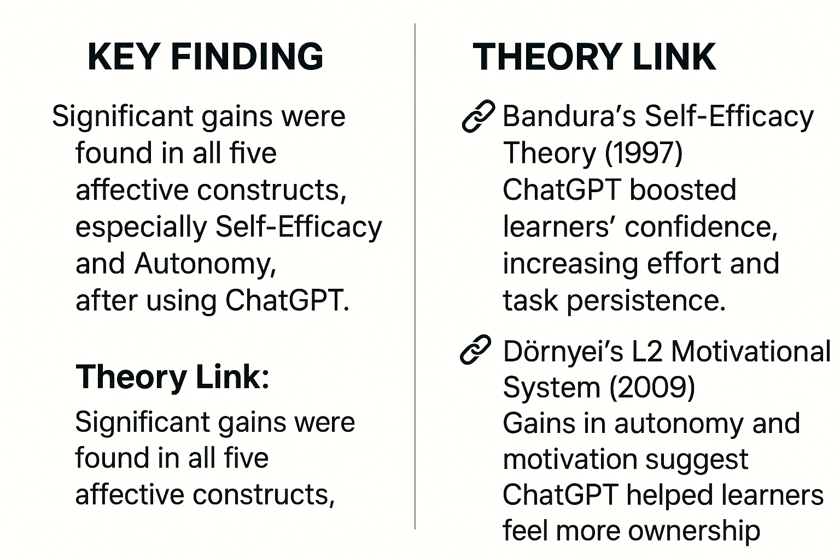


4. Pre-Post Gains in Motivation & Self-Efficacy
✅ RQ Addressed: RQ2 – The effect of ChatGPT on self-efficacy and motivation
📄 Data Source: Pre/Post Questionnaire on Affective Variables (Q7–Q11)
Table 4. Paired-Samples T-Test Results for Affective Construct Gains
Construct | Mean Diff. | t | Sig. (2-tailed)
Self-Efficacy | -0.442 | -8.61 | < .001
Autonomy | -0.467 | -8.42 | < .001
Growth Belief | -0.400 | -7.31 | < .001
Attitude | -0.400 | -6.71 | < .001
Task Motivation | -0.433 | -8.04 | < .001

Slide 21
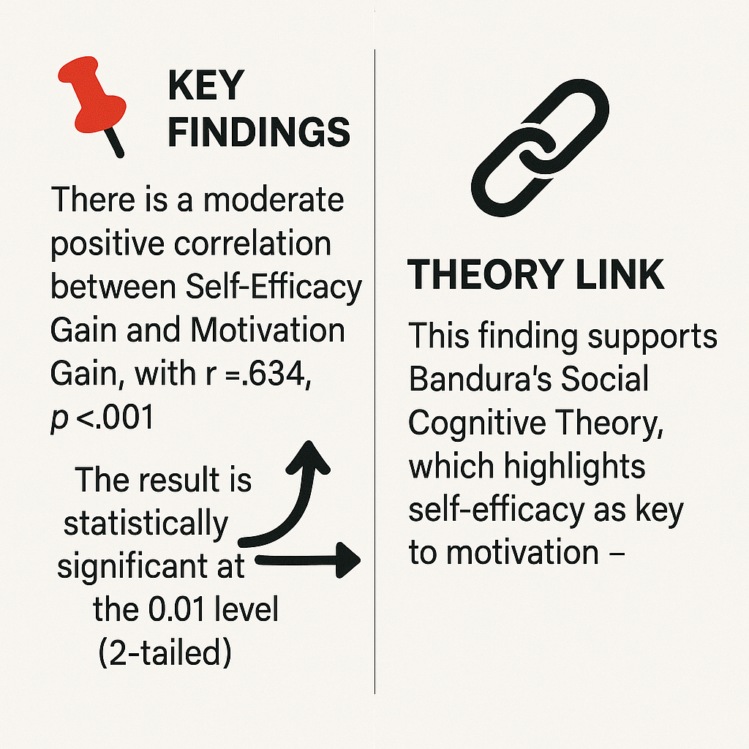
5. Correlation Between Motivation & Self-Efficacy Gains
✅ RQ Addressed: RQ2 – The relationship between motivation and self-efficacy?
📄 Data Source: Derived Variables (Efficacy_Gain, Motivation_Gain from Q7 & Q11)
Table 6: Pearson Correlation Between Self-Efficacy Gain and Motivation Gain
Efficacy Gain | Pearson Correlation | 1
 | Sig. (2-tailed) | <.001
 | N | 120
Motivation Gain | Pearson Correlation | .634**
 | Sig. (2-tailed) | <.001
 | N | 120

Slide 22
6. Aligning Student Experiences with Statistical Evidence
Question | Purpose / Aligned Constructs
1. In what ways did ChatGPT support or change how you planned, monitored, or revised your writing? | 🧠 RQ1 – Metacognitive strategies
2. How did using ChatGPT affect your confidence, enjoyment, or motivation while writing? | 💬 RQ2 – Self-efficacy and motivation
3. Do you feel the final essay still reflects your own ideas and effort? Why or why not? | ⚠️ RQ1 & RQ2 – Autonomy, authorship, and overreliance

Slide 23
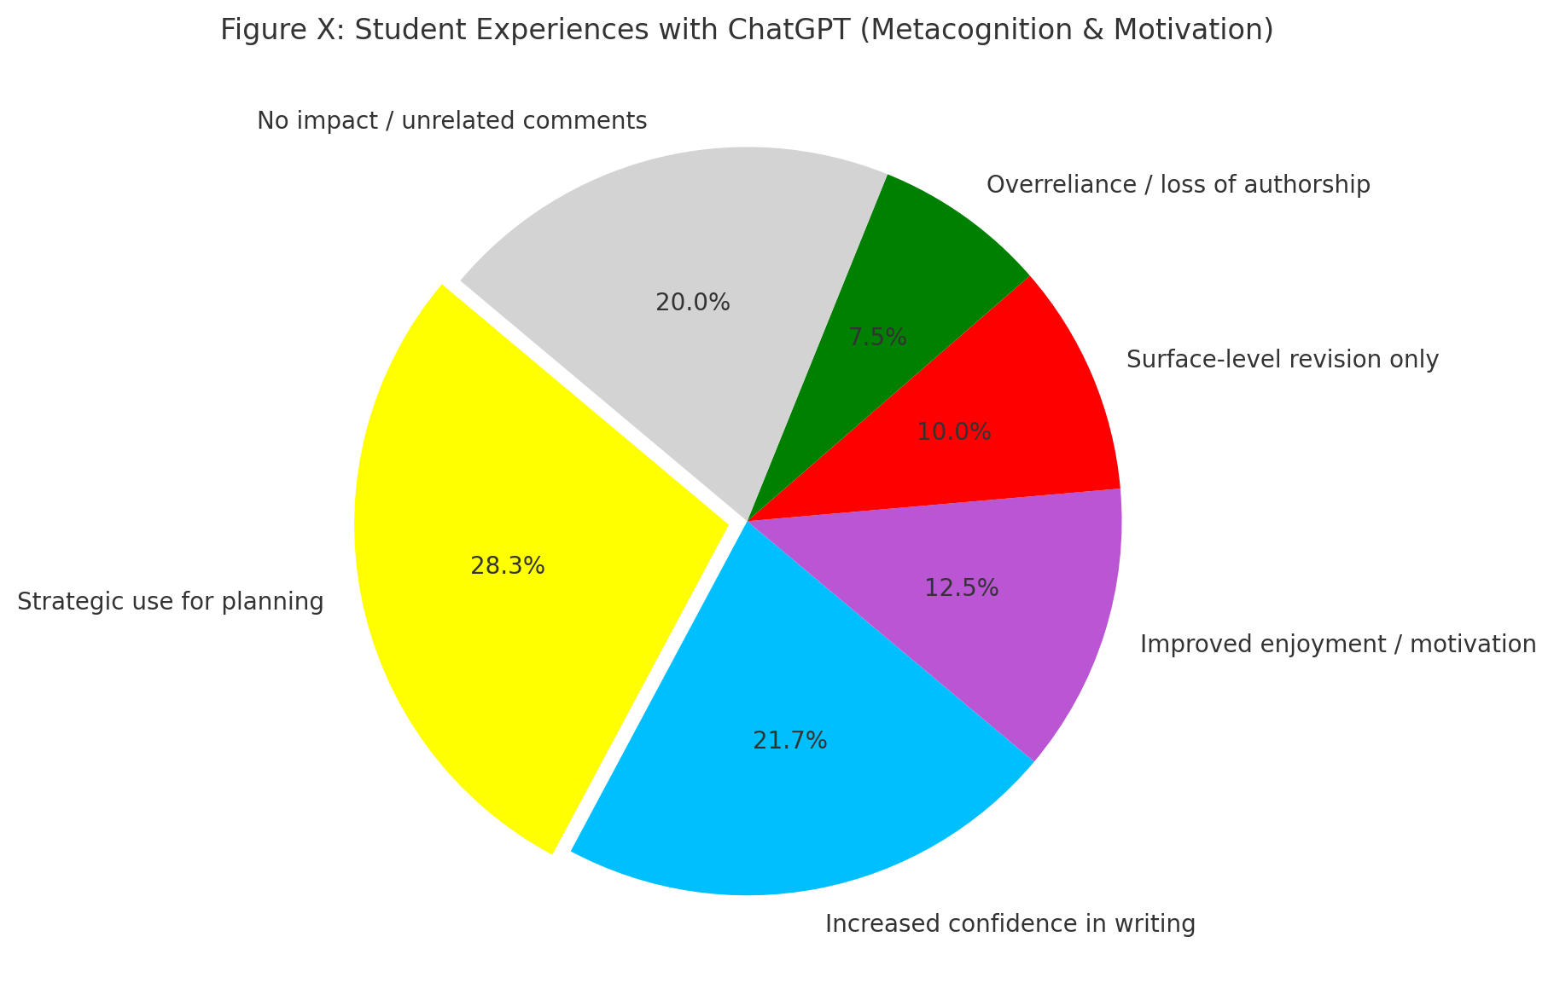
6. Aligning Student Experiences with Statistical Evidence
✅ RQ Addressed: RQ1 (Metacognition) + RQ2 (Self efficacy and motivation)
📄 Data Source: Student reflective responses
“It helped me clarify and expand my arguments.”
“I feel more capable after using it. Like my English is better.”
“I enjoy writing more when ChatGPT helps me get started.”
“I just copied the outline and rewrote it.”
“It doesn’t feel like my writing anymore.”
Figure 1: Student Experiences with ChatGPT (Metacognition & Motivation)

Slide 24
VI. S.M.A.R.T. AI Framework

Slide 25
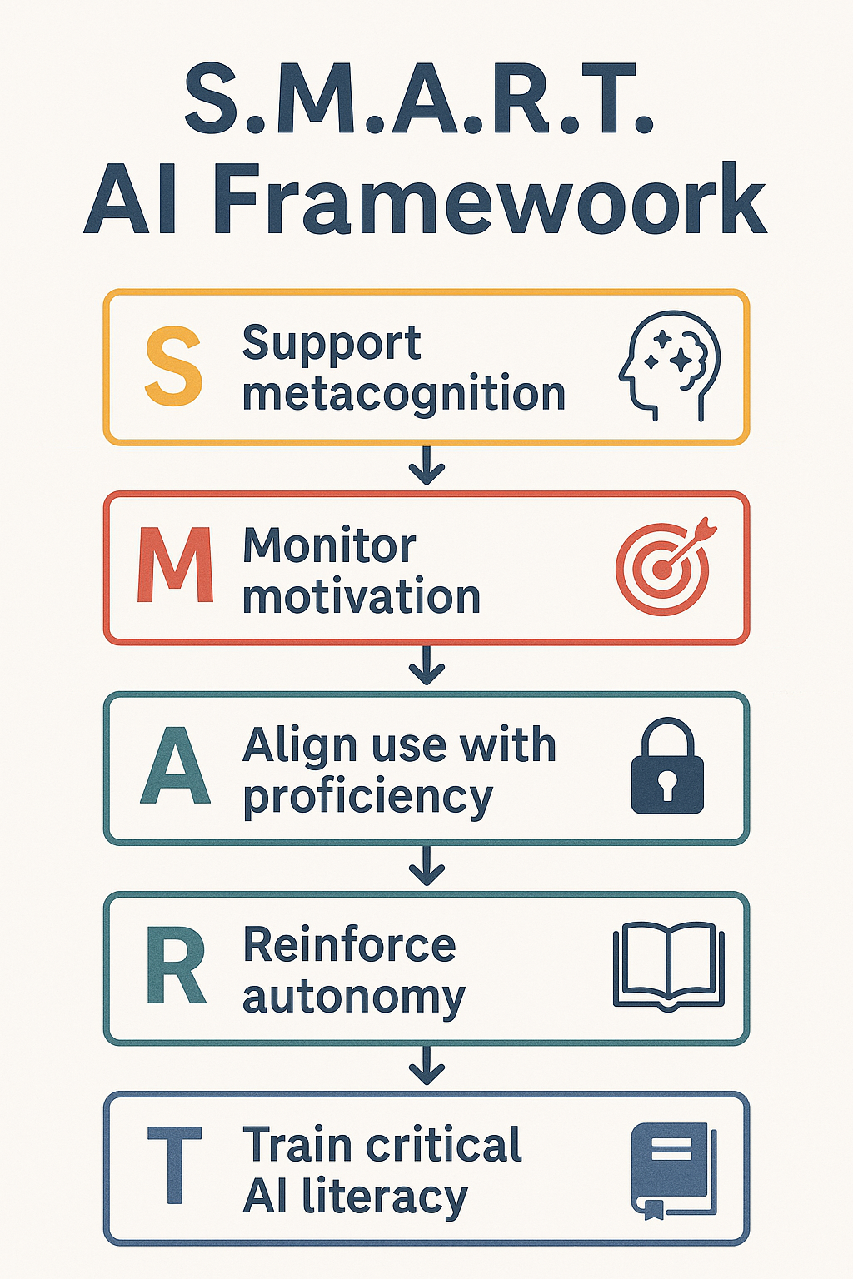
Core Idea | Recent Support
Help students plan, monitor, revise writing | Aladini et al. (2025)
Build confidence and sustain writing effort | Teng (2024); Chen (2025)
Match AI use to student level (B1/B2) | Erol (2025)
Promote ownership despite AI assistance | Aladini et al. (2025)
Teach students to evaluate AI content critically | Teng (2024); Bloom's Taxonomy

Slide 26
VII. Conclusion & Implications

Slide 27

Conclusion
🤖 ChatGPT as a Scaffold
✏️ Enhanced planning and revision skills for higher-proficiency learners.
⚠️ Risk of reduced monitoring and reflective engagement among lower-proficiency learners.
💡 Impact on Motivation
🚀 Boosted confidence and willingness to write.
📉 Possible drop in intrinsic motivation if overreliance on AI reduces personal input.
📚 Pedagogical Model Proposed
🧩 S.M.A.R.T. AI Framework: 🧠 Support metacognition - ❤️ Monitor motivation - 🎯 Align use with proficiency - 🔓 Reinforce autonomy - 📖 Train critical AI literacy

Slide 28

Implications
👩‍🏫 For Teachers
🛠 Provide guided AI use rather than unrestricted access.
🎯 Tailor AI integration based on student proficiency levels.
🔍 Incorporate reflection tasks to maintain self-monitoring.
📘 For Curriculum Designers
📖 Embed AI literacy in writing courses.
📌 Align AI-assisted tasks with learning objectives, not just product quality.
📊 Use mixed-method evaluation to track cognitive and motivational changes.
🔬 For Researchers
⏳ Investigate long-term impacts of AI use on writing autonomy.
🌍 Explore cross-context variations in motivation and metacognition shifts.

Slide 29


Slide 30


