Slide 1


Peacemakers
Unit 7 ,page54

Slide 2
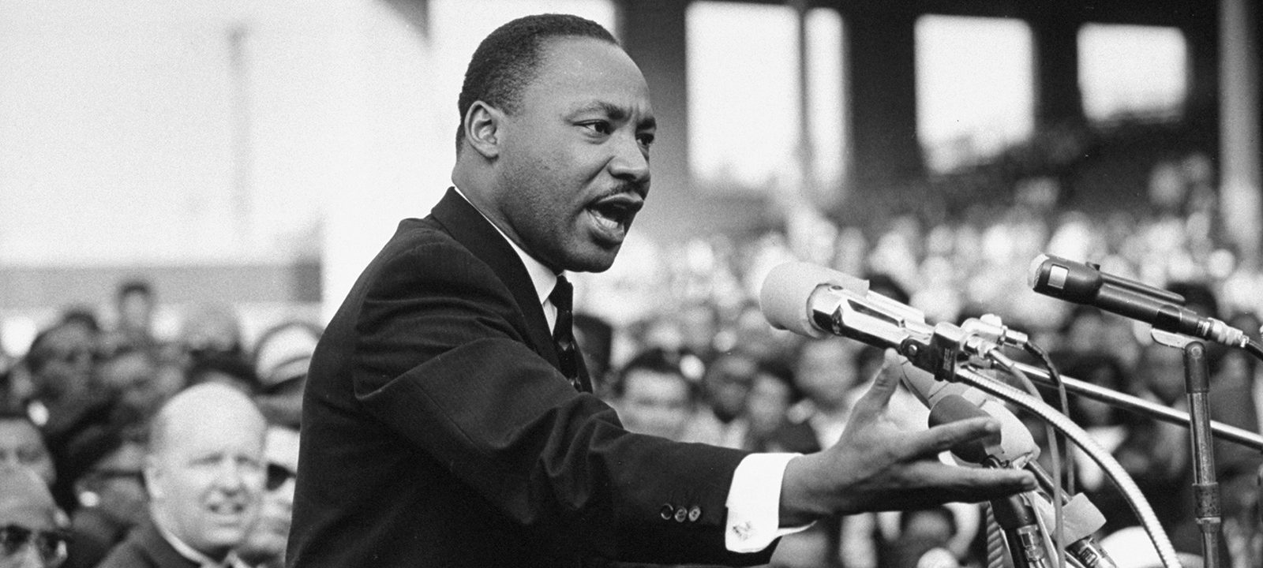
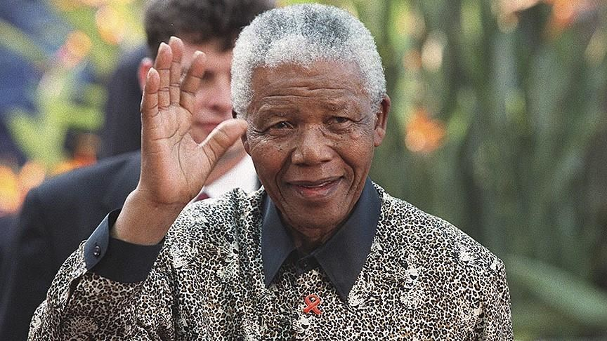
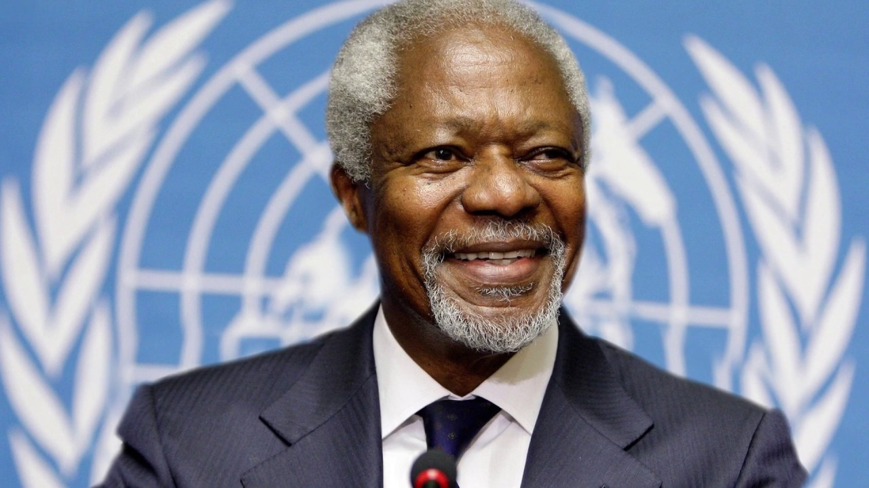
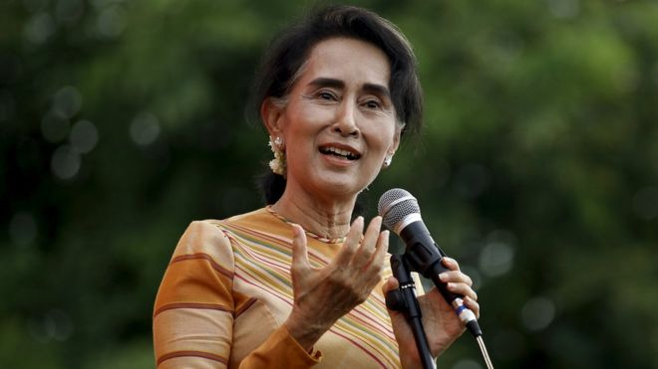
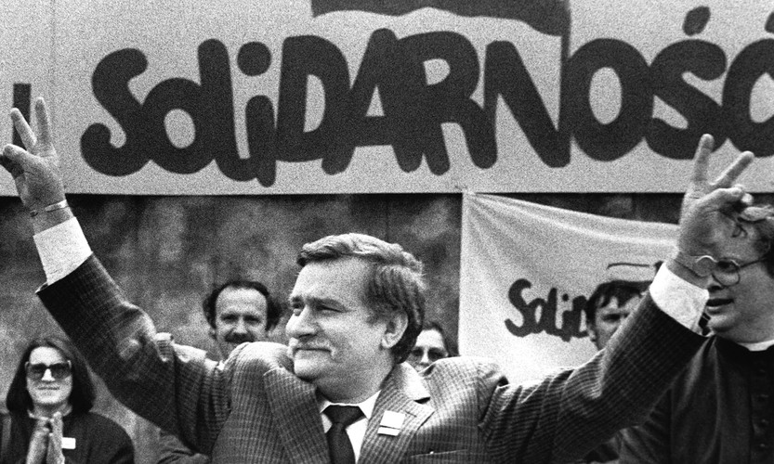
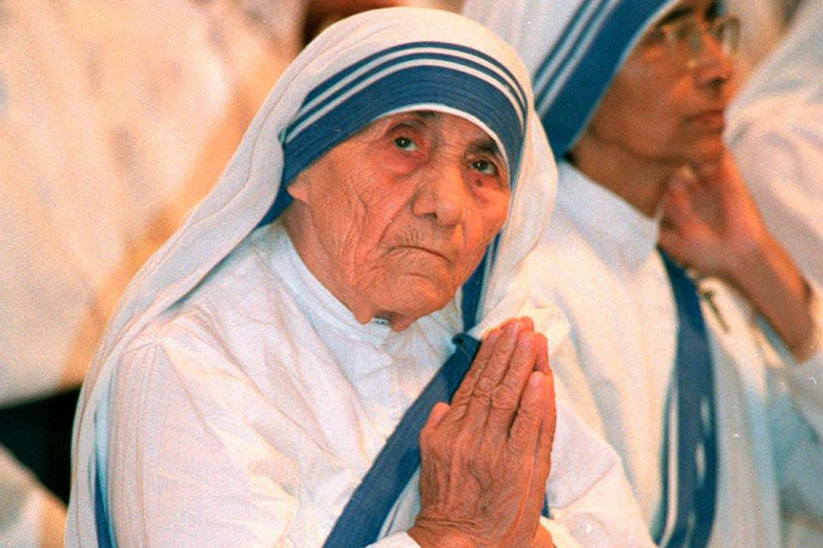

Do you recognize the people in the photos?
Martin Luther King Jr
Racism against Black in USA.
Nelson Mandela
President of South Africa, end racial inequality
1
2
Kofi Annan
Secretary General of the United Nations
Promote peace
Aung San Suu Kyi
Supporter of democracy in Myanmar.
What do you know about them?
4
3
Lech Walesa
Polish electrician
President in Poland
Mother Teresa
Catholic nun
Missionaries of Charity in India
5
6

Slide 3
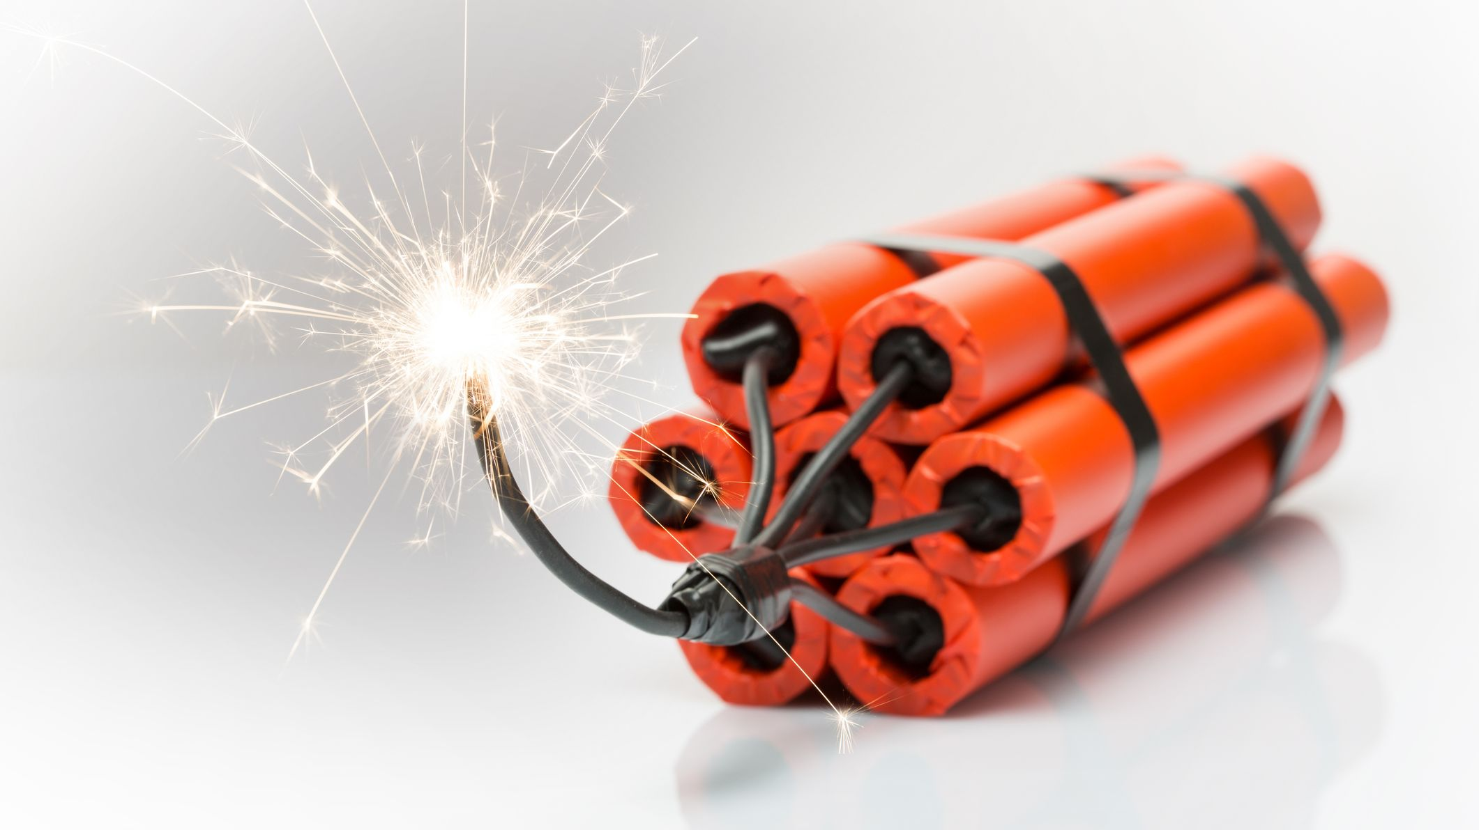
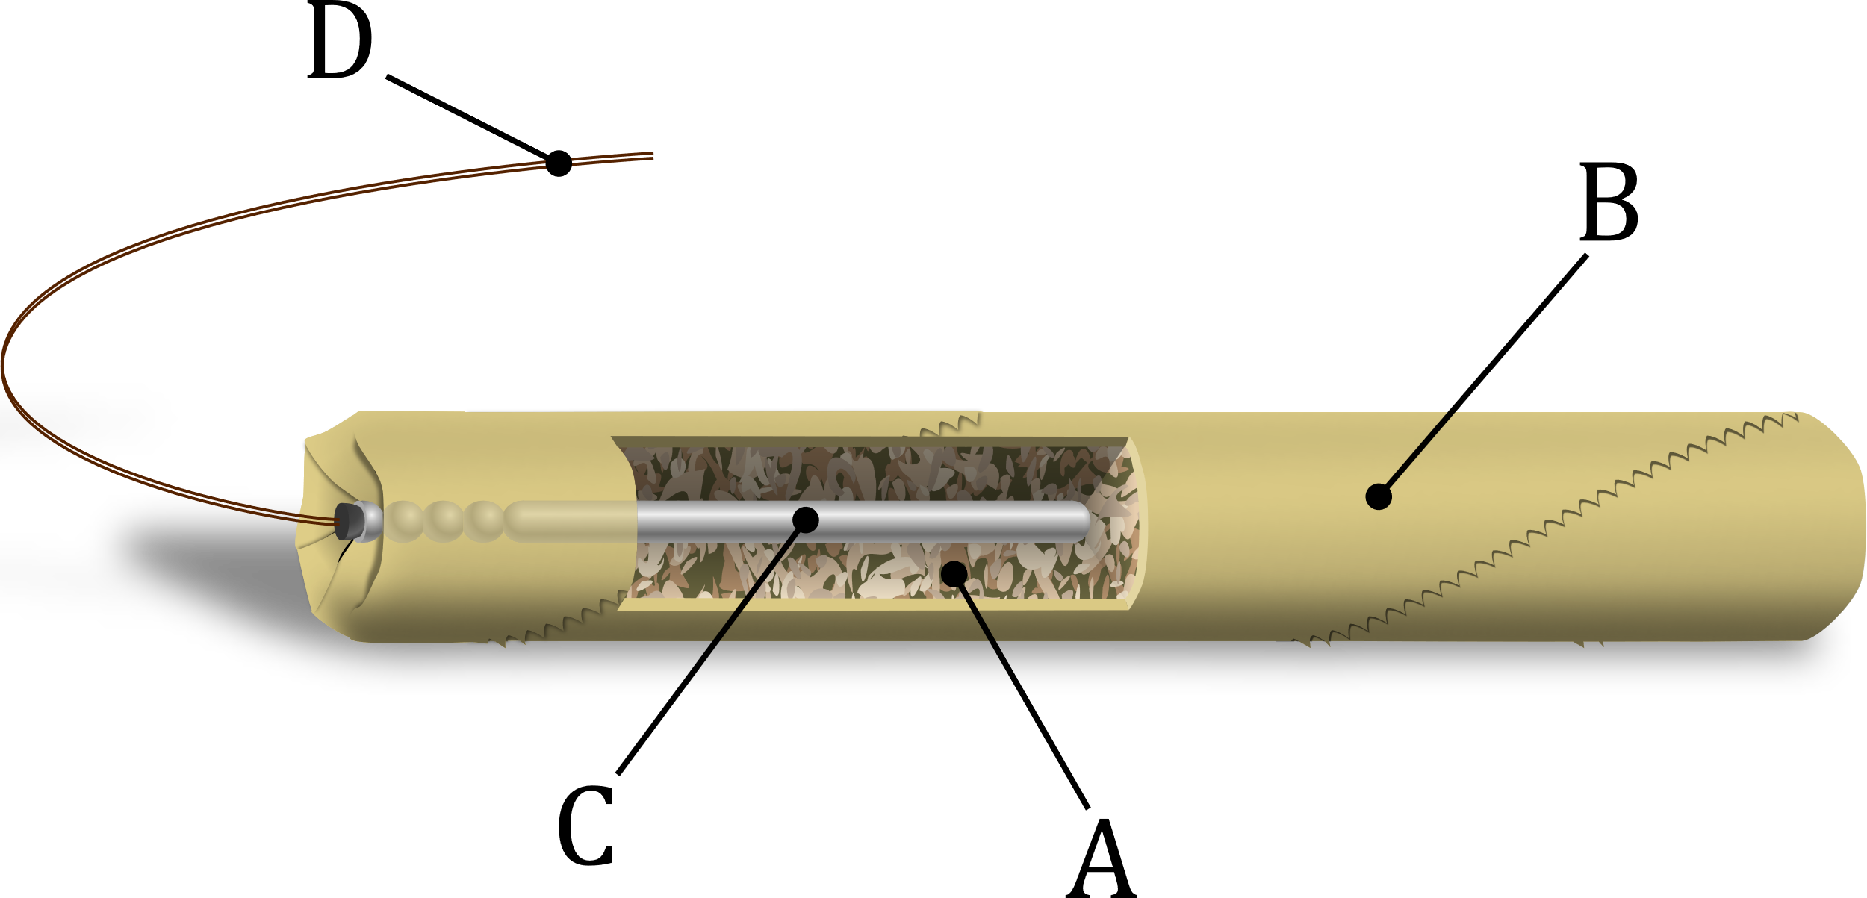
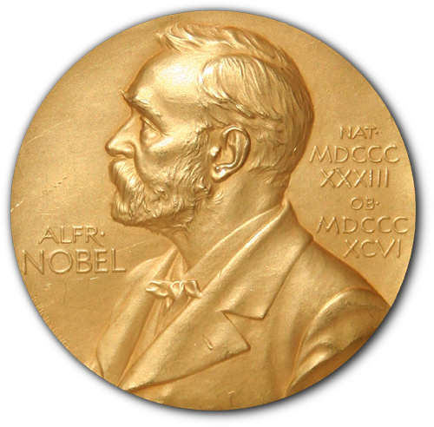
Matching
Nobel Prize
1
Explosive
2
Dynamite
3

Slide 4
Meanings
Nobel Prize: a prize given to those who promote physics, chemistry, medicine, literature and most significantly, peace
Dynamite /ˈdaɪ.nə.maɪt/ (n) a substance that causes something to blow up or explode
Explosive /ɪkˈspləʊ.sɪv/ (n) something that causes an explosion such as bombs

Slide 5
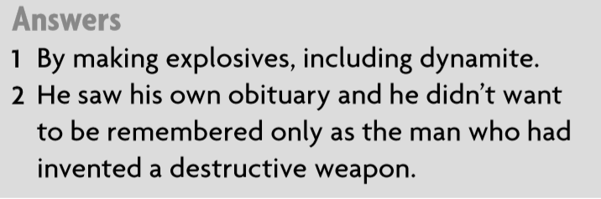
b. Read the text and answer

Slide 6

How to SCAN effectively?

Slide 7
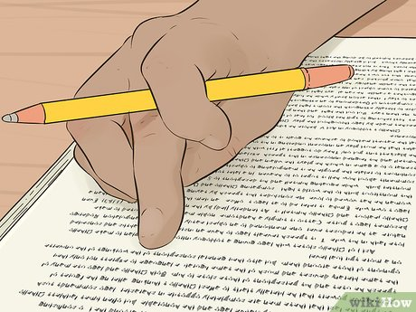
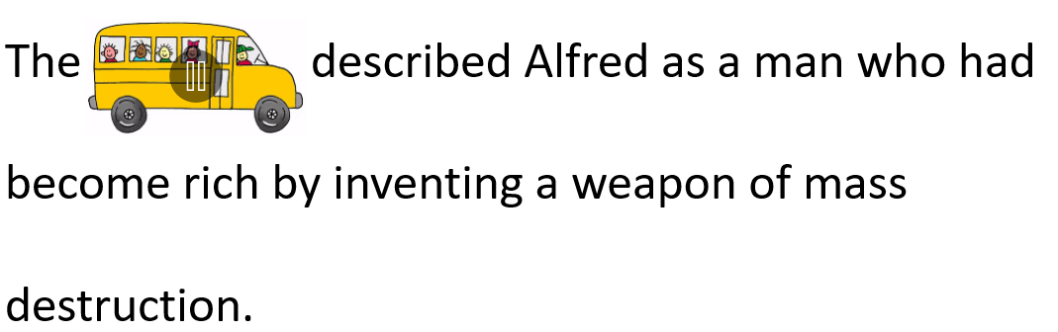
Use pens, pencils or fingers to follow the lines you are reading!
2. Pay attention to the key words, normally a unique or rare word!

Slide 8
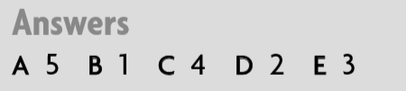
C. Add the sentences in the reading/
Listen and check

Slide 9
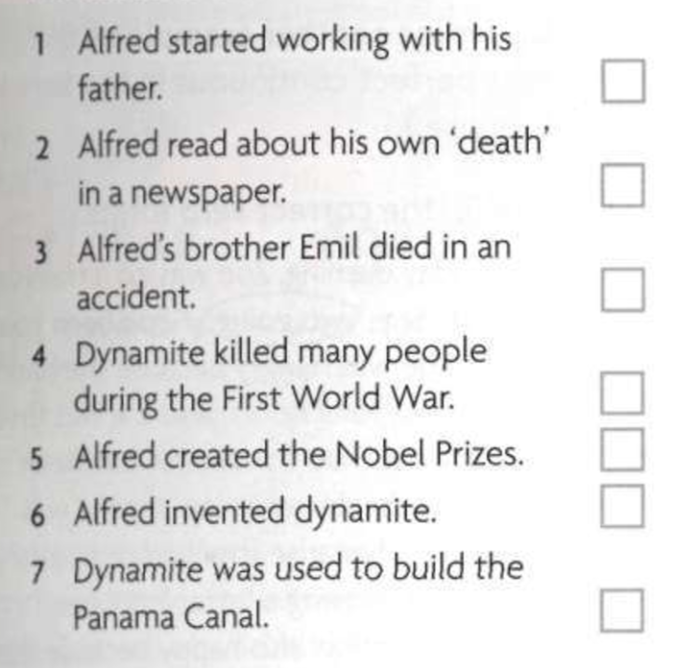
d. Order the events
1
6
2
5
7
3
4

Slide 10


Stop the Bus

Slide 11

a. admiration
They are all winners of the Nobel Peace Prize. But none of them would have received their prize and the recognition it brings.
b. money
c. ordeal
Recognition/ˌrek.əgˈnɪʃ. ə n/ (n) admiration and respect for someone’s achievement

Slide 12
a. helicopters
When Alfred joined the Nobel family company, it had been developing explosives for many years, working for the Russian army to produce landmines and sea mines.
b. computers
c. bombs
Explosive/ɪkˈspləʊ.sɪv/ (n) something that causes an explosion. Ex.: a bomb

Slide 13
a. success
He decided that he would use the great fortune
that he had made to reward people who had been working to promote good in society.
b. money
c. explosion
Fortune/ˈfɔː.tʃuːn/ (n) large sum of money

Slide 14
a. successful
But the family made even more money by manufacturing nitroglycerine, which was an effective but dangerous explosive.
b. harmful
c. important
Effective/ɪˈfek.tɪv/ (adj) successful or achieving something you want

Slide 15
a. explosive substance
Unfortunately, in the same year, the First World War started and, when it ended four years later, dynamite had been used to take away the lives of thousand men.
b. power
c. gun
Dynamite/ˈdaɪ.nə.maɪt/ (n) a substance that causes something to blow up/ explode

Slide 16
a. Circle
The obituary described Alfred as a man who had become rich by inventing a weapon of mass destruction.
b. death report
c. achievement
Obituary/ə ʊ ˈbɪtʃ.ʊə.ri/ (n) a report, usually in a newspaper, which gives news of someone’s death and facts about their lives.

Slide 17
a. upset
When Alfred read this review of his life, he was horrified and decided to do something about it.
b. horrible
c. shocked
Horrified/ˈhɒr.ɪ.faɪd/ (adj) to be very shocked

Slide 18
a. encourage
Peace Prize was awarded to the person who had done the most, or the best, work to promote friendship between countries.
b. discount
c. join
Promote/prəˈməʊt/ (v) to encourage/persuade people to do support something

Slide 19
a. prizes
Peace Prize was awarded to abolish armies or to hold and promote peace conferences.
b. meetings
c. relationships
Conferences/ˈkɒn.f ə r. ə n t s/ (n) meetings

Slide 20
a. famous
The result was dynamite, which became an immediate success all over the world.
b. medical
c. quick
Immediate/ɪˈmiː.di.ət/ (adj) happening quickly or very soon after something else

Slide 21
If you gave a Nobel prize to someone in our class, who would you give?
Why?

Slide 22
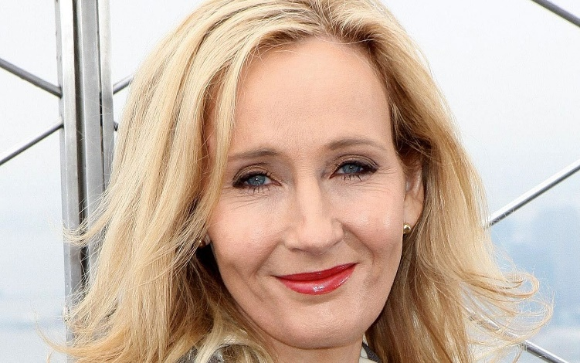
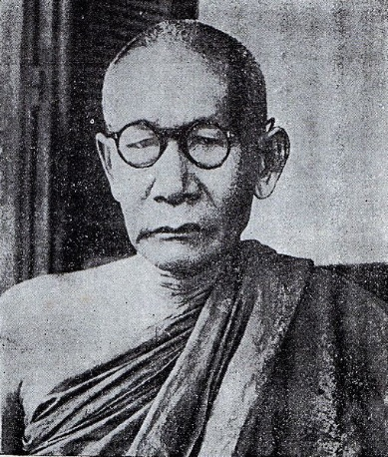
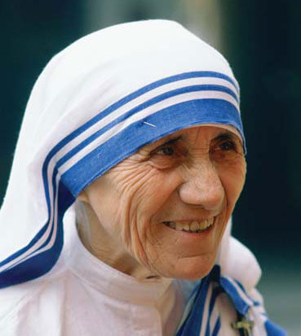
Writing
Write about someone that should be given a Nobel Prize!
Here are some questions you should consider:
What is his/her name?
What did he or she do to promote Peace / Physics/ Chemistry/ Medicine or Literature?
What do you think about him/her?

Slide 23


Slide 24

Challenge
True/False

Slide 25
or
True
False
________1. Alfred Nobel was the first winner of the Nobel Peace Prize.
________2. Alfred was the first member of his family to develop explosives.
________3. Dynamite was safer than nitroglycerine.
________4. Alfred Nobel was not a rich man.
________5. Alfred Nobel is still alive.
False
False
True
False
False

