Slide 1
Structure of a Reading Lesson and Effective Strategies
Presenter: Mr. SIM Channang
August 29, 2025, 3:25 PM
ATL213-Floor 2

Slide 2
Contents
01
Lead-in
Discovering participants’ experiences
02
Teaching reading structure
03
Useful techniques
Practical techniques in each stage
04
Application
Creating a full set lesson plan

Slide 3
Objectives
By the end of this workshop, participants will be able to:
1
understand the basic structure of teaching reading
2
explore some useful techniques in each stages
3
design a well-rounded reading lesson plan
4
indirectly learn the presentation style of the presenter

Slide 4
Lead-in
PC talks for one minute
CPs have to work in pairs.
Ask your partner, and your partner will ask you back
Once the time is up, CPs will be asking to report their partners’ ideas

Slide 5

thaw si het icetmopanr fo ingeadr?
What is the importance of reading?

Slide 6
owh ouldw yuo chaet ingeadr?
How would you teach reading?

Slide 7
thaw aer oury seeanllchg in chiteang ingeadr?
What are your challenges in teaching reading?

Slide 8
01. Identifying task
Skim Vs. Scan

Slide 9
Important aspects
1. Skimming
Read quickly to get the gist of a passage: discover key topics, main ideas, theme, or basic structures, etc.
2. Scanning
Move eyes quickly over the text to locate a specific piece of information: name, address, fact, price, number, or date, etc.

Slide 10
Practice –
Handout 1
Instruction
Work in pairs with someone sitting next to you
Put the reading tasks ( question types) into their correct skills
You have 7 minutes to complete that
Share your answers to your partners

Slide 11
Stand up Vs Sit down
You have to stand up if you think it is Skimming.
You have to sit down if you think it is Scanning.

Slide 12
Stand: Skim/ Sit: Scan
1. Multiple Choice Questions
2. Diagram, plan, map, label completion
3. Matching headings
4. Short-answer questions
5. Matching specific information
6. Matching sentences endings
7. True/ False/ Not Given
8. Identify writer’s views
9. Summary, note, table, flow-chart completion
10. Identify writer’s claims/ Opinion
Scan
Scan
Skim
Scan
Scan
Scan
Scan
Skim
Scan
Skim

Slide 13
How many stages in a reading lesson?
1. Pre-reading
Lead-in + Pre-teach vocabulary/ Concept
2. While-reading
1 small task
2 big tasks
3. Post-reading
Speaking
Writing

Slide 14
1. Pre-reading
Lead-in
Provide a small talk or discussion of the theme of the reading.
Do not teach the details of the text
Show a picture/video and use guided questions
It should not be too long.

Slide 15
1. Pre-reading
Pre-teach vocabulary/ Concept
Choose between 3 – 5 words
Do not pre-teach too many words or else it will become a vocabulary lesson.
Pay attention to the difficult words that students will struggle understanding the text.
It can be big words, names, or process.

Slide 16
2. While-reading
Task 1
Practice skimming skills. It must be a skimming task.
The question should be one or two to understand the whole text main idea or what is it about?

Slide 17
2. While-reading
Task 2 + Feedback
This the main task.
You can choose a task to serve your aim ( Skim or Scan)
Explain the task clearly and give more time for students to read and do without helping them.
Ask them to compare answers with partners and give feedback.
During feedback, try to elicit the answers from the text such as Paragraph 1 , Line 2 .

Slide 18
2. While-reading
Task 3 + Feedback
This the main task.
You can choose a task to serve your aim ( Skim or Scan)
Explain the task clear and give more time for students to read and do without helping them.
Ask them to compare answers with partners and give feedback.
During feedback, try to elicit the answers from the text such as Paragraph 1 , Line 2 .
This task should be more challenging or difficult.

Slide 19
3. Post-reading
Productive task
This task is created to test if students can generalize the concept from the reading text.
It can be in a form of speaking or writing.
Some questions should be featured the main concepts form the text and some can be about their personal story or country.
It can be a role play or group project as well.

Slide 20
Pre-
Writing
Speaking
Post
While-
Lead-in
Pre-teach (vocab/concept)
Small Task (skim)
Main Task 1
Main Task 2
?
?
A Structure of Reading
Lesson
?
?
?
?
?

Slide 21
Let’s analyze!
Look at this reading exercise and analyze the stage of the reading lesson.( HD 2)

Slide 22
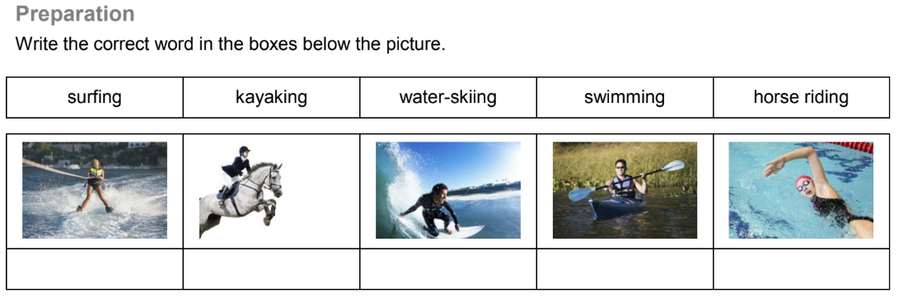
Pre-reading
Lead-in
Pre-teach vocabulary

Slide 23
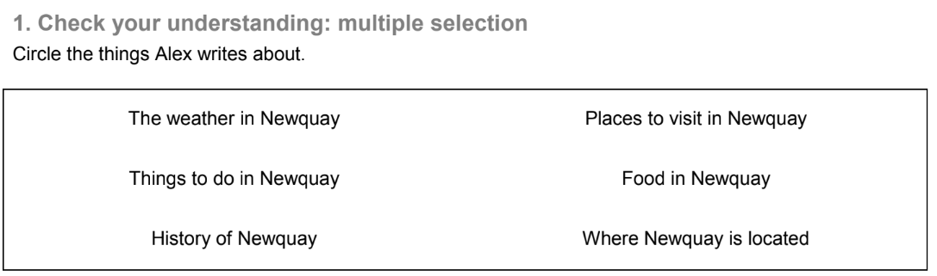
While-reading
Task 1
Task 2

Slide 24
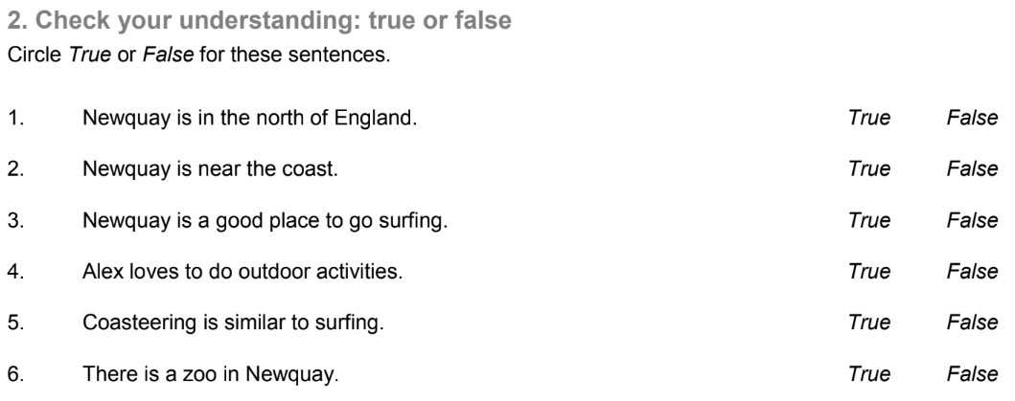
While-reading
Task 3

Slide 25
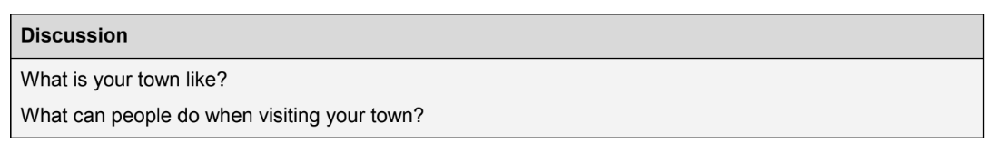
Post-reading
Speaking

Slide 26

Optional – if there is a time only
Practical Application
Design a reading lesson based on the material given
Pre-reading
1
While-reading
2
Post-reading
3

Slide 27
Suggested Techniques
Pre-teach
While-reading
Matching picture
Short Video
Play melody
Monitor regularly
Post-reading
Games
Speaking
Personal topic
- Banana reading
- Vocabulary from context

Slide 28
Pre-
Writing
Speaking
Post
While-
Lead-in
Pre-teach (vocab/concept)
Small Task (skim)
Main Task 1
Main Task 2
A structure of Reading
Lesson

Slide 29
An acceptable plan
While-reading
Task 2 + Feedback 2
Pre-reading
Lead-in + Pre-teach
Post-reading
Speaking
Interview/Survey
While-reading
Task 1+ Feedback 1

Slide 30





Do you have any questions?
simchannang@gmail.com

