Slide 1
EFL Teachers’ Learning to Integrate L2 Pragmatics into In-Use Textbooks: Insights from Self-Designed Instructional Activities
Presenter: Dr. Anh Ton-Nu, School of Foreign Languages, University of Economics Ho Chi Minh City (UEH), Vietnam

Slide 2
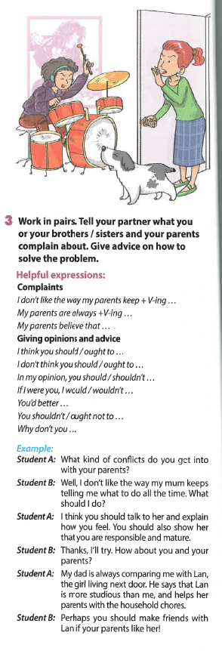
Introduction
What is Pragmatics?
Why is its teaching important?

Slide 3
Literature Review
A long-standing neglect or exclusion of L2 pragmatics in ESL/ EFL teacher education (Ton-Nu, 2024; Ton-Nu & Nguyen, 2023; Ishihara, 2011).
Insufficient L2 pragmatic input to help teachers facilitate the overall development of students’ communicative competence (Ton-Nu & Murray, 2020; McConachy & Hata, 2013; Ren & Han, 2016).
The line of research into pre-service teacher education and in-service teacher professional development (henceforth PD) in L2 pragmatics is still limited (Cohen et al., 2023; Glaser, 2023; Ishihara, 2011; Ngai & Janusch, 2018; Vellenga, 2011; Yates & wigglesworth, 2005).
Among these, traditional training workshops have been shown to effectively raise participants’ awareness of the taught content, as demonstrated in the studies by Ishihara (2011) and Glaser (2023), and are also efficient in terms of time and cost, as noted by Yates and wigglesworth (2005). However, none of these studies analysed the features that contribute to the effectiveness of their PD workshops.

Slide 4
Research Question
What impact did the training workshop, designed with effective PD features, have on participating teachers’ awareness and knowledge of L2 pragmatics and its teaching?

Slide 5
Research Methods
The workshop in this study incorporated a type of experiment that fits within a case study framework, known as the ‘repeated measures design’ (Thomas, 2011, p. 132). As such, the workshop was preceded and followed by a pre-workshop and a post-workshop questionnaire completion task.
Participants: 43 Vietnamese EFL high-school teachers
Collected data: 86 completed questionnaires (43 pre-workshop and 43 post-workshop) and six posters showcasing self-designed L2 pragmatic activities created by the 43 participating teachers. (The teachers worked in six groups to design 10- to 20-minute activities that integrated L2 pragmatic knowledge into the lessons in their textbooks.)

Slide 6
Findings
The impact of the one-day training workshop:
Participants’ changes in their understanding of L2 pragmatics and their evaluation of L2 pragmatic content in their in-use textbooks. Evidence of change was based on teachers’ re-articulation of the aspects presented under the definition of L2 pragmatics and their evaluation of the usefulness of the in-use textbooks regarding L2 pragmatic content. The quality of evaluation was based on its alignment with the findings from the researcher’s investigation into L2 pragmatic content inclusion in the current Vietnamese EFL textbooks. The results from this study showed a general neglect of L2 pragmatics in these textbooks (Ton-Nu & Murray, 2020);
Their statements of achievements after the workshop regarding knowledge, teaching skills, and other accomplishment from the workshop;
And their self-designed pragmatic activities.

Slide 7
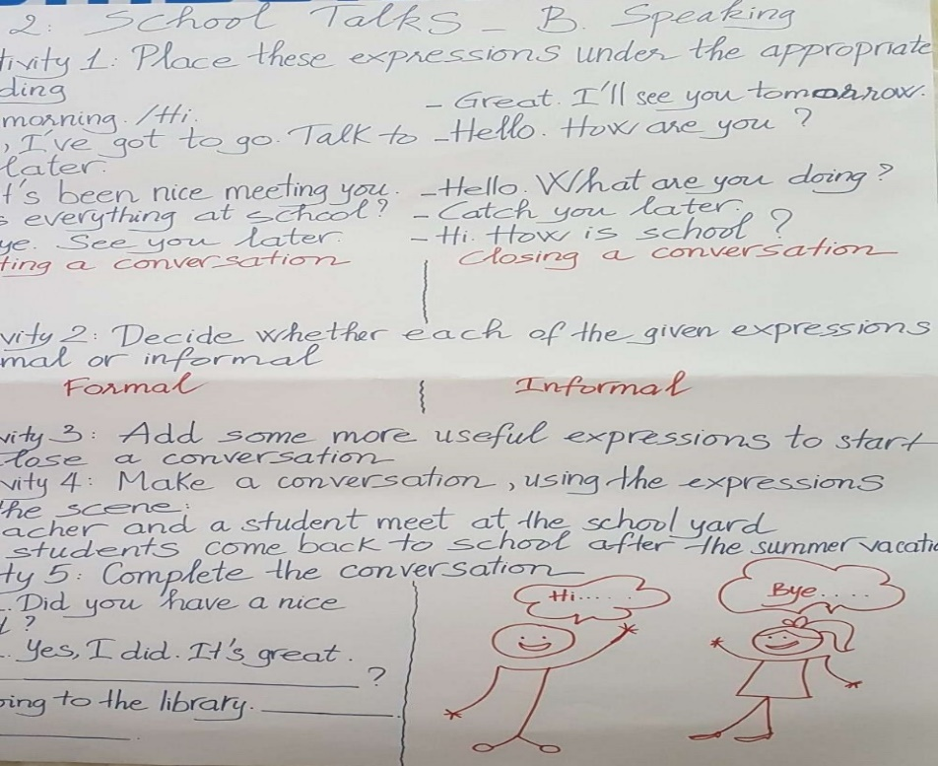
Findings (cont’d): Poster 1
Type of lesson: Speaking
Focused pragmatic knowledge: pragmalinguistic resources - formality

Slide 8
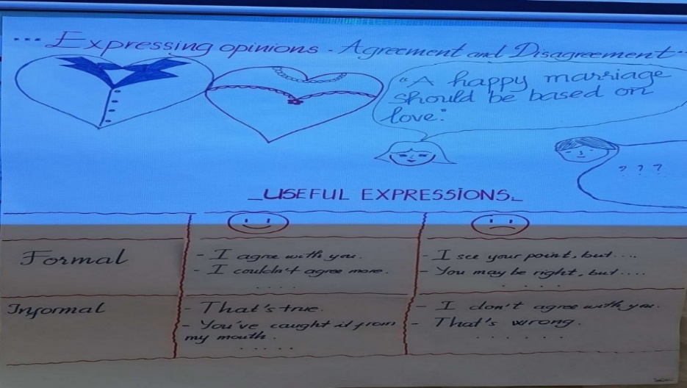
Findings (cont’d): Poster 2
Type of lesson: Speaking
Focused pragmatic knowledge: pragmalinguistic resources – Speech acts & formality

Slide 9
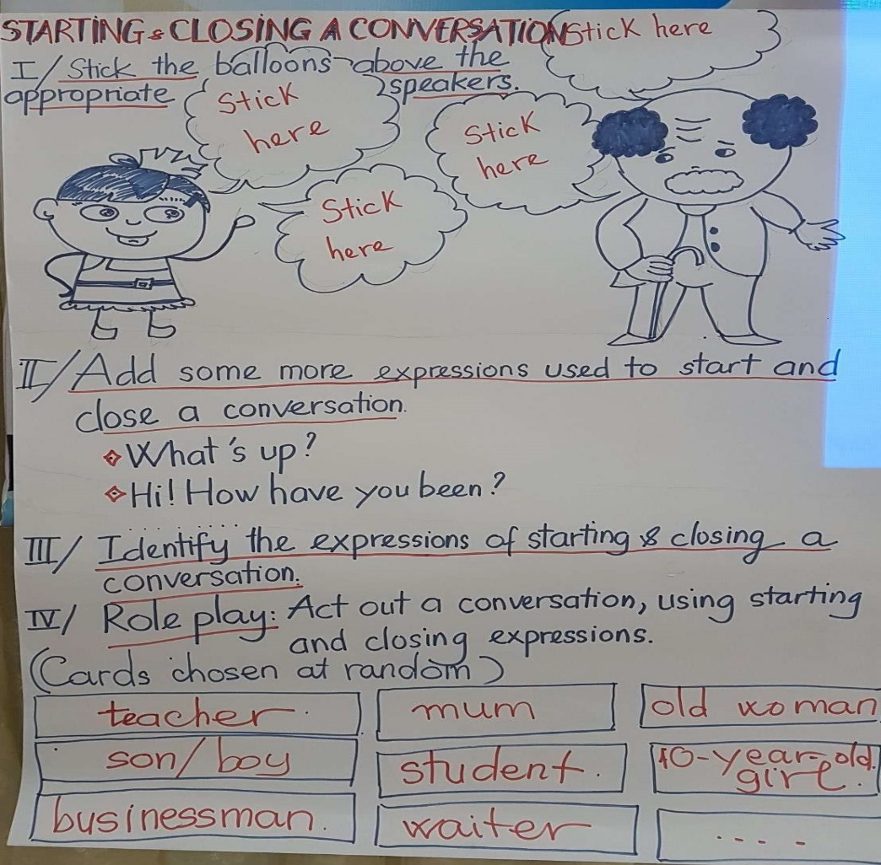
Findings (cont’d): Poster 3
Type of lesson: Speaking
Focused pragmatic knowledge: pragmalinguistic resources & conversational skills

Slide 10
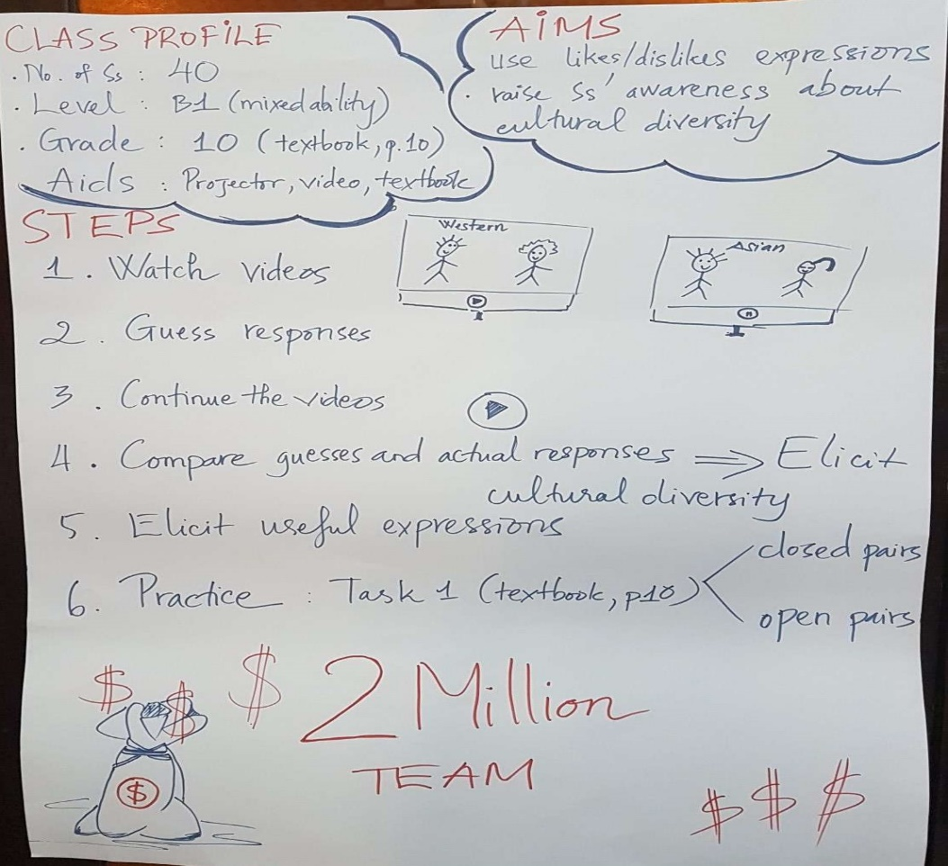
Findings (cont’d): Poster 4
Type of lesson: Speaking
Focused pragmatic knowledge: sociopragmatic knowledge about cultural diversity

Slide 11
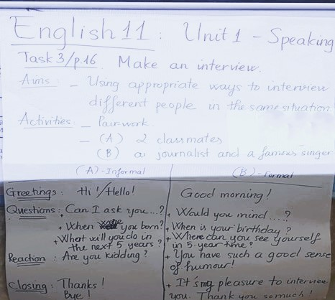
Findings (cont’d): Poster 5
Type of lesson: Speaking
Focused pragmatic knowledge: conversational skills

Slide 12
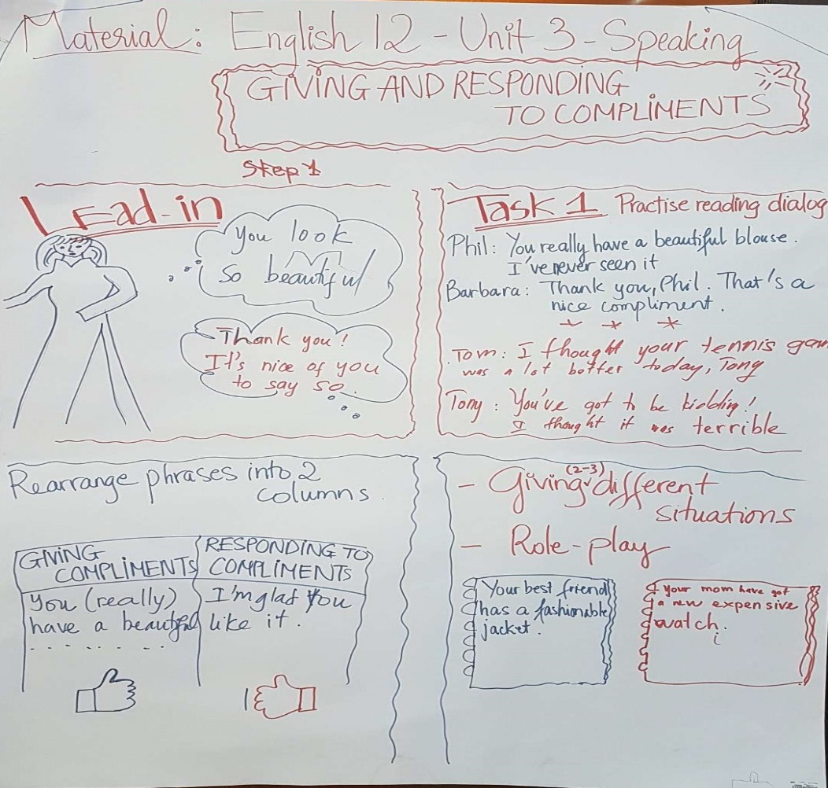
Findings (cont’d): Poster 6
Type of lesson: Speaking
Focused pragmatic knowledge: pragmalinguistic resources – speech acts

Slide 13
Discussion
The findings indicate that the workshop was successful in enhancing participants’ understanding of L2 pragmatics and enabling them to make informed evaluations of the L2 pragmatic content in their textbooks. The workshop significantly raised the teachers’ awareness of the importance of teaching L2 pragmatics, and they began to demonstrate a better understanding of how to incorporate it into their lessons.
This highlights, firstly, the effectiveness of PD workshops in introducing new knowledge, as confirmed by previous studies (e.g. Borg & Al-Busaidi, 2012; Ekanayake & wishart, 2015; Ha & Murray, 2021; Nguyen & Newton, 2021).

Slide 14
Discussion (cont’d)
While training workshops have been criticized for positioning teachers as passive recipients of knowledge (Hoban, 2002; Kennedy, 2014), the model used in this study suggests that carefully designed workshops with effective PD features can still be highly beneficial.
A novel aspect of this PD event is that it relies solely on a one-day training workshop, unlike previous studies which featured longer durations and follow-up activities (Ekanayake & wishart, 2015; Ha & Murray, 2021; Nguyen & Newton, 2021).
This study serves as an example of how in-service teachers could be initially introduced to L2 pragmatics teaching.

Slide 15
Conclusion and Implications
The participants’ positive feedback on this initial PD event in L2 pragmatics suggests a need for additional PD opportunities in this area for in-service teachers.
The PD intervention in this study was an initial step in exploring Vietnamese EFL teachers’ awareness of L2 pragmatics and assessing the impact of this modest-scale event on their cognitions and practices. Future PD activities could incorporate other important content on L2 pragmatics and its teaching that was not covered in this PD event—such as alternative resources like the CARLA Project website, audio/video recordings of real-world interactions, corpora, and model expressions for teaching speech acts—to further enhance teachers’ knowledge of L2 pragmatics instruction.

Slide 16
Reference
Ton-Nu, A. (2024). Raising EFL teachers’ awareness of L2 pragmatic teaching via teacher professional development: The impact of an effective training workshop. Language Awareness. https://doi.org/10.1080/09658416.2024.2436439

Slide 17

Thank you for your attention

