Slide 1
#981
English-Only or Multilingual Support?
Investigating Learner Tension Across Instructional Contexts in Tertiary Classrooms
Trương Anh Khoa¹ – PhD Candidate in TESOL
Lê Thị Thanh Tâm² – Master of Education

Slide 2

1.
RATIONALE
English-Only or Multilingual Support?
Investigating Learner Tension Across Instructional Contexts in Tertiary Classrooms
28/11/2014

Slide 3
2.
HYPOTHESIS AND RESEARCH QUESTIONS
H1: There will be a significant difference in learner tension among the three instructional contexts in tertiary classrooms.
RQ1: How do different language uses influence the learning tension of English-majored tertiary students in terms of communication apprehension, test anxiety, and fear of negative evaluation?
RQ2: What are the emotional and academic experiences of English-majored tertiary students in different language-use contexts?

Slide 4
3. RESEARCH METHOD
Research design: mixed-method
Setting: a private university in an urban area in Ho Chi Minh City
Participants: 52 English-majored students
Students’ demographics
Group | N | Gender |  | Age | Ethnicity | English competence
 |  | Male | Female
Control | 52 | 20 | 32 | 19-21 | Vietnamese | intermediate

Slide 5
3. RESEARCH METHOD
Different language-use contexts
English-Only: L1 is totally avoided, supported by the Theory of Second Language Acquisition (Krashen, 1981)
Translanguaging: L1 and L2 are switched to foster students’ full linguistic repertoire of features and meanings, and facilitate a “decolonizing project” (opens spaces for social and cognitive justice) (García & Li Wei, 2022)
First-language focus: L1 is mainly used to bring cognitive and sociolinguistic positions for the students (Campa & Hossein, 2009; Macaro, 2009), with limited space for L2 (in professional-skills courses)

Slide 6
3. RESEARCH METHOD
Data | Instrument for Collection | Instrument for Analysis | Notes
Quantitative | Foreign Language Classroom Anxiety Scale (FLCAS) by Horwitz et al. (1986) | SPSS version 27 | reliability analysis (piloting) Test for normality Non-parametric version of one-way ANOVA: Friedman test
Qualitative | semi-structured interviews | Quirkos version 2.5 | thematic analysis

Slide 7
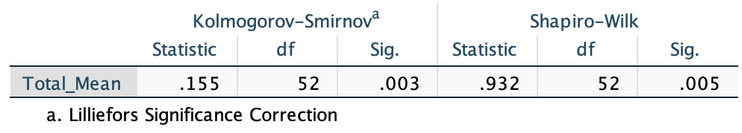
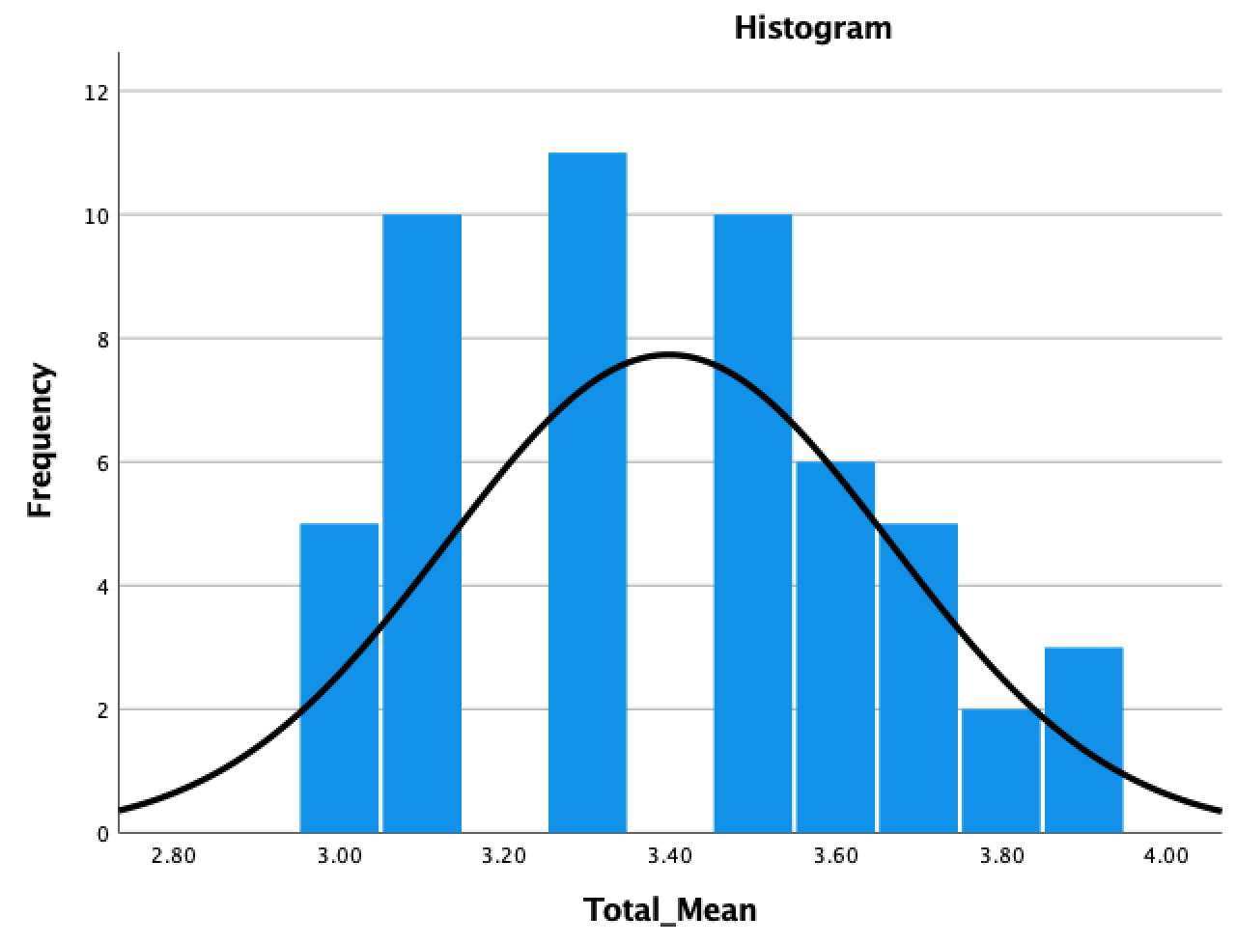
4. RESULTS
4.1 Reliability analysis (before the survey)
Cronbach’s Alpha = 0.795
Corrected Item-Total Correlation: 0.495-0.621
4.2 Test for normality (after the survey)
→ Data was not normally distributed → Friedman test (non-parametric version) was selected to analyze data

Slide 8
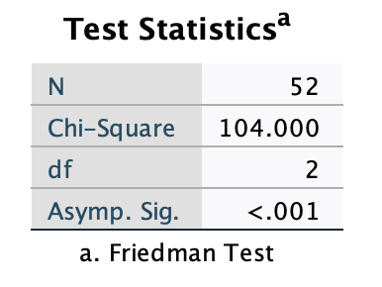
4. RESULTS
4.3 Hypothesis testing
(Friedman test)
→ statistically significant → reject H₀ and accept H₁ (There is a significant difference in learner tension among the three instructional contexts in tertiary classrooms.
4.4 Compare tension between groups (post-hoc test: Wilcoxon signed-rank test)
Wilcoxon signed-rank
 | Translanguaging vs English-Only | L1 Focus vs English-Only | L1 Focus vs Translanguaging
Z | -6.318^{b} | -6.338^{b} | -6.625^{b}
Asymp. Sig. (2-tailed) | <.000 | <.000 | <.000
Bonferroni Correction to avoid Type I error: α = 0.05 ÷ 3 = 0.017
Conclusion: English-only > Translanguaging > L1-focused

Slide 9
4. RESULTS
4.5 Themes from 15 semi-structured interviews (Thematic Analysis Framework, Braun & Clarke, 2006, coded by Quirkos v2.6)
 | English-Only | Translanguaging | L1-focus
Communication Apprehension | alienation when language barriers exist tension when listening to long lecture in English | increased confidence through flexible use of languages positive sense of vn identity and belonging | more active classroom discussions faster comprehension of complex concepts
Test Anxiety | more familiar with tests fear of misunderstanding major concepts | better confidence in answering complex questions | limited exposure to tl input risk of slowing down communicative competence
Fear of Negative Evaluation | fear of making pronunciation mistakes judgment from classmates for low proficiency | immediate support in l1 from peers pressure when producing tl output in high-stakes tasks | sense of safety in classroom interactions willing to debate when evaluated

Slide 10
5.
TEACHING IMPLICATIONS
Balance Input and Support through Translanguaging: Use English (TL) as the main medium but allow occasional use of L1 to scaffold complex concepts and support comprehension.
Normalize Errors and Peer Support: Encourage “safe talk zones” where making mistakes in TL is not penalized.
Foster Gradual TL Confidence: Begin with low-stakes activities where students can use L1 support if necessary, then progressively increase TL-only tasks as students’ comfort grows.

Slide 11

English-Only or Multilingual Support?
Investigating Learner Tension Across Instructional Contexts in Tertiary Classrooms
#981
Any questions?
You can find me at:
036 396 4844
anhkhoa090196@gmail.com

