Slide 1
Evaluating an English Language Textbook and Developing Supplementary Activities for EFL Learners
Na Nguyen Thi Le
Can Tho 29.08.2025

Slide 2
OUTLINE OF PRESENTATION
1
2
3
Research Questions
Introduction
Methodology
4
5
6
Data Findings
Supplementary Design
Conclusion

Slide 3
1. INTRODUCTION
Higher education institutions, including Hung Vuong University, are focused on improving English language skills.
Rationale
Textbooks are integral to the learning process; provide structured content, activities, and resources for students to engage with the target language.
Despite being used for several terms, the
effectiveness of the "Inside Reading 1" Textbook at HVU has NOT been formally evaluated.
Notes:
Let’s start with the Rationale of Textbook Evaluation, English is now essential for both personal development and global competitiveness in areas like trade, technology, and education.

Slide 4
RESEARCH PURPOSE
- To identify the strengths and weaknesses of the Inside Reading Textbook 1 currently used for English linguistic students at Hung Vuong University.
- To develop reading comprehension activities to address the limitations.
Notes:
Therefore, this study aims to: ... and meet the requirements of B1 level.

Slide 5
RESEARCH QUESTIONS
1. What are the perceived strengths and weaknesses of the Insides Reading 1 Textbook, particularly in relation to its reading comprehension activities?
2. What types of supplementary reading comprehension activities can be developed to address the limitations?
Notes:
To achieve the proposed objectives, the study addresses the following two research questions:

Slide 6
Aydin's (2009) Framework for Textbook Evaluation
To evaluatie effectiveness of reading textbooks in developing reading comprehension skills at B1 level.
Key Components of Aydin's Framework:
This framework focuses on developing critical reading skills, student autonomy, and the alignment of textbook content with educational objectives.
Content Relevance to Reading Development
Methodological Clarity and Support
Task Engagement and Student Autonomy
Practicality and Teacher Support
Notes:
In my study, the framework of Aydin (2009) for Textbook Evaluation has been applied. This framework is aimed to evaluate effectiveness of reading textbooks in developing reading comprehension skills at B1 level. There are 4 Keys Components of Aydin's Framework:
The reason for choosing this framework is as

Slide 7
Methodology
Design
Mixed-method approach
Instruments
Students’ Questionaires
Semi-structured Teachers’ Interviews
Notes:
Next is the Methodology, this study used both quantitative and qualitative methods to collect data for the research. There are 2 data collection instruments: Students’ Questionnaires: adapted from Aydin’s framework consists of five sections: Overall textbook Evaluation; Pre-reading Activities; While-reading Activities; Post-reading Activities and Student Preferences and Activity Effectiveness.
The second tool is Teachers’ Interviews. The interview consists of four sections, mirroring the structure of the student questionnaires: Pre-reading Activities; While-reading Activities; Post-reading Activities and Suggestions for Improvements.

Slide 8
60 English Linguistics students at Foreign Language Department, HVU
4 teachers in charge of teaching Reading Course
PARTICIPANTS
Notes:
Participants of the study are 60 English linguistics students from FLD, HVU who have used the Insides Reading 1 textbook. And 4 teachers who are in charge of teaching this reading textbook series also participate in the study.

Slide 9
FINDINGS
Strengths of Inside Reading 1 Textbook
Identified Weaknesses
Recommendations for Supplementary Materials
Notes:
Now, I will present to you the data findings. There are 3 main findings from this study:

Slide 10
Overall Findings of Inside Reading Textbook 1
Strengths
Pre-reading Activities
Activate students' background knowledge and boost motivation
Introduce key vocabulary in context
No need for supplementary materials
Vocabulary Development
Effective vocabulary acquisition through pre-reading tasks
Essential for reading comprehension at B1 level
Limitations
While-reading Activities
Limited to basic comprehension tasks (only true/false statements tasks)
Lack of deeper analytical activities (e.g., identifying main ideas, text structures)
Need for more complex tasks
Post-reading Activities
Lack of critical thinking or real-world application of knowledge
Need for more collaborative, reflective, and analysis-based tasks
Notes:
From the data, several strengths of Inside Reading 1 emerged:
However, there are some notable limitations:
oLimited to basic comprehension tasks (e.g., true/false statements)
oLack of deeper analytical activities (e.g., identifying main ideas, text structures)
Need for more complex tasks like multiple-choice, gap-fill, and sentence insertion

Slide 11
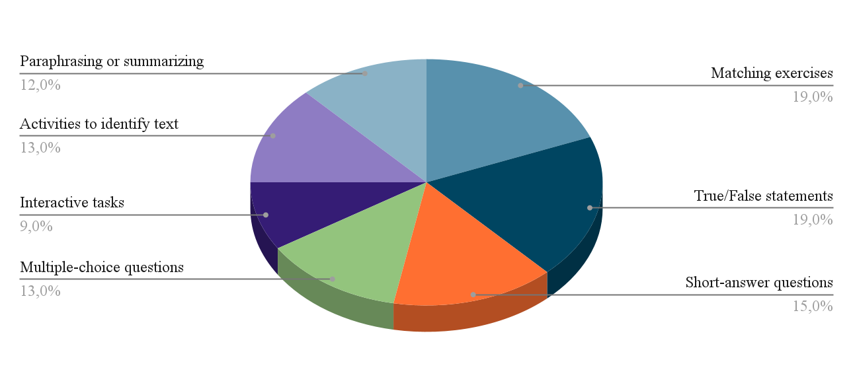
Student Feedback on Limitations
Chart 4.1: Distribution of Task Types in the Inside Reading Textbook
Notes:
Statistically, in the Chart 4.1, The chart shows that True/False and matching tasks make up 19% of exercises in Inside Reading 1, focusing on basic comprehension.

Slide 12
Student Feedback on Limitations
Notes:
However, in chart 4.2, students expressed a need for more variety.To meet B1 PET standards, tasks like multiple-choice and gap-fill exercises are necessary to deepen engagement and enhance reading comprehension.

Slide 13
Supplementary Activities Design
Design Principles
Relevance and Practical Application
Clarity and Accessibility
Scaffolded Progression
Alignment with B1 Competencies
Collaborative and Interactive Learning
Notes:
Now let’s move on the Supplementary Activities Design.
There are 5 principles for designing supplementary activities:

Slide 14
Supplementary Activities Design
Proposed Activities for While-reading
Multiple-Choice Questions
Fill-in-the-Gap Activities
Choose the Correct Sentence for the Gap
Skimming and Scanning Exercises
Proposed Activities for Post-reading
Collaborative Projects
Guided Passage Summaries
Structured Group Discussions
Notes:
To address the limitations, I propose the following supplementary activities:

Slide 15
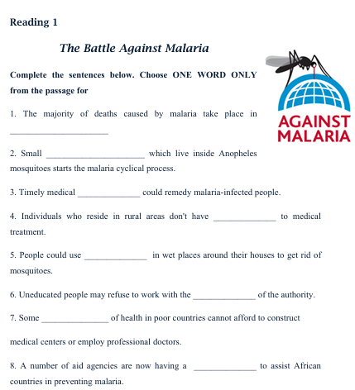
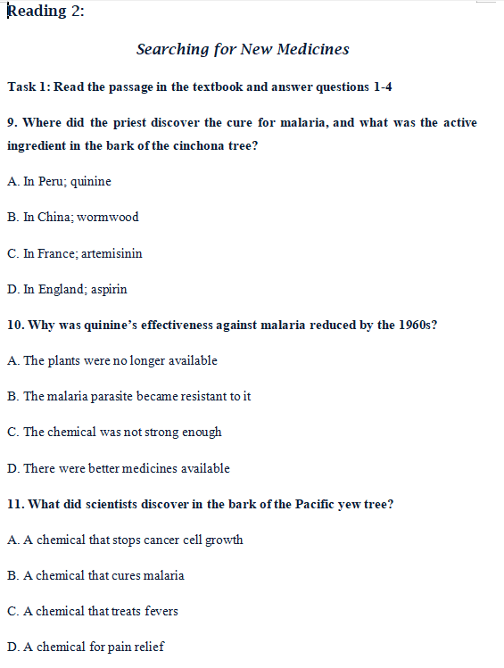
Example of Supplementary Activities
UNIT 2: FIGHTING DISEASE

Slide 16

Example of Supplementary Activities
UNIT 2: FIGHTING DISEASE
Task 2: Imagine you are a scientist working in a rainforest. Present the steps you would take to collaborate with indigenous healers to discover new medicines.
What challenges do you think you would face, and how would you overcome them?
Tip for Students: Consider the ethical issues, the potential cultural misunderstandings, and the role of modern science versus traditional knowledge.

Slide 17
PEDAGOGICAL IMPLICATIONS
Teachers should not rely solely on the textbook. They need to adapt and supplement it to meet students’ needs. Activities that promote critical thinking, group interaction, and higher-order reading skills should be added.
Students are encouraged to take a more active role in learning, rather than depending only on the textbook. Supplementary activities can help them improve not only reading but also communication and analytical skills.
Textbook writers should consider cultural context and practical classroom use. More extended tasks are needed to support academic reading and communication skills.
Notes:
The findings of this study have several implications:

Slide 18
THANK YOU
FOR YOUR ATTENTION
Notes:
To sum up, this study shows that while the textbook is a useful resource, it cannot fully meet learners’ needs without teacher adaptation. By evaluating the textbook carefully and designing supplementary activities, we can make reading lessons more engaging, effective, and communicative.
I hope that my findings can offer practical guidance for instructors and materials developers, and also contribute to the improvement of EFL reading instruction in Vietnam.
Thank you very much for your attention. I’m happy to take any questions.

