Slide 1
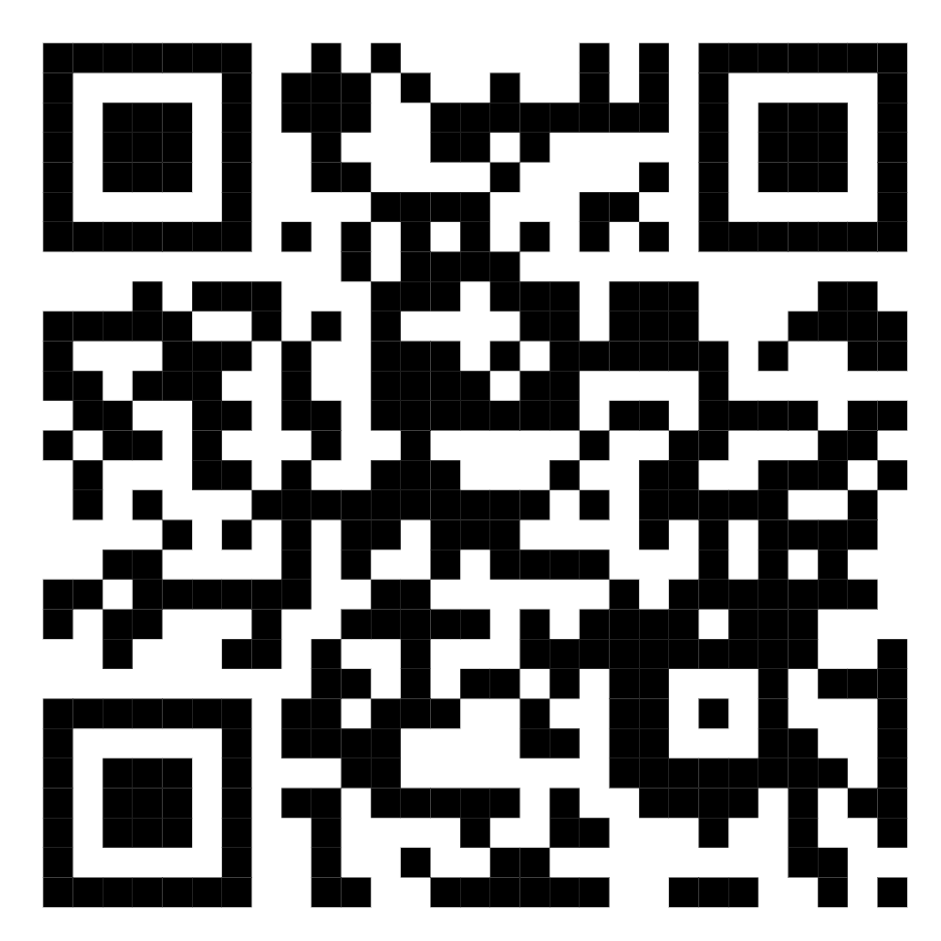
AN ANALYSIS OF CULTURAL CONTENTS IN ENGLISH TEXTBOOK
FOR SIXTH GRADERS IN VIETNAM
THI MINH NGOC VO, ULIS-VNU | August 29th 2025

Slide 2
Introduction
Language and culture are inseparable in education (Kramsch, 2014)
Culture as the “fifth skill” in language learning (Kramsch, 2014)
Vietnam’s 2018 English Curriculum emphasizes intercultural communicative competence – ICC (MOET, 2018)
English 6 – Global Success textbook: widely used, transitional grade level (Hoa et al., 2024)
Need to evaluate cultural content integration

Slide 3
Research Aims & Questions
Aim: Examine how cultural content is presented in English 6 – Global Success
Focus: Alignment with 2018 General Education Curriculum (MOET, 2018)
Research Questions:
How have cultural contents been integrated into English 6 Global Success?
To what extent does the textbook align with MOET (2018) objectives on cultural awareness?

Slide 4
Literature review
Framework – Byram’s checklist (1993)
8 categories of culture in textbooks:
Cate 1: Social identity & groups
Cate 5: Socialization & life cycle
Cate 2: Social interaction
Cate 6: National history
Cate 3: Beliefs & behaviors
Cate 7: National geography
Cate 4: Social & political institutions
Cate 8: Stereotypes & national identity

Slide 5
Literature review
Framework - Cortazzi & Jin’s Model (1999, adapted)
Cortazzi & Jin’s Cultural Sources
Original model (1999):
Source Culture (SC): learners’ own national or local culture
Target Culture (TC): cultures of countries where English is 1st/2nd language
International Culture (IC): cultures from countries where English is used as an international language
Adapted in this study:
Pure SC, Pure TC, Pure IC
Mix SC (SC + TC/IC)
Mix IC-TC (IC + TC)

Slide 6
Literature review
Trimodal Cultural Integration Model (TCIM)
Group 1: Integrated engagement → cultural info + required interaction
Group 2: Open-ended exploration → prompts for further discovery
Group 3: Passive exposure → cultural info without active engagement

Slide 7
Research approach
Mixed-methods design
Qualitative content analysis: coding cultural categories (Forman & Damschroder, 2007)
Quantitative analysis: frequency counts & percentages
Combines interpretation + measurement

Slide 8
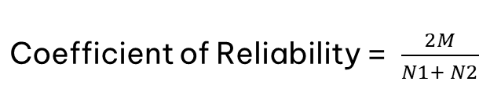
Data collection & analysis
Phase 1 - Pilot evaluation of Unit 1
Coding frameworks:
Cortazzi & Jin (SC, TC, IC, Mix SC, Mix IC-TC)
Byram (Cate 1–8)
TCIM (Group 1–3)
Inter-rater reliability tested (Holsti’s formula)
Agreement rate: 0.972
Holsti’s formula (Neuendorf, 2017)
Coefficient of Reliability = $\frac{2M}{N1+ N2}$
M (activities): The number of observed indicators agreed by Coder 1 and Coder 2.
N1, N2: The number of observed indicators in each Coder

Slide 9
Data collection & analysis
Phase 2 – Full evaluation
Full evaluation of both volumes of English 6 Global Success
Expert consulted for accuracy
At least 1 page in every 2 units double-checked
Results synthesized in Excel → converted into percentages
Categories: cultural source, cultural category, TCIM group

Slide 10
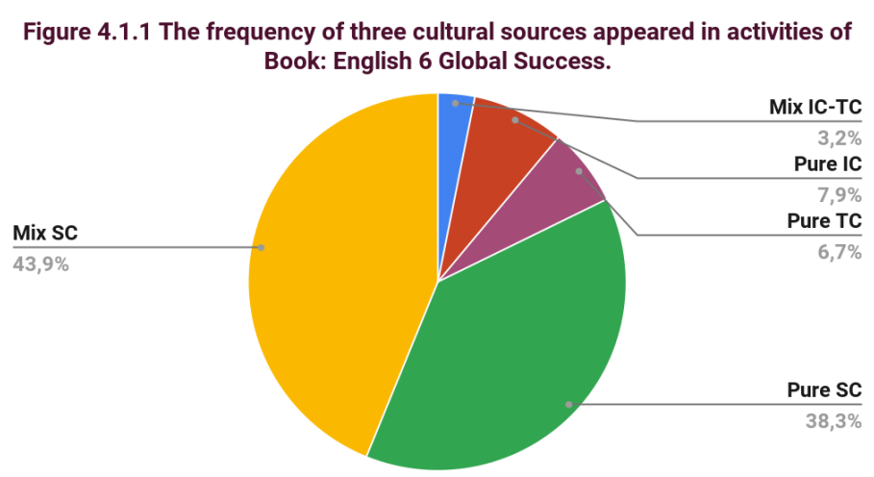
Findings
Total cultural activities: 253/449 (56.34%)
Integration of cultural contents in English 6 Global Success

Slide 11
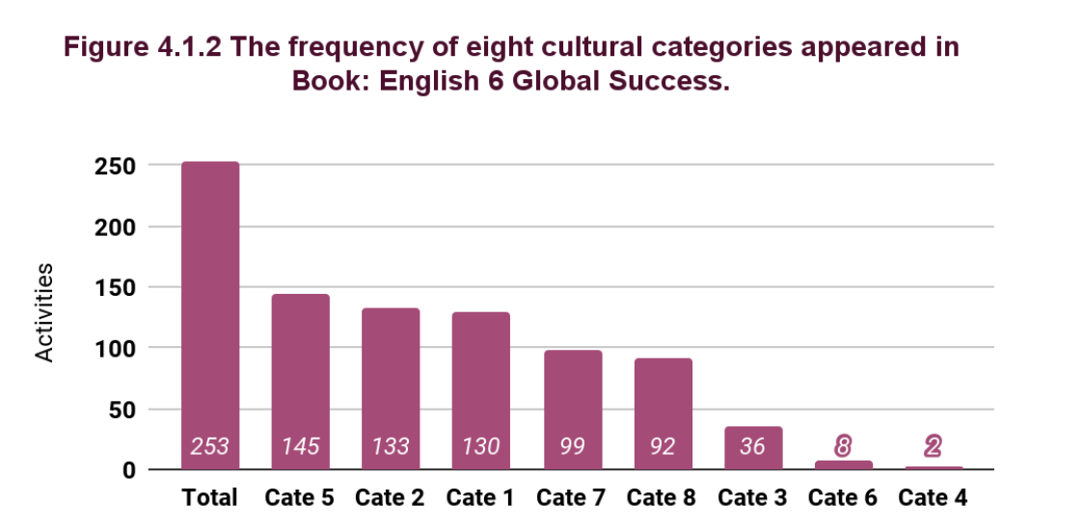
Findings
Total cultural activities: 253/449 (56.34%)
Integration of cultural contents in English 6 Global Success

Slide 12
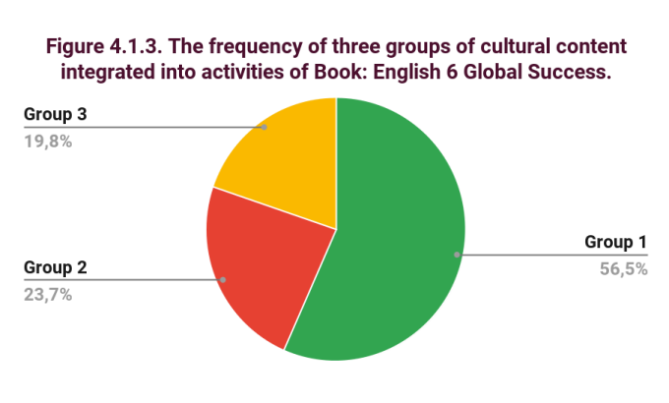
Findings
Total cultural activities: 253/449 (56.34%)
Integration of cultural contents in English 6 Global Success

Slide 13
Alignment with 2018 General Curriculum (MOET)
Strong alignment:
  Promotes pride in national culture (82.2% SC-based activities)
  Relatable contexts for Grade 6 learners
Weak alignment:
  Limited exposure to Target & International cultures (14.6% combined)
  Risks insufficient preparation for global communication
Overall: Supports national identity, but limited in fostering global citizenship
Findings
Alignment with 2018 Curriculum (MOET)

Slide 14
Cultural presence = 56.34% → higher than some intl. studies (e.g., Syahri & Susanti, 2016)
Strong focus on SC (82.2%) vs. more TC-focused findings elsewhere (Faris, 2014)
Focus on everyday categories (Cate 5, 2, 1)
Very limited “Social & political institutions” (Cate 4)
→ age-appropriate (proposed in 2018 Curriculum)
Discussion
Comparison & Interpretation

Slide 15
Conclusion
56.34% of textbook activities include cultural content
Strong emphasis on Source Culture (SC + Mix SC = 82.2%)
Limited representation of Target (6.7%) & International cultures (7.9%)
Most frequent category: Socialization & life cycle (Cate 5)
Predominant mode: Integrated cultural engagement (Group 1 – 56.5%)
Alignment: Good for national pride, weak for global citizenship

Slide 16
Recommendations
For textbook developers:
Increase & diversify Target and International culture content
Go beyond “surface culture” → include values, daily practices
Develop hybrid cultural content (Mix SC, Mix IC-TC)
For teachers:
Supplement with authentic global cultural materials
Adapt activities to encourage reflection & comparison
Need professional development in cultural pedagogy
For policymakers (MOET):
Provide clearer guidelines on balance of SC–TC–IC
Invest in teacher training for intercultural teaching

Slide 17
Reference
Baldwin, J. R., Coleman, R. R. M., González, A., & Shenoy-Packer, S. (2014). Intercultural communication for everyday life. John Wiley & Sons.
Brown, H. D. (2007). Principles of language learning and teaching (5th ed.). Pearson Education.
Byram, M. (1993). Language and culture learning: The need for integration. In M. Byram (Ed.), Germany, its representation in textbooks for
teaching German in Great Britain (pp. 3-16). Peter Lang.
Byram, M. (1997). Teaching and assessing intercultural communicative competence. Multilingual Matters.
Cortazzi, M., & Jin, L. (1999). Cultural mirrors: Materials and methods in the EFL classroom. In E. Hinkel (Ed.), Culture in second language teaching
and learning (pp. 196-219). Cambridge University Press.
Hall, E. T. (1976). Beyond culture. Anchor Books.
Kramsch, C. (1988). The cultural discourse of foreign language textbooks. In A. Valdman (Ed.), Proceedings of the Symposium on the Evaluation of
Foreign Language Textbooks (pp. 63-88). Indiana University Press.
Kramsch, C. (2014). Teaching foreign languages in an era of globalization: Introduction. Modern Language Journal, 98(1), 296-311.

Slide 18
Reference
Hoa, C. T. H., Tran, L. B., & Tan, K. H. (2024). ANALYZING CULTURAL REPRESENTATION IN AN EFL COURSE BOOK
NEWLY APPLIED IN VIETNAM SECONDARY EDUCATION. Arts Educa, 38.
Ministry of Education and Training. (2018). Chương trình giáo dục phổ thông môn Tiếng Anh (Ban hành kèm theo
Thông tư số 32/2018/TT-BGDĐT ngày 26 tháng 12 năm 2018 của Bộ trưởng Bộ Giáo dục và Đào tạo) [General
education program - English language subject (Issued with Circular No. 32/2018/TT-BGDĐT dated December
26, 2018, by the Minister of Education and Training)].
Nguyen, T. H. H. (2018). A study on the Features of Source culture, Target culture and International culture
Represented in textbook Tiếng Anh 10, Tiếng Anh 11 and Tiếng Anh 12 of the 10-Year Curriculum [Nghiên cứu những
biểu hiện văn hóa nguồn, văn hóa đích và văn hóa quốc tế trong sách giáo khoa Tiếng Anh 10, Tiếng Anh 11 và
Tiếng Anh 12 chương trình 10 năm]
Syahri, I., & Susanti, R. (2016). An analysis of local and target culture integration in the English textbooks for
senior high school in Palembang. Journal of Education and Human Development, 5(2), 97-102.

