Slide 1

Teaching Vietnamese Students Critical Evaluation of AI Writing Feedback
Presenter: Pham Thi Ha Anh (MA)
Hong Bang International University

Slide 2
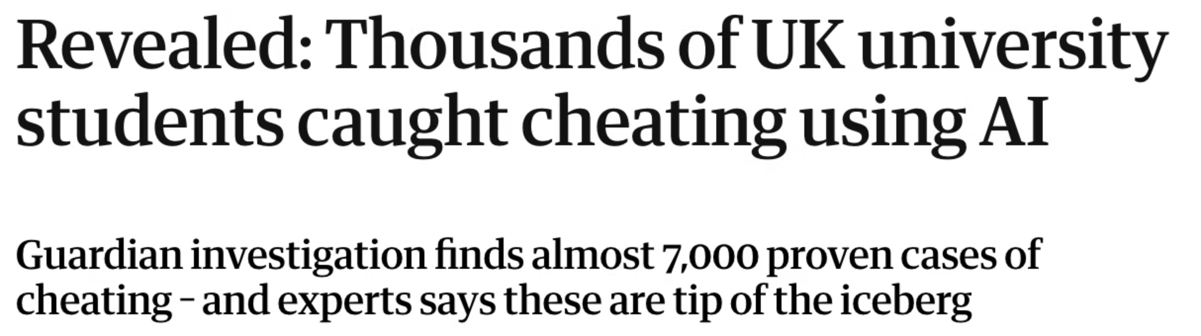
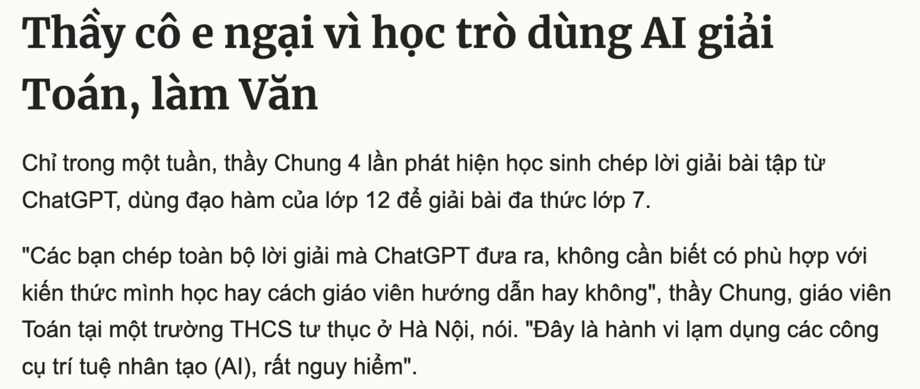
(The Guardian, 2025)
(Vnexpress, 2025)

Slide 3
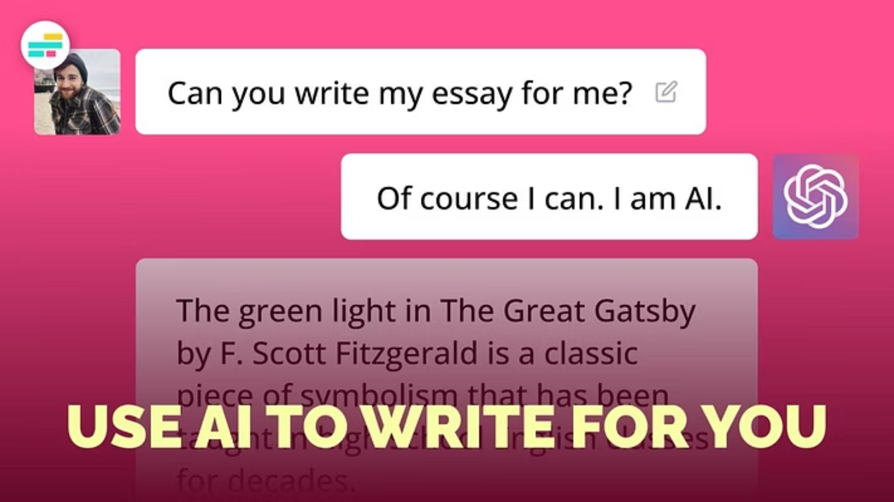
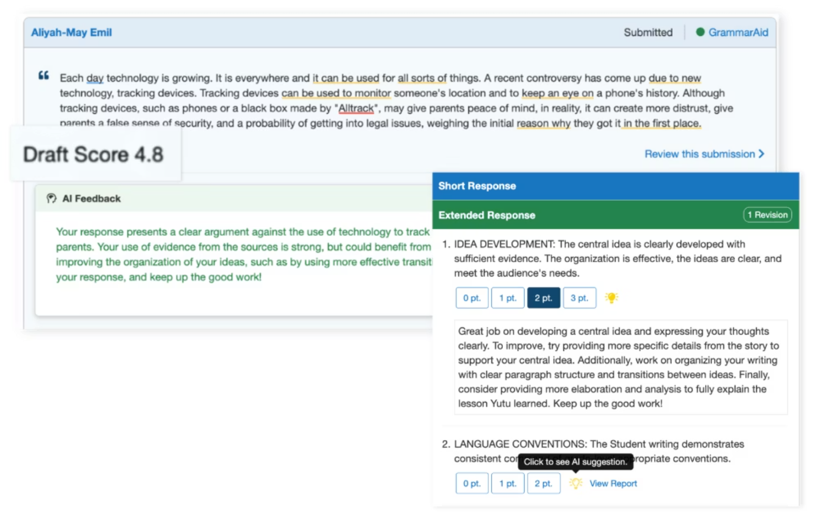

Slide 4
Research Gap
While AI writing tools can significantly improve students' writing quality, particularly in content and organization (Smith & Jones, 2022), concerns persist about:
Over-reliance on automated suggestions
Decreased learner autonomy
Reduced development of self-editing skills
(Davis et al., 2023)
Vietnamese learners often implement AI changes without understanding the underlying rationale or considering whether suggestions align with their communicative intentions and cultural identity (Nguyen & Tran, 2024)

Slide 5



1. Literature Review: AI as Writing Feedback Tools
Revolution in Learning
Effective Identification
Learner Evaluation
AI writing assistants offer immediate, personalized feedback previously available only through intensive teacher-student interactions (Johnson & Chen, 2021).
AI tools effectively identify grammatical errors, suggest vocabulary improvements, and provide structural recommendations (Lee & Kim, 2020).
Effectiveness depends significantly on learners' ability to evaluate and selectively implement suggestions
Research shows AI-generated feedback can be more readable and detailed than instructor feedback, while maintaining high agreement levels with instructor feedback on certain aspects of student writing (Garcia & Miller, 2023).

Slide 6


To effectively use AI as a writing feedback tool
Cultivating Critical Thinking
Building Digital Literacy
Students must develop critical thinking skills to evaluate AI-generated feedback and apply suggestions thoughtfully.
Digital literacy is essential for students to effectively navigate, utilize, and understand the capabilities of AI technologies.

Slide 7
Critical Thinking in Second Language Writing
Critical thinking in second language writing encompasses:
Ability to analyze, evaluate, and synthesize information (Smith, 2019)
Making informed decisions about language use and content organization (Johnson & Lee, 2020)
Research applying Bloom's taxonomy to ESL writing instruction shows that when teachers create innovative settings leading learners through all critical thinking stages, students demonstrate:
Widened scope with more enjoyment after brainstorming
Better learning outcomes in writing (Garcia & Miller, 2021)

Slide 8
Digital Literacy in the Age of AI
Digital literacy extends beyond basic technological competency to include:
Ability to critically evaluate AI-generated content
Understanding limitations of automated systems
Balancing AI assistance with human judgment
(Johnson & Lee, 2023)
Studies show integrating AI feedback into online writing instruction can substantially benefit learners by:
Offering more supportive learning contexts
Fostering motivation and confidence
Improving writing proficiency
(Wang & Kim, 2022)

Slide 9








Challenges for Vietnamese Students
Grammar Problems
Vocabulary Difficulties
Significant differences between Vietnamese and English grammar structures (Le & Pham, 2020)
Limited English vocabulary restricts expression (Nguyen & Tran, 2021)
Mother Tongue Interference
Organization Issues
Vietnamese linguistic patterns influencing English writing (Hoang, 2022)
Troubles organizing ideas in English academic writing (Vo, 2019)
Cultural factors in Vietnamese educational contexts traditionally emphasize teacher authority and student compliance, potentially creating reluctance to question or critically evaluate suggestions (Pham & Duong, 2018).

Slide 10
Methodology Overview
Research Design
Participants
Mixed-methods convergent parallel design examining AI literacy intervention effects on Vietnamese ESL students' writing development and critical evaluation skills
45 intermediate-level Vietnamese ESL students (ages 19-24) at a private university in Ho Chi Minh City
IELTS 5.0-6.0 proficiency
78% regularly used AI tools for writing
89% "usually" or "always" accepted AI suggestions without modification

Slide 11
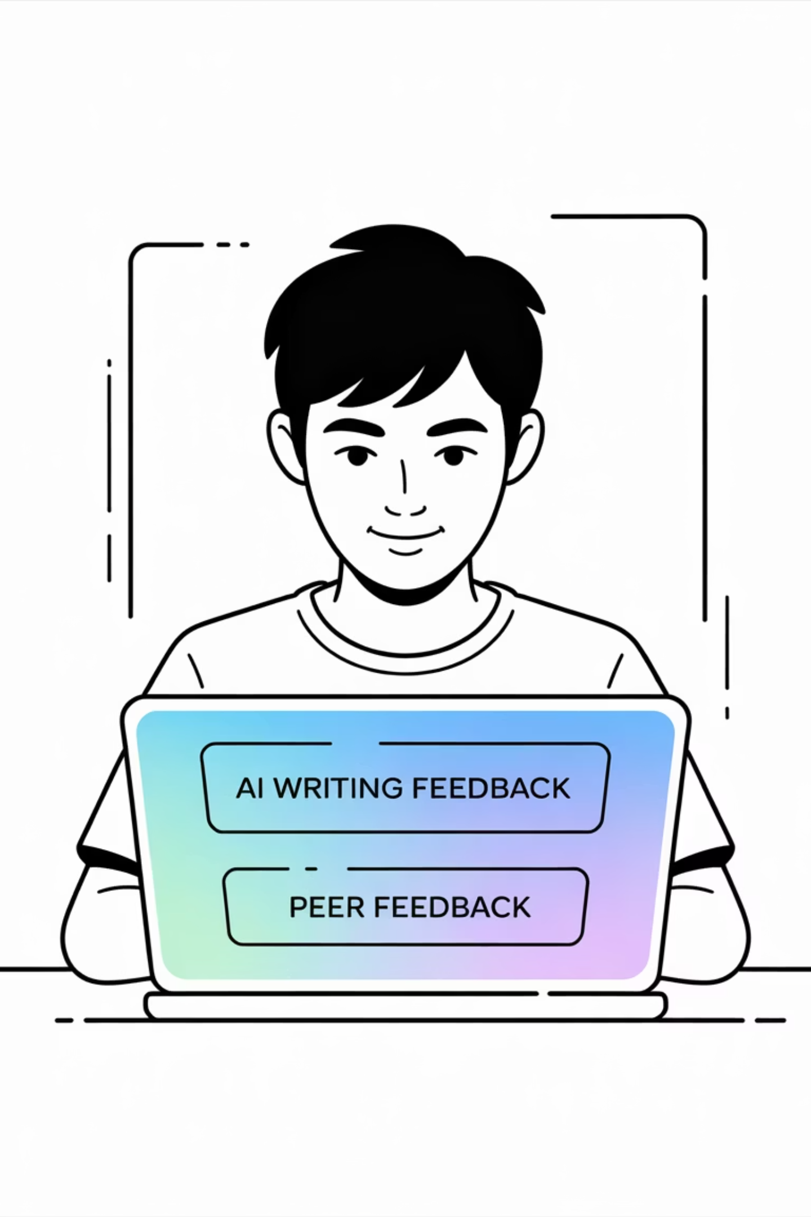
Eight-Week Intervention Design
1
Weeks 1-2: AI Strengths & Limitations Training
Students learned to recognize areas where AI tools excel and systematic exploration of AI weaknesses through guided discovery activities
2
Weeks 3-4: Integrated Peer & AI Feedback
Development of skills in providing/receiving constructive human feedback and synthesizing feedback from multiple sources
3
Weeks 5-6: Strategic Prompt Engineering
Instruction in crafting effective prompts that elicit high-quality AI responses and advanced prompting techniques
4
Weeks 7-8: Structured Reflection
Systematic reflection on AI feedback effectiveness and collaborative reflection sessions

Slide 12
Data Collection & Analysis
Quantitative Measures
Qualitative Data Sources
Pre/mid/post writing assessments
Think-aloud protocols during AI feedback evaluation
Pre-, mid- and post-intervention writing samples assessed using standardized rubrics: organization & structure, content development, language use, cultural voice preservation
Semi-structured interviews

Slide 13
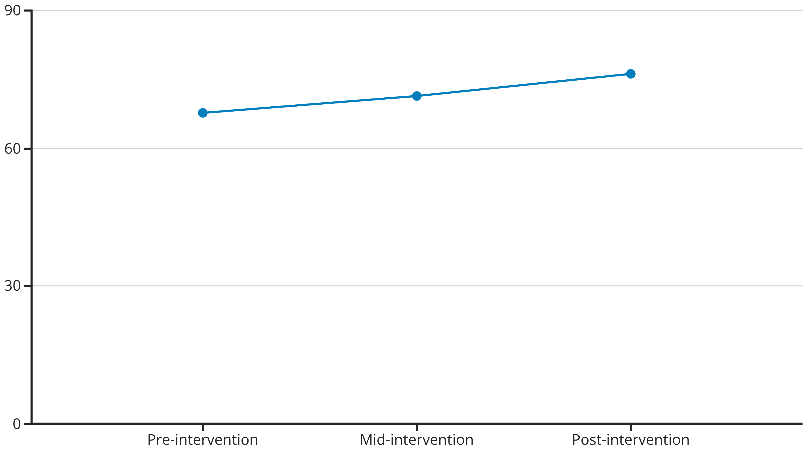
Quantitative Results: Writing Quality
Significant improvement across three assessment points (F(2,88) = 18.47, p < .001, ηp² = .295), representing a 12.4% overall improvement. This pattern aligns with research showing advanced AI literacy skills produce stronger effects on writing quality than basic technical usage.

Slide 14
Quantitative Results: Component-Specific Improvements
32%
23%
Organization & Structure
Content Development
15%
54%
Language Use
Cultural Voice Preservation

Slide 15
Qualitative Findings: Key Themes
Sophisticated AI Capability Understanding
Integration of Human and AI Feedback
Culturally-Informed Evaluation
"Now I understand that my peer gives me ideas about content and cultural things, AI gives me technical help, and I need to combine them" (Student E, Week 8)
"I used to worry that my Vietnamese examples made my English wrong. Now I know AI can help me express Vietnamese ideas clearly in English without losing meaning" (Student K, Post-interview)
"I use different prompts for different purposes. For grammar, I can trust AI mostly. For cultural content, I ask it to 'help me improve this while keeping my Vietnamese perspective,' then I evaluate if it really understood my culture" (Student C, Week 8)

Slide 16
Prompt Engineering Development
Advanced Prompts (Week 8)
Mid-Intervention (Week 5)
Early Prompts (Week 1)
"I'm a Vietnamese student writing for American professors about traditional medicine. Please help me improve clarity and academic style while maintaining cultural authenticity. Specifically focus on transitions between paragraphs and suggest ways to explain Vietnamese concepts that Americans might not understand" (Student G)
Increased specificity: "Help me improve the grammar and organization of this essay about Vietnamese festivals, but keep the cultural examples" (Student F)
Generic requests: "Fix my essay" (Student F)

Slide 17
Discussion: Key Findings
Effectiveness of Framework
Cultural Identity Preservation
Large effect size for critical evaluation skills, exceeding typical outcomes for general critical thinking interventions (Smith et al., 2022) and aligning with research on AI's impact on critical writing scores (Johnson & Lee, 2021).
Students navigated linguistic improvement while preserving cultural authenticity. This extends research on Vietnamese learners' cultural pride (Nguyen, 2020), showing it can be leveraged in AI literacy education.
Metacognitive Development
Hybrid Feedback Models
Metacognitive awareness developed, supporting sociocultural theory in technology-mediated language learning (Vygotsky, 1978; Lantolf, 2000). Students' articulated reasoning showed self-regulation crucial for effective AI use (Zhang, 2023).
Students integrated AI feedback with other sources, demonstrating critical evaluation essential for responsible AI use (Wilson & Chen, 2021). Training should emphasize complementary relationships between AI and human feedback.

Slide 18
Limitations & Future Research
Study Limitations
Future Research Directions
Focus on Vietnamese learners at one institution limits generalizability
Longitudinal studies tracking students across multiple semesters
Intermediate proficiency level may not represent full spectrum of ESL learners
Cross-cultural validation with diverse ESL populations
Six-week intervention period may not show long-term retention
Studies comparing evaluation training across different AI platforms
Examines only one AI writing tool (ChatGPT)
Research on optimal balance between AI assistance and critical evaluation
Absence of control group limits conclusions about specific contribution
Teacher professional development research

Slide 19
References
Chen, L., Wang, M., & Liu, S. (2022). Creating supportive ESL classroom environments for critical thinking development. *Journal of Second Language Writing*, 45(2), 78-92.
Davis, R., Thompson, K., & Martinez, A. (2023). Over-reliance on automated writing feedback: Implications for learner autonomy. *Computers & Education*, 189, 104-118.
Ennis, R. H. (1985). A logical basis for measuring critical thinking skills. *Educational Leadership*, 43(2), 44-48.
Freire, P. (1970). *Pedagogy of the oppressed*. Continuum International Publishing Group.
Garcia, M., & Kim, J. (2023). Balancing AI assistance with autonomous writing skill development. *Language Learning & Technology*, 27(1), 45-62.
Garcia, M., & Miller, D. (2021). Bloom's taxonomy in ESL writing instruction: A systematic review. *TESOL Quarterly*, 55(3), 412-438.
Garcia, M., & Miller, D. (2023). Comparing AI-generated and instructor feedback in ESL writing contexts. *Applied Linguistics*, 44(2), 234-251.
Hoang, T. (2022). Mother tongue interference in Vietnamese EFL writing. *Asian EFL Journal*, 24(3), 89-105.
Jacobs, H. L., Zinkgraf, S. A., Wormuth, D. R., Hartfiel, V. F., & Hughey, J. B. (1981). *Testing ESL composition: A practical approach*. Newbury House Publishers.
Johnson, A., & Chen, L. (2021). Personalized AI feedback in second language writing instruction. *ReCALL*, 33(2), 156-172.
Johnson, A., & Lee, S. (2020). Critical thinking in second language writing pedagogy. *Modern Language Journal*, 104(4), 678-695.
Johnson, A., & Lee, S. (2023). Digital literacy competencies in the age of artificial intelligence. *Computers & Education*, 195, 104-721.
Lantolf, J. P., & Thorne, S. L. (2006). *Sociocultural theory and the genesis of second language development*. Oxford University Press.
Le, H., & Pham, N. (2020). Contrastive analysis of Vietnamese and English grammar structures. *Vietnam Journal of Linguistics*, 15(2), 34-48.
Lee, K., & Chen, M. (2023). AI integration in second language writing instruction: Current trends and challenges. *CALL Journal*, 34(1), 23-41.
Lee, S., & Kim, H. (2020). Effectiveness of AI writing tools in error identification and correction. *System*, 89, 102-198.
Miller, R., & Brown, K. (2019). Critical thinking interventions in educational settings: A meta-analysis. *Educational Psychology Review*, 31(4), 789-812.
Nguyen, A., & Tran, B. (2021). Vocabulary challenges in Vietnamese EFL learners' academic writing. *English Language Teaching*, 14(8), 67-78.
Nguyen, H., & Tran, L. (2024). Cultural identity preservation in AI-mediated language learning. *Language and Culture*, 18(1), 45-62.
Pham, D., & Duong, M. (2018). Authority and compliance in Vietnamese educational contexts. *Asian Education Review*, 12(3), 156-171.
Smith, J. (2019). Defining critical thinking in second language contexts. *Applied Linguistics Review*, 10(2), 234-251.
Smith, J., & Jones, R. (2022). AI writing tools and student writing quality: A longitudinal study. *Computers and Composition*, 65, 102-118.
Vygotsky, L. S. (1978). *Mind in society: The development of higher psychological processes*. Harvard University Press.
Wang, L. (2024). Student acceptance patterns of AI-generated writing suggestions. *Educational Technology Research*, 42(3), 178-195.
Wang, L., & Kim, S. (2022). Integrating AI feedback in online writing instruction: Benefits and challenges. *Distance Education*, 43(2), 245-262.
Wilson, P., Davis, M., & Taylor, J. (2020). AI feedback tools and higher-order writing skills development. *Journal of Writing Research*, 12(1), 89-107.
Vo, T. (2019). Academic writing organization challenges for Vietnamese EFL students. *International Journal of Applied Linguistics*, 29(2), 234-248.

