Slide 1
Teacher-Mediated
AI Feedback with Native App
Exploring Agency and Autonomy
in IELTS Speaking Practice
August, 2025
Nguyễn Vũ Xuân Triều • Curtin University
Nguyễn Phương Trinh • Benedictine University

Slide 2

Agenda
01 | Introduction
02 | Background
03 | Methodology
04 | Results & Findings
05 | Discussion
06 | Conclusion

Slide 3

INTRODUCTIONBACKGROUNDMETHOD

Slide 4

PRESENTERS
Nguyễn Vũ Xuân Triều
BA in English Language Studies
– Da Lat University
MA student in Applied Linguistics
– Curtin University

Slide 5

PRESENTERS
Nguyễn Phương Trinh
BA in English for Business and Tourism
– Sai Gon University
MA in Linguistics
(with TESOL Specialisation)
– Benedictine University
MA student in Instructional Technology
– Maryland University Global Campus

Slide 6
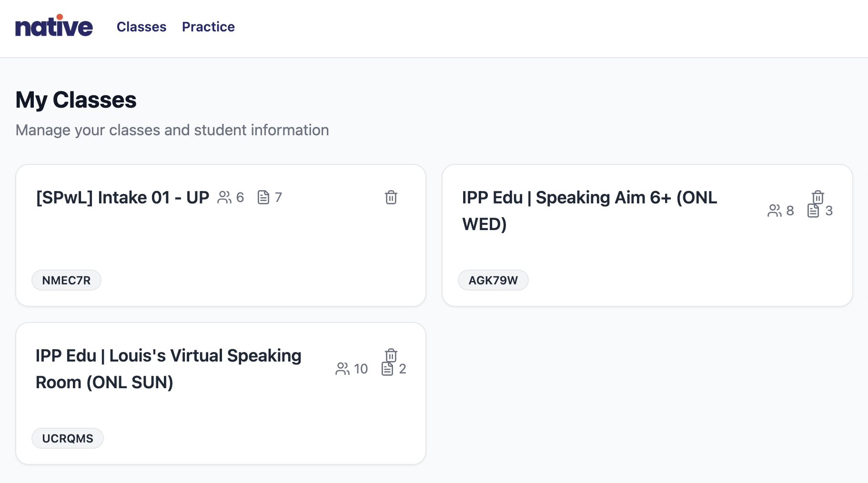
What is “Native?
Native is an app developed in the US, functioning as an LMS for distributing speaking practices and giving feedback on students’ performance.

Slide 7
INTRODUCTIONBACKGROUNDMETHODOLOGYRES

Slide 8


Motivation
AI feedback tools are increasingly integrated into language learning and IELTS preparation.
LEARNERS
Value immediate,
automated scoring
Struggle to interpret
and apply feedback
TEACHERS
Teacher’s role
remains central
Build trust & egangement
in AI feedback
Notes:
The motivation for this study comes from a simple observation: AI tools are rapidly entering classrooms, especially in IELTS preparation, where feedback is time-intensive and high-stakes. Learners often find automated scoring useful for practice, but they also report confusion or skepticism about what the feedback really means.
This is where teachers come in. Teachers are not passive facilitators—they mediate, scaffold, and reframe the feedback so that it becomes actionable. Mediation can build trust, guide reflection, and foster autonomy.

Slide 9
Research Gap
Existing studies focus
largely on tool efficacy
or learner perceptions.
Few have examined
the teacher–AI–student
interactional triad.
1
2
Unexplored teachers’ role
in mediating AI
for meaningful feedback.
Requiring research on how mediation shapes autonomy, motivation,
and learning behaviours.
3
4
Notes:
However, when we looked at the literature, we noticed a gap. Most studies still focus either on whether the tool ‘works’ or on what learners think about it. Very few examine the social processes in which teachers and students interact with AI feedback together. The role of teachers as active mediators, especially in high-stakes contexts like IELTS speaking, remains underexplored.
This study, therefore, seeks to fill that gap by situating AI feedback in its instructional ecosystem—an ecosystem shaped by teacher agency and pedagogical practices, not by the tool in isolation.

Slide 10
Purpose of the Study​
1 Investigate how teacher agency and mediation shape learner engagement with AI-generated feedback.
2 Examine the social and pedagogical processes through which teachers interpret, scaffold, and reframe feedback for students.
3 Contribute to understanding teacher roles as active agents in AI-supported instruction, rather than focusing on the tool in isolation.
Notes:
“Our purpose in this study is to highlight the human dimension in AI-mediated classrooms. Rather than asking whether the app itself ‘works,’ we focus on how teachers act as mediators: how they design tasks, interpret feedback, and guide students in acting on it.
This perspective foregrounds teacher agency — an underexplored aspect in AI-in-education research. It treats AI feedback as part of a broader instructional ecosystem, where meaning and impact depend on what teachers do with it.

Slide 11

Research Questions
1 | How do teachers design and implement IELTS Speaking tasks on Native app?
2 | How do learners interpret and act on AI-generated feedback when mediated by teachers?
3 | What roles do teachers play in influencing students’ trust, motivation, and learning behavior?
Notes:
First, how teachers design and implement IELTS speaking tasks, and the rationales behind those choices.
Second, how learners interpret and act on AI-generated feedback once teachers help them make sense of it.
Third, what roles teachers take up in mediating feedback, especially in terms of trust, motivation, and learning behaviors.
And finally, how the routines between teachers, the AI system, and students collectively influence learners’ sense of agency in speaking practice.”

Slide 12
Theoretical Framework
Sociocultural Theory (Vygotsky, 1978)
Learning is socially mediated; tools and human agents co-construct knowledge → Teachers interpret AI feedback as a cultural artifact that scaffolds learner development.
Learner Autonomy (Benson, 2011; Little, 1991)
Autonomy is co-constructed, not an individual trait → Teacher mediation can enable or constrain learner agency in using AI feedback.
Technology Mediation Theory (Warschauer, 1998; Wertsch, 1998)
Technology reshapes classroom roles and routines → AI feedback tools alter power dynamics, participation, and instructional practices, but do not act autonomously.
Notes:
“Our theoretical framework integrates three perspectives:
First, Sociocultural Theory reminds us that learning is never just individual—it is mediated by tools and social interaction. In this study, AI feedback is seen as a cultural artifact. Its educational value depends on how teachers interpret and scaffold it, much like any textbook or rubric.
Second, we draw on Learner Autonomy Theory. Autonomy is not a fixed characteristic; it is socially co-constructed. Teachers play a critical role here: by mediating AI feedback, they can foster autonomy—helping students act on feedback in productive ways—or unintentionally constrain it if feedback remains opaque.
Finally, Technology Mediation Theory helps us see AI tools as reshapers of the learning environment. Technologies are not neutral; they reconfigure classroom routines, power dynamics, and the roles of teachers and learners. In our case, Native can shift how speaking practice is structured, but it does so through the human choices teachers make in integrating it.
Together, these frameworks position teacher mediation as central: teachers are not passive facilitators but active co-designers of AI-enhanced learning.”

Slide 13
BACKGROUDMETHODOLOGYRESULTS&FINDINGS

Slide 14
Research Design
QUALITATIVE-DOMINANT MIXED METHODS
EXPLORATORY & INTERPRETIVE
(capturing social processes,
aligning with sociocultural perspectives)
EMPHASIS IS ON MEDITATION
(not just on learning outcomes)
Notes:
“In terms of design, our study is a qualitative-dominant mixed methods project. While we gathered some quantitative traces, like frequency of submissions and re-records, the main focus was exploratory and interpretive: to capture the social processes of how teachers and students worked with AI feedback. This aligns with sociocultural traditions, where the emphasis is on mediation rather than outputs alone.

Slide 15






Participants
PURPOSEFUL SAMPLING
Primary: 4 Vietnamese IELTS instructors
Secondary: 28 students from 4 classes
Notes:
The participants are equally central to this design.
On the teacher side, we worked with four Vietnamese IELTS instructors. These teachers were not just casual users of Native—they actively integrated it into their speaking classes, designed tasks around it, and engaged in reflective practice. Their pedagogical experience ranged from several years in IELTS teaching to active involvement in teacher development.
On the learner side, we observed around twenty-eight students, spread across the teachers’ four classes. These learners were mostly late teenagers to young adults, preparing for IELTS with entry levels between Band 4.5 and 6.0. Importantly, they were not just exposed to the app in isolation—they used it repeatedly with teacher mediation, meaning they received explicit guidance on interpreting and acting on AI-generated feedback.
We adopted purposeful sampling to ensure that both teachers and students had sustained, meaningful engagement with the app. This meant our data would reflect not only initial impressions but also evolving routines and reflective practices over time.”

Slide 16




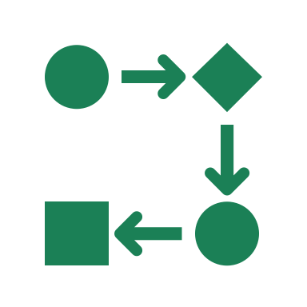


Instruments & Data Sources
Semi-structured Interviews
Reflective
Journals
Classroom Observations & Screen Recordings
Artifacts
& System Data
Surveys (3 phases)
Field Notes
Ethics
Notes:
“To address our research questions, we collected data from multiple sources, ensuring both breadth and depth.
First, we conducted semi-structured interviews. Teachers were interviewed twice: once at the start to capture their task design decisions and beliefs about AI feedback, and again later to reflect on their evolving mediation practices. Students were also interviewed to understand how they received and acted on AI-generated feedback, and how trust and motivation factored into their learning.
Second, we gathered reflective journals. Teachers wrote weekly entries about their mediation choices, challenges, and reflections. Selected students also kept journals, noting their responses to AI feedback, their emotional reactions, and any perceived growth in autonomy.
Third, we conducted classroom observations and screen recordings. These provided real-time evidence of how feedback was actually acted upon, helping us triangulate between what participants reported and what we observed.
Fourth, we analyzed artifacts and system data from the Native platform. This included tasks, scores, feedback categories like fluency and coherence, dashboard snapshots, and behavioral traces such as submission frequency and number of re-records.
We also administered three phases of surveys: before, during, and after the study. These captured shifts in trust, engagement, motivation, and learner autonomy.
Finally, I kept field notes throughout, documenting contextual dynamics and contradictions between reported experiences and observed practices.
All of this was conducted under strict ethical procedures: informed consent, pseudonym use, confidentiality, and reflexive positioning to ensure transparency in the research process.
Together, these instruments created a robust, triangulated dataset that allowed us to examine teacher mediation and learner responses from multiple angles.”

Slide 17
Analytic Approach
Thematic Analysis (Braun & Clarke): Coding cycles: Open → Axial → Selective
• I.e. “Teacher override,” “Trust in the machine,” “Feedback as motivation,” “Scaffolding agency”
Cross-case Comparison: to contrast teacher mediation strategies
• Compare alignment/misalignment between mediation and learner uptake
Artifact Triangulation
• Match AI feedback categories (fluency, grammar, coherence, lexis) with learner behaviours
• Behaviours traced: re-recording, journaling, clarification requests, reflective shifts
Trustworthiness
• Triangulated data sources (interviews, journals, observations, artifacts, surveys)
• Researcher reflexivity and field notes to check for bias
Notes:
“Our analysis followed the thematic analysis framework of Braun and Clarke. We began with open coding, identifying initial categories in interview transcripts, journals, and observations. These included concrete codes such as ‘teacher override’ when instructors corrected or reframed AI feedback, or ‘trust in the machine’ when learners expressed belief in its scoring.
From there, we moved to axial coding, clustering these codes into broader conceptual categories—for example, connecting ‘feedback confusion’ with ‘scaffolding agency.’ Finally, through selective coding, we refined themes that cut across the dataset, such as feedback as motivation and mediation as sense-making.
We then conducted cross-case comparisons across the four participating teachers. This allowed us to see not just what happened in one classroom, but how mediation strategies varied and how student responses differed—sometimes aligning with teacher intentions, and sometimes diverging.
A crucial step was artifact triangulation. We categorized AI feedback into domains like fluency, grammar, coherence, and lexical resource, and mapped these against learner behaviors. For example, when feedback emphasized fluency, some students re-recorded multiple times, while others ignored it until the teacher highlighted cohesion strategies in class. This triangulated approach allowed us to move beyond self-reports and see how feedback was enacted in practice.
Finally, we ensured trustworthiness by triangulating across instruments—interviews, reflective journals, observations, system artifacts, and surveys—and through reflexive field notes that documented contextual dynamics and any contradictions between what participants said and what they actually did.
In short, the analytic approach allowed us to capture both the patterns and the tensions of teacher-mediated AI feedback: not just what teachers and students said, but what they did in practice.”

Slide 18
METHODOLOGYRESULTS&FINDINGSDISCUSSIONC

Slide 19
RQ1: What can teachers do on “Native”?

Slide 20
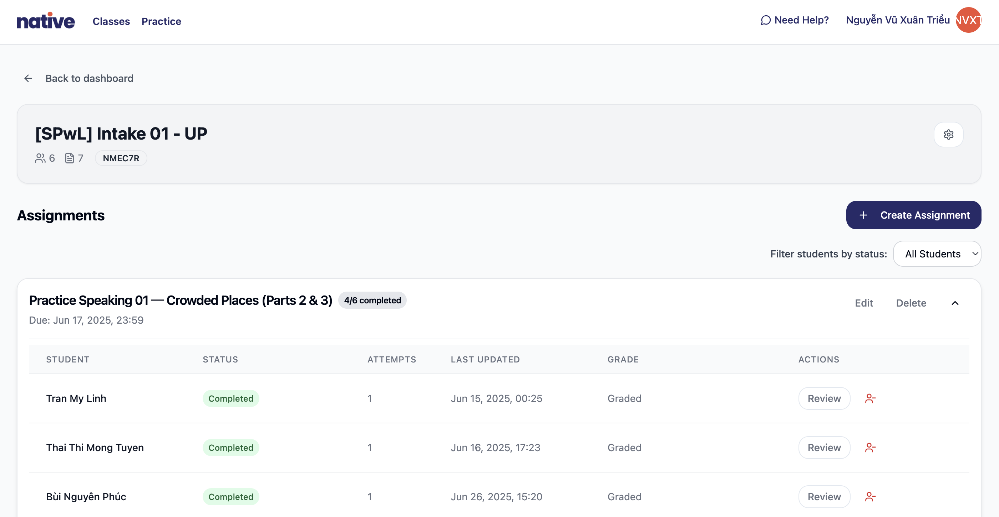
RQ1: What can teachers do on “Native”?
P1
P2
P3

Slide 21
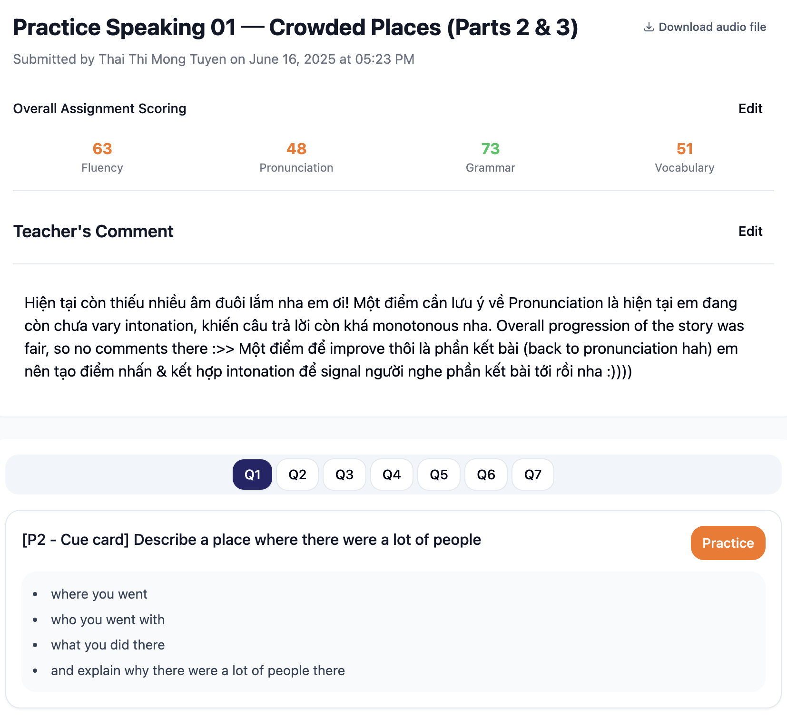
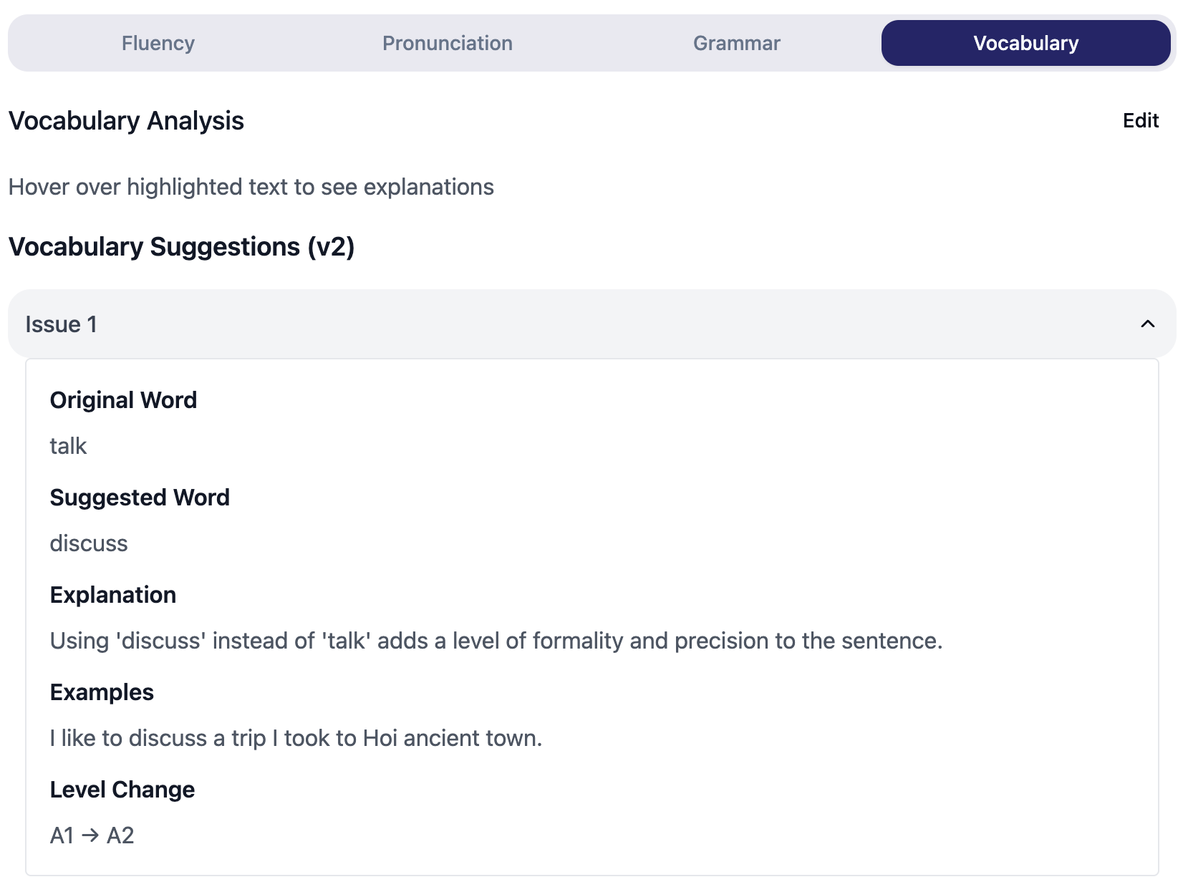
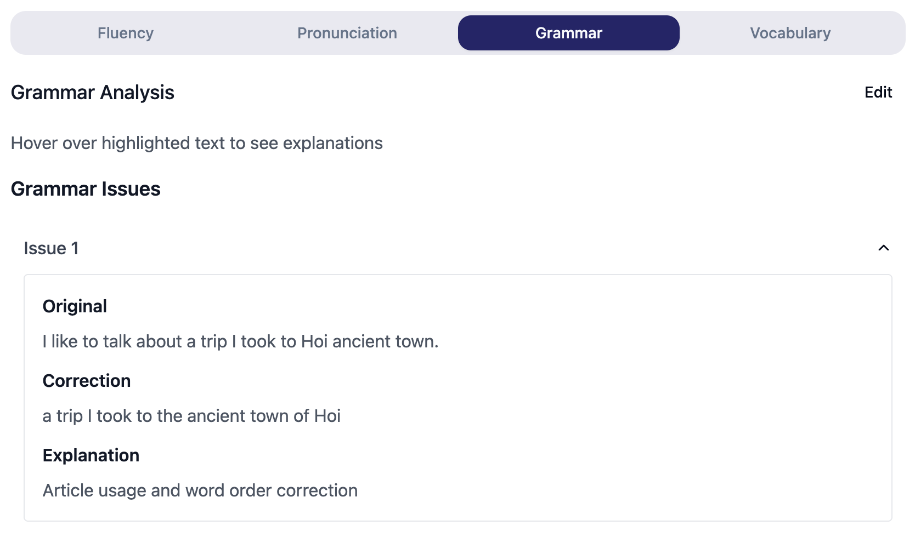
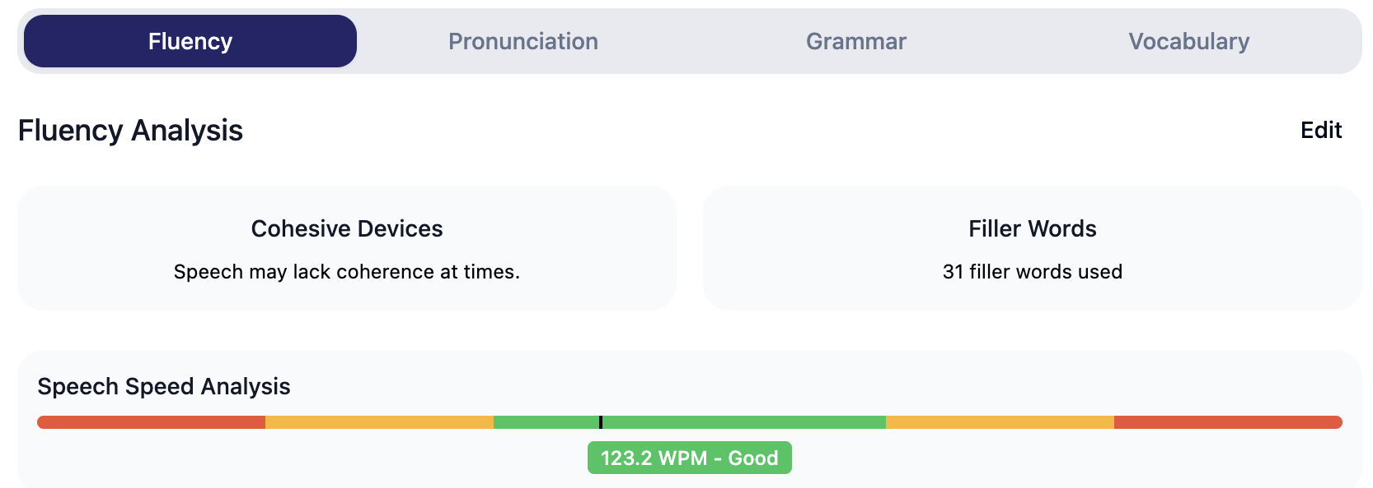
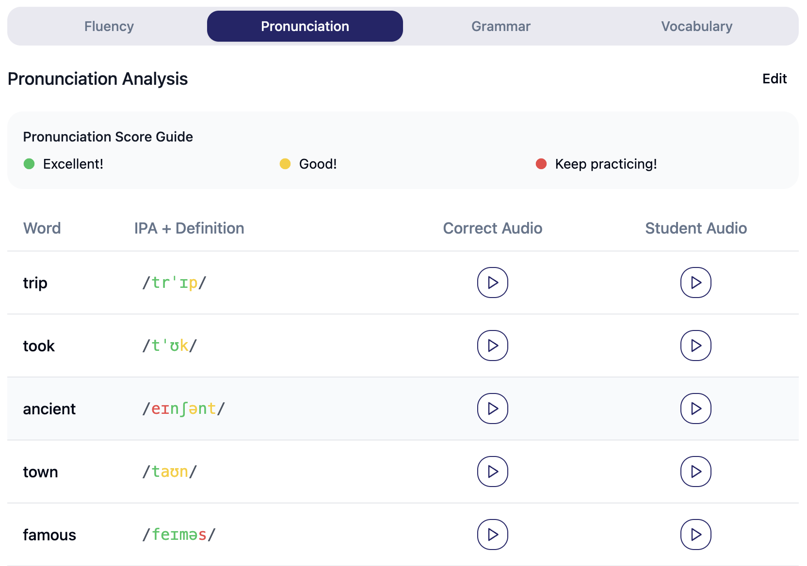
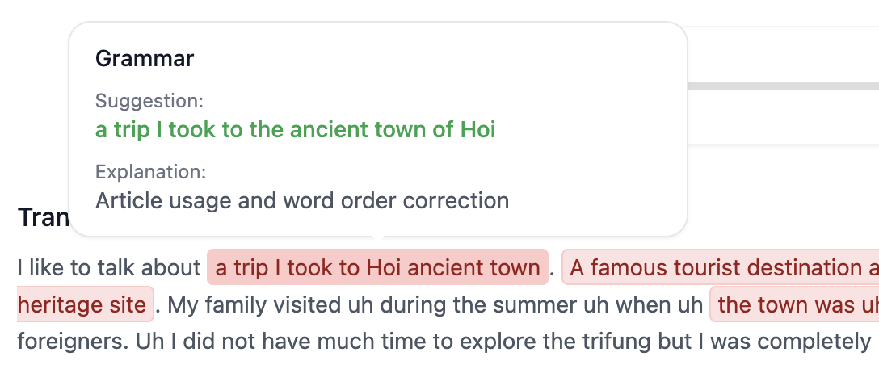
RQ1:
What can teachers do on “Native”?
P2

Slide 22
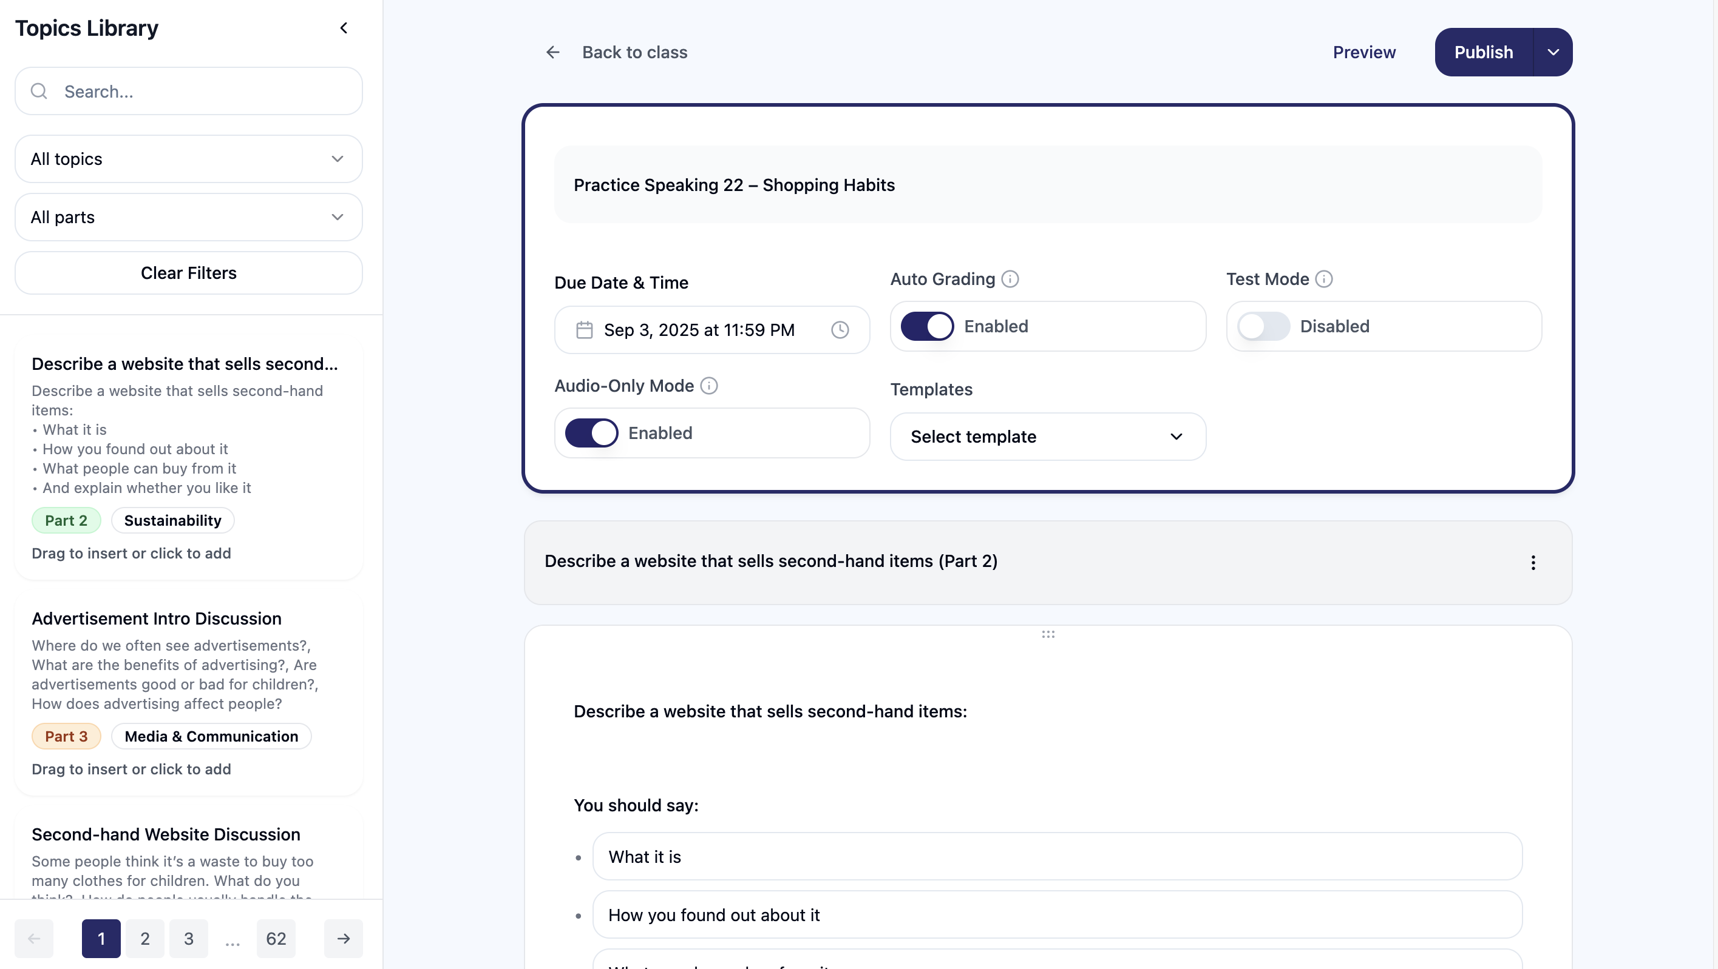
RQ1: What can teachers do on “Native”?
Notes:
Answer. Teachers embed Native into IELTS-aligned tasks (P1–P3), give pre-task guidance, then interpret/reframe the app’s scores/comments into concrete targets (e.g., “add linkers for coherence”), set focused re-record goals, and monitor submission + re-record counts on dashboards. This design turns raw scores into teachable moves and closes the loop with follow-up mediation.

Slide 23








RQs 2&3: Emerging Themes (Preliminary)
Trust-building strategies
Submission & purposeful
re-recording
Reflective self-monitoring
Overall Insight
Teacher mediation shifts AI feedback from evaluation → instruction that prompts action
Teachers reframed or clarified AI scores & comments to build learners’ confidence in interpreting automated feedback
Shift from vague reactions → specific, actionable reflection
Journals/feedback show growing autonomy
Learners submitted more frequently
Re-recording linked to specific foci (fluency, coherence, lexical range)
Notes:
Our preliminary analysis suggests three notable patterns emerging across classrooms.
First, trust-building strategies. Teachers often acted as interpreters of AI feedback. For instance, when students expressed doubt about an unexpectedly low fluency score, teachers contextualized the metric, clarified what fluency really meant in IELTS terms, and linked it to concrete speaking strategies. This mediation was key to building learner trust—students became more willing to engage with the AI feedback once teachers validated or reinterpreted it.
Second, we observed increased submission frequency and purposeful re-recording. With teacher scaffolding, learners moved beyond simply ‘retrying until the score improved.’ Instead, they re-recorded with specific goals: slowing down to improve coherence, using more cohesive devices, or experimenting with lexical resource. System logs confirmed a higher frequency of submissions, but the crucial difference was that these were targeted rather than random attempts.
Third, we noted a shift toward more reflective self-monitoring. Early student journals contained vague remarks like ‘my fluency is bad.’ Over time, especially after guided mediation, entries became more specific and strategic—such as ‘I need to add linking words to make my sentences flow.’ This indicates a move toward greater learner autonomy, not in isolation but as a socially constructed outcome of mediation.
Together, these themes demonstrate that teacher mediation transforms AI feedback from what might otherwise feel like cold evaluation into actionable instruction. The shift is not only behavioral—more re-records, more submissions—but also cognitive, as learners begin to reflect more deeply and self-regulate their speaking practice.”

Slide 24
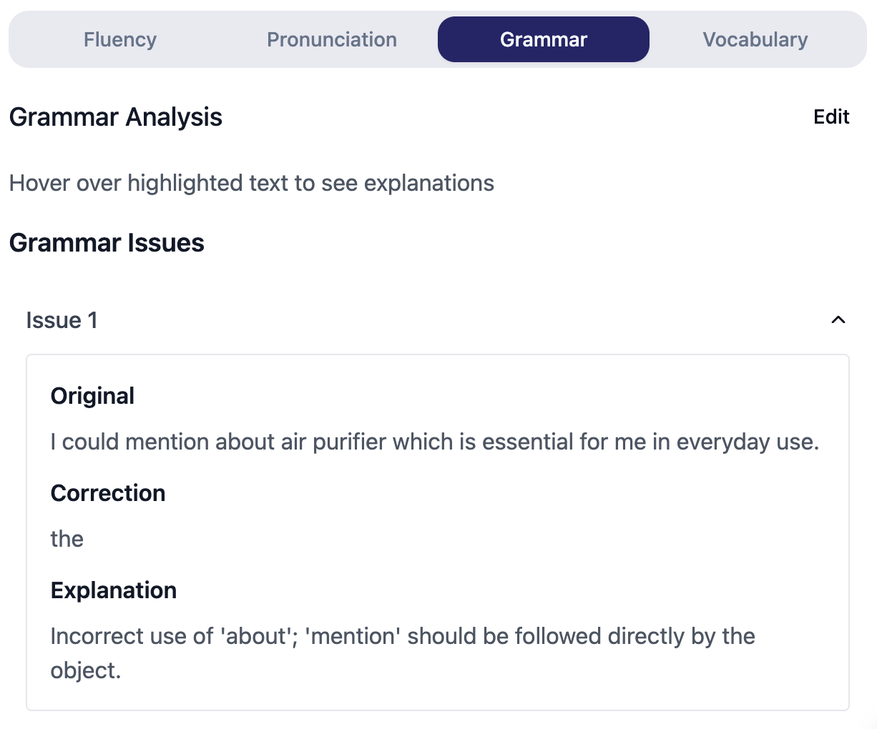
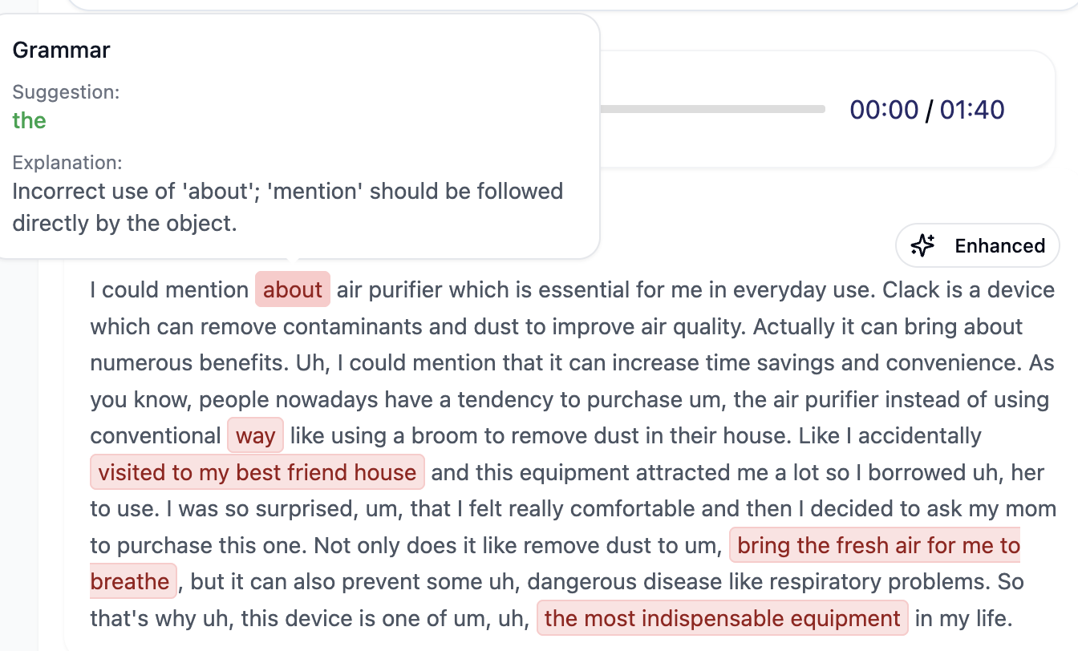
RQs 2&3: The Feedback–Mediation Loop
When AI Feedback Clarity is guaranteed, students are more likely to take action, prompting enhanced Actionability.
Notes:
This thematic map shows categories orbiting a core loop of teacher–AI–student interaction.
At the starting point, the clarity of AI feedback determines its actionability. If the message is vague—such as ‘improve fluency’—learners often don’t know how to act. But when teachers reframe and unpack that feedback, it becomes a catalyst for change.
This leads us to the second category: teacher mediation as the sense-making engine. Teachers interpret rubric terms—like ‘coherence’—and translate them into concrete linguistic moves, for example: ‘use linkers such as however or on the other hand.’ This translation is what makes feedback actionable.
The third category is iteration affordance. With clear goals, learners re-record rapidly and with focus. Instead of repeating blindly, they approach each attempt as a targeted exercise, whether on fluency, grammar range, or cohesion. These re-takes become the mechanism of change.
Fourth, learner agency functions as the driver of action. Even with teacher scaffolding, it is the student’s decision to re-record, reflect in journals, or integrate feedback that pushes learning forward. Agency is co-constructed but enacted individually.
Finally, technology and UX frictions act as brakes on the loop. When metrics are opaque or the interface is not intuitive, students may disengage. In our observations, this was where teacher mediation became especially important in keeping learners engaged.
Taken together, the loop illustrates that AI feedback alone does not guarantee learning. It is when feedback clarity, teacher mediation, iteration, and learner agency align—while minimizing UX frictions—that the cycle becomes productive.”

Slide 25
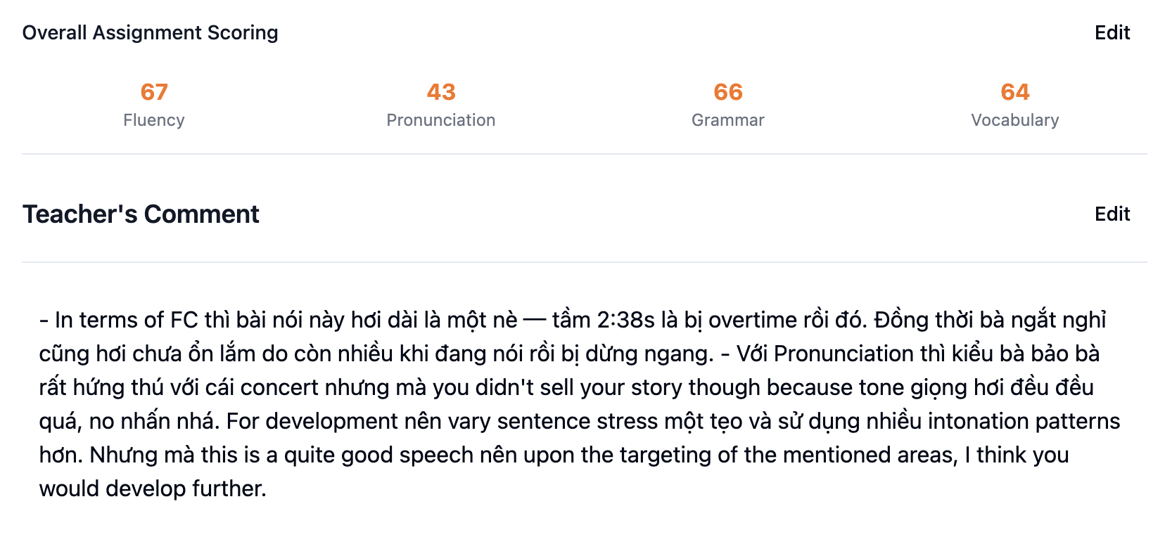
RQs 2&3: The Feedback–Mediation Loop
Teacher Mediation can encourage the Sense-making Engine,
which means rigid rubrics can be turned into linguistic moves.
a human touch, non-replicable by AI!
Notes:
This thematic map shows categories orbiting a core loop of teacher–AI–student interaction.
At the starting point, the clarity of AI feedback determines its actionability. If the message is vague—such as ‘improve fluency’—learners often don’t know how to act. But when teachers reframe and unpack that feedback, it becomes a catalyst for change.
This leads us to the second category: teacher mediation as the sense-making engine. Teachers interpret rubric terms—like ‘coherence’—and translate them into concrete linguistic moves, for example: ‘use linkers such as however or on the other hand.’ This translation is what makes feedback actionable.
The third category is iteration affordance. With clear goals, learners re-record rapidly and with focus. Instead of repeating blindly, they approach each attempt as a targeted exercise, whether on fluency, grammar range, or cohesion. These re-takes become the mechanism of change.
Fourth, learner agency functions as the driver of action. Even with teacher scaffolding, it is the student’s decision to re-record, reflect in journals, or integrate feedback that pushes learning forward. Agency is co-constructed but enacted individually.
Finally, technology and UX frictions act as brakes on the loop. When metrics are opaque or the interface is not intuitive, students may disengage. In our observations, this was where teacher mediation became especially important in keeping learners engaged.
Taken together, the loop illustrates that AI feedback alone does not guarantee learning. It is when feedback clarity, teacher mediation, iteration, and learner agency align—while minimizing UX frictions—that the cycle becomes productive.”

Slide 26
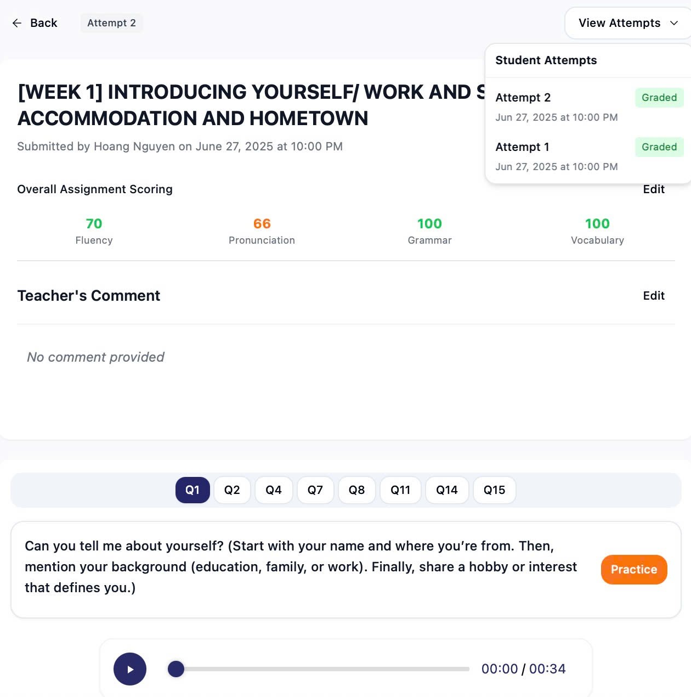
RQs 2&3: The Feedback–Mediation Loop
As students possess
Iteration Affordance, they can actively choose to retake whenever they want to, which helps build a Mechanism for Change.
Notes:
This thematic map shows categories orbiting a core loop of teacher–AI–student interaction.
At the starting point, the clarity of AI feedback determines its actionability. If the message is vague—such as ‘improve fluency’—learners often don’t know how to act. But when teachers reframe and unpack that feedback, it becomes a catalyst for change.
This leads us to the second category: teacher mediation as the sense-making engine. Teachers interpret rubric terms—like ‘coherence’—and translate them into concrete linguistic moves, for example: ‘use linkers such as however or on the other hand.’ This translation is what makes feedback actionable.
The third category is iteration affordance. With clear goals, learners re-record rapidly and with focus. Instead of repeating blindly, they approach each attempt as a targeted exercise, whether on fluency, grammar range, or cohesion. These re-takes become the mechanism of change.
Fourth, learner agency functions as the driver of action. Even with teacher scaffolding, it is the student’s decision to re-record, reflect in journals, or integrate feedback that pushes learning forward. Agency is co-constructed but enacted individually.
Finally, technology and UX frictions act as brakes on the loop. When metrics are opaque or the interface is not intuitive, students may disengage. In our observations, this was where teacher mediation became especially important in keeping learners engaged.
Taken together, the loop illustrates that AI feedback alone does not guarantee learning. It is when feedback clarity, teacher mediation, iteration, and learner agency align—while minimizing UX frictions—that the cycle becomes productive.”

Slide 27
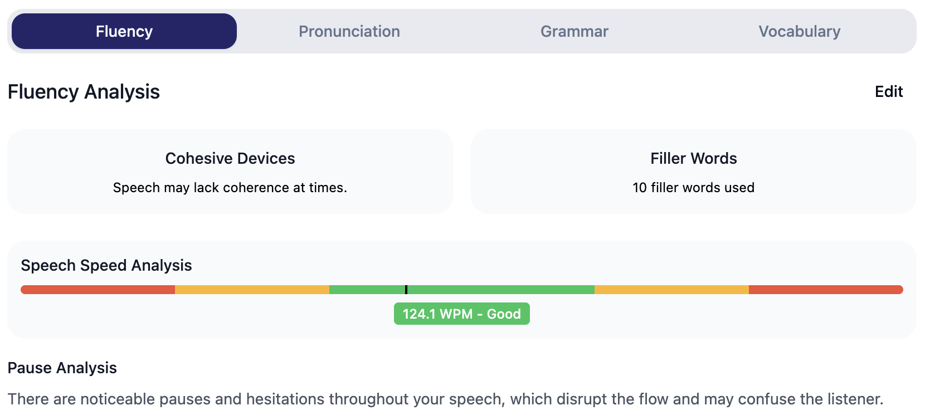
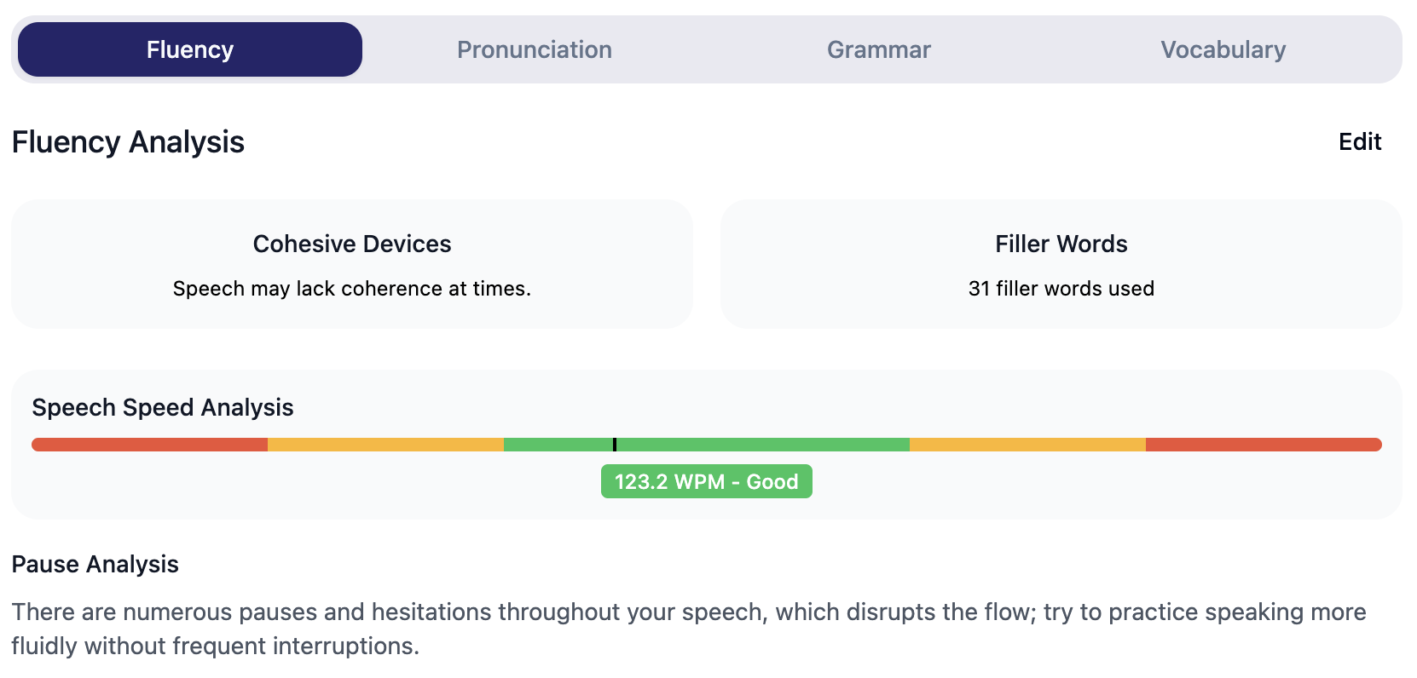

RQs 2&3: The Feedback–Mediation Loop
Frictions of the UI/UX or the opaque metric systems may cause Brakes in the Loop as students feel dissociated from using the platform.
The teacher’s mediation is, therefore, extremely important in students’ continued usage.
Notes:
This thematic map shows categories orbiting a core loop of teacher–AI–student interaction.
At the starting point, the clarity of AI feedback determines its actionability. If the message is vague—such as ‘improve fluency’—learners often don’t know how to act. But when teachers reframe and unpack that feedback, it becomes a catalyst for change.
This leads us to the second category: teacher mediation as the sense-making engine. Teachers interpret rubric terms—like ‘coherence’—and translate them into concrete linguistic moves, for example: ‘use linkers such as however or on the other hand.’ This translation is what makes feedback actionable.
The third category is iteration affordance. With clear goals, learners re-record rapidly and with focus. Instead of repeating blindly, they approach each attempt as a targeted exercise, whether on fluency, grammar range, or cohesion. These re-takes become the mechanism of change.
Fourth, learner agency functions as the driver of action. Even with teacher scaffolding, it is the student’s decision to re-record, reflect in journals, or integrate feedback that pushes learning forward. Agency is co-constructed but enacted individually.
Finally, technology and UX frictions act as brakes on the loop. When metrics are opaque or the interface is not intuitive, students may disengage. In our observations, this was where teacher mediation became especially important in keeping learners engaged.
Taken together, the loop illustrates that AI feedback alone does not guarantee learning. It is when feedback clarity, teacher mediation, iteration, and learner agency align—while minimizing UX frictions—that the cycle becomes productive.”

Slide 28
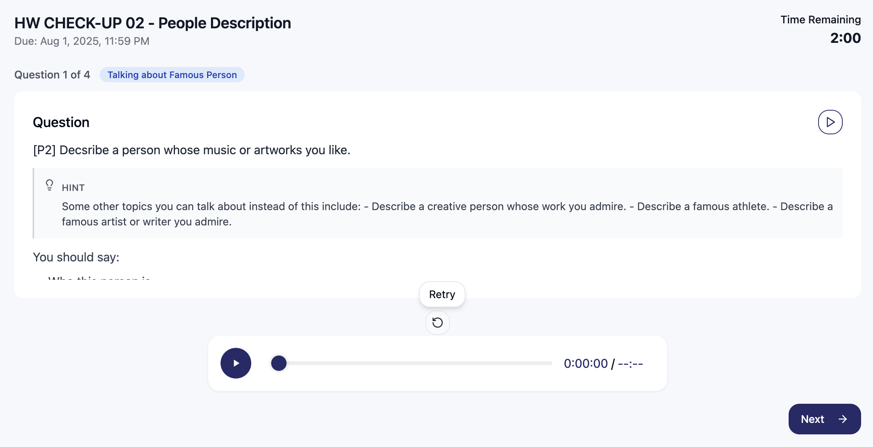
RQs 2&3: The Feedback–Mediation Loop
Learner Agency, paired with an in-app feature, promotes their Driver of Action, letting them choose to reflect and re-record to extend learning.
Notes:
This thematic map shows categories orbiting a core loop of teacher–AI–student interaction.
At the starting point, the clarity of AI feedback determines its actionability. If the message is vague—such as ‘improve fluency’—learners often don’t know how to act. But when teachers reframe and unpack that feedback, it becomes a catalyst for change.
This leads us to the second category: teacher mediation as the sense-making engine. Teachers interpret rubric terms—like ‘coherence’—and translate them into concrete linguistic moves, for example: ‘use linkers such as however or on the other hand.’ This translation is what makes feedback actionable.
The third category is iteration affordance. With clear goals, learners re-record rapidly and with focus. Instead of repeating blindly, they approach each attempt as a targeted exercise, whether on fluency, grammar range, or cohesion. These re-takes become the mechanism of change.
Fourth, learner agency functions as the driver of action. Even with teacher scaffolding, it is the student’s decision to re-record, reflect in journals, or integrate feedback that pushes learning forward. Agency is co-constructed but enacted individually.
Finally, technology and UX frictions act as brakes on the loop. When metrics are opaque or the interface is not intuitive, students may disengage. In our observations, this was where teacher mediation became especially important in keeping learners engaged.
Taken together, the loop illustrates that AI feedback alone does not guarantee learning. It is when feedback clarity, teacher mediation, iteration, and learner agency align—while minimizing UX frictions—that the cycle becomes productive.”

Slide 29



RQs 2&3: Illustrative Evidence (in-vivo excerpts)
Iteration Affordance
Teacher Mediation
Learner Agency
P4: “Recorded about five times… next time felt faster.”
P13: “Fluency is not just speed… use cohesive devices.”
P21: “Need feedback on linking words and organisation.”
Notes:
To ground these themes, I want to share a few representative in-vivo excerpts from our dataset.
The first example comes from a student journal: ‘Recorded about five times… next time felt faster.’ This illustrates iteration affordance. What might look like repetitive re-recording actually became purposeful practice, where each attempt was faster and more fluent than the last.
The second example is from a teacher-student interaction: ‘Fluency is not just speed… use cohesive devices.’ This shows teacher mediation. The teacher is reframing an AI-generated fluency score by expanding its meaning. Instead of simply equating fluency with speed, the teacher contextualizes it in IELTS terms—encouraging the use of linking expressions. This demonstrates how teachers serve as the sense-making engine in the feedback loop.
Finally, we have a student comment: ‘Need feedback on linking words and organization.’ This points to learner agency. The student moves from passively receiving scores to actively requesting targeted feedback. It indicates a shift toward more specific, reflective self-monitoring.
Together, these excerpts illustrate how mediation processes transform AI feedback from static scores into dynamic opportunities for learning. They exemplify the categories of iteration, mediation, and agency that we mapped earlier.”

Slide 30
RESULT OVERVIEW
Research Question | Answer
RQ1. How do teachers design and implement IELTS Speaking tasks on the Native app? | Teachers embed Native into IELTS-aligned tasks (P1–P3), give pre-task guidance, then interpret/reframe scores/comments into concrete targets (e.g., “add linkers for coherence”), set focused re-record goals, and monitor submission + re-record counts on dashboards—turning raw scores into teachable moves and closing the loop with follow-up mediation.
RQ2. How do learners interpret and act on AI-generated feedback when mediated by teachers? | With mediation, learners submit more frequently and re-record purposefully (targeting fluency, coherence, or lexis rather than “retrying blindly”), while reflections shift from vague (“my fluency is bad”) to specific, actionable self-monitoring. Dataset maps feedback types → behaviors (re-record, seek clarification, journal reflection).
RQ3. What roles do teachers play in influencing students’ trust, motivation, and learning behavior? | Teachers act as the sense-making engine: they build trust by contextualising scores, motivate via targeted tasks/quick wins, and shape behavior by setting explicit re-record foci and micro-interventions from dashboard traces. Net effect: teachers as co-designers whose mediation enables or constrains autonomy; the app supports rather than replaces pedagogy.

Slide 31
FINDINGSDISCUSSIONCONCLUSION

Slide 32
Discussion & Pedagogical Implications
Discussion
Teachers as co-designers, not passive implementers
Mediation enables or constrains autonomy
App value = contingent on mediation → supports pedagogy, doesn’t replace it
Pedagogical Implications
Embed feedback interpretation routines into class/homework cycles
Use dashboards & submission traces to guide micro-interventions
Scaffold focused re-recording (linkers, referencing, coherence)
Notes:
“In our discussion, we position teachers as co-designers of tech-enhanced learning. They are not passive users of AI tools. Their mediation—through sense-making, scaffolding, and task design—determines whether autonomy is enabled or constrained. Importantly, the app’s value lies not in replacing pedagogy but in supporting it.
From this, several pedagogical implications arise. Teachers can embed explicit feedback interpretation routines into both classwork and homework, so that AI outputs are never left ambiguous. Dashboards and submission traces allow teachers to identify where micro-interventions are needed—whether with individuals or whole classes. Finally, teachers can scaffold re-recording with clear linguistic foci: for example, working specifically on linkers, referencing devices, or coherence markers. These practices align directly with the mechanisms of change we observed in our findings.”

Slide 33
FINDINGSDISCUSSIONCONCLUSION

Slide 34
Implications for Design
Design Implications (Research-Driven, Subtle)
Rubric explanations + examples → make scores more interpretable
One-click re-record prompts → focus on specific aspects (e.g., linkers)
Lightweight teacher tools → annotation, task templates
Trust & continuity cues → build confidence in the feedback loop
Notes:
“Alongside pedagogy, our data suggest implications for design. I emphasize here that this is not advocacy for a product, but a reflection of needs that emerged through mediation.
Teachers and learners both benefit from rubric explanations with examples, so feedback categories become more transparent. One-click re-record prompts tied to specific aspects—such as ‘try again focusing on linkers’—would help learners iterate with purpose. For teachers, lightweight tools for annotation or task templates would make mediation more efficient. And finally, clearer trust and continuity cues would help sustain engagement over time, reassuring learners that the system is consistent and pedagogically aligned.
These design implications reflect teacher-facing affordances surfaced by our data, showing how technology can better support, rather than replace, the work of teachers.”

Slide 35
Limitations
Small-scale, context-specific sample (Vietnamese IELTS classes)
Qualitative emphasis; limited generalizability
Reliance on self-report (journals, interviews) → possible bias
Findings are preliminary; need longitudinal validation
Notes:
“In terms of limitations, this study is small in scale and context-specific, focused on four Vietnamese IELTS classes. The qualitative emphasis offers depth but reduces generalizability, and our reliance on self-reported data—through interviews and journals—introduces the possibility of bias. These are early, preliminary findings, which need to be tested through larger and longer-term validation.

Slide 36
Future Work
Longitudinal designs → track mediation effects over time
Comparative studies → with/without structured mediation
Behavioural trace analysis → link submissions, re-records to outcomes
Feature discoverability → study learner uptake of underused features
Connected-speech diagnostics → address learner demand for advanced feedback
Notes:
Looking ahead, our future work addresses these limitations directly. We plan longitudinal designs to follow learners and teachers over time, and comparative studies to see what changes when structured mediation is present versus absent. We also want to connect behavioral traces, such as submission frequency and re-record counts, more directly to learning outcomes.
Another line of inquiry concerns feature discoverability—why some functions of the app are underused and how mediation shapes their uptake. And finally, many learners themselves requested more sophisticated connected-speech diagnostics—things like linking, reductions, or rhythm—which could significantly extend the scope of feedback.
Together, these directions build on the present study, aiming for both stronger evidence and more nuanced understanding of how teacher mediation and AI feedback interact in real classrooms.”

Slide 37
REFERENCES
Benson, P. (2011). Teaching and Researching: Autonomy in Language Learning (2nd ed.). Routledge. https://doi.org/10.4324/9781315833767
Little, D. (1991). Learner Autonomy: Definitions, Issues and Problems. Authentik.
Vygotsky, L. S. (1978). Mind in Society: The Development of Higher Psychological Processes. Harvard University Press.
Warschauer, M. (1998). Researching technology in TESOL: Determinist, instrumental, and critical approaches. TESOL Quarterly, 32(4), 757-761. https://doi.org/10.2307/3588010
Wertsch, J. V. (1998). Mind as Action. Oxford University Press.

Slide 38


For any further questions:
Nguyễn Vũ Xuân Triều • ngtrieu21@gmail.com
Nguyễn Phương Trinh • suzienguyen2311@gmail.com
Trần Thu Hương (from Native) • jessie@nativespeaking.ai

