Slide 1
AI Tools for IELTS Vocabulary: A Comparative Reflection
Presenter: Cao Van Anh
School of Languages and Tourism - Hanoi University of Industry

Slide 2
OUTLINE
Overview of the presentation
Rationale
Literature Review
Methodology
Finding
Discussion

Slide 3
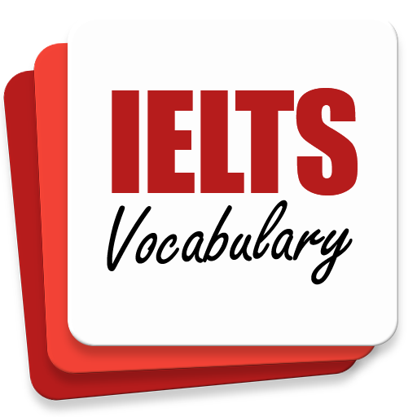



Why this study?
IELTS - vocabulary - AI - Personalized learning
Research Gap
Notes:
Research Gap: No comparative study exists on the effectiveness of Gemini, ChatGPT, and NotebookLM for IELTS vocabulary instruction

Slide 4
Research Questions
What are the comparative strengths and weaknesses of Gemini, ChatGPT, and NotebookLM in addressing common IELTS vocabulary challenges in terms of their features, functionalities, accuracy, adaptability, and user interface?
How do these AI tools facilitate learner autonomy and personalized learning paths within IELTS preparation contexts?

Slide 5
Theoretical Foundation
Vocabulary
Nation's (2001) four strands for effective learning (input, output, learning, fluency)
Learning Theory
Constructivism (Vygotsky, 1978) emphasizes learners actively building knowledge, supported by AI's personalized scaffolding
Learner Autonomy
Holec’s (1981) concept of learner autonomy has become relevant with modern digital tools like AI

Slide 6
METHODOLOGY
Research Design & Context
Teacher
Researcher
Qualitative Reflective Practice
Who
25 highschoolers (4.0-5.0 IELTS course)
Where
A private language center in Hanoi

Slide 7
METHODOLOGY
Classroom Observation Logs
real-time notes on student engagement and tool performance
Student Feedback
Informal discussions and structured reflection questions
Student-Created Materials
Quizzes, stories, etc., created with the AI tools
Data Collection & Analysis
Tool Familiarization
Active Implementation
Creative Application
Weeks 9-12
Weeks 5-8
Weeks 1-4
Data analysis: systematic & comparative
Functionality
Accuracy
User Experience

Slide 8
RESULTS
Overview of key findings
Time saving
Critical Literacy
Strategic Use

Slide 9
Comparative Analysis
Strengths & Weaknesses
Gemini vs. ChatGPT vs. NotebookLM

Slide 10
 | ChatGPT | Gemini | NotebookLM
Functionality & Features | Strong for comprehensive examples, nuanced synonyms, and systematic error correction. | Great for visual contextualization and organizing data into spreadsheets. | Unique for document-based analysis and contextual relevance.
Accuracy & Adaptability | Consistently high accuracy and superior adaptability to different proficiency levels. | Significant accuracy issues (e.g., "hallucinating" words) but offers valuable visual features. | Moderate accuracy; great for content within documents but limited outside of them.
User Experience & Autonomy | Intuitive, conversational interface. | Excellent integration with Google ecosystem and offers collaborative editing. | Steeper learning curve, but fosters ownership and is great for self-directed document analysis.
Example: https://docs.google.com/document/d/1ni4vB-nGDbabkwrAUzgFdLqHPjud1I8tyEs7dsiKVdM/edit?tab=t.0

Slide 11
Discussion: Key Interpretations
Beyond "Is It Effective?"

Slide 12
No single “best” tool
Learner Autonomy
ChatGPT: conversational learning autonomy
Gemini: organizational autonomy
NotebookLM: research autonomy
Accuracy: non-negotiable
Functionality vs. Reliability: e.g. Gemini’s trade-off (Spreadsheet export vs. hallucinations)
Subjectivity: instructor + researcher
Sample size: 25
Limited focus: 3 AI tools
Timeframe: 3 months
Rapidly Evolving Field
Limitation

Slide 13
Implications
IELTS Instructors: multi-tool strategy + AI literacy skills (verification, prompt engineering) alongside content
Curriculum Designers: strategic tool selection and critical AI evaluation
Educational Administrators: accuracy and pedagogical alignment in robust teacher training
Future Research:
  Longitudinal studies to see long-term effects
  AI for other language skills
  ethical considerations and academic integrity
Practical Implications & Future Research:
What's Next for Educators & Researchers?

Slide 14
Q & A

Slide 15


Cao Van Anh: anh.cao01@haui.edu.vn

