Slide 1
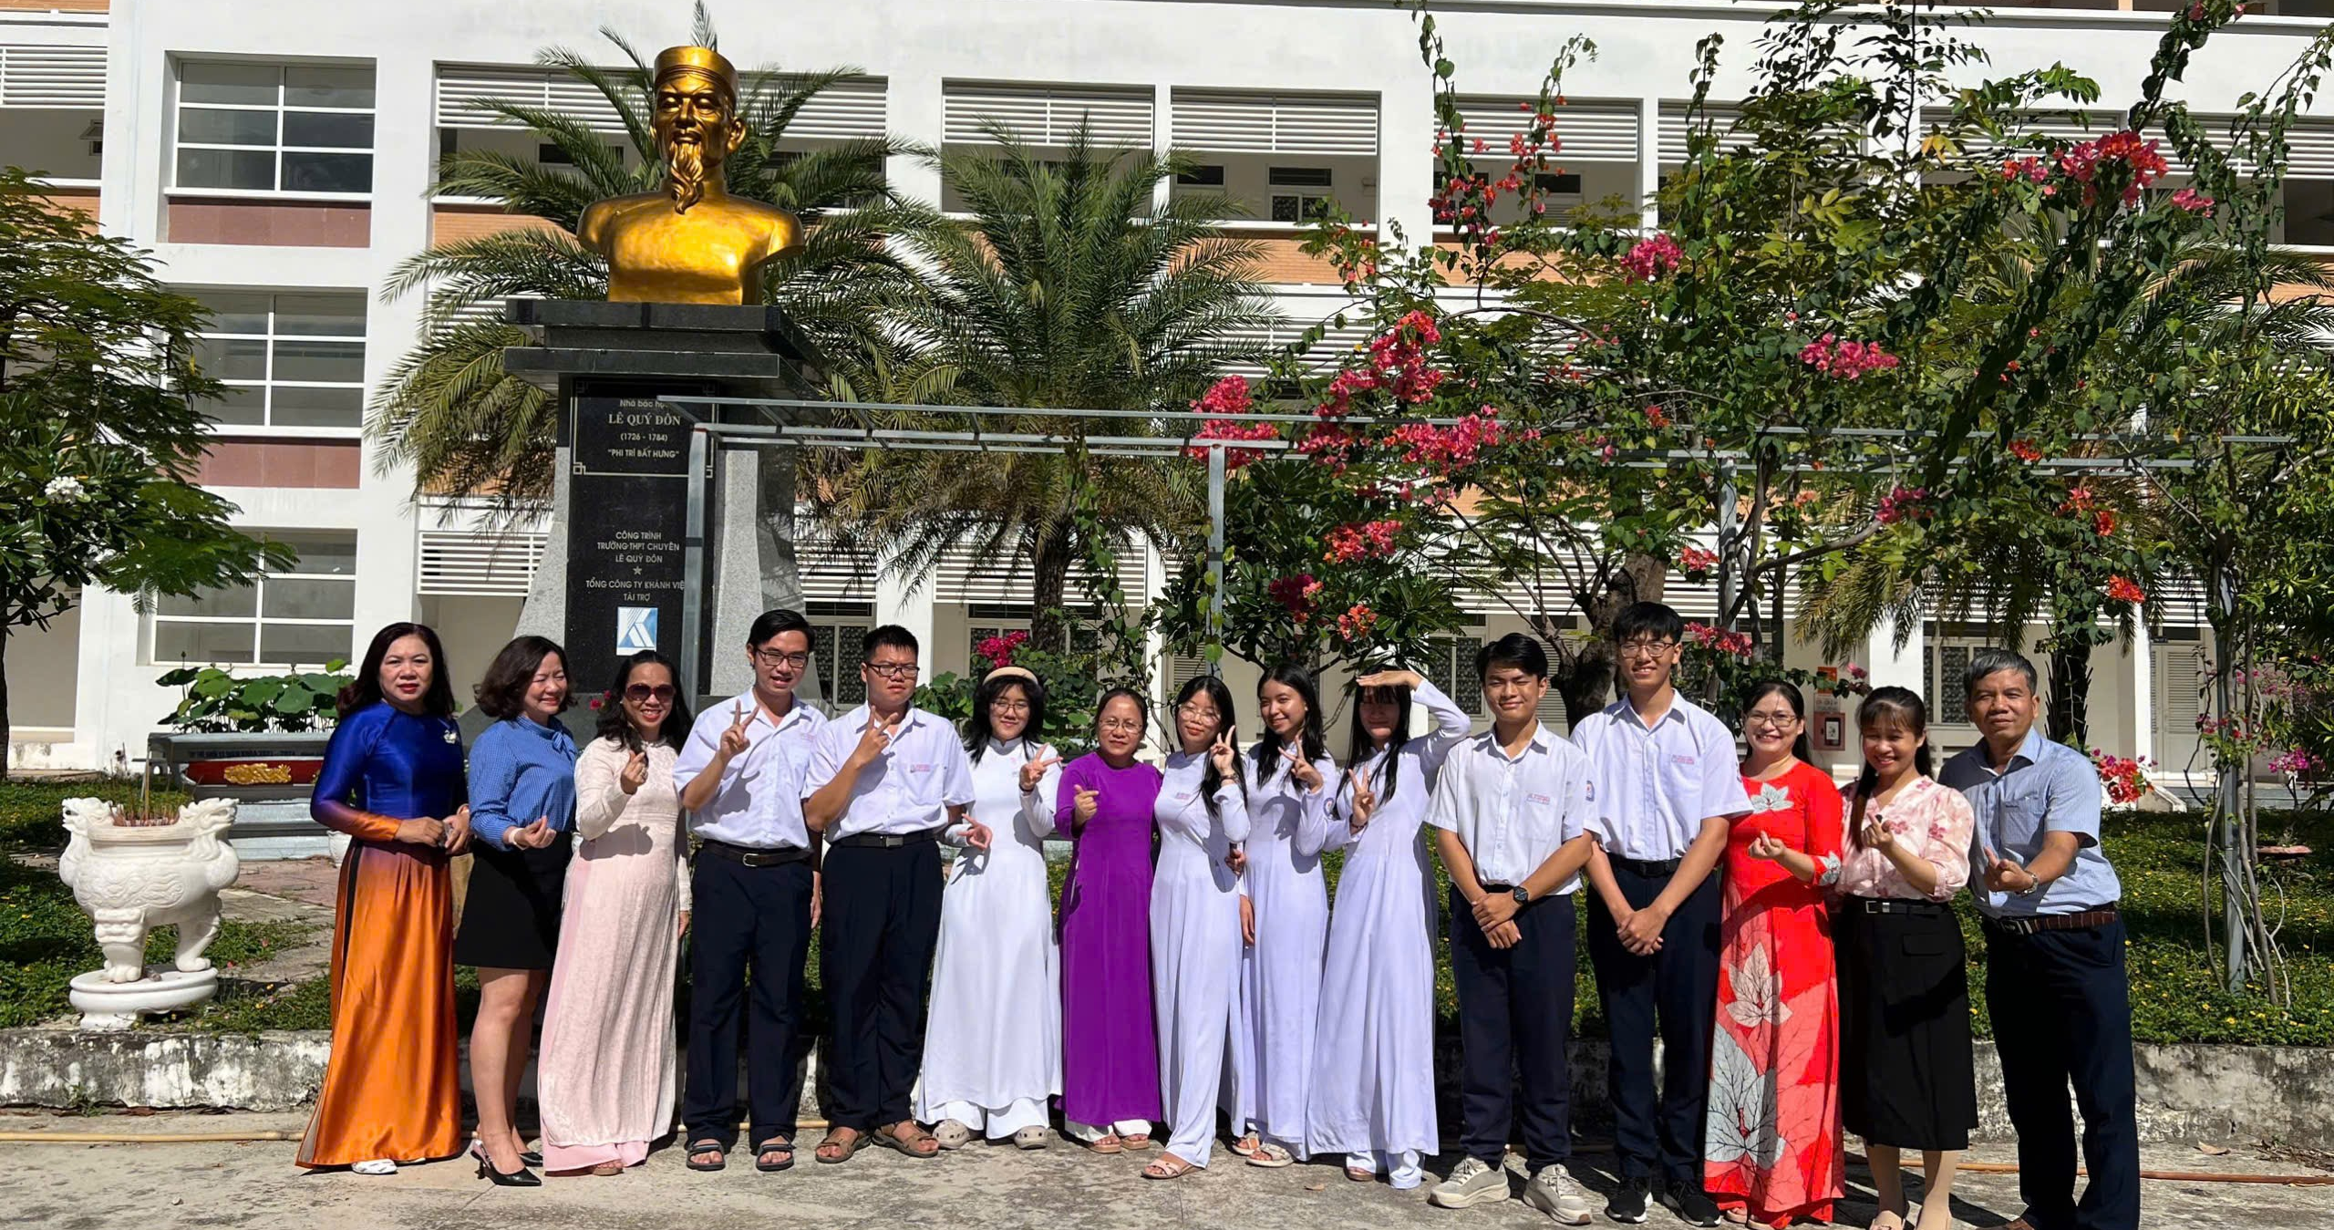

Slide 2
ME

Slide 3
Khanh Hoa’s NEC (National English Competition) Team | 2024 - 2025

Slide 4



Slide 5
Redemption on NEC of schoolyear 2025 - 2026

Slide 6

Redemption on NEC of schoolyear 2025 - 2026

Slide 7


Slide 8
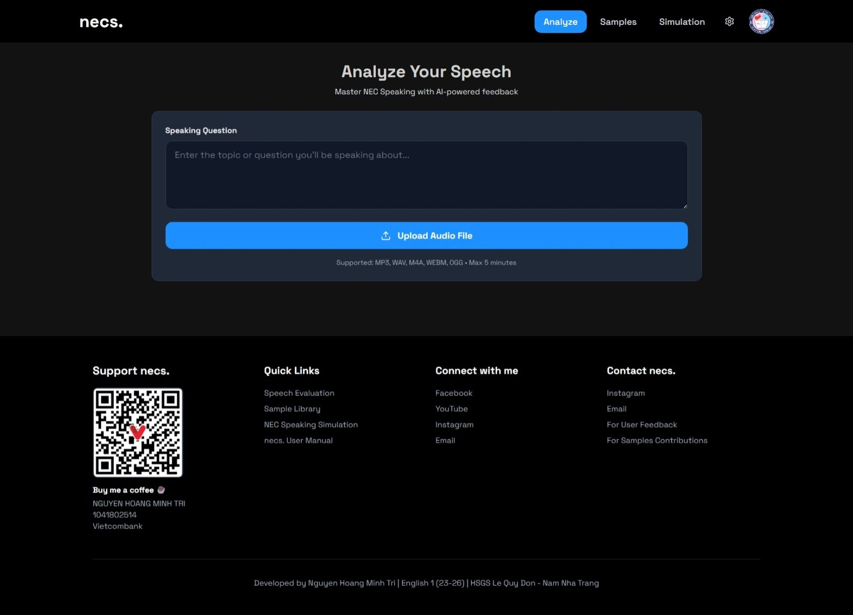
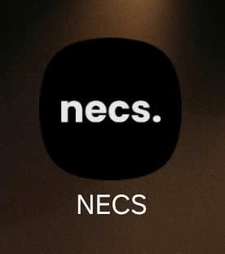
necspeaking.com

Slide 9
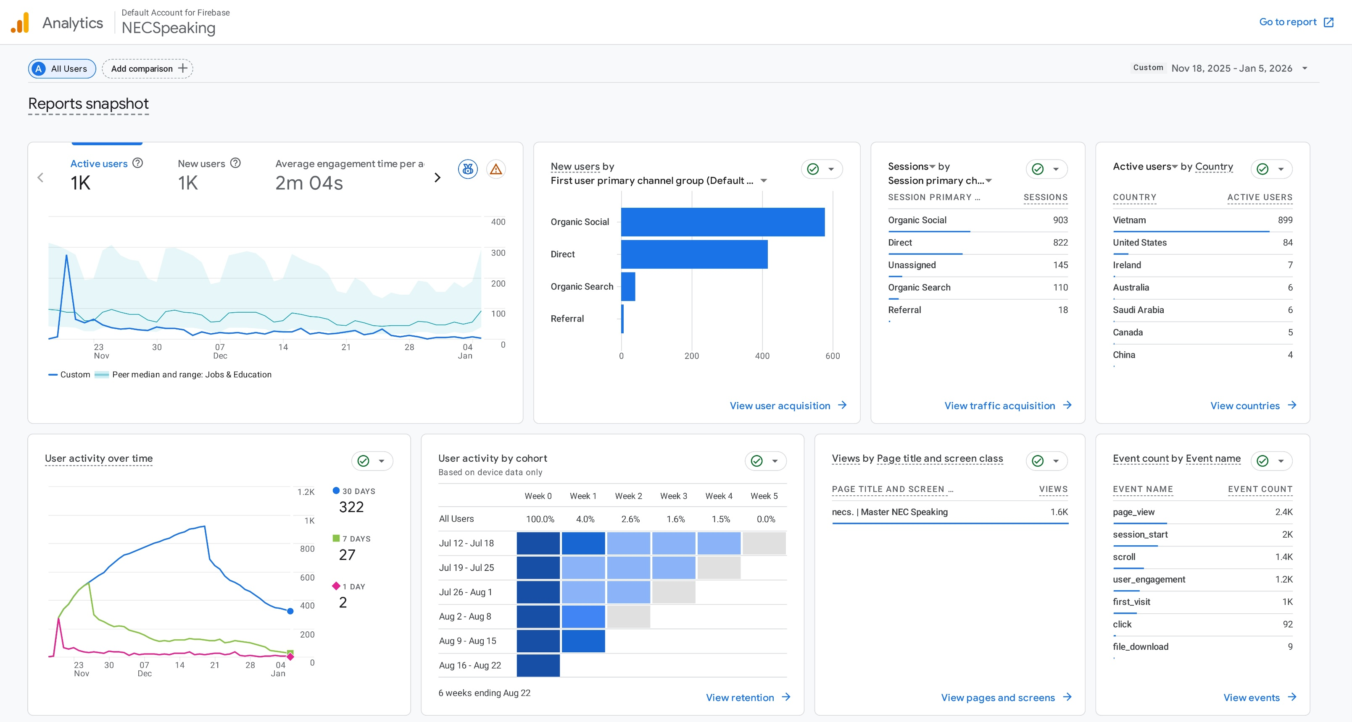

Slide 10


Slide 11



Teacher “Minh Tri”, specializing in…

Slide 12
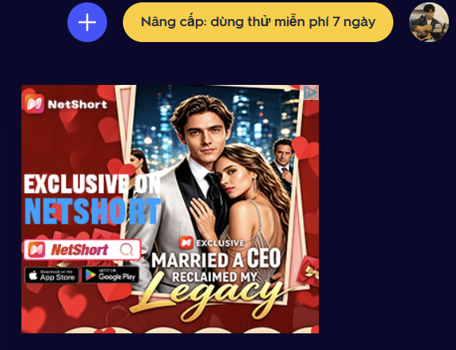
PAYWALLS
ADVERTISMENTS

Slide 13



Slide 14




Empowering Teachers to Create Educational Applications Through AI-Assisted Development

Slide 15
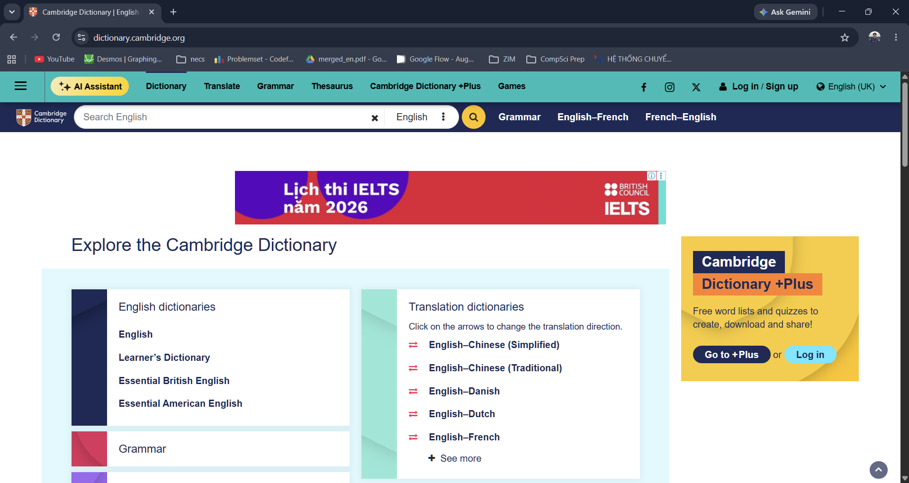
1. What is an HTML file?
Online functions
Offline functions

Slide 16
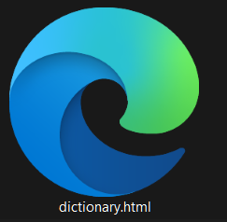
1. What is an HTML file?
Remove all online functions

Slide 17



2. The benefits
Normal Website

Slide 18
2. The benefits
HTML files
Runs locally
=> Can be used offline & shared like a file
Free third-party hosting
=> Prevent us from malfunctions

Slide 19
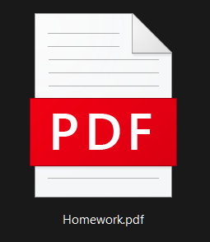
3. The application – For students

Slide 20
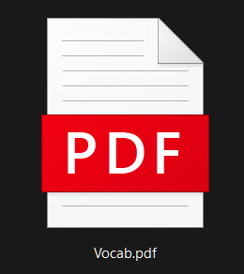
3. The application – For students

Slide 21
3. The application – For teachers
Education: Do you think schools should focus more on practical skills or academic knowledge?
Technology: How has technology changed the way people communicate with each other?
Work: Why do some people choose to work for large companies while others prefer small businesses?
Environment: What can governments do to encourage people to live in a more environmentally friendly way?
Travel: Why do you think international tourism has become so popular?
Children: Should parents allow their children to make their own decisions from a young age?
Social Media: Do you think social media has had a positive or negative impact on society?
Cities: What are the main problems that people face when living in large cities?
Money: Do you think people today are more concerned about money than people in the past?

Slide 22
3. The application – For teachers

Slide 23
3. The application – For teachers

Slide 24
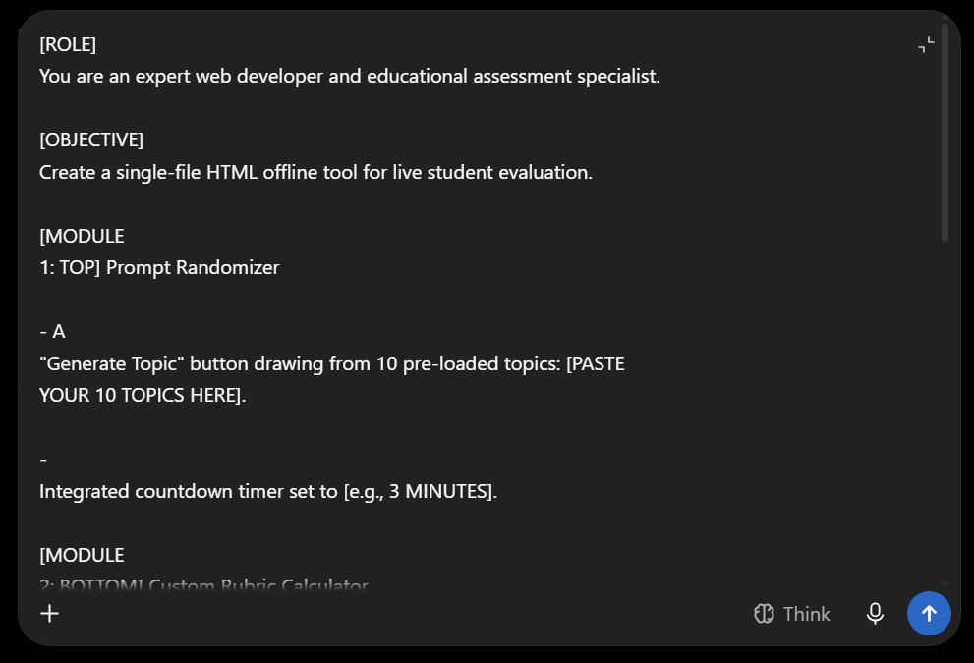
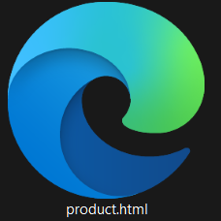
The four-step guide
Customize & Generate
Save

Slide 25
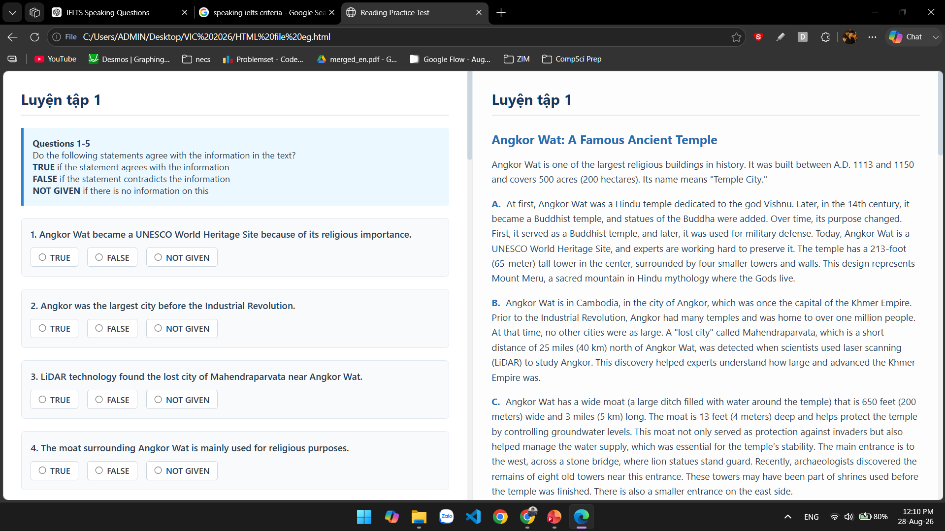
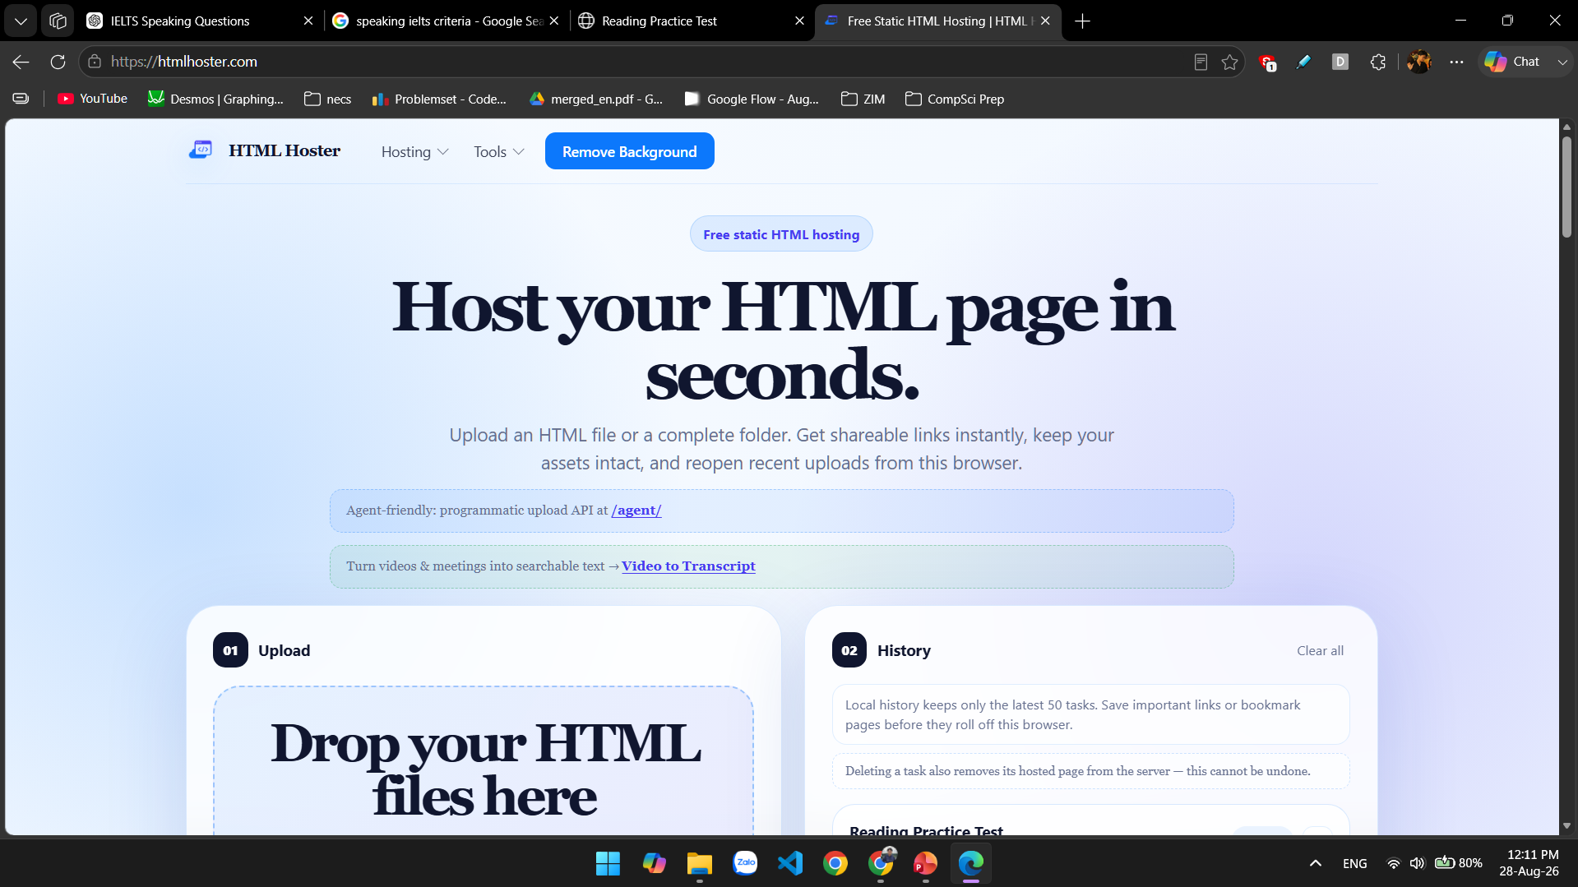
The four-step guide
Run
Host

Slide 26
What’s next?

Slide 27
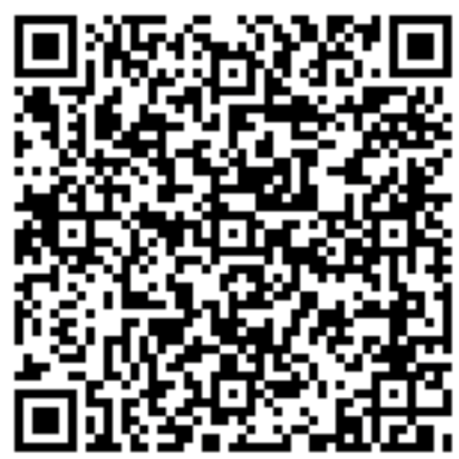
A little gift for my audience

