Slide 1




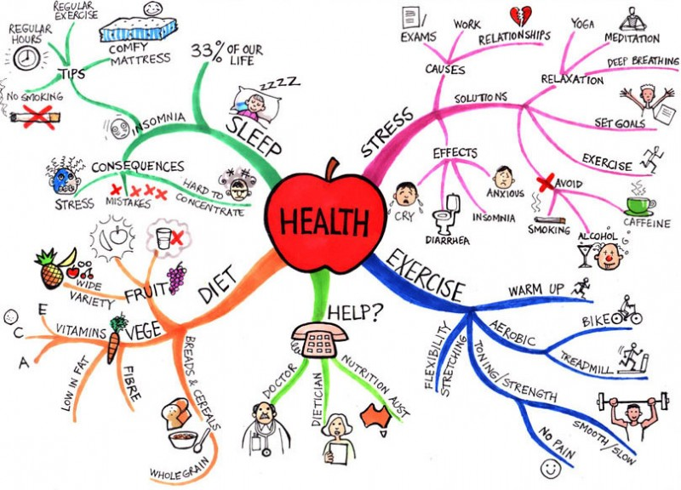
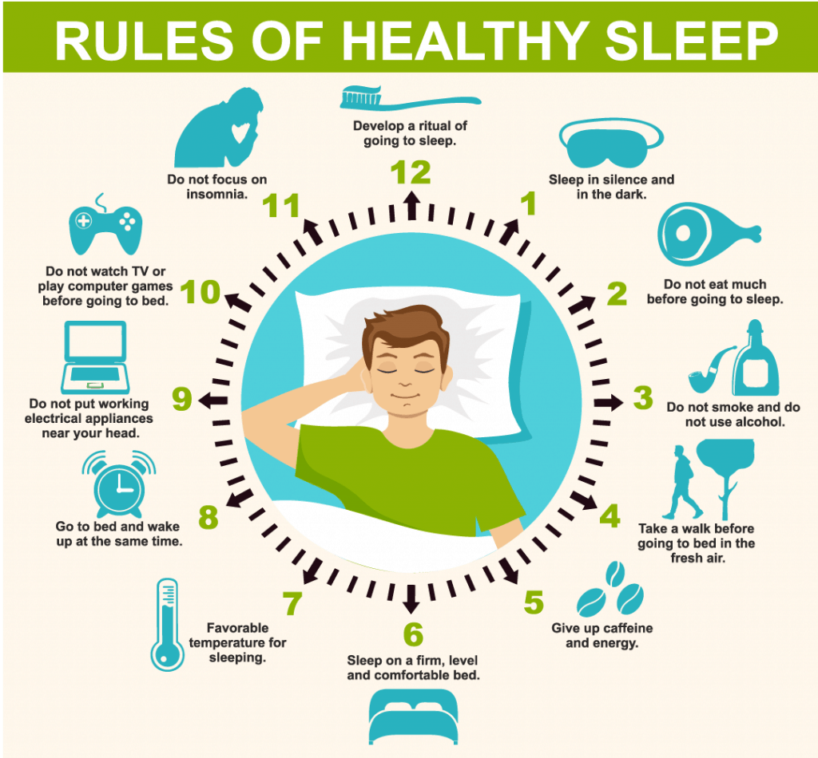
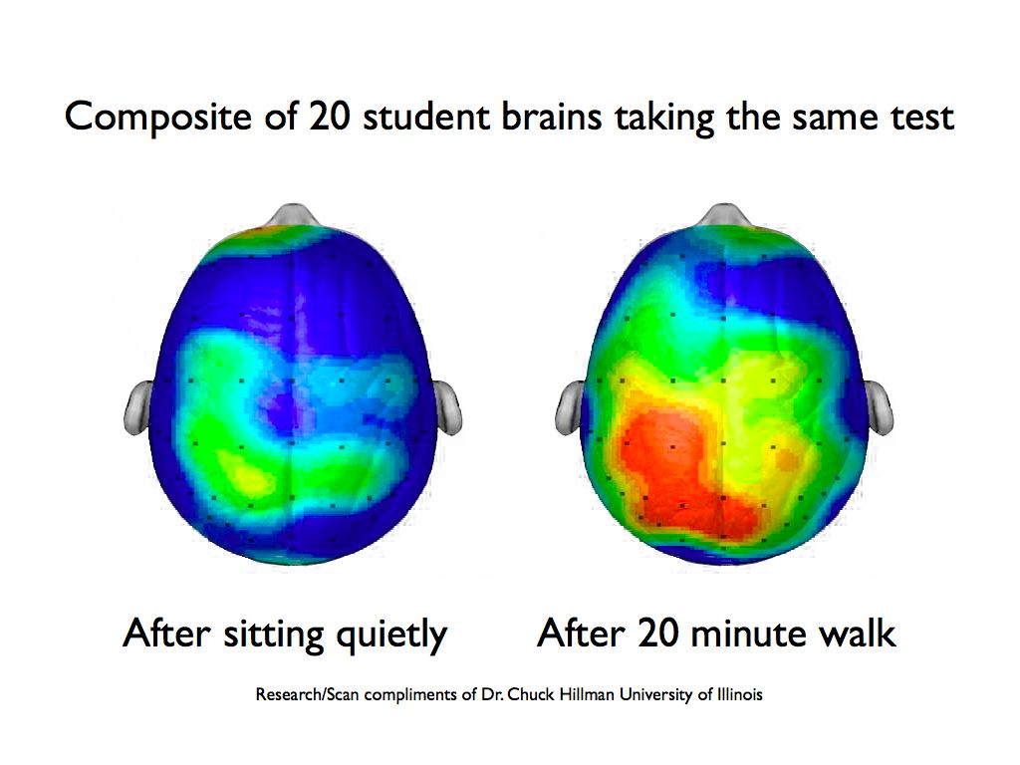
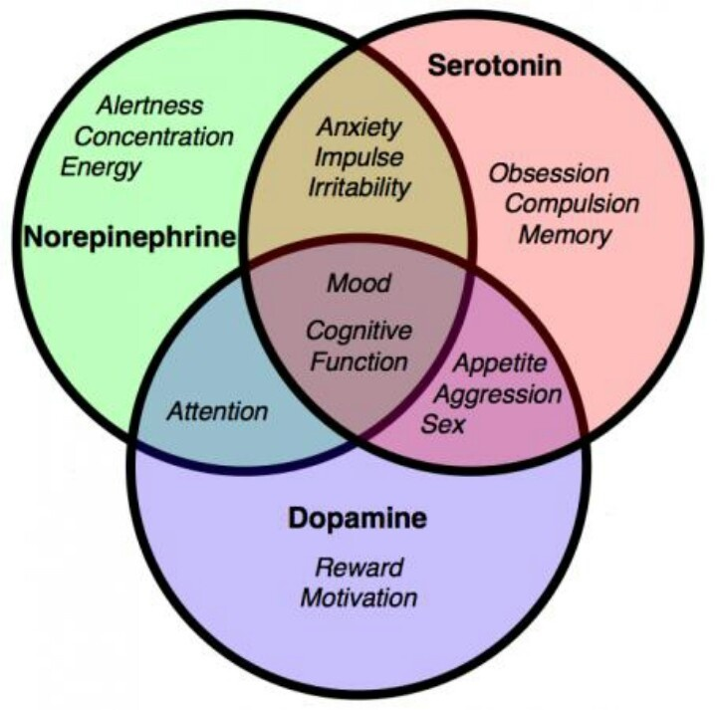


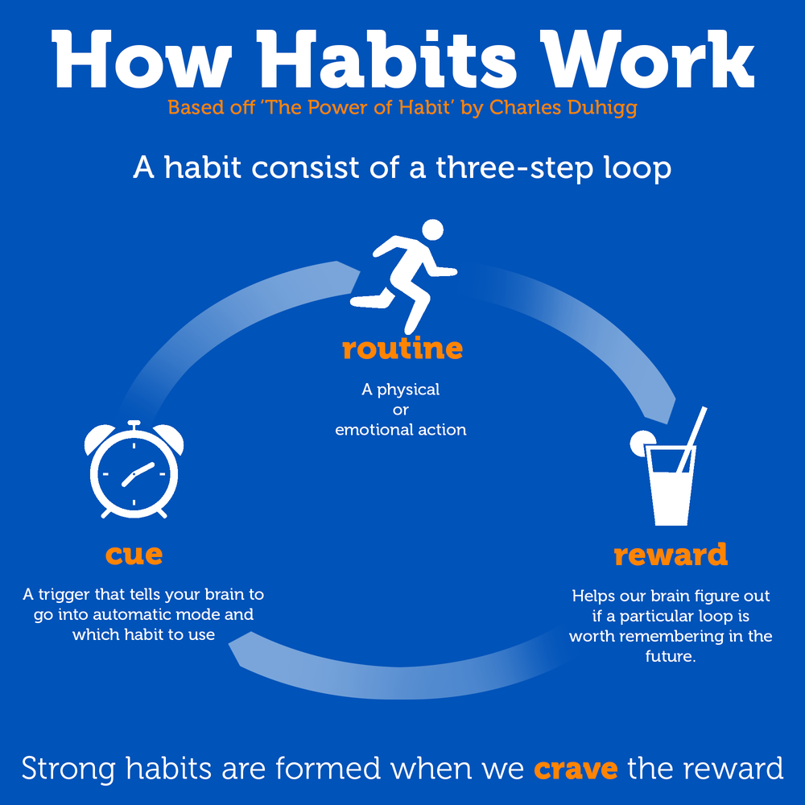

Both students and teachers are often unaware of the highly significant and interrelated mind-body connection, which plays a pivotal role in the effectiveness of learning and overall health. In typical classrooms, students often exhibit signs of self-defeating lifestyle-related habits that can inhibit learning, memory, and long-term goal achievement. For example, online and social media addictions often create sleep-deprived students who are less likely to effectively pay attention and remember, thus reducing learning potential. Through various communicative classroom tasks and activities, teachers can simultaneously gain content knowledge, raise awareness and provide engaging opportunities for discussion and reflection via topics such as making and breaking habits, sleep, exercise, intermittent movement, nutrition, hydration, understanding stress, and time management.
The principle research method includes Classroom Action Research undertaken by observation, written feedback, course content summaries and reflection reports. This presentation aims to briefly outline and engage participants with content implemented in various university contexts, fine-tuned over the past twenty years. It is anticipated that attendees will have at their disposal simple methods that can be briefly and easily implemented in their teaching contexts and become aware of specific and beneficial lifestyle-related content.
*Start here
Which areas do you need to pay most attention to?
(4)
(1) (2) (3)
Sleep
*The brain is more active when we are sleeping and is critical for memory consolidation, attention, focus and many other important factors that support a healthy body.
*Go to sleep and wake up at the same time every day, even on weekends. * Avoid screen time at least one hour before bed * Expose yourself to early morning sunlight. Refer to (1)
Exercise and Intermittent Movement
* Exercise supports attention spans, motivation, rate of learning, concentration, alertness. * Enables survival and creation of new brain cells. Refer to (2)
* The human body was designed for movement not stillness, and now we sit much longer than we used to which is creating various problems.
* The brain needs to be oxygenated, which is carried by the blood. *Exercise elevates and balances neurotransmitters, three main regulators - Refer to (3)
* Get up and move around a little at least hourly. * Excessive sitting is linked to premature death and disease.
Nutrition
Problems *Chemical imbalances. *Cycles of high and low crashes of attention. * Excessive sugar and highly processed foods reduce attention, and memory.
* Gut-Brain Axis- is the two-way communication between your gut and brain. *Microbiome bacteria is imbalanced by sugar which impacts neurotransmitters
* Consume a variety of fermented foods * Choose healthy fats and consider that different foods effect people differently based on DNA and genetic response
Optimal Hydration
* Promotes neural signals & overall healthy brain function. *With only 2% dehydration- brain performance & processing capacity is reduced.
* Moist lungs enable circulation of nutrients and oxygen to the bloodstream & brain, supporting information processing. * Foods also contain various amounts of water.
*Drink water when you wake up and sipping gradually throughout the day is best. *Everyone has different optimal water requirements, drink when you feel thirsty.
Understanding Stress
Stress is your reaction to stressors: our reaction to life events and can be external or internal. *Stress is not the problem our perceptions of events is.
*Changing our minds is more important than reducing the number of stressors. * Stressors are challenging instigators for growth, survival and high performance and are also culprits in breaking down the mind-body. *Prolonged stress carries excessive allostatic load is destructive to various systems including the brain.
* Supportive environments, our tribe, reduces inflammation, boosts immune function. *Chronic stress and cortisol can then affect, sleep, appetite, mood, exhaustion, adrenal fatigue, and increase fat storage. *De-stressors: Healthy Lifestyle- diet, nutrition, exercise.
Habits
Are you aware of both your positive (keystone habit) and negative habits? Our daily actions operate on a neurlogical feed back loop. For change to take place the CUE and the REWARD stay the same, while the ROUTINE should change as necessary. Strong CRAVINGS drive the whole loop. For example, change the reward from unhealthy snacks to nutritious fruit, gradually increasing the frequency. * Which current habit do you need to modify or replace?
Habit Shift Approaches: Tiny Habits & Implementation Intentions
(1) Take a behavior you want, make it tiny, find where it fits naturally in your life. Initiate a brief habit ➔30 seconds to create momentum for greater changes A.B.C
Anchor Moment “After I..” ➔ get to the kitchen Tiny Behavior “I will.”➔stretch and breathe for 20 seconds Celebration “I did it” “YES!”➔ double fist pump-YES! Dopamine
(2) Implementation Intentions- STEP 1 Select an Action-time-place →I will study English at 6pm on the bus (specific) Pair it with an existing habit- *After I write my to-do list for the day, I will immediately begin my first task.*When I see a set of stairs I will use them instead of the escalator. STEP 2 Creative. Attractive. Emotionally driven such as watching a movie while exercising STEP 3 Response. Easy in thought or action, less than two minutes STEP 4 what is immediately rewarded is repeated, use a habit tracker and never miss twice
Metacognition is thinking about your thinking- monitoring and guiding your own mental processes enabling you to understand how you learn, plan and solve problems.
Through awareness you can catch yourself and cognitively reframe the situation as it happens and intentionally alter your internal dialogue. This can be used for personal growth such as; learning new skills faster and breaking bad habits, student learning through self-regulation and subsequent tasks such as encouraging active learning.
Classroom Strategies and Tasks
*Include content that specifically reflects the negative physical and mental effects of (1) sedentary lifestyles, (2) lack of nutrition in most fast food and highly processed food (3) chronic sleep deprivation (4) social media addiction and excessive screen time. (5) positively highlight and discuss the effective health habits students already undertake
(6) Habits- initially focus on small changes as they are more likely to stick and can eventually become permanent
* Integrate the four skills * focus on awareness raising, not making students feel bad about themselves * student hand-raising survey approach* vary the task length *Short youtube videos ie. then a brief writing reflection about the content,* habit recognition writing activity, habit tracking app research and use, *writing- “Effects of my new habits”, “reducing screen time”, pairwork interviews, health related presentations, lifestyle journaling/diary, two-week sleep challenge (7 hours or more), Course content reflection and pair/group discussions
Student Feedback: I was really glad to hear so much about the health aspects related to learning skills. It made me realize once again how important it is to stay healthy in order to study effectively (Rena, 2025). Through the one-week sleep challenge I realized that getting more then seven hours is best for me. When I slept less than seven hours, I had trouble waking up in the morning and felt sleepy during afternoon lectures (2025, Anon.) General feedback: Improved length of sleep, elimination of game apps, writing to-do lists, integrating more movement throughout the day, increased exercise frequency etc.
References: Available upon request
Are you ready to make changes to your own life and more positively your influence students’ learning and health? Contact Steve, jugovic@sta.tenri-u.ac.jp
Lifestyle Choice Reflections: Tiny Habit Changes for Broad Teaching Impact
Steve Jugovic Associate Professor
Department of English and American Languages, Tenri University, Nara Japan
jugovic@sta.tenri-u.ac.jp

