Slide 1







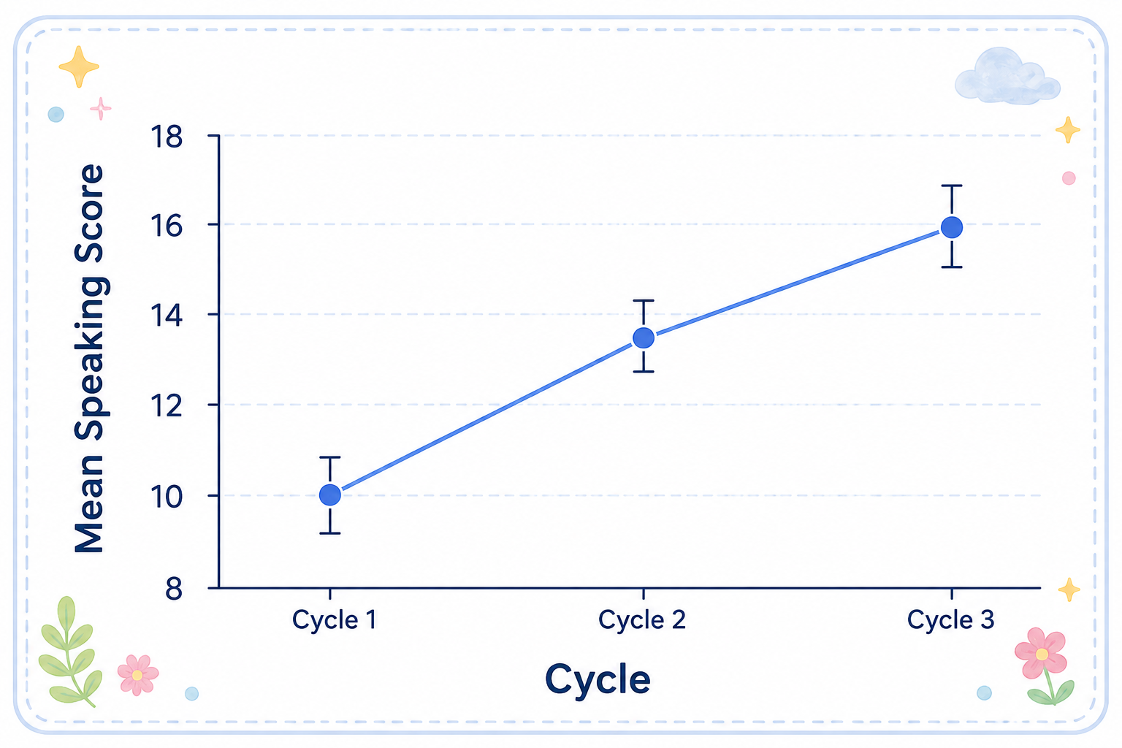





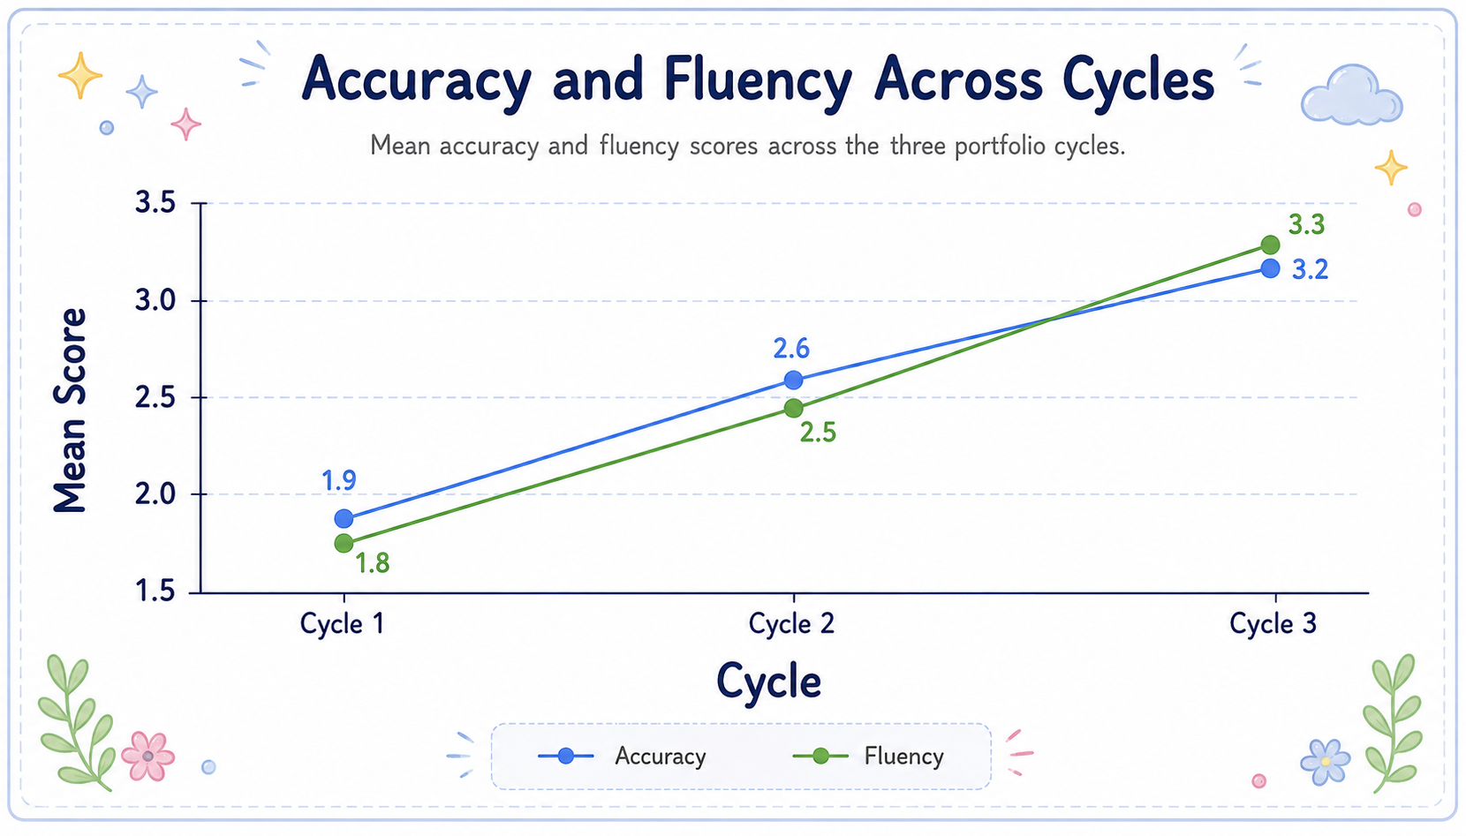



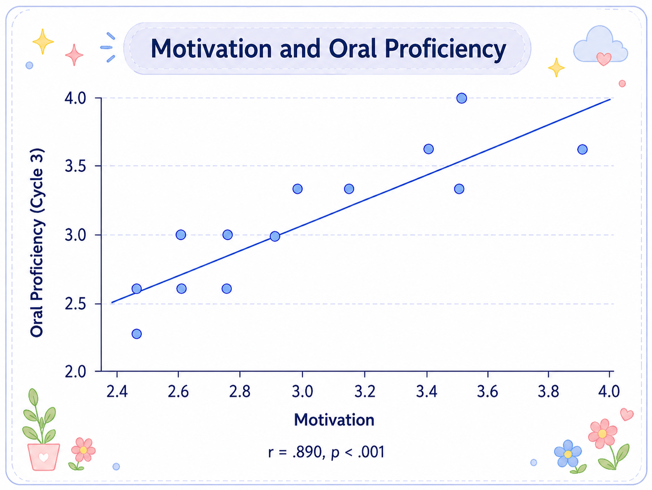


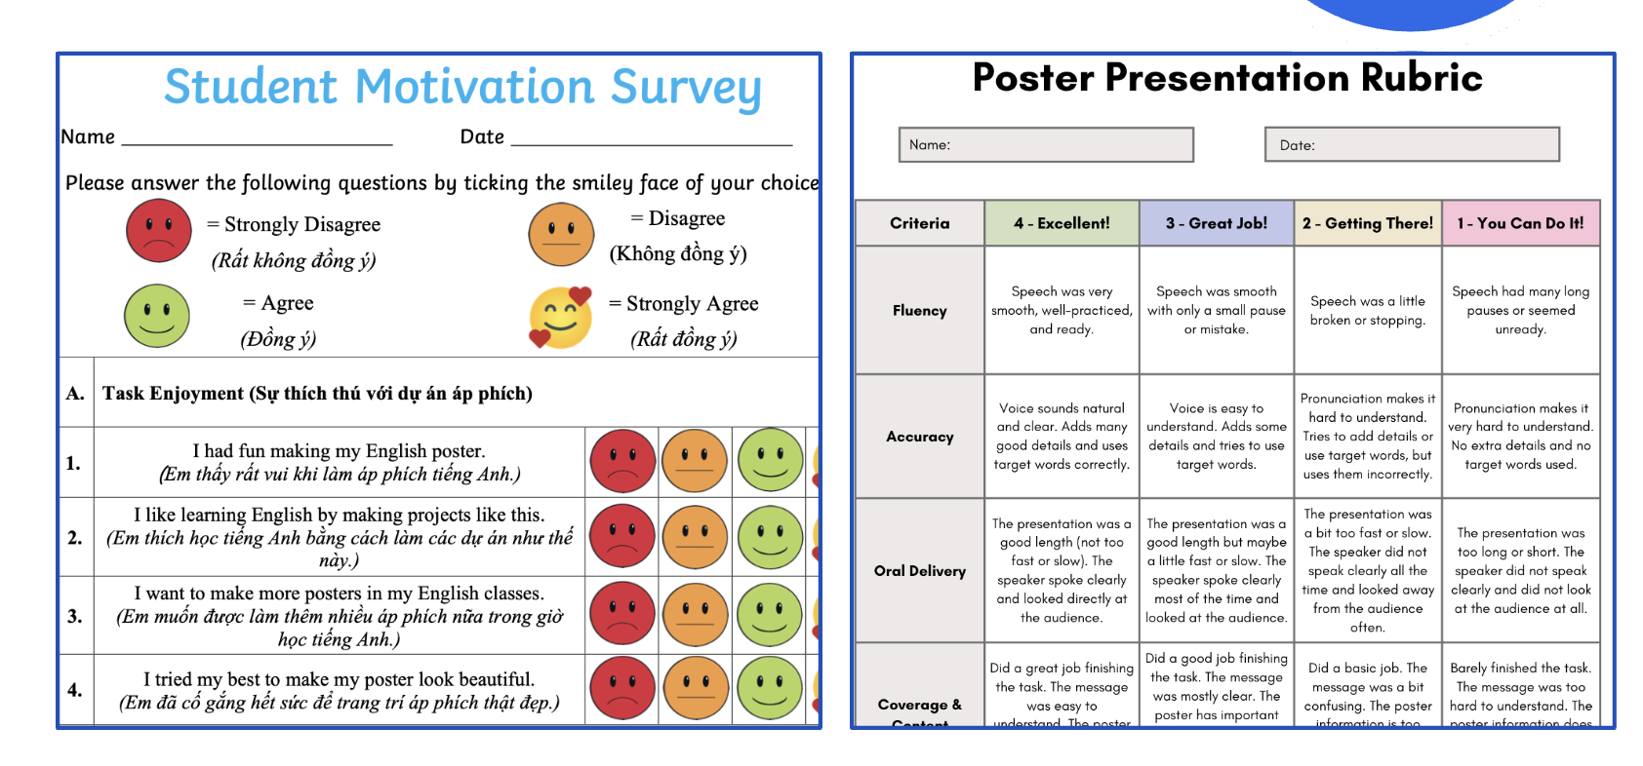



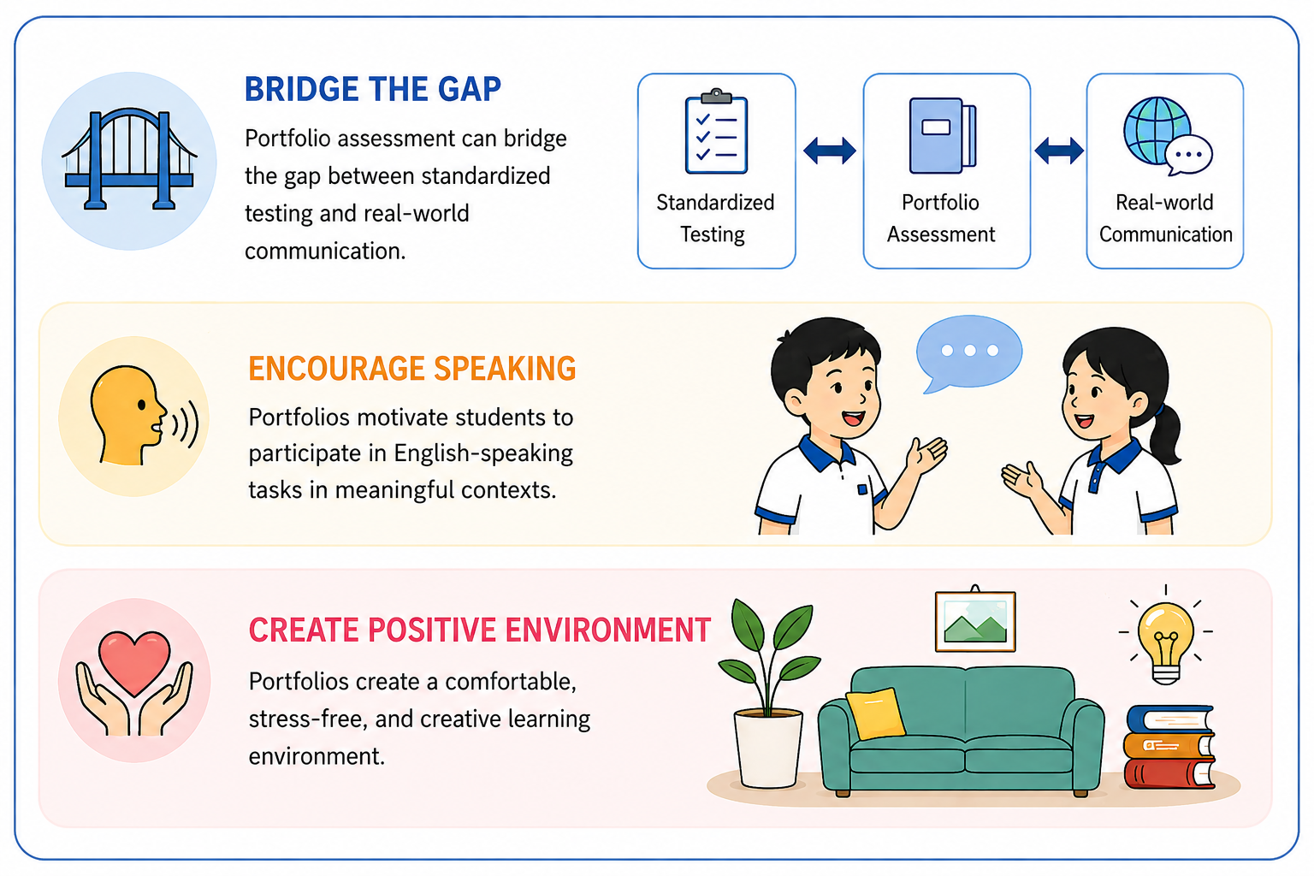




ID: 2670
1. INTRODUCTION
4. KEY FINDINGS
Background
Finding 1: Overall Speaking Performance
Communication competence is increasingly emphasized in English education in Vietnam.
Problem
High-stakes testing remains dominant, focusing mainly on writing, listening, and reading while neglecting speaking.
Aim
To investigate portfolio-based alternative assessment for developing speaking competence in real-life contexts while encouraging motivation.
Speaking performance increased significantly across the three portfolio cycles, F(2, 52) = 142.10, p < .001.
2. RESEARCH QUESTIONS
Finding 2: Accuracy & Fluency
How does portfolio-based assessment influence students’ speaking performance?
What is the relationship between students’ motivation and oral proficiency?
3. METHODOLOGY
Both accuracy and fluency improved significantly across the three cycles (ps < .001).
Participants
27 students at Kim Dong Primary School in Ho Chi Minh City
Design
Classroom-based research
Intervention
3 poster-and-presentation cycles
Finding 3: Motivation & Oral Proficiency
Data Collection
Data Analysis
4-point analytic rubric
Smiley-face motivation survey
Descriptive statistics
Repeated measures ANOVA
Pearson correlation
Students’ motivation was strongly and positively associated with Cycle 3 oral proficiency (r = .890, p < .001).
5. CONCLUSION
Three Portfolio Cycles
Cycle 1
Cycle 2
Cycle 3
Portfolio task were poster-making and oral presentation in real-life contexts.
6. REFERENCES
Gardner, R. C. (2010). Motivation and second language acquisition: The socio-educational model. Peter Lang.
Genesee, F., & Upshur, J. A. (1996). Classroom-based evaluation in second language education. Cambridge University Press.
Hamayan, E. V. (1995). Approaches to alternative assessment. Annual Review of Applied Linguistics, 15, 212–226.
Brown, H. D. (2004). Language assessment: Principles and classroom practices. Pearson Education.
Brown, J. D., & Hudson, T. (1998). The alternatives in language assessment. TESOL Quarterly, 32(4), 653–675.
Demirel, M., & Duman, H. (2015). The use of portfolio in English language teaching and its effects on achievement and attitude. Procedia - Social and Behavioral Sciences, 191, 2634–2640.

