Slide 1

FROM ENGLISH LEARNING TO DISCIPLINARY KNOWLEDGE
CO-CONSTRUCTION IN VIETNAMESE HIGHER EDUCATION
PHẠM THỊ THANH THÙY – neu vn

Slide 2
TODAY… A BIG SHIFT…
Institutions → rethink their role,
Educators → redesign pedagogy,
Students → passive learning → active participation.

Slide 3
THEORETICAL FRAMEWORK
• Human Capital Theory (Becker, 1993)
→ English proficiency functions as a form of human capital that improves employability, productivity, international mobility, and participation in the global labor market.
• Linguistic Capital Theory (Bourdieu, 1991)
→ English is not merely a communication tool, but a form of symbolic and economic capital associated with academic prestige, professional opportunities, and social mobility.
• Cognitive Load Theory (Sweller, 1988)
→ Students entering ESP/EMI classrooms without prior disciplinary language preparation often experience excessive cognitive overload because they must process both subject content and unfamiliar academic English simultaneously.
* Self-determination theory of Deci và Ryan, (2000)
* Self-regulated Learning Theory of Barry Zimmerman (2002)

Slide 4
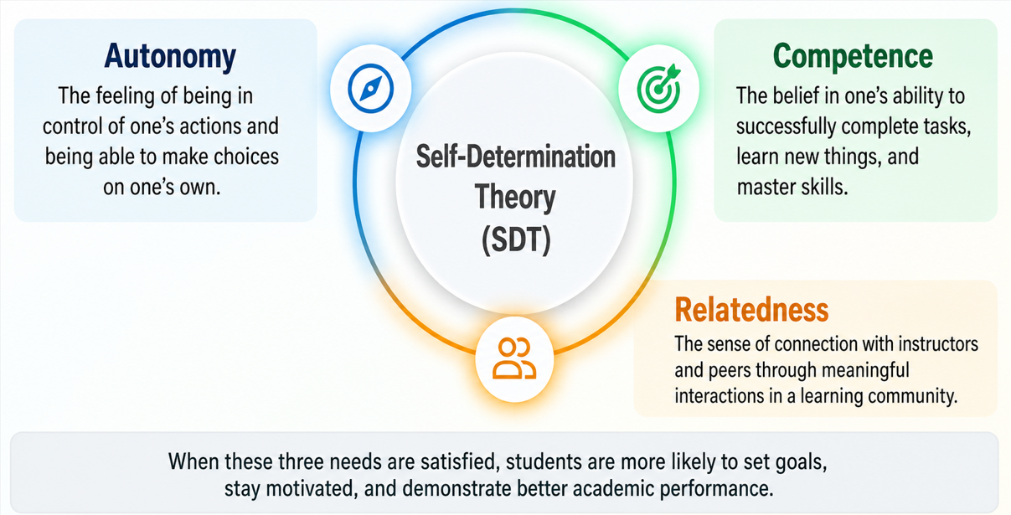
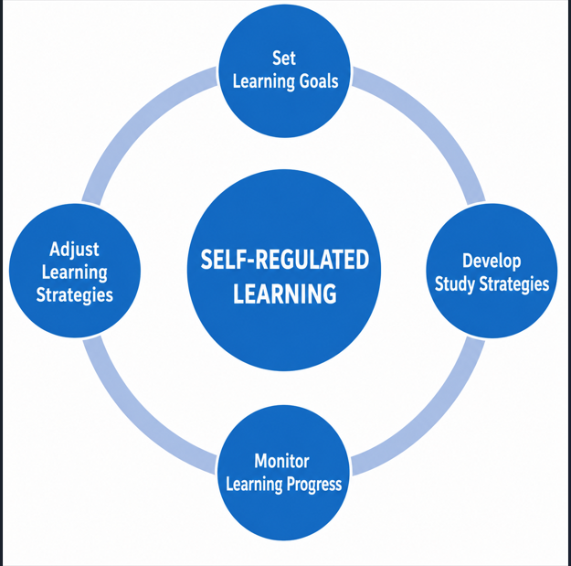
Self-determination theory of Deci và Ryan, (2000) Self-regulated Theory of Zimmerman (2002)

Slide 5
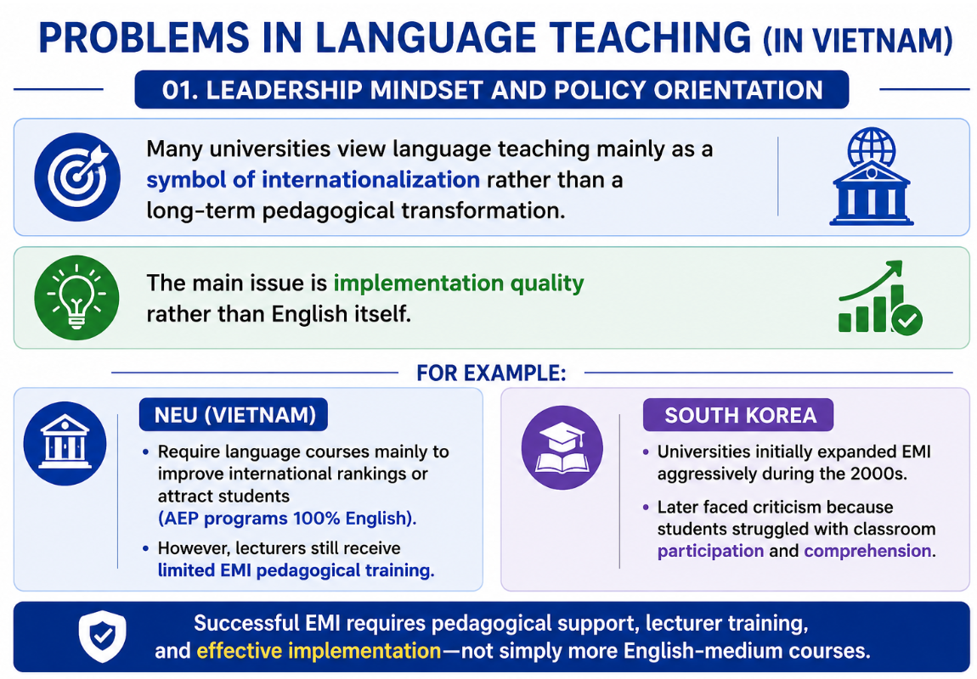

Slide 6
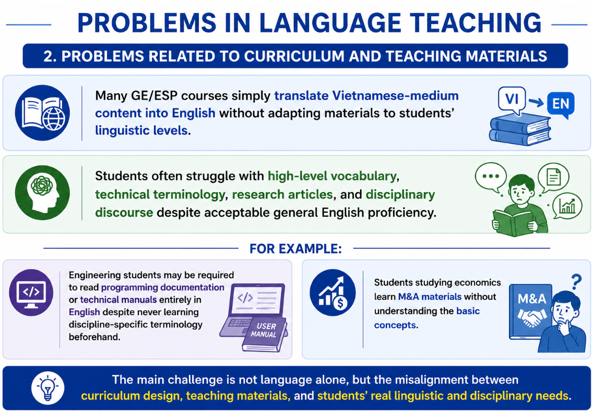

Slide 7
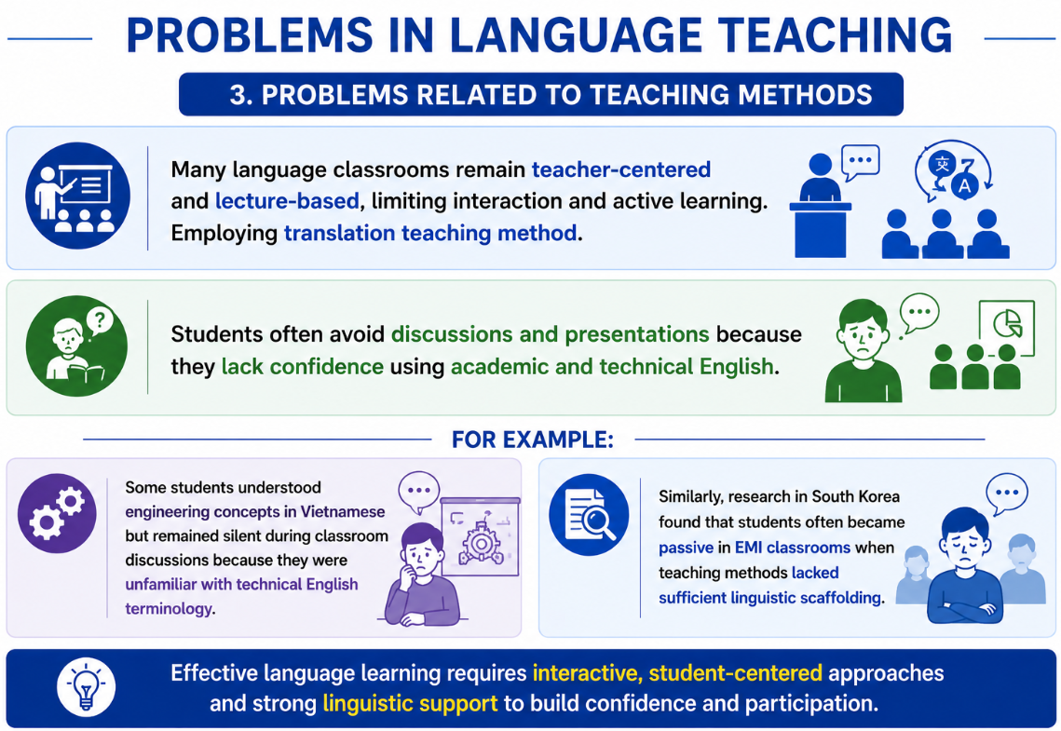

Slide 8
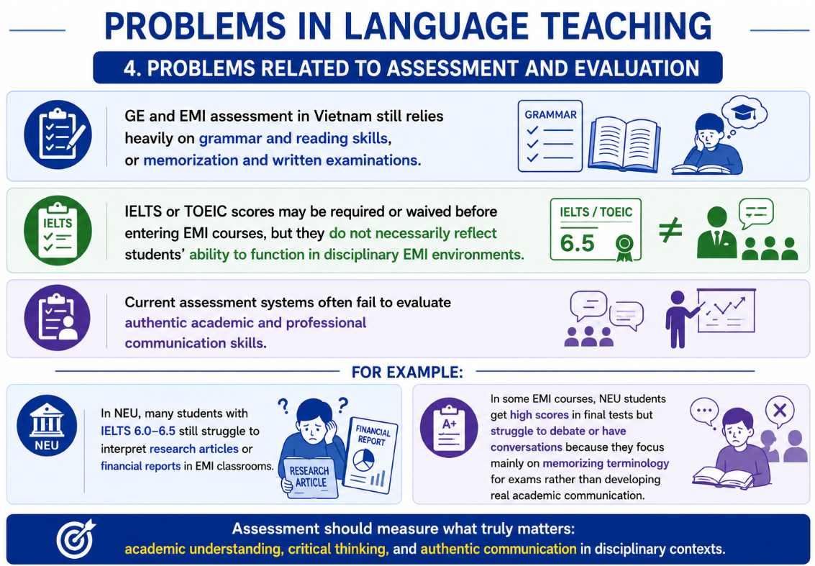

Slide 9
NEU – MAIN CHALLENGES
The Problem is not simply language proficiency.
→ The problem is the disconnect between language learning and knowledge production.
The Problem is in the face of a structural limitation:
→ English is learned, … but not fully used as a tool for thinking, questioning, and constructing knowledge.

Slide 10
NEU – CURRENT CHALLENGES (More Details)
1. Lack of Systematic Integration Between ESP and EMI
ESP courses are often separated from disciplinary curricula instead of functioning as preparation for EMI.
Students entering EMI without ESP preparation frequently experience cognitive overload and passive participation.

Slide 11
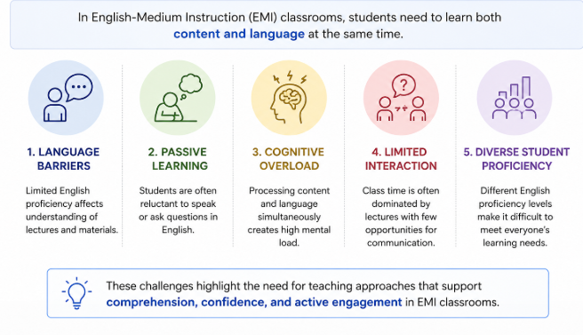
NEU – CURRENT CHALLENGES
2. Dual requirements in EMI teaching

Slide 12
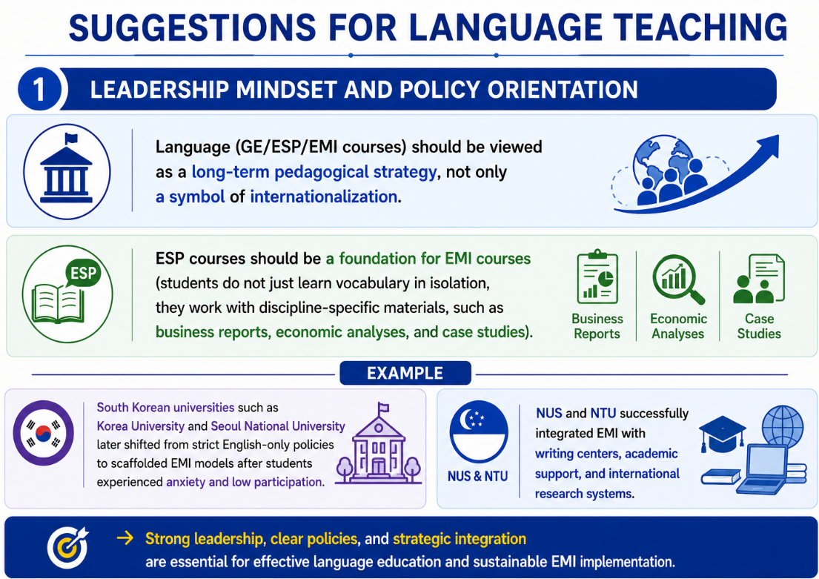

Slide 13
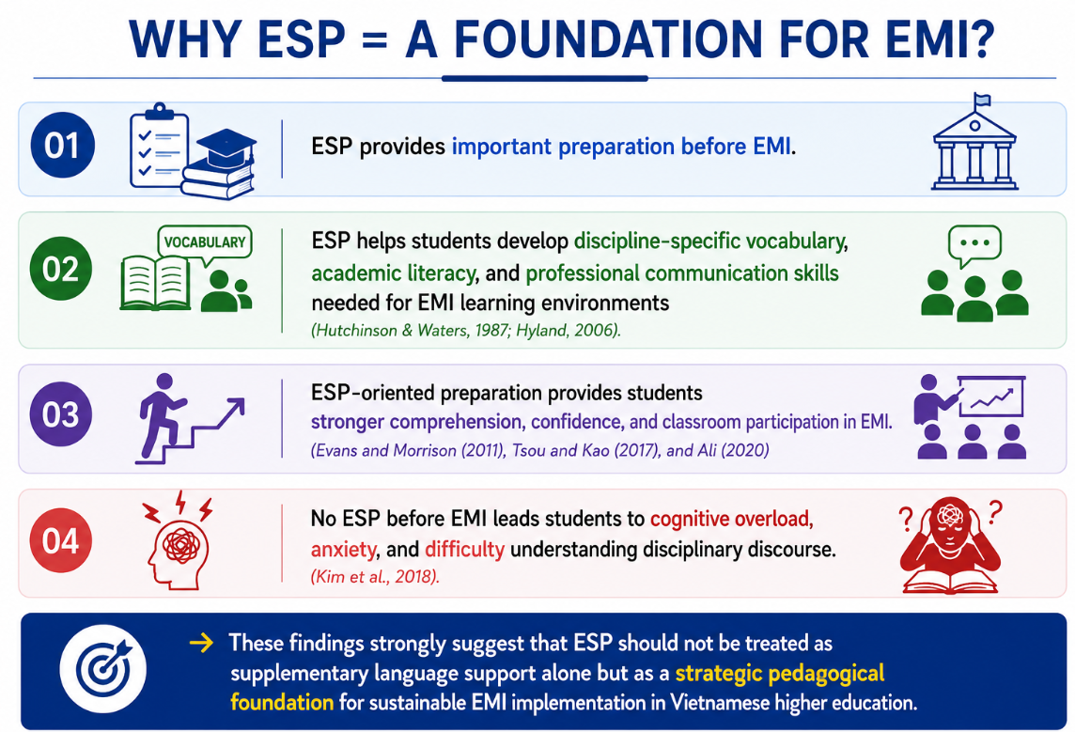

Slide 14
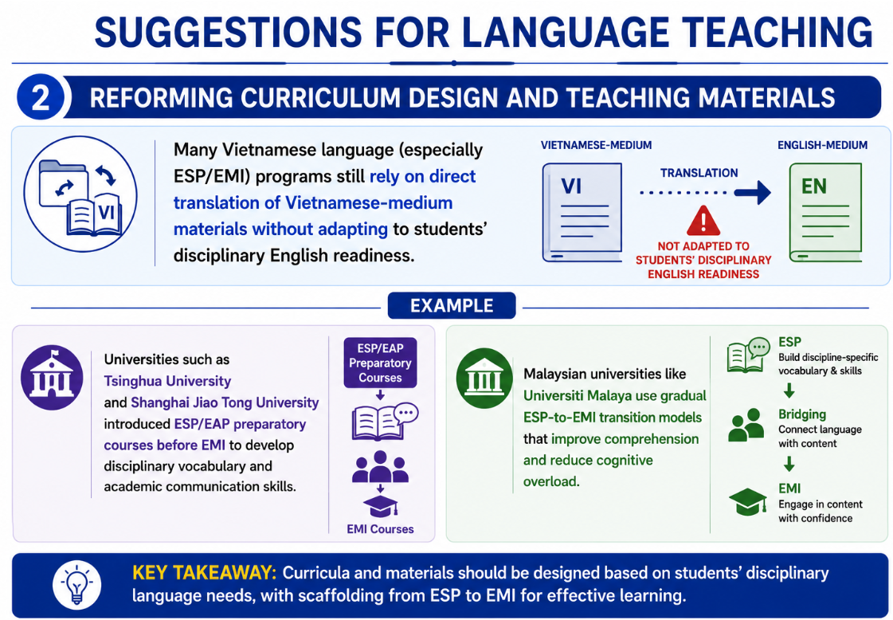

Slide 15
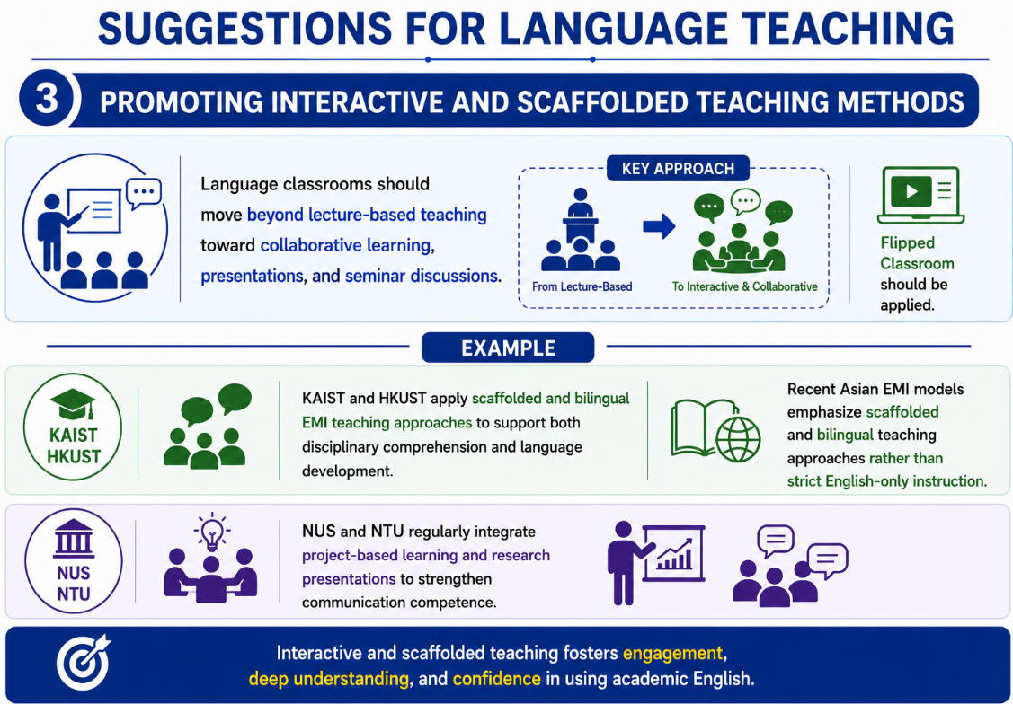

Slide 16
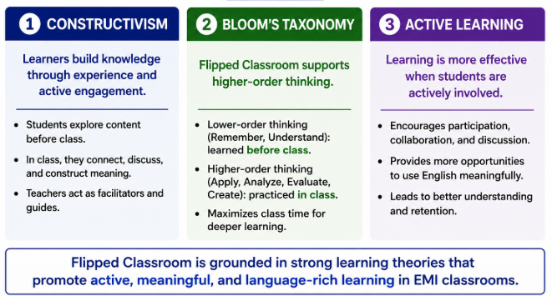
Why Flipped classroom? Theoretical Support

Slide 17
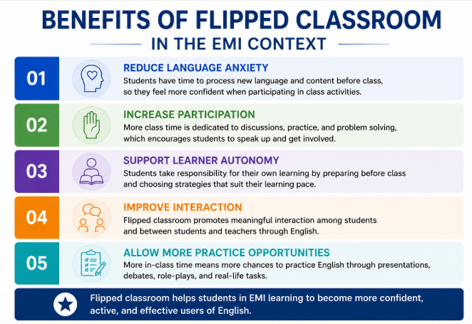

Slide 18
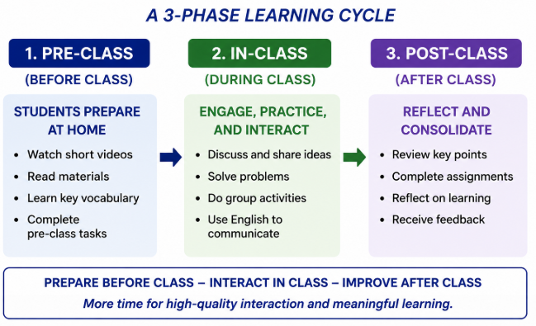
How Flipped Classroom Works

Slide 19
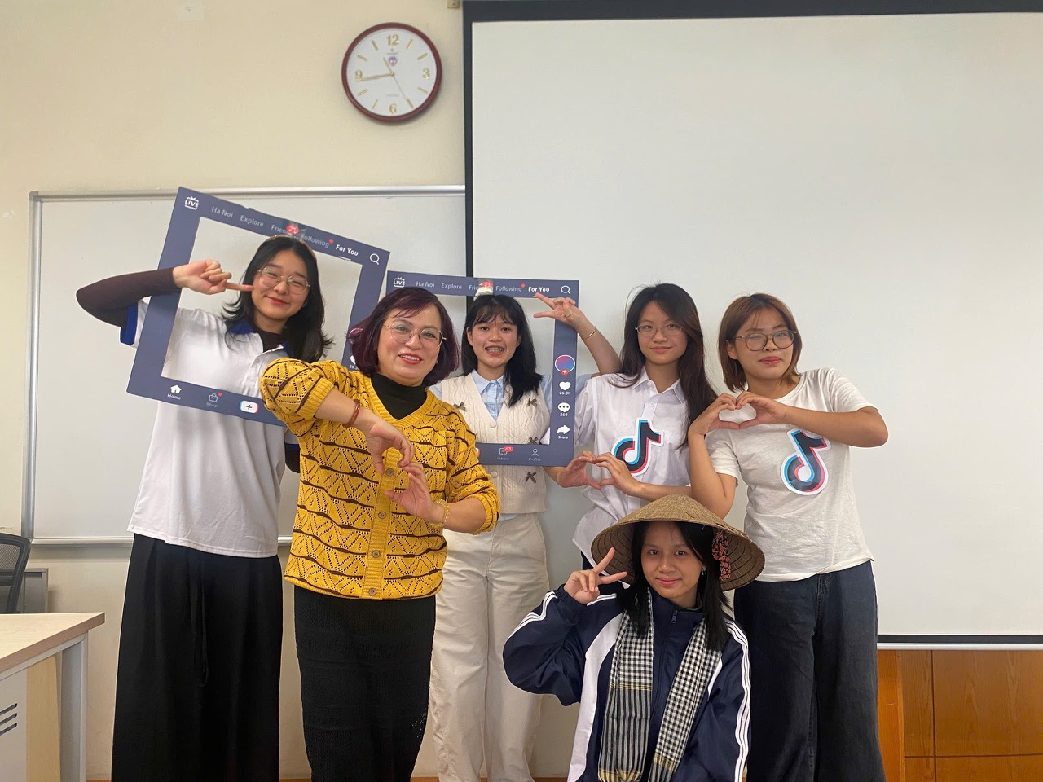
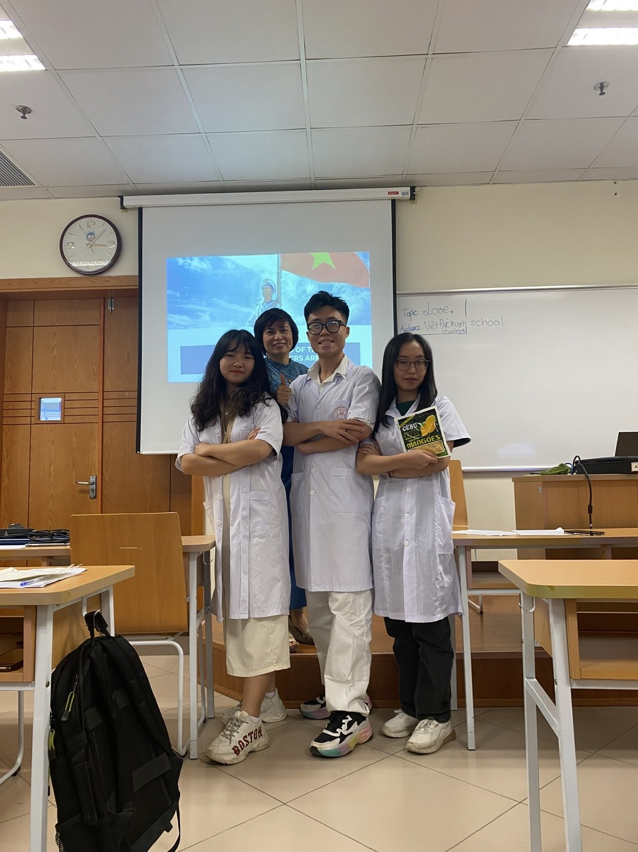
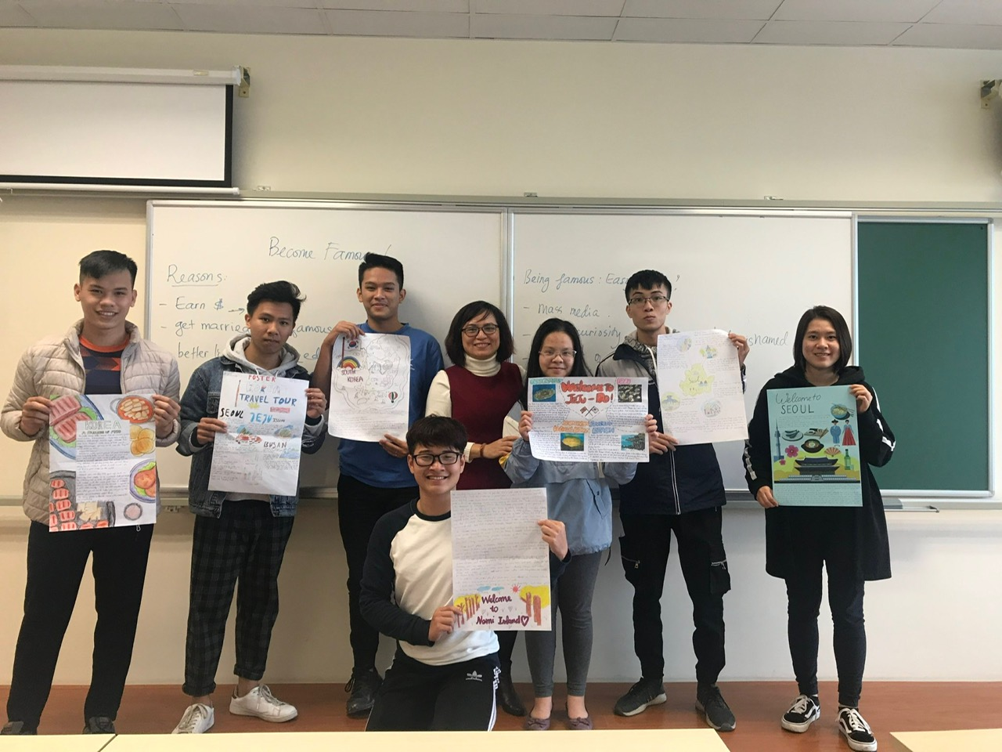
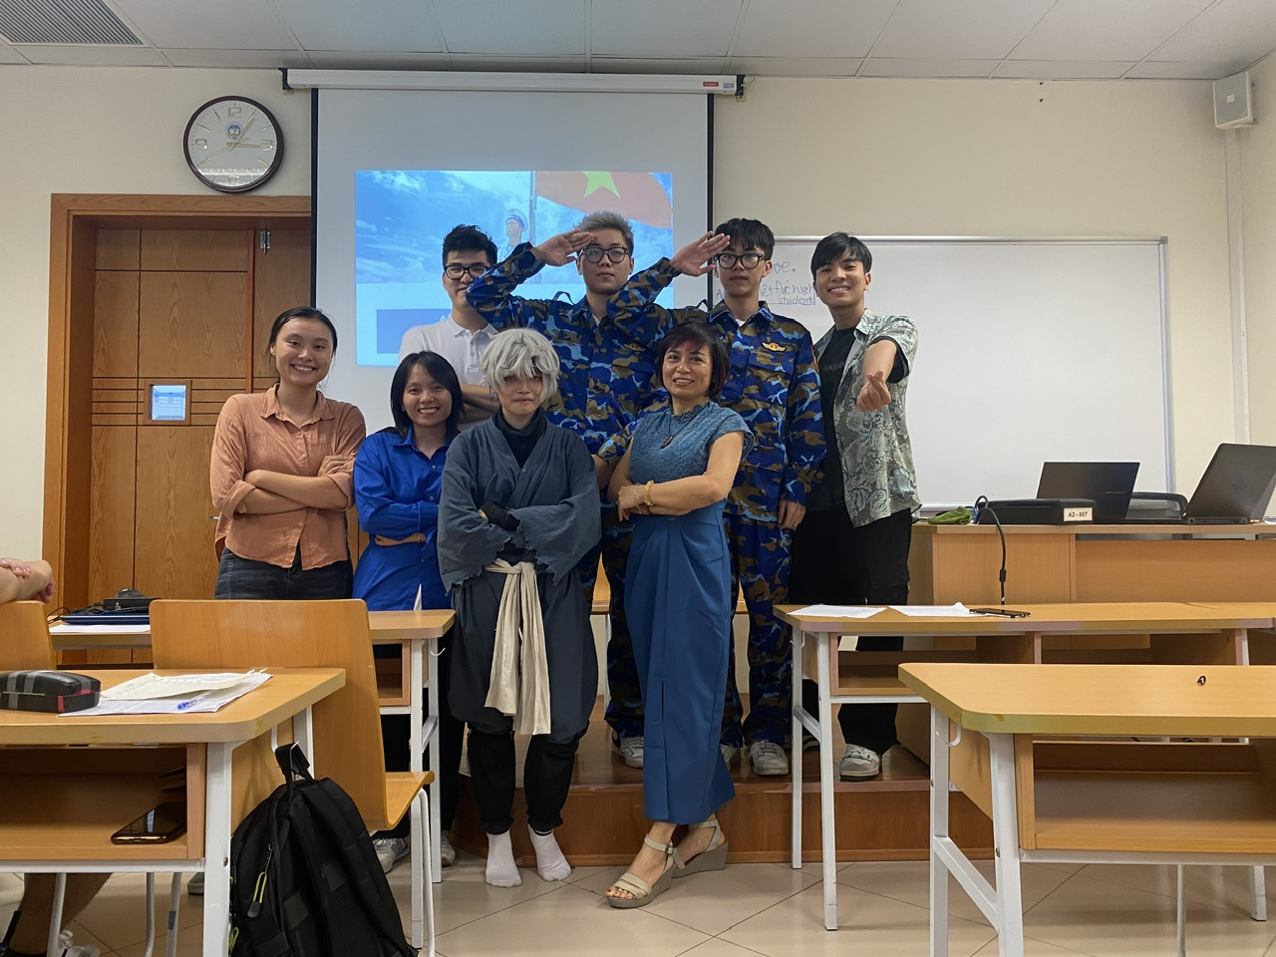
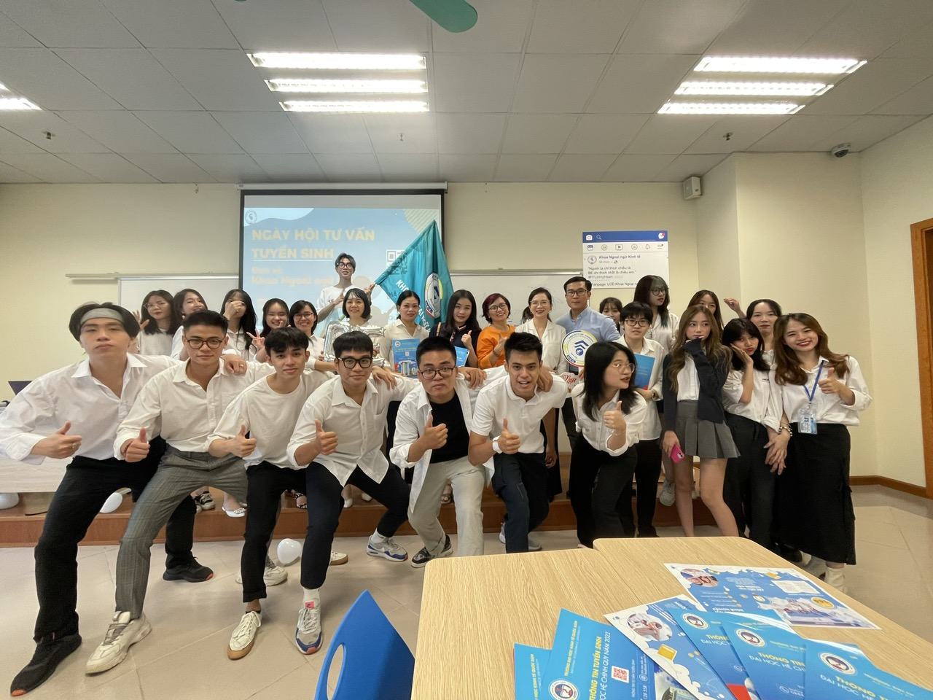
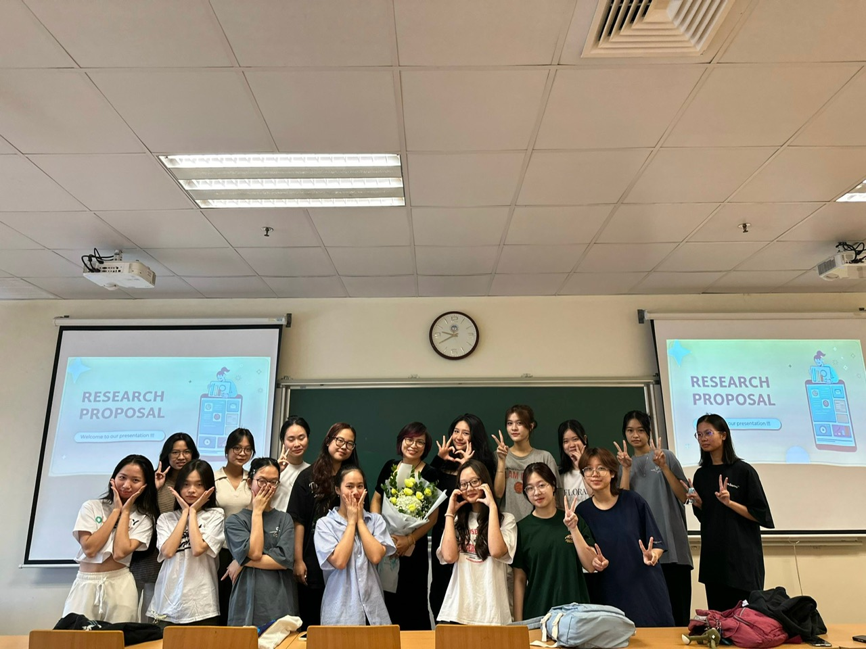

Slide 20
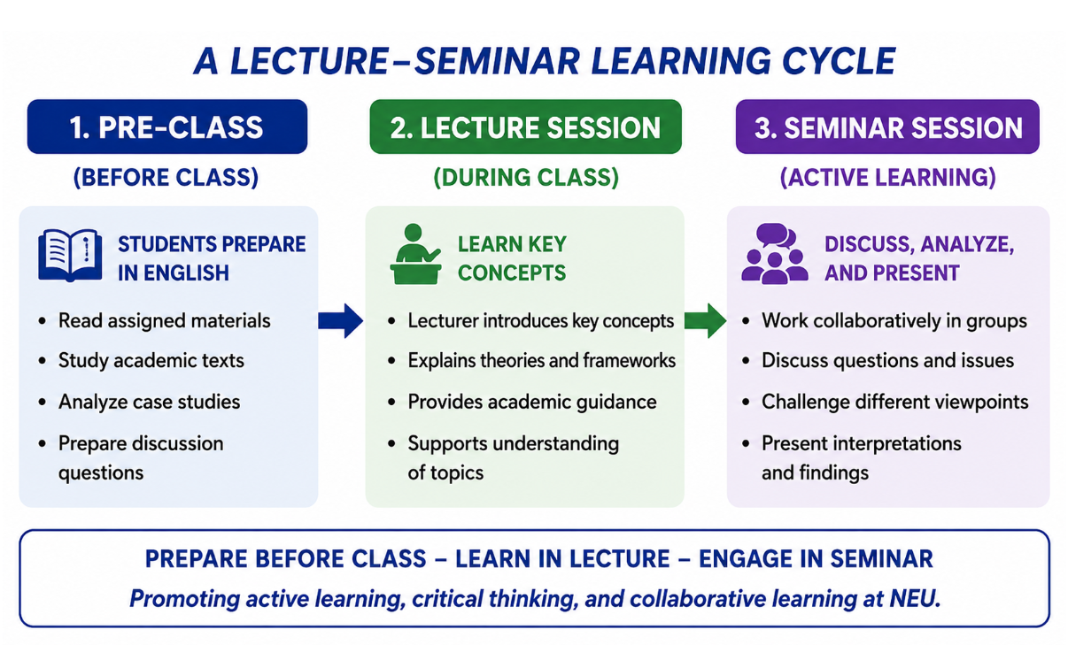
NEU REALITY

Slide 21
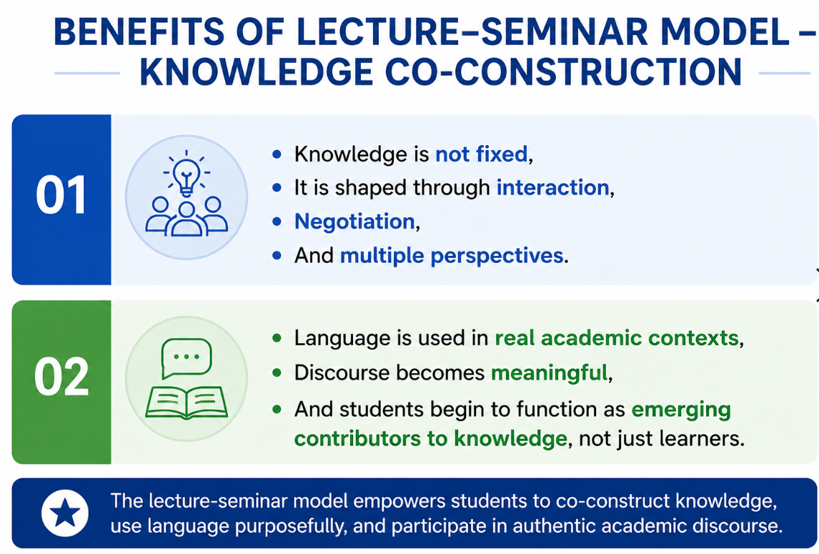

Slide 22
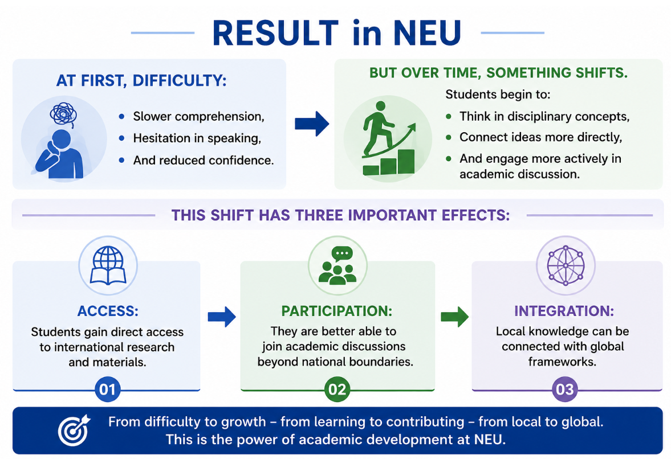

Slide 23
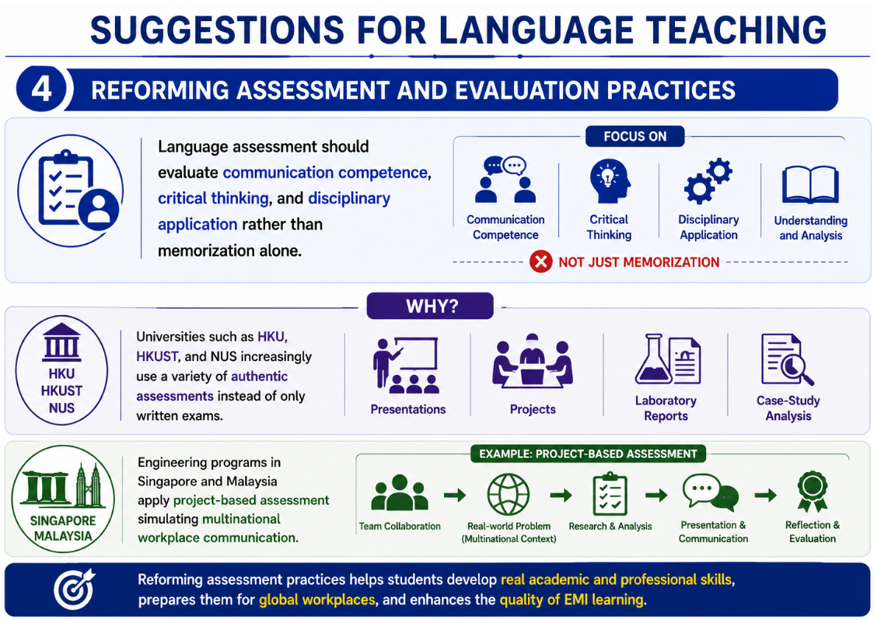

Slide 24
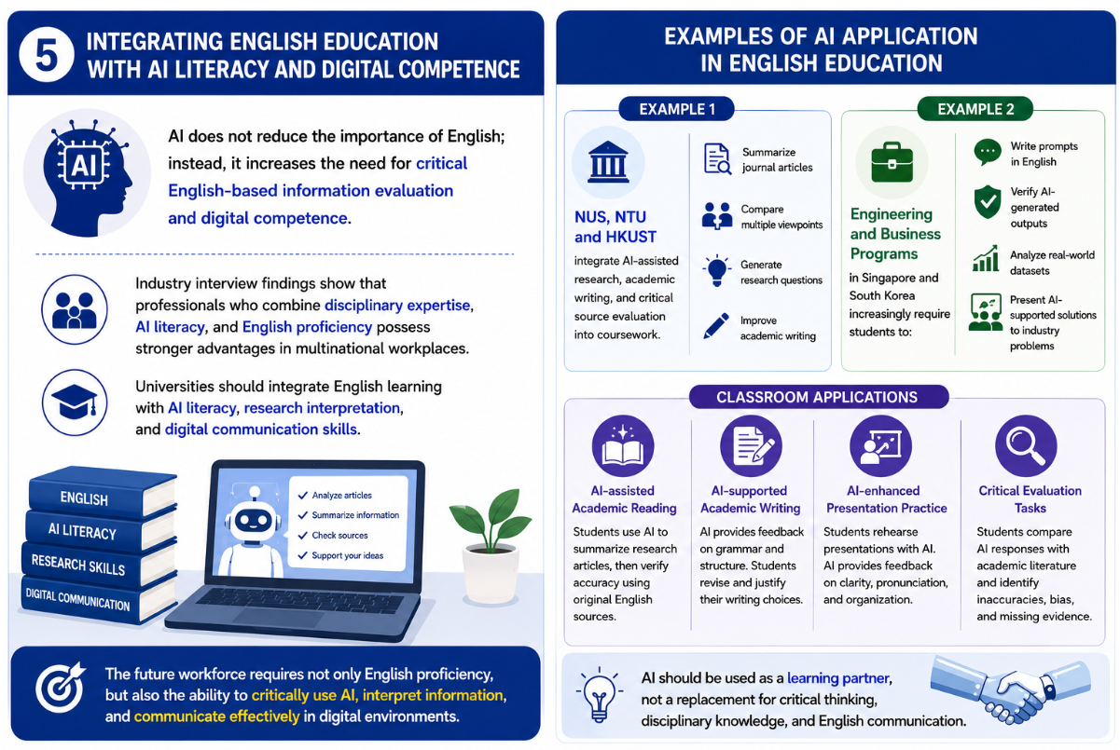
SUGGESTIONS FOR LANGUAGE TEACHING

Slide 25


Slide 26
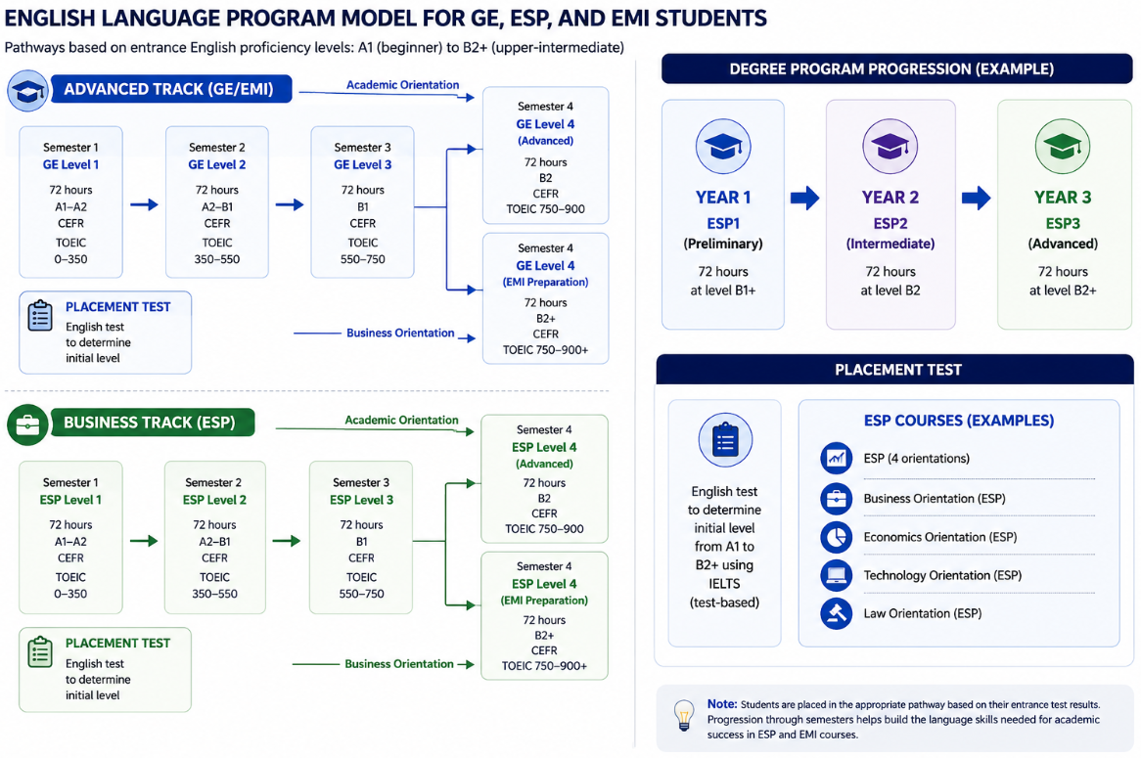
STORY IN NEU

Slide 27
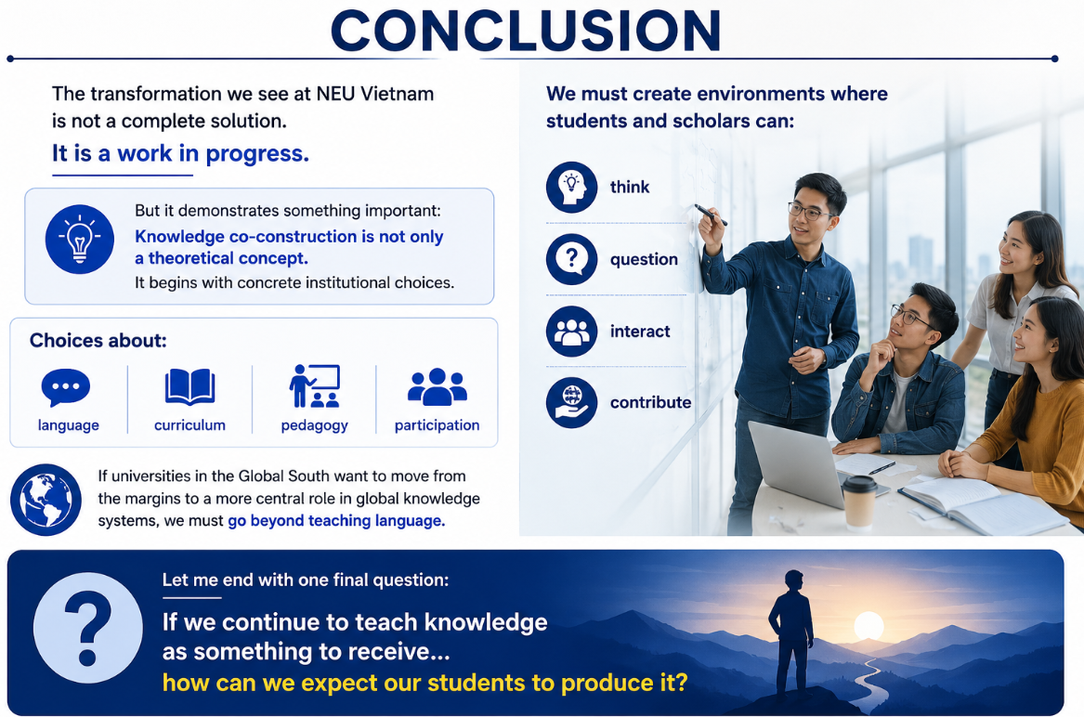

Slide 28


