Slide 1

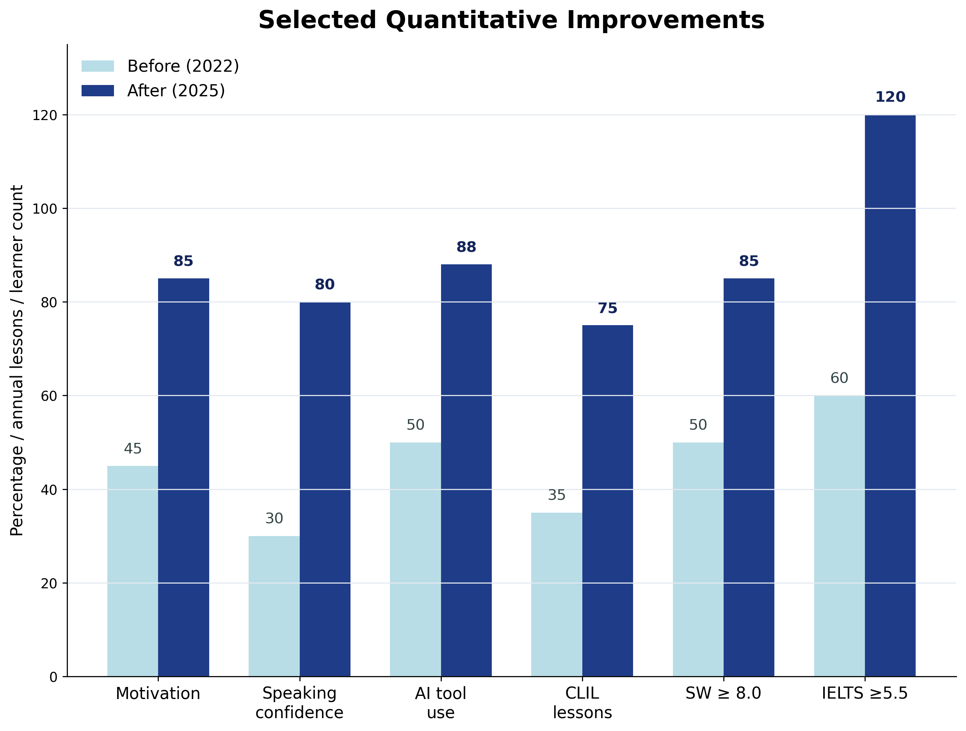
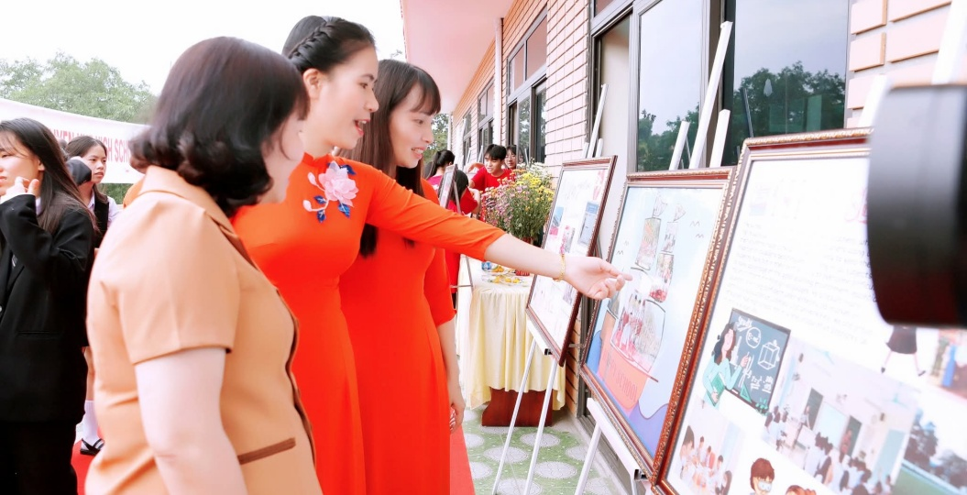
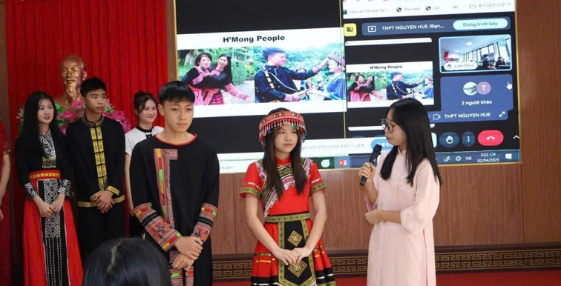
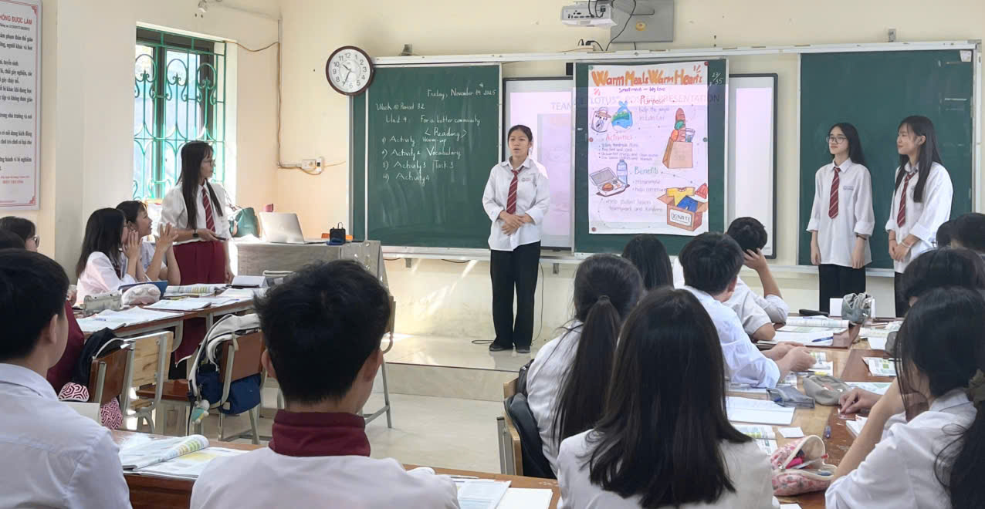
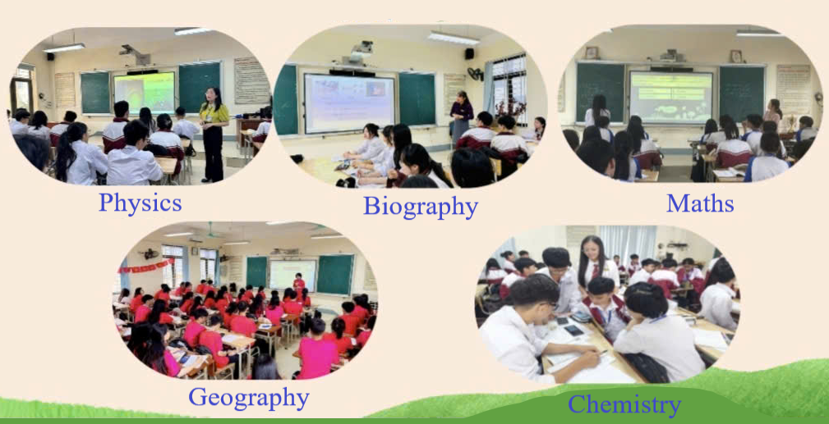
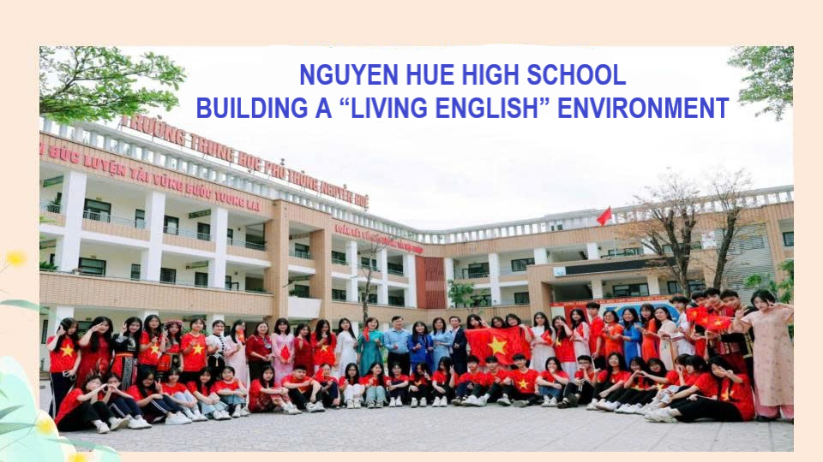
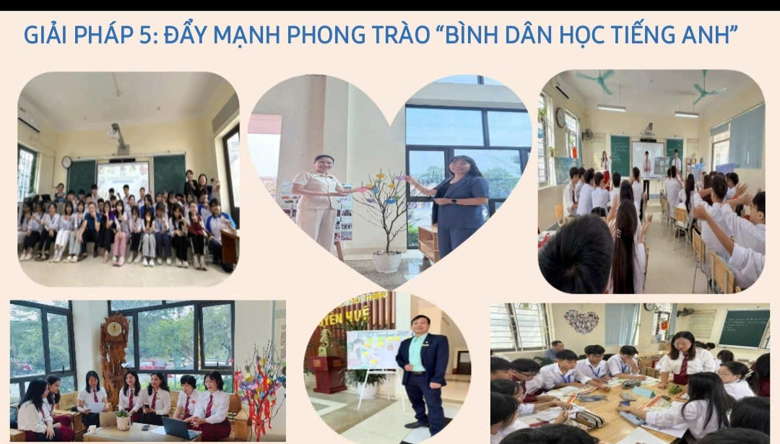
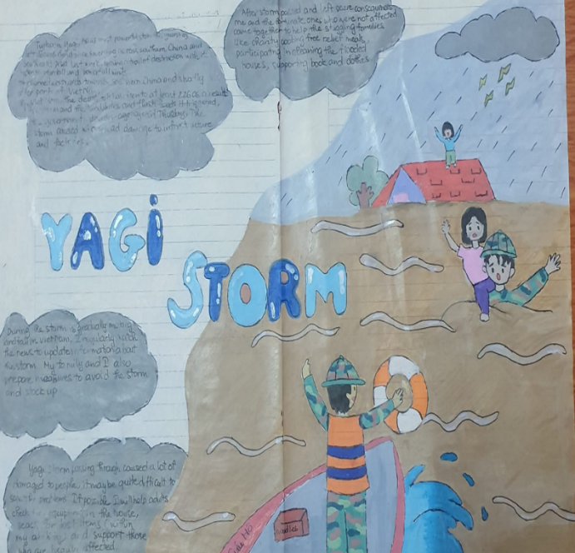
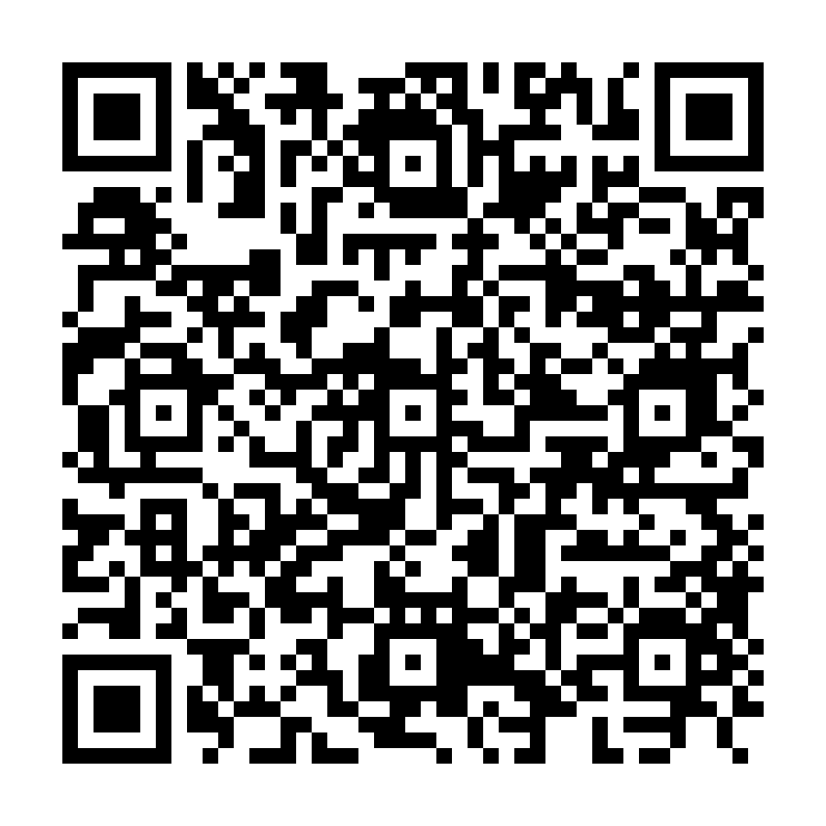
BEYOND CLASSROOMS:
BUILDING AN ENGLISH LEARNING ECOSYSTEM
A practical school-wide model for the EFL-to-ESL transition at Nguyen Hue High School, Lao Cai
ID #2346 | Strand: EFL to ESL Transition | Poster Session: Day 2, 08:45–09:30
Hà Kiều Hoa · Nguyễn Triệu Kim Thảo | Department of Education and Training of Lao Cai – Nguyen Hue High School, Lao Cai, Vietnam | hkhoa.c3nhue@yenbai.edu.vn
INTRODUCTION: THE CHALLENGE
METHODOLOGY & CONTEXT
KEY QUANTITATIVE FINDINGS
Vietnam’s 2018 General Education Curriculum positions English as a vehicle for communicative competence and authentic language use.
In rural and mountainous Lao Cai, students often have limited opportunities to use English meaningfully beyond formal classrooms. At Nguyen Hue High School, English had often been approached as an examination subject rather than a living tool for communication.
Design: action research — plan → act → observe → reflect → improve.
Setting: Nguyen Hue High School, Lao Cai Province.
Duration: 2022–2025.
Participants: 1,560 students (Grades 10–12) and 76 teachers across subject areas.
Data sources: surveys, observations, interviews / focus groups, school documents, and student artefacts such as posters, videos, STEM presentations, and AI-based products. Triangulation was used to strengthen reliability.
+50 pp
+40 pp
+38 pp
Speaking confidence
Student motivation
Teachers using AI
+114%
+35 pp
+100%
CLIL lessons / year
Speaking/Writing ≥8.0
IELTS ≥5.5
RESEARCH QUESTIONS
BEFORE-AFTER INDICATORS
RQ1. How can a school-wide English learning ecosystem expand meaningful English use beyond formal classrooms?
RQ2. What changes are observed in learner motivation, speaking confidence, communicative competence, and digital literacy?
RQ3. What principles can support an EFL-to-ESL transition in similar school contexts?
THE ENGLISH LEARNING ECOSYSTEM MODEL
The model shifts English from a single subject to an ecosystem of authentic communicative opportunities across classroom, digital, extracurricular, interdisciplinary, and community spaces.
1. Language
Colors Club
2. Digital & experiential
contests
THEORETICAL FRAMEWORK
ENGLISH
LEARNING
ECOSYSTEM
The poster synthesizes five complementary lenses:
• Experiential learning: experience, reflection, application.
• Sociocultural constructivism: interaction and mediated practice.
• Communities of practice: participation builds communicative identity.
• CLIL: English as a medium for content learning and innovation.
• World Englishes / ESL transition: English localized as a functional school language.
3. Community-
based learning
4. STEM/STEAM
in English
Note: Indicators combine percentages, annual lessons, and learner counts; values are selected to show institutional impact.
5. Community English
+ AI for Everyone
QUALITATIVE FINDINGS
EVIDENCE FROM PRACTICE
Learner transformation: students moved from rote learning to authentic communication; English became “a real part of life”.
Teacher professional growth: English and non-English teachers collaborated on AI-assisted and bilingual project-based lessons.
Community impact: English became a medium for cultural expression, local pride, environmental awareness, and school-community connection.
IMPLEMENTATION PRINCIPLES
1. Start from local realities and student identity.
2. Link activities to textbook themes and real-life tasks.
3. Make English visible through clubs, exhibitions, media products, and school events.
4. Build teacher capacity through monthly AI and English workshops.
5. Use rubrics, products, reflection, and annual review for continuous improvement.
Bilingual exhibition
Cross-border English classroom
Student-led project presentation in English
CLIL / project lessons
IMPLICATIONS FOR EFL-TO-ESL TRANSITION
ILLUSTRATIVE PATHWAY
For schools: create sustainable English-speaking spaces, not one-off events.
For teachers: use AI to amplify task design, feedback, multimedia production, and assessment.
For policy: support local school ecosystems where English is used for learning, innovation, and community communication.
For similar contexts: start small, document products, mentor peers, and scale through annual cycles.
From formal input to authentic output
POSTER TAKE-AWAY
Unit theme
Project task
AI / digital support
Public sharing
Reflection & scaling
English should not merely be taught — it should be lived.
The Nguyen Hue model suggests that a sustainable school-wide English learning ecosystem can support gradual EFL-to-ESL transition through authentic communication spaces, teacher empowerment, AI-supported creativity, and community-linked learning.
Example: a Global Success unit becomes a poster, film, debate, STEM demo, or community message presented in English.
REFERENCES & ACCESS
Dewey, J. (1938). Experience and education.
Kolb, D. A. (1984). Experiential learning.
Ministry of Education and Training. (2018). General Education Curriculum – English Subject Framework.
UNESCO. (2020). Education for sustainable development goals.
Vygotsky, L. S. (1978). Mind in society.
Wenger, E. (1998). Communities of practice.
Promoting the “English for Everyone” Initiative
Community campaign
Scan for abstract
ID #2346
Corresponding author:
Hà Kiều Hoa
hkhoa.c3nhue@yenbai.edu.vn
VietTESOL International Convention 2026 | Repositioning English: From Foreign to Second Language | Danang, 27–29 August 2026

