Slide 1





A Descriptive Study Of Grammatical Range
In English Majors’ Spontaneous Speech
At a Mekong Delta University.
Presenter: Pham Thi Kim Anh
Affiliation: Can Tho University
ID #2028

Slide 2
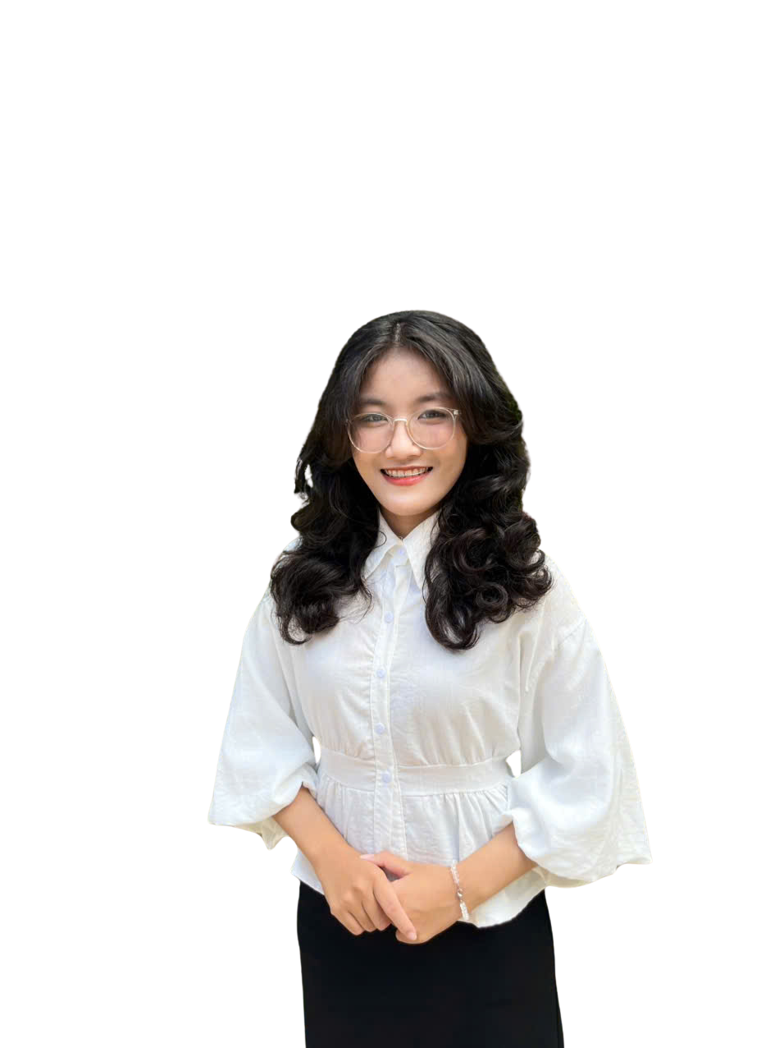


ABOUT ME
PHAM THI KIM ANH
  B.A. in English Studies, School of Foreign Languages, Can Tho University
  Freelance EFL Teacher in Can Tho
  Email: kimanhag2809@gmail.com

Slide 3
A Descriptive Study Of Grammatical Range
In English Majors’ Spontaneous Speech
At a Mekong Delta University.
Presenter: Pham Thi Kim Anh
Affiliation: Can Tho University
ID #2028

Slide 4







AGENDA
Rationale
Research Aims & Research Questions
Literature Review
Methodology
Findings & Discussion
Conclusion & Suggestions
‹#›

Slide 5


RATIONALE
  Spontaneous speech is challenging, even high-proficiency Vietnamese English majors still struggle with it.
  Grammatical range is a key indicator of advanced speaking competence (especially in VSTEP and IELTS).
  There remains a gap between grammatical knowledge and actual spoken performance.
  In Vietnam, research on grammatical range in spontaneous speech is still limited.
‹2›

Slide 6


RESEARCH AIMS & QUESTIONS
analyze the range and use of grammatical structures in students’ spontaneous speech
  Which grammatical structures are most and least frequently used by students in spontaneous speech?
  To what extent do students demonstrate grammatical range in their spontaneous speech?
  Do students tend to overuse or avoid certain grammatical structures in their spontaneous speech?
‹#›
‹3›

Slide 7

LITERATURE REVIEW
Spontaneous speaking, or impromptu speaking: the act of expressing and presenting one's ideas with limited or no preparation (Hsieh, 2006)
Grammatical Range: the number and the variety of grammatical structures used by learners.
Cognitive Load Theory: The more a person has to learn or process in a short amount of time, the more difficult it is to process that information in working memory. (John Sweller, 1980s)
‹#›
‹4›

Slide 8
LITERATURE REVIEW
Automaticity: The skill of performing a task and processing information subconsciously and without deliberate effort.
(Dekeyser, 2001; Moors, 2006)
Adaptive Control of Thought (ACT) (Anderson, 1970s)
  Knowing grammatical rules: declarative knowledge.
  The real fluency, accuracy, and complexity: procedural knowledge (built through practice).
‹#›
‹5›

Slide 9
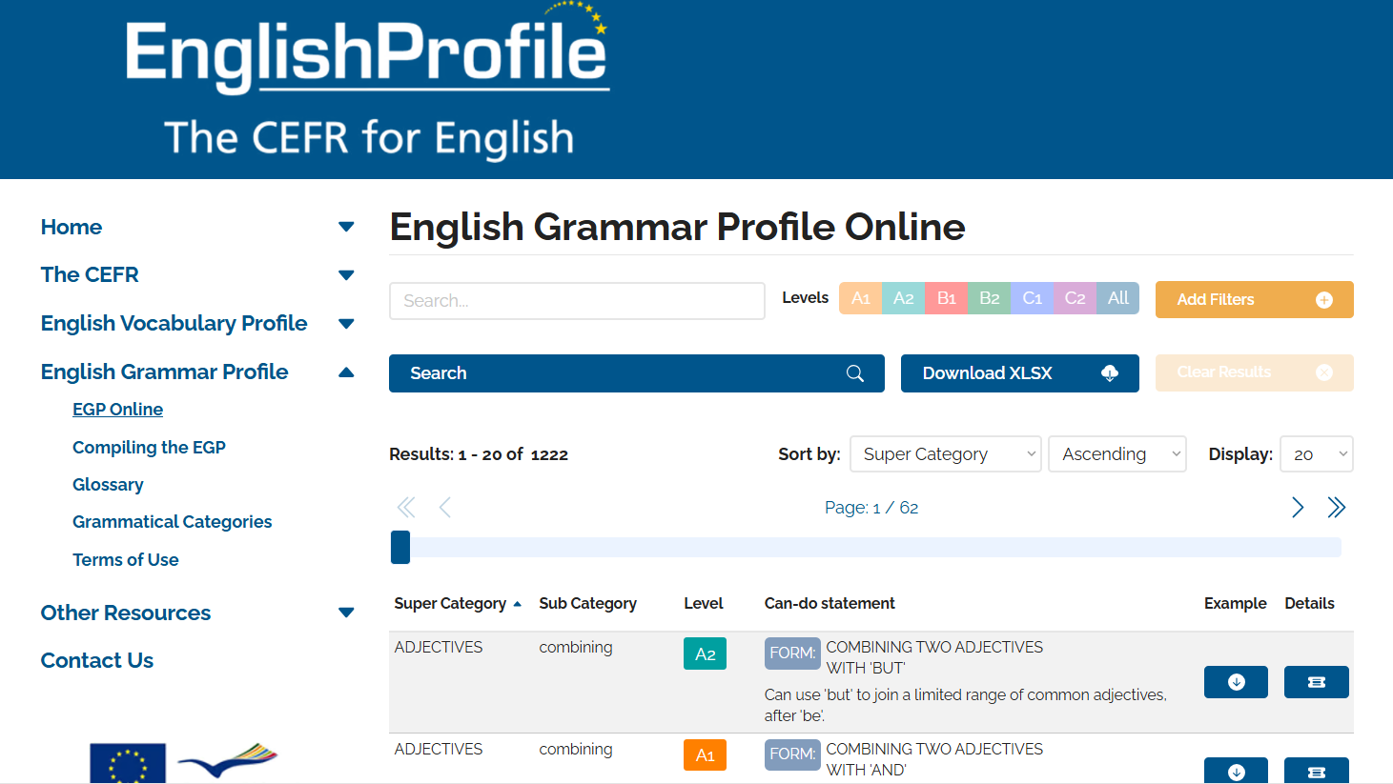
LITERATURE REVIEW
English Grammar Profile (EGP)
https://englishprofile.org/?menu=english-grammar-profile
‹6›

Slide 10

RESEARCH METHODOLOGY
  Design: Mixed-method approach (quantitative + qualitative)
  Participants: 40 final-year English-major students from the School of Foreign Languages at a university in Viet Nam
  Sampling: convenience, purposive, and snowball sampling
  Criteria: completion of the Advanced Grammar course and the Listening–Speaking C1.1 course
‹#›
‹7›

Slide 11

RESEARCH METHODOLOGY
Simulated speaking test (VSTEP Part 3 format)
Audio recording & transcription
Manual coding + EGP classification
Semi-structured interview
Data interpretation & conclusion
40 participants
8 representatives
‹#›
‹8›

Slide 12
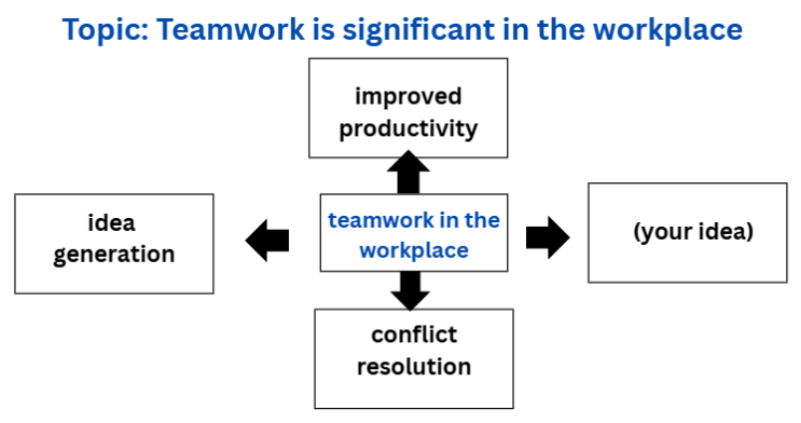
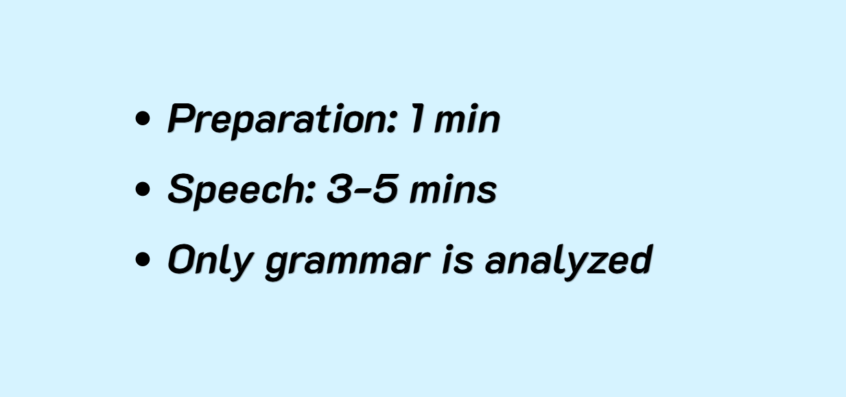
RESEARCH METHODOLOGY
‹#›
‹8›

Slide 13


RESEARCH METHODOLOGY
Simulated speaking test (VSTEP Part 3 format)
Audio recording & transcription
Manual coding + EGP classification
Semi-structured interview
Data interpretation & conclusion
40 participants
8 representatives
‹#›
‹8›

Slide 14
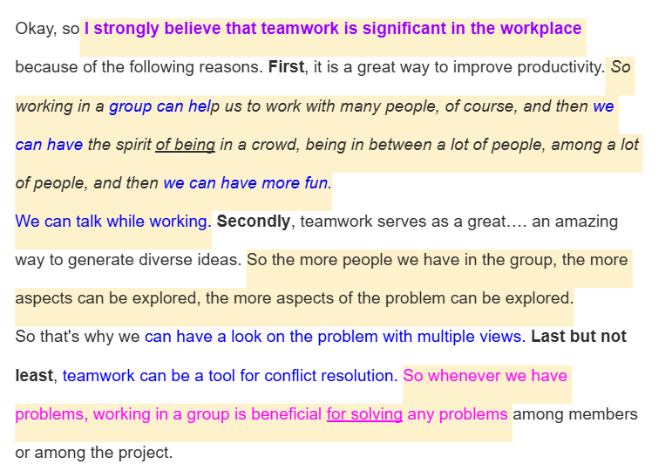
RESEARCH METHODOLOGY
‹#›
‹8›

Slide 15

RESEARCH METHODOLOGY
Semi-interview structure
Part 1: Language Processing & Anxiety
Explore cognitive & emotional factors.
Corresponding transcript & audio recording provided
→ Participants recall their performance in the simulated test.
Part 2: Performance Recall

Slide 16

RESEARCH METHODOLOGY
Part 2: Performance Recall
  Did you find this sentence difficult to say? If so, which part did you find difficult?
  Did you try to simplify the sentence?
  Your response used a lot of [... structures]. Why did you use these structures so frequently? Do you think you could have expressed the idea using different structures?
  Are you familiar with the structure “[X]”?
  If so, why did you not use it in your speaking response?

Slide 17

FINDINGS & DISCUSSION
Overview of Grammatical Structures
  41 grammatical structures were identified
  Distribution was highly uneven
‹#›
‹9›

Slide 18
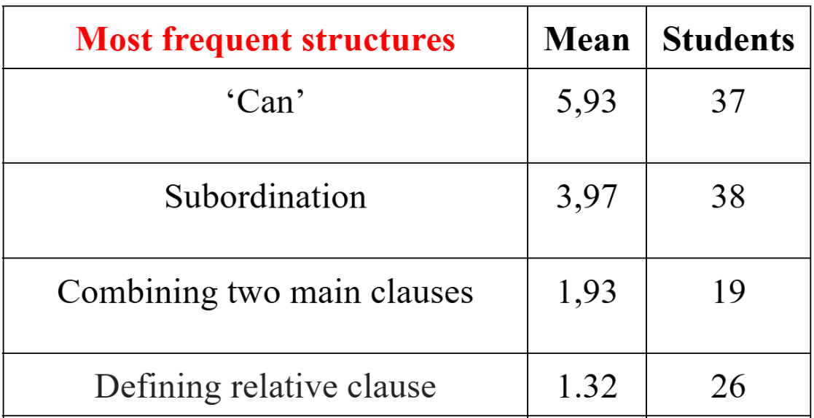
FINDINGS & DISCUSSION
Overview of Grammatical Structures
earlier practice
highly usablity in multiple contexts
automization => quick retrieval
‹#›
‹10›

Slide 19
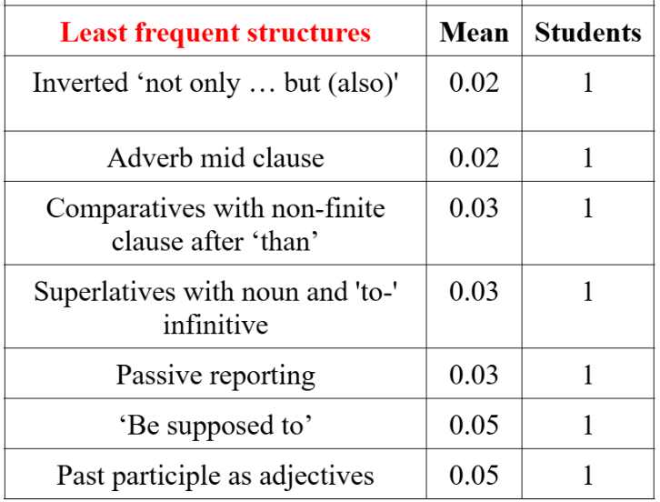
FINDINGS & DISCUSSION
Overview of Grammatical Structures
time pressure
lack of prior planning
multi-tasking demands
high cognitive load
low automaticity
‹#›
‹10›

Slide 20
FINDINGS & DISCUSSION
Grammatical Range and Level per Participant
Range
  4–13 structures / speaker
Complexity
  mostly A1–B1
  limited B2–C2
  only 1 C2 case
A wider range did not always correspond to higher complexity.
‹#›
‹11›

Slide 21
FINDINGS & DISCUSSION
Qualitative Findings
  Avoidance of advanced structures
  Preference for familiar forms
  Instinctive use of grammar (rare control)
‹#›
‹12›

Slide 22

FINDINGS & DISCUSSION
Qualitative Findings
  Avoidance of advanced structures
  Preference for familiar forms
  Instinctive use of grammar (rare control)
Explanation:
Familiar forms have lower processing cost and are easier to recall.
Fluency was prioritized over grammar sophistication
‹#›
‹12›

Slide 23

CONCLUSION & SUGGESTIONS
Students have:
solid grammatical foundation >< limited in complexity
a competence–performance gap
‹#›
‹13›

Slide 24

CONCLUSION & SUGGESTIONS
For teachers / lecturers:
  Equal focus on gammatical range as accuracy
  Include more impromptu speaking tasks alongside planned speaking tasks
  Use scaffolding strategies ⟶ reduce reliance on simple, safe sentence patterns
‹#›
‹14›

Slide 25


CONCLUSION & SUGGESTIONS
For curriculum & assessment design:
  Design lessons: grammar theory = spoken practice
  Integrate impromptu speaking activities into the syllabus
  Include grammatical range and spontaneous speech in assessment (instead of relying mainly on prepared presentations or written reports).
‹#›
‹14›

Slide 26

CONCLUSION & SUGGESTIONS
RECOMMENDATIONS FOR
FUTURE RESEARCH
LIMITATIONS
  More diverse sample
  Examine different speaking tasks
  More analytical frameworks
  Refine coding procedures & spoken-data analysis methods
  Small sample from one university
  One speaking task type only
  Possible coding constraints in EGP classification
‹#›
‹15›

Slide 27
THANK YOU FOR
YOUR KIND ATTENTION

