Slide 1




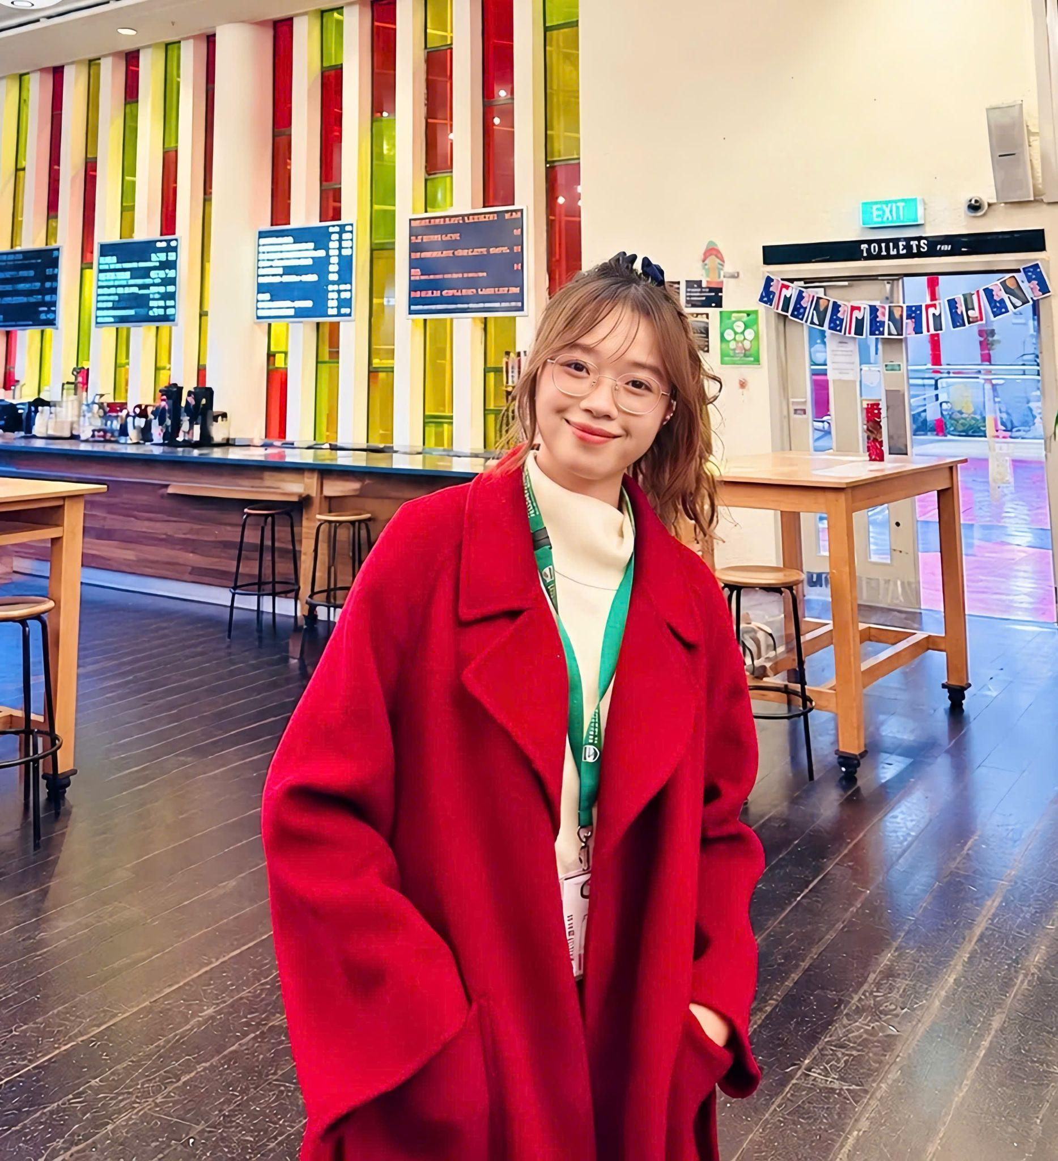
FROM AUTOMATED DRAFTS TO EMPIRICALLY SUPPORTED PRACTICE
Fostering Teacher Agency via Visual Research Brokering
TRAN THI THUY TRANG
Education: Master of TESOL Student at Victoria University of Wellington (NZD $10,000 Scholarship)
Experience:
ESOL Teacher (Wellington, NZ)
4+ years teaching K-12 & IELTS (Vietnam)
“I cannot directly teach millions of students, but I can walk alongside the teachers who guide those millions.”
VIETTESOL INTERNATIONAL CONVENTION 2026

Slide 2
PRESENTATION ROADMAP
!
✓
PART 1
PART 2
PART 3
THE PROBLEM
THE BRIDGE
THE PROOF &
CLOSURE
VIETTESOL INTERNATIONAL CONVENTION 2026
thuytranggv2003@gmail.com

Slide 3

THE TRAP OF AUTOMATED DRAFTS
!
The AI Trap
!
The Historical Bias
“If students and teachers are not careful and intentional with regard to how generative AI could become a metaphorical linguistic crutch for some students.”
(Pack & Maloney, 2024, p. 1011)
“Generative AI relies on a mathematical rather than a linguistic model of language. LLMs work so well at generating language because their training is based not on fixed rules but on actual language use.”
(Godwin-Jones, 2024, p. 9)
“However, such training can induce algorithmic biases toward over-represented associations that do not reflect current knowledge or practices.”
(Dornburg & Davin, 2025, p. 342)
“Many of the lesson plans created by ChatGPT reflected aspects of the audio-lingual method, a behaviorist approach popular in the 1970s in which learners listened to and repeated pre-scripted dialogues.”
(Dornburg & Davin, 2025, p. 342)
VIETTESOL INTERNATIONAL CONVENTION 2026

Slide 4
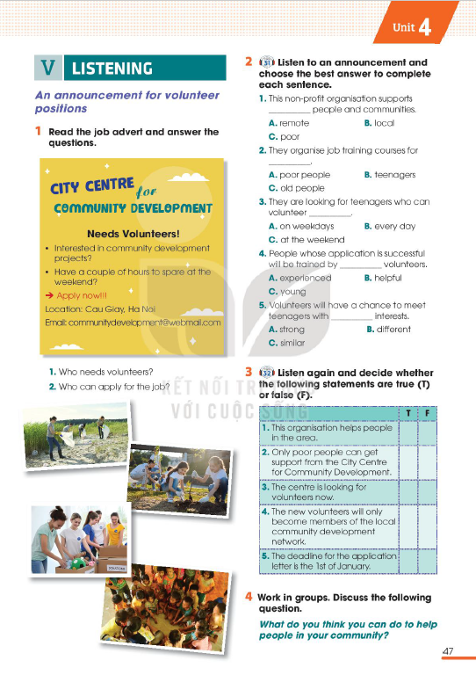
Global Success 10
Unit 4: For a better community
Lesson 5: Listening
Global Success 10
Global Success 10
Unit 4: For a better community
Lesson 5: Listening
VIETTESOL INTERNATIONAL CONVENTION 2026
thuytranggv2003@gmail.com

Slide 5
Lesson Plan Design
GEMINI PROMPT:
“You are a professional ESL Teacher. Design an interesting, engaging, and interactive lesson plan for the Listening lesson.
This is a mixed-level class (A2-B1), with 40-45 Grade 10 students. They often panic when an audio starts, and struggle with missing words/catching speakers’ message.”
VIETTESOL INTERNATIONAL CONVENTION 2026
thuytranggv2003@gmail.com

Slide 6

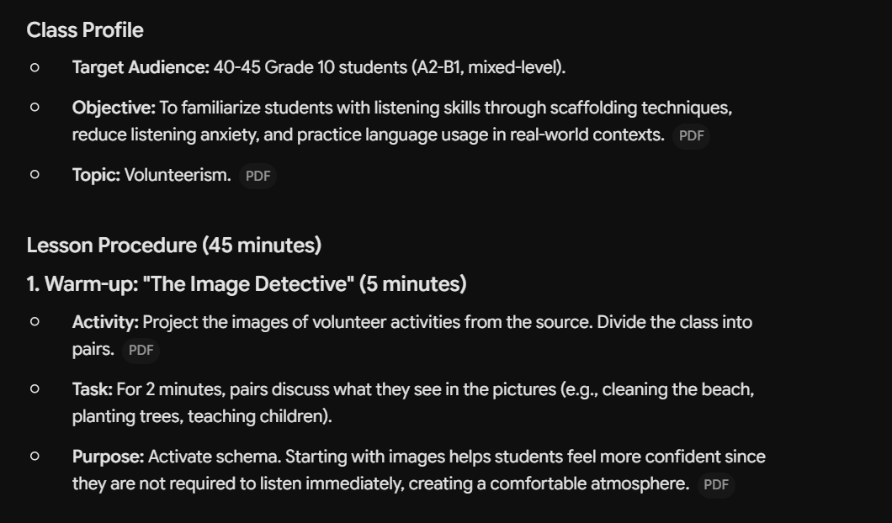
GEMINI-CREATED LESSON PLAN
Global Success 10
Unit 4: For a better community
Lesson 5: Listening
VIETTESOL INTERNATIONAL CONVENTION 2026
thuytranggv2003@gmail.com

Slide 7
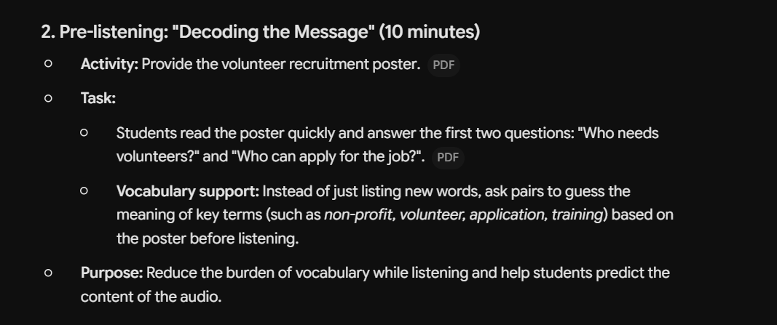
GEMINI-CREATED LESSON PLAN
Global Success 10
Unit 4: For a better community
Lesson 5: Listening
VIETTESOL INTERNATIONAL CONVENTION 2026
thuytranggv2003@gmail.com

Slide 8
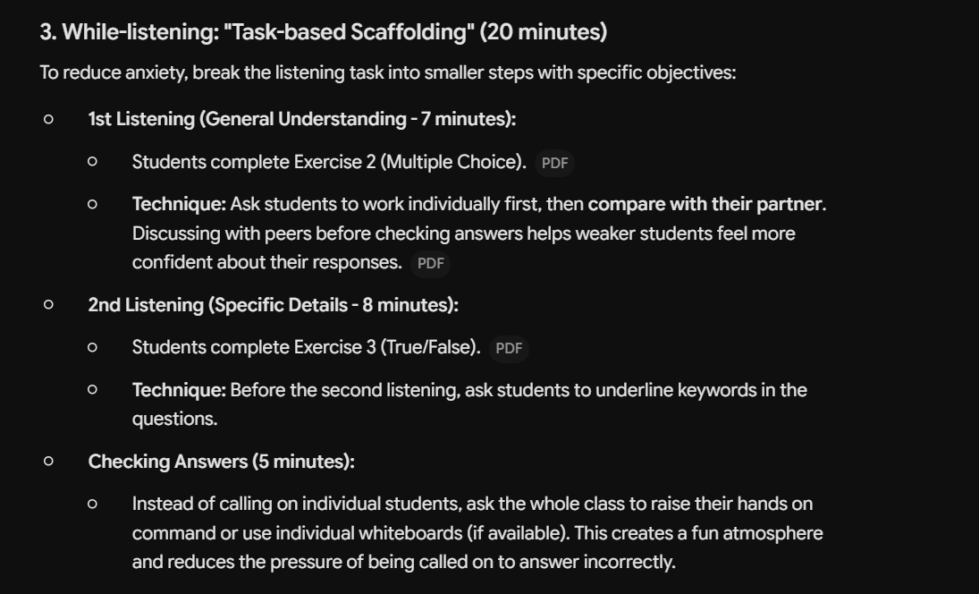
GEMINI-CREATED LESSON PLAN
Global Success 10
Unit 4: For a better community
Lesson 5: Listening
VIETTESOL INTERNATIONAL CONVENTION 2026
thuytranggv2003@gmail.com

Slide 9
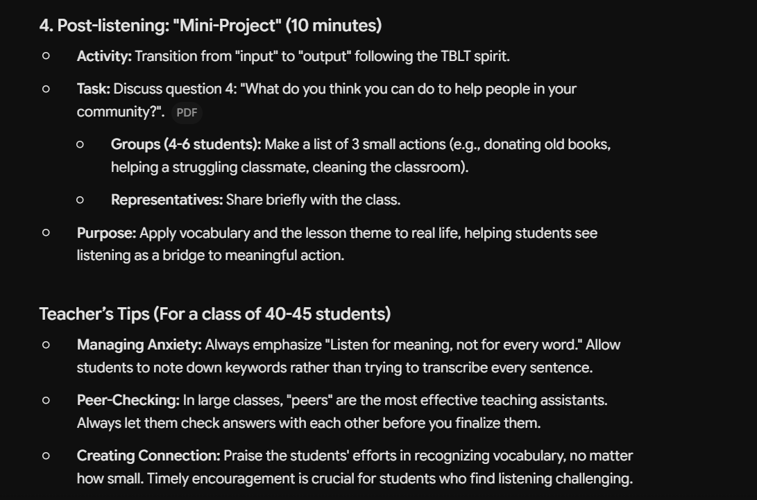
GEMINI-CREATED LESSON PLAN
Global Success 10
Unit 4: For a better community
Lesson 5: Listening
VIETTESOL INTERNATIONAL CONVENTION 2026
thuytranggv2003@gmail.com

Slide 10
BRIDGING THE GAP: THE RESEARCH–PRACTICE DIALOGUE
The Global Barrier
81.7%
of teachers cite “a lack of time” as the overwhelming factor for not doing research
(Borg, 2009, p. 373)
▼
Sato’s Warning
“Without a dialogue, L2 researchers may conduct studies irrelevant to real-world teaching; L2 teachers may rely only on personal intuition.”
(Sato, 2022, p. 509)
▼
The Solution TESOLgraphics
“Individual researchers endeavor to make research more accessible as well. For instance, TESOLgraphics (Infographics | TESOLgraphics) produces infographics based on meta-analyses or narrative reviews.”
(Sato, 2022, p. 519)
VIETTESOL INTERNATIONAL CONVENTION 2026
VietTESOL 2026
3

Slide 11
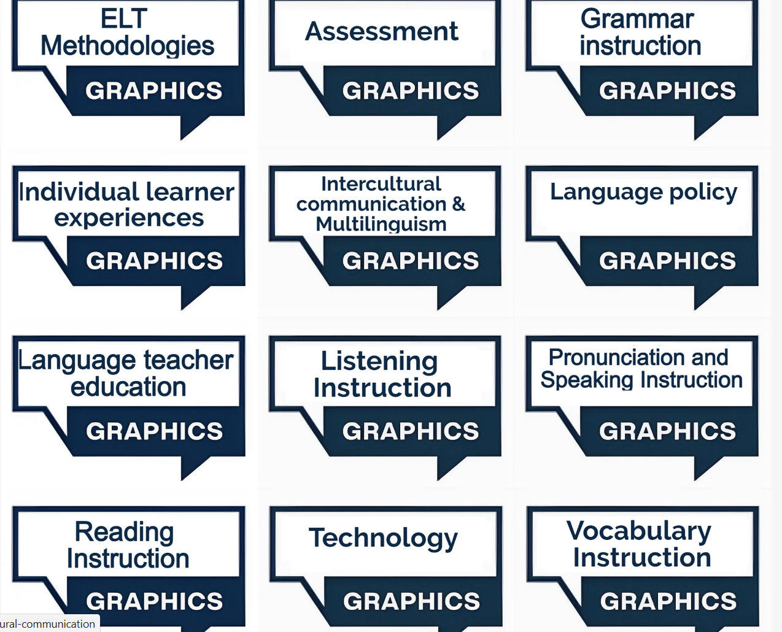
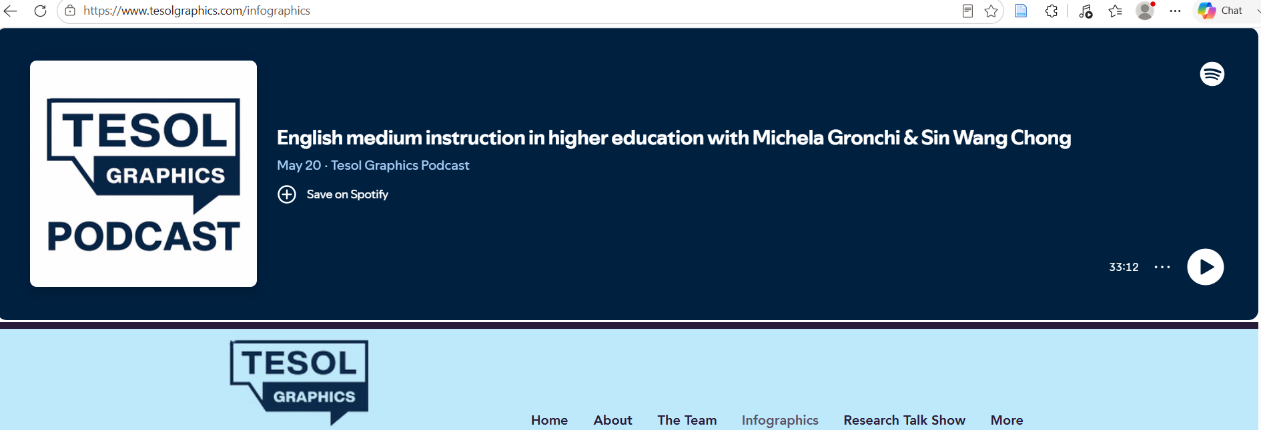

TESOLGRAPHICS
VIETTESOL INTERNATIONAL CONVENTION 2026
VIETTESOL INTERNATIONAL CONVENTION 2026
thuytranggv2003@gmail.com

Slide 12
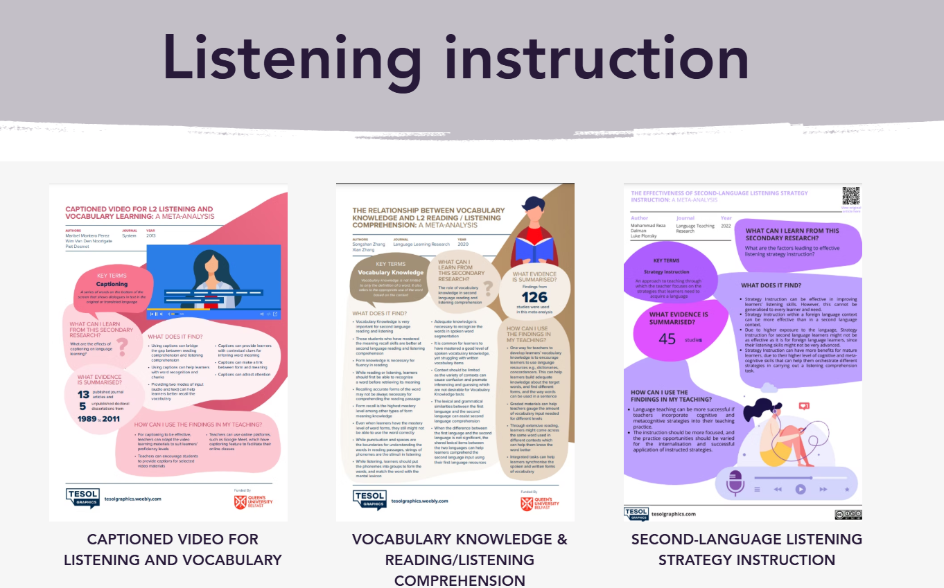
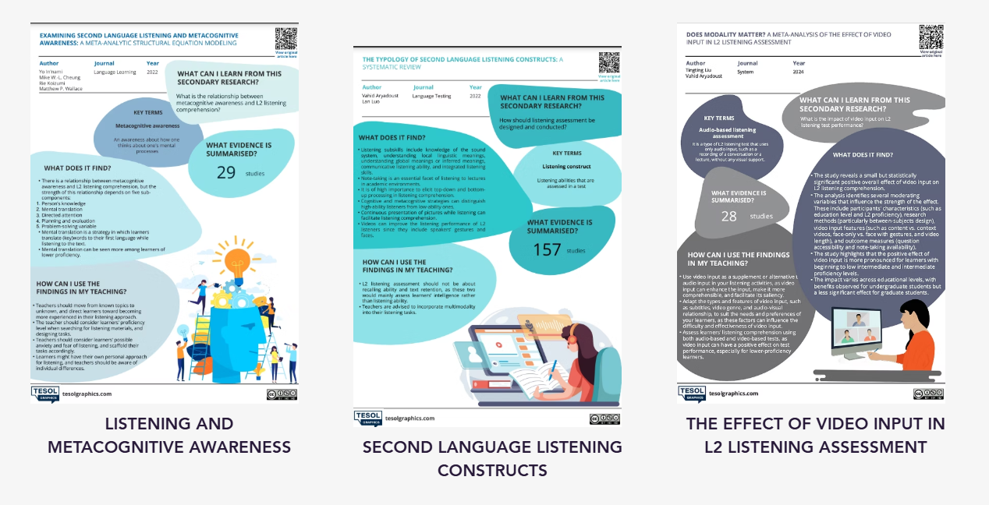
TESOLGRAPHICS
VIETTESOL INTERNATIONAL CONVENTION 2026
VIETTESOL INTERNATIONAL CONVENTION 2026
thuytranggv2003@gmail.com

Slide 13
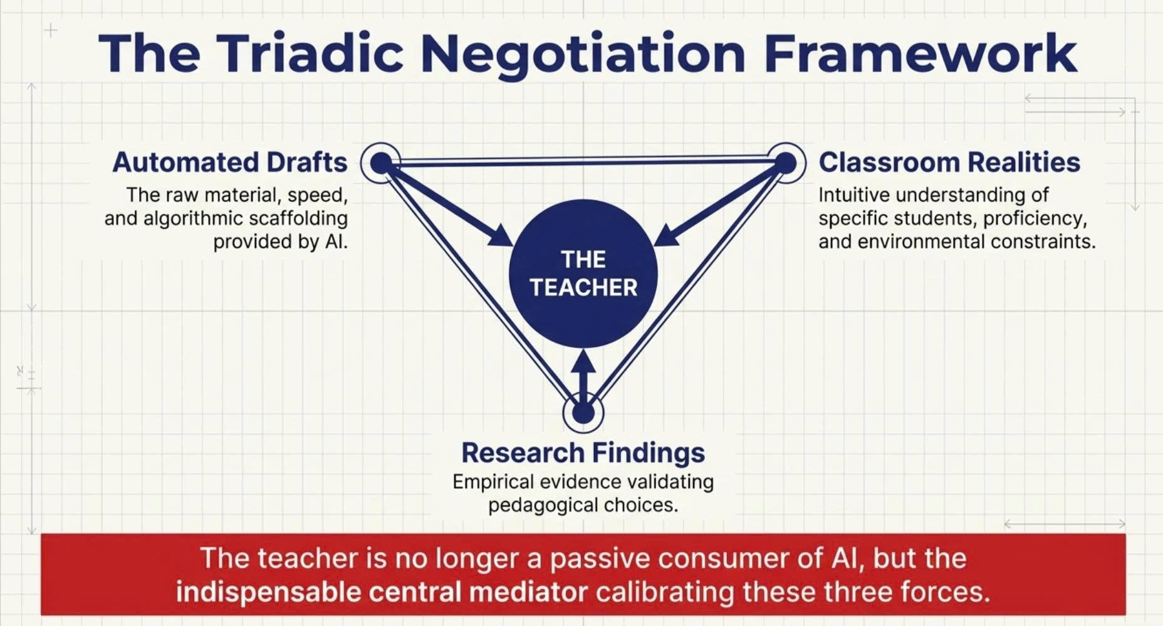
VIETTESOL INTERNATIONAL CONVENTION 2026

Slide 14
THE TRIADIC NEGOTIATION FRAMEWORK
Emergent Agency
Agency should be characterized as an emergent phenomenon instead of a capacity possessed innately.
(Priestley et al., 2015)
🏫
AI
TEACHER
AGENCY
Automated Drafts
Classroom Realities
Intentional Authority
"LTA is a language teacher's intentional authority to make choices and act accordingly in his or her local context.“
(Kayi-Aydar, 2019, p. 18)
📊
TESOLgraphics
VIETTESOL INTERNATIONAL CONVENTION 2026
4

Slide 15
Lesson Plan Design
GEMINI PROMPT:
“You are a professional ESL Teacher. Design an interesting, engaging, and interactive lesson plan for the Listening lesson.
This is a mixed-level class (A2-B1), with 40-45 Grade 10 students. They often panic when an audio starts, and struggle with missing words/catching speakers’ message.”
VIETTESOL INTERNATIONAL CONVENTION 2026
thuytranggv2003@gmail.com

Slide 16
FROM AUTOMATED DRAFTS TO EMPIRICALLY SUPPORTED PRACTICE
BEFORE
PROCESS
AFTER
TRIADIC NEGOTIATION
✓
AI
1
2
3
EMPIRICALLY SUPPORTED PRACTICE
1. AI Suggestion
2. Practical Judgment
3. TESOLgraphics
AI Suggestion
TEACHER AGENCY
VIETTESOL INTERNATIONAL CONVENTION 2026
VIETTESOL INTERNATIONAL CONVENTION 2026
thuytranggv2003@gmail.com
VietTESOL 2026
5

Slide 17
THE 4-STAGE REFLECTION PROTOCOL: STEP-BY-STEP ANALYSIS
1. AI Suggestion | 2. Practical Judgment | 3.TESOLgraphics | 4. Final Decision
What instructional sequence does the AI suggest? | How does this align OR conflict with your teaching context and pedagogical knowledge? | What does empirical evidence suggest? Do you find any alignment or conflict? | How do you finally transform the AI’s draft and evidence-based suggestion into your own lesson plan?
VIETTESOL INTERNATIONAL CONVENTION 2026
VietTESOL 2026
5

Slide 18

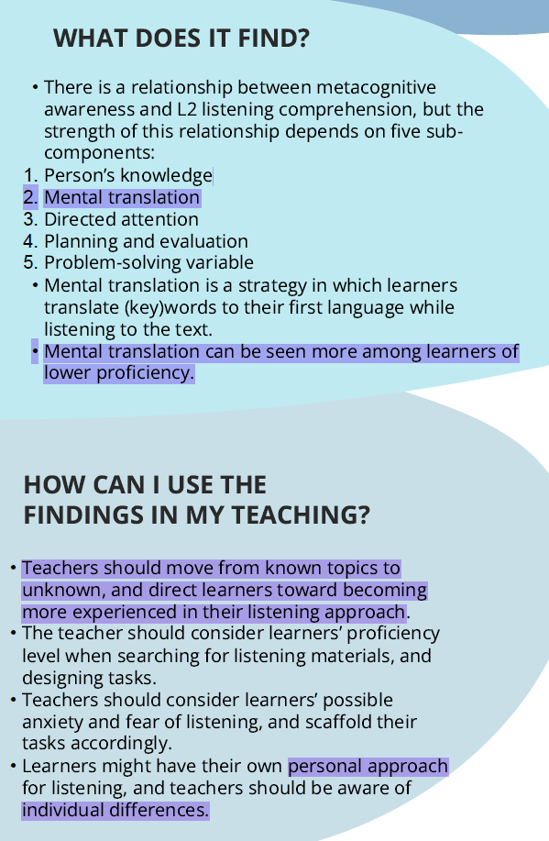
STAGE 1: PRE-LISTENING
Pairs -> Meaning guessing (non-profit, volunteer, application, training) based on the poster before listening.
1. AI Suggestion
2. Practical Judgement
A good strategy -> Prevent audio overwhelm
-> Possibly guess the main content of the audio.
In'nami et al. (2022): Consider proficiency level; Scaffold to reduce listening anxiety; Low proficiency -> Mental translation; Individual approaches.
3. TESOLgraphics
Adapt: Vocabulary meaning guessing
-> Picture-to-Word matching + Pronunciation; Mixed-level pairing (Strong + Weak)
4. Final Decision
VIETTESOL INTERNATIONAL CONVENTION 2026
VietTESOL 2026
thuytranggv2003@gmail.com
VIETTESOL INTERNATIONAL CONVENTION 2026
5

Slide 19
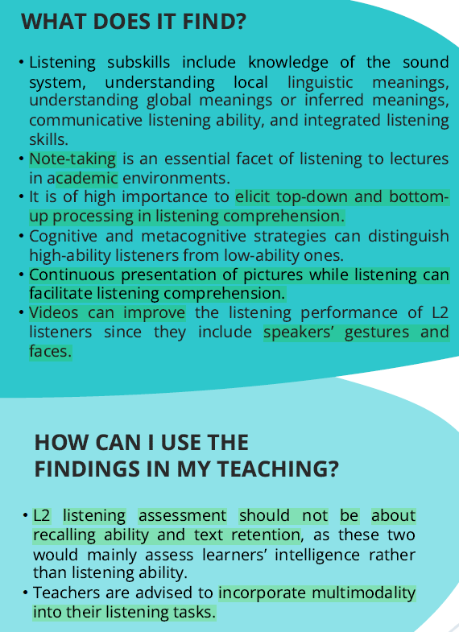
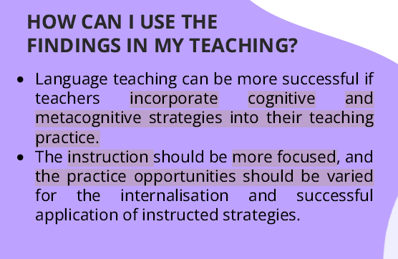
STAGE 2: WHILE-LISTENING
1. AI Suggestion
1st Listen: MCQs (individually -> peer sharing)
2nd Listen: True/False (underline keywords -> the whole class)
2. Practical Judgement
Helpful -> Peers interaction
Pre-task support
Aryadoust & Luo (2022): Visuals -> comprehension; Continuous pictures reduce cognitive load.
Dalman & Plonsky (2022): Explicit cognitive/metacognitive strategy instruction; Varied practice opportunities.
3. TESOL
graphics
4. Final Decision
Adapt: Create a visual slideshow synchronized with audio cues
Explicit phonological teaching in connected speech.
VIETTESOL INTERNATIONAL CONVENTION 2026
VietTESOL 2026
thuytranggv2003@gmail.com
VIETTESOL INTERNATIONAL CONVENTION 2026
5

Slide 20
THE FINAL LESSON PLAN = TEACHER AGENCY
Pre-listening: Image-to-sound matching activity
(Eliminated Mental Translation)
✓
While-listening: Audio synchronized with a continuous visual slideshow (Eliminated Cognitive Overload)
✓
Strategy Focus: Explicit instruction on phonological decoding
(Fostered true Strategy Instruction)
✓
Empirically Supported Practice achieved via Triadic Negotiation.
VIETTESOL INTERNATIONAL CONVENTION 2026
9

Slide 21
THE 4-STAGE REFLECTION PROTOCOL: STEP-BY-STEP ANALYSIS
1. AI Suggestion | 2. Practical Judgement | 3. TESOLgraphics | 4. Final Decision
What instructional sequence does the AI suggest? | Does the suggestion fit my learners and teaching context? | What does empirical evidence suggest? Do you find any alignment or conflict? | How do you finally transform the AI’s draft and evidence-based suggestion into your own lesson plan?
PRE-LISTENING Pairs: Guess the meaning of key terms (non-profit, volunteer, application, training) -> the poster before listening. | A good strategy -> Prevent audio overwhelm -> Possibly guess the main content of the audio. | In'nami et al. (2022): Consider proficiency level; Scaffold to reduce listening anxiety; Low proficiency => Mental translation; Individual approaches. | Adapt: Vocabulary meaning guessing -> Picture-to-Word matching + Pronunciation; Mixed-level pairing (Strong +Weak)
WHILE-LISTENING 1st Listen: Multiple Choice (individually -> peer sharing) 2nd Listen: True/False (underline keywords -> the whole class) | Helpful with Peers interaction; Pre-task support | Aryadoust & Luo (2022): Visuals facilitate comprehension; Continuous pictures reduce cognitive load. Dalman & Plonsky (2022): Explicit cognitive or metacognitive strategy instruction; Varied practice opportunities. | Adapt: Create a visual slideshow synchronized with audio cues; Explicit phonological teaching in connected speech.
VIETTESOL INTERNATIONAL CONVENTION 2026
5

Slide 22
LET’S PRACTICE!
20:00
A
Reading Instruction
B
Writing Instruction
Choose a lesson/a part of a lesson you are going to teach
Prompt AI tools for the Lesson Plan
Do the 4-step Reflection:
AI’s suggestion - Evaluation – TESOLgraphics
– Final decision
Choose a lesson/a part of a lesson you are going to teach
Prompt AI tools for the Lesson Plan
Do the 4-step Reflection:
AI’s suggestion - Evaluation – TESOLgraphics
– Final decision
VIETTESOL INTERNATIONAL CONVENTION 2026
10

Slide 23
Consolidation 1: Cognitive Anchor
“Being a planner and forethinker, the agentic individual then links thought to action, which involves self-monitoring, self-guidance and corrective self-reactions.”
(Bandura, 2001, p. 8)
VIETTESOL INTERNATIONAL CONVENTION 2026
10

Slide 24
Consolidation 2: Pedagogical Imperative
“Adaptation was necessary... and should be done to improve students' learning.”
“With thoughtful selection and acceptance of the textbooks and relevant support from other agents, both teachers became competent and agentive in making modifications to make the materials fit better in their local teaching contexts.”
(Dao et al., 2025, p. 9)
(Dao et al., 2025, p. 9)
VIETTESOL INTERNATIONAL CONVENTION 2026
10

Slide 25
Consolidation 3: Threat of Inaction
“If students and teachers are not careful and intentional with
regard to how generative AI tools are used to support writing, these
tools may provide meaningful interaction that promotes the internalization of language knowledge and skills; simply put, generative AI could become a metaphorical linguistic crutch for some students.”
(Pack & Maloney, 2024, p. 1012)
VIETTESOL INTERNATIONAL CONVENTION 2026
10

Slide 26
Consolidation 4: Irreplaceable Human
“Current AI language tutors at best complement expert human
language tutors by offering unlimited repetitive practice and feedback on linguistic form that makes time for expert tutors to engage with knowledge and meaning, provide more creative opportunities to use language, and engage with the whole learner at a human level.”
(Handley, 2024, p. 553)
VIETTESOL INTERNATIONAL CONVENTION 2026
10

Slide 27
AI generates text.
Teachers generate learning.
“Current intelligent language tutors are not only lacking in the affective dimension and their ability to engage and counsel learners but also in the pedagogical dimension.”
(Handley, 2024, p. 553)
VIETTESOL INTERNATIONAL CONVENTION 2026
10
12

Slide 28
KEY TAKEAWAYS
!
Cognitive Anchor
Pedagogical Imperative
Threat of Inaction
Irreplaceable Human
self-monitoring
self-guidance
corrective self-reactions
“Adaptation was necessary...”
“metaphorical linguistic crutch”
“complement expert human language tutors”
AI generates text - Teachers generate learning
VIETTESOL INTERNATIONAL CONVENTION 2026
VIETTESOL INTERNATIONAL CONVENTION 2026
thuytranggv2003@gmail.com
10
12

Slide 29
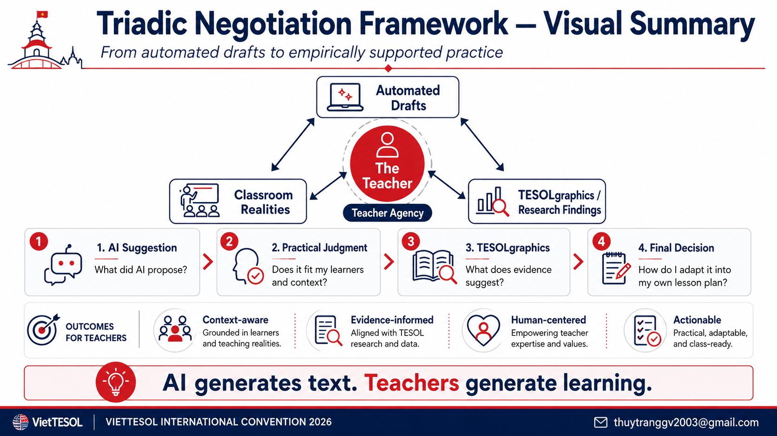

Slide 30
REFERENCES
Aryadoust, V., & Luo, L. (2022). The typology of second language listening constructs. Language Testing.
Borg, S. (2009). English language teachers' conceptions of research. Applied Linguistics, 30(3), 358-388.
Dalman, M. R., & Plonsky, L. (2022). The effectiveness of second-language listening strategy instruction: A meta-analysis. Language Teaching Research.
Dao, T. T. D., Ngo, P. L. H., & Chi, D. N. (2025). Teacher agency and curriculum changes: A case study of two English teachers in Vietnam and their implementation of the new textbooks policy at the classroom level. TESOL Journal, 14, e70055.
Dang, T. C. T., & Seals, C. (2018). An Evaluation of Primary English Textbooks in Vietnam: A Sociolinguistic Perspective. TESOL Journal, 9(1), 93-113.
Dornburg, A., & Davin, K. J. (2025). ChatGPT in foreign language lesson plan creation: Trends, variability, and historical biases. ReCALL, 37(3), 332-347.
Godwin-Jones, R. (2024). Distributed agency in second language learning and teaching through generative AI. Language Learning & Technology, 28(2), 4-31.
Handley, Z. (2024). Has artificial intelligence rendered language teaching obsolete? The Modern Language Journal, 108(2), 548-555.
In'nami, Y., Cheung, M. W.-L., Koizumi, R., & Wallace, M. P. (2022). Examining second language listening and metacognitive awareness: A meta-analytic structural equation modeling. Language Learning.
Kayi-Aydar, H. (2019). Language teacher agency: Major theoretical considerations, conceptualizations and methodological choices. Positioning Theory in Applied Linguistics.
Pack, A., & Maloney, J. (2024). Using Artificial Intelligence in TESOL: Some Ethical and Pedagogical Considerations. TESOL Quarterly, 58(2), 1007-1018.
Sato, M., & Loewen, S. (2022). The research-practice dialogue in second language learning and teaching: Past, present, and future. The Modern Language Journal, 106(3), 509-527.
VIETTESOL INTERNATIONAL CONVENTION 2026
10
12
VietTESOL 2026
13

Slide 31
THANK YOU
Q&A
Let's Connect & Collaborate
Name: Tran Thi Thuy Trang
Email 1: Thuytranggv2003@gmail.com
Email 2: Tranthi10@myvuw.ac.nz
Institution: Victoria University of Wellington
VIETTESOL INTERNATIONAL CONVENTION 2026
10
12

