Slide 1




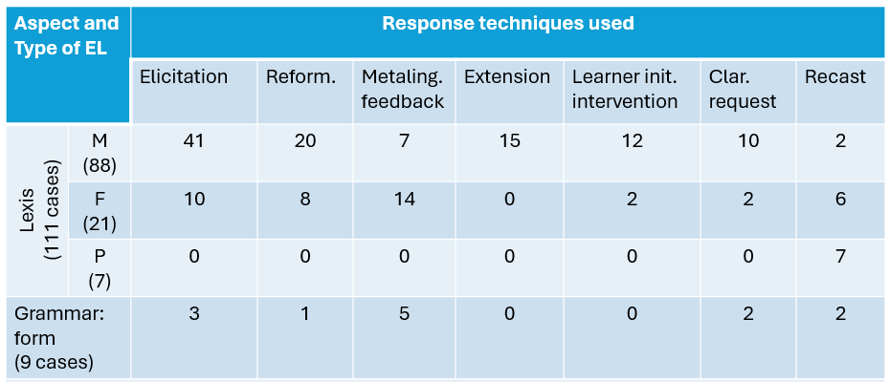
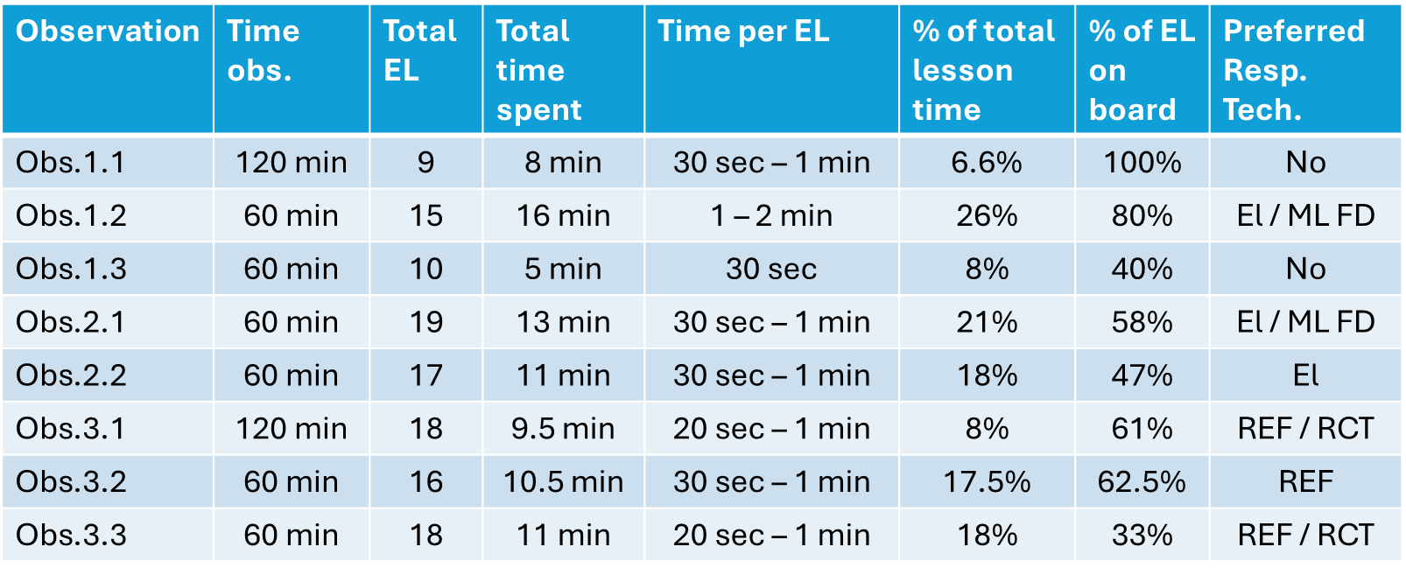
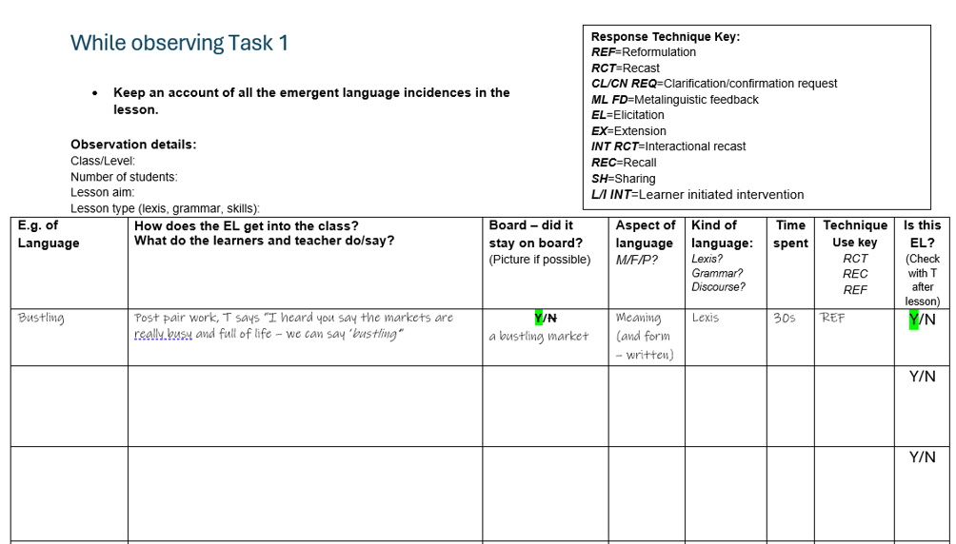
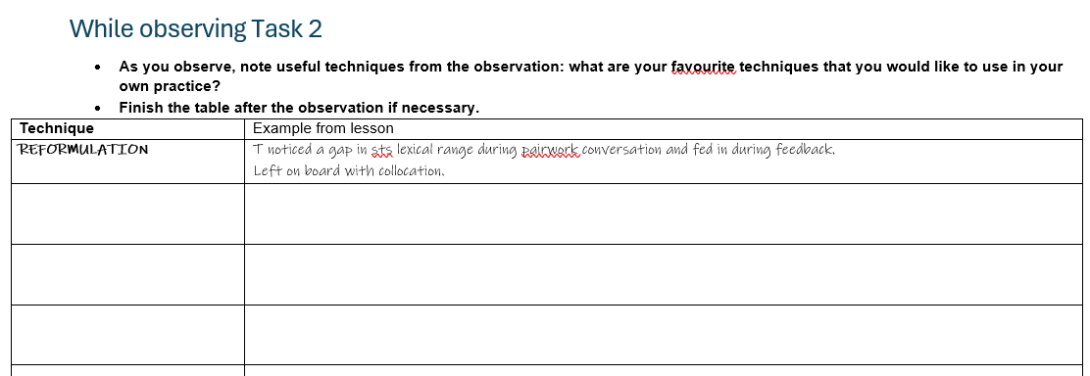
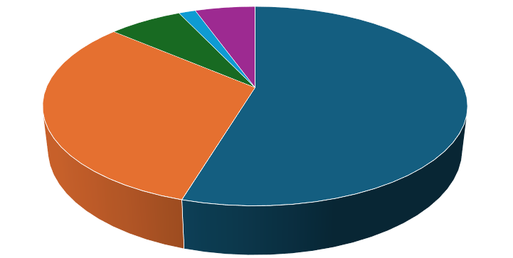
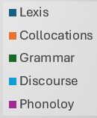
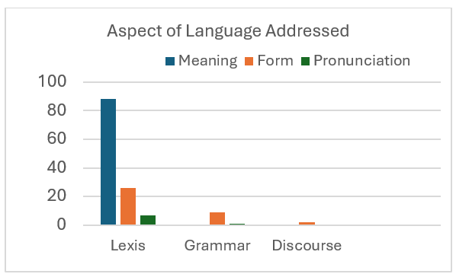

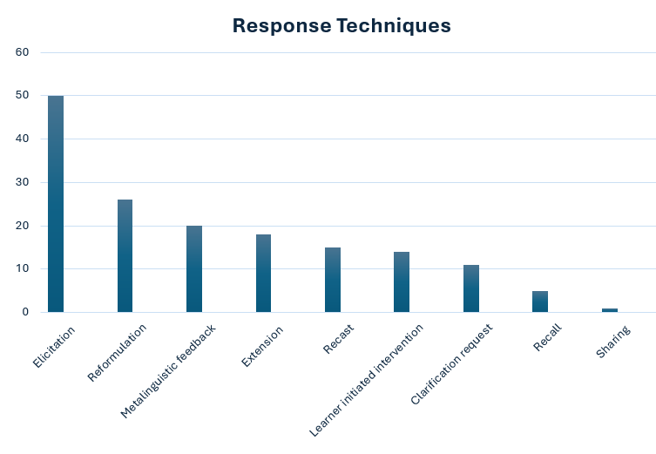


DEALING WITH EMERGENT LANGUAGE IN A YOUNG LEARNER ESL CLASSROOM: PRACTICAL TOOLS FOR TEACHERS
HANNA SKALEVSKA,
Teacher of English, British Council Vietnam
ABSTRACT
This presentation reports key findings of a research project conducted through continuous classroom observations as part of the DipTESOL course, focusing on ways to deal with emergent language in a Young Learner ESL classroom within the framework of modern CLT, TBL and CLIL principles widely applied in language centres and bilingual/international schools across Vietnam. The research is informed by the response taxonomy proposed by Norrington-Davies and builds on Long’s ‘Focus on Form’ approach, according to which language is more effectively acquired when addressed at the point of need. The study investigates which kinds and aspects of language teachers most frequently address as emergent, including lexis, grammar, collocations, phonology, and discourse features; which feedback and response techniques teachers employ when working with emergent language; and how much classroom time is devoted to it. A practical outcome of the project was the development of a classroom observation instrument designed as a ready-made tool for in-service teacher professional development through peer observation or self-reflection using lesson recordings. This instrument enables systematic collection of data on working with emergent language in Young Learner ESL classrooms, including types and aspects of language addressed, response and boarding techniques used, time allocation, as well as common lesson stages in which emergent language may occur. The findings offer valuable insights for both novice and experienced ESL teachers by suggesting possible combinations of techniques that appear effective when responding to different language aspects, for instance, elicitation or reformulation combined with metalinguistic feedback for form-focused responses on lexis and grammar..
KEY FINDINGS
Response techniques varied depending on the kind and aspect of language addressed. All phonology EL were responded to using recast. Both cases of discourse EL were addressed by metalinguistic feedback and reformulation. Metalinguistic feedback was also the most common technique used to respond to grammar EL. When addressing meaning of lexis EL, teachers referred to elicitation (46%), reformulation (23%) and extension (17%) accompanied by clarification request (11%) and metalinguistic feedback (8%). Most lexis EL focused on form was responded to by metalinguistic feedback (62%) and elicitation (47%) (Figure 4). Figure 4. How much time do teachers spend on emergent language in the classroom? All the teachers observed spent on average from 30 sec. to 1 min. on each case of EL addressed, that resulted in eight to sixteen minutes of lesson time depending on the number of EL teachers responded to during the lesson. On average, it resulted in 17.5% to 26% of lesson time spent on EL for a 60-minute lesson, and 6.6% - 8% for a 120-minute lesson. The lowest time spent on EL was during an IELTS lesson (Obs.1.3). It was noticed that teachers who used elicitation and metalinguistic feedback as their main response techniques (Obs.1.2, 2.1 & 2.2) spent more time on EL compared to teachers who used reformulation or recast and clarification request as their main feedback methods (Obs.3.1 & 3.2). There was a visible correlation between the time spent and the amount of EL presented on the board. Thus, teachers who spent most time on EL within a 60-minute lesson (Obs.1.2 & 2.1) had 80% and 58% of EL respectively being depicted on the board. At the same time, in Obs.3.3 where only 33% of EL stayed on the board, the teacher spent 11 minutes responding to 18 cases of EL, that resulted in only 18% of lesson time (Figure 5). Figure 5
RESEARCH QUESTIONS AND METHODOLOGY
Research questions Question 1: What kind of language do teachers work with as emergent language (lexis, grammar, collocations, phonology, discourse features)? Question 2: What are the most frequent techniques (feedback methods) teachers use to respond to emergent language? Question 3: How much time do teachers spend on emergent language in the classroom? Methodology The study employed a classroom observation methodology involving 10 hours of in-class observations of DELTA/DipTESOL-qualified teachers working with secondary-level learners at British Council centres. A structured observation instrument was used to systematically record instances of emergent language and teachers’ responses to them. The instrument was designed to address three research questions mentioned above. The observations provided both quantitative and qualitative data on the occurrence, treatment, and duration of emergent language episodes in naturally occurring classroom interaction. Classroom Observation Instrument (COI)
FUTURE IMPLICATIONS
The results of the in-class observations suggest several practical implications for responding to Emergent Language (EL) in Young Learner ESL classrooms. Effective classroom practice may be supported by: - designating a specific area of the board for recording and visualising EL; - organising EL on the board according to parts of speech, grammatical structures, or recurring topic patterns); - making greater use of elicitation, metalinguistic feedback, and clarification requests, as these techniques encourage greater learner participation and engagement with the language; - prioritising reformulation and extension where appropriate, rather than relying predominantly on recasts. The observations also indicate that EL can be addressed without significantly disrupting lesson flow. In many cases, responding to an instance of EL requires only a brief intervention, typically around 30 seconds to one minute. This suggests that addressing emergent language can be integrated into ongoing classroom interaction rather than being treated as a separate or time-consuming activity. Furthermore, classroom observations highlight the value of teacher awareness of the contexts in which EL commonly emerges. In Young Learner classrooms, EL frequently occurs through student-initiated interventions and can provide opportunities for meaningful, learner-centred language work. When addressed appropriately, such moments can support learners in noticing, exploring, and incorporating new language into their own production. The data collected may provide a useful basis for further investigation by teachers and teacher educators, particularly in relation to: - which techniques are most frequently used to respond to different types and aspects of EL; - which response techniques are more or less time-consuming; - which language areas are most commonly addressed as EL in Young Learner classrooms; - which combinations of response techniques appear most appropriate for different types of emergent language. The findings may also offer practical guidance for both novice and experienced teachers when selecting and combining response techniques. For example, elicitation or reformulation combined with metalinguistic feedback may be particularly useful when addressing lexical or grammatical EL relating to form; recasts may provide an efficient response to phonological EL; and clarification requests or elicitation combined with extension may be useful when responding to EL related to lexical meaning. Overall, the findings suggest that systematic attention to emergent language can be incorporated into Young Learner ESL lessons in ways that are brief, responsive, and learner-centred, while also creating additional opportunities for meaningful language development.
KEY FINDINGS
What kind of language do teachers work with as emergent (lexis, grammar, collocations, phonology, discourse feature)? After performing 10 hours of classroom observations, comprising two 120-minute lessons and six 60-minute lessons, I found out that all the teachers mostly worked with lexis as EL, that constitutes 90% of all the EL addressed, 33% of which being collocations. All the teachers observed addressed only 1-2 cases of grammar language as EL respectively, thus making it 7% of the total number of EL. There were only two cases of discourse EL (Obs.1.2 & Obs.3.1). Phonology issues were addressed seven times, constituting 5.7% of total EL (Figure 1). Language addressed as EL Figure 1. Figure 2. To better analyze the type of language being addressed as EL I have added the ‘Aspect of language’ section to the COI. Results show that when it comes to lexis EL, all the teachers mostly responded to meaning (81 out 111 cases), form was addressed 18 times, form/meaning – 5 times, pronunciation – 4 times, pronunciation/meaning – 2 times and form/pronunciation – 1 time. In terms of grammar EL, in 8 out of 9 cases teachers addressed form and in 1 case – form/pronunciation. In both cases of discourse EL teachers addressed the incorrect use of form (sentence frame) (Figure 2). What are the most frequent techniques (feedback methods) teachers use to respond to emergent language? Figure 3. Different teachers demonstrated a tendency to prioritise certain response techniques. Thus, in Obs.1.2, 2.1 and 2.2 teachers mostly used elicitation accompanied by metalinguistic feedback or extension, while in Obs.3.1, 3.2 and 3.3 there was a tendency to use explicit reformulation together with metalinguistic feedback or clarification request.
REFERENCES
Chinn, R. (2020). Working with emergent language. Teacher Development (129). Chinn, R. & M. Lamb (2104) Giving feedback on language. https://www.ihlondon.com/blog/posts/2014/giving-feedback-on-language/ Chinn, R., Norrington-Davies, D. (2023). Working with Emergent Language. Pavilion Publishing and Media Ltd. Ellis, R. (2016). Focus on form: a critical review. Language Teaching Research 20(3). Gholami, L. & J. Gholami (2018) Uptake in incidental focus-on-form episodes concerning formulaic language in advanced adult EFL classes. Language Teaching Research. 1-31 Kerr, P. (2017). Giving feedback on speaking. Part of the Cambridge Papers in ELT series. Cambridge: Cambridge University Press. Kerr, P. (2020). Giving feedback to language learners. Part of the Cambridge papers in ELT series. Cambridge: Cambridge University Press Lyster, R. & L. Ranta (1997) Corrective feedback and learner uptake: negotiation of form in communicative classrooms. SSLA. 20: 37-66 Long, M. (2015). Second Language Acquisition and Task-Based Language Teaching. Hoboken: John Wiley and Sons. Norrington-Davies, D. (2020). Emergent language: working with spontaneous language. Modern English Teacher (128). Spada, N. (2015) SLA Research and L2 Pedagogy: Misapplications and questions of relevance. Language Teaching. 48/1: 69-81
Out of 122 cases of EL addressed during 10 hours of observations, 50 cases were responded to using elicitation, 26 – reformulation, 20 – metalinguistic feedback, 18 – extension, 15 – recast, 11 – clarification request and 5 – recall. There were 14 cases of learner-initiated interventions and 1 case of sharing. Interactional recast was not used. Metalinguistic feedback was usually accompanied by elicitation (35%), reformulation (20%) or recall. Elicitation was often used together with extension (14%) and clarification request (8%), while reformulation was used either alone (73%) or with metalinguistic feedback (15%). This finding tallies with the research results presented by Norrington-Davies, who also discovered that some teacher feedback turns involved more than one type of intervention (Norrington-Davies, 2020) (Figure 3).
Lancaster Luminaire Building, 1154 D. Lang, Lang
British Council | Hanoi | 100000 | Vietnam
+84 703950982
Hanna.Skalevska@britishcouncil.org

