Slide 1




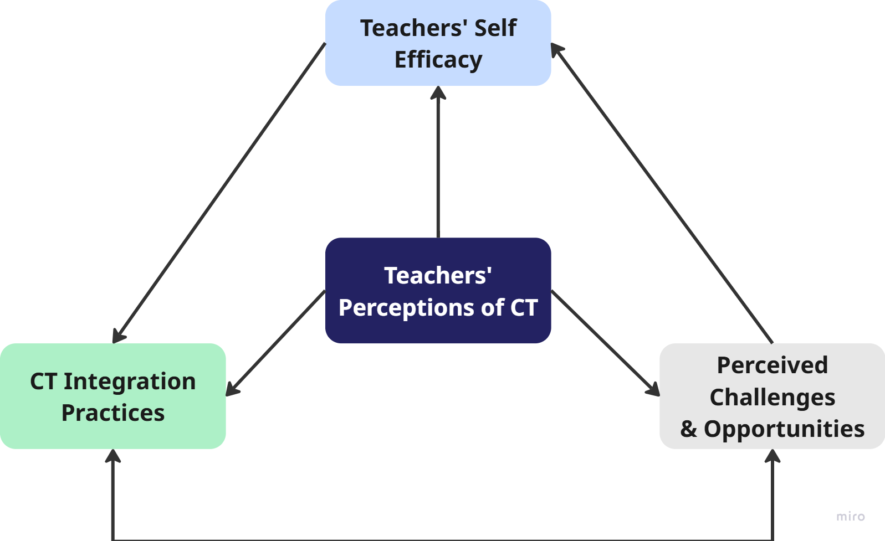

Understanding Finnish Primary Teachers’ Perceptions and Practices of Computational Thinking
Ta Thao Nguyen (ttnguyen@ufl.udn.vn)
Faculty of Foreign Languague Teacher Education, UFLS-UD
INTRODUCTION
RESEARCH QUESTIONS
Computational Thinking (CT) has been discussed in many curriculum reforms globally, and part of Finland’s National Core Curriculum since 2016, but has no explicit definition of it.
Teachers are key agents for implementation, yet prior research shows inconsistent understanding of CT.
This study asks Finnish primary teachers directly: how do you understand CT, how confident are you, and how does it show up in your classroom.
RQ1: What are teachers’ perceptions of CT?
  How do teachers integrate CT into practice?
  What opportunities/challenges arise?
RQ2: What is teachers’ self-efficacy regarding CT and its integration?
QUANTIATIVE FINDINGS
RESEARCH DESIGN
44% slightly/not familiar with the term CT — yet 81% rate it very/somewhat important
69% (22 of 32) have integrated CT-related activities, mostly in maths (73%) and problem-solving (68%), least in programming (36%)
Highest-rated opportunity: prepares students for future challenges (M=4.22); lowest-rated: makes learning relevant through real-life problems (M=3.81)
Highest-rated challenge: lack of PD opportunities (M=3.84); lowest: difficulty coordinating cross-curricular (M=3.16)
Self-efficacy extremes: want more PD (M=4.09) vs. know where to find resources (M=2.72)
Design Details | Cross-sectional survey (originally planned as mix-methods; revised due to low responses)
Sample | 32 Finnish primary teachers across grades 1-6 (72% female, ~50% with 0-5 years of experiences)
Instruments | 5-point Likert scale (perceptions, self-efficacy, opportunities, challenges), 2 open-ended items
Analysis | Descriptive statistics (SPSS) + content analysis of open responses
CONTENT ANALYSIS OF OPEN RESPONSES
DISCUSSION & IMPLICATIONS
Uncertainty in defining CT — 10 of 32 teachers hedged with words like "guess" or "not sure" when asked to define CT themselves.
  "A guess: using sequences of logical thinking to break down complex problems.“
CT-in-practice example — the clearest concrete illustration was a Finnish-language "teacher robot" task (writing step-by-step instructions, debugging when a step is missing)
    "I have used with students how to teach a teacher-robot small tasks such as drinking from a glass of water... what happens if the machine does not receive the correct instructions.“
Barriers expressed in their own words — time, structure, and training came up more than resources or curriculum text per se.
    "It is very hard to add or change one's own teaching... because of the lack of time / support / structure / education."
Understanding CT does not automatically translate into confident practice — sustained, practical professional development is the main lever, not curriculum text alone.
CT integration is already happening informally.
Curriculum guidance needs to be clearer on what CT means and how to assess it, without undermining Finnish teachers’ professional autonomy.
Language classrooms are an under-used site for CT: instruction-writing and sequencing tasks already resemble algorithmic thinking — a natural bridge for TESOL practice.
KEY TAKEWAYS
Sustained PD
Clearer Guidance
Protected Planning Time

