Slide 1
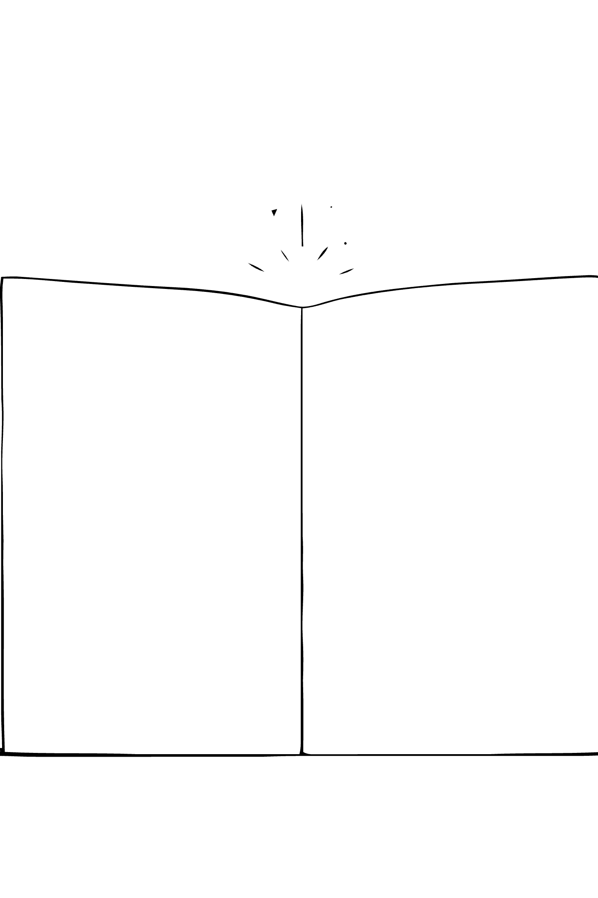




Processing Factors and Learner Strategies in
Biblical Idiom Comprehension
A Study of Vietnamese EFL Learners
LÊ ĐIỀN CHÂU ANH

Slide 2

He washed his hands of the whole affair.

Slide 3

A learner who was certain and wrong
"He washed his hands of the whole affair."
A C1 learner reads this. She answers incorrectly. She thinks it is about cleanliness.
She rates her confidence: 5 out of 5. Completely certain.
She is not guessing. Everything told her she had understood.

Slide 4
Two different questions
MOST IDIOM RESEARCH ASKS
THIS STUDY ASKS
Do learners know they are failing?
Do learners fail?
Well documented. Missing background knowledge lowers accuracy.
Not established. And this is the question that decides whether the gap ever closes.
Gap is visible → learner looks it up
Gap is invisible → nothing happens
Nobody looks up what they think they already know.
Schema theory predicts the failure (Carrell & Eisterhold, 1983); it is silent on whether learners notice it.
Calibration research asks exactly that (Lin & Zabrucky, 1998; Schraw, 2009).
4

Slide 5
Difficulty that does not announce itself
L2 readers assemble idiom meaning word by word, even when context favours the figurative reading (Cieślicka, 2006; Senaldi & Titone, 2024).
ORDINARY HARD IDIOM
BIBLICAL IDIOM
SURFACE SIGNAL
SURFACE SIGNAL
rare word, odd structure
None. Every word is frequent
LEARNER EXPERIENCE
LEARNER EXPERIENCE
“I don’t know this”
“That makes sense”
SELF-REPAIR TRIGGERED
SELF-REPAIR TRIGGERED
Yes. Looks it up
No. Nothing triggers it
Failure reports itself
The alarm never rings

Slide 6
Background on Idioms
Idioms, and one subtype that behaves strangely
Idioms in L2 Learning
L2 Processing
Biblical Idioms
Meaning is not recoverable from the individual words
General vocabulary knowledge does not guarantee success
Word-by-word assembly
Context does not stop it, even when it favours the figurative reading
High-frequency words only
A perfectly plausible literal reading
No warning signal at all
Libben & Titone (2008)
Cieślicka (2006);
Senaldi & Titone (2024)
Pinnavaia (2012)
6

Slide 7
Literature Review
How L2 learners process idioms
1973–1988
1999–2008
2006
2024
Competing accounts
of idiom access
Hybrid processing
models
Literal-Salience
Model proposed
Eye-tracking confirms
the literal bias
Bobrow & Bell (1973); Swinney & Cutler (1979);
Gibbs (1980); Cacciari & Tabossi (1988)
Libben & Titone (2008)
Cieślicka (2006)
Senaldi & Titone (2024)
all native speakers
familiarity helps consistently
L2 learners MUST compute the literal meaning
context does not rescue L2 readers
8

Slide 8
Literature Review
Do learners know when they have not understood?
The illusion of knowing
Where confidence comes from
Has the picture changed since 1982?
Two recent meta-analyses
Readers told to hunt for contradictions still rated comprehension high when they missed them
Confidence is inferred from cues, above all how fluent the processing felt
Prinz et al. (2020)
94 studies
r = 0.24
Yang et al. (2023)
115 studies · 15,889 people
Glenberg et al. (1982)
Koriat (1997)
r = 0.178
Assembling easy words feels fluent. Fluency is normally a good cue but with biblical idioms it betrays the learner.
9

Slide 9
Why this matters for Vietnamese EFL learners
THREE FACTORS, ALL WORKING AGAINST VIETNAMESE LEARNERS
Cross-language similarity
Soto-Sierra & Ferreira (2024)
LOW
Vietnamese has no biblical idiom stock — no L1 equivalent to lean on
Transparency
O’Reilly et al. (2025)
LOW
Meaning depends on a narrative, not a metaphor you can work out
Signalling in context
Pinnavaia (2012)
LOW
They circulate in ordinary, non-religious English
Nothing marks them as needing background
7

Slide 10
Three research questions
RQ1
RQ2
RQ3
Calibration
Group Differences
Strategy Profiles
How accurately do learners judge their own idiom comprehension?
How does calibration differ across three groups with different exposure to biblical narrative?
What strategy profiles emerge?

Slide 11
Methodology
Cross-sectional and correlational
Convenience sampling, deliberately over-sampling Christians so that biblical schema actually varies.
ONE SURVEY, FOUR MOVING PARTS
253
20
after EVERY item
14
adult EFL learners
in Vietnam
multiple-choice
idiom items
confidence rated 1–5
strategy items
Likert 1–5
1
2
3
4
5
10 biblical
10 everyday
factor analysis → clusters
B1 35% · B2 33% · C1 32%
1 = pure guess … 5 = completely certain
60
153
40
Non-Christian
Christian
Religious
Notes:
Say the sampling limitation yourself, in your own words.

Slide 12
Finding 1: The Comparison Set Was Harder
82.7%
68.1%
Biblical Idioms
Non-Biblical Idioms
Mean accuracy
Mean accuracy
The two sets are not "hard" and "easy."
They are hard in two different ways and that is what makes the comparison informative.

Slide 13
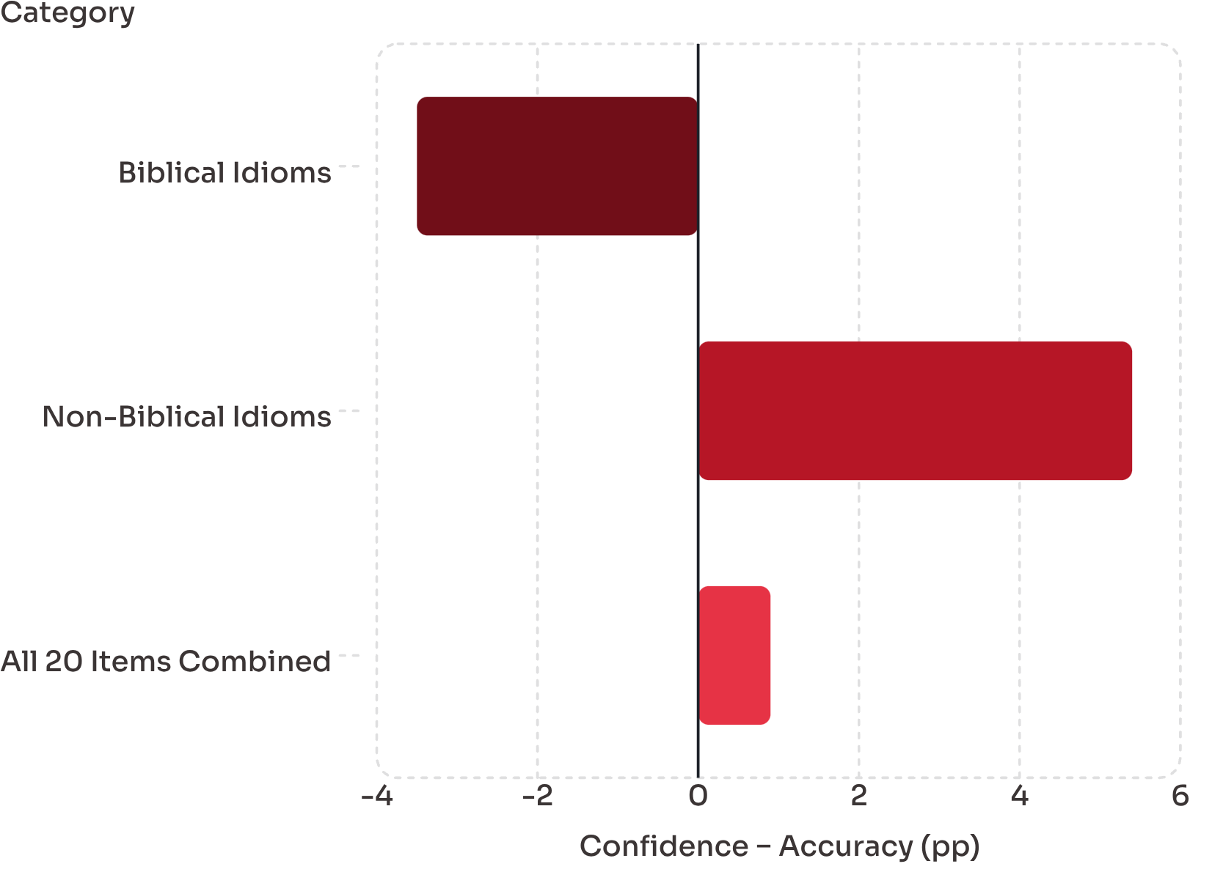
Finding 2
A perfect average, hiding two opposite errors
+0.9
All 20 combined
Not significant — they cancel out
+5.4
Non-biblical idioms
Over-confident, p < .001
−3.5
Biblical idioms
Under-confident, p = .003

Slide 14
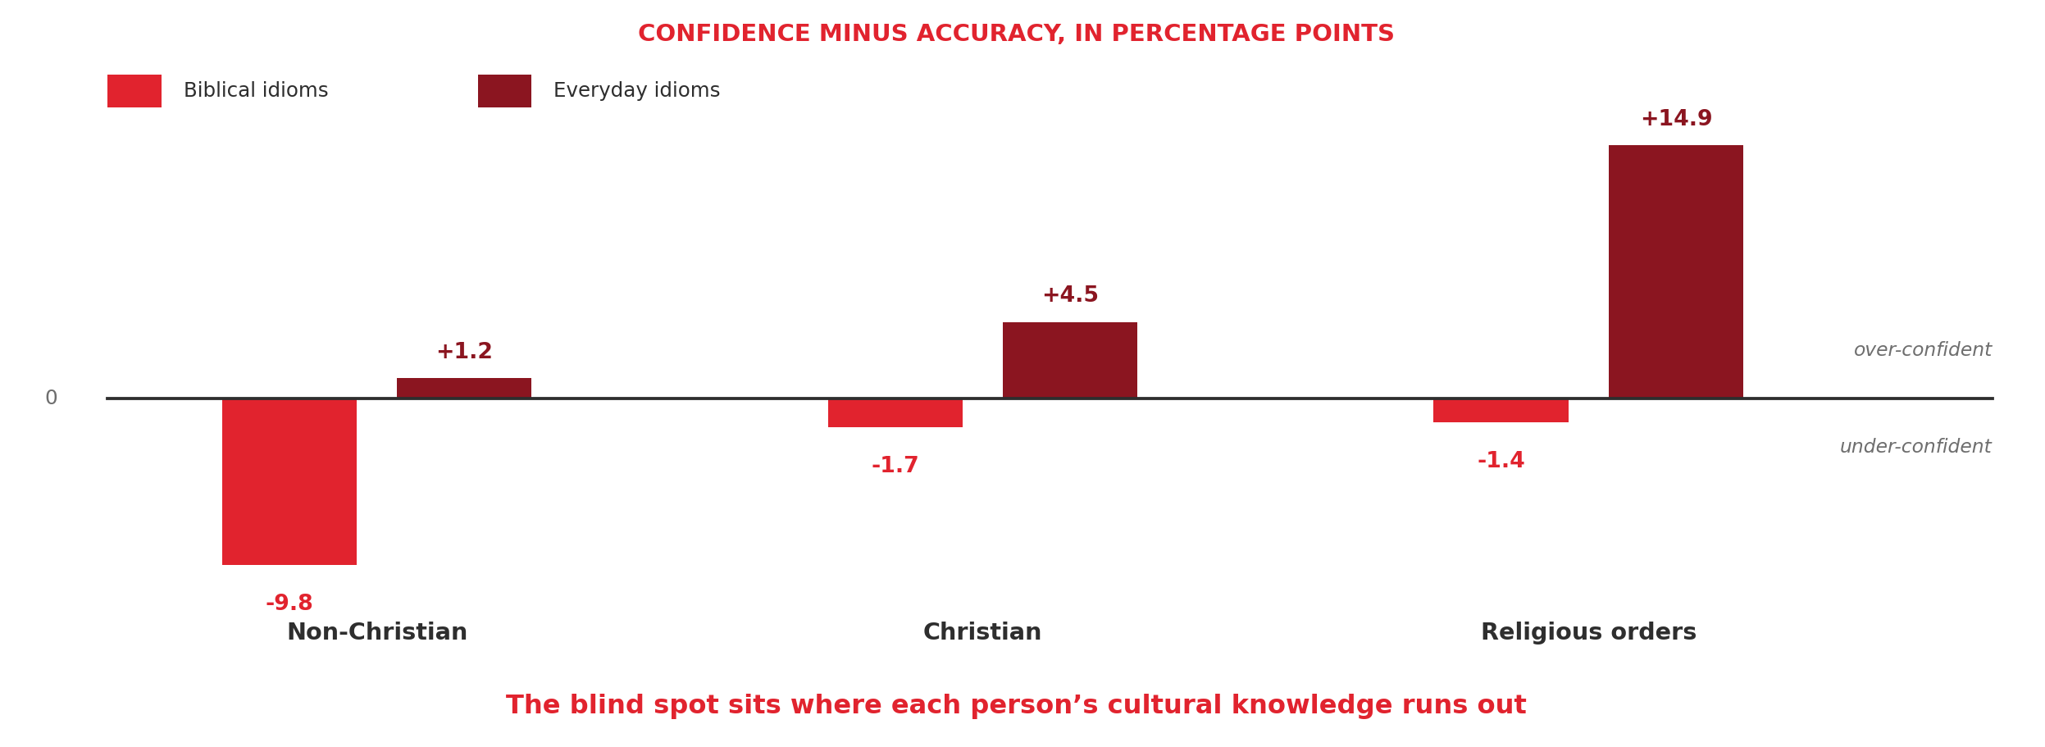
Finding 3: Every group is blind somewhere different
Non-Christian
Christians
Religious orders
Biblical 74.3% / −9.8
Everyday 74.8% / +1.2
Biblical 84.2% / −1.7
Everyday 68.2% / +4.5
Biblical 89.8% / −1.4
Everyday 57.5% / +14.9
The most cautious group — they know the gap is there
Mild over-confidence on the everyday set
Best on biblical, worst on everyday — and most confident there
14

Slide 15
Findings 4 & 5: Specificity and the Limits of Strategy
4 · THE EFFECT IS DOMAIN-SPECIFIC
5 · STRATEGIES RAISE SCORES, NOT SELF-AWARENESS
Biblical idiom score
Higher comprehension?
ρ = 0.40
✓
YES — on both idiom sets
p < .001
Everyday idiom score
Better self-assessment?
ρ = 0.11
×
NO — no difference at all
not significant
Biblical knowledge predicts biblical idiom scores and nothing else. Not a “good learners are good at everything” effect.
Even learners who agreed most strongly with “I check whether I have really understood” were no better at knowing which items they got right.
Non-Christians had the highest share of C1 learners and the lowest biblical idiom scores.
Biblical knowledge works but silently. Learners do not experience it as a distinct strategy.
15

Slide 16
Key Takeaways
1 · Cultural knowledge gaps are invisible gaps
2 · The blind spot moves with the learner
3 · Better strategies will not fix it
An unknown word announces itself. An idiom made of easy words whose meaning lives in an unheard story does not. Proficiency does not compensate.
It sits wherever each person’s cultural knowledge runs out. Non-Christians know their biblical gap and under-rate themselves; members of religious orders do not see their everyday-idiom gap.
Strategy use raises scores but not self-assessment. Since nobody looks up what they think they already know, cultural background has to be taught actively.

Slide 17
REFERENCES
Alptekin, C. (2006). Cultural familiarity in inferential and literal comprehension in L2 reading. System, 34(4), 494–508. https://doi.org/10.1016/j.system.2006.05.003
Bartlett, F. C. (1932). Remembering: A study in experimental and social psychology. Cambridge University Press.
Bobrow, S. A., & Bell, S. M. (1973). On catching on to idiomatic expressions. Memory & Cognition, 1(3), 343–346. https://doi.org/10.3758/BF03198118
Burson, K. A., Larrick, R. P., & Klayman, J. (2006). Skilled or unskilled, but still unaware of it: How perceptions of difficulty drive miscalibration in relative comparisons. Journal of Personality and Social Psychology, 90(1), 60–77. https://doi.org/10.1037/0022-3514.90.1.60
Cacciari, C., & Tabossi, P. (1988). The comprehension of idioms. Journal of Memory and Language, 27(6), 668–683. https://doi.org/10.1016/0749-596X(88)90014-9
Carrell, P. L., & Eisterhold, J. C. (1983). Schema theory and ESL reading pedagogy. TESOL Quarterly, 17(4), 553–573. https://doi.org/10.2307/3586613
Carrol, G., Conklin, K., & Gyllstad, H. (2016). Found in translation: The influence of the L1 on the reading of idioms in a L2. Studies in Second Language Acquisition, 38(3), 403–443. https://doi.org/10.1017/S0272263115000492
Carrol, G., Littlemore, J., & Gillon Dowens, M. (2018). Of false friends and familiar foes: Comparing native and non-native understanding of figurative phrases. Lingua, 204, 21–44. https://doi.org/10.1016/j.lingua.2017.11.001
Cieślicka, A. (2006). Literal salience in on-line processing of idiomatic expressions by second language learners. Second Language Research, 22(2), 115–144. https://doi.org/10.1191/0267658306sr263oa
Dörnyei, Z. (2005). The psychology of the language learner: Individual differences in second language acquisition. Lawrence Erlbaum Associates.
Farooqui, A., & Sonbul, S. (2025). "Not my cup of tea": The effect of proficiency, frequency, and congruency on L2 knowledge of idioms. Language Teaching Research. Advance online publication. https://doi.org/10.1177/13621688251351019
Gibbs, R. W. (1980). Spilling the beans on understanding and memory for idioms in conversation. Memory & Cognition, 8(2), 149–156. https://doi.org/10.3758/BF03213418
Gignac, G. E., & Zajenkowski, M. (2020). The Dunning-Kruger effect is (mostly) a statistical artefact: Valid approaches to testing the hypothesis with individual differences data. Intelligence, 80, Article 101449. https://doi.org/10.1016/j.intell.2020.101449

Slide 18
REFERENCES
Glenberg, A. M., Wilkinson, A. C., & Epstein, W. (1982). The illusion of knowing: Failure in the self-assessment of comprehension. Memory & Cognition, 10(6), 597–602. https://doi.org/10.3758/BF03202442
Jansen, R. A., Rafferty, A. N., & Griffiths, T. L. (2021). A rational model of the Dunning–Kruger effect supports insensitivity to evidence in low performers. Nature Human Behaviour, 5(6), 756–763. https://doi.org/10.1038/s41562-021-01057-0
Koriat, A. (1997). Monitoring one's own knowledge during study: A cue-utilization approach to judgments of learning. Journal of Experimental Psychology: General, 126(4), 349–370. https://doi.org/10.1037/0096-3445.126.4.349
Krueger, J., & Mueller, R. A. (2002). Unskilled, unaware, or both? The better-than-average heuristic and statistical regression predict errors in estimates of own performance. Journal of Personality and Social Psychology, 82(2), 180–188. https://doi.org/10.1037/0022-3514.82.2.180
Kruger, J., & Dunning, D. (1999). Unskilled and unaware of it: How difficulties in recognizing one's own incompetence lead to inflated self-assessments. Journal of Personality and Social Psychology, 77(6), 1121–1134. https://doi.org/10.1037/0022-3514.77.6.1121
Libben, M. R., & Titone, D. A. (2008). The multidetermined nature of idiom processing. Memory & Cognition, 36(6), 1103–1121. https://doi.org/10.3758/MC.36.6.1103
Lin, L.-M., & Zabrucky, K. M. (1998). Calibration of comprehension: Research and implications for education and instruction. Contemporary Educational Psychology, 23(4), 345–391. https://doi.org/10.1006/ceps.1998.0972
Magnus, J. R., & Peresetsky, A. A. (2022). A statistical explanation of the Dunning–Kruger effect. Frontiers in Psychology, 13, Article 840180. https://doi.org/10.3389/fpsyg.2022.840180
Nguyen, P.-B.-T., Phan, N. H., Le, T. V., Tran, L. H. T., & Pham, T. T. T. (2022). Learning idioms for English majors: Vietnamese students' perceptions of difficulties and learning strategies. European Journal of Education Studies, 9(11), 97–121. https://doi.org/10.46827/ejes.v9i11.4531
O'Malley, J. M., & Chamot, A. U. (1990). Learning strategies in second language acquisition. Cambridge University Press.
O'Reilly, D., Onysko, A., Rasse, C., Papitsch, L., Colston, H., & van der Horst, I. (2025). High ceilings and ingenuine allies: Tapping into the idiom meaning knowledge of first and second language speakers of English. Language and Cognition, 17, Article e72. https://doi.org/10.1017/langcog.2025.10029
Orfan, S. N. (2020). Afghan EFL students' difficulties and strategies in learning and understanding English idioms. Cogent Arts & Humanities, 7(1), Article 1796228. https://doi.org/10.1080/23311983.2020.1796228

Slide 19
REFERENCES
Oxford, R. L. (1990). Language learning strategies: What every teacher should know. Newbury House.
Oxford, R. L. (2017). Teaching and researching language learning strategies: Self-regulation in context (2nd ed.). Routledge.
Pinnavaia, L. (2012). Yesterday's idioms today: A corpus linguistic analysis of Bible idioms. In R. V. Fjeld & J. M. Torjusen (Eds.), Proceedings of the 15th EURALEX International Congress (pp. 701–714). University of Oslo.
Prinz, A., Golke, S., & Wittwer, J. (2020). How accurately can learners discriminate their comprehension of texts? A comprehensive meta-analysis on relative metacomprehension accuracy and influencing factors. Educational Research Review, 31, Article 100358. https://doi.org/10.1016/j.edurev.2020.100358
Rose, H., Briggs, J. G., Boggs, J. A., Sergio, L., & Ivanova-Slavianskaia, N. (2018). A systematic review of language learner strategy research in the face of self-regulation. System, 72, 151–163. https://doi.org/10.1016/j.system.2017.12.002
Schraw, G. (2009). A conceptual analysis of five measures of metacognitive monitoring. Metacognition and Learning, 4(1), 33–45. https://doi.org/10.1007/s11409-008-9031-3
Senaldi, M. S. G., & Titone, D. (2024). Idiom meaning selection following a prior context: Eye movement evidence of L1 direct retrieval and L2 compositional assembly. Discourse Processes, 61(1–2), 21–43. https://doi.org/10.1080/0163853X.2024.2311637
Soto-Sierra, V., & Ferreira, R. A. (2024). The influence of cross-language similarity and transparency on idiom knowledge in non-immersed L2 speakers. System, 122, Article 103287. https://doi.org/10.1016/j.system.2024.103287
Swinney, D. A., & Cutler, A. (1979). The access and processing of idiomatic expressions. Journal of Verbal Learning and Verbal Behavior, 18(5), 523–534. https://doi.org/10.1016/S0022-5371(79)90284-6
Titone, D. A., & Connine, C. M. (1999). On the compositional and noncompositional nature of idiomatic expressions. Journal of Pragmatics, 31(12), 1655–1674. https://doi.org/10.1016/S0378-2166(99)00008-9
Vo, T. D. M., & Nguyen, V. L. (2020). An investigation of Vietnamese EFL teenage learners' knowledge of common English idioms: Implications for idiom instruction. European Journal of Foreign Language Teaching, 5(1), 48–67. https://doi.org/10.46827/ejfl.v5i1.3178
Yang, C., Zhao, W., Yuan, B., Luo, L., & Shanks, D. R. (2023). Mind the gap between comprehension and metacomprehension: Meta-analysis of metacomprehension accuracy and intervention effectiveness. Review of Educational Research, 93(2), 143–194. https://doi.org/10.3102/00346543221094083

