Slide 1
Based On A 6-Level Hierarchy of Feedback: WHAT DO TEACHERS FOCUS ON?
The study focuses on the teaching purposes and language choices of teachers’ embedded commentary on upper secondary school EFL students’ writing within a test-oriented Vietnamese context. Well-grounded in an adapted classification framework (Derham et al., 2022; Hattie & Timperley, 2007), the research explores how educators balance the dual roles of judging and guiding. To achieve this, a quantitative document analysis was conducted on 1,434 comments extracted from 55 students’ essays, utilizing the Linguistic Inquiry and Word Count (LIWC-22) software. The findings reveal that feedback is predominantly concentrated on surface-level editorial corrections, heavily overshadowing self-regulatory guidance. Linguistically, however, teachers shift from detached, impersonal phrasing when evaluating to more personalized, insight-driven language when providing developmental feedback. These results highlight a critical need for professional development that prepares teachers to implement cognitively engaging feedback.
Nguyễn Nam Khánh
Independent scholar

Slide 2
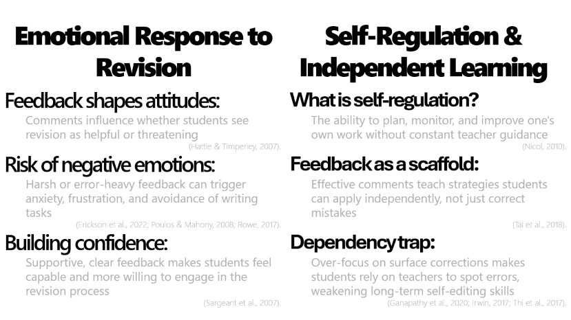
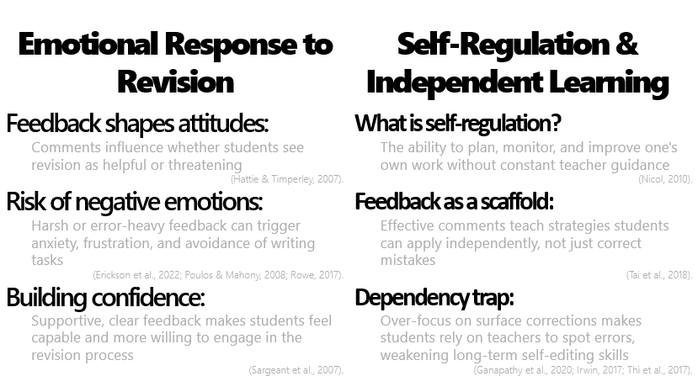
The Role of In-text Feedback:
Shapes revision attitudes and self-regulation.
(Hattie & Timperley, 2007; Wisniewski et al., 2020)

Slide 3
Emotional Response to Revision
Self-Regulation & Independent Learning
Feedback shapes attitudes:
  Comments influence whether students see revision as helpful or threatening
(Hattie & Timperley, 2007).
Risk of negative emotions:
  Harsh or error-heavy feedback can trigger anxiety, frustration, and avoidance of writing tasks
(Erickson et al., 2022; Poulos & Mahony, 2008; Rowe, 2017).
Building confidence:
  Supportive, clear feedback makes students feel capable and more willing to engage in the revision process
(Sargeant et al., 2007).
What is self-regulation?
  The ability to plan, monitor, and improve one's own work without constant teacher guidance
(Nicol, 2010).
Feedback as a scaffold:
  Effective comments teach strategies students can apply independently, not just correct mistakes
(Tai et al., 2018).
Dependency trap:
  Over-focus on surface corrections makes students rely on teachers to spot errors, weakening long-term self-editing skills
(Ganapathy et al., 2020; Irwin, 2017; Thi et al., 2017).

Slide 4
The Role of Feedback:
Shapes revision attitudes and self-regulation.
(Hattie & Timperley, 2007; Wisniewski et al., 2020)
The Problem:
Heavy reliance on direct corrective feedback due to test-oriented pressures in Vietnam.
(Luong, 2025; Nguyen et al., 2024)
Consequences:
Erodes self-editing confidence and limits authentic writing competence.
(Ganapathy et al., 2020; Thi et al., 2017)

Slide 5
Research Questions
What pedagogical patterns exist in teachers' written comments on students' writing?
  Are comments focused on surface corrections or deeper learning strategies?
How are linguistic aspects distributed across different types of in-text feedback?
  What word choices do teachers use—supportive, critical, or neutral?

Slide 6
Theoretical Framework
Adapted from Updated Framework adapted from Derham et al., 2022

Slide 7
Pedagogical Framework
Level 6: Self-regulation development feedback
(enabling students’ independence and self-assessment skill)
Level 5: Process-oriented feedback
(guidance for work improvement related to approaching the writing process and stratagies)
Level 4: Task performance feedback
(guidance for work improvement related to writing prompt)
Level 5: Process-oriented feedback
(guidance for work improvement related to approaching the writing process and stratagies)
Level 1: Personal recognition
(General compliment)
Level 2: Editorial feedback
(Focus on correcting minor issues, such as grammar, punctuation, vocabulary, and pronunciation)
Level 3: Task evaluation feedback
(work’s quality judgement without instruction for improvement)
Adapted from Updated Framework adapted from Derham et al., 2022

Slide 8
Pedagogical Framework
Level 6: Self-regulation development feedback
(enabling students’ independence and self-assessment skill)
Level 5: Process-oriented feedback
(guidance for work improvement related to approaching the writing process and stratagies)
Level 4: Task performance feedback
(guidance for work improvement related to writing prompt)
Level 5: Process-oriented feedback
(guidance for work improvement related to approaching the writing process and stratagies)
Level 1: Personal recognition
(General compliment)
Level 2: Editorial feedback
(Focus on correcting minor issues, such as grammar, punctuation, vocabulary, and pronunciation)
Level 3: Task evaluation feedback
(work’s quality judgement without instruction for improvement)
Adapted from Updated Framework adapted from Derham et al., 2022

Slide 9
Pedagogical Framework
Level 6: Self-regulation development feedback
(enabling students’ independence and self-assessment skill)
Level 5: Process-oriented feedback
(guidance for work improvement related to approaching the writing process and stratagies)
Level 4: Task performance feedback
(guidance for work improvement related to writing prompt)
Level 5: Process-oriented feedback
(guidance for work improvement related to approaching the writing process and stratagies)
Level 1: Personal recognition
(General compliment)
Level 2: Editorial feedback
(Focus on correcting minor issues, such as grammar, punctuation, vocabulary, and pronunciation)
Level 3: Task evaluation feedback
(work’s quality judgement without instruction for improvement)
Adapted from Updated Framework adapted from Derham et al., 2022

Slide 10
Pedagogical Framework
Level 6: Self-regulation development feedback
(enabling students’ independence and self-assessment skill)
Level 5: Process-oriented feedback
(guidance for work improvement related to approaching the writing process and stratagies)
Level 4: Task performance feedback
(guidance for work improvement related to writing prompt)
Level 5: Process-oriented feedback
(guidance for work improvement related to approaching the writing process and stratagies)
Level 1: Personal recognition
(General compliment)
Level 2: Editorial feedback
(Focus on correcting minor issues, such as grammar, punctuation, vocabulary, and pronunciation)
Level 3: Task evaluation feedback
(work’s quality judgement without instruction for improvement)
Adapted from Updated Framework adapted from Derham et al., 2022

Slide 11
Pedagogical Framework
Level 6: Self-regulation development feedback
(enabling students’ independence and self-assessment skill)
Level 5: Process-oriented feedback
(guidance for work improvement related to approaching the writing process and stratagies)
Level 4: Task performance feedback
(guidance for work improvement related to writing prompt)
Level 5: Process-oriented feedback
(guidance for work improvement related to approaching the writing process and stratagies)
Level 1: Personal recognition
(General compliment)
Level 2: Editorial feedback
(Focus on correcting minor issues, such as grammar, punctuation, vocabulary, and pronunciation)
Level 3: Task evaluation feedback
(work’s quality judgement without instruction for improvement)
[Adapted from Updated Framework adapted from Derham et al., 2022]

Slide 12
An opinion essay on the topic "Social media is beneficial for teenagers"
5
Example of feedback – level
“Your body paragraphs each contain a clear main point. To improve the structure and flow for your next essay, try using more varied transition words to guide the reader from one paragraph to the next. Using phrases like 'Furthermore,' 'On the other hand,' or 'In addition' will make your writing more professional. Please use this link to the list of transition words we reviewed in class to practice for future assignments.”
6
Example of feedback - level
“Remember in our last lesson when we discussed how the strongest opinions often acknowledge the other side of the argument? You've provided some excellent examples of social media's benefits. Now, to make your point even more persuasive, think about how you could briefly mention a common concern (like online safety) and then explain why you believe the benefits still outweigh that risk. Re-reading your work with this strategy in mind will help you build more convincing arguments in your future essays.”
4
Example of feedback – level
“Your introduction gives a good background on the topic, but your main opinion is not stated clearly. In this essay, your thesis statement should directly state whether you agree or disagree with the prompt. You need to rewrite this sentence to clearly present your position so the reader knows exactly what you will argue.”

Slide 13
Key Findings – Feedback Patterns
Dominance of Surface-level Correction:
Editorial feedback (Level 2): 64.9% (Most frequent).
Task evaluation (Level 3): 15.7%.
Scarcity of Developmental Guidance:
Process-oriented feedback (Level 5): 4.4%.
Self-regulation development (Level 6): 1.6%.
Emphasis on short-term text improvement rather than metacognitive skill cultivation.

Slide 14
More feedback doesn’t always mean better outcomes…excessive feedback leads to cognitive load
(Mujtaba et al., 2024)

Slide 15
Linguistic Framework
Henderson, M., Ajjawi, R., Boud, D., & Molloy, E. (2019). Identifying Feedback That Has Impact. In The Impact of Feedback in Higher Education (pp. 15–34). Springer International Publishing. https://doi.org/10.1007/978-3-030-25112-3_2

Slide 16
Key Findings – Linguistic Analysis

Slide 17
Key Findings – Linguistic Analysis
RESULTS
RQ2: How are linguistic aspects distributed across different types of in-text feedback?
Impersonal pronouns (19%)
“it”, “this” and “these”
focus on the task rather than the student
establish a neutral evaluative stance.
TABLE 2. IN-TEXT COMMENTS ACROSS LINGUISTIC DOMAINS BY COMMENT CATEGORY

Slide 18
PERSONAL PRONOUNS
❌: You made this sentence sound awkward
✅: This sentence sounds awkward
IMPERSONAL PRONOUNS
#neutral
#objective
#sugarcoated
keeps the student from feeling defensive and keeps the door open for revision and learning.

Slide 19
Key Findings – Linguistic Analysis
RESULTS
RQ2: How are linguistic aspects distributed across different types of in-text feedback?
Curiosity
guided questions
helps students at different linguistic proficiency to reach a higher levels of reflective writing skill.
fostering a safer emotional environment
Personal pronouns
words like “you”, “your” and occasionally “I”
teachers create a more interpersonal dynamic that acknowledges the students’ agency in the learning process.
Discrepancy
“should”, “would”, and “could”
signal normative expectations and potential improvements, guiding students toward specific corrective actions.
a shift towards more personalized guidance while maintaining task focus
TABLE 2. IN-TEXT COMMENTS ACROSS LINGUISTIC DOMAINS BY COMMENT CATEGORY

Slide 20
Key Findings – Linguistic Analysis
RESULTS
RQ2: How are linguistic aspects distributed across different types of in-text feedback?
Discrepancy
“would”, “should”, and “could”
function as bridges to future improvements.
Insight
“think”, “know”, and “understanding”
encourage students to reflect on their process and develop greater self-awareness.
Positive emotion
“good”, “better”, and “improve”
create an optimistic framework for growth that can enhance students’ engagement and self-efficacy.
a distinct shift toward growth-oriented, future-focused guidance.
TABLE 2. IN-TEXT COMMENTS ACROSS LINGUISTIC DOMAINS BY COMMENT CATEGORY

Slide 21
Key Findings – Linguistic Analysis
Highest use of impersonal pronouns (19%) and differentiation words (21%) -> Detached & neutral stance.
Highest use of impersonal pronouns (19%) and differentiation words (21%) -> Detached & neutral stance.
Highest use of impersonal pronouns (19%) and differentiation words (21%) -> Detached & neutral stance.

Slide 22
Discussion & Pedagogical Implications
Key Insights
Practical Steps
Too much correction backfires
  Focusing only on fixing errors can overwhelm students and distract them from learning bigger writing skills
(Mujtaba et al., 2024)
For teachers
  Instead of correcting every single mistake, try asking guiding questions like, "Does each sentence express a complete thought?" This helps students learn to self-edit
(Pollari & Leontjev, 2023).
Trust matters
  When teachers use supportive language, students feel safer and are more open to feedback
(Telio et al., 2015; Erickson et al., 2022)
For schools
  Training programs should help teachers understand different feedback types and the real impact of their word choices—not just what to correct, but how to say it.
Better feedback = Less surface correction + More supportive, thought-provoking guidance

Slide 23
Conclusion & Limitations
Conclusion
Effective feedback relies on both the pedagogical level targeted and the relational/cognitive language used to deliver it.
Limitations
Small sample size, single public-school context, single coder, and lack of data on students' long-term reactions.
Future Research
Incorporate student perspectives, formal inter-rater agreement (e.g., Cohen's kappa), and track long-term writing outcomes.

