Slide 1
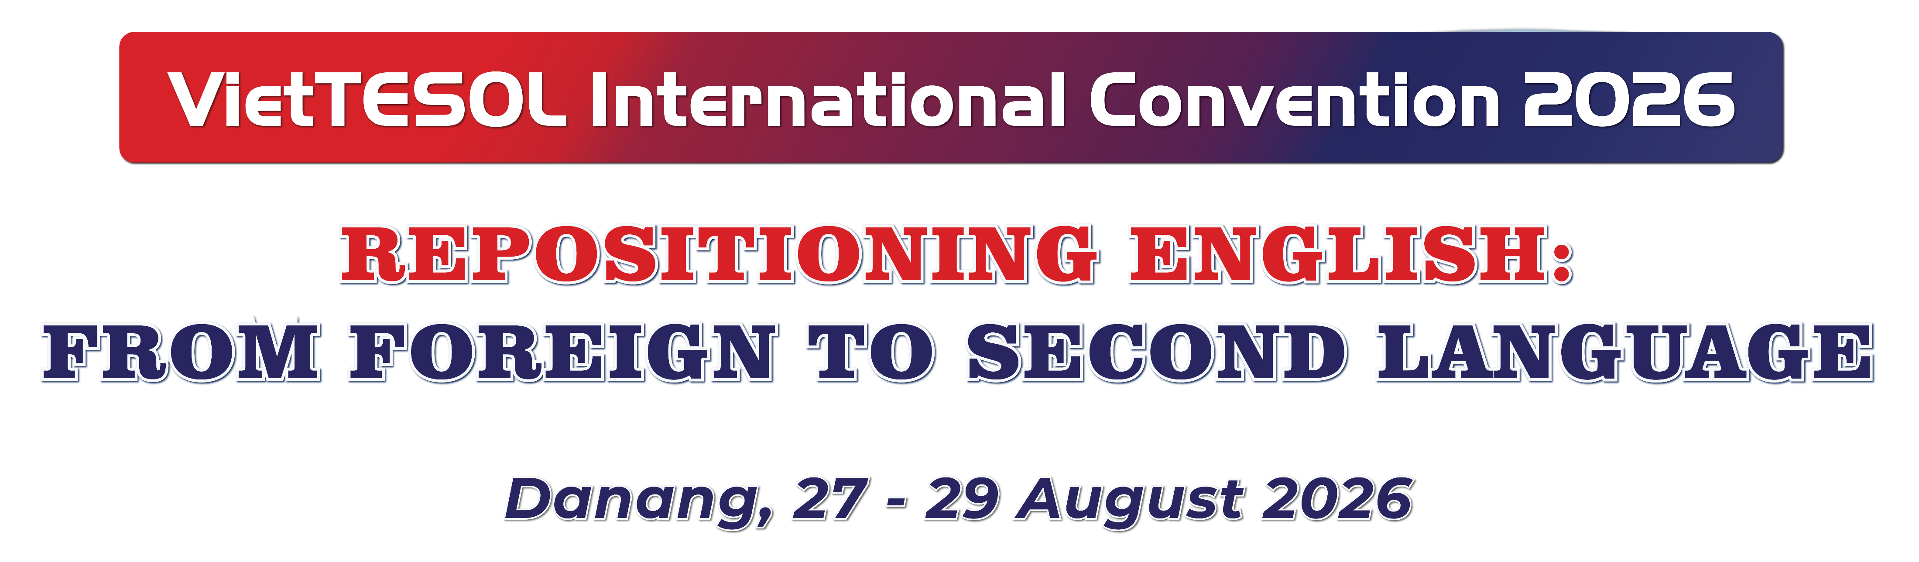





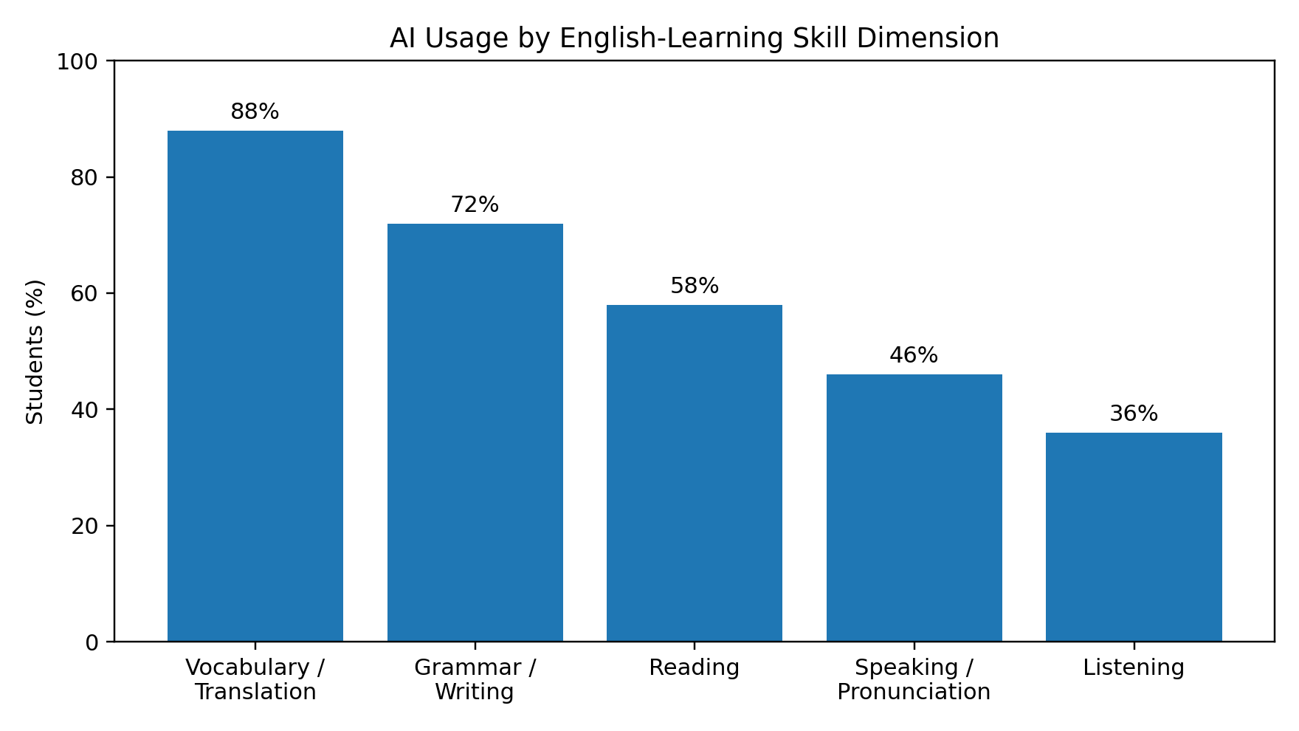
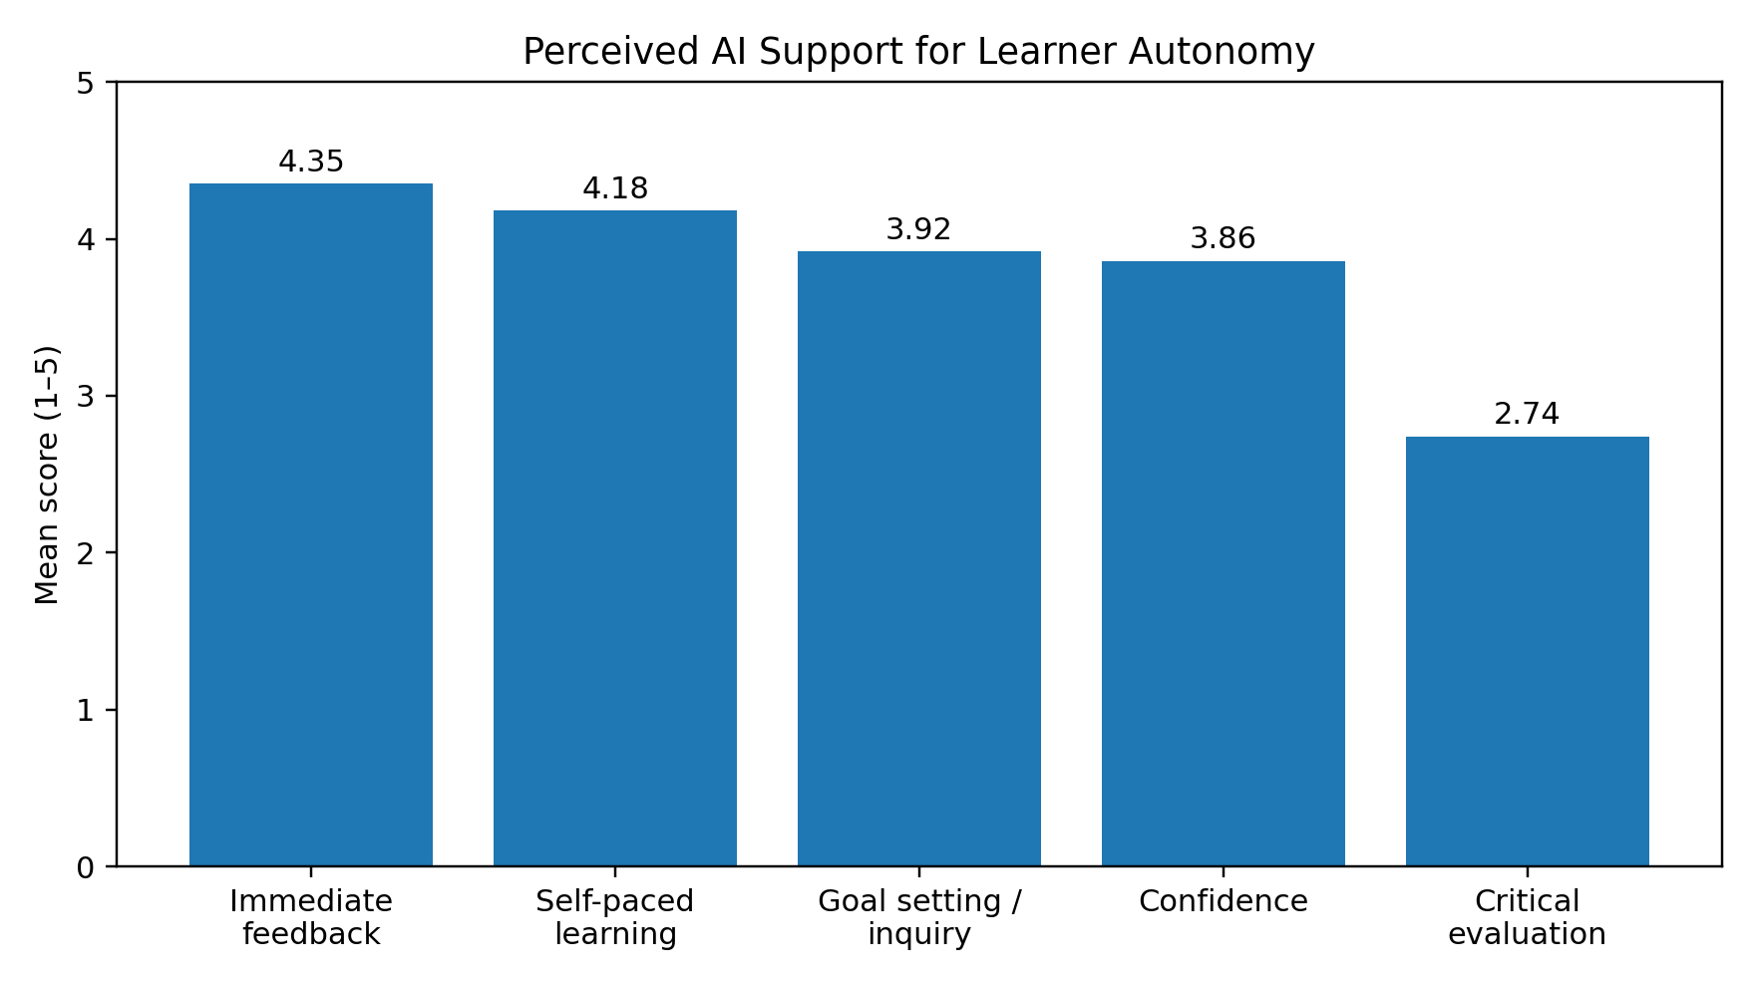
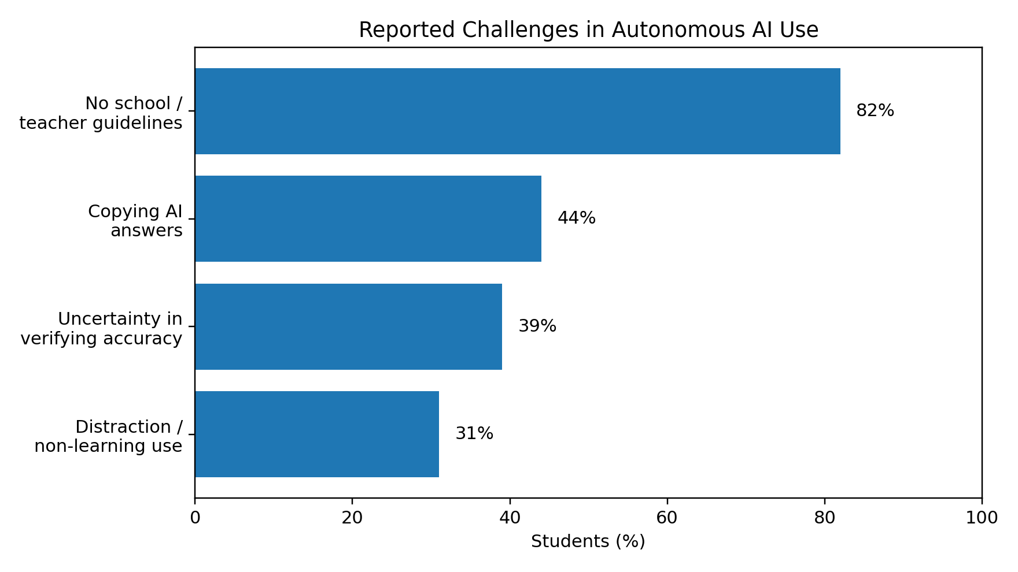

ID#2311- Technology Use and Learner Autonomy: A Study of English Students in Public High Schools in Suburban Hanoi, Vietnam
TRINH CONG MINH, 2026
Hanoi Pedagogical University 2
Abstract
This study examines the role of Artificial Intelligence (AI) tools in fostering learner autonomy among English as a Foreign Language (EFL) high school students in suburban Hanoi and adjacent regions. An explanatory sequential mixed-methods design was conducted with 150 students from three public high schools: Xuan Hoa High School, Phuc Yen High School, and Me Linh High School, with 50 students from each school across Grades 10–12. Quantitative data were collected through a 20-item five-point Likert-scale questionnaire, followed by semi-structured interviews with 12 students. The findings indicate that students most frequently used AI for vocabulary and translation (88%), followed by grammar checking and writing (72%), reading comprehension (58%), speaking and pronunciation (46%), and listening practice (36%). Students reported particularly strong support from AI for immediate feedback (M = 4.35) and self-paced learning (M = 4.18), while critical evaluation of AI-generated suggestions was comparatively weak (M = 2.74). The qualitative evidence further highlighted copying of AI-generated answers, uncertainty about verifying accuracy, and the absence of explicit school or teacher guidance. The findings suggest that AI can facilitate functional independence in English learning, but access to AI alone does not guarantee reflective learner autonomy. Explicit pedagogical guidance and critical evaluation practices are therefore important for helping students use AI as a learning resource rather than as a substitute for thinking.
Keywords: Artificial intelligence; learner autonomy; EFL learning; suburban high schools; educational technology.
1.1. Context and Problem Statement
The integration of Artificial Intelligence (AI) into Computer-Assisted Language Learning (CALL) has expanded rapidly. For public high school students in suburban and peri-urban areas such as Xuan Hoa, Phuc Yen, and Me Linh, access to intensive foreign-language environments and private language academies may be more constrained than in central metropolitan districts. AI applications such as ChatGPT, ELSA Speak, QuillBot, and LingoDeer have consequently emerged as accessible sources of language-learning support.
However, technological availability should not be equated with learner autonomy. Learner autonomy involves learners taking charge of aspects of their learning, including setting goals, selecting resources, monitoring progress, and evaluating learning outcomes. When AI is used without structured guidance, students may complete tasks more efficiently while engaging less deeply with the language and with the reasoning behind AI-generated answers. The central issue, therefore, is not simply whether students use AI, but how AI use interacts with different dimensions of learner autonomy.
1.2. Research Questions
RQ1. What are the prevalent patterns and frequencies of AI tool usage for English learning among high school students in the targeted suburban schools?
RQ2. To what extent does the use of AI tools enhance learner autonomy across core English language skills?
Q3. What challenges and behavioral limitations do students face when utilizing AI tools autonomously?
4. Findings and Discussion
1. Introduction
4.1. Patterns of AI Use (RQ1)
Vocabulary acquisition and translation were the dominant AI use cases, reported by 88% of students. Grammar checking and writing followed at 72%, while reading comprehension, speaking/pronunciation, and listening accounted for 58%, 46%, and 36%, respectively. The pattern indicates that students were more likely to use AI for tasks that provide immediate linguistic assistance than for productive oral or listening practice.
4.2. Perceived Contribution to Learner Autonomy (RQ2)
The strongest reported dimension was immediate error correction and feedback (M = 4.35, SD = 0.65), followed by self-paced learning and flexibility (M = 4.18, SD = 0.72). Personalized goal setting and inquiry received M = 3.92 (SD = 0.81), while confidence in low-anxiety practice was M = 3.86 (SD = 0.78). By contrast, critical evaluation of AI suggestions was substantially lower (M = 2.74, SD = 0.94). This contrast is central to the study. AI appears to provide strong functional affordances—especially speed, feedback, and flexibility—while the reflective dimension of autonomy is weaker. Thus, students may become more independent in accessing assistance without necessarily becoming equally independent in judging whether that assistance is accurate or appropriate.
Figure 1. AI usage by English-learning skill dimension (N = 150).
2. Literature Review
2.1. Conceptualizing Learner Autonomy in Language Acquisition
Learner autonomy in language education entails self-determination in setting learning objectives, selecting relevant materials, monitoring progress, and conducting self-assessment (Benson, 2011; Little, 2007). Autonomous learners are expected to exercise agency over learning decisions and to reflect on their learning processes. Cotterall (2000) further emphasizes the role of curriculum design in creating conditions that support autonomous learning.
2.2. AI-Assisted Language Learning and Autonomy
AI-driven language applications can provide adaptive support, automated feedback, speech-recognition practice, and access to learning resources. These affordances may support self-paced learning and reduce barriers to obtaining immediate assistance. In EFL contexts, AI can therefore function as an accessible learning partner or tutor, particularly outside the classroom.
2.3. Cognitive Offloading and Over-Reliance Risks
The benefits of AI are accompanied by risks. When learners accept AI-generated answers without checking, explaining, or revising them, cognitive effort may be shifted from the learner to the technology. Such cognitive offloading can undermine the reflective component of autonomy. The present study therefore considers both the enabling and constraining dimensions of AI-supported English learning.
Figure 2. Mean scores for reported AI-supported autonomy dimensions (1–5 scale).
4.3. Challenges and Behavioral Limitations (RQ3)
The most frequently reported challenge was the absence of explicit school or teacher guidance concerning AI use (82%). In addition, 44% of students acknowledged a tendency to copy AI-generated answers passively, 39% reported uncertainty about verifying accuracy, and 31% reported distraction or non-learning use. These findings suggest that the educational value of AI depends substantially on how students are guided to interrogate, verify, and transform AI outputs.
Figure 3. Reported challenges in autonomous AI use.
3.1. Research Design and Sampling
The study employed an explanatory sequential mixed-methods design. A sample of 150 students was drawn equally from three public high schools. Each school contributed 50 students distributed across Grades 10, 11, and 12. The sample included 50 Grade 10, 50 Grade 11, and 50 Grade 12 students in total.
3.2. Instruments and Data Collection
The quantitative instrument consisted of 20 items rated on a five-point Likert scale (1 = Strongly Disagree; 5 = Strongly Agree). The items addressed AI utilization, perceived support for learner autonomy, and practical challenges. Qualitative data were collected through semi-structured interviews with 12 students, four from each school, to provide contextual explanations for the quantitative patterns.
3.3. Data Analysis
Quantitative results were summarized using percentages, means, and standard deviations. The qualitative component was used to identify behavioral patterns and challenges associated with students’ autonomous AI use. Because the original dataset reported in the study is descriptive, the present interpretation avoids treating the reported means as evidence of a causal effect of AI.
3.4. Ethical Considerations
The study involved high school students and therefore requires appropriate institutional permission, informed consent/assent procedures, confidentiality, and voluntary participation. These procedural details should be stated explicitly in the final submission if they were implemented in the original data collection.
5. Conclusion and Pedagogical Implications
AI technology presents clear opportunities for independent English learning among public high school students in suburban Hanoi and adjacent areas. The findings show strong perceived support for immediate feedback and self-paced learning, but considerably weaker performance in critical evaluation. The central implication is that AI access alone is insufficient for developing genuine learner autonomy.
5.1. Implications for Teachers
Teachers can integrate prompt engineering and output-critique activities into English lessons. Students can be asked to identify grammatical errors, awkward phrasing, unsupported claims, or alternative answers in AI-generated materials before producing their own responses.
5.2. Implications for Schools
Schools can establish clear expectations for ethical AI use and provide digital-AI-literacy activities that address verification, attribution, privacy, and responsible use. The high percentage reporting a lack of guidance indicates a need for institutionally consistent support.
5.3. Limitations and Future Research
The study is based on self-reported data from 150 students in three public high schools and therefore should not be generalized beyond the sampled context without caution. The descriptive design also limits causal claims about AI and learner autonomy. Future research can strengthen the evidence through validated autonomy measures, longitudinal designs, pre/post comparisons, comparison groups, and more systematic qualitative integration.
References
Benson, P. (2011). Teaching and researching: Autonomy in language learning (2nd ed.). Routledge.
Cotterall, S. (2000). Promoting learner autonomy through the curriculum: Principles for designing language courses. ELT Journal, 54(2), 109–117.
Godwin-Jones, R. (2023). Partnering with AI: Intelligent agents as tutors, conversation partners, and collaborators in language learning. Language Learning & Technology, 27(2), 1–21.
Holec, H. (1981). Autonomy and foreign language learning. Pergamon Press.
Kohnke, L., Moorhouse, B. L., & Zou, D. (2023). ChatGPT for language teaching and learning. RELC Journal, 54(2), 537–550.
Little, D. (2007). Language learner autonomy: Some fundamental considerations revisited. Innovation in Language Learning and Teaching, 1(1), 14–29.
Warschauer, M., & Ware, P. (2006). Automated writing evaluation: Defining the classroom research agenda. Language Teaching Research, 10(2), 157–180.
3. Methodology
5. Conclusion and Pedagogical Implications
School | Grade 10 | Grade 11 | Grade 12 | Total
Xuan Hoa High School | 17 | 17 | 16 | 50
Phuc Yen High School | 16 | 17 | 17 | 50
Me Linh High School | 17 | 16 | 17 | 50
Total | 50 | 50 | 50 | 150
Faculty of English
Hanoi Pedagogical University 2

