Slide 1

Can a translation preserve everything?
“Nói đùa đấy, chứ đây mà lại chả cần đấy thì đấy cần đếch gì đây? Thôi đi, làm bộ vừa vừa chứ... Bán một xu nào.”
the same message?
“I’m kidding. Of course I need you! We need each other! Take it easy. Give me a xu’s worth of sugarcane.”
Is this …

Slide 2
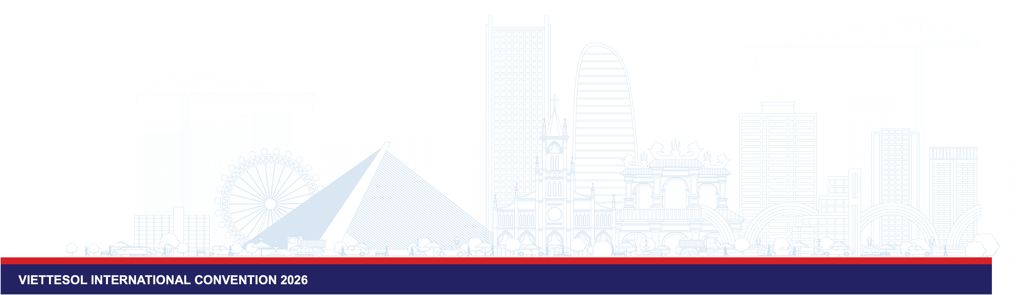
Why does it matter?
Preserve the original?
Globalization
Translation connects cultures
Produce natural English?
loss
Vietnamese Literature
Bring Vietnamese voices to global readers
&
Translation Challenge
Meaning • Style • Naturalness
gain

Slide 3





LOSS AND GAIN IN DUMB LUCK - THE TRANSLATION OF SỐ ĐỎ BY VU TRONG PHUNG
Luu Quy Khuong ¹, Nguyen Manh Tuong ^{2*}
¹ The University of Da Nang, University of Foreign Language Studies
^{2*} Dong A University

Slide 4
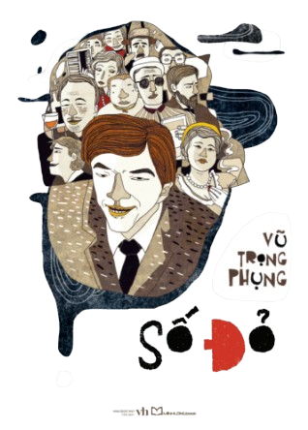
What Is Missing?
Previous studies:
English-Vietnamese translation
Specific translation strategies
Particular linguistic or cultural phenomena
Our gap:
Vietnamese-English literary translation
Systematic translation procedures
Lexical • Structural • Pragmatic
humor
                G. Mîndreci, “Managing gains and losses in translations”, Management Strategies Journal, vol. 31, no. 1, pp. 139–145, 2016.
                I. G. A. Utamayasa, I. W. Pastika, and N. W. Sukarini, “Loss and gain in translation process in Big Nate comic strips books into Indonesian”, Journal of Language and Translation Studies, vol. 3, no. 1, 2017. https://www.academia.edu/download/79057682/17831.pdf
                S. M. Sari, “Translation techniques of loss and gain in the translation of novel If I Stay”, CaLLs (Journal of Culture, Arts, Literature, and Linguistics), vol. 6, no. 1, pp. 17–28, 2020.
                N. T. Q. Hoa and N. T. M. Tam, “Loss and gain in the Vietnamese translational equivalents of stylistic devices used in the novel series The Lord of the Rings by J. R. R. Tolkien”, The University of Danang - Journal of Science and Technology, vol. 18, no. 6, pp. 106–111, 2020. https://doi.org/10.31130/jst-ud2020-105E
                L. T. Nhung, “An investigation into loss and gain in the translation of a comic ‘The Adventures of Tintin: Tintin in America’ into Vietnamese version ‘Những cuộc phiêu lưu của Tintin: Tintin trên đất Mỹ’”, Master’s thesis, The University of Danang, Da Nang, 2020. https://data.ufl.udn.vn/handle/UFL/460
                D. T. M. Hien and T. T. T. Thao, “Loss and gain phenomena in the English translations of conceptual metaphors of ‘human status’ in Trinh Cong Son’s songs”, The University of Danang - Journal of Science and Technology, pp. 70–73, 2016.
                N. T. Q. Hoa and T. T. Y. Nhi, “Loss and gain in the Vietnamese translation of stylistic devices used in Uncle Tom’s Cabin by Harriet Beecher Stowe”, The University of Danang - Journal of Science and Technology, 2017.
                I. Oudad and N. Azmi, “Loss and gain in translating culture: Year of the Elephant’s novella as a case study”, International Journal of Language and Literary Studies, vol. 5, no. 1, 2023. https://doi.org/10.36892/ijlls.v5i1.1242
                Q. Wang, M. Amini, and D. T. A. L. Tan, “Loss, gain, and equivalence in the translation of culture-loaded words in To Live: A Novel”, International Journal of Language, Literacy and Translation, vol. 8, no. 1, pp. 17–34, 2025. https://doi.org/10.36777/ijollt2025.8.1.117
                T. T. T. Hương, “An investigation into loss and gain in English–Vietnamese translational version of the book ‘Happy Teachers Change the World’ by Thich Nhat Hanh and Katherine Weare”, Master’s thesis, The University of Danang, Da Nang, 2020.
                T. Goldfajn, “Translation and loss-aversion”, TTR: Traduction, Terminologie, Rédaction, vol. 33, no. 1, pp. 81–98, 2020. https://doi.org/10.7202/1071149ar
                J. L. Itieba, D. Barasa, and B. Mudogo, “Contextual meaning loss and gain in the translation of George Orwell’s Animal Farm from English to Kiswahili”, Nairobi Journal of Humanities and Social Sciences, vol. 7, no. 2, 2023. https://doi.org/10.58256/b41mnc92
wordplay
irony

Slide 5
i. What types of loss and gain occur in Dumb Luck?
RESEARCH QUESTIONS
ii. How are they manifested at three linguistic levels?
Lexical | Structural | Pragmatic
iii. What factors contribute to their occurrence?

Slide 6
Theoretical Framework
[5] S. Bassnett
Translation Studies.
London: Routledge, 2002.
[1] M. Baker
In Other Words: A Course Book for Translation, 3rd edition.
New York: Routledge, 2018.
[2] P. Newmark
A Textbook of Translation.
London: Longman, 1988.
loss & gain
translation procedures
multi-level equivalence

Slide 7
Data & Methodology
Methods
Contrastive
Descriptive
Statistical
Qualitative
Data sources:
Số đỏ (Vietnamese)
Dumb Luck (English translation)
Sampling:
20 chapters × 5 samples = 100 translation units
Coding:
Loss / Gain: Lexical | Structural | Pragmatic

Slide 8
96 Loss
More frequent
WHAT IS FOUND?
100
units
62 Gain
Systematic pattern

Slide 9
L
O
S
S

Slide 10
Lexal loss:
“cò kè bớt một thêm hai” => “bargain”
“đêm thu tịch mịch” => “autumn night”
L
O
S
S
Structural loss:
“nhà nước cũng khôn” => “state’s clever decision”
Pragmatic loss:
“tiêu thụ một bữa cơm” => “eating an elegant meal”
“Mời hai ngài vào!” => “After you, Gentlemen,” he said sarcastically
c

Slide 11
G
A
I
N

Slide 12
Lexal gain:
“Quan Phù Thái Tuế”
=> “my stars - Quan Phù and Thái Tuế”
G
A
I
N
Structural gain:
“chơi” => “swung their rackets”
Pragmatic gain:
“rất xứng đáng với chức du học sinh”
=> “and more than deserving of the exalted title foreign exchange student”

Slide 13
Key insights
Loss
modifiers
style
impliciness
Gain
clarity
naturalness
expliciness
Communicative balance
meaning ~ readbility

Slide 14
Translation is about strategically redistributing meaning
without compromising the author’s voice
or the target reader’s natural reading experience.
So what?

Slide 15
Implications
Translation Teaching:
Recognize & justify loss and gain
Translation Handbook
non-equivalence cases
compensatory strategies
Professional translators:
Balance fidelity and naturalness
Translation Handbook:
Decision-making checklist

Slide 16
THANK YOU
FOR YOUR TIME AND ATTENTION

