Slide 1

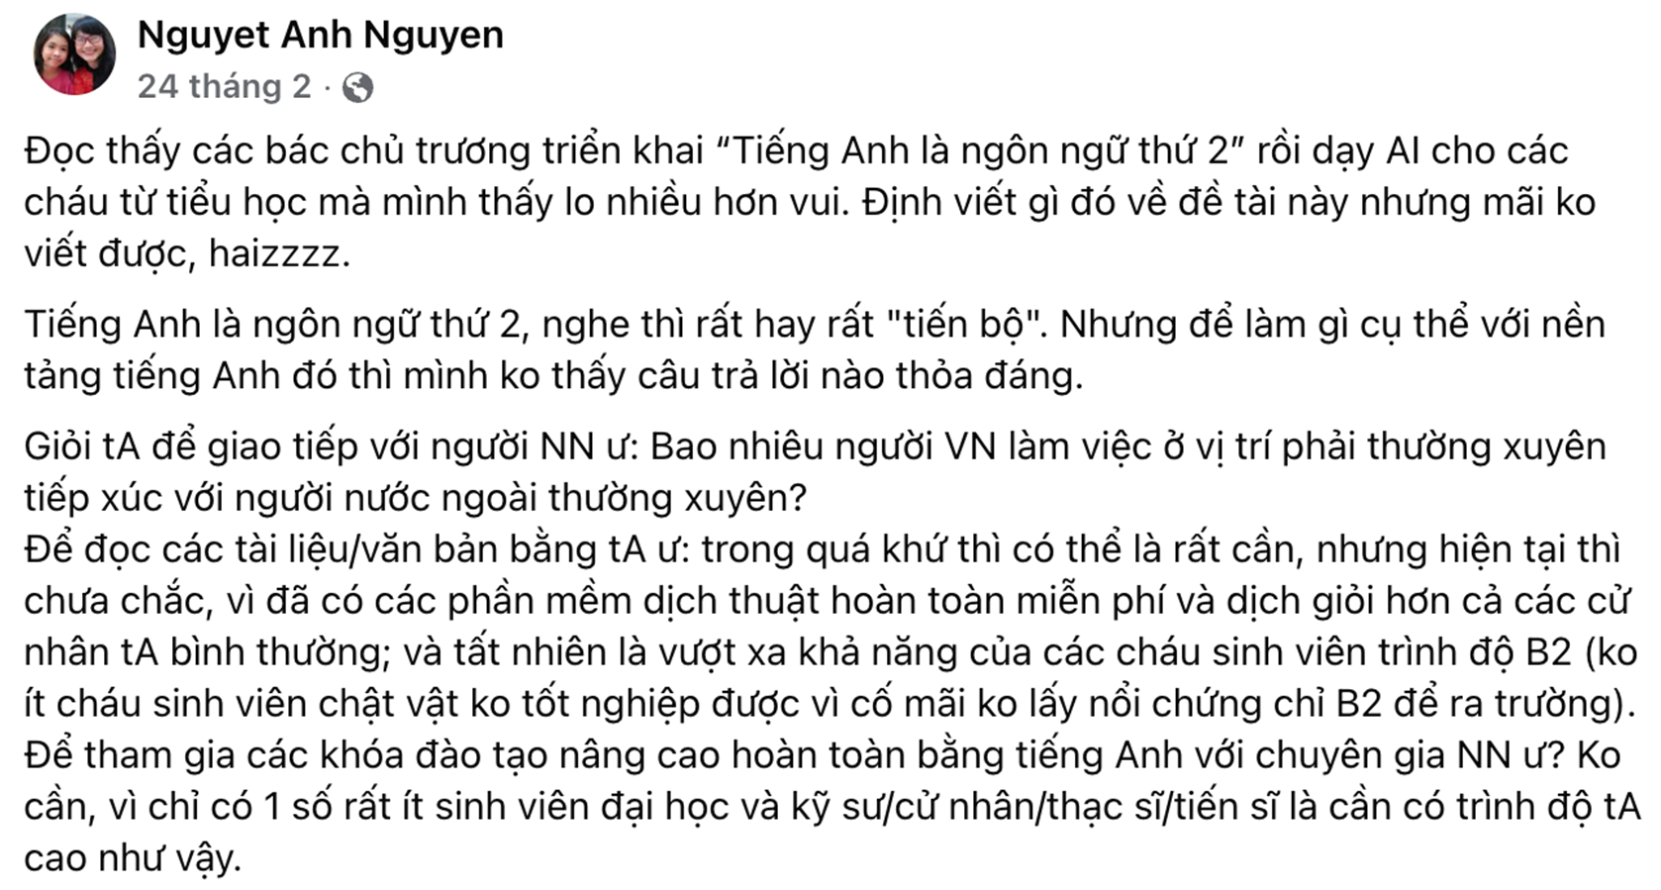




Slide 2





Handbooks for Supporting
Vietnamese Students’ Use of English
in Classroom Interaction
Group members: Ngoc Diep, Hoai An, Dang Thu
Supervisor: Ph.D Tran Huong Quynh
Presenter: Dang Thu
Da Nang, 28/08/2026

Slide 3







Table of Contents
Research
Methodology
Findings & Discussion
Introduction
Handbooks
in use

Slide 4
Introduction

Slide 5
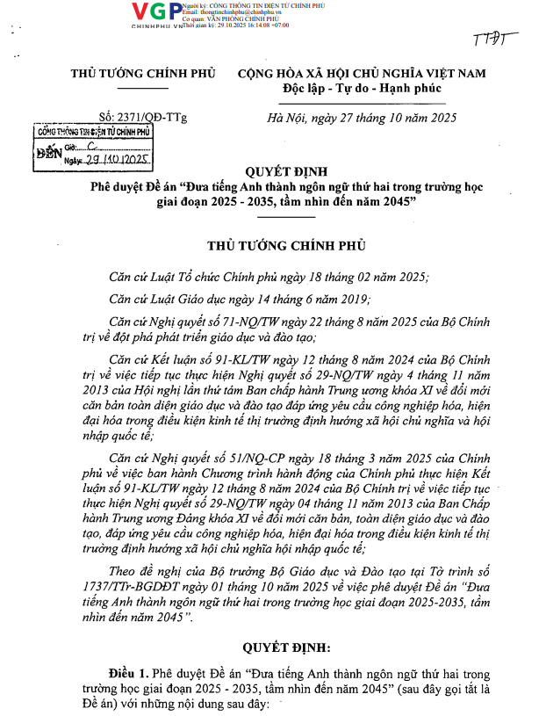
POLICY CONTEXT
Decision
No. 2371/QĐ-TTg
Oct 27, 2025
‘INTRODUCING ENGLISH AS A
SECOND LANGUAGE IN SCHOOLS,
2025–2035, VISION TO 2045'

Slide 6
RESEARCH RATIONALE
01
02
03
04
Policy goal
Classroom need
Practical gap
Our response
A handbook providing classroom English expressions for familiar school situations.
English should become a second language in schools.
Students need English for daily classroom interactions.
Many students lack short, ready-to-use expressions for real-time communication.

Slide 7
RESEARCH QUESTIONS
1. What English language patterns and expressions do pupils currently use in recurring classroom interaction situations? What additional expressions do they need in those situations?
2. How can a set of classroom-English guidelines and handbooks support students in using English more confidently and appropriately in classroom interaction?

Slide 8
Research
Methodology

Slide 9
RESEARCH DESIGN
AND DEVELOPMENT
05
Phase 5
Handbook design
and development
Qualitative multi-phase design to explore real classroom communication and develop practical student handbooks.
04
01
02
03
Phase 4
Teacher interviews
for validation
Phase 1
Phase 2
Phase 3
Conceptual Framework Selection and Adaptation
Classroom Observation and Data Collection
Classroom
Discourse Analysis

Slide 10



PHASE 1: Conceptual Framework Selection and Adaptation
Categories of classroom interaction situations by Harper and O’Brien (2015)
02
01
Managing individual
Beginning the lesson
04
03
Working collaboratively
Managing behavior and classroom community
06
05
Ending the lesson
Interacting about learning and assessment

Slide 11



PHASE 2: Classroom Observation and Data Collection
3 schools
6 classes
220 students
Tran Dang Ninh Middle school
Nam Dinh, Ninh Binh
Phung Chi Kien Middle school
Nam Dinh, Ninh Binh
Duc Lang Primary school
Duc Tho, Ha Tinh
Two classes of 5th grade
(Math and English)
Three classes of 6th grade
(Bio, Chem, and English)
One class of 7th grade
(English)
49 Grade 5 pupils
142 Grade 6 students
29 Grade 7 students

Slide 12
PHASE 3
Discourse Analysis
Jefferson Transcription System
Jefferson
Transcription System
  01
was used to transcribe recordings in detail, capturing pauses, hesitation, overlap, and intonation. This ensured accurate analysis of real classroom interaction.
Principles of
Conversation Analysis
Principles of Conversation Analysis (CA)
  02
were applied to examine turn-taking, repair strategies, and communication breakdowns in naturally occurring talk.

Slide 13
Findings & Discussion

Slide 14

Students ARE interacting, but English resources are uneven
INTERACTION IS PRESENT
(across all 6 situations)
MOSTLY THROUGH L1
  Beginning the lesson
  Individual work
  Behavior & classroom community
  Learning & Assessment
  Collaborative work
  Ending the lesson
  Vietnamese dominates in spontaneous, peer-to-peer interaction.
  English appears more in familiar routines and when prompted by teacher.

Slide 15
A qualitative pattern in English availability
High
ROUTINE
Predictable, low-risk
  Easy = Beginning + Ending the lesson
  Medium = Individual work, Learning & Assessment
  Difficult = Work collaboratively, Behavior & Classroom community
L2 Usage
L2 use decreases as situations become more complex and spontaneous
SPONTANEOUS
Unpredictable, high-risk
Low
Low (Easy)
Situational Complexity
High (Difficult)

Slide 16







From Classroom Data to Functional Language Needs
Opening & Closing
Idea Responding & Developing
Clarifying & Confirming
Feedback
Group Interaction
Communication Repair

Slide 17
Handbooks
in use

Slide 18






Handbooks In Use
A friendly supplement
Students use whenever they need help.
How it is organized
By familiar classroom situations, not grammar units.
What it provides
Short, simple, ready-to-use expressions.
How it supports students
  Less pressure
  More confidence
  More classroom English use.

Slide 19

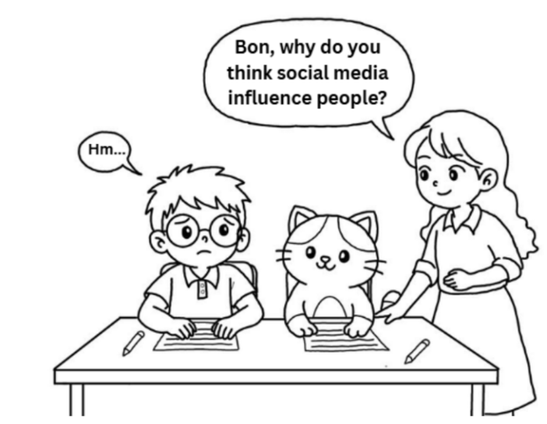
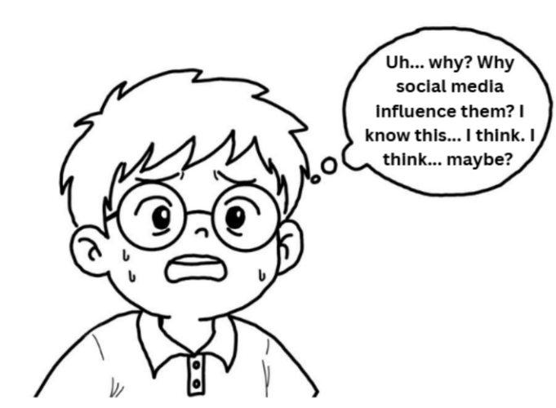



1. THE SITUATIONAL CONTEXT

Slide 20
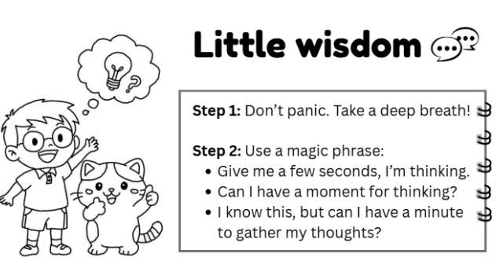

2. TARGET LANGUAGE
3. ADVICE & ENCOURAGEMENT

Slide 21


THANK YOU FOR LISTENING!

