Slide 1


Slide 2
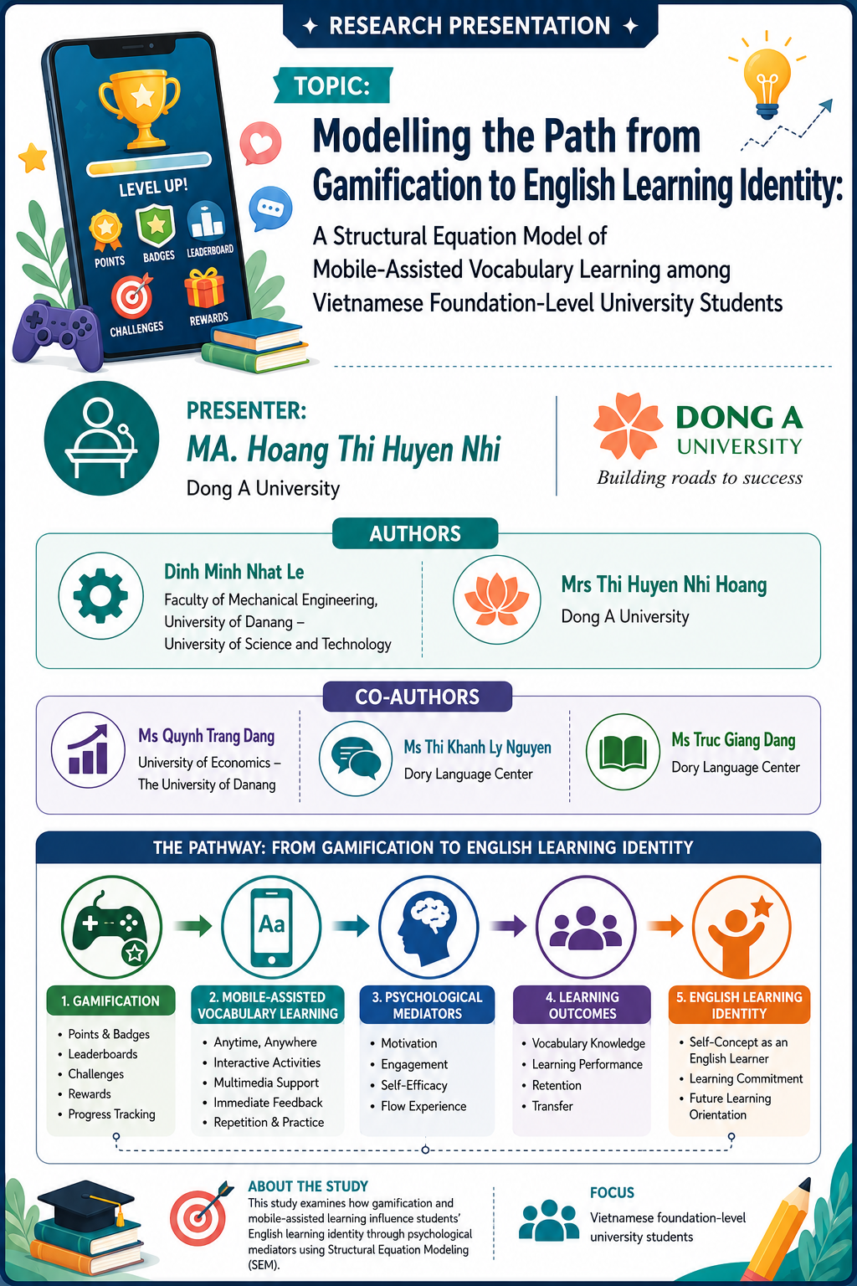

Slide 3


From Gamification to Identity
A Structural Equation Model of Mobile-Assisted Vocabulary Learning in Vietnamese EFL
Gamification
Identity

Slide 4





The Contextual Gap in Vietnamese EFL
Traditional EFL Constraints
Gamified MALL Affordances
- Examination-oriented instruction
- Large class sizes limit interaction
- Passive reception and rote memorization
- Teacher-centered pedagogy
- Autonomous goal-setting
- Interactive cognitive engagement
- Personalized learning paths
- Immediate, actionable feedback

Slide 5








Gamification as Psychological Scaffolding
Autonomy
Competence
Relatedness
Progress Tracking & Custom Levels
Badges, Rewards & Feedback
Leaderboards & Team Challenges
Empowers self-directed learning paths
Provides tangible evidence of mastery
Fosters social connection and comparison
SDT Insight: Satisfying these three innate psychological needs transforms potentially tedious vocabulary drills into intrinsically motivating experiences.

Slide 6
















The Five Core Constructs
GAM:
Gamification
ENG: Learner Engagement
SRL:
Self-Regulation
EFF: Learning Effectiveness
ELI: English Learning Identity
Integration of game design elements (badges, feedback, progress) into apps.
Active behavioral, emotional, and cognitive participation during tasks.
Goal-setting, progress monitoring, and metacognitive strategy adjustment.
Tangible improvements in vocabulary knowledge, retention, and test performance.
The perception of English learning as integral to one's self-concept and capability.

Slide 7

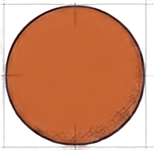
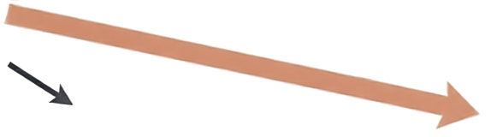

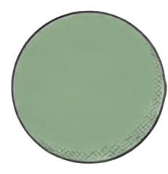
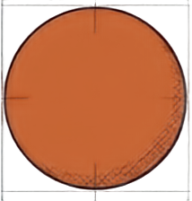
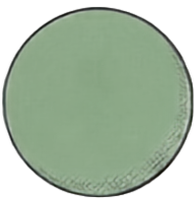




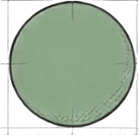
The Complete Structural Pathway
H8
H1. Gamification influences Learner’s engagement
H2. Gamification influences Self-regulation
H3. Engagement influences Learning effectiveness
H4. Self-regulation influences Learning effectiveness
H5. Learning effectiveness influences English learning identity (ELI)
H6. Engagement influences ELI
H7. Self-regulation influences ELI
H8. Gamification indirectly influence ELI through engagement and learning effectiveness
H9. Gamification indirectly influence ELI through self-regulation and learning effectiveness
H10. Self-regulation role moderates the relationship between gamification and learning effectiveness
ENG
(Engagement)
H6
H1
H3
EFF
H5
ELI
GAM
(Gamification)
(Learning Effectiveness)
(English Learning Identity)
H10
H4
H2
SRL
H7
(Self-Regulation)
H9

Slide 8

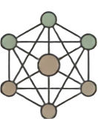







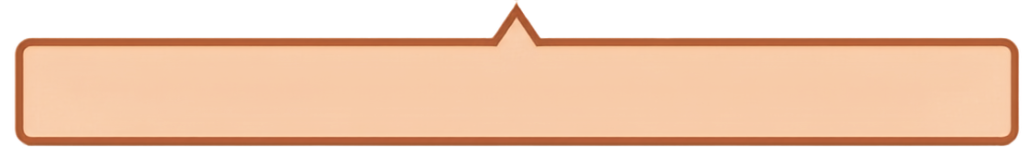
Methodology at a Glance
The Sample
The Instrument
The Engine
Vietnamese foundation-level university students.
A critical demographic at the intersection of vocabulary acquisition and identity formation.
25-item questionnaire on a 5-point Likert scale.
Adapted for
mobile-assisted
vocabulary learning.
Partial Least Squares Structural Equation Modeling (PLS-SEM) executed via SmartPLS SmartPLS 4.0.
Rigorous Testing: Bootstrapping procedure utilized 5,000 resamples to ensure robust significance testing for complex mediation.

Slide 9




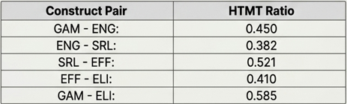
Measurement Model Validation
Outer Loadings
Reliability
Convergent Validity
>0.80
>0.90
>0.70
All item loadings exceeded the 0.70 threshold, ranging from 0.806 to 0.875.
Cronbach's Alpha & Composite Reliability demonstrated excellent internal consistency.
Average Variance Extracted (AVE) substantially surpassed the 0.50 requirement.
Discriminant Validity
Heterotrait-monotrait (HTMT) ratios strictly below 0.60 (max 0.585) - well under the 0.90 conservative limit, proving distinct construct measurement.

Slide 10



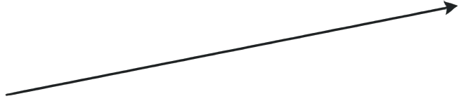

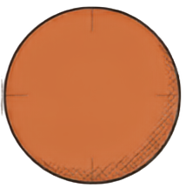



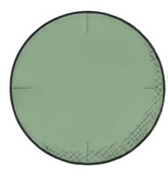

Building the Model: The Dual Activators
ENG
(Engagement)
β = 0.247, p < 0.001
GAM
(Gamification)
Gamification significantly drives active cognitive and affective participation.
β = 0.298, p < 0.001
SRL
(Self-Regulation)
Gamification strongly fosters metacognitive goal-setting and strategy use.

Slide 11

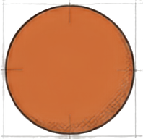
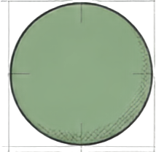

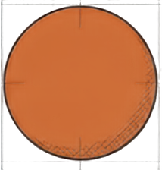

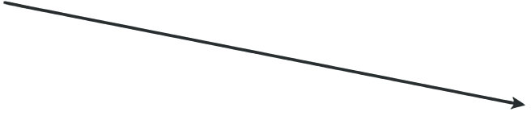
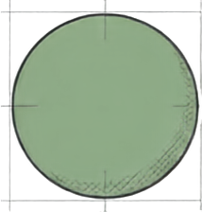
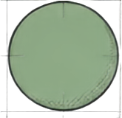


Building the Model: The Core Mediators
ENG
β = 0.367, p < 0.001
EFF
(Engagement)
(Learning Effectiveness)
β = 0.297, p < 0.001
GAM
Active engagement is a massive driver of vocabulary acquisition.
(Gamification)
SRL
β = 0.214, p < 0.001
SRL
(Regulation)
(Self-Regulation)
Self-regulation ensures steady, strategic learning gains.
Key Insight: Gamification triggers the behavioral and metacognitive mechanisms that mandate actual learning.

Slide 12








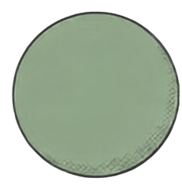







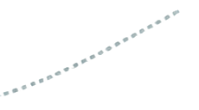








Building the Model: Competence Forges Identity
ENG
(Engagement)
β = 0.367, p < 0.001
Full Mediation Confirmed. Direct paths from Engagement and Self-Regulation to Identity are strictly absent.
EFF
(Learning Effectiveness)
ELI
(English Learning Identity)
β = 0.528, p < 0.001
GAM
(Gamification)
(Strongest Predictor)
SRL
(Regulation)
β = 0.214, p < 0.001
Direct rather paths to change self-concept.
Insight: Feeling engaged or setting goals is not enough to change self-concept. Learners must experience tangible improvements to internalize an “English Learner Identity”.

Slide 13





The Multiplier Effect:
Gamification × Self-Regulation
Interaction Term
β = 0.215, p < 0.001
High Self-Regulation
Gamification is highly effective, but high Self-Regulation acts as a synergistic multiplier. Learners with strong metacognitive skills possess the capacity to ruthlessly exploit gamified features - like progress tracking and feedback - for maximum learning gains.
Learning Effectiveness
Low Self-Regulation
Gamification Intensity

Slide 14




The Complete Structural Pathway
ENG
β = 0.367, p < 0.001
The Affective-Behavioral Route (β = 0.48, p = 0.001)
β = 0.367, p < 0.001
(Engagement)
EFF
β = 0.528, p < 0.001
ELI
GAM
(Gamification)
(Learning Effectiveness)
(English Learning Identity)
(Strongest Predictor)
β = 0.215, p < 0.001
SRL
The Metacognitive-Strategic Route (β = 0.34, p = 0.001)
(Self-Regulation)
β = 0.214, p < 0.001
Gamified MALL operates via dual, parallel chains of mediation that simultaneously capture a learner’s heart (Engagement) and mind (Self-Regulation).

Slide 15


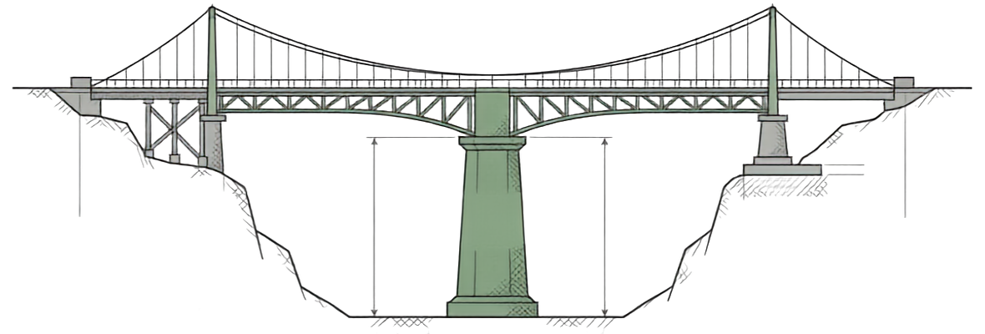











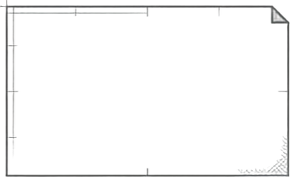
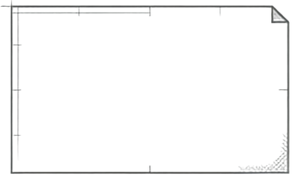
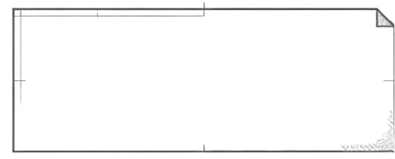
Insight I: The Dominance of Effectiveness
App Mechanics
Long-Term Identity
EFFECTIVENESS
(Competence)
The Competence Imperative
The Design Mandate
The Bridge
Gamification cannot just be “for engagement’s sake.” If mechanics do not relentlessly drive spaced repetition and retrieval practice, identity formation will fail.
Identify formation in second language acquisition is rooted in mastery. Repeated failure undermines identity; tangible success affirms it.
Improved vocabulary knowledge, longer retention, and higher test scores provide the undeniable evidence learners need to view themselves as capable English users.

Slide 16



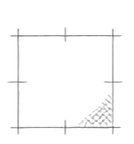

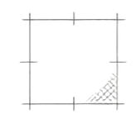














Insight II: Affective vs. Metacognitive Routes
The Engagement Pathway
The Self-Regulation Pathway
Higher indirect effect (β = 0.048)
Highly synergistic indirect effect (β = 0.034)
Capitalizes on enthusiasm, active participation, and deep concentration.
Capitalizes on goal-setting, time management, and strategy adjustment.
Crucial for overcoming the low intrinsic motivation typical of traditional rote-learning environments.
Critically important for foundation-level students who require externally scaffolded structures.
Captures the learner's initial attention and emotional investment.
Builds the autonomous capability required for lifelong language learning.

Slide 17

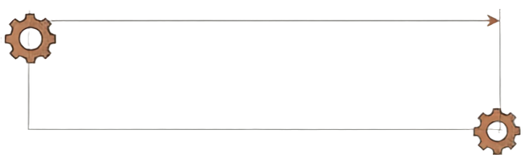
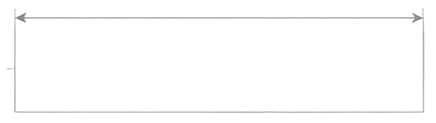









An Architect’s Blueprint for Gamified MALL
Metacognitive Scaffolding
Affective Triggers
Implement immediate, competence-affirming feedback loops.
Embed explicit goal-setting tools directly into the user interface.
Design culturally conscious leaderboards. Offer collaborative, team-based competition to align with collectivist norms in Vietnam.
Use visual progress dashboards that help learners objectively analyze and adjust their study strategies.
Ensure challenges require deep cognitive processing, avoiding mechanics based solely on rapid tapping.
Provide adaptive difficulty scaling for low-SRL learners who require heavy external structure.

Slide 18










Redefining the English Learner
Transcending Constraints
Dual Processing
Gamification bypasses traditional rote-learning environments by satisfying innate psychological needs.
It operates simultaneously through immediate emotional engagement and long-term self-regulation.
The Ultimate Transformation
Properly designed gamified MALL transforms foundation-level students from passive receivers of vocabulary into autonomous, capable, and highly invested English learners.

Slide 19

THANK YOU FOR YOU LISTENING!

