Slide 1


SPEAKER: MR ANH LE NAM (PEOPLE’S SECURITY UNIVERSITY)
REFRAMING ENGLISH SELF-DIRECTED LEARNING ACTIVITIES THROUGH ARTIFICIAL INTELLIGENCE AMONG PUBLIC SECURITY UNIVERSITY CADETS
1

Slide 2
WHY THIS STUDY?
RESEARCH PROBLEM & STUDY GAP
SPEAKER: MR ANH LE NAM (PEOPLE’S SECURITY UNIVERSITY)
2

Slide 3


WHY THIS STUDY?
FROM AI-ASSISTED TASKS TO THE OVERALL SELF-DIRECTED LEARNING PROCESS
AI IS CHANGING LANGUAGE LEARNING
THE RESEARCH GAP
Personalization, immediate feedback, flexible practice, and expanded access to resources.
Previous work often examines individual language skills or discrete learning tasks.
THE MISSING CONTEXT
Less is known about AI and the overall self-directed learning process in highly disciplined Public Security Universities.
SPEAKER: MR ANH LE NAM (PEOPLE’S SECURITY UNIVERSITY)
3

Slide 4

LEARNING RESOURCES
GENERATE EXERCISES
GIVE IMMEDIATE FEEDBACK
SIMULATE CONVERSATIONS
SUPPORT LEARNERS BEYOND THE CLASSROOM

Slide 5

“HOW DOES AI REFRAME THE OVERALL PROCESS OF ENGLISH SELF-DIRECTED LEARNING?”

Slide 6

SETTING GOALS
MONITORING PROGRESS
SELF - DIRECTED LEARNING
SELECTING RESOURCES
ADJUSTING STRATEGIES
ORGANIZING LEARNING ACTIVITIES
EVALUATING ONE'S OWN LEARNING

Slide 7
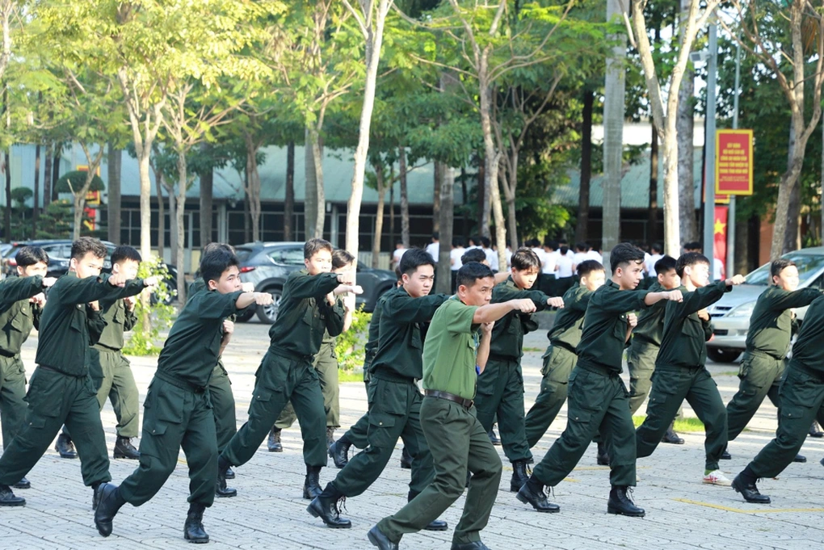
DISTINCTIVE EDUCATIONAL ENVIRONMENT
  Centrally organized academic and training schedules;
  Strict discipline;
  Professional training objectives;
  Information-security requirements.

Slide 8
WHY THIS STUDY?
FROM AI-ASSISTED TASKS TO THE OVERALL SELF-DIRECTED LEARNING PROCESS
AI IS CHANGING LANGUAGE LEARNING
THE RESEARCH GAP
Personalization, immediate feedback, flexible practice, and expanded access to resources.
Previous work often examines individual language skills or discrete learning tasks.
THE MISSING CONTEXT
Less is known about AI and the overall self-directed learning process in highly disciplined Public Security Universities.
SPEAKER: MR ANH LE NAM (PEOPLE’S SECURITY UNIVERSITY)
8

Slide 9
RESEARCH QUESTIONS
SPEAKER: MR ANH LE NAM (PEOPLE’S SECURITY UNIVERSITY)
9

Slide 10
RESEARCH QUESTIONS
  RQ1: How is AI reframing English self-directed learning activities among cadets?
---> FOCUS ON LEARNING PROCESS
  RQ2: How does the Public Security University context influence AI use in English self-directed learning?
---> FOCUS ON CONTEXTS
  RQ3: What opportunities and challenges emerge from integrating AI into English self-directed learning?
---> FOCUS ON IMPLICATIONS RISKS
SPEAKER: MR ANH LE NAM (PEOPLE’S SECURITY UNIVERSITY)
10

Slide 11
METHODOLOGY
EXPLANATORY SEQUENTIAL MIXED METHODS
SPEAKER: MR ANH LE NAM (PEOPLE’S SECURITY UNIVERSITY)
11

Slide 12



METHODOLOGY
Explanatory sequential mixed methods design:
  Quantitative data tell us what is happening.
  Qualitative data help explain why and how it is happening.
PHASE 1 — QUANTITATIVE
→ EXPLANATION
PHASE 2 — QUALITATIVE
  1,000 cadets
  4 Public Security Universities
  Questionnaire
  5-point Likert scale
  Descriptive statistics
Quantitative findings identify the main patterns and inform the interview protocol.
  24 participants (08 cadets, 08 English lecturers, 08 educational managers)
  Semi-structured interviews
  Thematic analysis
12
SPEAKER: MR ANH LE NAM (PEOPLE’S SECURITY UNIVERSITY)

Slide 13
WHAT DID WE MEASURE?
4 DIMENSIONS + KEY SCORES
SPEAKER: MR ANH LE NAM (PEOPLE’S SECURITY UNIVERSITY)
13

Slide 14
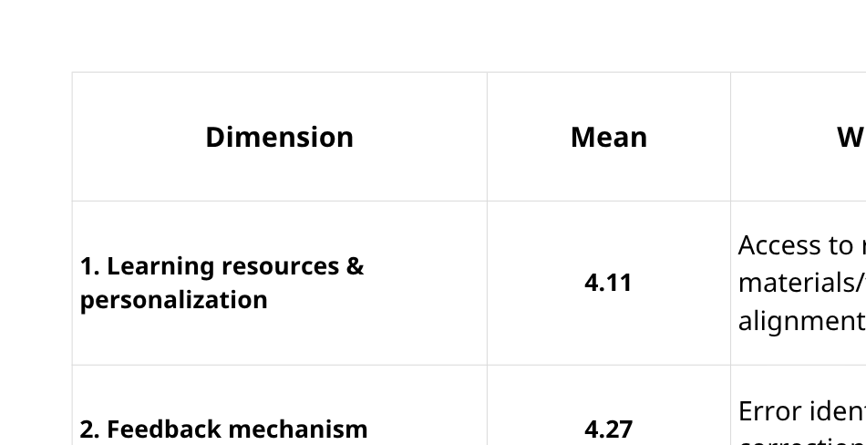
WHAT DID WE MEASURE?
FOUR DIMENSIONS OF AI-SUPPORTED ENGLISH SELF-DIRECTED LEARNING
14
SPEAKER: MR ANH LE NAM (PEOPLE’S SECURITY UNIVERSITY)

Slide 15

OUR INTERPRETATION
AI receives relatively high evaluations for helping learners perform learning tasks, but a lower evaluation for helping learners manage the overall learning process.
15

Slide 16
FINDING 1
AI SUPPORTS LEARNING TASKS
SPEAKER: MR ANH LE NAM (PEOPLE’S SECURITY UNIVERSITY)
16

Slide 17



FINDING 1
AI SUPPORTS LEARNING TASKS
RESOURCES & PERSONALIZATION
FEEDBACK
LANGUAGE PRACTICE
  Highest-rated dimension
  M = 4.27
AI quickly identifies errors, explains them, and suggests alternative expressions.
  M = 4.11
AI expands access to learning resources and adapts materials/tasks to learner needs.
  M = 4.09
AI creates additional opportunities for practice outside formal classroom time.
AI PROVIDES A READILY AVAILABLE LEARNING PARTNER — ESPECIALLY FOR TASK EXECUTION AND FEEDBACK.
17

Slide 18
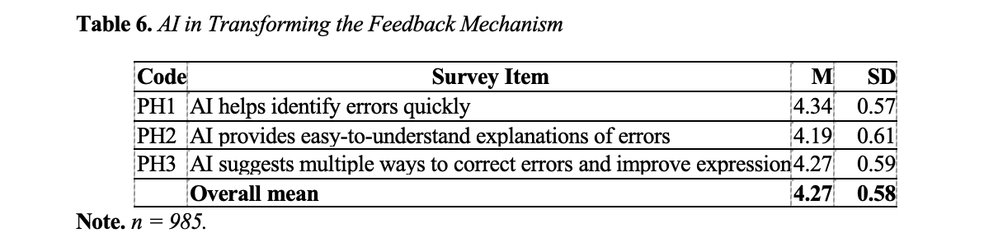
FINDING 1
AI SUPPORTS LEARNING TASKS
SPEAKER: MR ANH LE NAM (PEOPLE’S SECURITY UNIVERSITY)

Slide 19
FINDING 2
PUBLIC SECURITY CONTEXT MATTERS
SPEAKER: MR ANH LE NAM (PEOPLE’S SECURITY UNIVERSITY)
19

Slide 20



FINDING 2 - CONTEXT MATTERS
AI CREATES FLEXIBILITY, BUT THE INSTITUTIONAL CONTEXT SETS BOUNDARIES
DISCIPLINE & SECURITY
TIME
PROFESSIONAL ORIENTATION
  Demanding academic and training schedules limit continuous learning.
  AI helps cadets use short periods of available time.
  CD2: M = 4.15
  AI use must comply with institutional rules.
  Sensitive information should not be entered into AI platforms.
  CD3: M = 4.18
  The need to avoid entering sensitive information into AI platforms received a mean of 4.13.
  AI is not always well suited to English for Public Security purposes.
  Instructor guidance remains important.
  CD5: M = 3.55
TECHNOLOGY ALONE DOES NOT DETERMINE EDUCATIONAL VALUE; CONTEXT MATTERS.
20

Slide 21
FINDING 3
THE AUTONOMY PARADOX
SPEAKER: MR ANH LE NAM (PEOPLE’S SECURITY UNIVERSITY)
21

Slide 22

FINDING 3 - THE AUTONOMY PARADOX
AI CAN SUPPORT SELF-DIRECTED LEARNING WHILE CREATING NEW RISKS OF DEPENDENCE
AI SUPPORTS AUTONOMY
AI MAY UNDERMINE AUTONOMY
  Independent access to resources
  Immediate feedback
  Flexible practice
  Support for difficult tasks
  Greater learning convenience
• Immediate reliance on AI
• Insufficient critical analysis
• Reduced independent thinking
• Difficulty evaluating accuracy
• Weak monitoring and self-assessment
monitoring learning progress — 3.65
self-assessing strengths and weaknesses — 3.61.
AI MAKES SELF-REGULATION MORE IMPORTANT.
(Learners increasingly need to regulate not only their own learning, but also their interaction with AI.)
22

Slide 23
WHAT DOES THIS MEAN?
THEORETICAL INTERPRETATION
SPEAKER: MR ANH LE NAM (PEOPLE’S SECURITY UNIVERSITY)
23

Slide 24
WHAT DOES THIS MEAN?
THE GOAL IS NOT TO REPLACE LEARNER AUTONOMY — BUT TO STRENGTHEN RESPONSIBLE AI-MEDIATED AUTONOMY.
  AI IS NOT JUST A TOOL: AI participates in multiple stages of the learning process: resources, feedback, practice, and task support.
  SELF-REGULATION BECOMES MORE IMPORTANT: Learners must decide when to use AI, formulate appropriate prompts, evaluate outputs, verify information, and take responsibility.
  CONTEXT DETERMINES VALUE: AI integration must align with discipline, information security, professional objectives, and educational goals.
24

Slide 25
EDUCATIONAL
IMPLICATIONS & CONCLUSION
SPEAKER: MR ANH LE NAM (PEOPLE’S SECURITY UNIVERSITY)
25

Slide 26
EDUCATIONAL IMPLICATIONS & Conclusion
AI REALIZES ITS EDUCATIONAL VALUE ONLY WHEN IT SUPPORTS AUTONOMY, CRITICAL THINKING, VERIFICATION, AND RESPONSIBLE LEARNING.
FOR UNIVERSITIES:
FOR ENGLISH LECTURERS:
FOR CADETS:
  Establish clear AI-use guidelines
  Protect information security
  Address academic integrity
  Align AI use with training objectives
  Design tasks requiring verification
  Develop critical evaluation of AI outputs
  Maintain guidance for professional English
  Assess learning processes, not only products
  Set learning goals independently
  Verify AI-generated information
  Use AI as support, not substitution
  Retain responsibility for learning
THE OBJECTIVE SHOULD NOT SIMPLY BE TO INCREASE AI USE. THE OBJECTIVE SHOULD BE TO DEVELOP RESPONSIBLE, CRITICAL, AND PEDAGOGICALLY MEANINGFUL AI USE.
26

Slide 27
LIMITATIONS, FUTURE RESEARCH
SPEAKER: MR ANH LE NAM (PEOPLE’S SECURITY UNIVERSITY)
27

Slide 28
LIMITATIONS & Future Research
AI REALIZES ITS EDUCATIONAL VALUE ONLY WHEN IT SUPPORTS AUTONOMY, CRITICAL THINKING, VERIFICATION, AND RESPONSIBLE LEARNING.
LIMITATIONS:
FUTURE RESEARCH:
KEY CAUTION:
  Self-reported questionnaire/interview data
  Four institutions
  Cross-sectional design
  No causal claims about English proficiency gains
  Longitudinal or experimental designs
  Behavioral data
  Learning journals
  Learning artifacts
  The study examines AI-supported self-directed learning processes and experiences.
  It does not establish that AI directly causes higher English proficiency.
28

Slide 29
SPEAKER: MR ANH LE NAM (PEOPLE’S SECURITY UNIVERSITY)
REFRAMING ENGLISH SELF-DIRECTED LEARNING ACTIVITIES THROUGH ARTIFICIAL INTELLIGENCE AMONG PUBLIC SECURITY UNIVERSITY CADETS
29

