Slide 1





VOCABULARY IN CHATGPT-GENERATED READING MATERIALS:
Opportunities and Challenges for Emerging ESL Education in Vietnam
Nhat Ha Nguyen (speaker)
University of Science and Education - The University of Danang
Xuechun Huang
University of Leeds
Assoc. Prof. Thi Ngoc Yen Dang
University of Leeds
Da Nang, 28th August, 2026

Slide 2




RESEARCH BACKGROUND
Extensive Reading
Reading a large amount of relatively easy and interesting material for general comprehension.
Need LOTS of appropriate texts to acquire vocabulary
Must be easy enough, varied, relevant, and available.
But developing materials takes time & resources
"This is where ChatGPT appears to offer an attractive solution."

Slide 3





RESEARCH PROBLEM
Opportunity
Concern
ChatGPT can generate:
"Does a text generated for A1 learners actually contain A1-appropriate vocabulary?"
1. Large quantities of texts
2. cost-free materials
3. Different levels, topics, etc.
Purpose of this study
To examine the vocabulary profile of ChatGPT-generated texts across A1-C2.
"Generate an A1 text" ?

Slide 4
Why Vocabulary Matters for Reading
Vocabulary load
The number of words learners need to know to comprehend a text (Nation, 2006).
Lexical coverage
The proportion of words in a text that learners need to know for comprehension (Nation & Webb, 2011).
95% coverage → minimal understanding, potentially with support
98% coverage → stronger basis for independent reading

Slide 5
Why Vocabulary Matters for Reading
Word frequency
3 categories:
High-frequency words are among the most commonly occurring words in English.
Mid-frequency words occur less often, but they are still important for learners because they help them comprehend academic texts.
Low-frequency words occur relatively rarely. Some of these may be specialised or technical words.

Slide 6


PREVIOUS RESEARCH
Previous studies (e.g. Uchida, 2025) suggest:
1. ChatGPT can generate texts at different levels
2. But generated texts may not always be appropriate
3. The difficulty of ChatGPT-generated texts can vary according to the length of texts, grammar, word count, etc.
WHAT IS MISSING?
Vocabulary load & word-frequency profile
Current Study Focus

Slide 7


RESEARCH QUESTIONS
📚
🔤
RQ1
RQ2
How many word families are needed to reach 95% and 98% coverage of ChatGPT-generated texts targeting A1–C2?
What is the coverage of high-, mid-, and low-frequency words in these generated texts?

Slide 8




RESEARCH METHODS
6 CEFR levels
4 topic types
A1 → A2 → B1 → B2 → C1 → C2
Everyday, Concrete, Abstract, Literary
Vocabulary load
Frequency
95% & 98% coverage
High / Mid / Low
Notes:
Write a text for CEFR A1 English language learners on an everyday topic: A trip to the local library

Slide 9
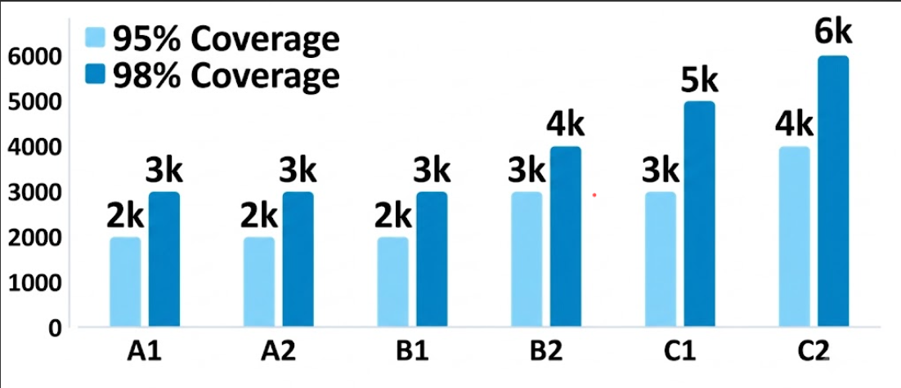
Result 1: Lexical Demand Increases
Higher CEFR level generally corresponds to greater lexical demand.

Slide 10




Result 2: Undifferentiated Lower Levels
A1
A2
B1
95%: 2,000
95%: 2,000
95%: 2,000
98%: 3,000
98%: 3,000
98%: 3,000
The same vocabulary bands were needed for all three levels, despite the fact that learners at these levels are expected to have substantially different vocabulary sizes.

Slide 11

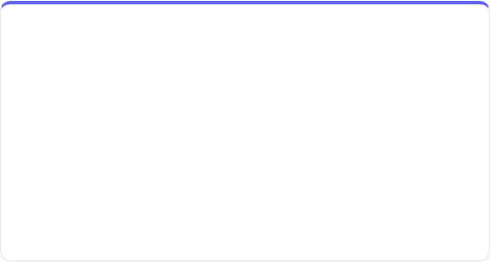
Result 3: The C2 Lexical Anomaly
Expected Benchmark
ChatGPT Actual Output
C2 Benchmark: 7,000–9,000+ word families. [adapted from Nation’s estimation]
C2 Output: Capped at only ~6,000 word families.
Impact: Fails to stretch advanced English learners.

Slide 12
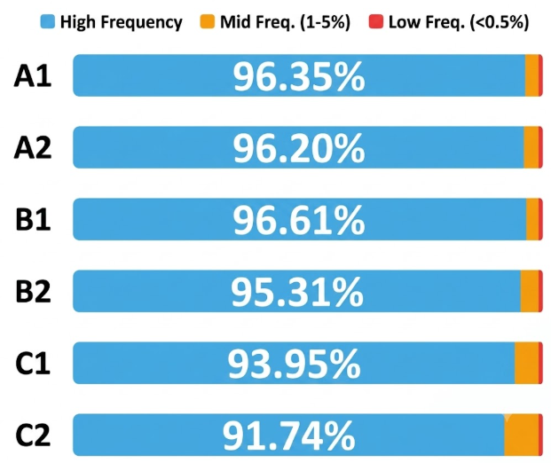

Result 4: High-Frequency Words Dominate
Key Takeaway
1. More than 90% of every corpus consisted of high-frequency words, while low-frequency words remained below 0.5%.
=> Similar to texts written by human.
2. Word frequency in texts generated by ChatGPT did not always match the target level.

Slide 13






IMPLICATIONS
What works
What doesn't fully work
What this means
Level sensitivity
Imperfect CEFR alignment
Human checking needed
ChatGPT shows some level sensitivity. Vocabulary demand generally increases appropriately from A1 → C2.
Exact vocabulary matching fails at lower levels (A1, A2) and advanced level (C2).
Prompting alone is not enough. Generated texts require teacher verification, checking, and manual adjustment before use.

Slide 14
IMPLICATIONS
Generate
CHECK
Adjust
Use

Slide 15
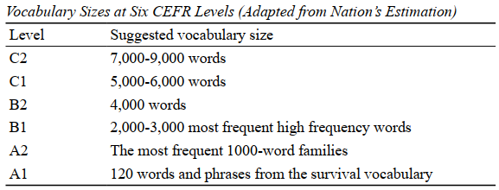
IMPLICATIONS
How teachers can check the vocabulary in ChatGPT-generated texts:
1. Use Nation’s figures as the vocabulary standard for CEFR levels
2. Check the lexical demand of ChatGPT-generated text with some tools like Lextutor.
Notes:
https://www.lextutor.ca/

Slide 16

MORE INFORMATION ON THIS STUDY
Nguyen, N. H., Huang, X., & Dang, T. N. Y. (2026). Lexical Profile of ChatGPT-generated Reading Materials Targeting EFL Learners Across the CEFR Levels. International Journal of TESOL Studies, 8(3), 113–133. https://doi.org/10.58304/ijts.260211 (OPEN ACCESS)

Slide 17
REFERENCES
Nation, I. (2006). How large a vocabulary is needed for reading and listening? Canadian Modern Language Review, 63(1), 59–82. https://doi.org/10.3138/cmlr.63.1.59
Nation, I.S.P. & Webb, S. (2011). Researching and analyzing vocabulary. Heinle Cengage Learning.
Uchida, S. (2025). Generative AI and CEFR levels: Evaluating the accuracy of text generation with ChatGPT-4o through textual features. Vocabulary Learning and Instruction, 14(1), 2078. https://doi. org/10.29140/vli.v14n1.2078

Slide 18
THANK YOU!
Do you have any questions?
Contact: nhathanguyen324@gmail.com

Slide 19








RESEARCH BACKGROUND
ChatGPT can generate human-like texts in response to prompts.
Generate large amounts of texts
Cost-free materials
Personalised needs
But can AI-generated materials be trusted for vocabulary learning?

Slide 20
