Slide 1





Creating micro-ESL environments
through listening-triggered drama with authentic materials
Đinh Công Triết
Ly Tu Trong High School for the Gifted, Can Tho City, Vietnam

Slide 2


Listening ended where communication could begin
PLAY
LISTEN
CHECK
MOVE ON
A familiar listening lesson
The answers were checked.
No student-to-student
interaction followed.

Slide 3

Four parts, guided by one classroom question
01
Why the study was needed
01
Rationale · policy context · research questions
02
How the study was framed and conducted
Literature · micro-ESL framework · participants · materials · procedures
03
What the evidence showed
Findings for RQ1 and RQ2
04
What the findings mean—and what remains uncertain
Limitations · classroom implications · conclusion
Rationale → framework & method → findings → implications & limits

Slide 4


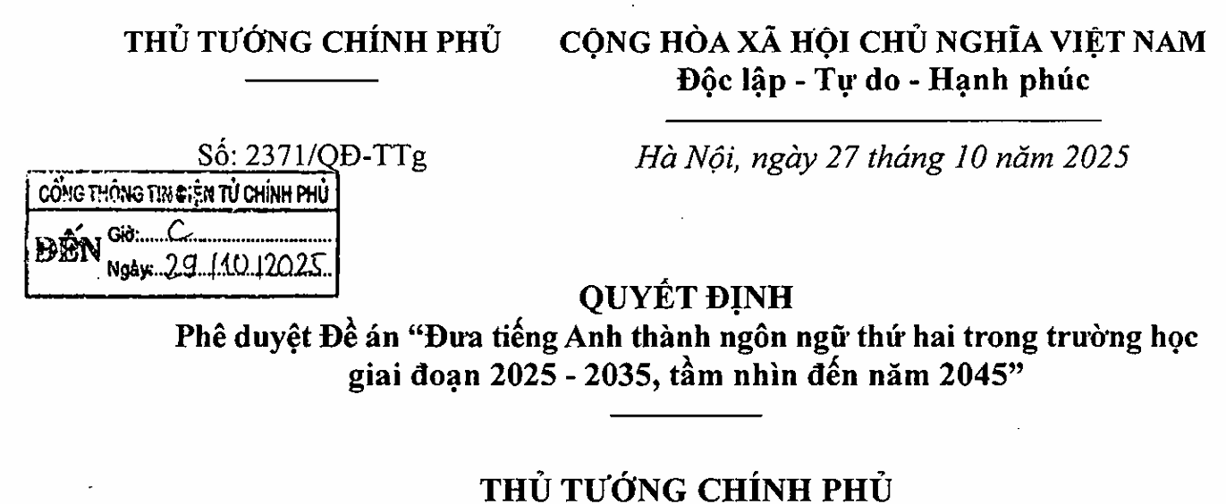
National ambition meets the ordinary lesson
2025–2035
The policy question
How can English become a second language in schools?
Vision to 2045
The classroom question
Can English become a classroom language, not just a classroom subject?
Decision No. 2371/QĐ-TTg · 27 October 2025

Slide 5

The missing bridge: comprehension → response
THE FAMILIAR ROUTE
THE BRIDGE TESTED
Listening
Listening
→
↓
↓
Correct answers
A response that alters
the next turn
The bridge is not ‘listening plus speaking’; it is a response that changes the next turn.

Slide 6
The listening text led to a four-step drama task
1
2
3
4
Listen
Understand
Prepare
Perform and respond
An authentic source with a real situation or problem
Ideas, emotions, conflict, useful language
Write roles and rehearse the scene
React when a classmate changes or forgets a line
Students first understood the source, then used it in a shared drama.

Slide 7
What micro-ESL meant in this study
01
English for the task
02
Responding to classmates
Students used English to carry out the drama.
Students listened and replied to what classmates said.
03
Changing language when needed
04
A shared reason to speak
Students rephrased, corrected, or added ideas.
The listening text gave the group a situation or problem.
These moments were brief and were not equally strong in every group.

Slide 8
Two deliberately simple research questions
RQ1
RQ2
How do listening-triggered drama tasks support students’ spontaneous use of English?
In what ways do these activities encourage interaction and contribute to a micro-ESL environment?
Spontaneous ≠ unprepared: students adapted, repaired, or extended prepared interaction in real time.

Slide 9

Three ideas shape the study
Authentic input
Prepared, then pushed
Drama continuum
Gilmore (2007):
Swain (1993):
Producing language can push learners to notice gaps in their linguistic resources and make their meaning more precise.
Kao & O’Neill (1998)
Authentic materials give learners access to natural discourse that textbooks may not fully represent, but their value depends on appropriate task design.
.
Rehearsed and spontaneous encounters can coexist as drama moves toward open communication
Sherman (2003):
Authentic video also supplies characters, situations and multimodal cues for further response.
Renandya and Nguyen (2023):
Planning can support fluency before learners face the demands of interaction.
Almond (2005):
Drama bridges controlled classroom work with “the complexity of unpredictable language and behaviour … in the outside world.”
Authentic input supplies the situation. Planning provides support. Interaction pushes learners to respond.

Slide 10
Small-scale action research across two classes
2
40
B2+
intact Grade 12 classes
students · 20 per class
general proficiency
Participation in lessons
Questionnaire returns
Recorded reflections
40
n = 40
6
Classroom-based evidence—not an experimental treatment

Slide 11
Preparation sat between listening and performance
Periods 1–2
1–2 weeks
Periods 3–4
1
2
3
Listen
Prepare
Perform
Background knowledge · vocabulary · comprehension
Write group scripts · rehearse roles · shape the scene
Enact · respond · adapt when the scene changes
Prepared performance + unprepared moments inside it

Slide 12
Three texts created three kinds of spoken pressure
01
02
03
Đặng Thùy Trâm
Alternative Math
Anilang
Diary + Don’t Burn
Satirical short film
Bioacoustics TED talk
Emotional reconstruction
Argumentative confrontation
Speculative invention
Sacrifice · family · historical memory
Defend · challenge · rebut · repair
Ethics · betrayal · creative ownership
Emotional interpretation · argumentative pressure · speculative invention

Slide 13
Scripts scaffolded performance—not spontaneity
PREPARED SCRIPT
LIVE PERFORMANCE
Shows
Reveals
≠
• understanding of the source
• organisation of roles
• planned language and confidence
• adaptation after a forgotten line
• response to an unexpected turn
• repair or extension in real time
The script built the world. Live performance tested whether students could keep it alive.

Slide 14
Each RQ followed a different evidence route
RQ1 · spontaneous English
RQ2 · interaction + micro-ESL
PRIMARY
Observation + video incidents
SUPPORTING
Questionnaire items 4–7
Reflections on improvisation and repair
PRIMARY
Peer-response and English-use indicators
SUPPORTING
Questionnaire items 8–11 and 19
Reflections on reacting and sustaining talk
Questionnaire enthusiasm provides context—not proof of interaction.

Slide 15
All ratings were positive—but interaction ranked lowest
Engagement
4.40
4.40
Authentic materials
4.23
highest: engagement
Spontaneity
4.04
4.03
Peer interaction
4.03
lowest: peer interaction
N = 40 · five-point scale

Slide 16
RQ1: Spontaneity appeared when wording ran out
“
What this shows
I had to remember
the key words—and then
make it up as I go.
PREPARED
Key words + a shared scene
NOT FULLY PREPARED
The exact wording of the next turn
S4 · recorded reflection
Brief responses still showed live language use.

Slide 17

Four forms of spontaneous English became visible
01
Paraphrase
02
Add
Reformulate a forgotten line instead of stopping
Introduce an unplanned idea, detail, or humour
03
Repair
04
Respond
Fix one’s own turn or rescue a teammate’s
React to an unexpected line while staying in role
English was solving an immediate problem inside the shared scene.

Slide 18
Watch when the script stops doing all the work
WATCH FOR
1
the first unexpected turn
▶
2
the next speaker’s response
STUDENT PERFORMANCE CLIP
3
whether the exchange
continues in English
Alternative Math: 2 minutes
Did English become necessary—even briefly?

Slide 19
A second clip shows source meaning entering the play
LISTEN FOR
1
a source idea or phrase
▶
2
a peer response beyond the script
STUDENT PERFORMANCE CLIP
3
repair or extension that keeps the scene moving
Anilang: 2 minutes
What travelled from listening into interaction?

Slide 20
RQ2: Reacting was easier than sustaining talk
STUDENT VOICE
Listened carefully
4.33
“I had to really pay attention to my classmates and respond to what they said in real time.”
Meaningful interaction
4.03
Kept conversation going
3.60
S5 · interview
Reactive response was visible; continuation remained the least secure.
N = 40 · item means

Slide 21
The tasks showed some, but not all, micro-ESL features
Feature
What we observed
What it means
English used for the task
Often
Used in many scenes, but not all
Replying to classmates
Clear
Strongest when a classmate changed the plan
Changing or correcting language
Brief
Appeared in short moments during performance
A shared reason to speak
Strong
Listening texts gave students content and roles
Continuing a conversation
Limited
This remained the most difficult feature
The tasks supported temporary micro-ESL conditions; they did not create a complete ESL environment.

Slide 22
Authentic materials provided ideas for speaking
DIARY
SATIRE
SCIENCE
Sacrifice + family loss
A disputed answer
Animal language + AI
A reason to express emotion
A position to defend
An ethical problem to develop in the drama
“It gave me more ideas and different perspectives on the same topic.” — S1 · interview

Slide 23
The study identified three important limitations
Student challenges
Practical challenges
Research limits
Nervousness
Remembering lines
Limited vocabulary
Rehearsal time
Grade 12 workload
Interest may fall if repeated often
Two gifted classes
Self-report bias
No fine-grained conversation analysis
“Please don’t place that much of a burden on students because we still try our best.” — S6 · interview

Slide 24
A ten-minute task can lead from listening to interaction
1 min
2 min
5 min
2 min
Choose
Assign
Interact
Review
A short moment with a clear problem
Give roles and a decision, not a full script
Require a follow-up question, challenge, correction, or added idea
Discuss the language students used to continue the conversation
Goal: students listen and respond to one another in English—not perform a polished play.

Slide 25
After comprehension, give students a reason to interact
Use an interesting source, clear roles, and a shared problem so students respond to one another in English.
QUESTIONS
Thank you

