Slide 1


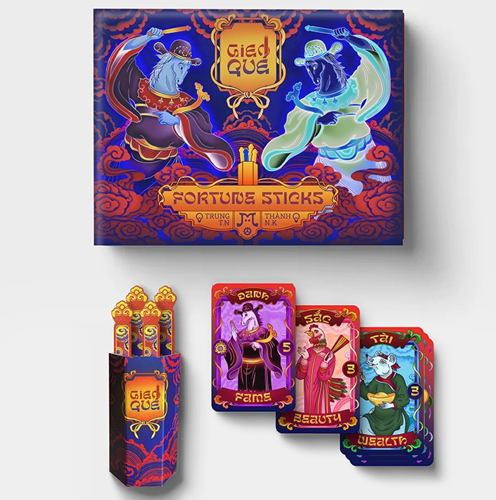







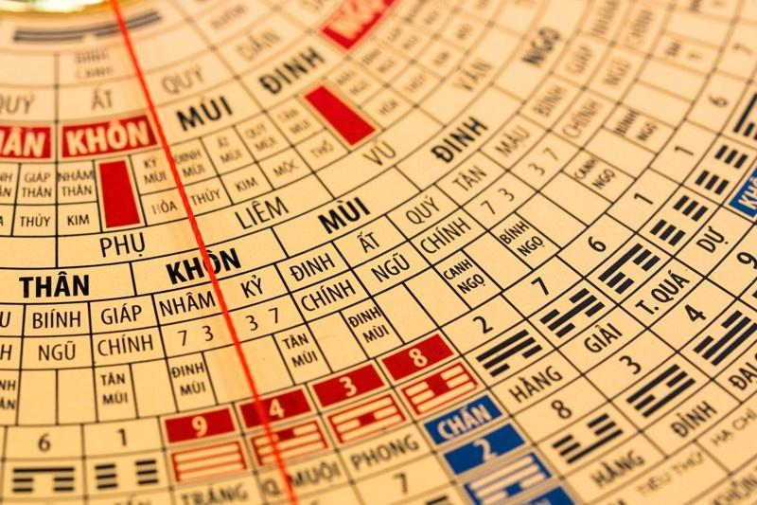



Slide 2





Rolling the Dice Across Cultures:
Tabletop Games for Identity and Belonging in Vietnam’s ESL Transformation

Slide 3

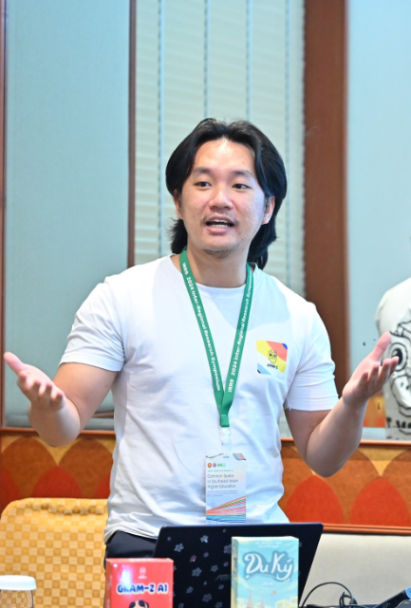


Khang, Trần - Mr. Ken
Ludic Language Pedagogy
GRAM-Z (an educational tabletop game studio in Hanoi)
9 years of EFL teaching
6 years of IELTS training
5 years of researching (game-based learning)
5 years of tabletop game designing

Slide 4


AGENDA
Introduction
Literature Review
Research
Findings
Demo
Discussions
Q&A

Slide 5
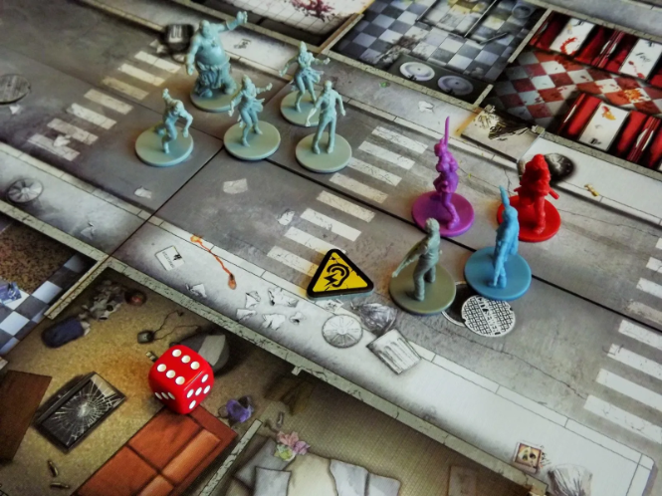


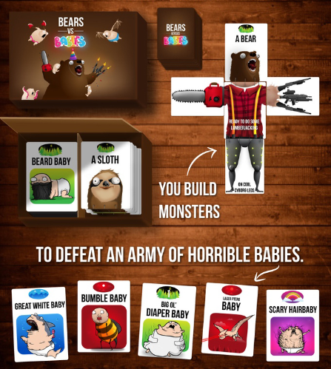
Introduction

Slide 6
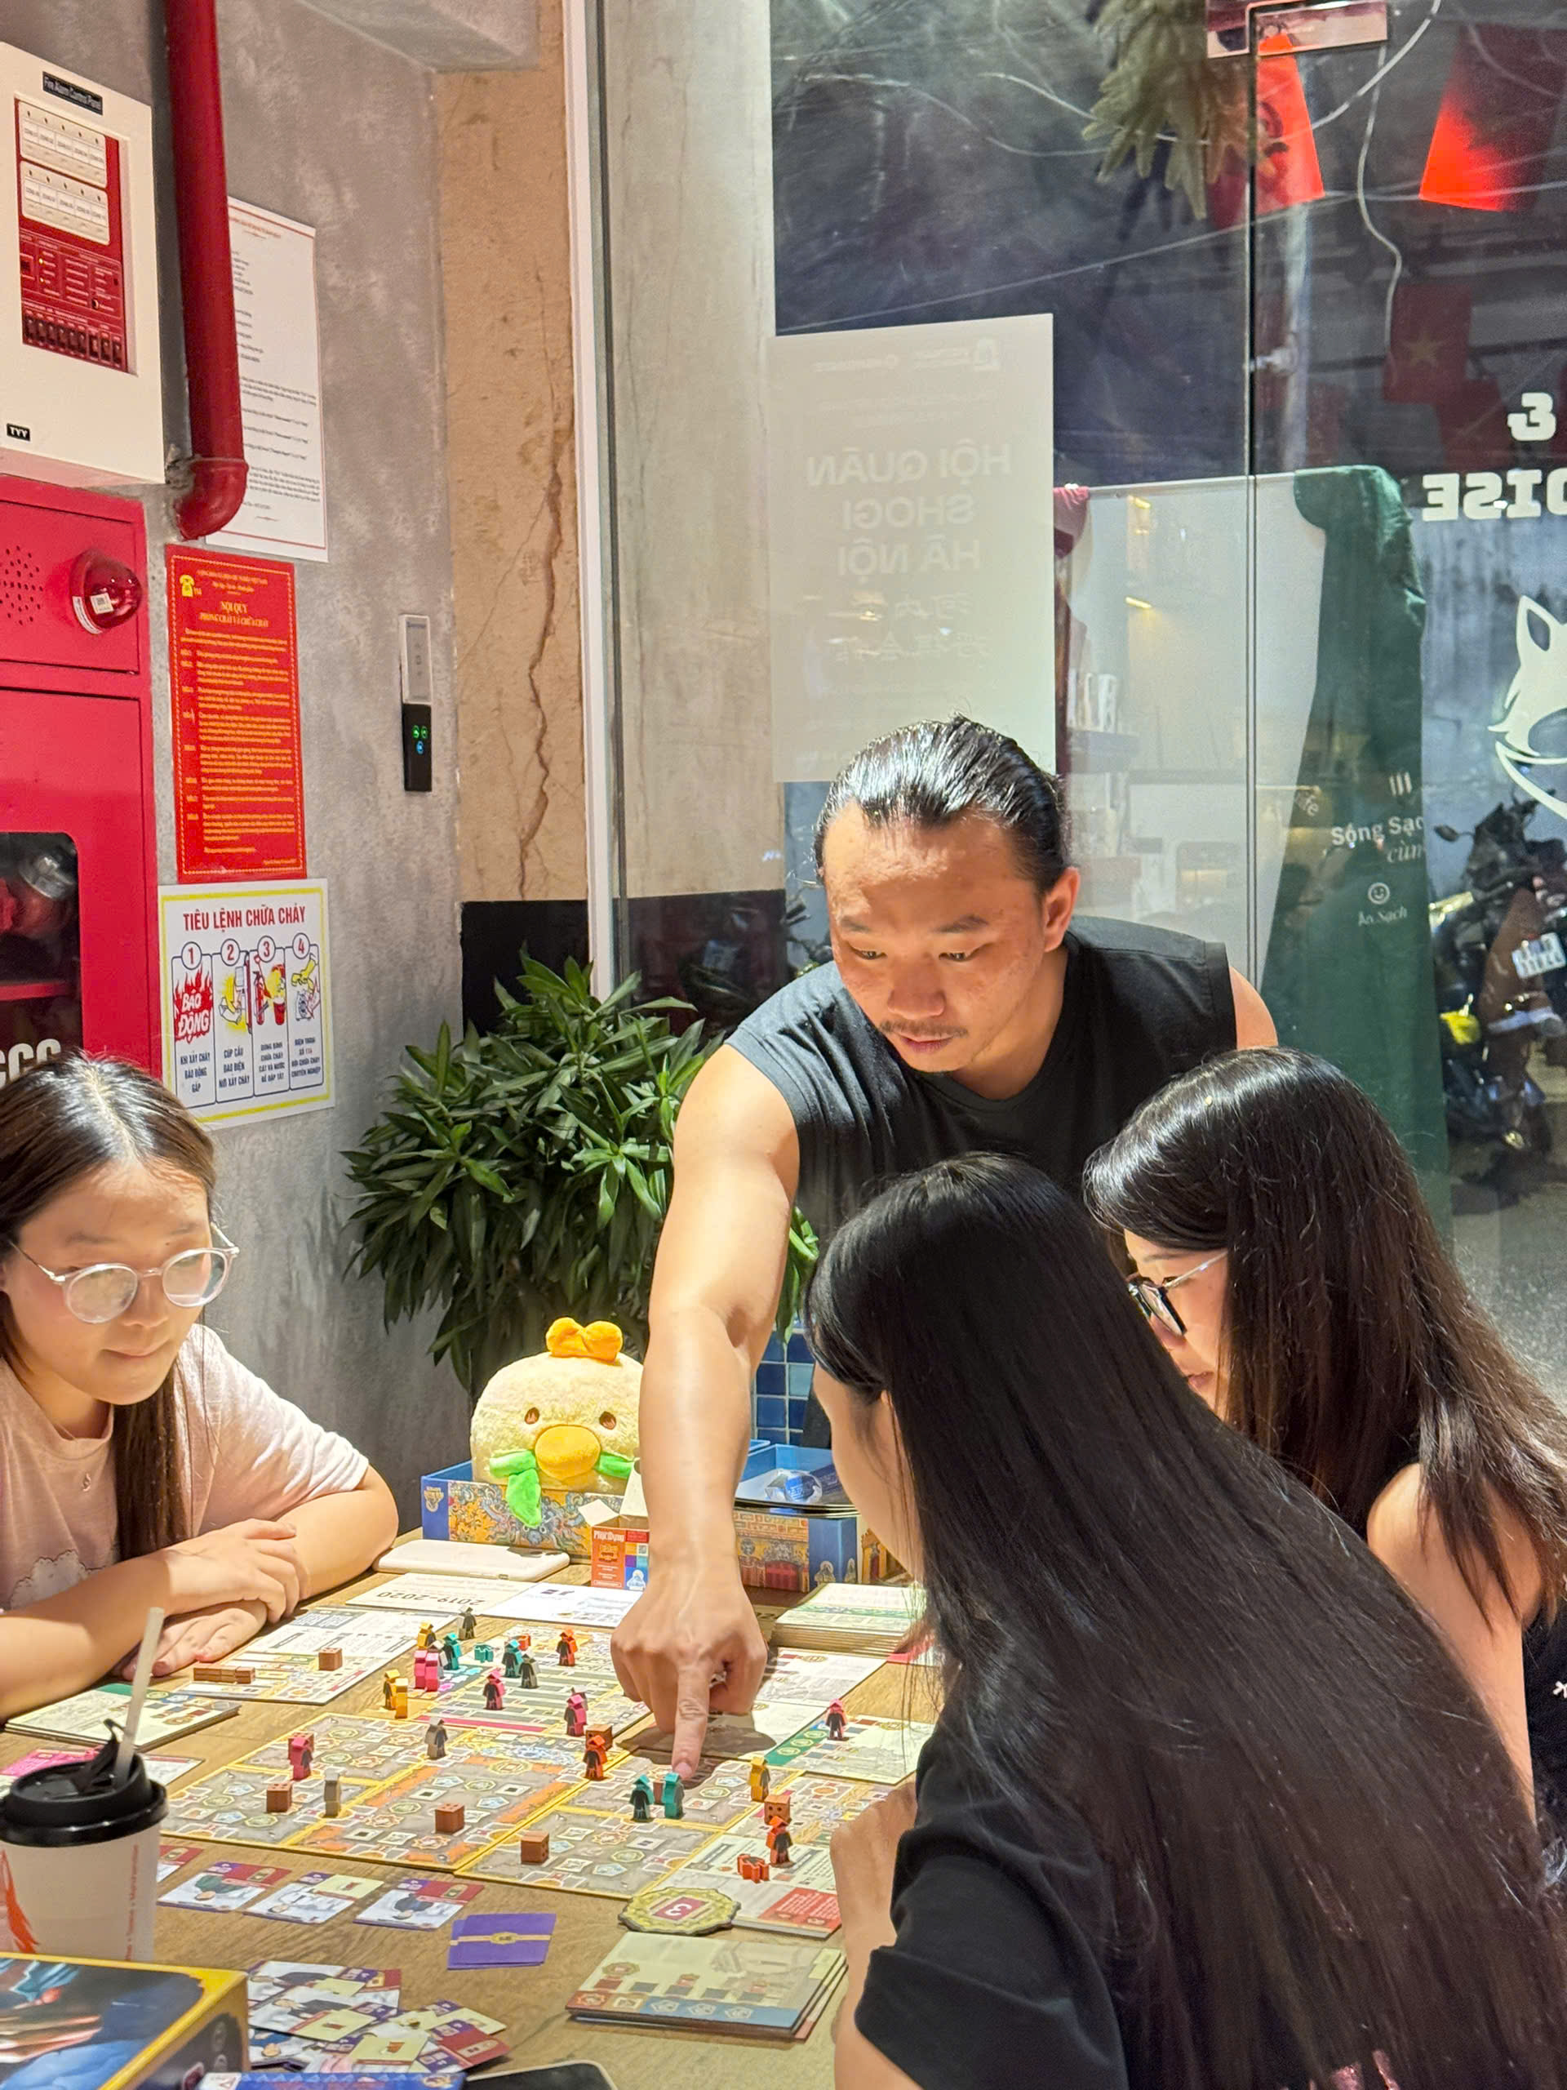
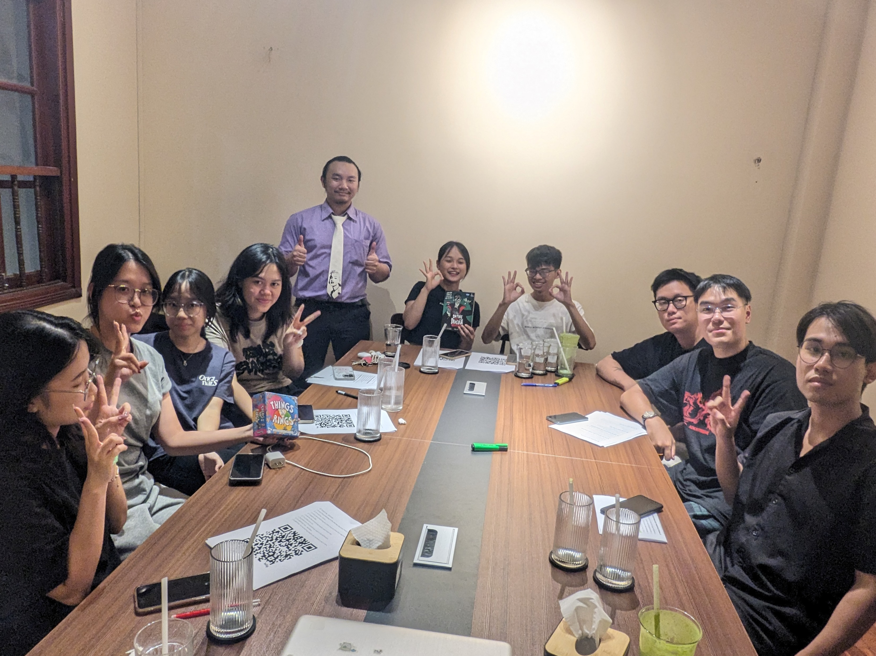
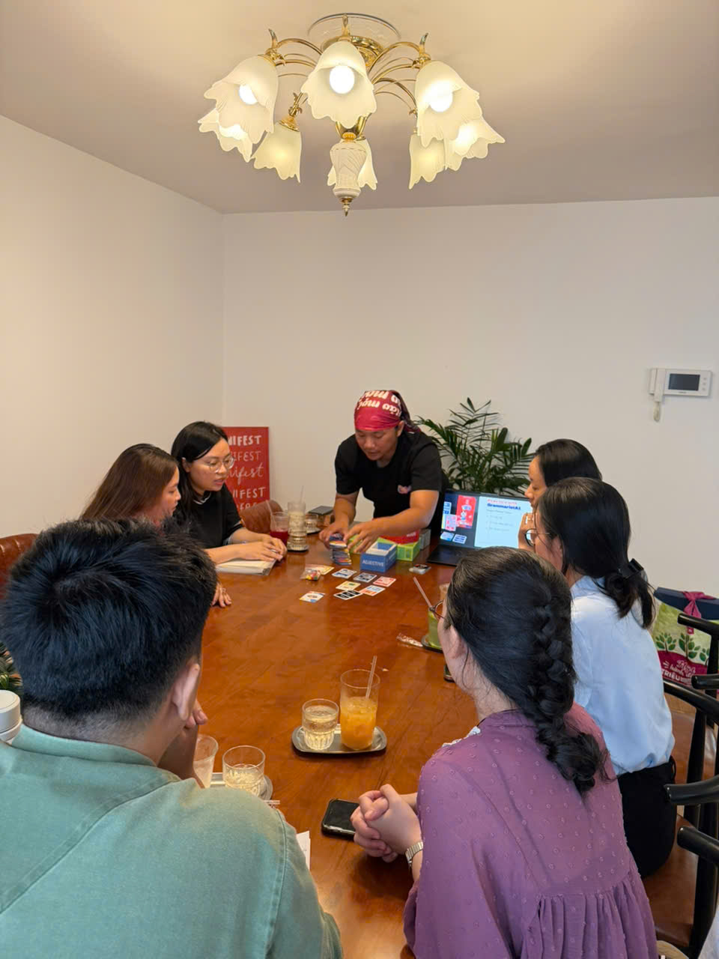
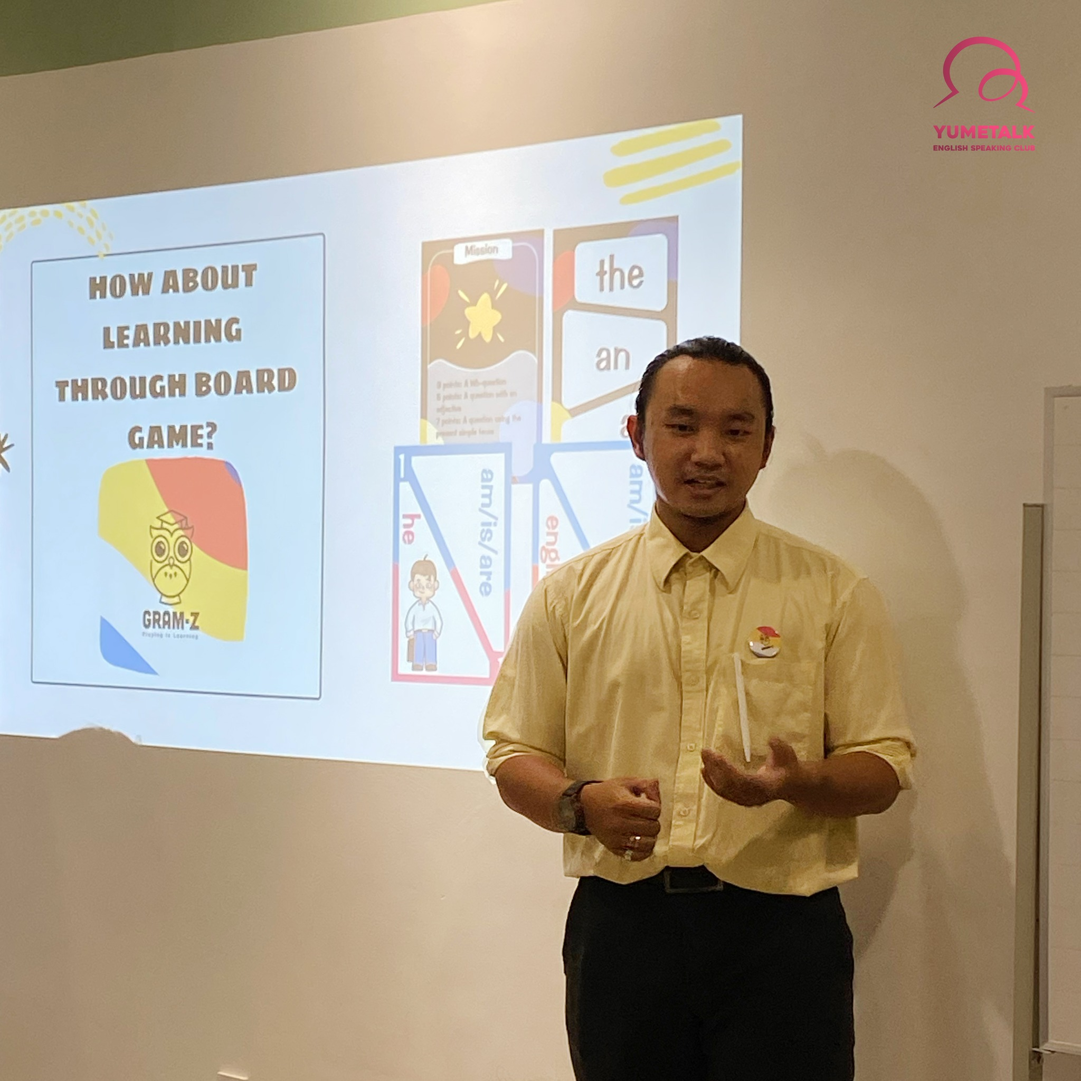
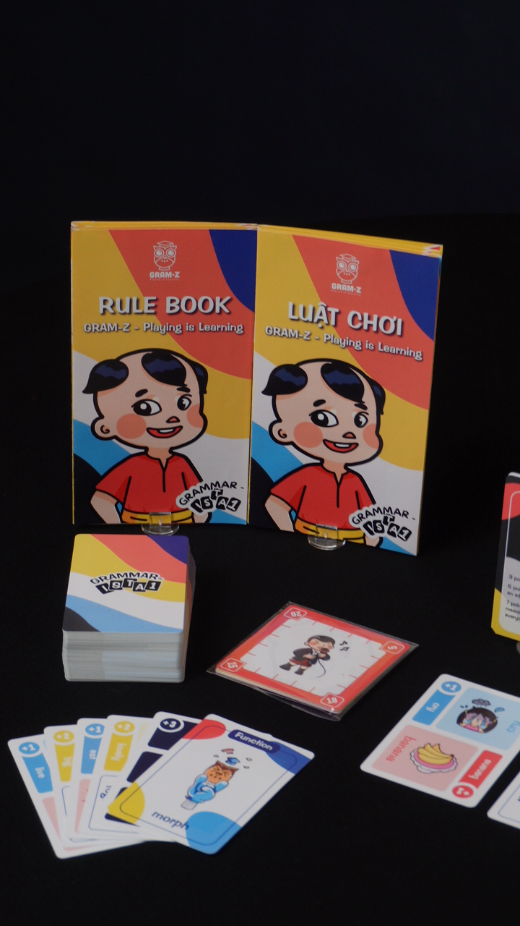
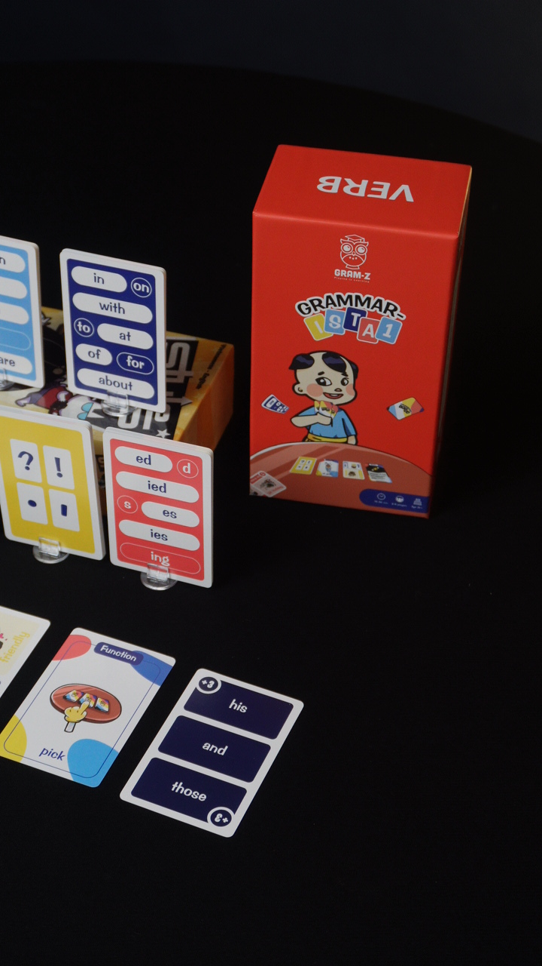
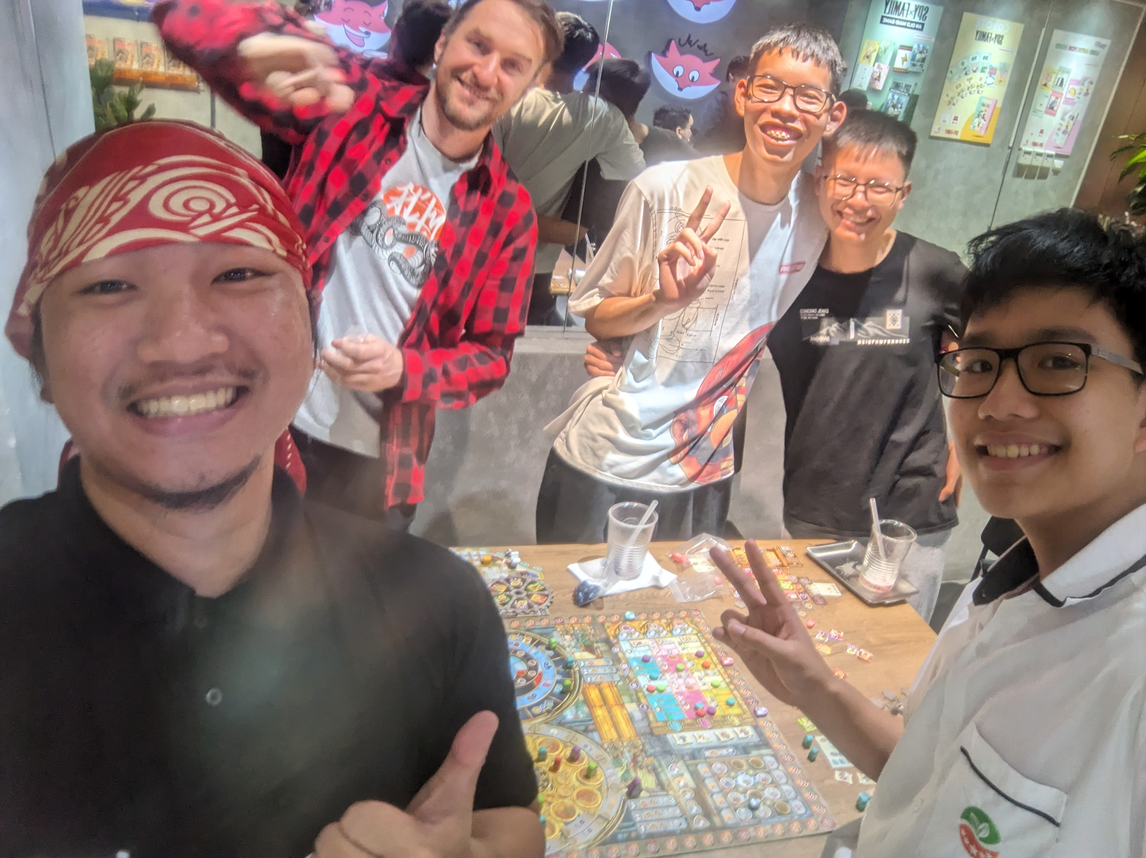
Introduction

Slide 7



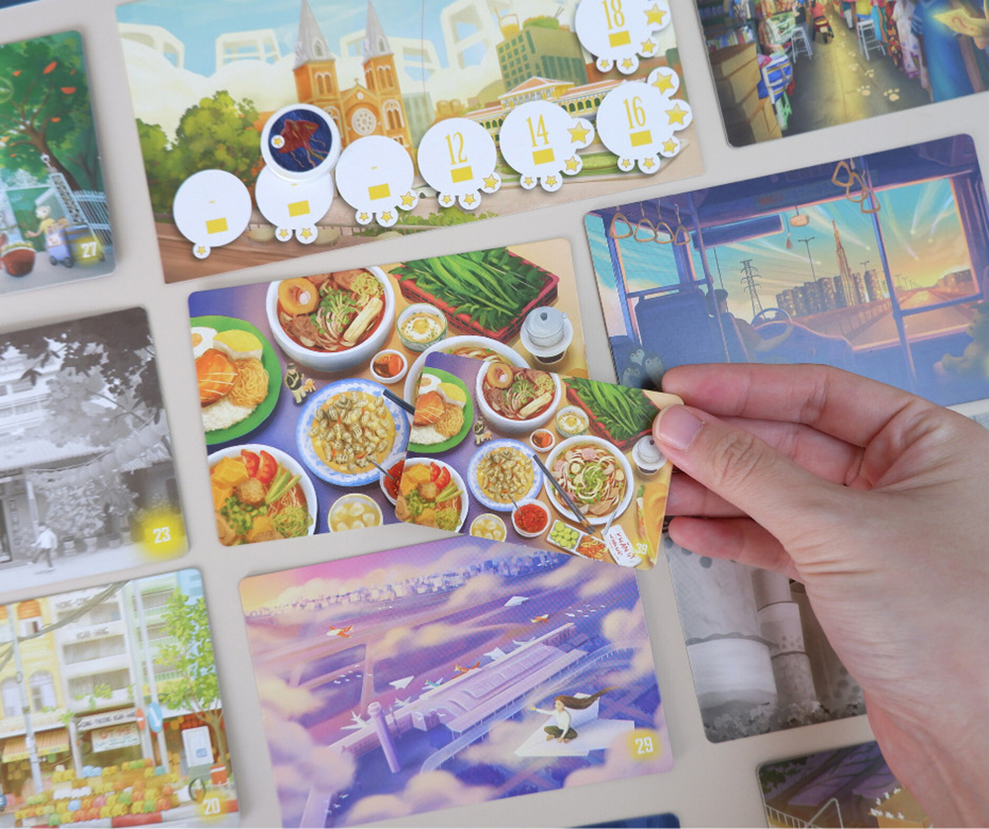
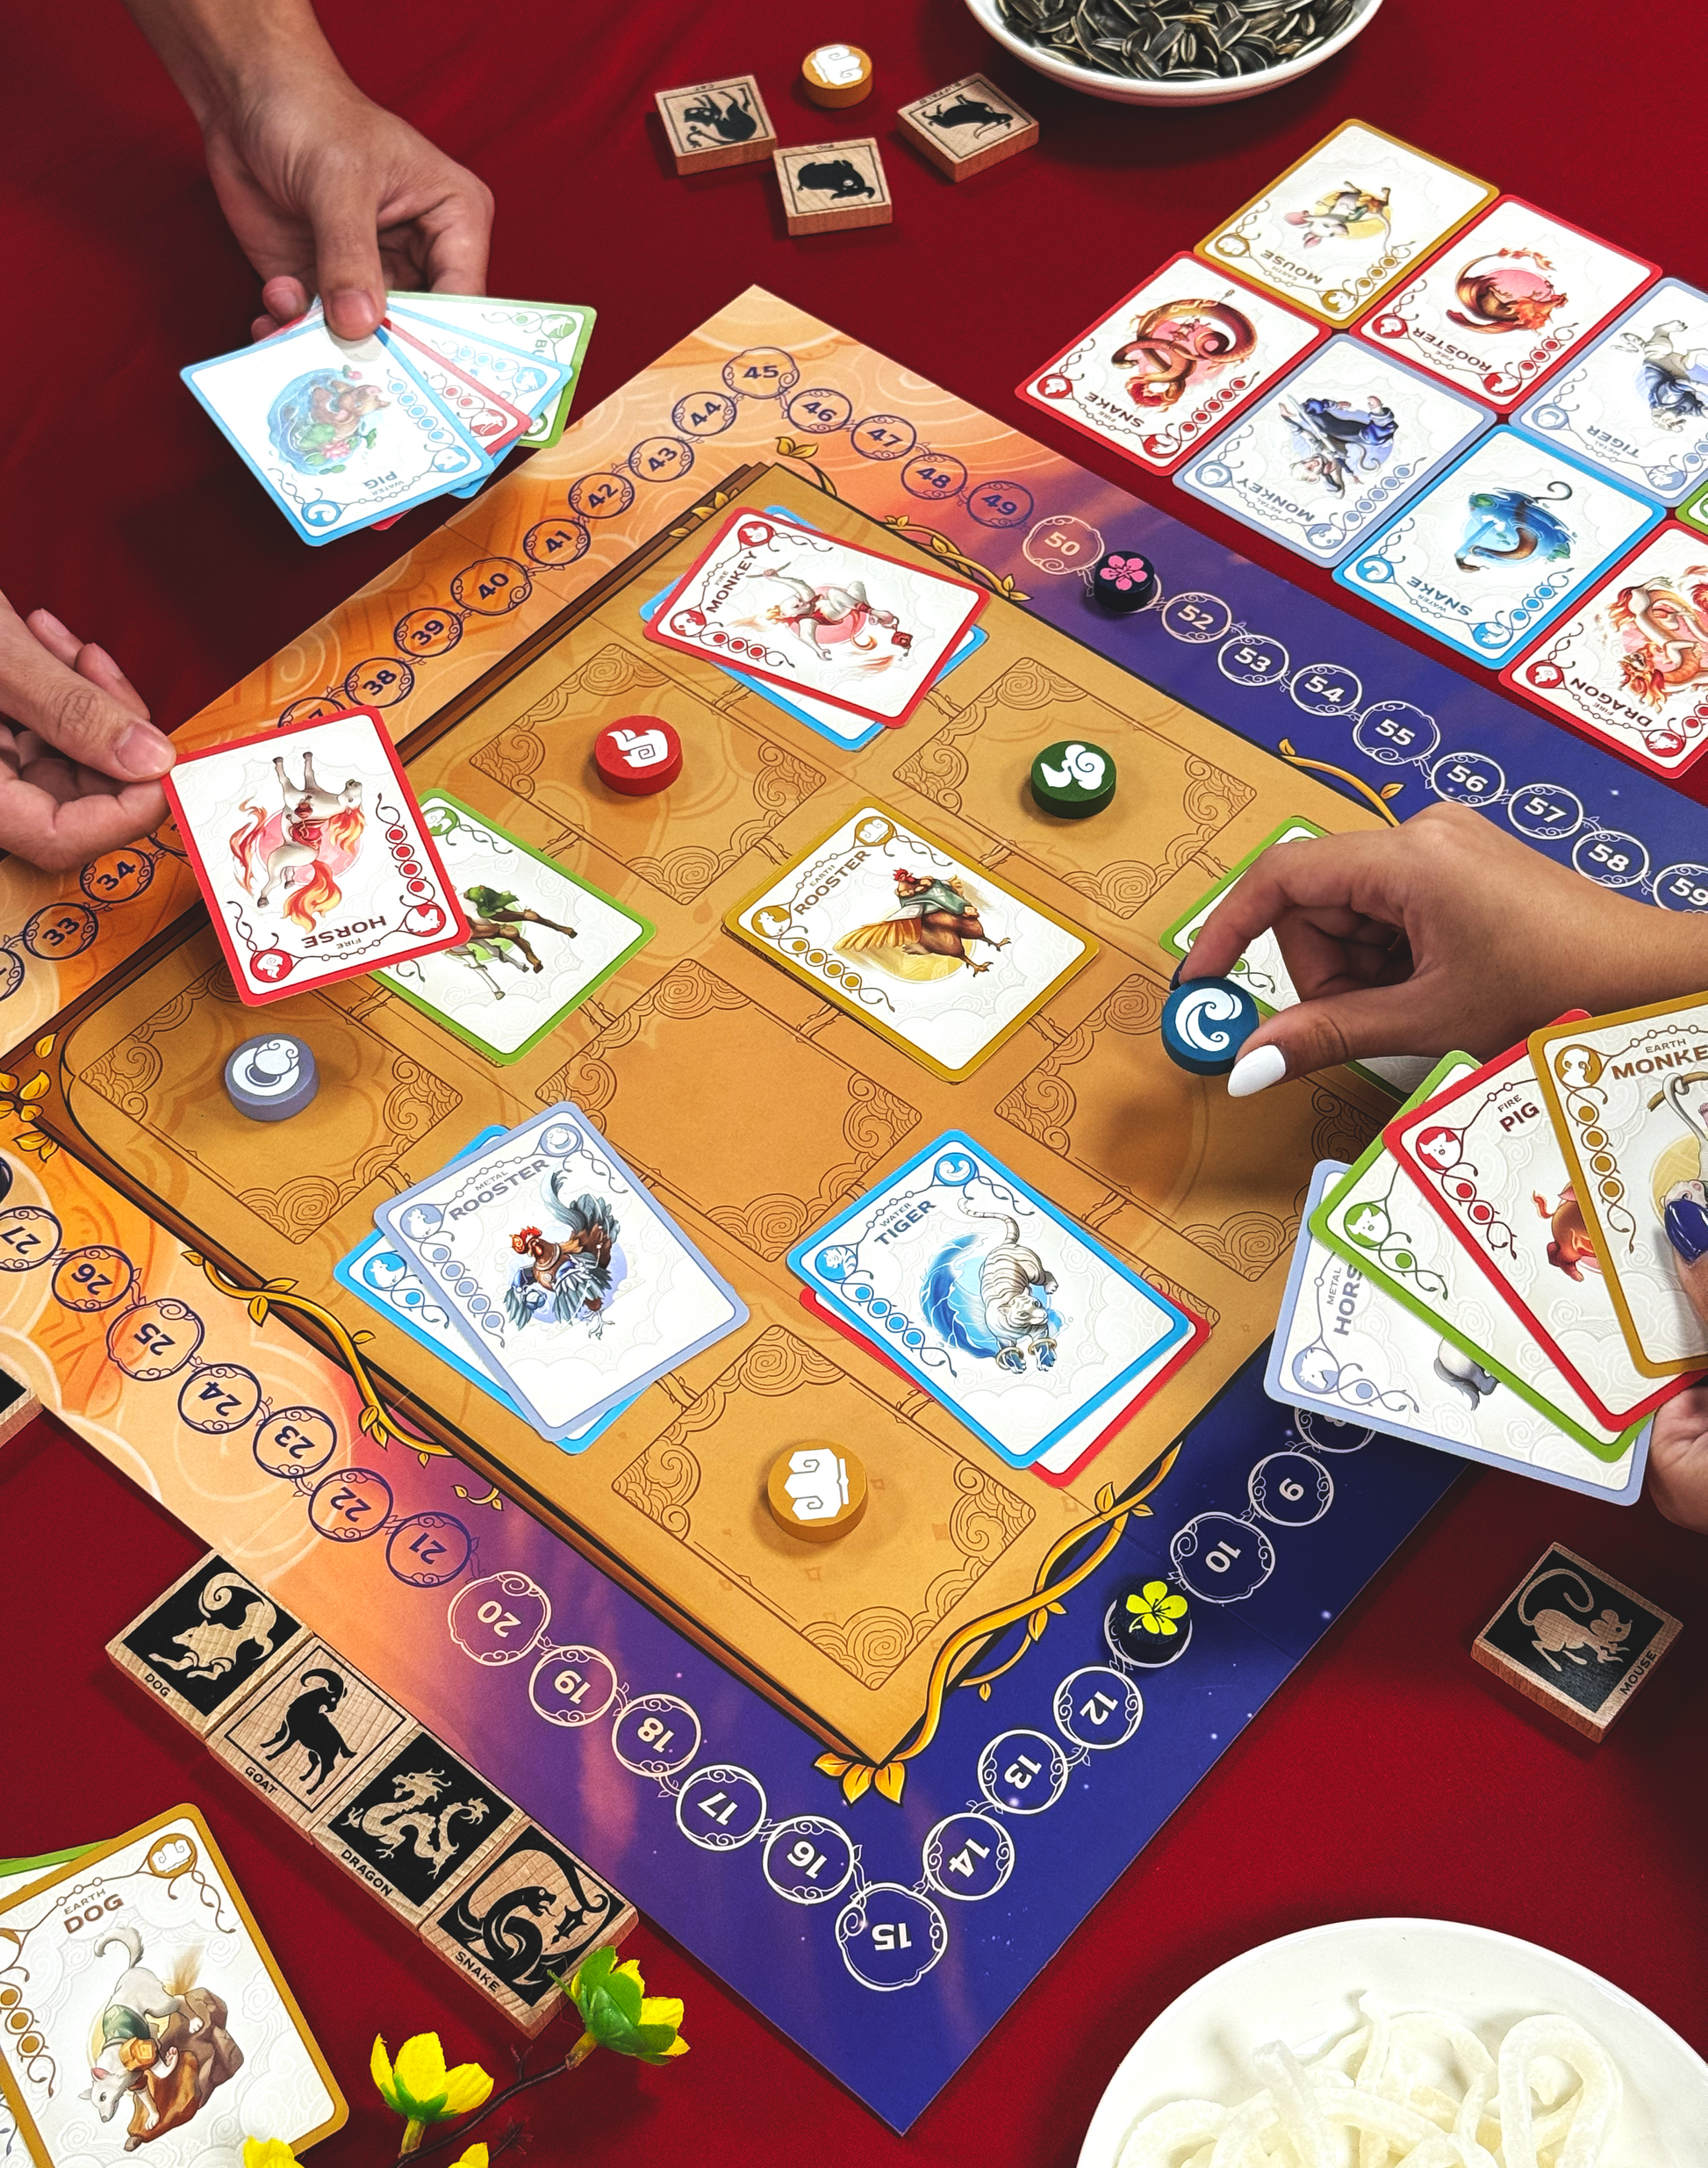



Literature Review
Gamification | Game-based Learning
the application of game elements (points, badges, levels, leaderboards, quests, etc.) in non-game contexts, to increase user motivation and engagement (Deterding et al., 2011) | the use of games with educational objectives to promote learning outcomes (Kanabar & Reeve, 2024)

Slide 8

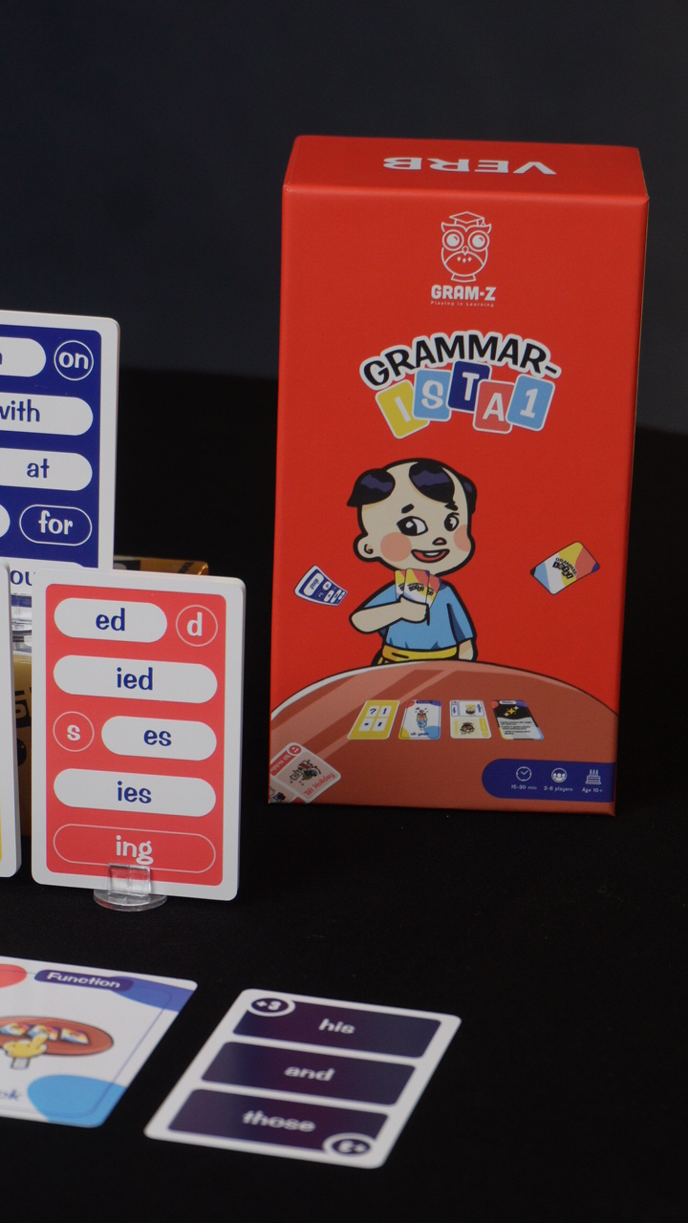
Literature Review
Game-based Learning
Video Games | Analog Games
digital divide (Livingstone & Helsper, 2007) steep learning curve for educators (Easterling, 2021) indirect communication and more controlled and quantifiable insights (Lee, 2024) | budget-friendly (Poth, 2025) versatile and highly-editable (Sarsenbaeva, 2023) active peer interaction (Sanako, 2025) seamless cultural transition

Slide 9
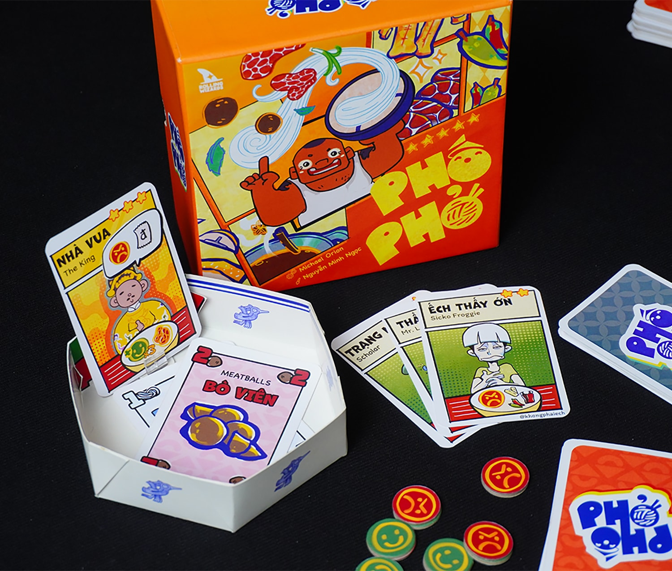
Literature Review
Game-based Learning
a system in which learners as players engage in an artificial conflict, defined by some sorts of rules that results in a quantifiable result (Zimmerman, 2004).

Slide 10
Literature Review
Authentic Learning
focuses on real-world, complex problems and their solutions, using role-playing exercises, problem-based activities, and participation in virtual communities of practice (Lombardi, 2007).

Slide 11
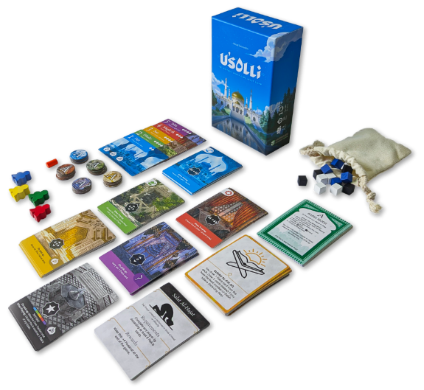
Literature Review
Intercultural communication
language learning must include cultural understanding, not just linguistic proficiency (Byram, 1989). Attitudes like openness and curiosity, cultural knowledge, skills of interpreting and relating, skills of discovery and interaction, and critical cultural awareness are essential dimensions of ICC.
using authentic cultural content in the language classroom rather than contrived examples (Deardorff, 2006)

Slide 12
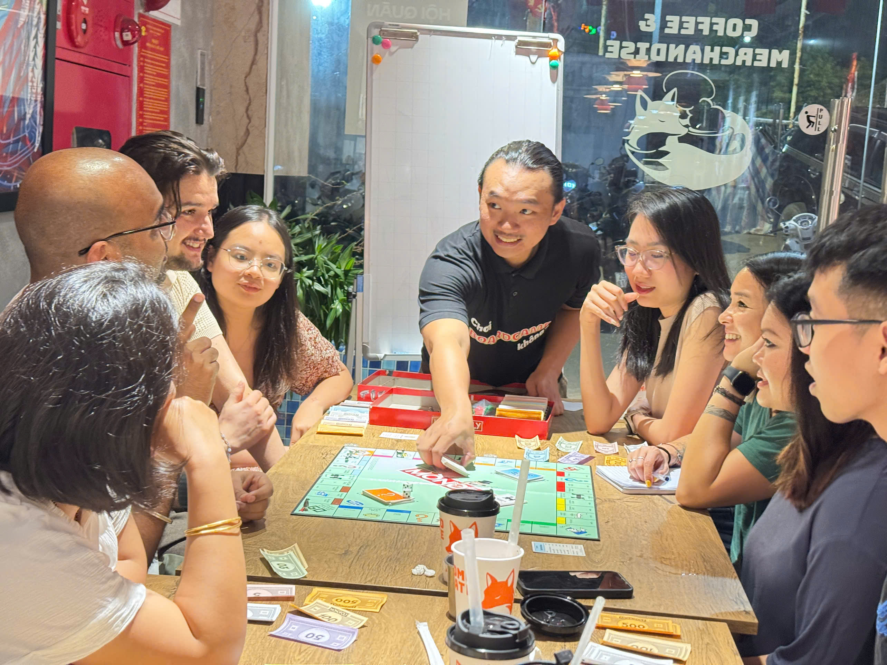
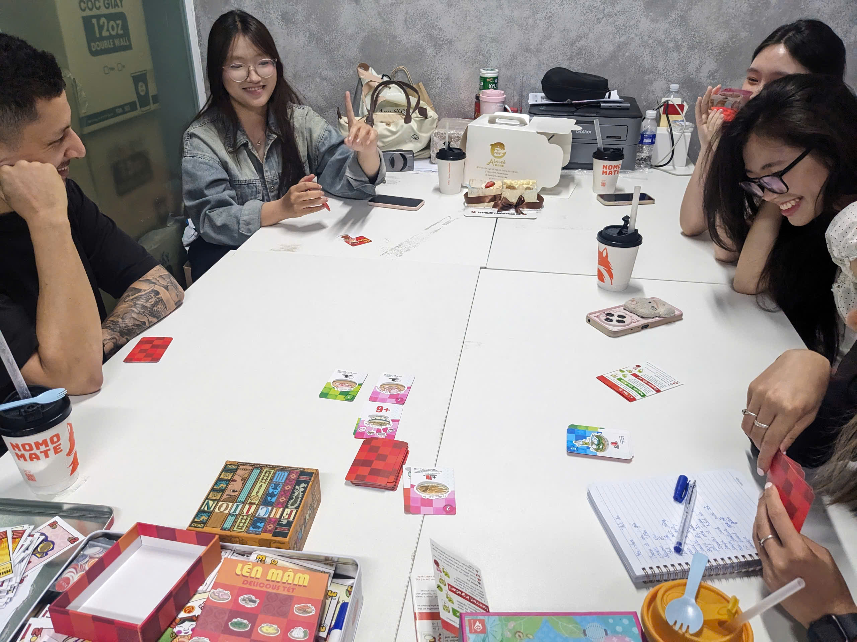
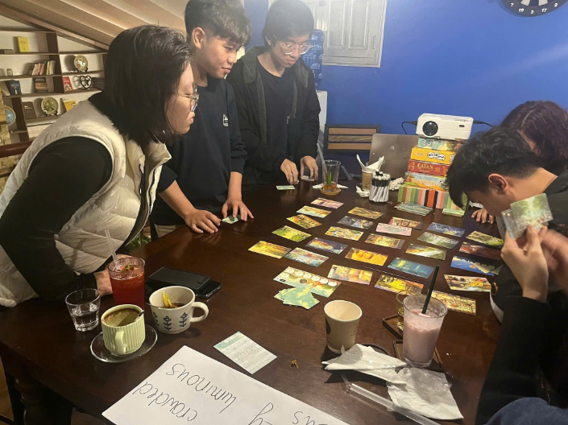
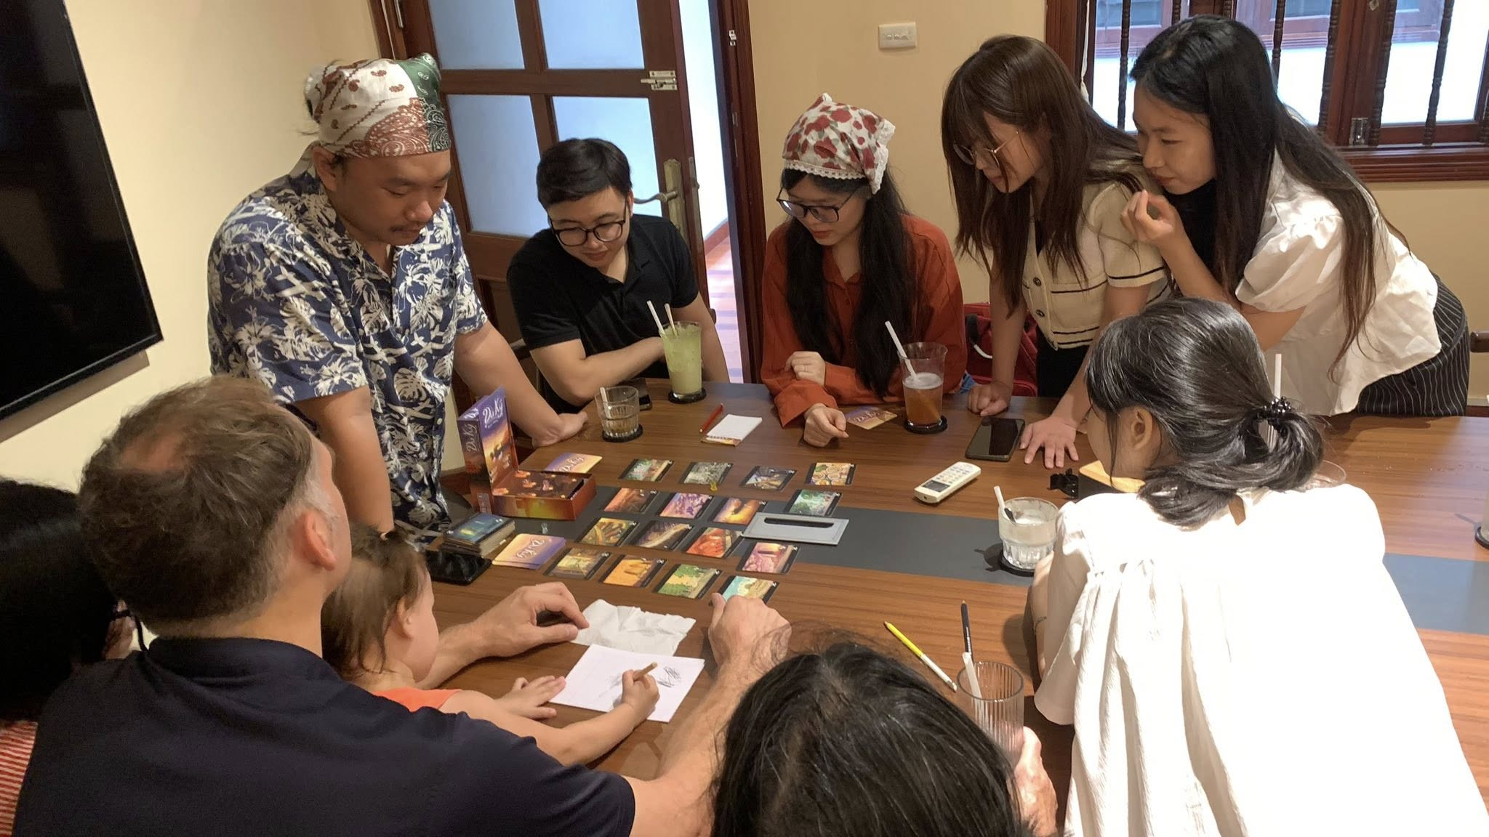
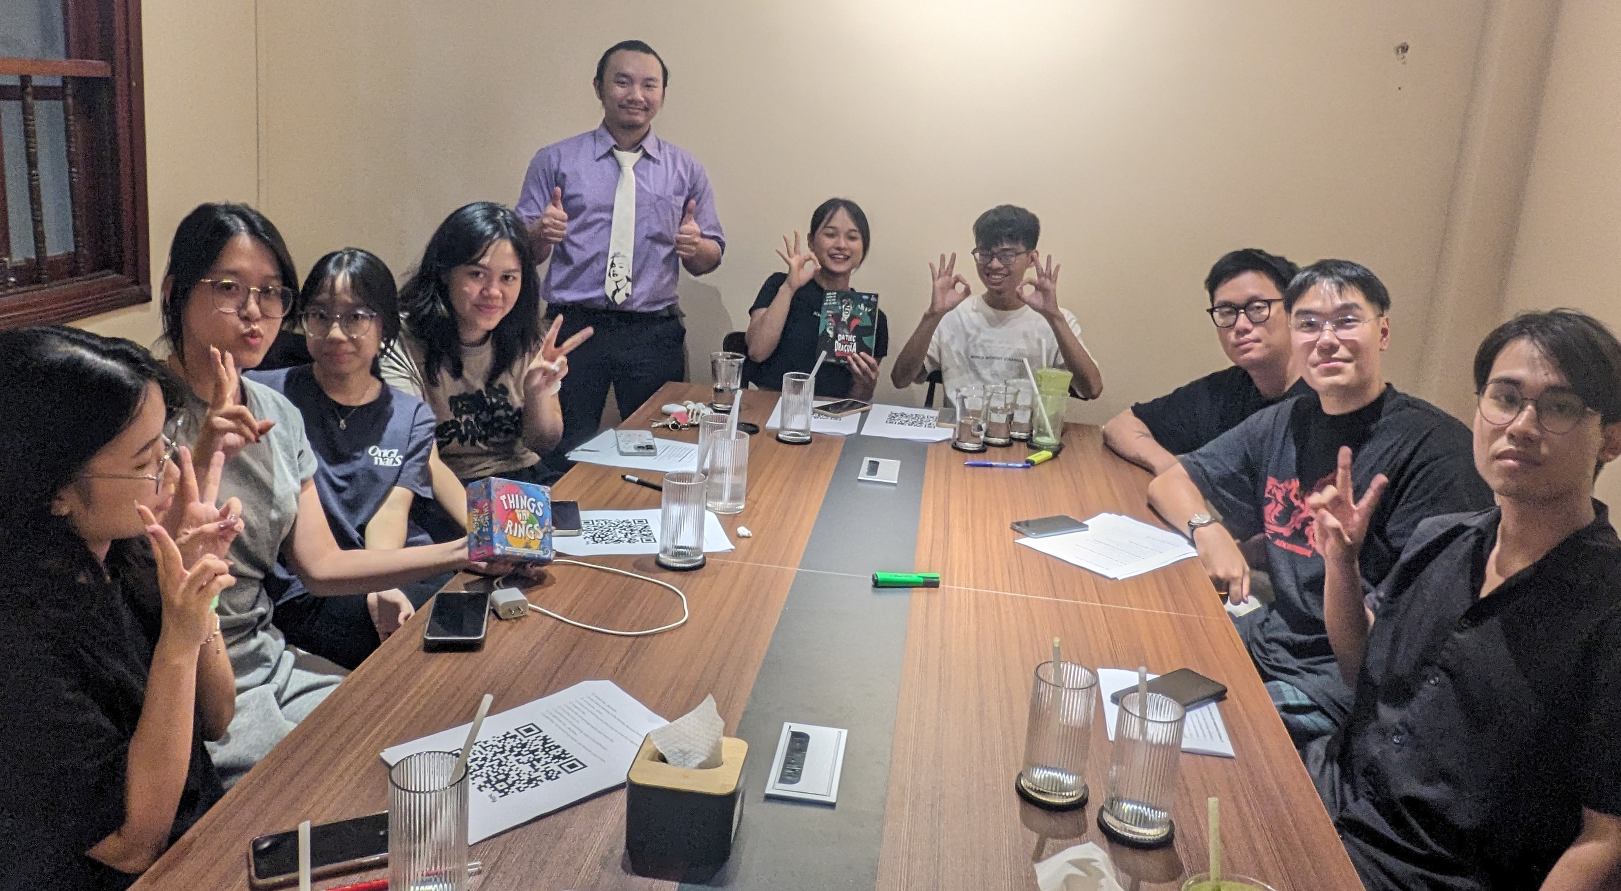
Research
small-sized classrooms
12 months
1.5 - 2 hours
7-8 attendants
university students
EFL teachers
international and local working professionals
qualitative + quantitative
narrative / thematic analysis

Slide 13
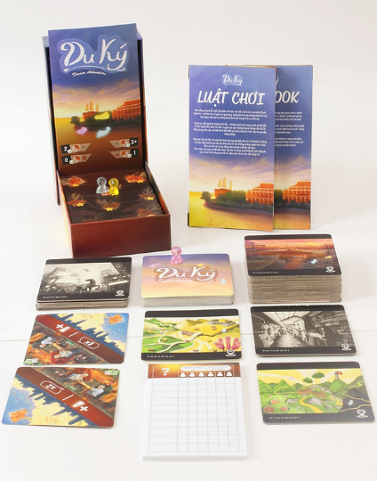
Demo Lesson #1
Main aim
Students will be able to use descriptive adjectives in describing places and sceneries.
Subsidiary aim
For students to use critical thinking and deduction skills in guessing their friends’ hints.
Classroom profile
Size: 18
Language Level: B1-B2

Slide 14

Think of a place and describe it
Focus on:
4 things you can see there
3 sounds you can hear there
2 scents you can smell there
1 emotion you can feel standing there

Slide 15

Adjectives to describe places and sceneries

Slide 16


Slide 17
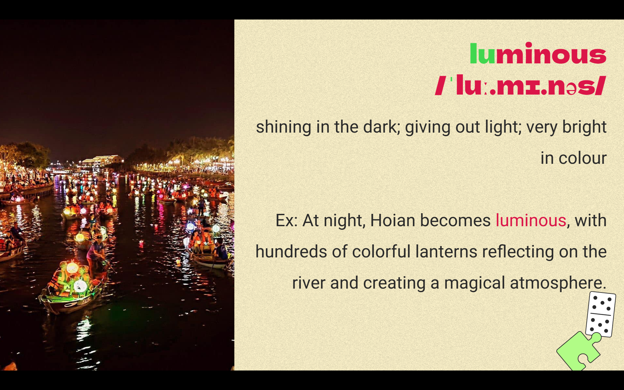

Slide 18


Slide 19
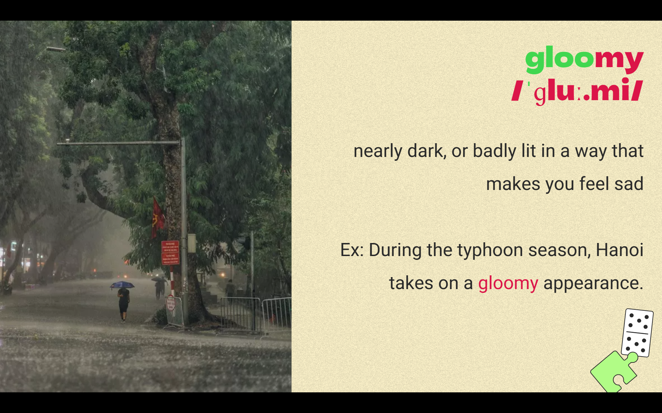

Slide 20
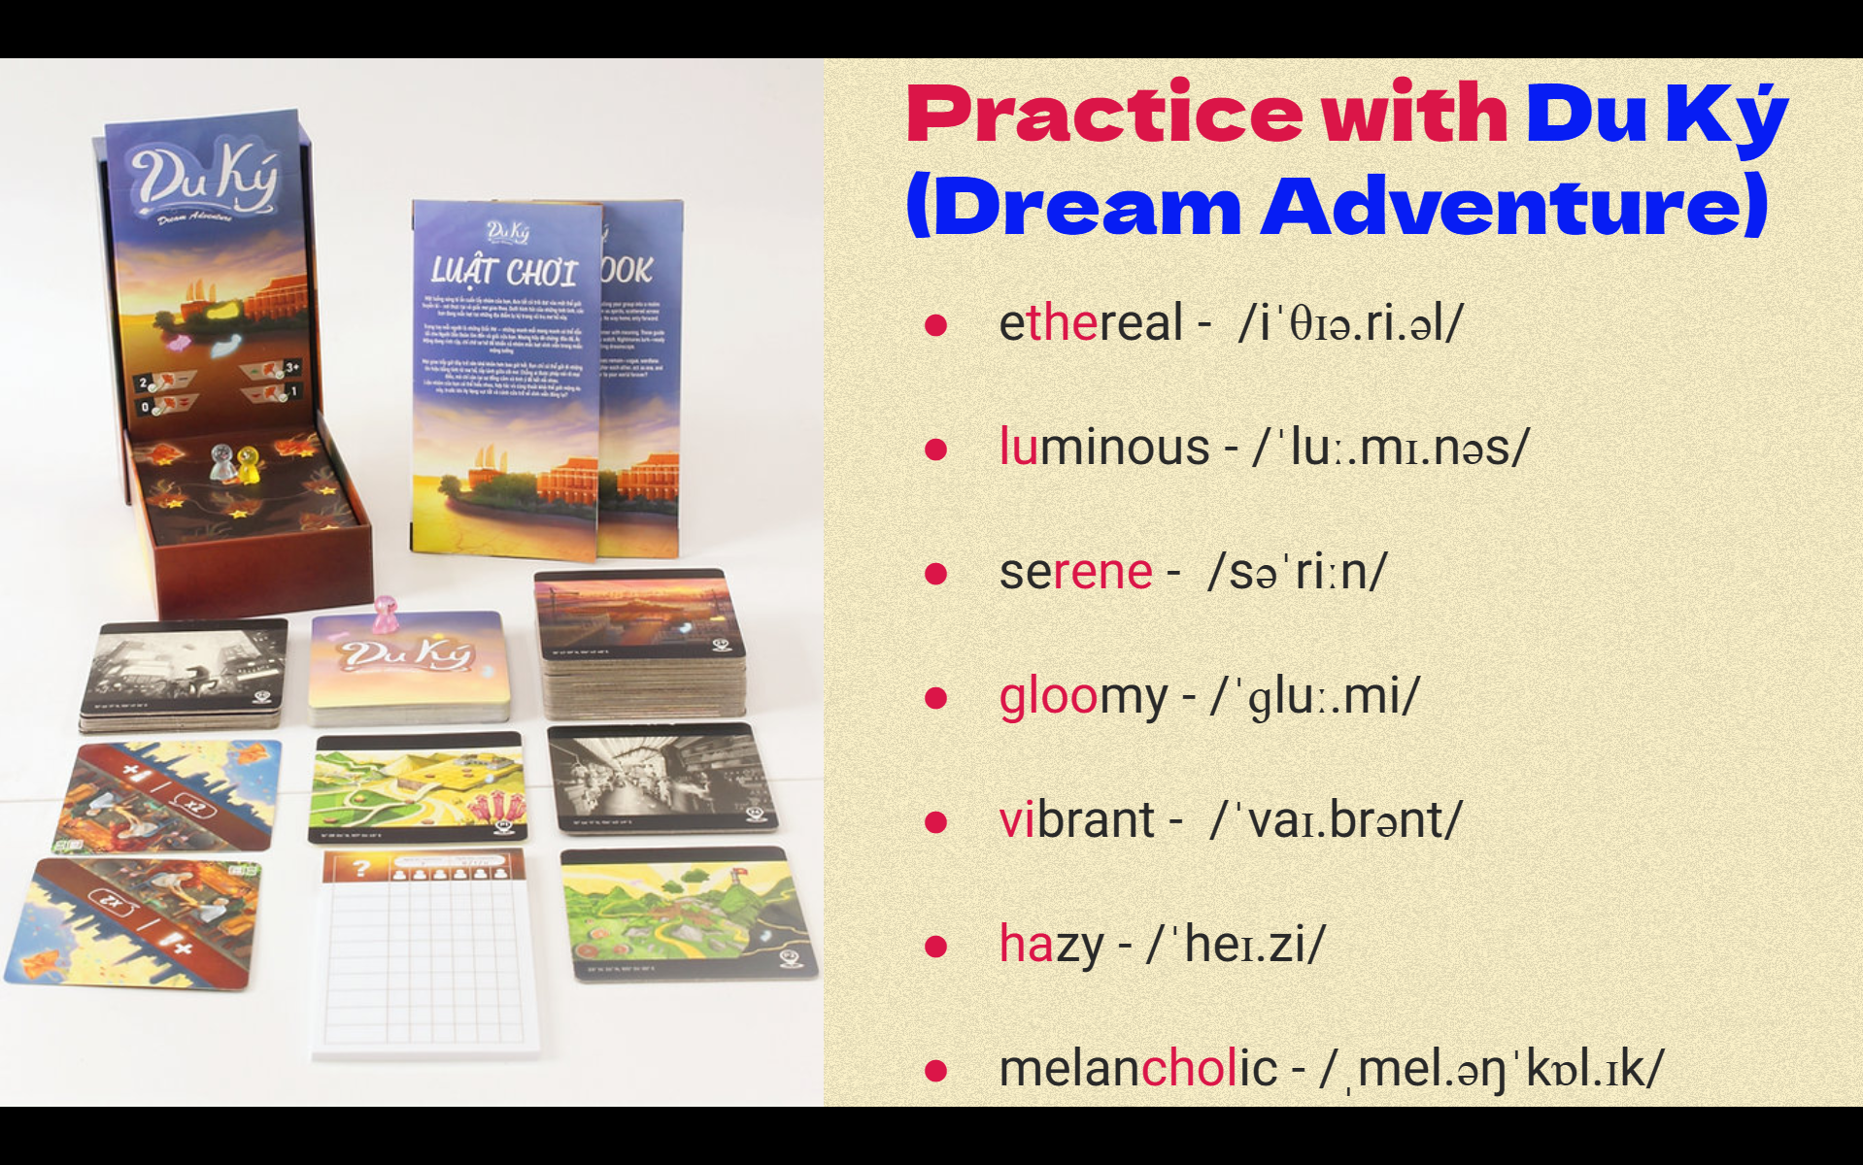

Slide 21
Demo Lesson #2

Slide 22
Demo Lesson #2
Individual greed and selfishness have been the basis of modern society. Some people think that we must return to the older and more traditional values of respect for the family and the local community in order to create a better world to live in.
To what extent do you agree or disagree?

Slide 23

Demo Lesson #3

Slide 24
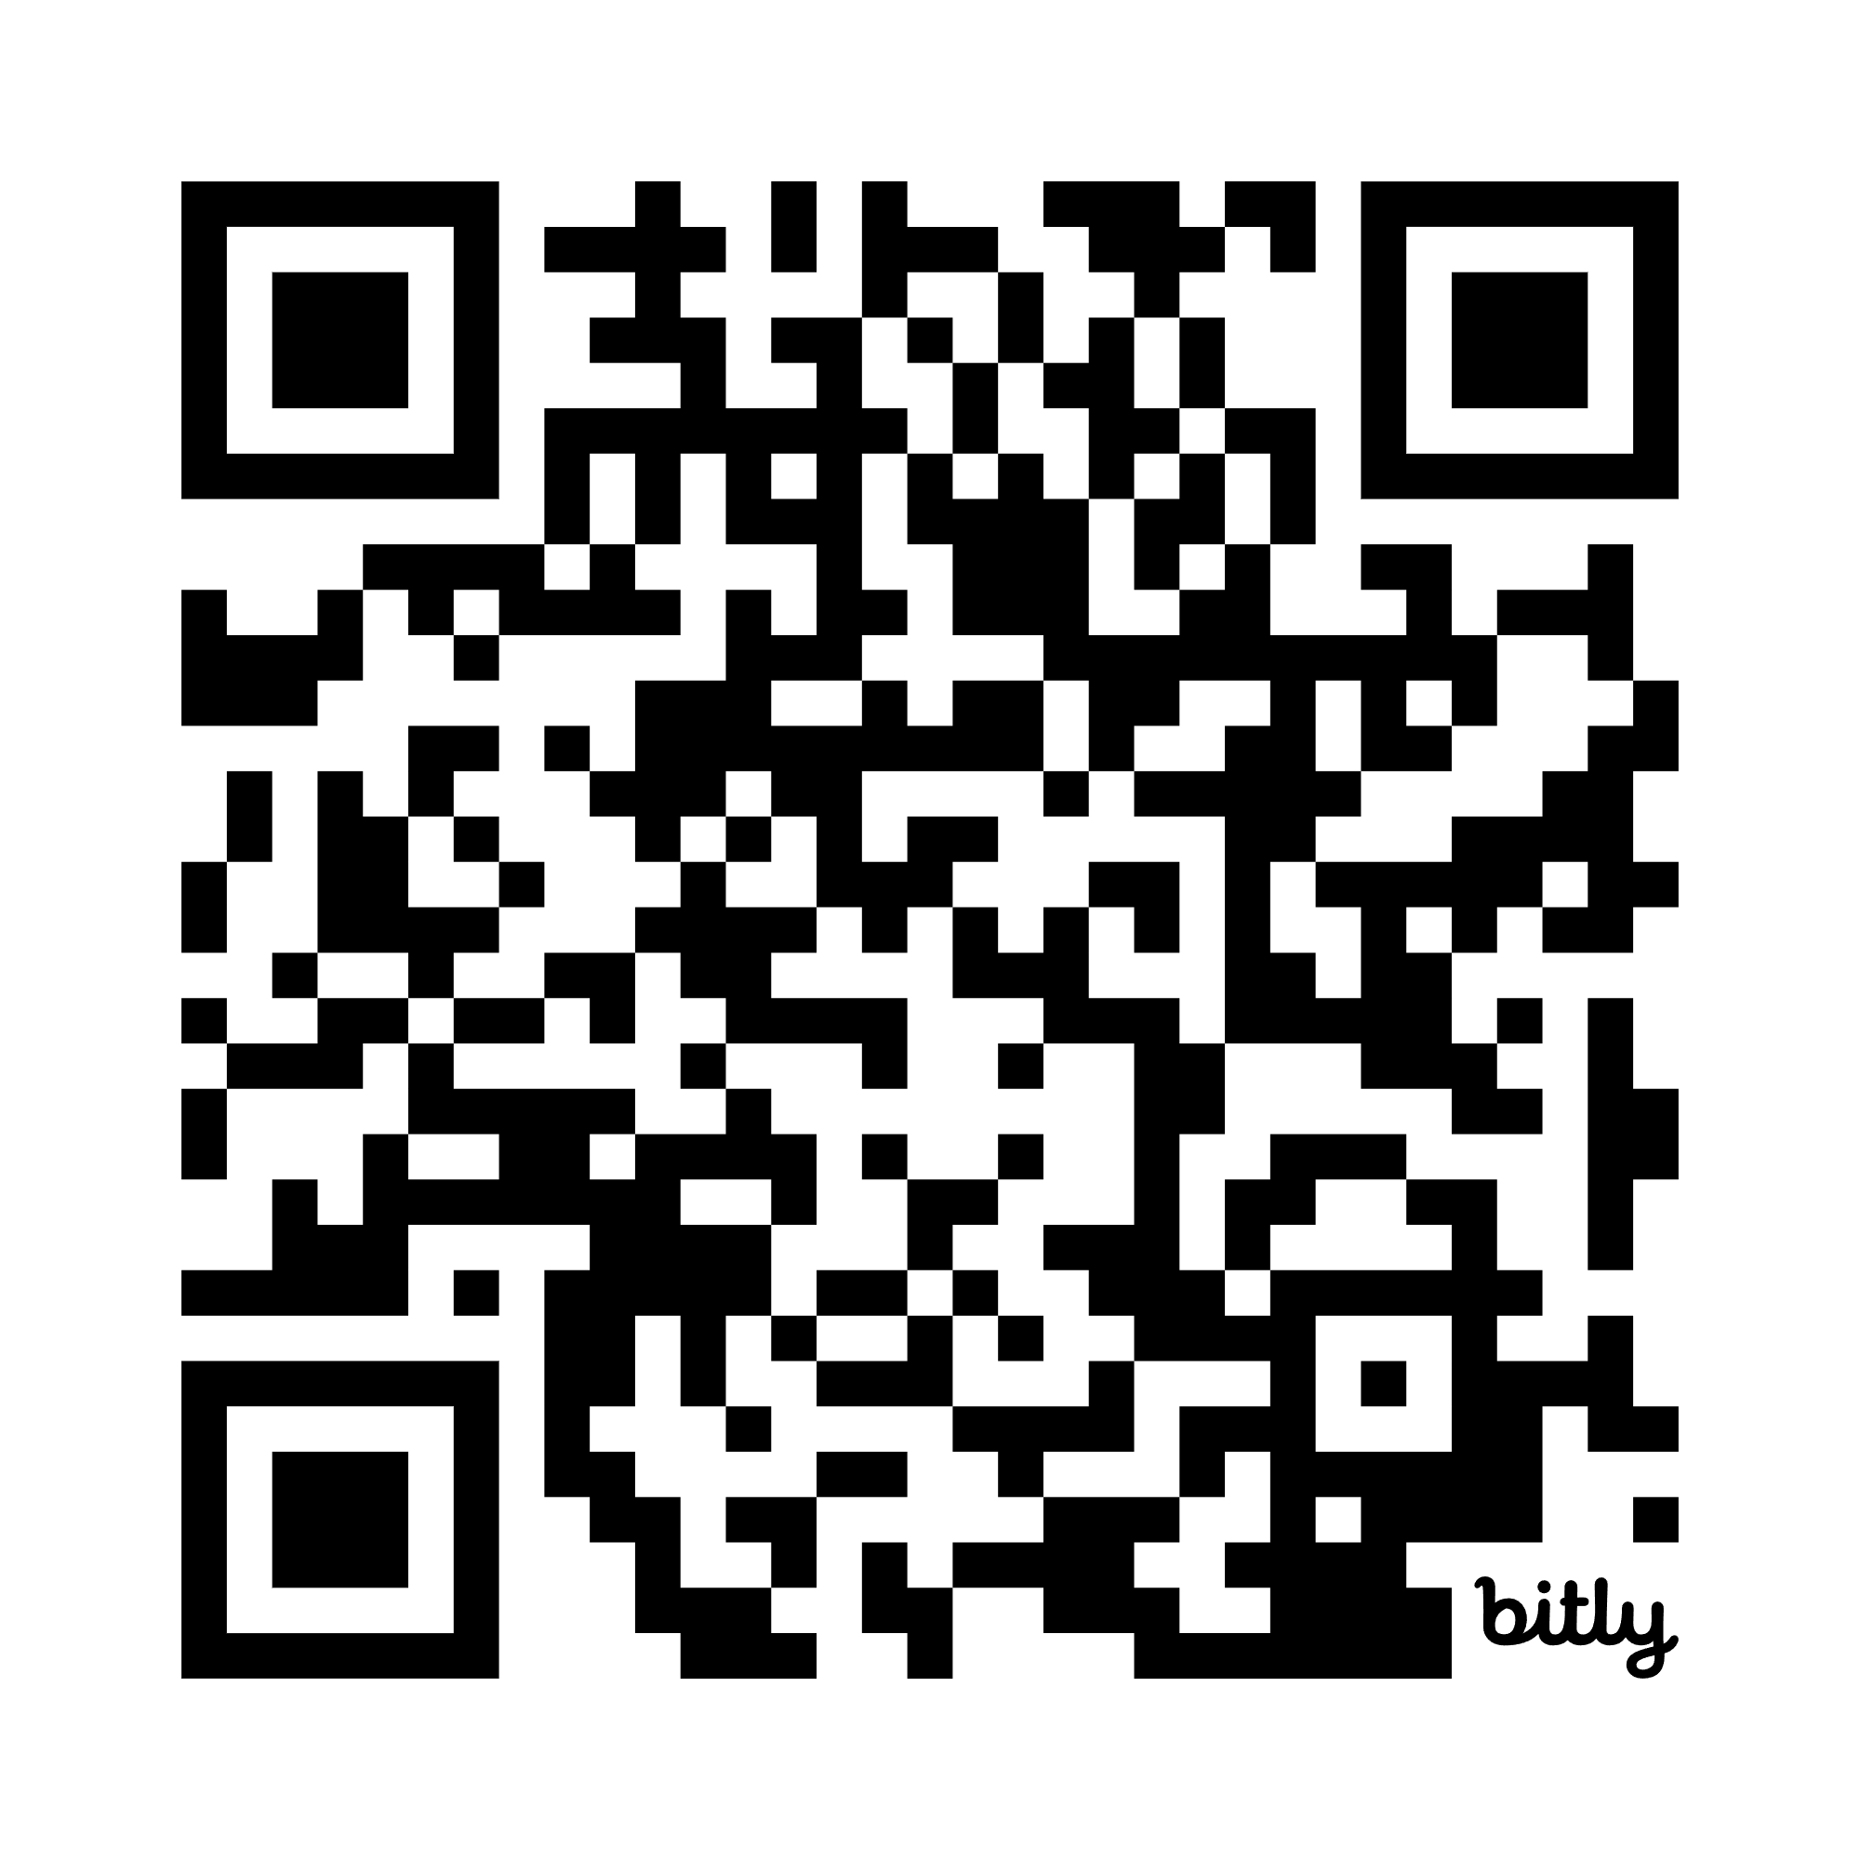
Q & A

