Slide 1





Improving Sentence Writing through Rotational Pair Work: Evidence from CEFR-Informed Classroom Assessment
Mr Joe Mary Ibañez
Teacher-SMTP
Benjamarachutit School, Thailand
Dr Georgios Georgiou
Assistant Professor of Linguistics University of Nicosia, Cyprus

Slide 2

Introduction
CEFR describes language proficiency through practical “can do” descriptors (Council of Europe, 2020).
Thailand uses CEFR as a national benchmark for English education.
Implementation remains challenging due to: limited teacher training, unclear assessment alignment, workload and time constraints. (e.g., Wudthayagorn, 2025).

Slide 3
Introduction
Writing is a particularly relevant skill area for CEFR-informed classroom assessment, which can be evaluated through analytic criteria (e.g., control of grammar, sentence formation, spelling) (Phuong et al., 2025).
A second strand of CEFR-informed writing growth concerns peer interaction and collaborative writing → when learners co-construct text or sentence meanings, they can strengthen accuracy and form–meaning mapping (Storch, 2011).
The main problem is that chances for interaction are limited due to time constraints.

Slide 4
Introduction
Station rotation solves these problems – it increases active engagement and repeated practice through short, focused tasks (Pho, 2021).
Rotational pair work supports varied peer interaction, manageable feedback, and predictable classroom routines (Judson, 2019).
For grammar-in-context writing, rotational design can be especially productive because it offers repeated micro-productions (short sentences) tied to changing prompts (Liu & Tang, 2025).

Slide 5
This study
The present study investigates whether CEFR-informed active rotational pair work can measurably improve Grade 9 Thai students’ sentence-level writing performance when interpreting common public signs using modal verbs.
It addresses a practical gap documented in Thai CEFR implementation research, namely, the fact that teachers need classroom-feasible, descriptor-informed routines that support instruction and provide credible evidence of learning.

Slide 6
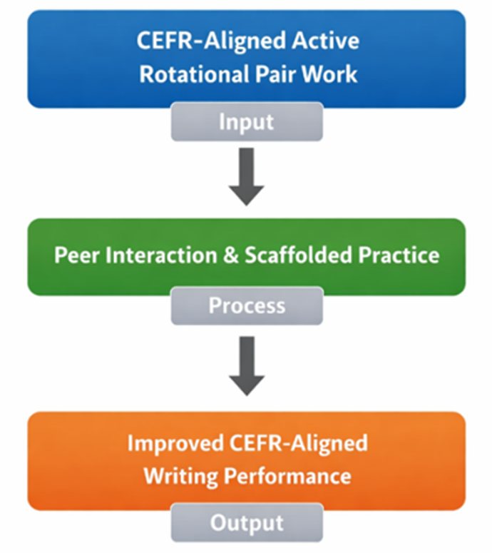
This study

Slide 7
Methodology – Participants
30 secondary school students (females = 16) from southern Thailand.
Enrolled in Grade 9 at Benjamarachutit School.
Students were between 14 and 16 years old (M = 14.8).
Their English proficiency ranged from A2 to B1, as determined by the school’s placement testing procedures.
No participant reported any language, cognitive, or visual disorder.

Slide 8
Methodology – Materials
32 printed public signs from everyday contexts: parks, shopping malls, schools, roads, and markets.
Distribution of signs: pretest: 6; posttest: 6 different but comparable signs; intervention: 20 signs.
Modal verbs targeted: must, must not, have to, can, can’t.
Color-coded categories: Prohibition, obligation, permission.
Task format: Students wrote one complete sentence per sign, matched to numbered answer-sheet spaces.

Slide 9
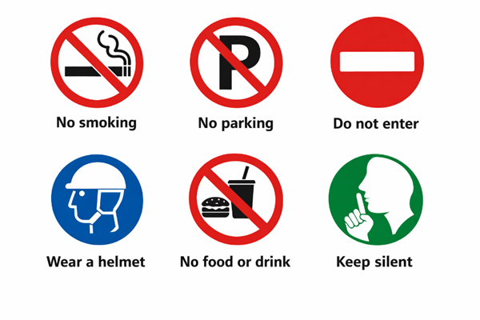
Methodology – Procedure
Pretest
Task: Look at each public sign. Write one complete sentence explaining its meaning. Use one modal verb: must, must not, have to, can, can’t (15 m)

Slide 10
Methodology – Procedure
Intervention
Two days after the pretest.
Class organization: 5 stations, 6 students per station, mixed-ability pairs based on placement-test bands.
Materials: 20 public signs, numbered response sheets, A4 clipboards.
Total duration: 50 minutes.
Lesson stages: a) Warm-up: 5 m, b) Instruction and scaffolding: 10 m, c) Guided practice: 5 m, d) Station rotation: 20 m, e) Whole-class wrap-up: 10 m.

Slide 11
Methodology – Procedure
Intervention
At each station, students worked in pairs to: interpret each sign, discuss possible modal choices, write one complete sentence per sign, and match responses to numbered answer-sheet spaces.
Rotation procedure: Four signs were placed at each station; students spent about 4 minutes at each station; a bell signaled clockwise movement; pairs were later reassigned to vary peer interaction.
Feedback and checking: Students peer-checked selected responses using a rubric; focus: grammar, sentence construction, and spelling/punctuation; the teacher gave feedback on common errors.

Slide 12
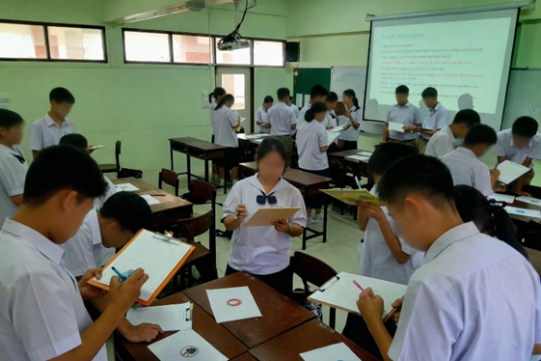
Methodology – Procedure

Slide 13
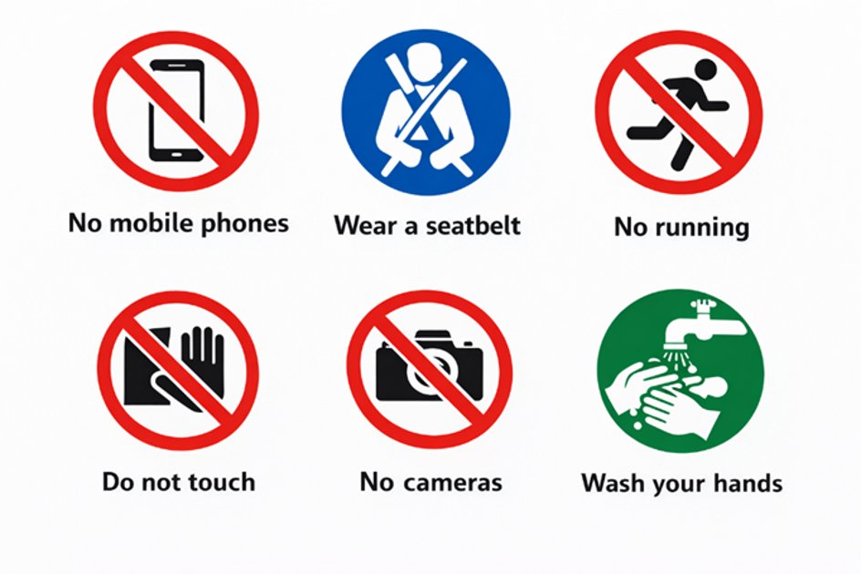
Methodology – Procedure
Posttest
Task: Same as pretest, but 6 new signs (15 m).

Slide 14
Methodology – Procedure
Assessment and scoring
CEFR-informed analytic rubric for sentence-level writing.
Three criteria: grammatical accuracy, sentence construction, orthographic control.
4-point scale: 1–4 for each criterion (one rater).
Unit of analysis: one sentence per sign.
Each sentence received three separate scores.
Reliability was acceptable to excellent: α = 0.77–0.92.
Mean criterion scores were used for descriptive reporting; sentence-level scores for inferential analysis.

Slide 15
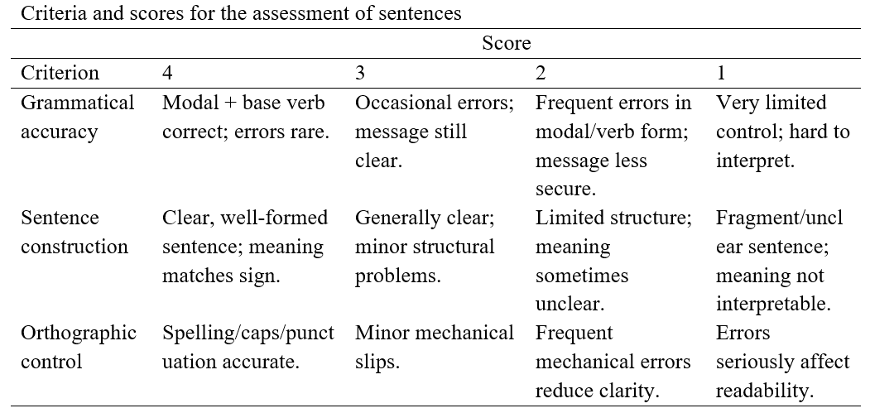
Methodology – Procedure

Slide 16
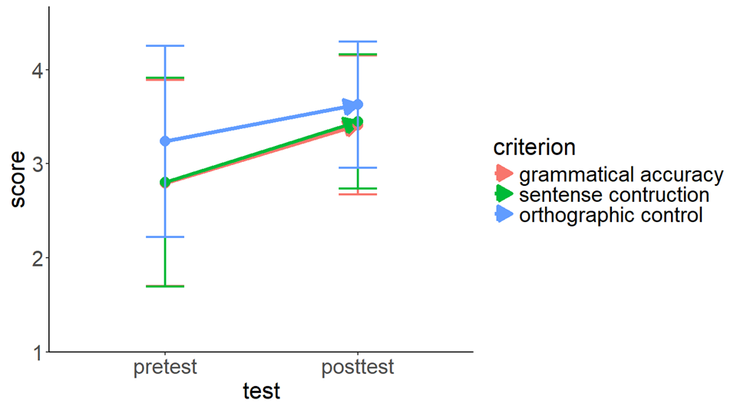
Results

Slide 17
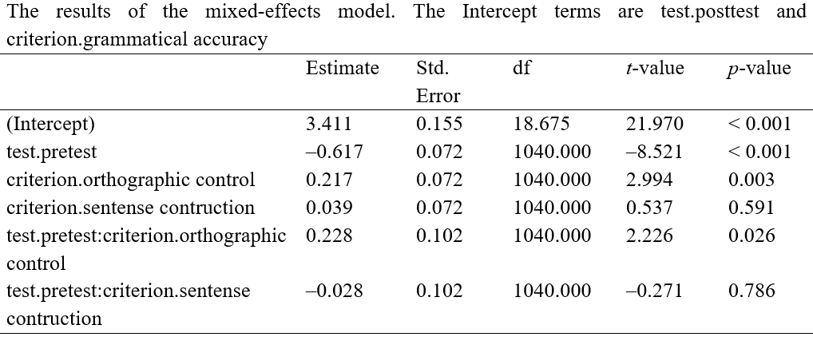
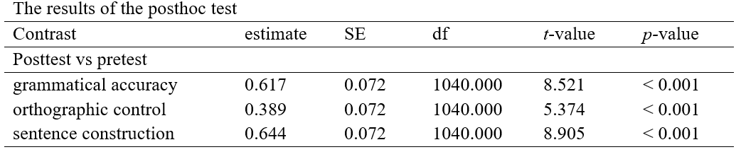
Results

Slide 18
Discussion
Overall improvement from pretest to posttest.
This improvement was statistically reliable across all three rubric criteria.
Converges with broader evidence that structured collaboration supports L2 writing development, particularly accuracy outcomes, because learners externalize decisions, notice form-meaning mismatches, and co-edit language (Elabdali, 2021; Storch, 2011).
Compatible with meta-analytic evidence that peer-assisted writing support yields robust improvements when interaction is guided (Li & Hampson, 2025).

Slide 19
Discussion
Larger gains for grammatical accuracy and sentence construction than for orthographic control.
Fit the intervention’s learning logic that repeated pair-based negotiation of sign meaning and immediate checking of the modal + base verb pattern should directly strengthen meaning-to-form mapping
→ collaborative writing creates opportunities for noticing and language-related discussion that are linked to improved accuracy and better written outcomes (Storch, 2011; Lázaro-Ibarrola, 2024).

Slide 20
Pedagogical value
Station-rotation pair work can support both instruction and assessment by generating short, observable performance samples during regular lessons (Sortwell et al., 2024).
Repeated micro-tasks can make CEFR-informed criteria easier to observe and score, especially for grammatical accuracy and sentence construction.
Peer checking could be taught explicitly through simple feedback prompts, such as modal choice, base verb form, and punctuation (Do, 2026).

Slide 21
Conclusions
Results reinforce the practical value of embedding assessment for learning within communicative tasks that translate CEFR “can do” descriptors into manageable classroom performances.
Limitations:
Small sample from a single school context.
Short intervention focused on a narrow linguistic target.
Rubric-based scoring requires further validation across raters.
Peer interaction processes were not directly measured, such as language-related episodes.

Slide 22



Thank you!
Dr Georgios Georgiou
Assistant Professor of Linguistics
Director of the Phonetic Lab
georgiou.georg@unic.ac.cy
http://georgiougeorg.com
Mr Joe Mary Ibañez
Teacher-SMTP
Benjamarachutit School
joemary.ibanez@gmail.com
joe@benjama.ac.th

