Slide 1

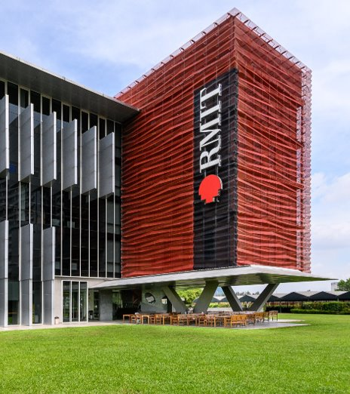
Beyond Workshops
Lessons from a 3-year Action Research Program
Loralee Simonitch
CELTA, BA, MSc, MATESOL
Professional Learning Specialist and Senior Educator
School of English and University Pathways (SEUP)
RMIT, Vietnam
Ready for what’s next
Notes:
Show of hands: who has done, or is currently doing, an action research project?
Now, whose action research project was a part of a formal program – One you had to apply to do?
And whose project was an informal, personal practice endeavor?
Great! Thank you! The reason I ask is because I believe, often, action research is largely done informally. Formal programs do exist, but many teachers also take the initiative to get it done on their own.

Slide 2
Agenda
01
Context
What did the Action Research program look like?
02
What Happened?
Key operational and design issues
03
What We Learned
Three core principles in action
04
Looking Ahead
Scaling up, mentorship, and year-round design
05
TakeawaysQ&A
Ready for what’s next
Notes:
For that reason – start with context: why formalize? What did the launch look like?
Next: key operational and design issues
Talk about what we learned and how we changed the program in years 1 and 2
Finally: end with what we are learning in year 3, how it informs us looking ahead.
After the takeaways, we should have time for a Q&A at the end

Slide 3
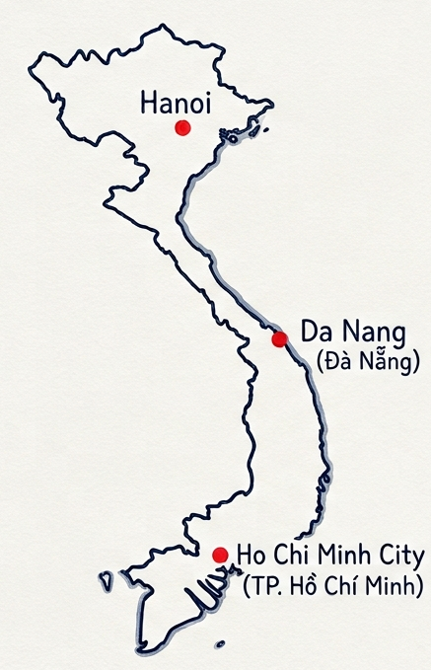
01 CONTEXT
Why Formalize Action Research?
Facilitate and encourage sharing, collaboration, and recognition
About 60 teachers across three campuses.
Foundation Studies
English for University
New Initiatives: Teens, IELTS
Ready for what’s next
Notes:
Let's start with why we formalized action research.
Two Main reasons
Reason 1: has to do with helping our teachers to collaborate and share their innovations.
RMIT has three main campuses, Ho Chi Minh City, Danang, and Hanoi
Roughly 60 teachers
And we have three different departments
A lot of people
variety of practice
Variety of schedules
It can be difficult for our teachers to reach across the aisle.
Even within a department, sharing can be difficult.
For example, EU.
Morning: 8-12.30
Afternoon, 1-5.30
Easily go weeks without saying hello to a teacher on a different shift, even if you are working with the same book on the same level.
Sharing does happen, passively.
Microsoft 365, SharePoint, Teams
Material might not have instructions, no explanations for why or outcomes.
Teachers who do go above and beyond might not get recognized.
One reason we wanted to formalize the program was to foster more collaboration, and make recognition of teacher achievements easier.

Slide 4
01 CONTEXT
Why Formalize Action Research?
Self-actualized professional learning fills the gaps in meeting teacher needs.
About 60 teachers across three campuses.
Foundation Studies
English for University
New Initiatives: Teens, IELTS
Diverse needs
Ready for what’s next
Notes:
Reason 2: Action research can empower teachers to take more active control of their professional growth
So many teachers
Spread out
Difficult to accommodate diverse professional learning needs.
Wait for workshops
Wait for training
Wait for opportunities

Slide 5
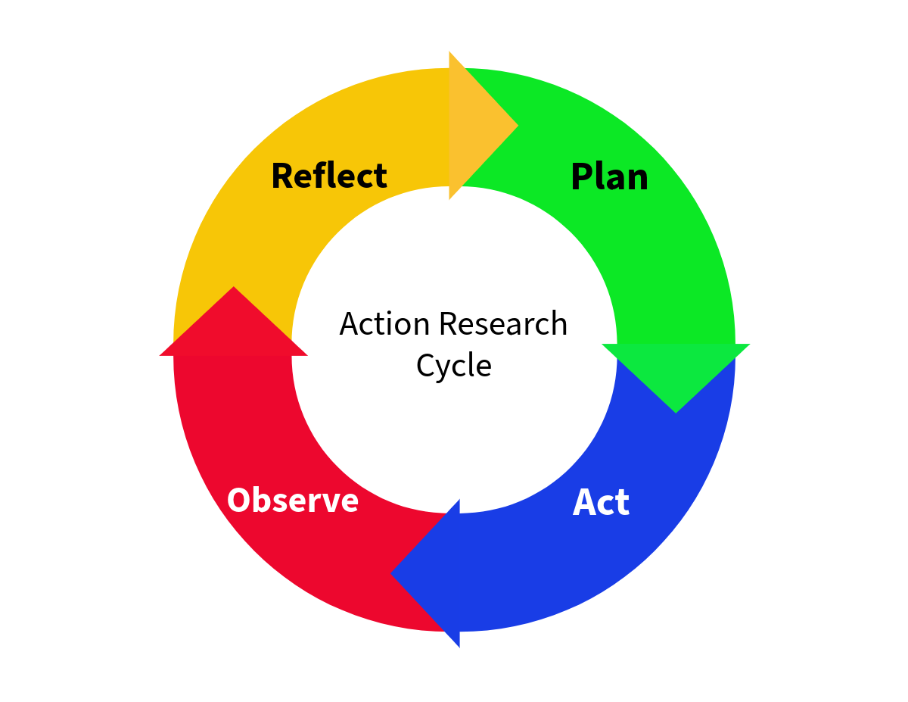
01 CONTEXT
Meeting the Demand: Self-Actualized Professional learning.
Teachers can become 'mini-experts' in a specific interest.
Foundation for future projects and leadership opportunities.
Teachers can better meet the changing landscape of English instruction in Vietnam.
Ready for what’s next
Notes:
Formalization = teachers can stop waiting.
Instead of passively taking on professional learning opportunities, teachers can use action research to personalize and self-actualize expertise.
teachers use what they learn develop their own workshops/trainings to deliver in house.
More recently (not an initial consideration)
As Vietnam transitions from English as a Foreign Language to English as a Second Language in educational contexts, empowering teachers to actively adapt their skillsets may become relevant in the future.

Slide 6
01 CONTEXT
The Original Design: Synchronous, Peer-focused groups
2 x 6-Month Cycles
3 x Synchronous Foundational Workshops
2 x Internal Showcases
What issues do you think appeared in our initial launch?
Ready for what’s next
Notes:
Now you know why we formalized action research.
What did the launch look like?
Initially: 2 6-month reflective cycles: from September – February, and then March – August.
We developed three synchronous face-to-face workshops.
Designed for teachers unfamiliar with action research
Foundational practices
Help identify and narrow down a focus
developing guiding research questions and goals
Planning, data collection methods, reflection techniques, ethical considerations, etc.
Collaborative, hybrid online/face-to-face meetings between peers and program facilitator.
Upon completion: internal showcase and sharing.
Turn to someone sitting near you.
think about SEUP’s context and this launch
what type of issues do you think we encountered?
Too much too quickly

Slide 7
02. WHAT HAPPENED?
Key Operational & Design Issues
Issue 01
DEADLINES VS REFLECTION
Generated a “one and done” mentality.
Issue 02
SCHEDULING CONFLICTS
Increased stress and pressure.
Issue 03
THE 'BORED VS LOST' SPLIT
“one-size-fits-all” fits no one.
What are your solutions?
Ready for what’s next
Notes:
Three issues in operation and design
First: Complying with stacked deadlines overwhelmed genuine reflective practice. Less chance of teachers following the iterative cycle.
The second issue: scheduling conflicts, busy cohort, multiple locations
The third issue: lack of differentiation and a strict adherence to one operational method
Teachers either bored with the pace
Lost in the pressure
Although the program and the workshops were considered helpful, we inadvertently increased everyone’s workload.
Before I say how we addressed the issues, please turn to each other. What solutions can you think of to address these issues?

Slide 8
The Pivot
Formal
Flexible
Hard deadlines
Sustainable Pacing
Synchronous Group Training
Scalable Personalization
One-Size-Fits-All approach
Meeting Teachers where they are
Ready for what’s next
Notes:
Redesigned our operational and learning structures.
From a formal, inflexible delivery to a more relaxed one.
From a tight schedule that demanded hard deadlines to sustainable pacing.
From synchronous, group work brainstorming training to scalable personalization.
From a one-size-fits-all approach, to meeting our teachers where they are.

Slide 9
03. WHAT WE LEARNED
Lesson 1: Sustainable Pacing
THE PROBLEM
2 x 6-month cycles
Stacked cycle deadlines
Teacher and Facilitator burnout
THE PIVOT
A single 12-month cycle
Natural decompression
Spaced milestones
Emergency cushion
THE PROOF
Spanning work halved the stress and doubled program applications.
Ready for what’s next
Notes:
The first pivot we made was towards sustainable pacing.
2 6-month timelines seemed reasonable.
Terms and courses: between 10-week intensive language courses, or 20-week foundation studies courses.
Teachers are busy
Additional conflicts were not considered:
Holidays
Annual leave
Illness
Emergencies
Administrative changes
We had no cushion, and one change risked the short timeline we set up.
A lot of pressure on teachers and the facilitator.
Decompress the program
12 months
Workshops, practices, deadlines naturally spread out
Pressure released
teachers had more flexibility, better accommodation and facilitator workload halved.
More time, not less, is needed to soften the edge of unexpected time constraints.
Announced changes, double expressions of interest

Slide 10
03. WHAT WE LEARNED
Lesson 2: Scalable Personalization
THE PROBLEM
Logistical gridlock
Group scheduling clashes
Repeated lectures
THE PIVOT
Asynchronous training (videos +templates)
1-1 Personalized milestone check-ins
THE PROOF
Personalized, high-value oversight without administrative burnout.
Ready for what’s next
Notes:
Second: scalable personalization
Energy spent getting everyone together.
teachers spread out over different campuses
working different timetables
Attempts at coordinating synchronous workshops not sustainable.
The facilitator run repeat workshops, not ideal
face-to-face collaboration = valuable
Reality = stressful
Transform delivery towards personalization
Year 2: adapted workshops to asynchronous delivery
Pre-recorded lessons
Quizzes
Practice templates and examples
Teachers set their own pace
Save work
Return to training at will
What did not change: synchronous group collaboration
feedback driven, after foundations set
Scheduling this was still an issue
Year 3: replaced post-workshop collaborative meetings with 1-1 check-ins teacher - facilitator.
Workshop Summative task finished = facilitator is notified and meeting is arranged.
Quality maintained
scheduling issues eliminated
stress and workload reduced.

Slide 11
03. WHAT WE LEARNED
Lesson 3: Meet Teachers Where They Are
THE PROBLEM
One size fits all bored experienced teachers
Redesign risked leaving inexperienced teachers behind
THE PIVOT
Path A: Full scaffolding with complete foundational workshops
Path B: Fast-track to the summative task.
THE PROOF
Experienced teachers stay focused, inexperienced teachers get the support they need to create effective projects.
Ready for what’s next
Notes:
Third: implementing a differentiation approach to the program operations.
Some teachers: interest, no ideas or experience with action research.
Need structure to gain confidence and develop the foundations needed to move forward.
Other teachers: familiar with action research, have ideas, started a project already on their own.
Want to get recognition or assistance
Create workshops
Develop conference presentation
Don’t need as much structure
how do we accommodate teachers who are at different points in their action research journey?
No changes to design, but relax operational requirements
a teacher already asked the necessary questions, designed the interventions, and started trialing in class, they don’t need guidance in questioning, designing, and trialing interventions in class.
asynchronous model: teachers to skip ahead to the workshop summative task
specific problem statement
a set of questions
a preliminary next-steps plan
A reflective practice
Submit – meet – move on
Teachers ahead allowed to continue projects
Others teachers who started with less clear ideas got the time and structure they needed to be successful.

Slide 12
04. LOOKING AHEAD
Looking Ahead: Scaling and Program Evolution
EVOLUTION 01
COMMUNITIES OF PRACTICE
Interest-based Communities of Practice (e.g., AI in education, Extensive Reading, Translanguaging)
EVOLUTION 02
PEER-TO-PEER MENTORSHIP
Mobilizing past program participants to act as active mentors for new cohorts, creating a sustainable, teacher-led training loop.
EVOLUTION 03
YEAR-ROUND CONTINUOUS CYCLE
Transitioning to a continuous year-round model where teachers join, complete the workshops, and showcase their projects on-demand, rather than on a single fixed date.
Ready for what’s next
Notes:
Continuously changing
More teachers – more voices – more adaptations
Looking ahead: further imbed the program into our Professional Learning Practice.
First, building communities of practice.
Teachers in AR can be tapped to lead special interest groups within the cohort.
Some examples of communities: AI in education, Extensive Reading, and translanguaging.
Second, Mentorship.
Teachers who have done a project can be mobilized to assist the program
mentors for new teachers, creating a sustained, teacher-led loop.
Third, transitioning to a continuous, year-round cycle.
Currently: single intake – single showcase
Future: teachers can join – complete workshops – showcase projects on demand.

Slide 13
05. KEY TAKEAWAYS
Conclusion: Balancing Flexibility with Accountability
AUTONOMY & FLEXIBILITY
Unlocking Teacher Ownership
• Flexible timelines that respect schedules and teacher pacing.
• Asynchronous, self-paced delivery of instructional inputs to remove calendar clash.
• Differentiated entry starting points that let advanced teachers fast-track while beginners get heavy scaffolding.
PROGRAM ACCOUNTABILITY
Preserving Research Quality
• Clear summative milestones: A strict final written report and a public showcase presentation are required from ALL participants.
• Personalized 1-1 check-ins as teachers reach milestones, replacing generic group sessions with rigorous qualitative oversight.
Ready for what’s next
Notes:
wrap up, key takeaway: sustaining a formalized action research program is about carefully balancing flexibility with accountability.
Giving teachers genuine ownership over how and when they engage with the program increases professional agency and decreases burnout.
Teachers get time, personalized experiences, and differentiated structure based on teacher needs
We meet them where they are and we respect their professional workloads.
formalization does require accountability.
We protect the quality: personalized, milestone-driven 1-1 check-ins.
By removing administrative and scheduling friction and maintaining high expectations, we can foster a sustainable, teacher-led culture of continuous growth.

Slide 14
Thank you!
Q& A
Ready for what’s next
Notes:
Thank you, and we have some time for Questions.

