Slide 13
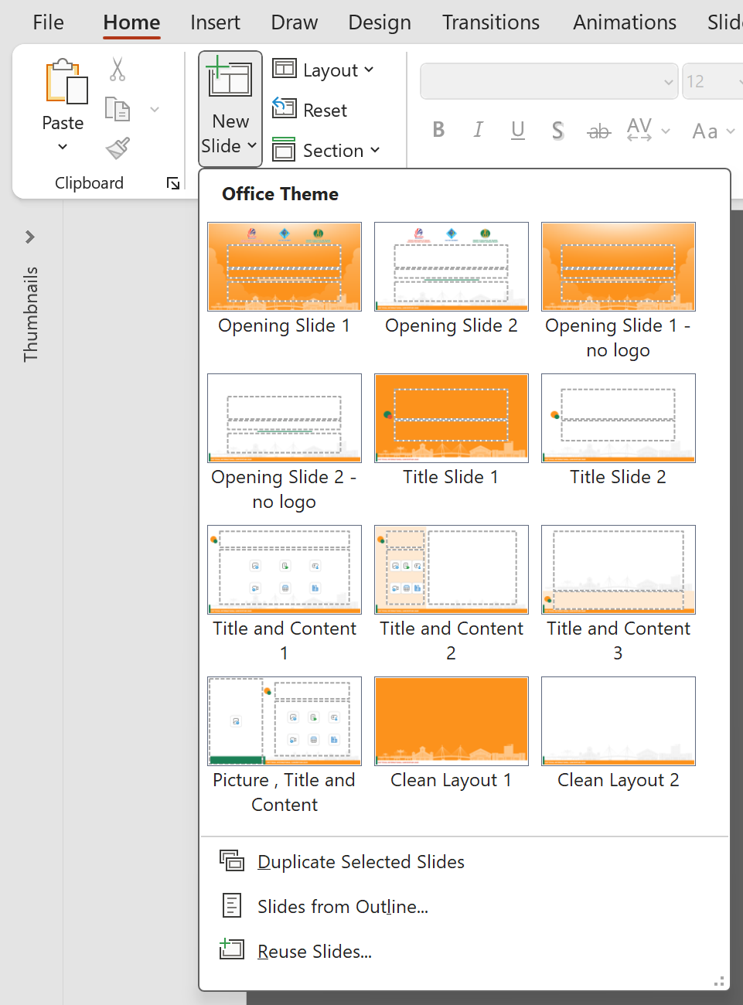
GUIDE TO VIEWING ALL AVAILABLE LAYOUTS, DESIGN ELEMENTS, AND THE PRIMARY COLOR PALETTE
Logos
Elements
#FC921C
#DE523B
#1B8056
Colors
View the full list of layouts by selecting
Home ➔ New Slide

